Slide 1
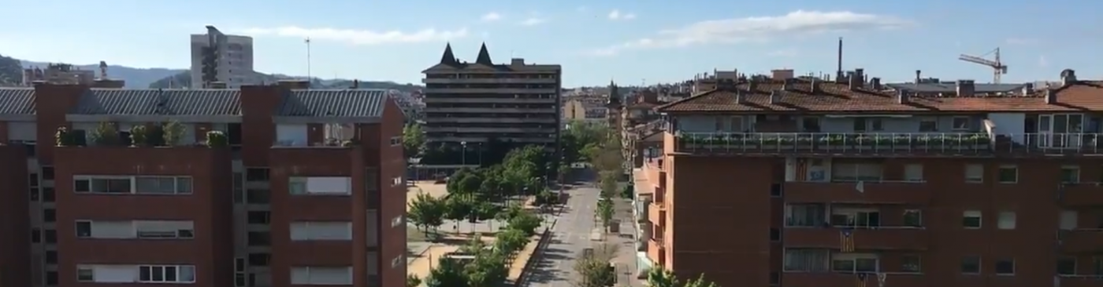


Soundscape of Catalonia during the first COVID-19 lockdown: Preliminary results from the Sons al Balcó project
La Salle: Rosa Ma Alsina, Ferran Orga, Roger Mallol, Marc Freixes, Xavier Baño
ISGlobal: Maria Foraster

Slide 2
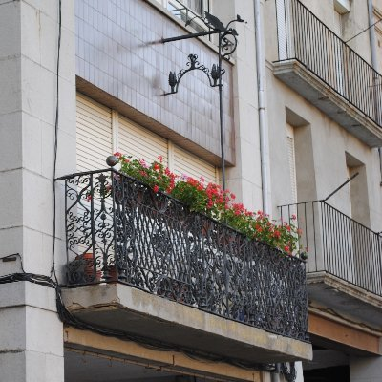
Sons al balcó: Soundscape map of the Confinement in Catalonia
GTM – La Salle and ISGlobal Joint Research Project.
Technical Goals:
  Draw the soundscape map of the Confinement in Catalonia, by means of
  Collecting objective data (short videos) and subjective data (questionnaires).
Social impact of the project: dynamic collaboration with citizens and other stakeholders to
  create social and environmental impact, and
  to widen awareness and design tools to improve citizenship development and empowerment, in order to
  support several Sustainable Development Goals from the UN.

Slide 3
Sons al balcó: Soundscape map of the Confinement in Catalonia
We designed a socio-acoustic survey implemented in LimeSurvey and distributed using social media (Twitter, LinkedIn)
  It included socio-demographics, quality of residential soundscape and the individual perception.
  Participants could upload short videos of their soundscapes at home and characterize several types of sounds.

Slide 4
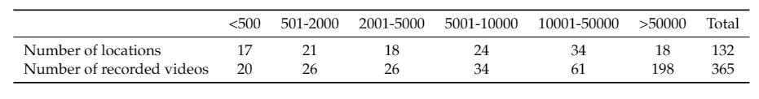
Sons al balcó: Soundscape map of the Confinement in Catalonia
At the end of the first campaign:
  366 short videos and questionnaires
Homogeneous distribution of data in the Catalan territory
Samples collected in both urban and rural environments.

Slide 5
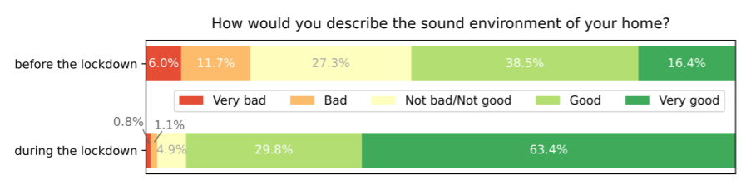
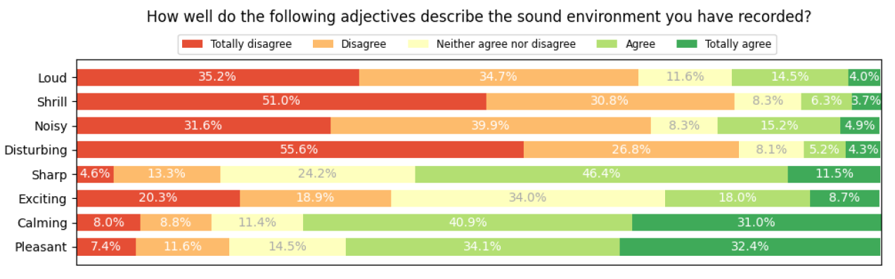
Sons al balcó: Soundscape map of the Confinement in Catalonia

Slide 6
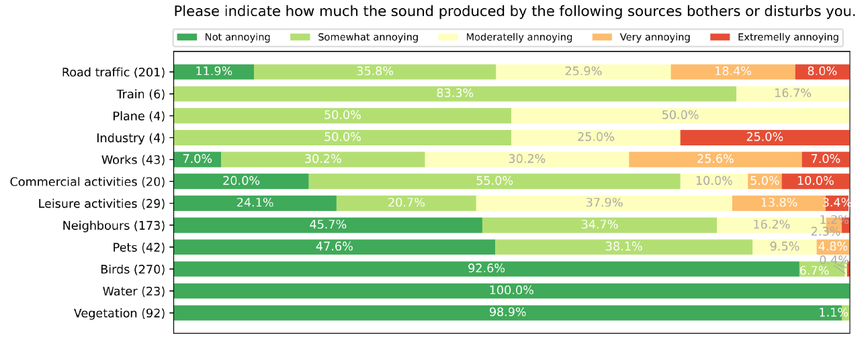
Sons al balcó: Soundscape map of the Confinement in Catalonia

Slide 7
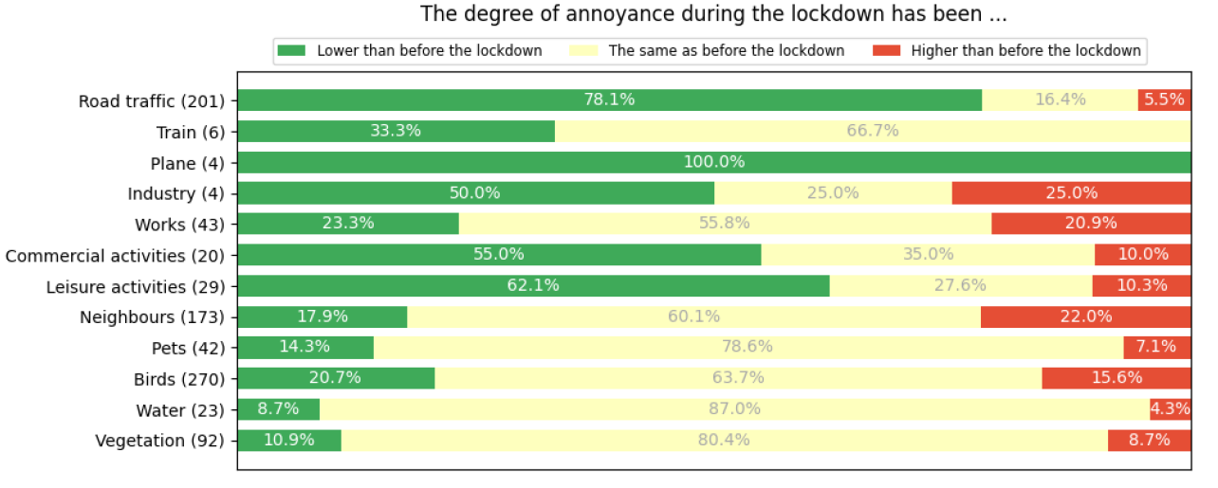
Sons al balcó: Soundscape map of the Confinement in Catalonia

Slide 8

Sons al balcó: Soundscape map of the Confinement in Catalonia
Next steps:
  Detailed analysis of the answers of the questionnaires taking into account socio-demography
  Acoustic and image processing of all the samples collected, and its relation with the questionnaires
  Comparison of the results of the video analysis with the L_{aeq} values from the WASNs deployed in several cities in Catalonia (Girona, Barcelona)
  Analysis of the social networks feedback during the confinement to complement the questionnaires
  Future collecting campaign during the so called ‘New Normal’
  @sonsalbalco

Slide 9
Sons al balcó: Soundscape map of the Confinement in Catalonia
La Salle: Rosa Ma Alsina, Ferran Orga, Roger Mallol, Marc Freixes, Xavier Baño
ISGlobal: Maria Foraster

