Slide 1
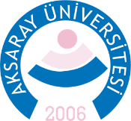
The Overview of Air Quality of Konya During COVID-19 Lockdown Periods
İlker Balcılar, PhD
Department of Environmental Engineering,
Aksaray University, Aksaray 68100, Turkey
ilkerbalcilar@aksaray.edu.tr
Notes:
Sayın hocalarım ve değerli katılımcılar, öncelikle sizlerin huzurunda bu sempozyumda emeği geçen herkese teşekkürlerimi iletmek istiyorum. Bugün benim yürütücüsü olduğum bir BAP projesi kapsamında yaptığımız bir çalışmanın ilk sonuçları hakkında konuşaçağım. Biz bu çalışma kapsamında Aksaray atmosferinde partikül maddeye bağlı eser element düzeylerinin zamansal değişimlerini inceledik ve bunların sonuçlarını sizlerle paylaşıyor olacağım.

Slide 2
1. Introduction
According to WHO, 91% of the world's population lives in places where the level of air pollutants exceeds the limits, and 7.2 million people die prematurely every year due to air pollution.
Particulate matter (PM), and nitrogen dioxide (NO₂) are listed as criteria pollutants by US EPA due their effects on human health.
Prolonged and high-level exposures to PM and NO₂ cause a wide range of effects, from impairing the respiratory system to premature death.
O₃
Pb
SO₂
NO₂
PM
CO
Criteria pollutants

Slide 3


1. Introduction
In response to the COVİD-19 pandemic, countries imposed lockdowns; business, school, shopping mall, market, restaurant closures; and public transportation limitations.
As a result of imposed restrictions, air quality has improved significantly in many parts of the world, especially in Europe and the USA.

Slide 4
1. Introduction
Turkish authorities confirmed the first COVID-19 case on March 11, 2020. Active COVID-19 cases have rapidly increased and >10000 total cases and 168 deaths reported as of March 30th. Turkish government implemented restrictions including closure of businesses, travel restrictions, and age-based lockdowns as of late March. To battle the ongoing surge in cases, full weekend lockdowns were introduced at metropolitan cities.
This study investigates air quality of Konya, which is the 7th biggest city in Turkey with a population of 2.2 million, during the full weekend lockdown periods.For this purpose, daily average concentrations of PM₁₀ and NO₂ of lockdown periods for 2020 compared with the same periods of 2018-2019.

Slide 5
2. Materials and Methods
Turkish government implemented restrictions, and age-based lockdowns as of late March. Four full weekend and holiday lockdowns were introduced at metropolitan cities between April 11th to May 3rd. During this period people were instructed to stay at home in total of 11 days out of 28 days.
Turkey has a 355 active monitoring stations operated under the National Air Quality Monitoring Network. Stations are located in urban and rural areas to measure emissions emitted from vehicles, industries and domestic.

Slide 6
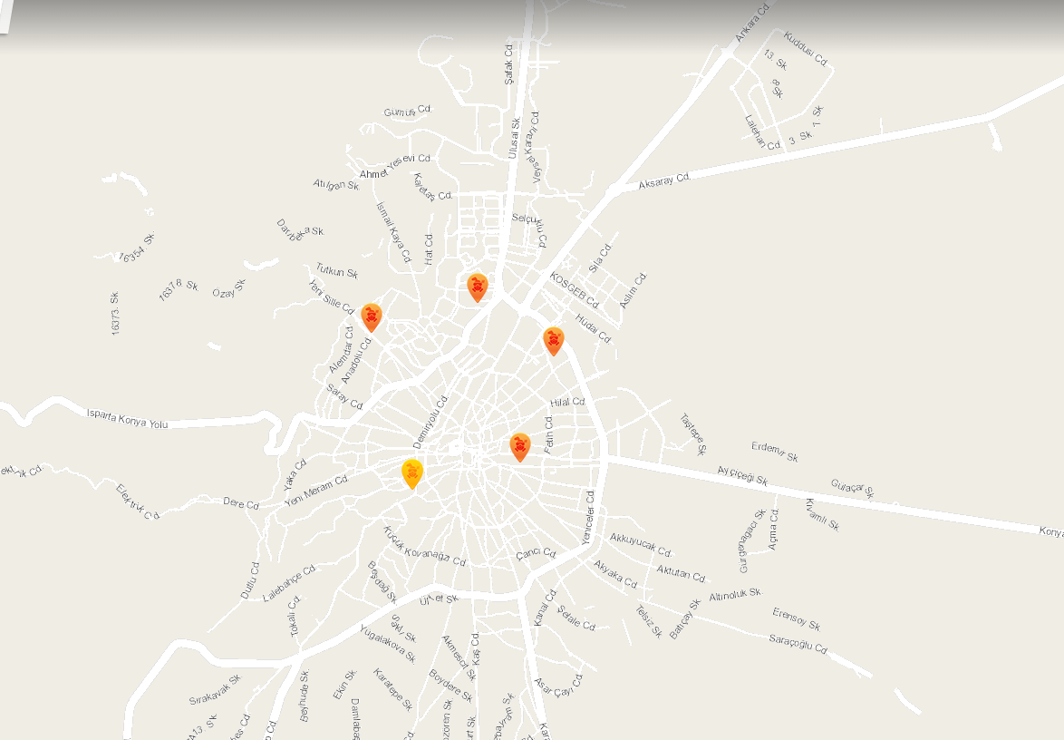
2. Materials and Methods
The station used in study is located at Konya city center (32° 30' 58.68"N, 37° 52' 5.16"E).
Hourly measurements of PM₁₀ and NO₂ for April 6th to May 3rd of 2018-2020 were downloaded through the web portal of the national network. The data obtained for Konya station was classified into two as current (2020) and historical (2018-2019).
Sampling Station

Slide 7
3. Results
The findings of this study evidence that the measured concentrations of PM₁₀ and NO₂ has declined significantly during the lockdown periods of COVID-19.
The highest reduction in Konya atmosphere was observed in PM₁₀ concentration. PM₁₀ concentration was declined 55.7% in 2020 compared to 2018-2019 period. The reduction observed for PM₁₀ is larger than Baghdad (15%), but less than Morocco (75%).

Slide 8
3. Results
NO₂ was declined significantly with an 37.7% in 2020 compared to 2018-2019 period. This reduction is larger than some USA cities (25.5 % overall), but less than European cities such as, Barcelona, Milan, Madrid, and Lisbon (>50%).

Slide 9

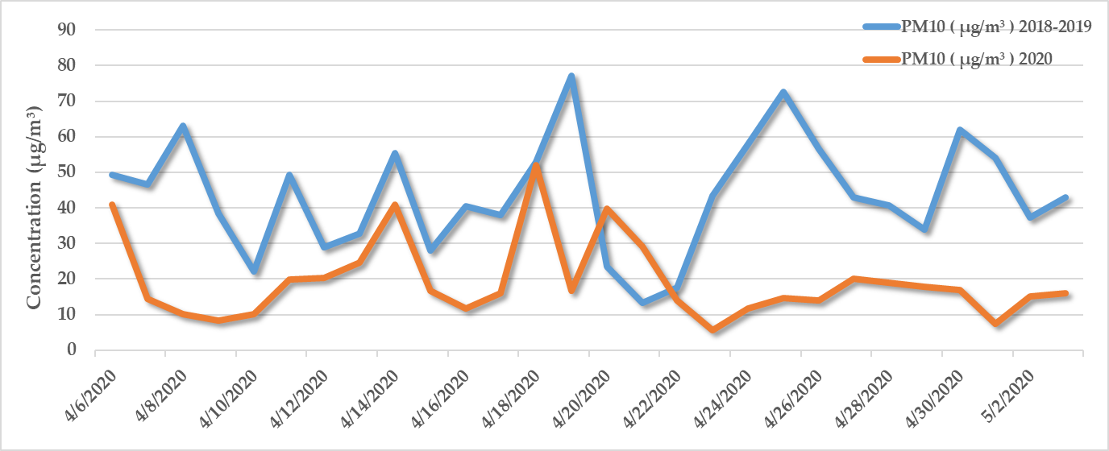
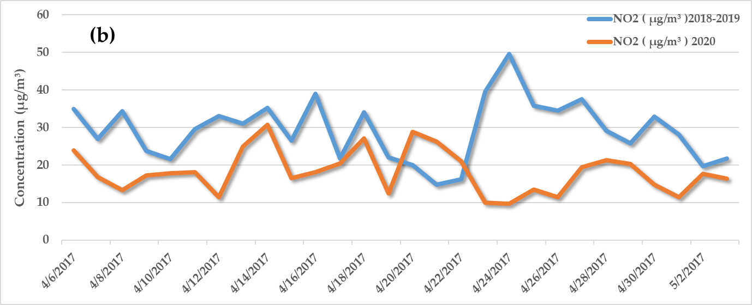
3. Results
The figures provides a visual time-series plots of daily average concentrations of PM₁₀ and NO₂ for April 6th to May 3rd of 2020, in relation to the daily average concentrations for April 6th to May 3rd of 2018-2019.
NO₂ levels were less reduced than PM₁₀. The main source of the NO₂ is traffic in urban areas. Sharp increases in concentrations of NO₂ were observed during weekdays after the full weekend lockdowns.

Slide 10
3. Results
PM in urban areas has other sources than traffic such as, industry, fossil fuel combustion. Even after the weekend and holiday lockdowns, industries and businesses remained closed. This may be responsible for the higher reduction in PM₁₀ compared to NO₂.

Slide 11
4. Conclusions
Measures taken to battle the COVID-19 virus have decreased the airborne pollutant levels as in many parts of the world.
In this study, it was shown that PM₁₀ and NO₂ concentrations decreased significantly during lockdown periods compared to the previous years.
It can be concluded that the reductions in concentrations of pollutants are due to the measures taken to battle the COVID-19 pandemic.
Air pollution is a common problem for the whole world, but it is known that the measures taken to solve it are still insufficient.
It is clearly observed that human activities have a great impact on air pollution.
Control measures that can keep the air pollution at a sustainable low level need to be taken.

Slide 12
THANK YOU
FOR YOUR TIME
AND ATTENTION

