Slide 1
The Impact of Precarious Work on Going to Work Sick and Sending Children to School Sick During the COVID-19 Pandemic
Mindy Shoss, University of Central Florida & Australian Catholic University
Hanyi Min, University of Central Florida
Kristin Horan, University of Central Florida
Ann Schlotzhauer, University of Central Florida
Jeannie Nigam, National Institute for Occupational Safety and Health, CDC
Naomi Swanson, National Institute for Occupational Safety and Health, CDC

Slide 3
Presenteeism During COVID-19
Presenteeism involves going to work sick
Using the ROI Rocket Survey firm, we recruited a sample of 303 individuals working full-time on site. Survey 1 was distributed August 27- September 4, 2020. This report examines responses to this survey and a follow-up survey distributed 3 weeks later.
We examined four forms of presenteeism:
Going to work sick in general
Going to work sick with a confirmed or possible COVID case
Going to work when a contact has confirmed or possible COVID case
Sending a child to school/daycare while sick

Slide 4
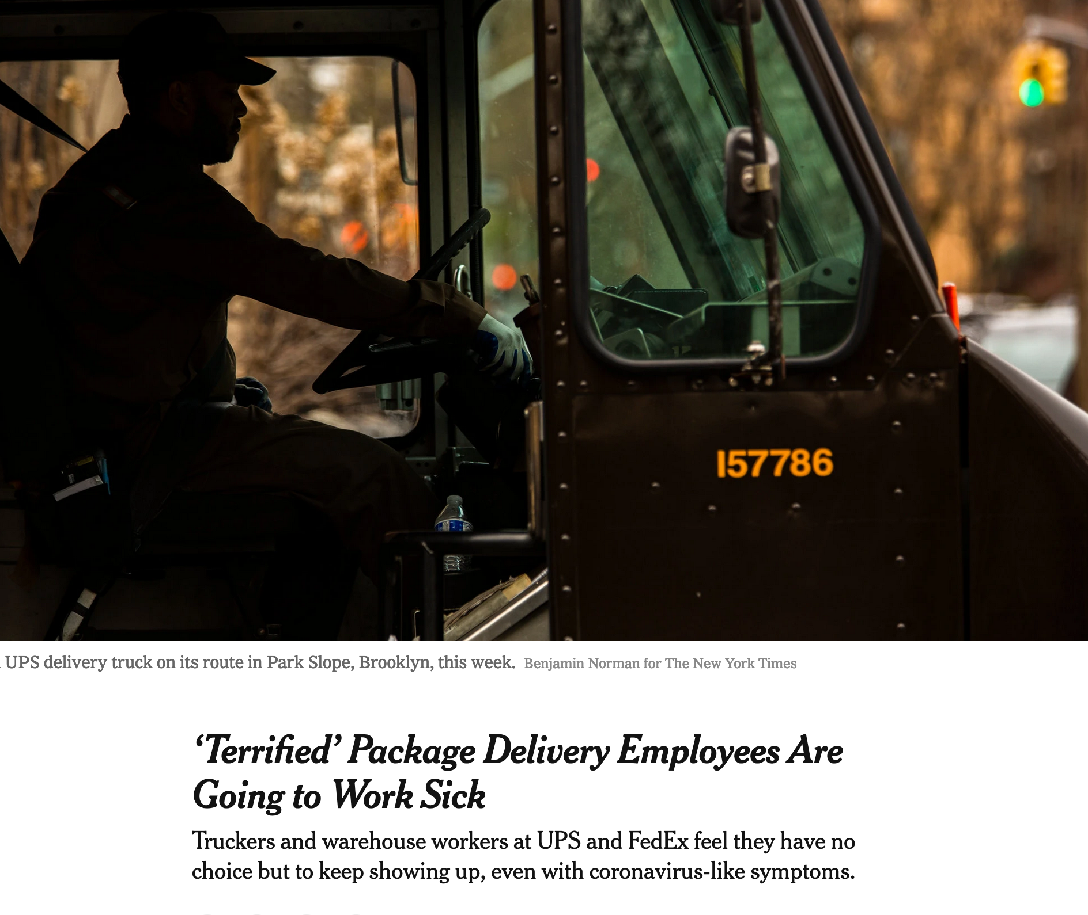

Slide 5
Precarious Work
Precarious work captures work conditions marked by:
Job insecurity
Financial insecurity
Worker vulnerability
Inability to exercise rights (e.g., to take a sick day)
Precarity creates fear and constrains choices
We examined precarious work conditions as a predictor of presenteeism
Benach et al., 2007; Kalleberg, 2009; Lusardi et al. 2011; Vives et al., 2010; Rudolph et al., 2020

Slide 6
Employer COVID Assistance?
We also examined the role of employer policies by asking participants the extent to which they benefitted from the following policies:
Provided additional or new paid sick leave options for some or all employees Waived attendance policy for some or all employees Offered pay for some or all employees who get sick with COVID-19 Offered pay for some or all employees who are subject to quarantine Offered regular pay for some or all employees, even those in offices/stores/worksites that are shut down due to the crisis Offered reduced pay for some or all employees, even those in offices/stores/worksites that are shut down due to the crisis Provided funds to help pay for the cost of medical check-ups for some or all employees | Created a relief fund to help workers in need Made back-up child-care available to some or all employees Engineered the workplace for infection prevention (through measures such as improving air quality and ventilation, adding physical barriers, or adding spaces that minimize contact like a drive through, etc.) Administered workplace policy for infection prevention in ways other than the policies mentioned above (through COVID-19 education policies, discontinuing nonessential travel, etc.) Established safe work practices for infection prevention (through resources, reminders, and policies that promote hygiene, such as hand washing) Provided or encouraged personal protective equipment for infection prevention (i.e. providing masks).

Slide 7
Methods
Using the ROI Rocket Survey firm, we recruited a sample of 303 individuals working full-time in-person at a work site
The sample is mostly female (74.75%) and Caucasian (83.67%).
Wave 1 of data collection took place between August 27 and September 4, 2020 (N= 303); and Wave 2 was distributed 3 weeks later (N =210).
Participants who only responded to the Wave 1 survey are significantly younger than those who participated in both surveys (t=2.91, p=.004), but these two groups did not significantly differ in gender (t=-.25, p=.80). Thus, we included age as a control.
The largest portion of the sample (27.24%) reported working in health care or social assistance, 8.97% work in retail trade, 7.31% in education, and the remainder in other industries.

Slide 8
Measures – Precarious Work
Construct | Sample item and reference
Job insecurity | “I feel uneasy about losing my job in the near future” Hellgren et al., 1999
Financial insecurity | “I have financial stability” Reverse coded, Munyon et al., 2020
Vulnerability | “Please indicate the frequency with which each of the following occurs... You are able to request better working conditions without being exposed to retaliation?” Reverse coded, Vives et al., 2015
Exercise Rights | “Please indicate how often you are able to do the following without obstacles from your work...Take sick leave when you need to” Vives et al., 2015

Slide 9
Measures - Presenteeism
Type of Presenteeism | Item
General Presenteeism (Johns, 2010) | How many days in the past 3 weeks (including today) did you go to work even though you were sick or not feeling well?”
COVID-Self Presenteeism | “Did you go to work at any point over the past 3 weeks after someone with whom you have had contact had a confirmed or possible case of COVID- 19?”
COVID-Contact Presenteeism | “Did you go to work at any point over the past 3 weeks even though you had a possible or confirmed case of COVID-19?”
Secondary Presenteeism | “Did one or more of the children living in your home attend daycare or school even though they had any of the following symptoms? (0 days-21 days) (COVID-symptoms from CDC)

Slide 10
Rates from Time 2 Survey
6.93% reported COVID-self presenteeism
10.45% reported COVID-contact presenteeism
15.38% of respondents with children (n=78) reported secondary presenteeism

Slide 11
Precarious Work Predictors (Time 1) | Time 2 Presenteeism General b(se) | Time 2 Presenteeism COVID19 b(se) | Time 2 Presenteeism Contact COVID19 b(se) | Time 2 Secondary Presenteeism b(se)
Financial Security | -.41 (.30) | .09 (.20) | -.07(.27) | -.16 (.25)
Job Insecurity | -.48 (.35) | -.38 (.24) | -.26 (.32) | 1.04 (.38)**
Vulnerability | 1.63 (.56)** | .94 (.38)* | 1.21 (.50)* | -.07 (.55)
Ability to Exercise Rights | -.28 (.31) | .01 (.21) | .10 (.28) | .01 (.28)
Age | .02 (.04) | .03 (.03) | -.03 (.04) | .01 (.05)
R² | .08 | .04 | .04 | .17
Table 1. Multiple regression results predicting Time 2 presenteeism variables from Time 1 precarious work. *p < .05; **p < .01

Slide 12
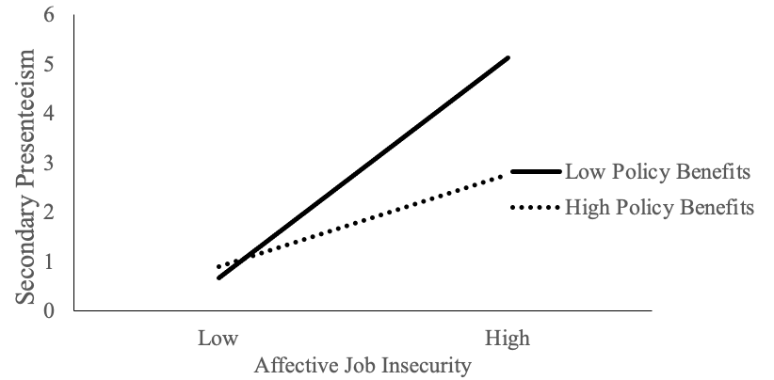
Figure 1. Interaction between affective job insecurity and employer policy benefits predicting secondary presenteeism (days sent child to school or daycare sick).

Slide 13
Conclusions
Precarious work conditions, particularly worker vulnerability and job insecurity, appear to be risk factors for virus spread
Safety net mechanisms at the organization level may serve to minimize some risk, at least to the extent to which they address the needs of workers

