Slide 1
THE IMPACT OF THE AVERAGE TEMPERATURE, HUMIDITY, WIND SPEED, ALTITUDE AND POPULATION DENSITY ON DAILY COVID-19 INFECTIONS’ EVOLUTION
Rachid LAGTAYI, Lamya LAIRGI , Abdelmajid DAYA, Ahmed KHOUYA

Slide 2
PLAN
Introduction
1
2
Data bases
3
Results and Discussion
Conclusion

Slide 3
Introduction Data bases Results and discussion Conclusion
Swin Flu
1918-1920
COVID 19
December 2019
Sars
Spanish Flu
39 million of deaths
2% of the world population
Ebola
Mers

Slide 4
Introduction Data bases Results and discussion Conclusion
30th April 2020
3,090,445
Detected Cases
217,769
Deaths
1,030,715
recovered

Slide 5
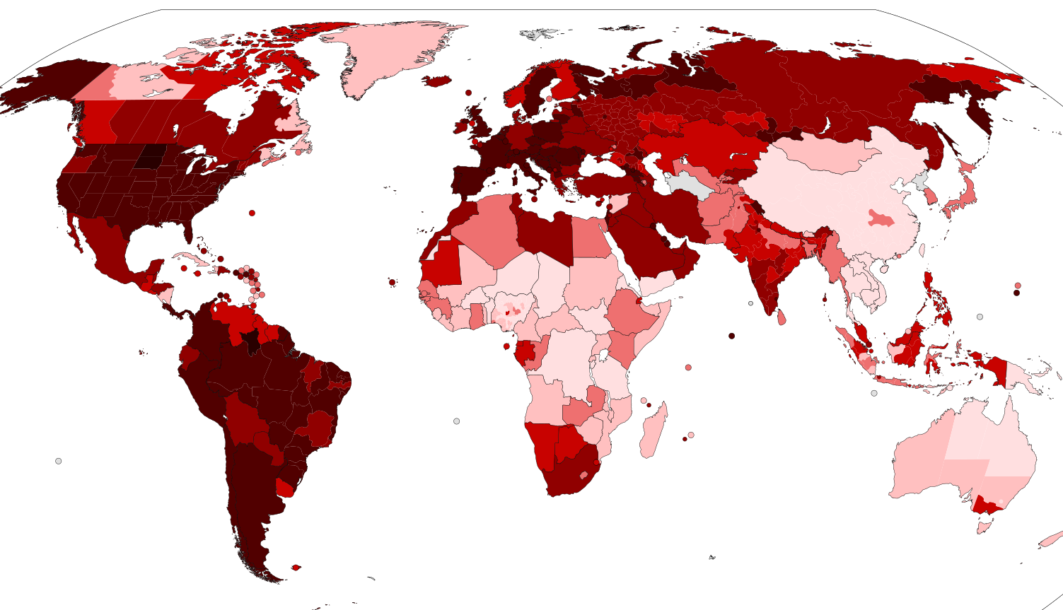
Introduction Data bases Results and discussion Conclusion
World Health Organization has announced a state of emergency
Study the impact of the daily average wind speed and population density on the daily number of COVID-19 infections around six different cities
Paris France
Lombardy Milan ITALY
New Yorkn USA
Madrid SPAIN
Casablanca Morocco
Wuhan CHINA
February the 1st to the 25th of April 2020

Slide 6
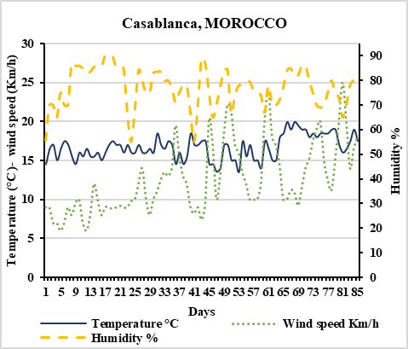
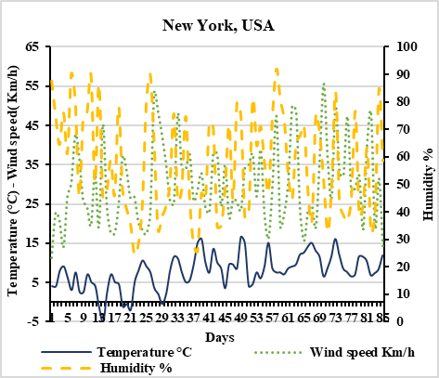
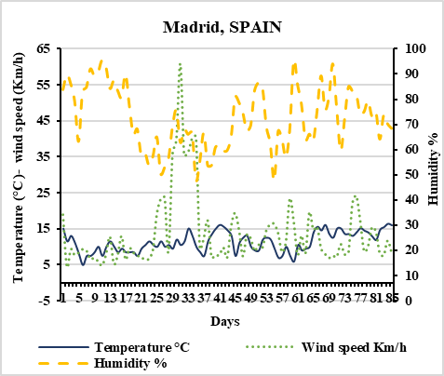
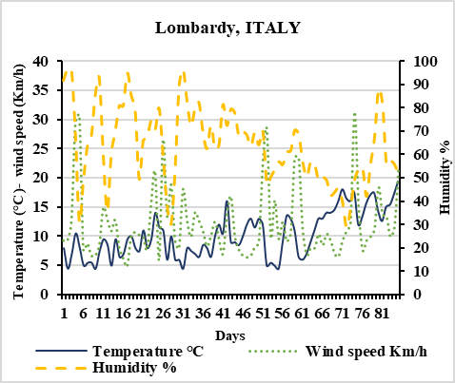
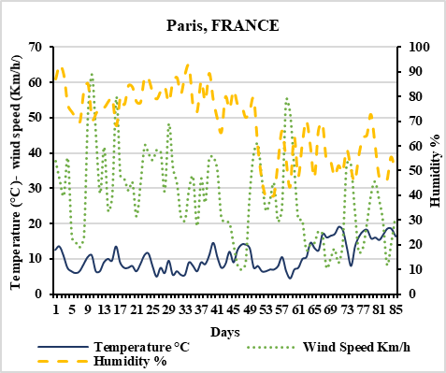
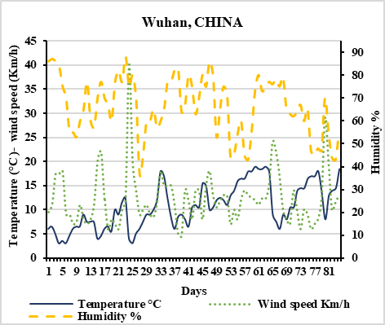
Introduction Data bases Results and discussion Conclusion
Climate data Polulation density data Daily and cumulated COVID-19 infections

Slide 7
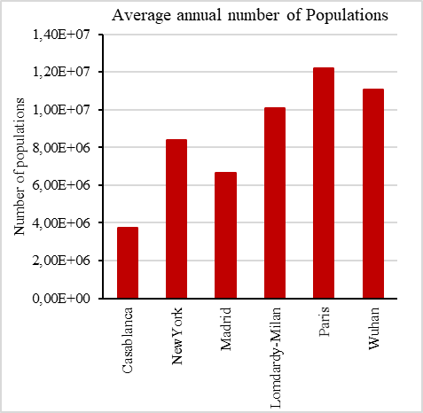
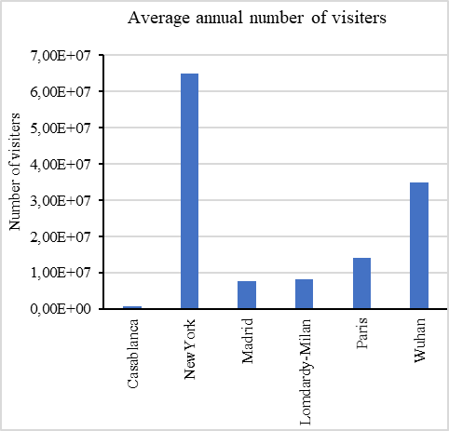
Introduction Data bases Results and discussion Conclusion
Climate data Polulation density data Daily and cumulated COVID-19 infections

Slide 8
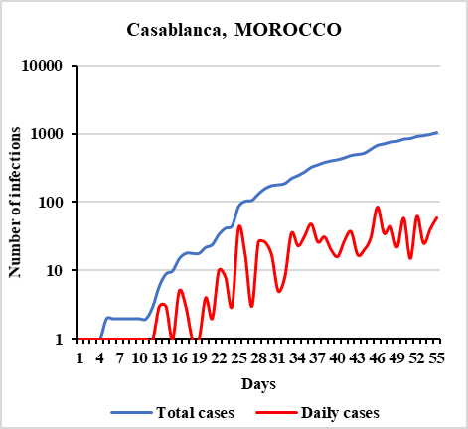
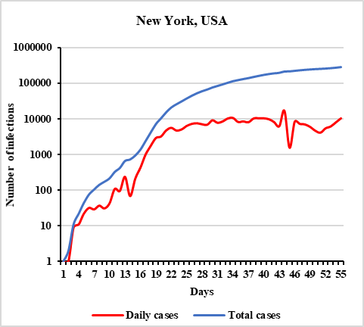
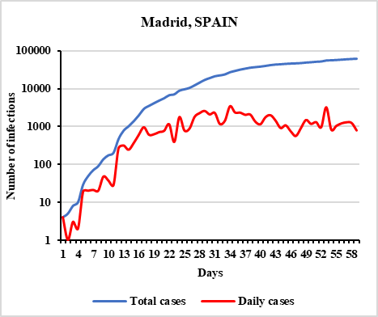
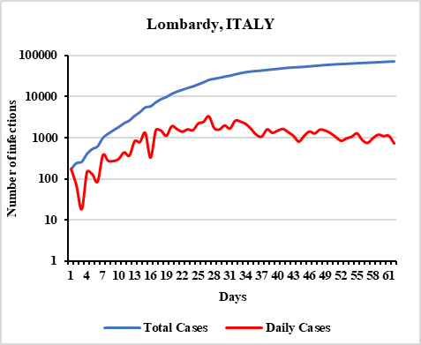
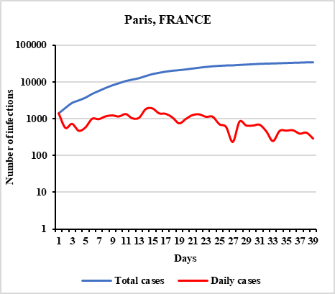
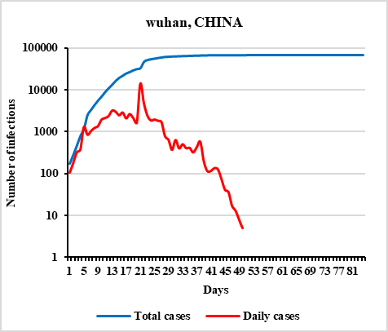
Introduction Data bases Results and discussion Conclusion
Climate data Polulation density data Daily and cumulated COVID-19 infections

Slide 9
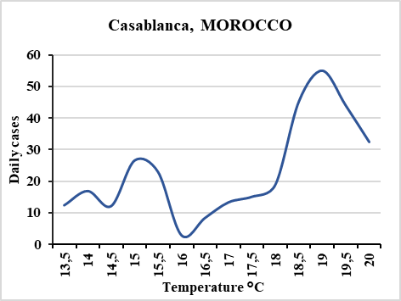
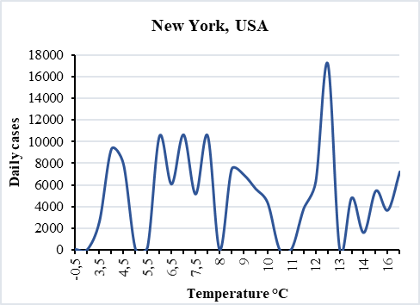
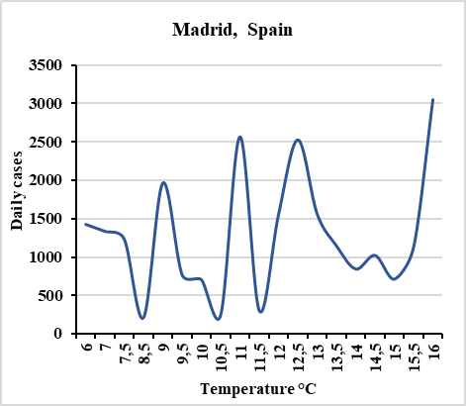
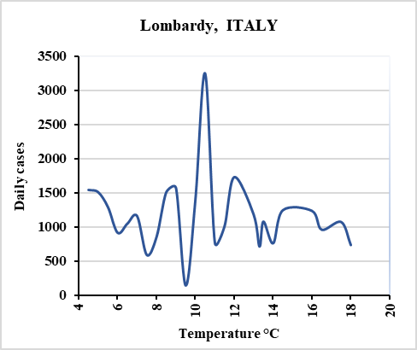
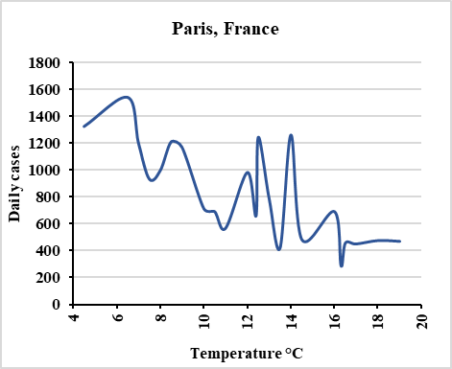
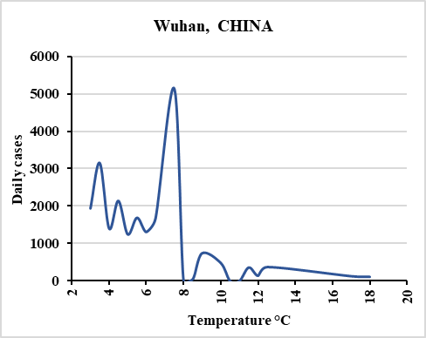
Introduction Data bases Results and discussion Conclusion
Temperature Effect Humidity Effect Wind Speed Effect Altitude and population density impact Proposed Mathematical Model

Slide 10
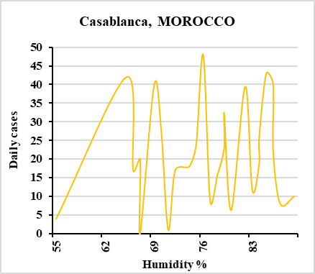
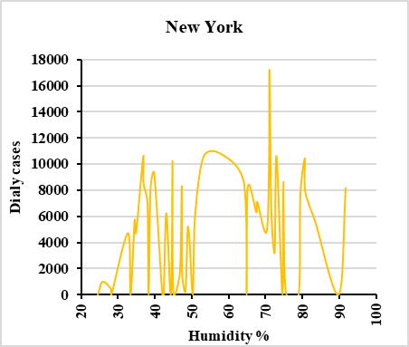
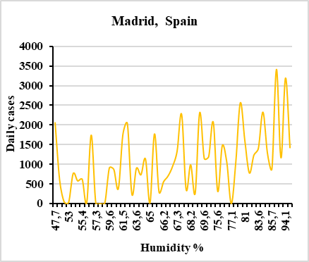
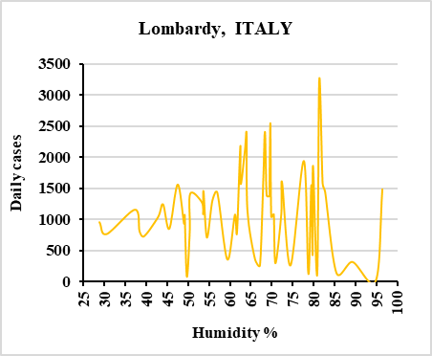
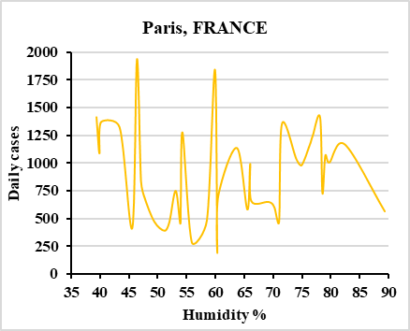
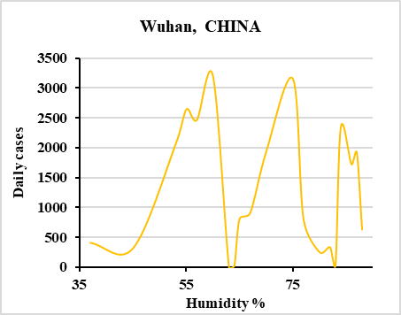
Introduction Data bases Results and discussion Conclusion
Temperature Effect Humidity Effect Wind Speed Effect Altitude and population density impact Proposed Mathematical Model

Slide 11
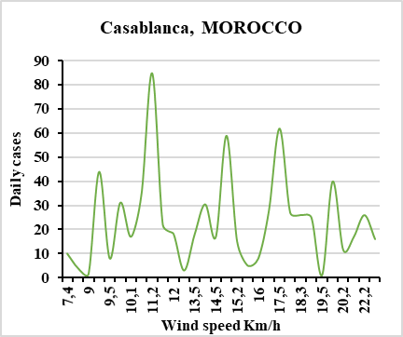
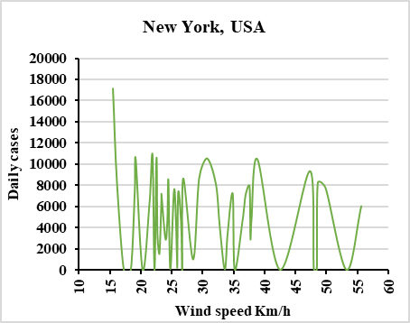
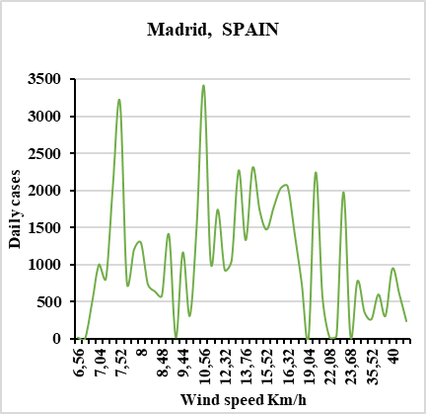
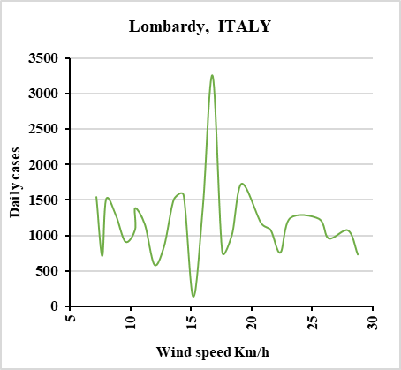
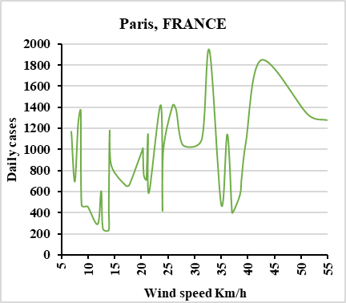
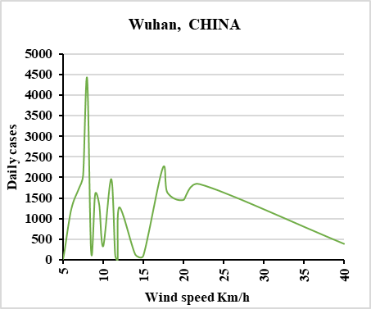
Introduction Data bases Results and discussion Conclusion
Temperature Effect Humidity Effect Wind Speed Effect Altitude and population density impact Proposed Mathematical Model

Slide 12
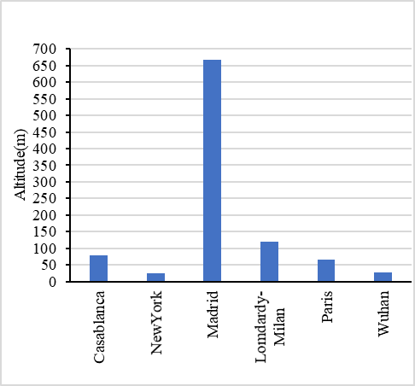
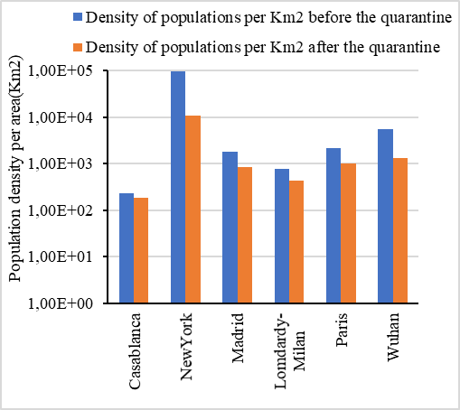
Introduction Data bases Results and discussion Conclusion
Temperature Effect Humidity Effect Wind Speed Effect Altitude and population density impact Proposed Mathematical Model

Slide 13
Introduction Data bases Results and discussion Conclusion
Temperature Effect Humidity Effect Wind Speed Effect Altitude and population density impact Proposed Mathematical Model
To estimate the impact of climatic parameters (Wind speed $W_{i}$) and population density on the variations of daily COVID-19 infections around the six cities under study.
P_{s} Average annual population density in a city
P_{t} Average annual visitors’ density across each city
Before quarantine: $P_{total}$= $P_{s}$+$P_{t}$
After quarantine: $P_{total}$= $P_{s}$
The average annual number of populations N(t) in a city could be presented as(You et al. 2020): N(t)=S(t)+I(t)+R(t)
The variables S (t), I (t) and R (t) vary over time and they could be presented by SIR model by a system of three differential equations as follow(McCluskey 2010; Satsuma et al. 2004):
$$\left\{\begin{aligned}\frac{dS}{dt}=−aS\left(t\right).I(t) \\ \frac{dI}{dt}=aS\left(t\right).I(t)−bI(t) \\ \frac{dR}{dt}=bI (t) \end{aligned}\right.$$
S (t): Number of susceptibles on day t.
I (t): Number of infected cases on day t.
R (t): Number of recovered patients on day t.
a: expected amount of people an infected person infects per day (a≃1/tip).
b: Proportion of recovered patients per day (b = 1/D), (D=14 days in our estimations).
tip: average incubation period (equals 5.75 days in our study)

Slide 14
Introduction Data bases Results and discussion Conclusion
Temperature Effect Humidity Effect Wind Speed Effect Altitude and population density impact Proposed Mathematical Model
Population density affected very highly the number of COVID-19 infections with a rate of 90%.
Climatic conditions (wind speed) contribute slightly in reducing the number of daily infected cases by an approximate rate of 10%.
$$\left\{\begin{aligned}\frac{dS}{dt}=−(a+γ)S\left(t−t_{ip}\right).I(t−t_{ip}) \\ \frac{dI}{dt}=\left(a+γ\right)S\left(t−t_{ip}\right).I\left(t−t_{ip}\right)−(b+γ)I(t) \\ \frac{dR}{dt}=(b+γ)I (t) \end{aligned}\right.$$
$γ$ is the proportion in which climatic conditions contribute in reducing the number of susceptibles then infections.
The population density factor affects the evolution of infections by 90%, while the climatic parameters affects it by only 10%, so 𝛾 < a, then, we estimated that 𝛾 ≃ $\frac{a}{9}$.
$$\left\{\begin{aligned}if S>\frac{a+γ}{b+γ} so \frac{dI}{dt}>0 \\ if S<\frac{a}{b} so \frac{dI}{dt}<0 \end{aligned}\right.$$

Slide 15
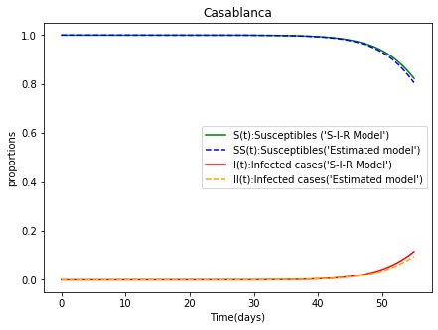
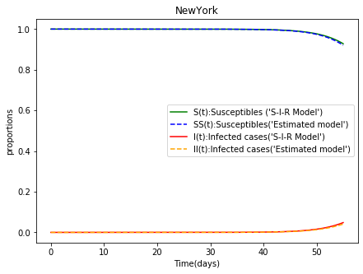
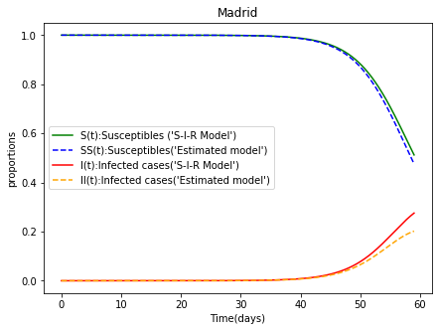
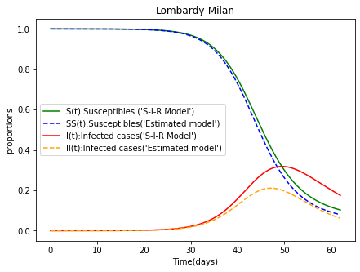
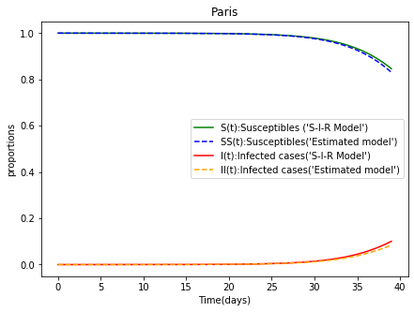
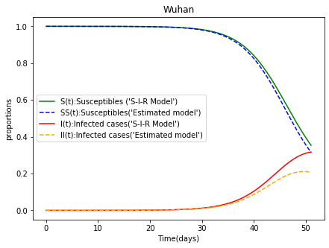
Introduction Data bases Results and discussion Conclusion
Temperature Effect Humidity Effect Wind Speed Effect Altitude and population density impact Proposed Mathematical Model

Slide 16
Conclusion
The temperature, the humidity and the altitude parameters have no impact on daily number of COVID-19 infections
For an average wind speed greater than 25km/h, the number of COVID-19 infections is slightly decreased with a rate of 10%.
Perspective: The results give serious thought to a special ventilation system in buildings and hospitals to reduce contamination by COVID-19
Results
The estimated mathematical model showed that the number of daily susceptibles and infections has slightly decreased compared to presented S-I-R model.
Population density has a significant impact on the daily COVID-19 spread with a rate of 90%.

Slide 17
Thank you for your attention

