Slide 1
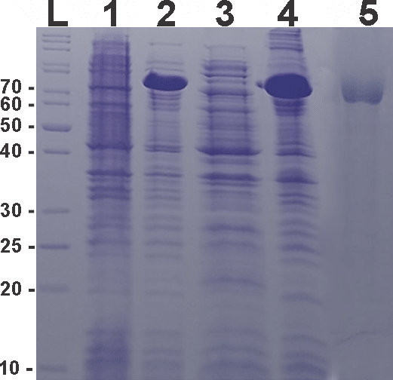
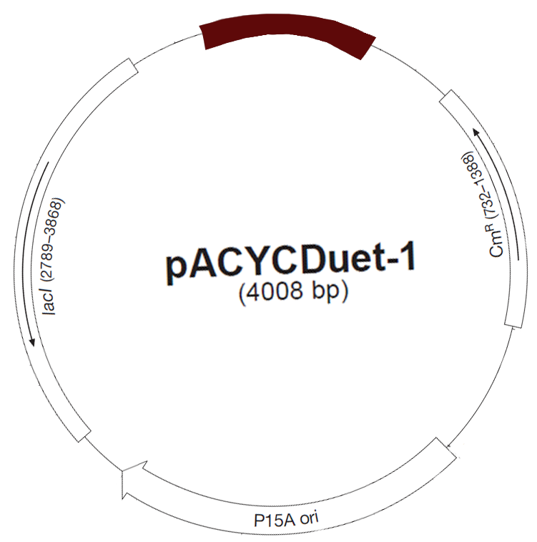
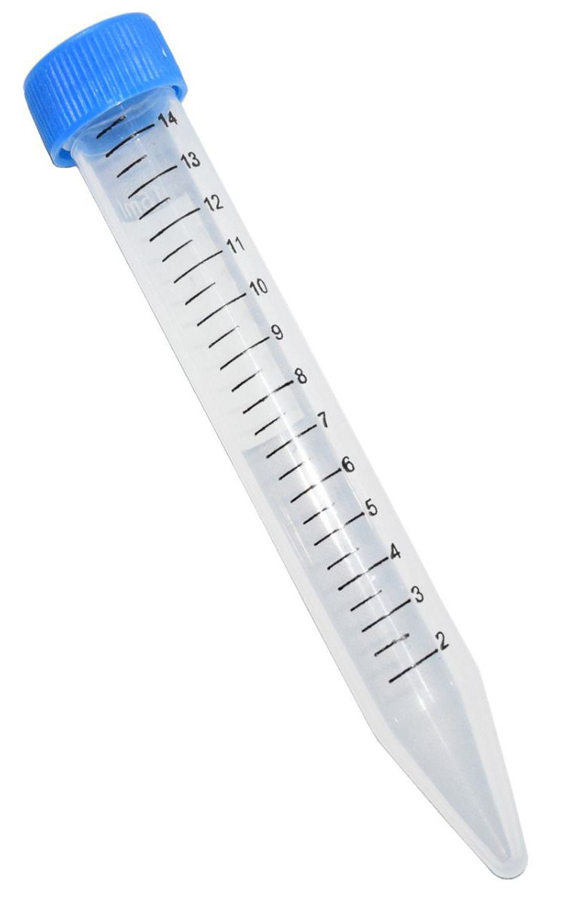
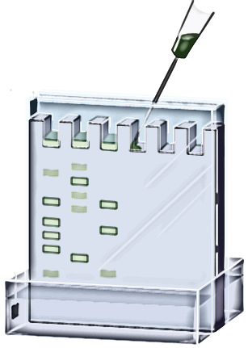
Cloning and expression of a Hemocyanin isolated from the centipede Cryptops iheringi
Kariny P. Cruz¹; Milton Y. Nishiyama Jr ³; Inácio de Loiola Meirelles Junqueira de Azevedo³; Geraldo Santana Magalhães¹; Lhiri Hanna Alves De Lucca Shimokawa-Falcão¹.² ¹Laboratory of Immunopathology, Butantan Institute, Brazil. ²Post-Graduation Toxinology, Instituto Butantan, Brazil. ³ Special Laboratory of Applied Toxinology, Instituto Butantan, Brazil.
INTRODUCTION
RESULTS AND CONCLUSION
In this work a transcriptomic analysis of the C. iheringi venom gland was performed to obtain a profile of the toxins of this species. In addition, the crude venom was subjected to mass spectrometry analysis to establish an association between unknown sequences. These approaches for the construction of a general profile of the venom gland expression of this species led to the he identification of a Hemocyanin (Hc) subunit.
Hemocyanins are copper-containing, respiratory proteins that occur in the haemolymph of many arthropod species. Here, we report the presence of Hc in the chilopode Myriapoda C. iheringi. Such respiratory proteins have long been considered unnecessary in Myriapoda, due to its tracheal systems.
These respiratory proteins are potent immunogens, which induce the synthesis of large amounts of specific antibodies. Studies pointed out its interaction with polymorphonuclear monocytes and lymphocytes and in vitro tests have shown a potential anticancer activit, with in vitro significant inhibition of the growth of cancerous strains of the breast, pancreas and prostate. Currently scientific data is mostly limited to the study of native Hc of M. crenulata molluscs, therefore, the biotechnological potential of Hcs isolated from centipedes is still unexplored.
The Hc sequence have a 76 kDa range. The Hc subunit sequence was succecefuly expressed as inclusion bodies. Refolding attempts provided soluble forms of Hc that now will be used to explore its anticancer activit.
SDS-PAGE 12% containing the expression and refolding of Hemocyanin after 4h of 1mM IPTG induction. Stained with Comassie blue .
L- Ladder, 1- bacterial pellet before 1mM IPTG induction, 2 - bacterial pellet after IPTG induction, 3- supernatant, 4- Refolded protein.
METHODS
REFERENCES
The Hc subunit sequence was synthesized with codon optimization for bacteria expression and the protein expressed as inclusion bodies. Refolding attempts provided soluble forms of Hc.
M. Jürgen., M. Arne., M. G. Andreas., R. Judith, G. Wolfgang., D. Frank., 2009. 10-Å CryoEM Structure and Molecular Model of the Myriapod (Scutigera) 6 × 6mer Hemocyanin: Understanding a Giant Oxygen Transport Protein. Elsevier.
S. Samantha., H. Nadja ., F. Rosa., P. Christian., B. Thorsten., 2018. Diversity, evolution, and function of myriapod hemocyanins. BMC Evolutionary Biology.
K. C. T. Riciluca., A. C. Borges.,J. F. R. Mello., U. C. de Oliveira.,D. C. Serdan., A. Florez-Ariza.,E. Chaparro.,M. Y. Nishiyama-Jr., A. Cassago.,I. L. M. Junqueira-de-Azevedo., M. van Heel., P. I. Silva Jr.,R. V. Portugal., 2020. Myriapod haemocyanin: the first three-dimensional reconstruction of Scolopendra subspinipes and preliminary structural analysis of S. viridicornis. Open Biology.
Hemocyanin
pET24b (+)
Transformation and expression in BL21-star bacteria
C. iheringi venom 10ug
THE AUTHORS ACKNOWLEDGE THE FINANCIAL SUPPORT OF
6 M Urea -100mM DTT
3 M Urea pellet wash
Cellular disruption
CORRESPONDENCE
kariny.cruz@butantan.gov.br
Slow buffer change for urea removal
SDS-PAGE

Slide 2
Cloning and expression of a Hemocyanin isolated from the centipede Cryptops iheringi
Kariny P. Cruz¹; Milton Y. Nishiyama Jr ³; Inácio de Loiola Meirelles Junqueira de Azevedo³; Geraldo Santana Magalhães¹; Lhiri Hanna Alves De Lucca Shimokawa-Falcão¹.² ¹Laboratory of Immunopathology, Butantan Institute, Brazil. ²Post-Graduation Toxinology, Instituto Butantan, Brazil. ³ Special Laboratory of Applied Toxinology, Instituto Butantan, Brazil.
INTRODUCTION
In this work, a transcriptomic analysis of the C. iheringi venom gland was performed to obtain a profile of the toxins of this species. In addition, the crude venom was subjected to mass spectrometry analysis to establish an association between unknown sequences. These approaches for the construction of a general profile of the venom gland expression of this species led to the he identification of a Hemocyanin (Hc) subunit.
Hemocyanins are copper-containing, respiratory proteins that occur in the haemolymph of many arthropod species. Here, we report the presence of Hc in the chilopode Myriapoda C. iheringi. Such respiratory proteins have long been considered unnecessary in Myriapoda, due to its tracheal systems.
These respiratory proteins are potent immunogens, which induce the synthesis of large amounts of specific antibodies. Studies pointed out its interaction with polymorphonuclear monocytes and lymphocytes and in vitro tests have shown a potential anticancer activit, with in vitro significant inhibition of the growth of cancerous strains of the breast, pancreas and prostate. Currently scientific data is mostly limited to the study of native Hc of M. crenulata molluscs, therefore, the biotechnological potential of Hcs isolated from centipedes is still unexplored.

Slide 3
METHODS
The Hc subunit sequence was synthesized with codon optimization for bacteria expression and the protein expressed as inclusion bodies. Refolding attempts provided soluble forms of Hc.
Hemocyanin
pET24b (+)
Transformation and expression in BL21-star bacteria
C. iheringi venom 10ug
6 M Urea -100mM DTT
Cellular disruption
3 M Urea pellet wash
Slow buffer change for urea removal
SDS-PAGE

Slide 4
RESULTS AND CONCLUSION
76 kDa
SDS-PAGE 12% containing the expression and refolding of Hemocyanin after 4h of 1mM IPTG induction. Stained with Comassie blue
L- Ladder, 1- bacterial pellet before 1mM IPTG induction, 2 - bacterial pellet after IPTG induction, 3- supernatant, 4- Refolded protein.
ACKNOWLEDGMENT
CORRESPONDENCE
kariny.cruz@butantan.gov.br

