Slide 1
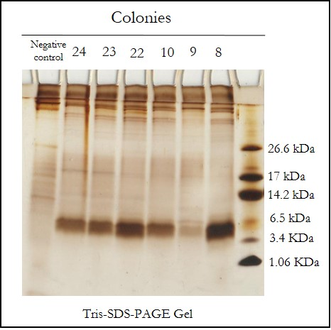
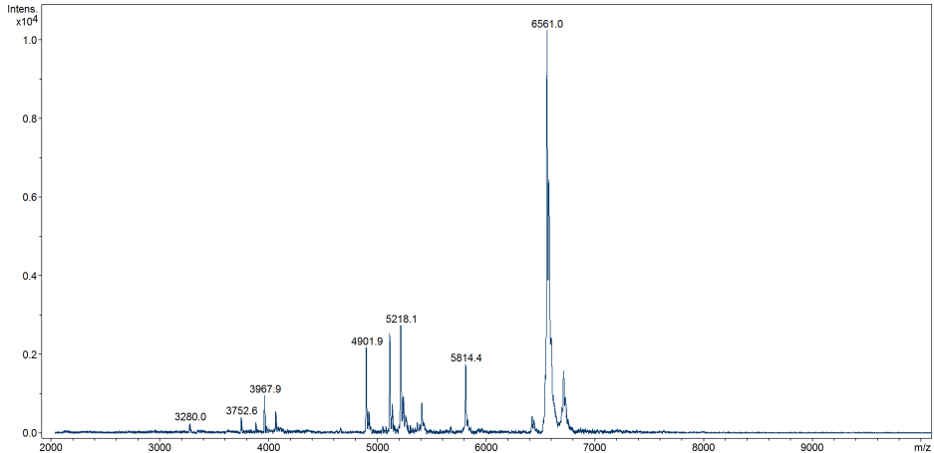
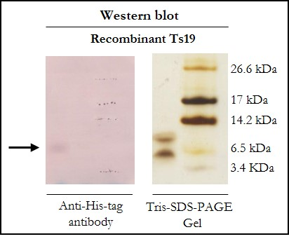
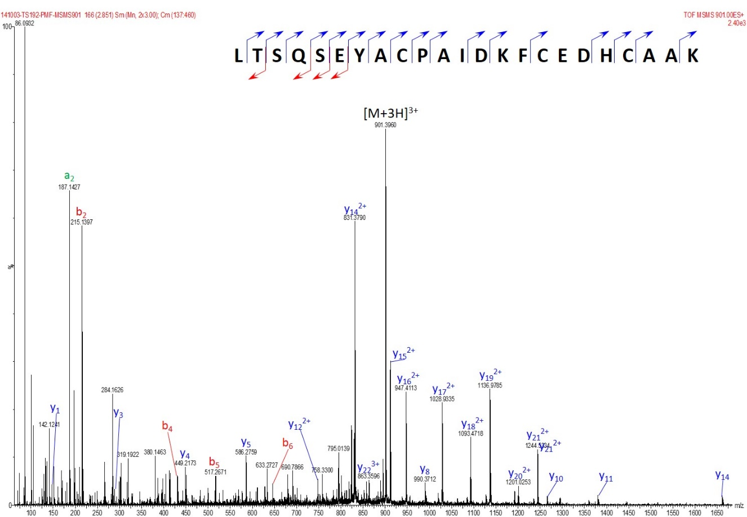
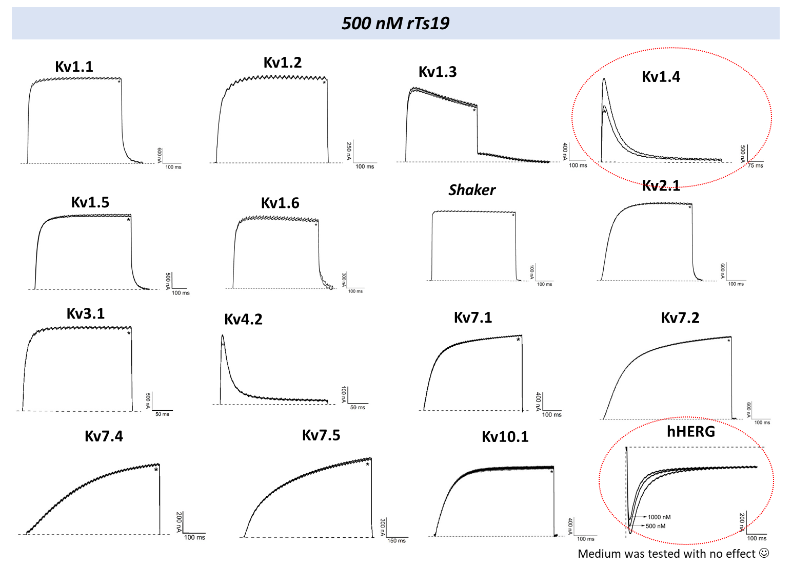
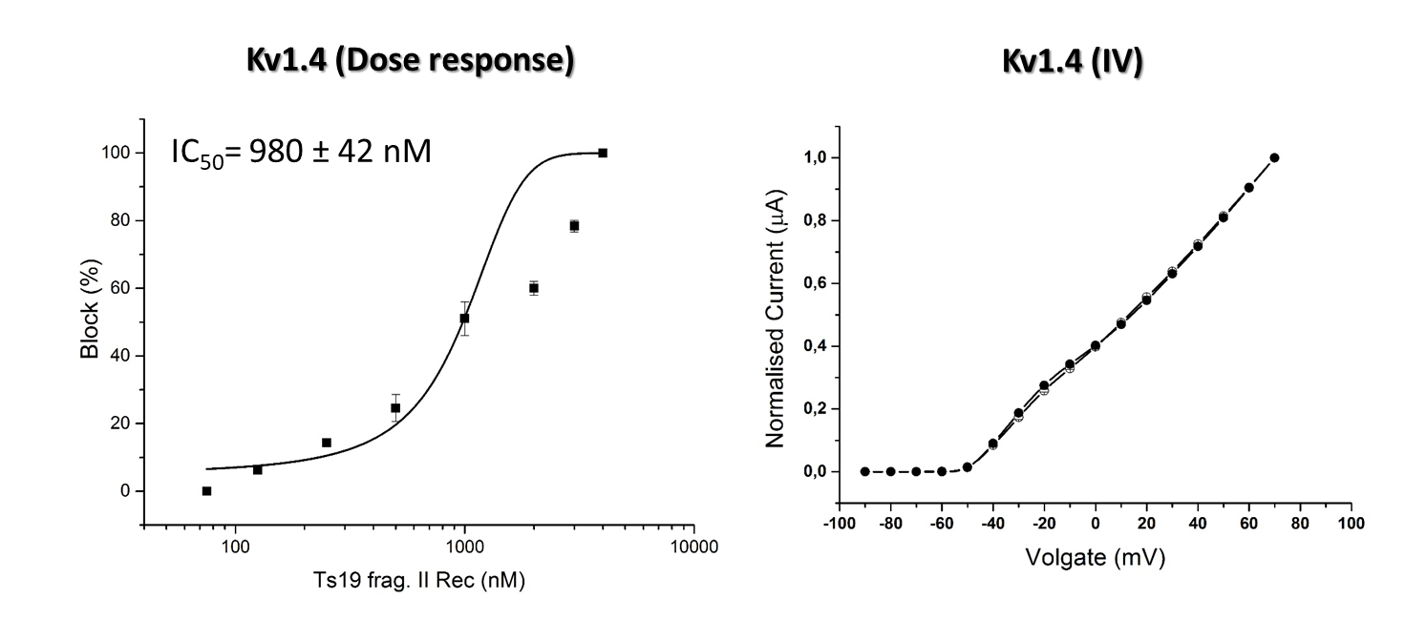
SHEDDING NEW LIGHTS ON THE RECOMBINANT β-KTX NEUROTOXIN FROM Tityus serrulatus: HETEROLOGOUS EXPRESSION, STRUCTURAL AND FUNCTIONAL CHARACTERIZATION
Fernanda Gobbi Amorim^{1*}, Johara Boldrini França², Francielle Almeida Cordeiro³, Felipe Augusto Cerni³, Manuela Berto Pucca⁴, Steve Peigneur⁵, Jan Tytgat⁵, Julien Echterbille¹, Loic Quinton¹, Eliane Candiani Arantes³
¹ Laboratory of Mass Spectrometry, Department of Chemistry, University of Liège, Liège, Belgium, ² Postgraduate Program in Ecosystem Ecology, Vila Velha University, Vila Velha, Brazil, ³ School of Pharmaceutical Sciences of Ribeirão Preto, University of São Paulo, Ribeirão Preto, Brazil, ⁴ Medical School, Federal University of Roraima, Boa Vista, Brazil, ⁵ Toxicology and Pharmacology, University of Leuven, Leuven, Belgium
* Corresponding author: Fernanda Gobbi Amorim, PhD - email: fernandagamorim@gmail.com
INTRODUCTION AND AIMS
RESULTS AND DISCUSSION
Neurotoxins are the major responsible for the symptoms caused by Tityus serrulatus envenoming due to their actions on ion-channels of excitable cells. However, the structural and functional analyses of these toxins is difficult due to the low amount of purified toxin obtained from the crude venom. The combination of “-omics” techniques allows the precise identification of novel components with biotechnological applications enabling its heterologous expression. We reported the heterologous expression of the recombinant Ts19 (rTs19), a β-KTx neurotoxin, and their structural and functional characterizations.
MALDI-TOF
Recombinant
Ts19 reduced
3 disulfide bridges
6561.0
P. pastoris impurities
Figure 1 – Heterologous expression of different colonies of Ts19 after 96h of induction. Tris-SDS-PAGE gel of the colonies and negative control. Ts19 was expressed in all colonies and showed a molecular mass around 6.5 kDa. The higher expression was observed in the colony 8.
MATERIAL AND METHODS
Figure 3 - Analysis of recombinant Ts19 after reduction by MALDI-TOF (DHB, reflectron positive mode). The molecular mass of reduced rTs19 confirms the presence of six cysteines included into three disulfide bridges. Also, the analysis showed some P. pastoris impurities.
The cDNA encoding Ts19 was obtained from Tityus serrulatus venom gland transcriptome, cloned into pPICZαA vector and transformed into the cells of KM71H Pichia pastoris strain (Fig.1). The toxin showed a higher expression after 96h of induction in buffered methanol-complex medium at 30°C. The toxin expression was confirmed by western blot using anti-His-tag antibody (Fig.2) and rTs19 was purified by immobilized metal affinity and C18 chromatography procedures. For mass spectrometry analyses, the toxin was reduced with 2µL of 0.1M of dithiothreitol (DTT) and 6µL of NH₄HCO₃ 0.5M, during 1h at 58°C. The sample was then alkylated with 2µL of 0.5M iodoacetamide (IAA) and incubated at 37°C during 1h, in dark. The toxin was finally digested by porcine trypsin (37°C during 2h). After each process, aliquots were collected and analysed by MALDI-TOF (Ultraflex II, Bruker) using 2,5-DHB as the matrix (Fig. 3). The molecular mass was determined by FT-ICR high-resolution mass spectrometry (Solarix, Bruker) (Fig. 4). Peptides generated by digestion were submitted to MS/MS fragmentation in a MALDI_TOF and Q-TOF mass spectrometers (SynaptG2, Waters) (Fig. 5 and 6). Data treatments and analysis were performed using FlexAnalysis 3.0, BioTools 3.2 and Sequence Editor bioinformatics softwares. Electrophysiological experiments and voltage-clamp with two microelectrodes on Xenopus laevis oocytes were performed to screen the action of rTs19 over 16 different subtypes of Kv channels. The rTs19 interacts with potassium channels, blocking Kv1.4 and hERG channels with a high potency (Fig.7A and 7B).
SolariX
Figure 2 – Western blot with Anti-His-Tag antibody. The analysis confirms the expression of rTs19 around the 6.5 kDa (arrow). rTs19 was expressed with a His-Tag and it was recognized by the antibody.
Molecular mass
MALDI-TOF
Peptide mass fingerprint
6555.06041
Abs. Int. * 1000
2701.662
250
11-33
200
2509.276
150
1359.812
39-57
2829.723
100
39-48
11-34
Figure 4 - Mass spectrum of the rTs19 obtained using a NanoMate-Triversa coupled to a SolariX (9.4T). (On top) Deconvoluted spectrum. The experimental monoisotopic mass (M=6555.060 Da) is very close to the theoretical one (M=6555.001 Da), corresponding to a difference of 9ppm.
50
1715.011
0
1000
1500
35-48
2000
2500
3000
3500
4000
m/z
SynaptG2: Fragmentation ion 901
Figure 5 – Peptide mass fingerprint obtained by MALDI-TOF. 82.5% of sequence coverage was obtained. Only the N-terminus is missing, mainly due to the generation by the trypsin of very small peptides that were not detected (ex: DK, MK, K). The m/z of the [M+H]⁺ of each fragment is indicated on the figure with its respective amino acid sequence identified by BioTools and Sequence Editor softwares.
Figure 6 - Sequencing of rTs19 to validate the expression process. CID of the m/z 901 (triply charged), which corresponds to the m/z 2701.7 in Figure 6. These ions refers to the sequence between 11-33 amino acid residues of rTs19.
A
CONCLUSION
B
These results demonstrated the first recombinant expression of a β-KTx neurotoxin from Tityus serrulatus. P. pastoris expression system seems to be an efficient, rapid and cheap method for obtaining such toxins in a recombinant methodology. Furthermore, these results may open new perspectives of bioprospection of the biological actions of rTs19.
Figure 7 - Electrophysiological experiments and voltage-clamp with two microelectrodes on Xenopus laevis oocytes. (A) Screening of the action of rTs19 over 16 different subtypes of Kv channels. (B) IC50 of rTs19 over Kv1.4 ion channel.
REFERENCES
FINANCIAL SUPPORT
CERNI, FA et al. Toxins, v. 6, n. 3, p. 892-913, 2014.
CERNI, FA et al. Peptides, v. 80, p. 9-17, 2016.
AMORIM, FG et al. Toxicology Letters, v. 229, S231, 2014.
Notes:
Results of the electrophysiological and voltage-clamp experiments indicating that thenew toxin blocked Kv1.2 channels, Kv1.3 and hERG

