Slide 1
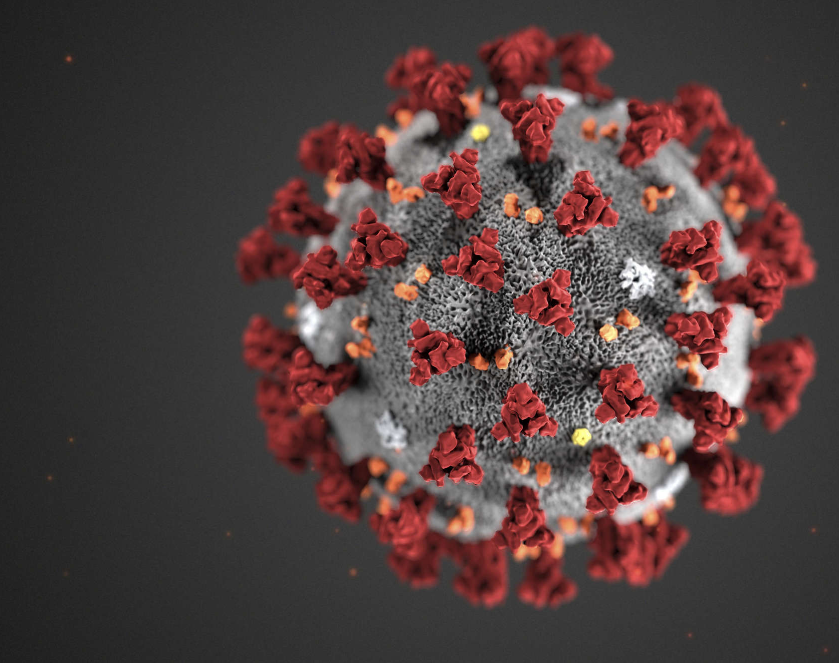
Dietitians’ quality of life before and during the Sars-CoV-2 pandemic (Brazil, 2020)
Raquel Adjafre da Costa Matos; Rita Akutsu; Renata Puppin Zandonadi; Raquel Braz Assunção Botelho
Ao meu pai

Slide 2
Quality of Life
Environment
leisure
Social well-being
Physcal well-being
Mental well-being
Culture
More than absence of diseases
Position in life
Patterns
Values
Beliefs
Spirituality
Hopes
WHOQOL GROUP, 1995

Slide 3
WHOQoL-BREF
Instrument to measure quality of life– OMS 1998.
Derived from WHOQoL-100.
It can be used in a variety of cultural settings.
Itens evaluated in a five-point scale – Likert scale (1932):
1 – “totally disagree” 5 – “totally agree”
The domains evaluated are: PHYSICAL, PSYCHOLOGICAL, SOCIAL RELATIONS AND ENVIRONMENT
LIKERT, 1932; WHOQOL GROUP, 1995

Slide 4
Pandemic: Severe Acute Respiratory Syndrome caused by Coronavirus 2 SARS-CoV-2
First reported in December 2019 in Wuhan, China
It quickly spread across the world and in March 2020 was declared a Pandemic
It caused depletion of human, health and economic resources.
The scientific community around the world seeks alternatives for treatment, cure and prevention.
BURKI et al., 2019; CUCINOTTA et al., 2020; JIANG et al., 2020 BEDFORD et al., 2020 SIDOR e RZYMSKI, 2020

Slide 5
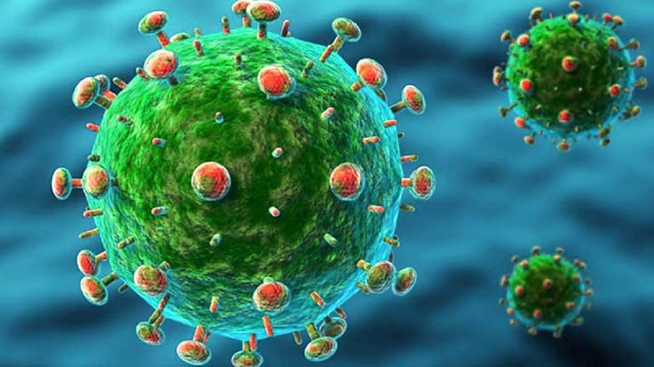
There are already 74,958,938 cases and 1,662,228 dead worldwide.
As a result, about 4 billion people were quarantined, working remotely and facing challenges to deal with the quarantine and its stressful events ... strict health regimes, social distance measures, blockages ...
Studies of previous outbreaks show a relevant impact on mental health and quality of life.
HOLMES et al., 2020; NGUYEN et al., 2020
BEDFORD et al., 2020
JOHNS HOPKINS UNIVERSITY, 2020
KHARSHIING et al., 2020
SIM et al.,2004

Slide 6
Restrictive measures
Psychological suffering
Bad mood
Irritability
Emotional disorders
Exhaustion
Rage
Panic
Stigma and xenophobia to those infected
Suicides ...
BEDFORD et al., 2020; GALEA et al., 2020; SAMLANI et al., 2020; REHMAN et al., 2020; BROOKS et al., 2020; SHIMIZU, 2020; BAO et al., 2020; BAO et al., 2020; WANG et al., 2020; WANG et al., 2020; XU et al., 2020; ZHANG et al., 2020; ABDEL-MONEIM, 2015; JACK, 2015; MAMUN e GRIFTHS, 2020.

Slide 7
SARS-CoV-2 . The mental health response to a pandemic depends on:
clinical evidence
media reports
number of cases
fatality rates
the transmissibility of the disease
isolation policies
WONG et al., 2005; ROY et al., 2020; WANG et al., 2020

Slide 8
And what is the context of health professionals in this pandemic?

Slide 9
Frontline professionals in the fight against SARS-CoV-2
need to be SAFE
Missing PPE
Too many patients
Increased workload / fatigue
Fear of infection
High risk of exposure
Excessive losses
Anguish over difficult decisions
Family isolation
Burnout
AGIUS et al., 2020; COOK, KURSUMOVIC e LEANNE, 2020; MEDICAL DEVICE NETWORK, 2020; ZHANG e MA, 2020

Slide 10
The health of the health professional is one of the biggest challenges of this Pandemic
More than 570 thousand infected health professionals
and 2.5 thousand killed by COVID-19 in the Americas until 7/2/2020.
Quality of life
health professional
Patient safety depends on the safety and health of the professional who takes care of him.
In the USA and Mexico - 1 in 7 cases of COVID is a healthcare professional
Constant changes and unclear safety protocols for healthcare professionals
India: depression (47%), anxiety (50%) and low quality of life (45%).
Italy: 20% depression and 8% anxiety.
China: anxiety ranged from 23% to 44.6%, depression 50.4%.
OPAS, 2020; AMNESTY INTERNATIONAL, 2020; SURYAVANSHI et al., 2020; ROSSI et al., 2020; HUANG et al., 2020; LAI et al., 2020; LU et al., 2020

Slide 11
Objectives
To evaluate the quality of life of Brazilian dietitians before and during the SARS-CoV-2 pandemic.
To characterize Brazilian dietitians working during the SARS-CoV-2 pandemic.

Slide 12
Participants
Brazilian dietitians and residents in Brazil
129.134 professionals in Brazil
Sample calculated considering an error (e) of 3% and a level of significance (α) of 5% = 1,059
HAIR, 2009
CFN – ESTATÍSTICAS, 2020

Slide 13
Sociodemographic characterization of the sample
region of Brazil,
sex,
age,
marital status,
children,
religion,
number of individuals living in the household,
family income,
schooling,
graduation time,
type of institution where you graduated,
service time,
occupation area,
type of company you work for.
1

Slide 14
COVID-19
Threee questions about COVID-19 were also included:
Did you continue to work during the COVID-19 pandemic?
Have you tested positive for COVID-19? and
Did anyone in your family test positive for COVID-19?
1

Slide 15
WHOQoL-BREF
2
26 items
Physical health
Psychological health
Social relations
Environmental health
OMS, 2011
Fleck
Escala Likert de 5 pontos

Slide 16
The application of the Instruments
The volunteers received the survey link, the invitation to participate and the informed consent form
GoogleForms® tool
Applied in the period from May 26 to June 7, 2020
Sent via email, messaging apps and social networks

Slide 17
Dietitians by region
Sample by region – 1,290 dietitians

Slide 18
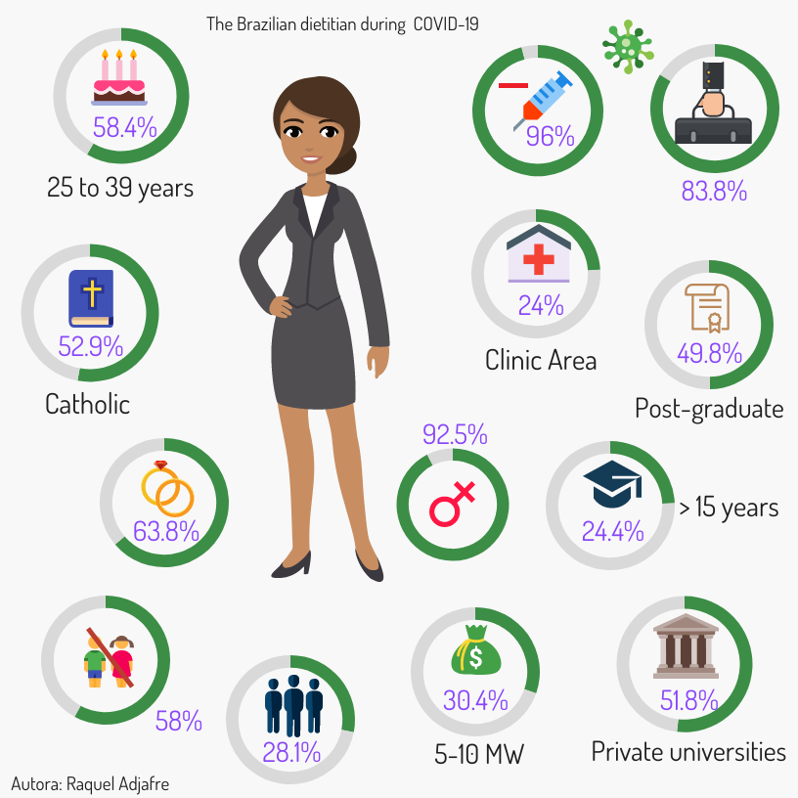
Who is the Brazilian dietitian?

Slide 19
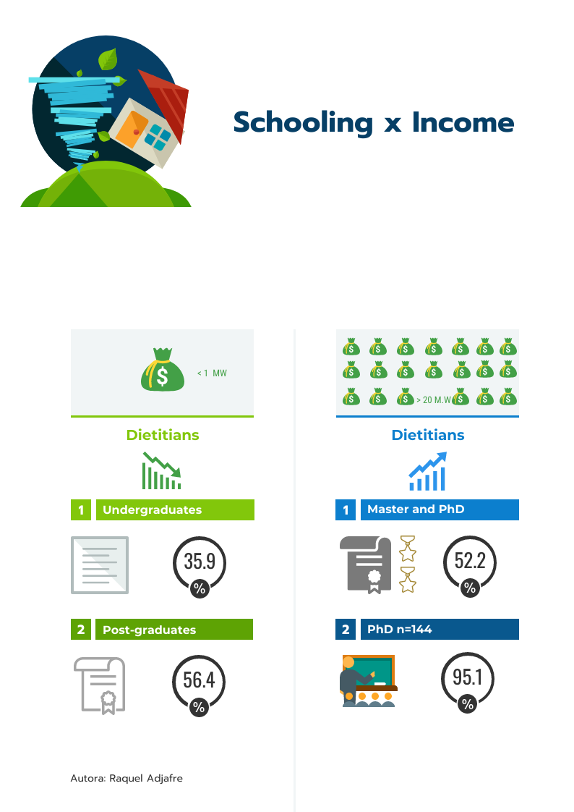

Slide 20
Quality of life of Brazilian nutritionists before and during the COVID-19 pandemic
1st study on the quality of life of nutritionists AND comparing the period before and during the SARS-CoV-2 pandemic.
Statistical difference between ALL variables:
WORST during Pandemic
Before
↑ 3.83 ±0.59
it brought fear and risk of death, psychological pressure, fear of losing family members, social isolation, unemployment, and several other unexpected changes in normal life (CAO et al., 2020; LAI et al., 2020).
During
↓3.36 ±0.66

Slide 21
Lowest score BEFORE and DURING
Physical health
Physical health
Highest score BEFORE Pandemic
α = 0.719
α = 0.798
Cronbach alfa = 0.925
drop in QOL in all DOMAINS during the pandemic
Most affected by Pandemic
Social relations
Environmental health
α = 0.773
α = 0.802

Slide 22
Despite the studies by Sedikides (2010) and Souza et et al. (2019) show otherwise
Before the pandemic
Not influenced QL
Sex
Having children
Number of workplaces
Where graduation took place
Religion
Area of work
During the pandemic
Not influenced QL
Sex
Having children
Number of workplaces
Where graduation took place
Religion
Testing + for SARS-CoV-2
Family member testing ++
HigherQL
Being PhD
+ 10 years of graduation
+ than 20 MW
Teaching area
Being married
Only 5.2% of the sample
HIGHER QL
Master> undergraduated
+ 15 years of graduation > up to 5 years
Income > 10MW
Higher QL
PhD
Teaching area
+ 10 years of graduation > up to 2 years
Income ↑ 5 MW > up to 5 MW
Work remotely or with adaptations
In a study conducted in Brazilians to assess QOL during the SARS-CoV-2 pandemic, a higher level of education also meant a better QOL (TEOTÔNIO et al., 2020).

Slide 23
Conclusions
The Quality of Life of Brazilian Nutritionists decreased with the Pandemic.
The worst was the phycological health.
More studies in the world evaluating this professional are needed.

