Slide 1


Mussels based food supplements: evaluation of emerging marine toxins is a necessary evil
1st International Electronic Conference on Toxins (IECT2021).
Dr. Paz Otero
Department of Pharmacology
University of Santiago de Compostela (USC)

Slide 2
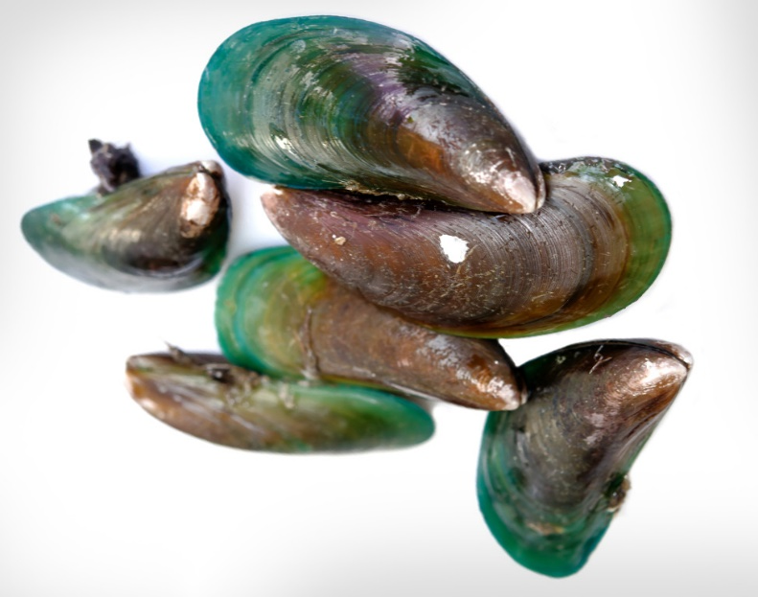
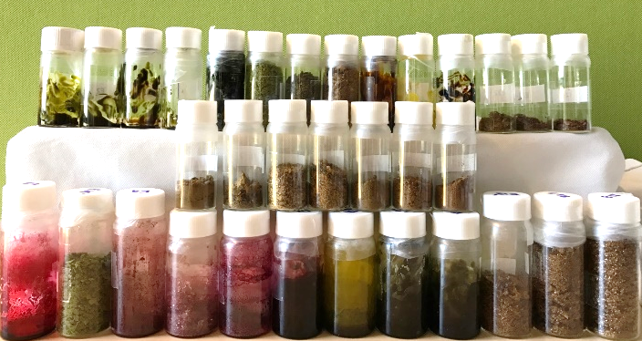
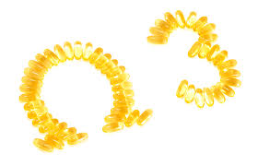
1st International Electronic Conference on Toxins (IECT2021).
Food supplements
Green lipped mussels
Sources of proteins, polyunsaturated fatty acids (PUFAs) and carbohydrates.
Green lipped mussels’ powder
(Food supplement)
Treatment of osteoarthritis
(anti-inflammatory activity)

Slide 3
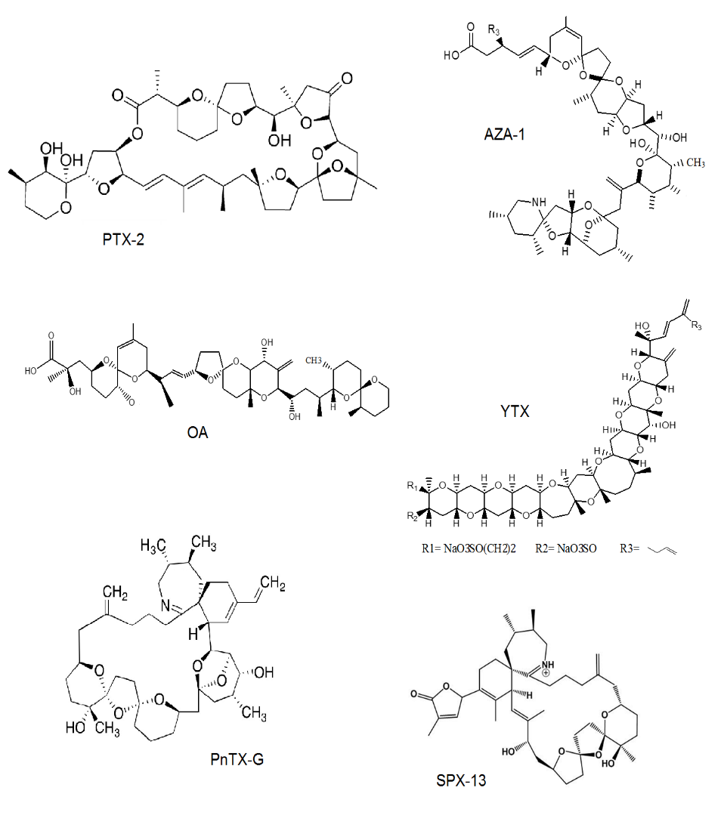
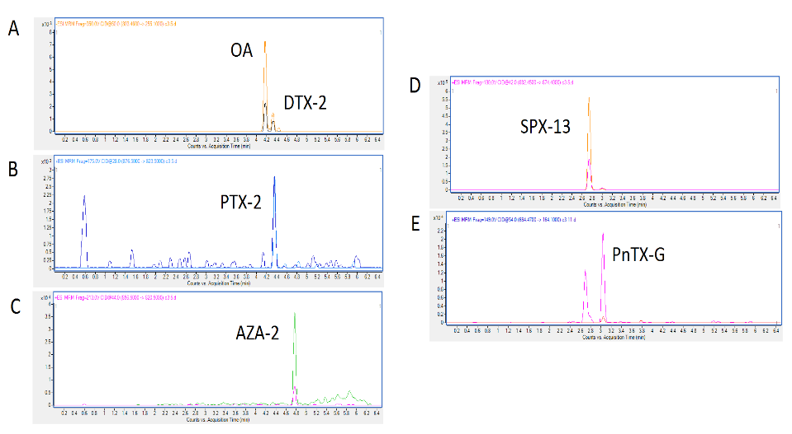
Marine Toxins
It is vital to consider the potential harmful phycotoxins that can be present in mussel extracts
Work objective
To investigate the presence of lipophilic marine toxins in dietary supplements of Perna canaliculus from New Zealand

Slide 4
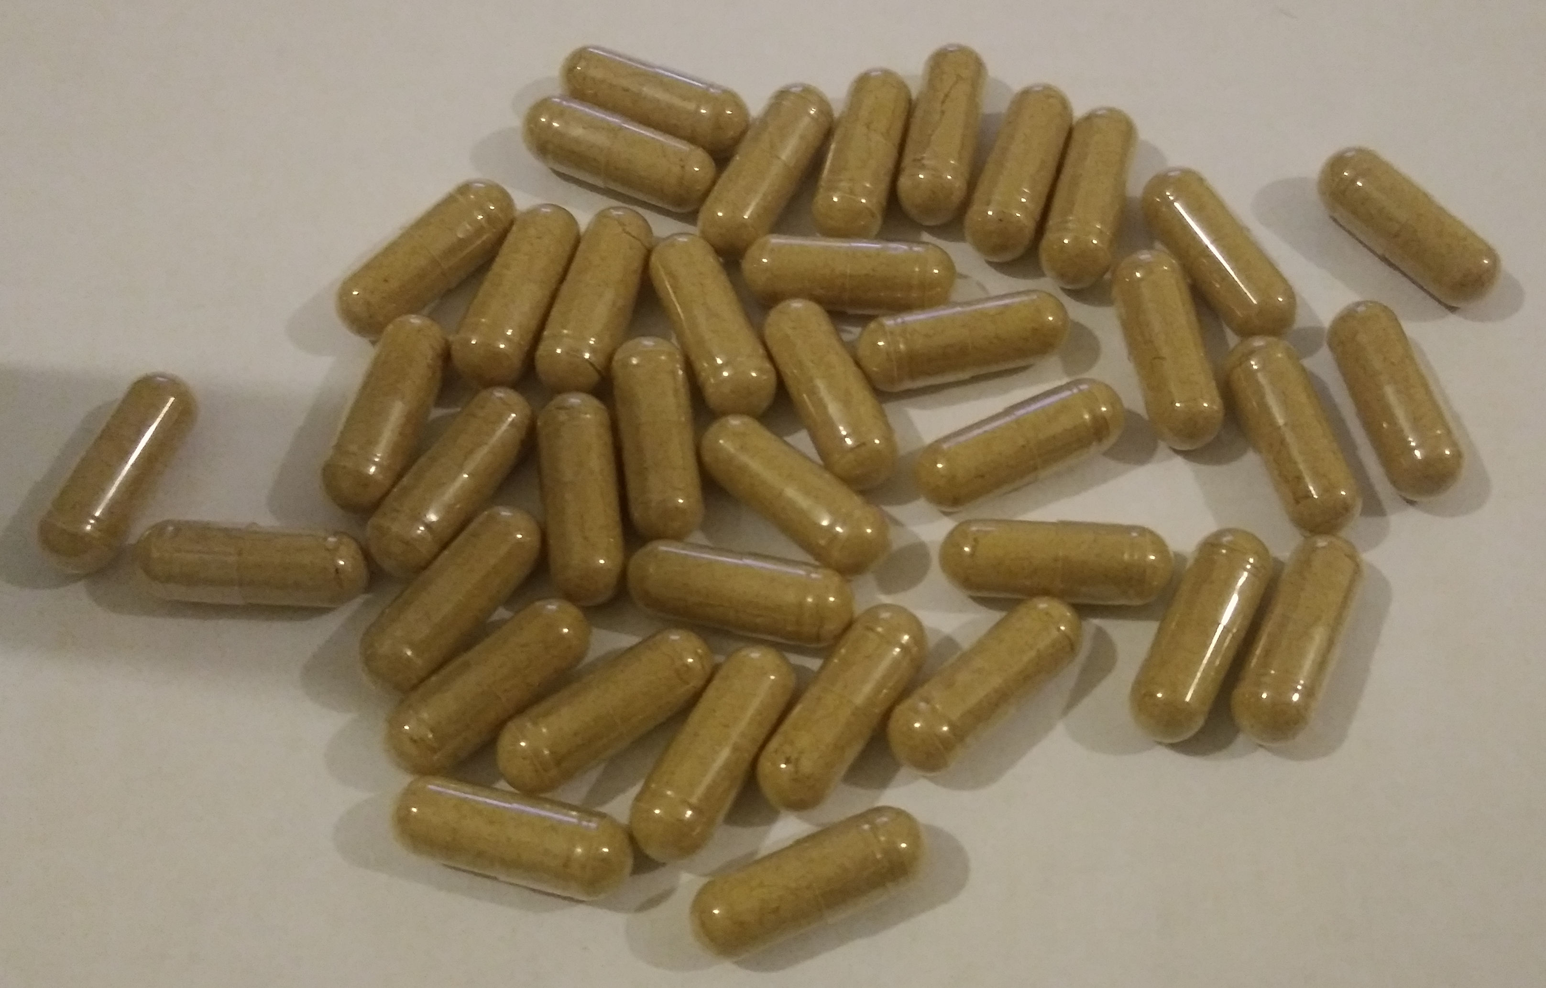
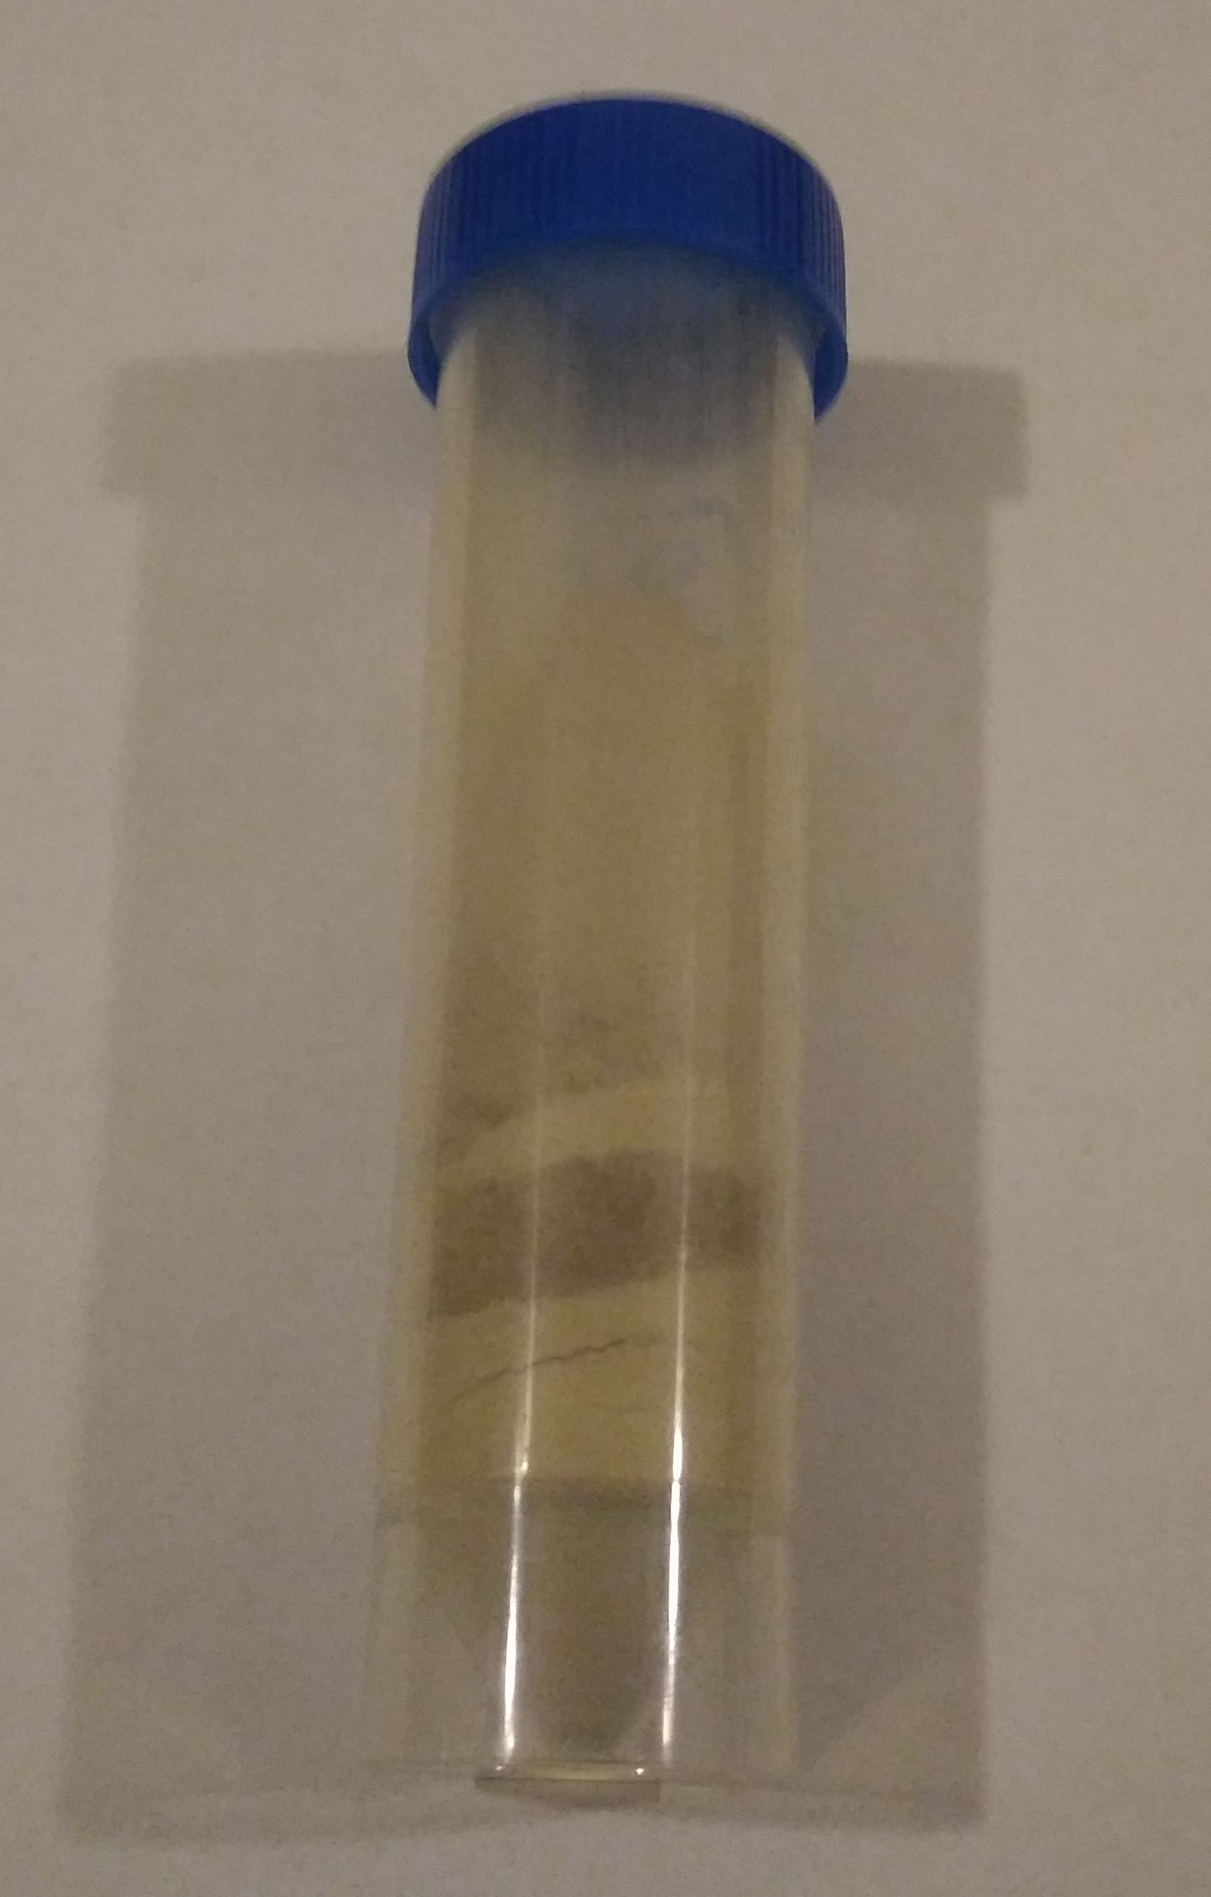
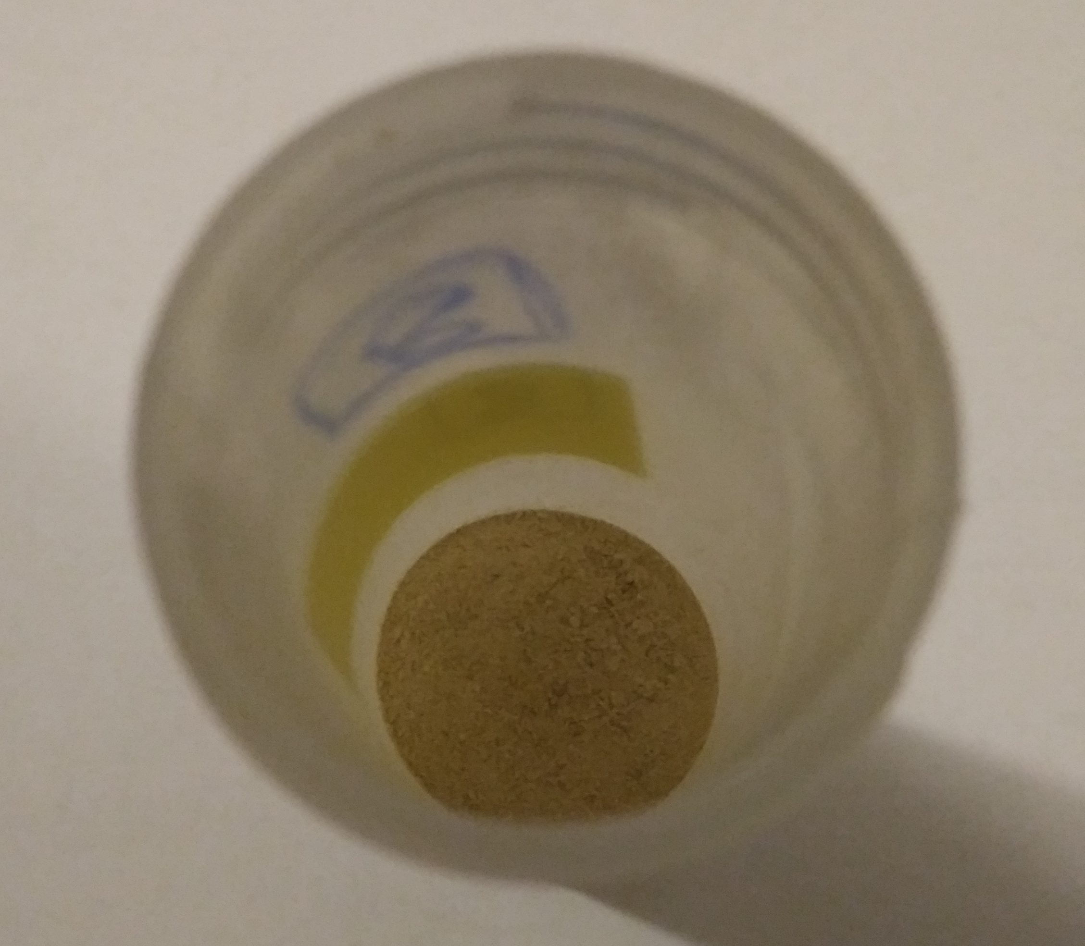
Marine Toxins
One capsule: 500 mg of concentrated green mussel
Green lipped mussels’ powder (P. canaliculus)
3 European Union (EU) distributors
Each sample was a homogenate of 40 capsules content (20g approx.).
Food Product | No. of samples
Dietary supplements (Green lipped mussels) for human | 6
Dietary supplements (Green lipped mussels) for animals (dogs) | 3
Table 1. Dietary samples for human and animal consumption.

Slide 5
Marine Toxins
Toxin extraction
1. Rehydration of food supplements.
1.64 mL of water
0.36 g of power food supplement
Humid mussel extract (82±0.02 g H2O/100 g).
2. Extraction acoording to the standard operation procedure (SOP) for the determination of lipophilic toxins in shellfish.
2 g of humid mussel extract
2 extractions with 100% MeOH
UPLC-MS/MS
Aliquot
Metanolic supernatants

Slide 6
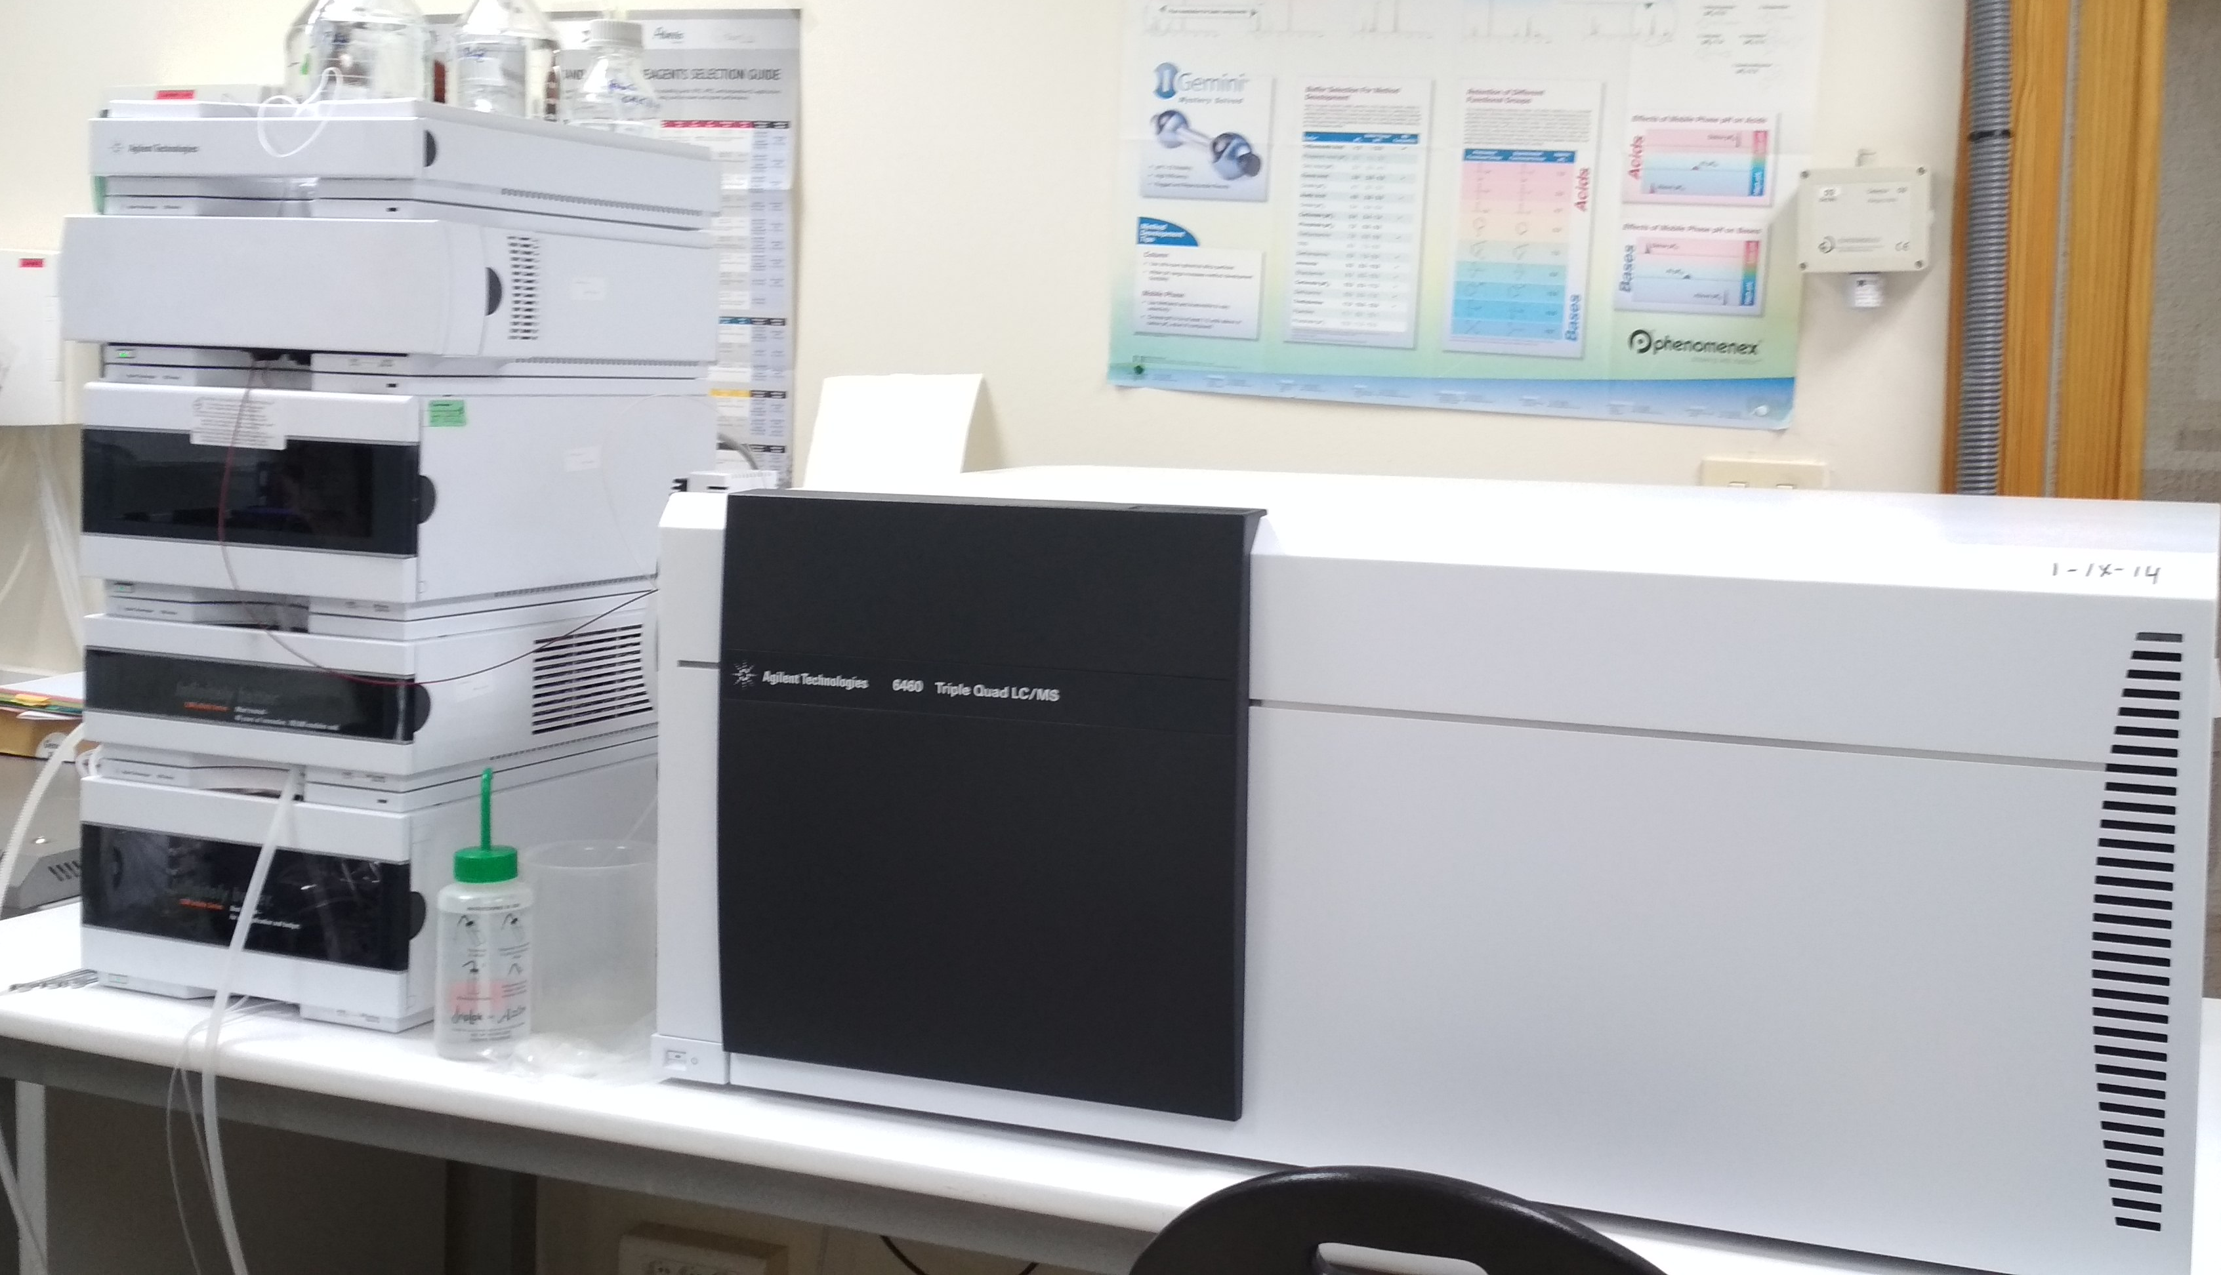
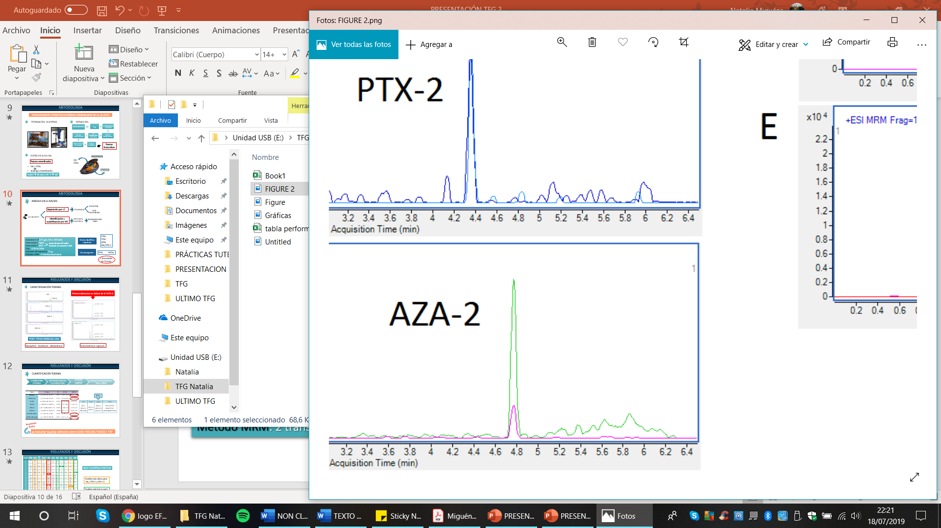
METHODOLOGY
3. ANALYSIS BY UPLC-MS/MS
MS detection:
Multiple Reaction Monitoring (MRM) mode
1290 Infinity ultra-high-performance LC system coupled to an Agilent G6460C Triple Quadrupole MS
Toxins | Precursor Ion | Product Ion | Frag | CE | CAV | Polarity
45-OH-homo-YTX | 1171.5 | 1091.5 | 250 | 40 | 4 | Negative
 |  | 869.5 |  | 88
45-OH-YTX | 1157.5 | 1077.5 | 240 | 38 | 4 | Negative
 |  | 871.5 |  | 86
Homo-YTX | 1155.48 | 1075.5 | 250 | 40 | 4 | Negative
 |  | 869.4 |  | 88
YTX | 1141.47 | 1061.5 | 240 | 38 | 4 | Negative
 |  | 855.4 |  | 86
PTX-1 | 892.5 | 821.5 | 175 | 28 | 2 | Positive
 |  | 213.2 |  | 44
PTX-2 | 876.5 | 823.5 | 175 | 28 | 2 | Positive
 |  | 213.2 |  | 44
AZA-1 | 842.5 | 824.5 | 206 | 32 | 2 | Positive
 |  | 806.5 |  | 44
AZA-2 | 856.5 | 838.5 | 213 | 36 | 4 | Positive
 |  | 820.5 |  | 44
AZA-3 | 828.5 | 810.5 | 216 | 32 | 2 | Positive
 |  | 792.5 |  | 44
OA/DTX-2 | 803.46 | 113.2 | 350 | 66 | 7 | Negative
 |  | 255.1 |  | 50
DTX-1 | 817.5 | 255.1 | 350 | 54 | 7 | Negative
 |  | 113 |  | 70
SPX-13 | 692.45 | 674.4 | 180 | 42 | 4 | Positive
 |  | 164.1 |  | 54
SPX-13,19 | 678.44 | 660.4 | 149 | 30 | 4 | Positive
 |  | 164.1 |  | 54
SPX-20G | 706.47 | 688.4 | 152 | 30 | 4 | Positive
 |  | 164.1 |  | 54
PnTX-G | 694.47 | 458.3 | 149 | 30 | 4 | Positive
 |  | 164.1 |  | 54
PnTX-E | 784.5 | 446.3 | 149 | 30 | 4 | Positive
 |  | 164.1 |  | 54
PnTX-D | 782.48 | 446.3 | 149 | 30 | 4 | Positive
 |  | 164.1 |  | 54
PnTX-F | 766.5 | 446.3 | 149 | 30 | 4 | Positive
 |  | 164.1 |  | 54
PnTX-B and C | 741.47 | 458.3 | 149 | 30 | 4 | Positive
 |  | 164.1 |  | 54
PnTX A | 712.44 | 458.3 | 149 | 30 | 4 | Positive
 |  | 164.1 |  | 54
2 transitions
compound
Regulated lipophilic marine toxins
LC separation:
Column C18 (2.7 μm, 3.0 x 150 mm)
Mobile phase:
Water
ACN
Flow: 0.4 mL/min
Injection volumen: 5 μL
Formic acid 50 mM +
Ammonium formiate 2 mM
Emerging toxins CIs
+ frequent emerging toxins in Europe
SPXs/PnTXs

Slide 7
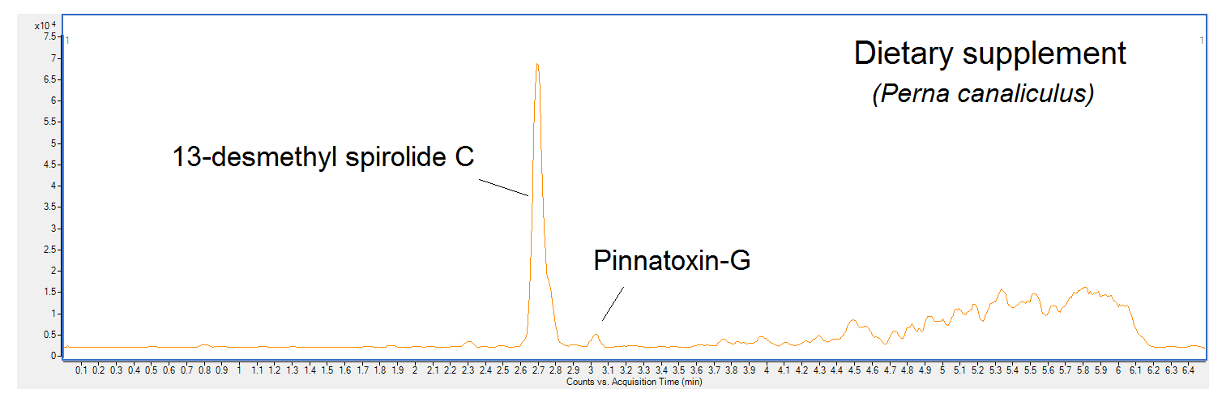
RESULTS
Chromatogram of dietary supplements of P. canaliculus
2.8 min
3 min
Figure 1. Total ion chromatogram (TIC) of dietary supplements (Green lipped mussels) for humans.

Slide 8
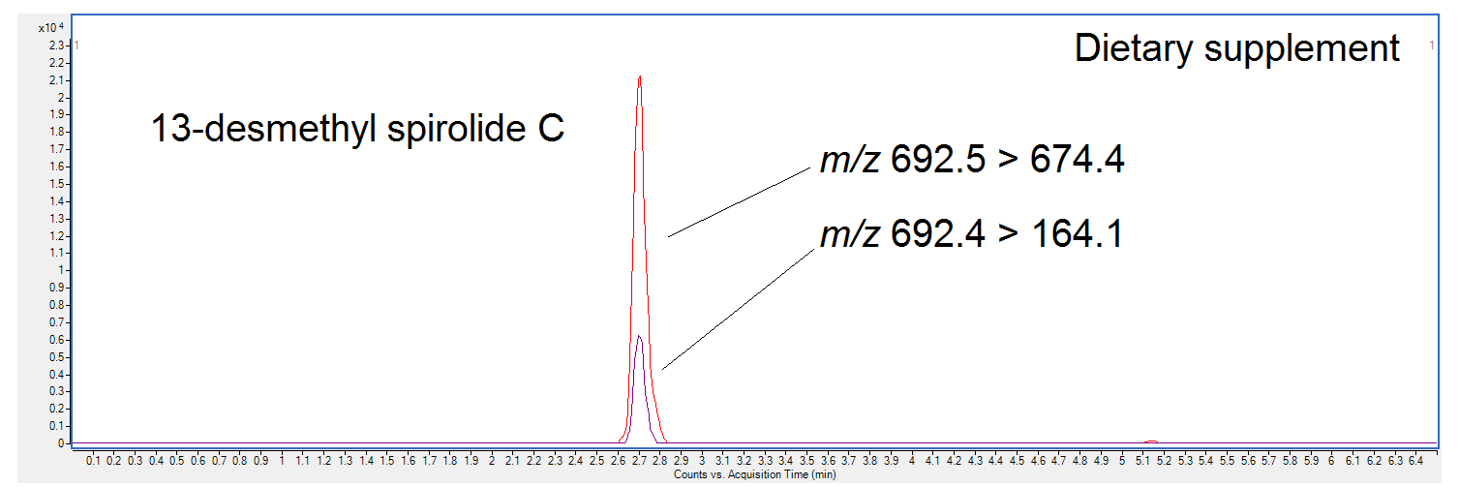
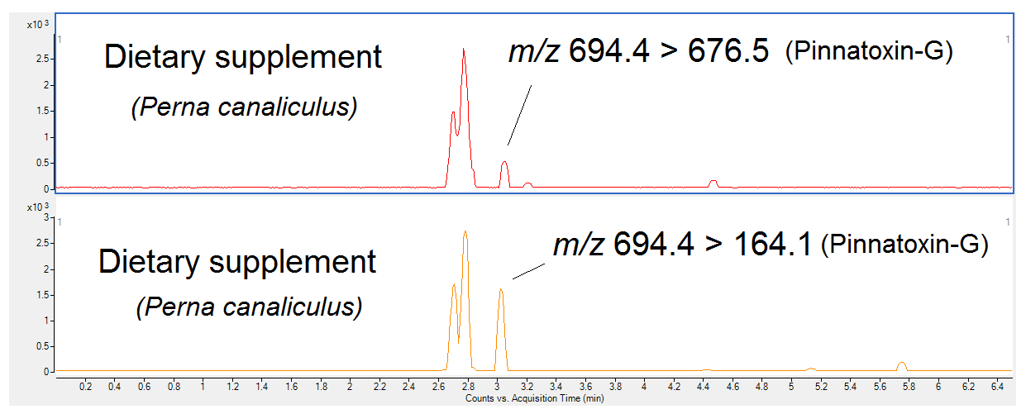
RESULTS
Chromatograms of dietary supplements of P. canaliculus
Figure 2. 13-desmethyl spirolide C analysis by Multiple Reaction Monitoring Chromatogram (MRM) from dietary supplements (Green lipped mussels) for humans.
Figure 3. Pinnatoxin-G analysis by Multiple Reaction Monitoring (MRM) (two channels) from dietary supplements (Green lipped mussels) for humans.

Slide 9
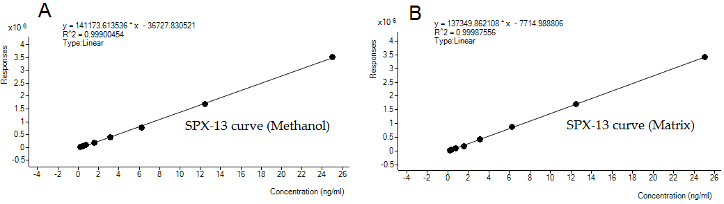
RESULTS
Quantification of the emerging 13-desmethyl spirolide C (SPX-13)
.
Calibration curves for spirolide 13-desmethyl spirolide C (SPX-13) in methanol (A) and matrix (B) in the range 0.19–25 ng/mL.
Negative effect which entailed a suppression of signal (−2.5%).
Linear regression in both cases (r² ≥ 0.998).
The maximum level of 13-desmethyl spirolide C in these supplements was 98 µg/kg.
(Limit of quantitation (LOQ, SPX-13) = 13.4µg/kg)

Slide 10
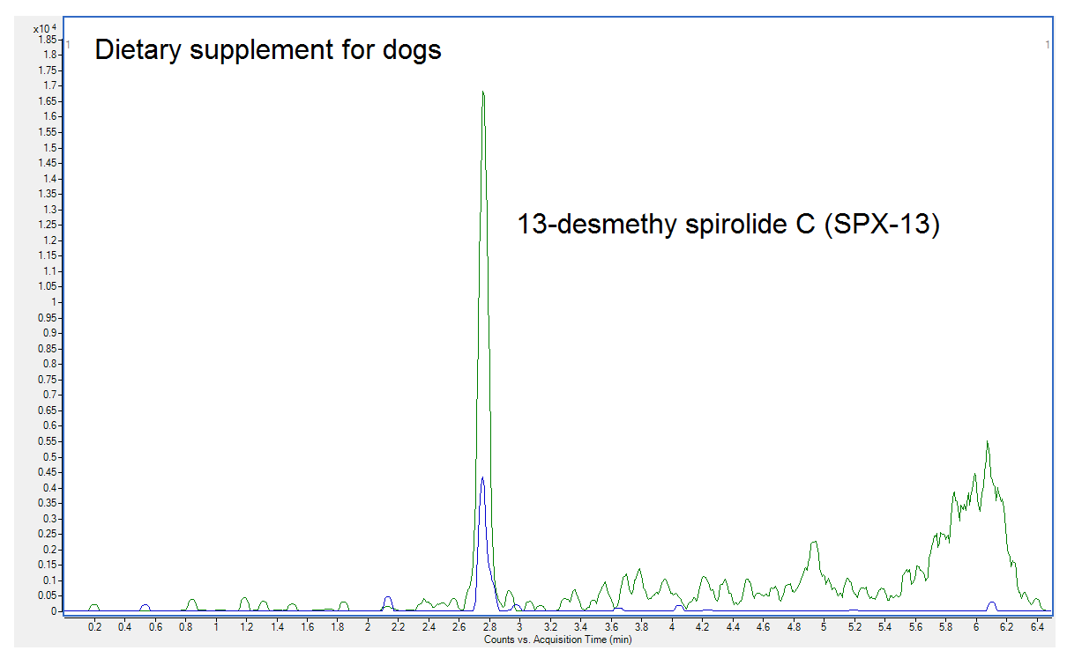
RESULTS
Food supplement samples of green lipped mussels for dogs.
Presence of 13-desmehtyl spirolide C ranging from 33 to 39 µg/kg (dry product).

Slide 11
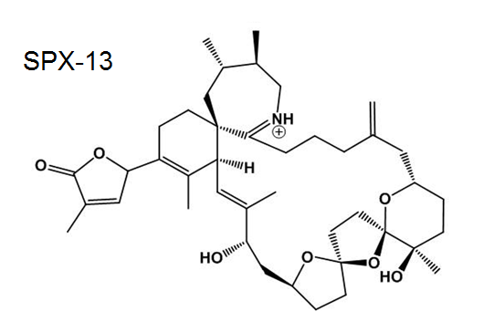
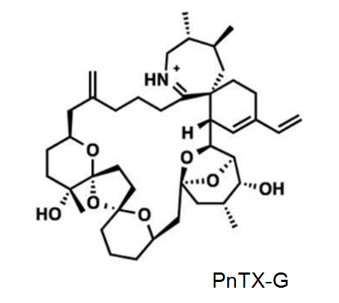
CONCLUSIONS
These samples constitute the first reported analyses of emerging marine cyclic toxins in mussel-based supplements (Perna canaliculus).
13-desmethyl spirolide C was found in dietary products intended for both human and animal consumption at levels up to 98 µg/kg and 39 µg/kg, respectively.
Besides, pinnatoxin-G was confirmed at trace levels.

Slide 12
1st International Electronic Conference on Toxins (IECT2021).
This work was supported by the programme “Juan de la Cierva 2016” from the Spanish Government (Ref. IJCI-2016-27774).
Thank you!!
Dr. Paz Otero
Department of Pharmacology
University of Santiago de Compostela (USC)

