Slide 1
1st International Electronic Conference on Toxins
Synergistic attenuation of cancer-related pain and implications on adverse effects by the use of methadone and Phα1β in C57BL/6J mice
MSc Luana Assis
luana.assisferreira@gmail.com

Slide 2
Introduction and Goals
Pain:
An unpleasant sensory and emotional experience associated with, or resembling that associated with, actual or potential tissue damage, (IASP, 2020).
One strategy to improve the therapeutic utility of opioids (widely used for pain relief) is to co-administer with other analgesic agents, such as Phα1β toxin, looking for reducing side effects and improving analgesy.
This work aims to test whether the in vivo antinociceptive interaction of methadone and Phα1β is sub-additive, additive or synergistic.

Slide 3
Melanoma cell injection induces tumor outgrowth and mechanical hyperalgesia
Pain Induction
Mechanical hyperalgesia induced by melanoma
B16-F10
(1 x 10⁵ cells)
Right hind paw
Aβ Fibers
DRG
Non noxious
stimuli
Spinal Cord

Slide 4
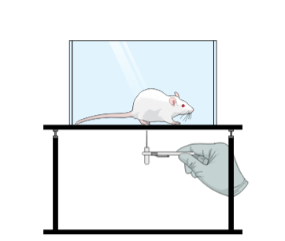
Acute treatment with Methadone, Phα1β, and their combination ameliorate mechanical hyperalgesia
Treatment
Methadone
Phα1β
Spider toxin
Methadone + Phα1β
Methadone
Phα1β

Slide 5
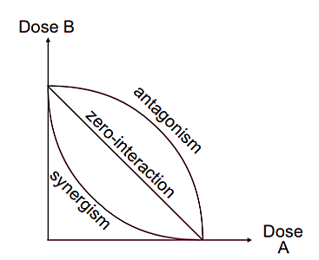
The antinociceptive interaction between Methadone and Phα1β is synergic
Isobologram

Slide 6
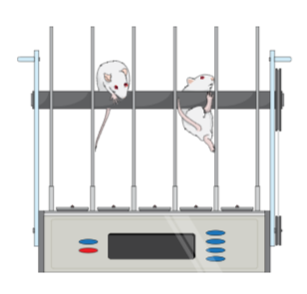
Synergistic attenuation mechanical hyperagesia by Methadone and Phα1β is not accompanied by severe side effects

Slide 7
Methadone, Phα1β and their combination restore morphine analgesic potential under an opioid-induced tolerance protocol

Slide 8
Conclusion
Our data show that a synergism occurred when s.c methadone was administered simultaneously with i.t Phα1β suggesting potency on the analgesic effect of these drugs when both are added together even in lower doses.
Thank you!
MSc Luana Assis
luana.assisferreira@gmail.com

