Slide 1
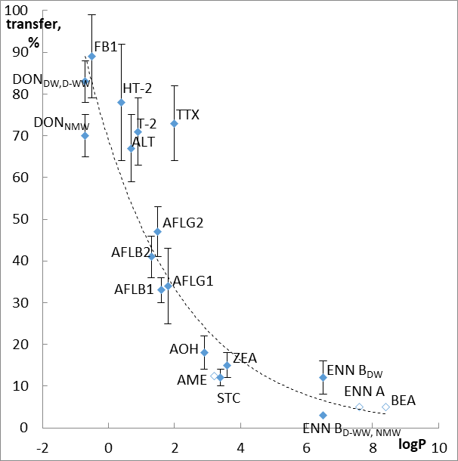
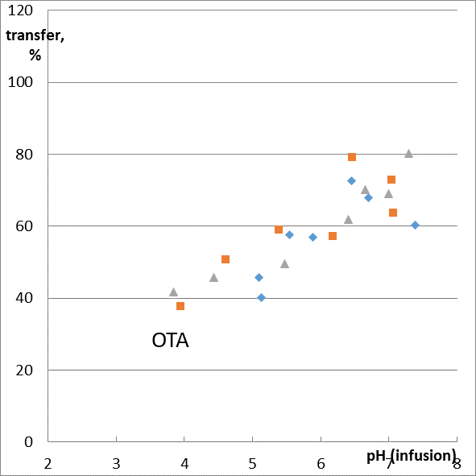
A cup of tea: transfer of mycotoxins from SPIKED matrix into infusion
Mariya Kiseleva*, Zakhar Chalyy and Irina Sedova
Federal Research Centre of Nutrition, Biotechnology and Food Safety, Moscow, Russia;
mg_kiseleva@ion.ru (M.K.), brew@ion.ru (Z.Ch.), isedova@ion.ru (I.S.)
Introduction
Camellia sinensis and herbal tea are daily basic food products. In general, their consumption depends on traditions, occupation and age. Turkey, Libya, Morocco, Ireland and the UK demonstrate the highest per capita consumption, China, the Russian Federation, Japan and India are in the list of the most important consuming countries [1]. Estimates of average chronic daily intake per capita are: 446 mL (C. sinensis black tea; all population; the RF) [2]; 124 mL (C. sinensis tea) and 61 mL (“herbal and other non-tea infusions”; all adults; the EU) [3].
Recent surveys reveal occurrence of AFLs, and STC up to dozens of μg/kg; OTA, ZEA and FBs – up to hundreds μg/kg; DON, MPA and Alternaria toxins – up to several mg/kg in these kinds of foods [4-12]. Regulations concern mainly AFLs and OTA: maximum level (ML) was set in the RF for AFL B1 in tea (5 μg/kg), in Argentina for AFL B1 and AFLs (5 and 20 μg/kg correspondingly), in Japan, China, Sri Lanka and India in the category “all foods” [13]. AFLs and OTA are regulated by the EU in ginger, liquorice root and extracts. MLs for AFLs in herbal drugs were set by European Pharmacopeia, while herbal teas and food supplements are not subjected to control (except mentioned above selected species) [12]. Risk assessments for mycotoxins in beverages are traditionally carried out basing on their concentration in dry matrix. Meanwhile, input is due to infusion only. The present study was aimed at evaluation of transfer rate of mycotoxins.
Factors affecting transfer: mycotoxins chemical and physical properties; matrix; water characteristics (usually temperature, hardness and pH); time
Model: two grams of spiked C. sinensis green tea “clean” matrix were infused with 100 mL of water heated to 99.9˚C for 30 minutes
methods
Studied factors: mycotoxins chemical and physical properties; water characteristics (hardness and pH)
* - may be produced by Aspergillus spp. also
* - water hardness: total dissolved solids
Detection
HPLC-MS/MS with HESI+
DON, ENNs and BEA
Titan C18, 100 × 2.1 mm, 1.9 μm ACN gradient
Other studied mycotoxins
Ascentis Express F5, 100 × 3.0 mm 2.7 μm; MeOH gradient
Micromycetes | Mycotoxins/spiking level, μg/kg:
Aspergillus spp. Penicillium spp. | AFLs (B1, B2, G1, G2), OTA – 80; STC -200; MPA – 6,000;
Fusarium spp. | DON – 10,000; ZEA – 1,000; T-2, HT-2 – 800; FB1, FB2* – 400; ENN B, ENN A, BEA – 2,000;
Alternaria spp. | TTX – 200; ALT – 1,000; AOH, AME – 2,000
Water | TDS*, mg/L | pH
Distilled (DW) | 4.4 | 3-9 (8 points with a unit step)
Deep-well (DW-W) | 155
Natural mineral water (NMW) | 238
Details: sample preparation: centrifugation of infusion; three replicates for each point (TDS, pH), quantification using “matrix-matched” calibration
Water characteristics: TDS and pH*
* - transfer vs pH of infusion is presented
Mycotoxins characteristics: acidic/basic properties and polarity
Highlighted blue - transfer is pH-dependent; green – TDS affects transfer rate; all others – polarity is decisive factor
RESULTS
- DW; - D-WW; - NMW
Transfer from naturally contaminated herbal tea samples: STC – 7-13%, OTA – 83%, MPA – 23-96%, ZEA – 30%, TTX – 59-84%; AOH – 28-61%, AME – 11%, ENN A, ENN B < 0.03%, BEA – 0.3-0.4% [14]
within the studied model
within the studied model
conclusions
$\begin{matrix}transfer \\ rate, \%\end{matrix}=f\{\begin{matrix}polarity \\ infusion pH \left(compounds with−COOH\right) \\ TDS \left(not significant for the most of studied mycotoxins\right) \end{matrix}\}$
Transfer, % | > 60% | 30-50% | <20% | pH-dependent
Mycotoxins | DON, T-2, HT-2, ALT, TTX, FB1 | AFLs | ZEA, STC, AOH, AME, ENNs, BEA | OTA, MPA, FB2
References: [1] FAO, 2018. CCP:TE 18/2, Emerging trends in tea consumption…; [2] Martinchik A.N. et al., Tea and coffee consumption among Russian population (in Russian). Voprosi pitanija, 2005. 74(3): p. 42-46; [3] EFSA: Comprehensive European Food Consumption Database; [4] Mannani N., et al., DOI: 10.1016/j.foodcont.2019.106882; [5] Pakshir K., et al., DOI: 10.1155/2020/2456210; [6] Cui P., et al., DOI: 10.1016/j.fct.2020.111830; [7] Ye Z., et al., DOI: 10.1016/j.envpol.2020.114180; [8] Reinholds I., et al., DOI: 10.3390/toxins12090555; [9] Kiseleva M.G., et al., DOI: 10.21668/health.risk/2020.1.04.eng; [10] Qin Lu et al., DOI: 10.1080/21501203.2020.1727578; [11] Chen L., et al., DOI: 10.3390/toxins12010030; [12] Duarte S.C., et al., DOI:10.1016/j.foodcont.2020.107290; [12] Altyn I.,et al., DOI: 10.3390/toxins12030182; [13] Sedova I., et al., DOI: 10.3390/toxins10110444; [14] Kiseleva M., et al., Mycotoxins in herbal tea: transfer into the infusion., 2021, WMJ, in press

