Slide 1
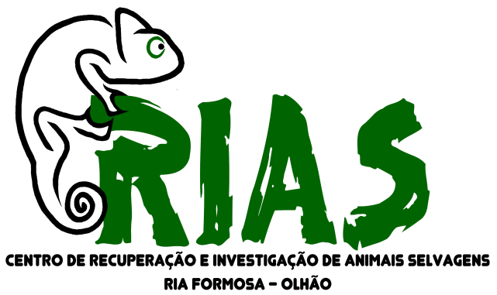
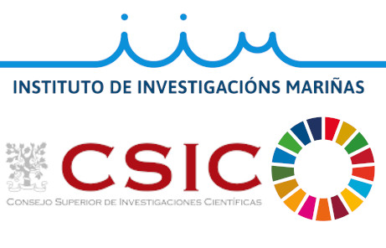
PARETIC SYNDROME IN GULLS FROM SOUTHERN PORTUGAL: SEARCHING
FOR THE CAUSATIVE AGENT
Begoña Ben-Gigirey¹, María Casero², Christelle Mazuet³, Pilar Riobó⁴, Francisco Rodríguez¹
¹Instituto Español de Oceanografía (IEO), Centro Oceanográfico de Vigo, Subida a Radio Faro 50, 36390, Vigo, Spain.
²RIAS Wildlife Rehabilitation and Research Centre, Parque Natural da Ria Formosa, 8700 – 194 Olhão, Portugal.
³Pasteur Institute, CNR Bactéries anaérobies et Botulisme, 25 rue du Dr Roux 75015 Paris, France.
⁴Instituto de Investigaciones Marinas, Consejo Superior de Investigaciones Científicas (IIM-CSIC),36208, Vigo, Spain.
Between 2010 and 2019, 2432 gulls (1125 Larus michahellis and 974 L. fuscus) with paretic syndrome were received at RIAS Wildlife Rehabilitation and Research Centre of Ria Formosa (Olhão, Faro). On admission 333 gulls were dead and 2099 were alive.
Clinical signs: different degrees of ascendant flaccid paresis, weakness, anorexia, diarrhea (flaccid cloacae), dyspnoea and, in some cases, death.
Dead animals were considered as paretic syndrome victims due to the presence of diarrhea, absence of injuries, the date of arrival concurring with a paretic syndrome outbreak and the necropsies findings. Admission numbers have been increasing every year, rocketing in 2019 (see Figures).
Gulls were classified in 5 different levels according to the symptoms severity (see Table). Treatment depended on the severity level and involved basic supportive care: fluid therapy, feeding assistance and treatment of secondary conditions until full autonomy was recovered.
What´s the posible cause?
Several biotic contaminants could be the potential cause of this syndrome: marine biotoxins, Clostridium botulinum, cyanotoxins and virus. Other factors (starvation, abiotic contaminants, etc) could also contribute to the gulls death. The veterinary from RIAS contacted several research Institutes seeking for collaborations that could help ascertain the reason of the continuous morbidity and mortality episodes. Pasteur Institute (Paris) and the Spanish Oceanographic Institute (IEO Vigo) agreed to perform toxin analyses.
Level | Symptoms | Admission procedures | Larus michahellis and L. fuscus
1 | Unable to fly Weakness & dropped wings Able to walk & autonomously feed Diarrhea | Subcutaneous fluid therapy Solid palatable food offered Water ad libitum
2 | Half-standing Mild anorexia or feeding autonomously Diarrhea | Subcutaneous fluid therapy Solid palatable food offered. If not accepted tube feeding Water ad libitum
3 | Hind limbs paralysis Mild dyspnoea Partial or complete third eyelid paralysis Anorexia Diarrhea | Subcutaneous fluid therapy Tube feeding until solid food accepted Water ad libitum
4 | Severe dyspnoea Complete third eyelid paralysis Legs & neck paralysis Anorexia Diarrhea | Subcutaneous and intravenous fluid therapy Repeat fluid therapy for 24 or 48 hours until tube feeding is safe
5 | Irreversible & severe full body paralysis Severe inability to breath Diarrhea Quick death | Subcutaneous and intravenous fluid therapy Repeat fluid therapy for 24 or 48 hours until tube feeding is safe
INTRODUCTION
The aim of this preliminary study was to evaluate if Amnesic Shellfish Toxins (Domoic acid, (DA)), Paralytic Shellfish Toxins (PSTs) or botulinum toxins could be the cause of the gulls paretic syndrome. This presentation compiles the results of the Clostridium botulinum and marine biotoxins analysis conducted at the French National Reference Centre for anaerobic bacteria and botulism, Pasteur Institute (Paris) and the Vigo Centre of the Spanish Oceanographic Institute, respectively.
Gulls increasing admission numbers over the years 2010-2019
OBJECTIVES
Monthly gulls admission at RIAS
METHODS & RESULTS
Clostridium botulinum analyses
Paralytic Shellfish Toxins analyses
Domoic acid analyses
Samples: livers & intestines from 5 gulls. Pooled in two groups according to the tissue.
Enrichment cultures of tissues in fortified cooked meat medium at 37°C and 15°C under anaerobic conditions. C. botulinum was isolated on agar selective medium.
DNA extraction from samples.
C. botulinum was investigated by targeted Real Time Polymerase Chain Reaction (PCR) on neurotoxin genes.
Presence of botulinum toxins was confirmed by a lethality test on mice (mouse bioassay). Mice were intraperitoneally injected with filtered supernatant of the culture.
Samples were positive for C. Botulimum
types C/D
Gulls samples: ten kidneys & contents from one cloacae.
Drawbacks: very small sample size, difficult homogenization, extraction had to be scaled down.
Double extraction with 0.1M HCl. Sample deproteination with trichloroacetic acid.
Analyses by Liquid Chromatography with Postcolumn Derivatization & Fluorescence Detection.
Samples re-run without oxidation: checking for naturally fluorescent compounds needed
GTX1, GTX2, GTX3, GTX4, dcGTX2, dcGTX3, GTX5, dcSTX, STX were not detected in any of the samples tested
Samples: twenty three gull samples: ten livers, ten intestines and three cloacae contents.
Drawbacks: small sample size, difficult homogenization (specially for intestines, hard to cut by Ultraturrax, pre-cutting needed).
Single dispersive extraction: with MEOH 50%
Liquid Chromatography coupled to High Resolution Mass Spectrometry.
DA was not detected in any of the samples tested
CONCLUSIONS
HPLC-FLD DETECTION
100.00
Naturally fluorescent compound. Sample non oxidized.
Domoic acid and Paralytic Shellfish Toxins do not seem to be the cause of the gulls paretic syndrome.
Samples tested point to Clostridium botulinum as the possible cause of the gulls paretic syndrome, or at least one of the causes. This bacterium is considered as a frequent cause of massive mortality events in seabirds. The symptoms caused in seabirds are very similar to the ones produced by PSTs.
Further studies are needed to evaluate the source of C. botulinum contamination.
Additional studies are planned in other Institutions to evaluate the potential implication of Cyanotoxins and Tetrodotoxins in the toxic episodes.
80.00
60.00
40.00
20.00
0.00
0.00
2.00
4.00
6.00
8.00
10.00
12.00
14.00
16.00
18.00
20.00
22.00
24.00
26.00
Minutes
REFERENCES
De La Iglesia, P.; Barber, E.; Giménez, G.; et al. High-throughput analysis of amnesic shellfish poisoning toxins in shellfish by ultra-performance rapid resolution LC-MS/MS. J. AOAC Int. 2011, 94, 555–564.
Gibble, C.M.; Hoover, B.A. Interactions between Seabirds &Harmful Algal Blooms. In Harmful Algal Blooms: A Compendium Desk Reference; S.E. Shumway, J.M. Burkholder & S.L. Morton Eds; John Wiley & Sons Ltd. 2018; pp. 223–242.
Mazuet C., Sautereau J., et al. An atypical outbreak of food-borne botulism due to Clostridium botulinum types B and E from ham. J Clin Microbiol. 2015, 53:722–726.
Rourke, W.A.; Murphy, C.J.; Pitcher, G.; Van De Riet, J.M.; et al. Rapid postcolumn methodology for determination of paralytic shellfish toxins in shellfish tissue. J. AOAC Int. 2008, 91, 589–597.
Rodríguez, F.; Garrido, J.L.; Sobrino, C.; Johnsen, G.; Riobó, P.; et al. Divinyl chlorophyll a in the marine eukaryotic protist Alexandrium ostenfeldii (Dinophyceae). Environ. Microbiol. 2016, 18, 627–643.
Sonne, C.; Alstrup, A.K.O.; Therkildsen, O.R. A review of the factors causing paralysis in wild birds: Implications for the paralytic syndrome observed in the Baltic Sea. Sci. Total Environ. 2012, 416, 32–39.
Van Hemert, C.; Schoen, S.K.; Litaker, R.W.; Smith, M.M.; et al. Algal toxins in Alaskan seabirds: Evaluating the role of saxitoxin and domoic acid in a large-scale die-off of Common Murres. Harmful Algae 2020, 92, 101730.
Vanhomwegen J, Berthet, N. Mazuet, C.; et al. Application of high-density DNA resequencing microarray for detection and characterization of botulinum neurotoxin-producing clostridia. PLoS One 2013, 8:e67510
IEO analyses were funded by project DIANAS (CTM2017-86066-R, MICINN), GRC-GAIN (IN607A 2019/04), and are a contribution of Unidad Asociada IEO-CSIC Microalgas Nocivas. We thank Sanidad Exterior (Vigo) for providing DA standard and Wade Rourke (Canadian Food Inspection Agency) for support with chromatographic conditions.

