Slide 1
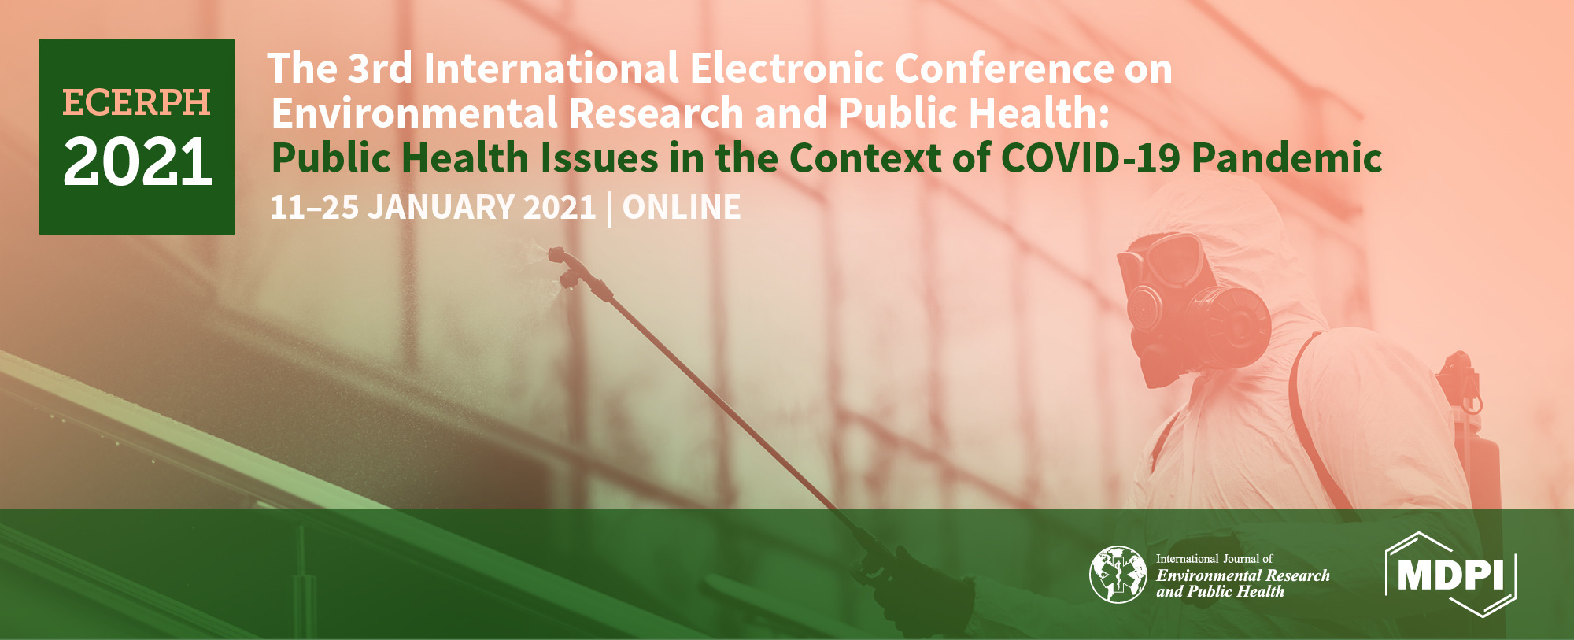
F. Exercise and Health
Maximal and explosive strength during COVID19: Impact on lower and upper limbs in Sport students
Ana Pereira and Luis Leitão
Polytechnic Institute of Setubal
Department of Science and Technology
11-01-2021

Slide 2
Exercise
Health
COVID19
Students
Introduction | Aim | Metodology| Results | Conclusions

Slide 3
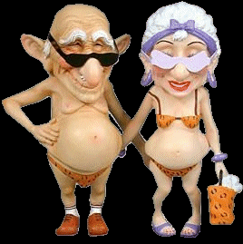
Introduction | Aim | Metodology| Results | Conclusions

Slide 4
Muscular Health
Decrease of funcional capacity
Functional Performance
Disease
Decrease of immunity
Malnutrition
PSYCHOSOCIAL DEPENDENCE
Introduction | Aim | Metodology| Results | Conclusions

Slide 5
Muscular Performance
↓ Aerobic Capacity
↓ Strength
↓ Muscular Power
↑ Difficulty AVD
↑ Fatigue
↑ Risc fall and fracture
↓ Decrease PA
↑ Inability
Introduction | Aim | Metodology| Results | Conclusions

Slide 6
Objetive:
1. Considering the widely established consequences of excessive screen time during COVID19 the present study aim to analyse the relation between maximal and power strength
2. Understand that physical exercises could be a mediating factor for effect on and overall perception of well-being.
Introduction | Aim | Metodology| Results | Conclusions

Slide 7
1. Objetive
~ Analyze the relation between maximal and power strength
Web of Science, MEDLINE, CINAHL, and Cochrane Central Register of Controlled Trials were searched based on a priori criteria of all studies evaluating the effect of an exercise program on maximal and power measures in young people
Keywords
Maximum strength, speed, upper limbs, lower limbs, COVID19
Introduction | Aim | Metodology| Results | Conclusions

Slide 8
24 students in Sports degree (age: 23.4±2.0 years) were evaluated at maximum strength through the maximum repetition test (1RM) in the bench press (SUP) and leg press (PP) exercises and for explosive force and speed at the throwing of the Medicinal Ball (LBM), Horizontal Jump (IH) and the Sprint test 10 meters (10SP).
Pearson's correlation (p<0.05) was used for the association between the variables.
Introduction | Aim | Metodology| Results | Conclusions

Slide 9
The results obtained were: 1RMSUP: 62.8±26.3 kg; 1RMPP: 239±90.1 kg; 10SP: 2.1±0.14 seconds; IH: 1.8±0.22 meters; and, LBM: 4.5±0.84 meters. A strong correlation was observed between strength and velocity in the lower limbs (10SP, IH and 1RMPP: between r=0.61 and r=0.84). Maximum strength of the lower limbs is fundamental for the performance in the 10SP and IH tests.
The relationship between exercise and health should also aim at the greater contribution of muscle symmetry in relation to maximum and predominant performance. Ensuring a positive association in the prescription of regular physical exercise particularly in difficult phases such as the pandemic COVID19. The fact that the students attended classes mostly online seems to have contributed to a weakness in the strength of the lower limbs, and may also be associated with a reduction in flexibility and body posture.
Introduction | Aim | Metodology| Results | Conclusions

Slide 10
The existing scientific evidence for the negative impact of excessive screen time on mental and physical health while providing new insights of physical exercise, specially strength training, during pandemic situation.
Introduction | Aim | Metodology| Results | Conclusions

Slide 11
Exercise
Health
COVID19
Students
Introduction | Aim | Metodology| Results | Conclusions

Slide 12
Ana Pereira, Ph.D. e-mail: ana.fatima.pereira@ese.ips.pt

