Slide 1
Boris G. ALIYEV
Altendorfer Str. 28, 09113, Chemnitz, Germany
e-mail: bgaliyev@mail.ru
Dark Matter, Dark Energy and Something Else in 5D Theory

Slide 2
The 1st electronic conference on Universe,
22-28 February 2021
Outline
Introduction.
Monad and dyad methods.
5D Geodetic Equations.
(4+1) and (3+1+1) reductions of the 5D Geodetic Equations
Integral of the x⁵ projected 5D Geodetic Equations and
new concept of the rest mass
V₄ and V₃ projected 5D Geodetic Equations.
4D Lorentz and Brance-Dicke Forces
New rest mass concept and related matters
5D Ricci identities and their physical consequences
Conclusions

Slide 3
The 1st electronic conference on Universe,
22-28 February 2021
Killing Equations

Slide 4
The 1st electronic conference on Universe,
22-28 February 2021
(4+1) reduction of the 5D Geodetic Equations
4

Slide 5
The 1st electronic conference on Universe,
22-28 February 2021
(3+1+1) reduction of the 5D Geodetic Equations

Slide 6
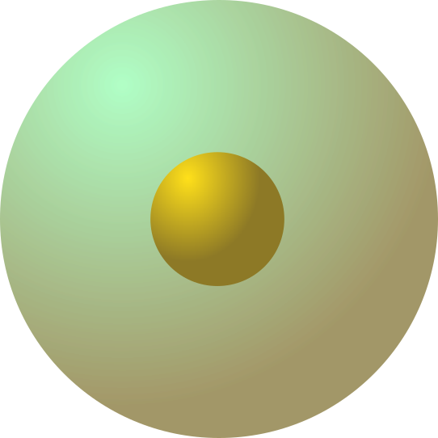
The 1st electronic conference on Universe,
22-28 February 2021
New (generalized) rest mass concept
5D particle
Q₀
No scalar charge!

Slide 7
The 1st electronic conference on Universe,
22-28 February 2021
Brake radiation force (Bremsstrahlung force)

Slide 8
The 1st electronic conference on Universe,
22-28 February 2021
or vise versa
1st pair of Maxwell’s equations

Slide 9
The 1st electronic conference on Universe,
22-28 February 2021
2nd pair of Maxwell’s equations
Here t₀ is cylindrical phase.

Slide 10
The 1st electronic conference on Universe,
22-28 February 2021
Conclusions
If one goes beyond the 5D optics, certain new and very non-trivial properties of the matter and 4D Universe may come into being. Specifically, a new concept of the rest mass may be obtained.
The implementation of the monad method to the (4+1) splitting of the 5D Ricci identities makes it possible to understand how the Riemannian structure of the World affects its physical properties.
It permits one to approach closer to the understanding of the magnetic monopole problem and the origins of the Maxwell equations.
The obtained results also provide new insight into the mechanism of the expansion of the 4D Universe and its acceleration.

Slide 11
The 1st electronic conference on Universe,
22-28 February 2021
Thank you very much for your attention!

