Slide 1
Phasor wheels for teaching quantum physics to school students
By Rahul Choudhary
The University of Western Australia
rkc.girija@gmail.com

Slide 2
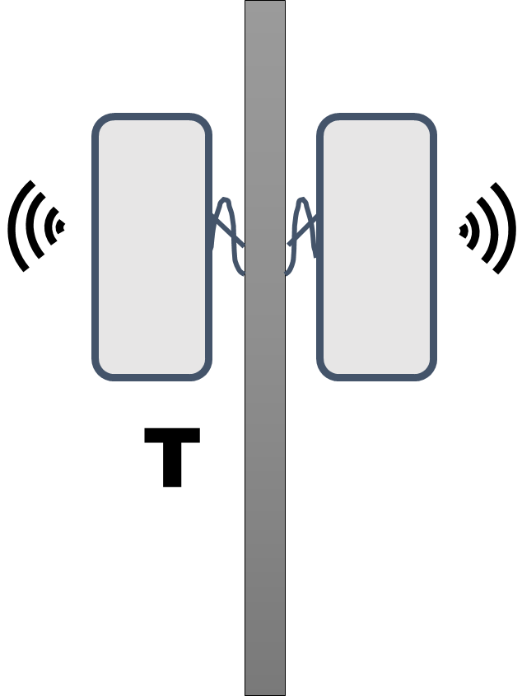
1
1
3
2
2
3
R
7
4
4
6
5
6
5

Slide 3
Y
C
C’
D
B
B’
D’
E
A
A’
E’
A’’
F’
H’
F
H
G’
G
Time
X

Slide 4
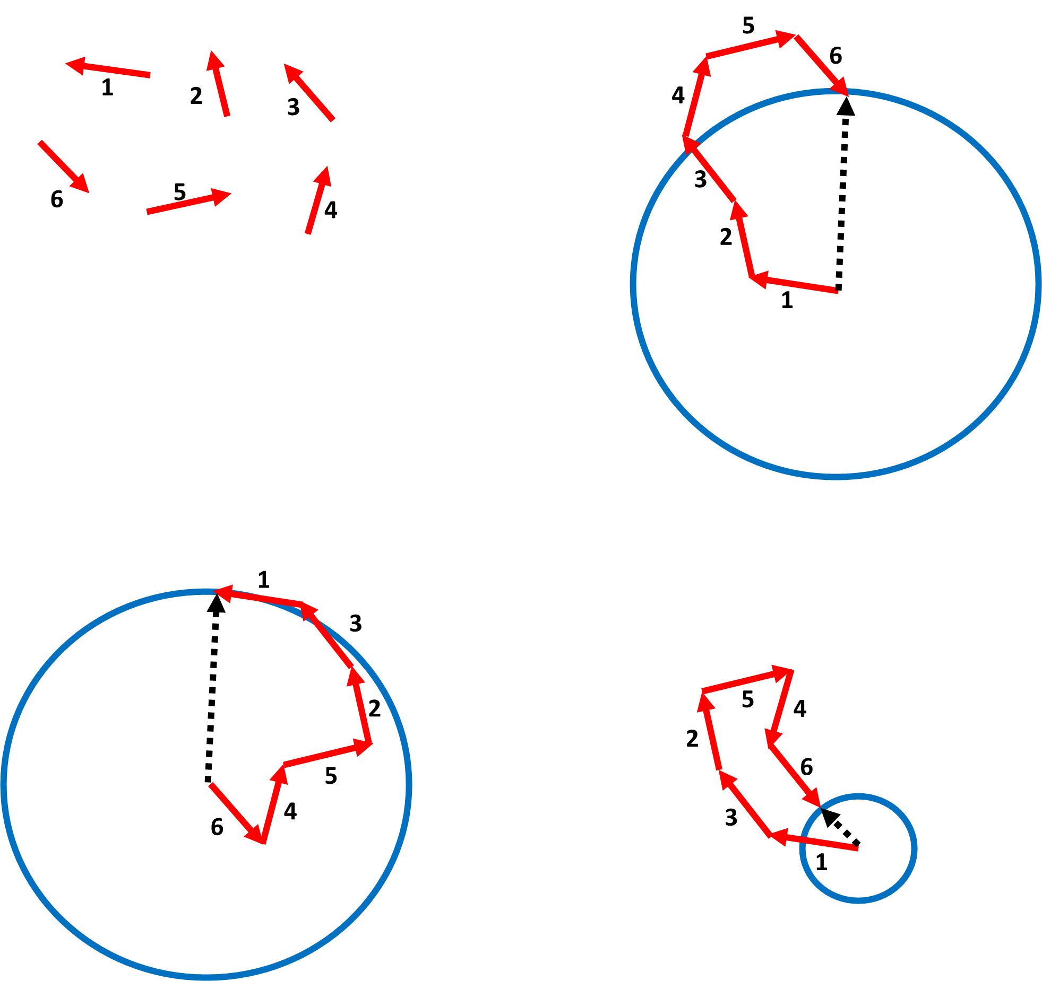

Slide 5
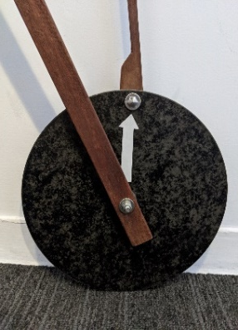
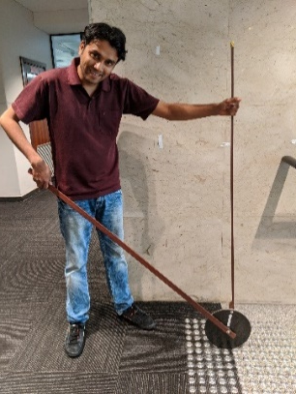
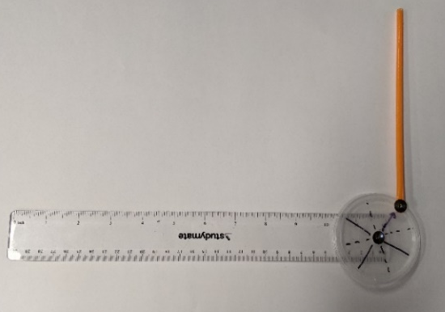

Slide 6
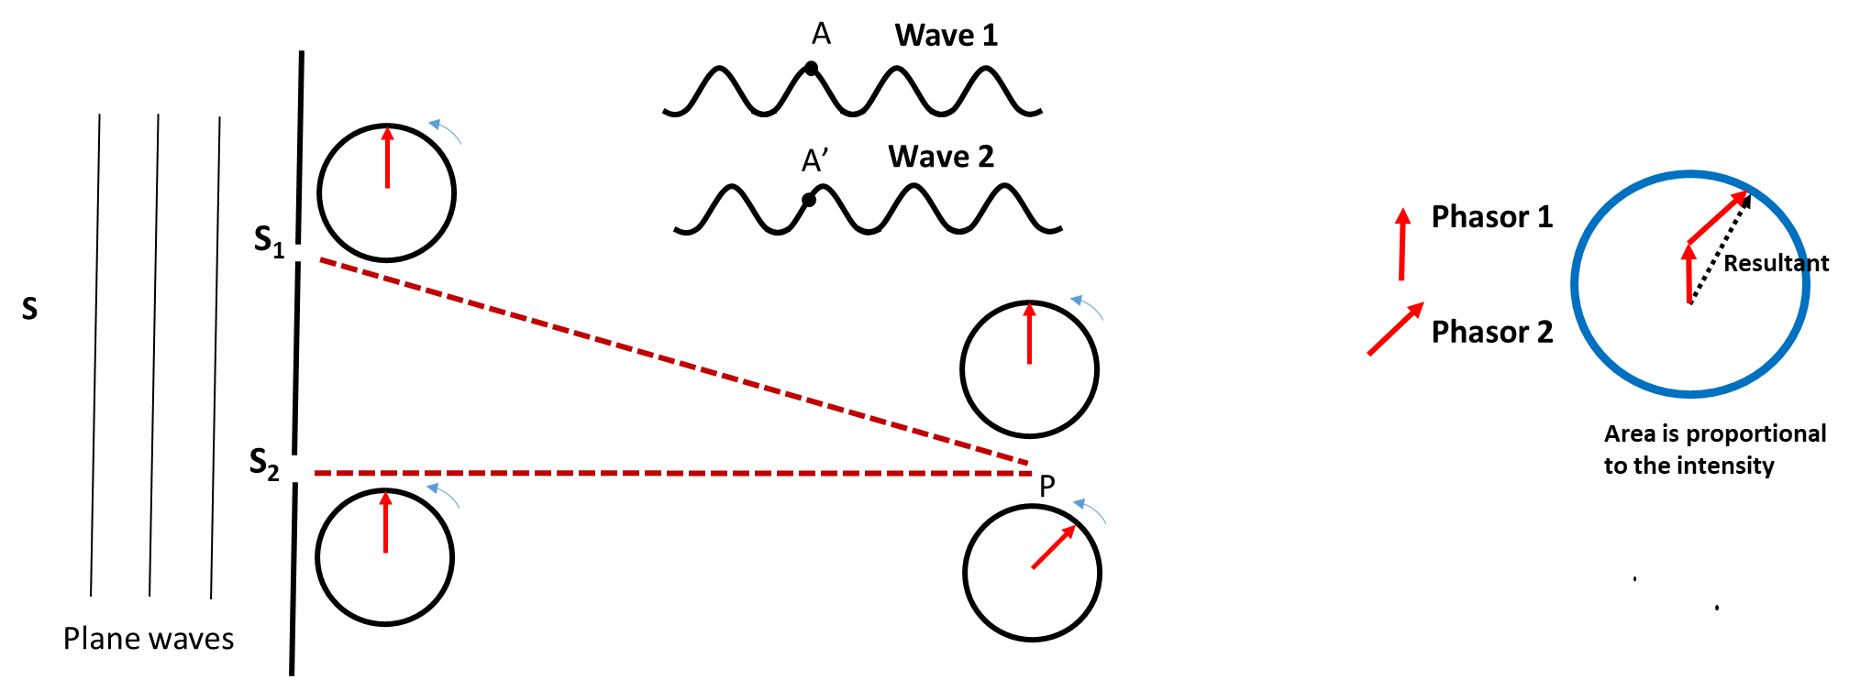

Slide 7
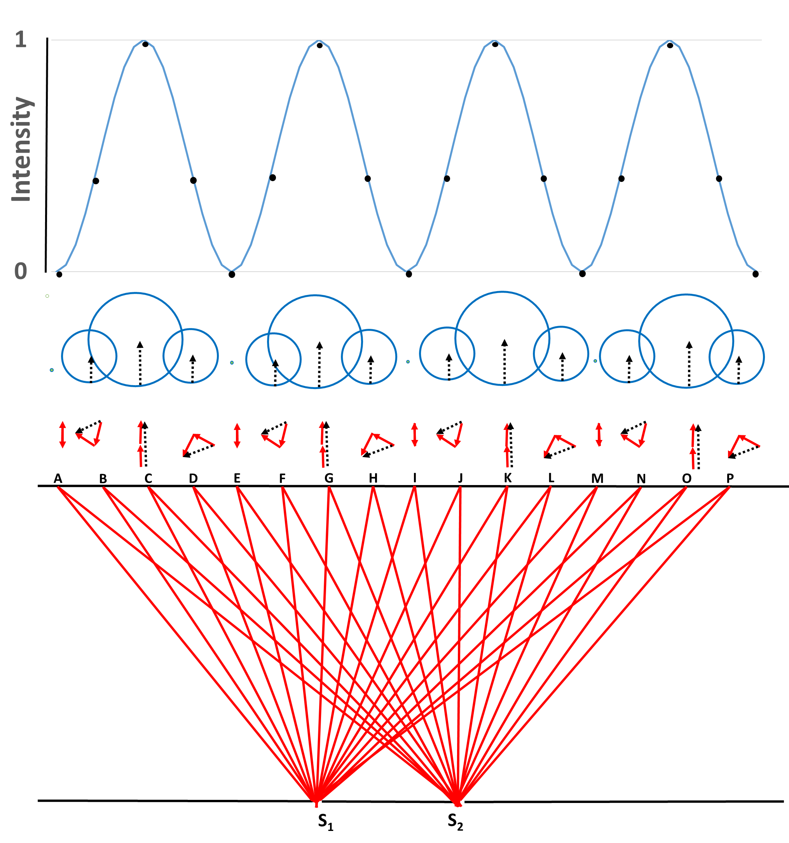

Slide 8
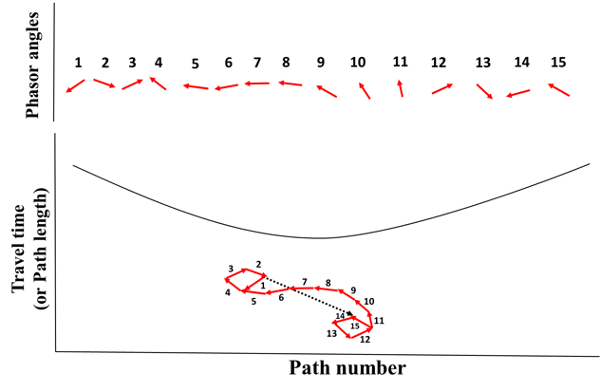
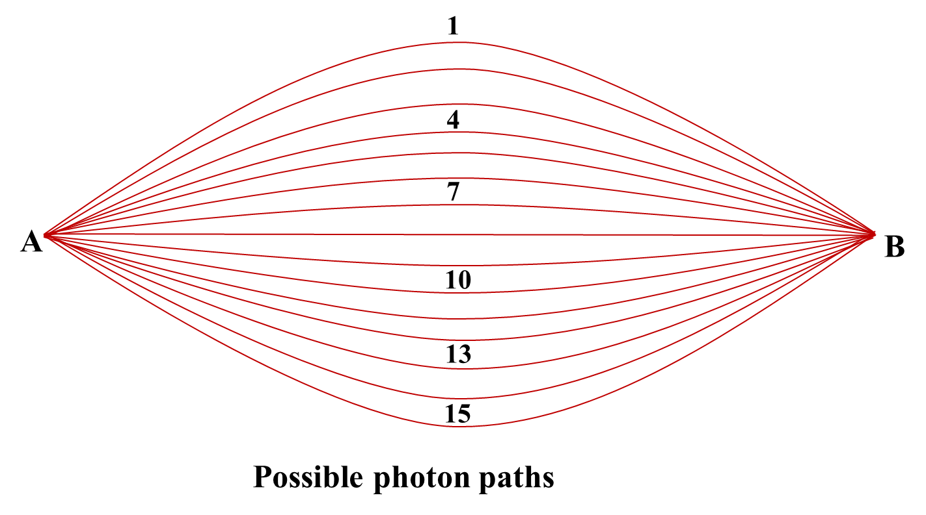

Slide 9
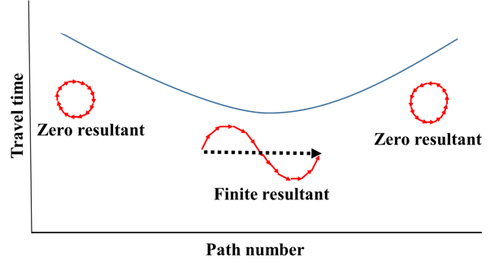
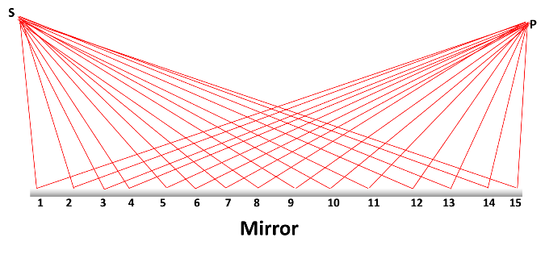

Slide 10
