Slide 1
Dark Matter: Reality or a Relativistic Illusion?‎‎
Asher Yahalom
Department of Electrical and Electronic Engineering, Ariel University
1st Electronic Conference on Universe
22/02/2021 - 28/02/2021

Slide 2
In memory of Donald Lynden-Bell.
A great scholar, a wonderful collaborator and a true friend.

Slide 3
Contents:
Retardation
Galaxies
Galaxy Rotation Curves
General Relativity adopted to the galactic case
Dark Matter
Mond
Conclusion

Slide 4
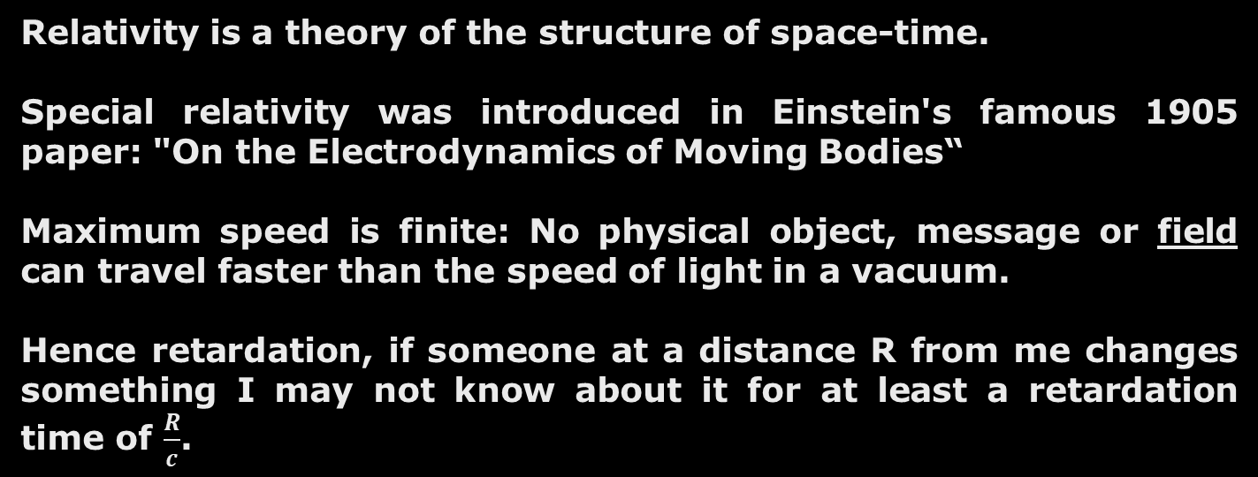
Retardation
Relativity is a theory of the structure of space-time.
Special relativity was introduced in Einstein's famous 1905 paper: "On the Electrodynamics of Moving Bodies“
Maximum speed is finite: No physical object, message or field can travel faster than the speed of light in a vacuum.
Hence retardation, if someone at a distance R from me changes something I may not know about it for at least a retardation time of $\frac{R}{c}$.

Slide 5
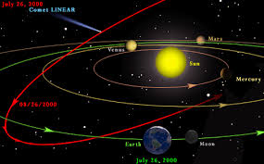
Example

Slide 6
Question & Answer
Suppose somebody have eliminated the sun how much time will it take us to notice (gravitationally and electromagnetically)?
The distance from the earth to the sun is: 149.6 million km
The speed of light in vacuum is:
299 792 458 m / s
Hence retardation in this case is: 8.3 minutes.

Slide 7
Fact I - Retardation
Galaxies are huge physical systems having dimensions of many tens of thousands of light years. Thus any change at the galactic center will be noticed at the rim only tens of thousands of years later. Those retardation effects seems to be neglected in naïve galactic modelling used to calculate rotational velocities of matter in the rims of the galaxy and surrounding gas.

Slide 8
Fact II – Strange Rotation Curves
If you forget about retardation

Slide 9
Are those two facts connected?

Slide 10
General Relativity

Slide 11
General Relativity

Slide 12
How can one solve those complex, tensor, non-linear partial differential equations for the case of galaxies?

Slide 13
Answer:
For most cases (galaxies included) it is not necessary to solve the full Einstein equation but only a linear approximation to them as only weak gravitational fields are involved.
For some cases such as compact objects (black holes) and the very early universe (big bang) strong gravitational fields are involved and one needs to use the exact Einstein equations.

Slide 14

5 April 1935 – 6 February 2018
I would like to thank the late Professor Donald Lynden-Bell for this very important observation.

Slide 15
Linear Approximation
(weak gravity)

Slide 16
Solution:

Slide 17
If the size of the object is much smaller than the distance to the observer will result in a different approximation leading to the famous quadruple equation of gravitational radiation as predicted by Einstein and verified indirectly in 1993 by Russell A. Hulse and Joseph H. Taylor, Jr. for which they received the Nobel Prize in Physics. The discovery and observation of the Hulse-Taylor binary pulsar offered the first indirect evidence of the existence of gravitational waves.
On 11 February 2016, the LIGO and Virgo Scientific Collaboration announced they had made the first direct observation of gravitational waves. The observation was made five months earlier, on 14 September 2015, using the Advanced LIGO detectors. The gravitational waves originated from the merging of a binary black hole system.
The current work involves a near field application of gravitational radiation while previous art discusses far field results.

Slide 18
Affine connection is first order.
zeroth order

Slide 20
The resulting geodesic:

Slide 21
Back to Newton?
If retardation is neglected or the density is static:

Slide 22
However, retardation cannot be neglected on galactic scales and the density is not static as mass is accreted from the intergalactic medium:

Slide 23
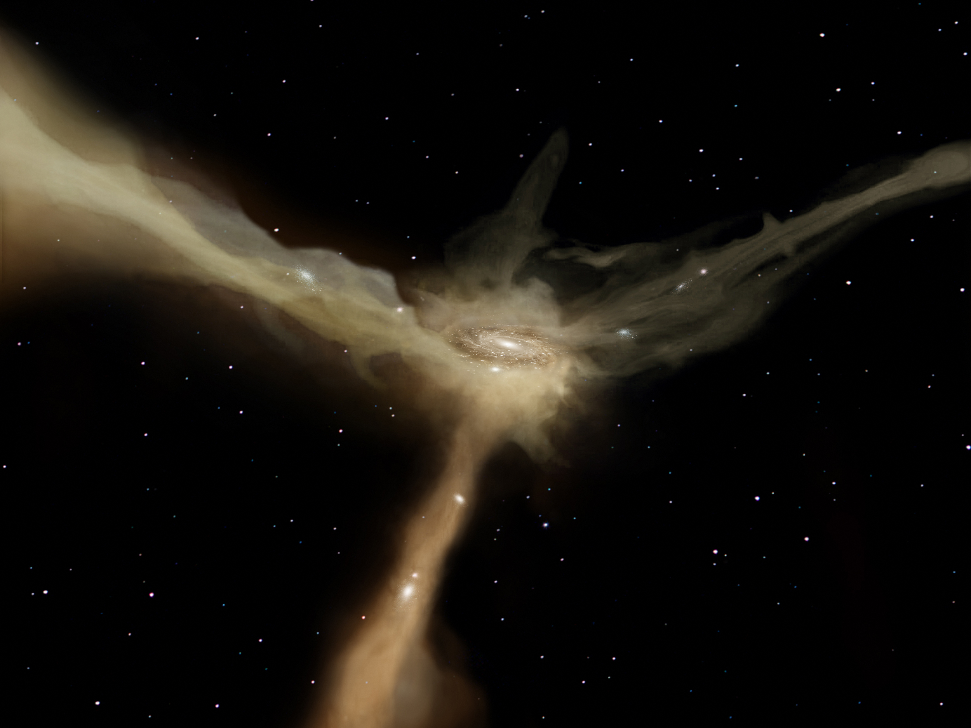

Slide 24
Beyond the Newtonian Approximation
Short Range!

Slide 26
Obviously for small distances Newtonian forces dominate over Retardation forces but what happens for large distances were Newtonian forces decline and Retardation forces are not reduced?

Slide 27
Retardation distance
Newtonian regime
Retardation regime

Slide 28
For large distances:
Retardation forces can be repulsive or attractive.

Slide 29
Mass is accreted from the intergalactic gas.
The intergalactic gas is depleted.
The retardation force is attractive in
the galactic scenario.

Slide 30
Alternative explanations for galactic rotation curves:
Dark matter
MOND (Modified Newtonian Gravity)

Slide 31
How can retardation effect be confused with a non existent “dark matter”?
However, F_{d} is really F_{r}

Slide 33
What can we learn from the incorrect MOND theory of gravity (but observationally fitting)?
Suggested by Milgrom and corrected for the relativistic case by Bekenstein

Slide 34
Assume small accelerations:

Slide 35
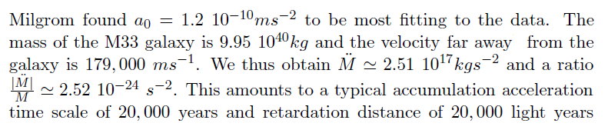

Slide 36
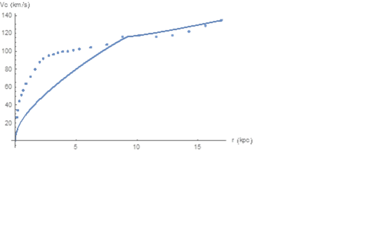
For Uniform Mass Distribution
I thank Dr. Michal Wagman (PhD graduate in Ariel University) for extracting he point of M33 rotation curve.

Slide 37
A better profile and a better fit

Slide 38
My best fit

Slide 39
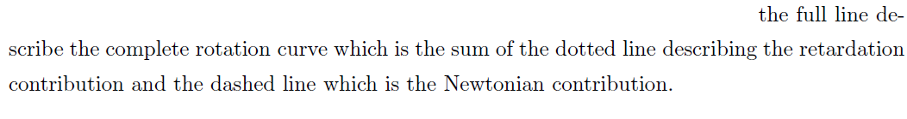
M/L =1
So M/L is not a fitting parameter as most authors assume.

Slide 40
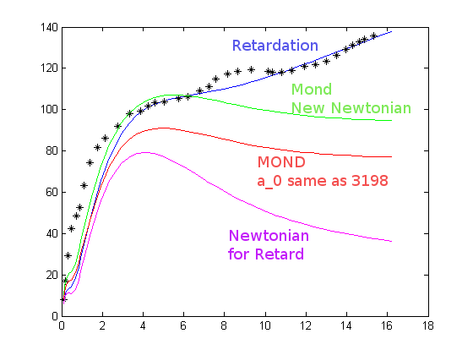
Work by Michal Wagman PhD student at Ariel University under my supervision.
M33

Slide 41
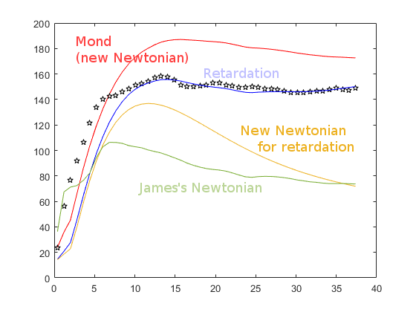
Work by Michal Wagman PhD student at Ariel University under my supervision.
NGC 3198

Slide 42
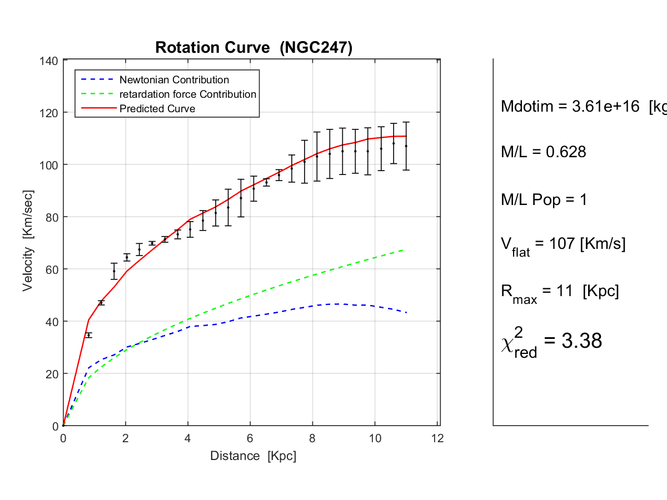
Work by Tomer Zimmerman & Roy Gomel
PhD students at Tel Aviv University

Slide 43
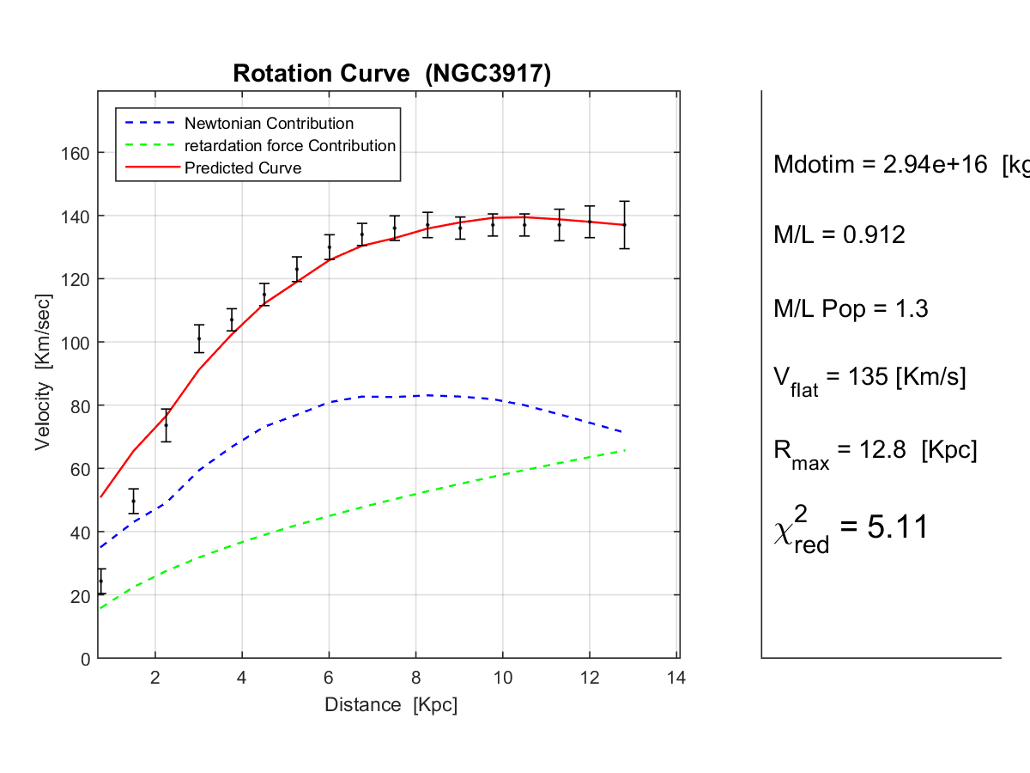

Slide 44
Michal’s Results
Rotation Curve fitting data for 11 galaxies. Columns are: (1) Name of the galaxy, (2) Galaxy type, (3) Mass model used for calculation where Double is short for double infinitesimally thin exponential disk model, Thick is short for exponential disk with a distribution in the z-axis. (4) Exponential disk model scale-length given in parsecs, (5) Central mass density, (6) mass flux change-to-mass ratio, (7) star birthrate of the galaxy type from Portinari et al and Kennicutt et al ; data retrieved from Kennicutt et al is denoted with an asterisk*. (8) mass-to-light ratio (9) MOND acceleration fitting parameter

Slide 45
Conclusion
We show that ”dark matter” and ”MOND” effects are explained in the framework of standard GR as effects due to retardation without assuming any exotic matter or modifications of the theory of gravity.

Slide 46
What will happen if the mass outside the galaxy is totally depleted or not yet depleted?
In this case retardation force should vanish. This was indeed reported recently for the galaxy NGC1052-DF2.

