Slide 1
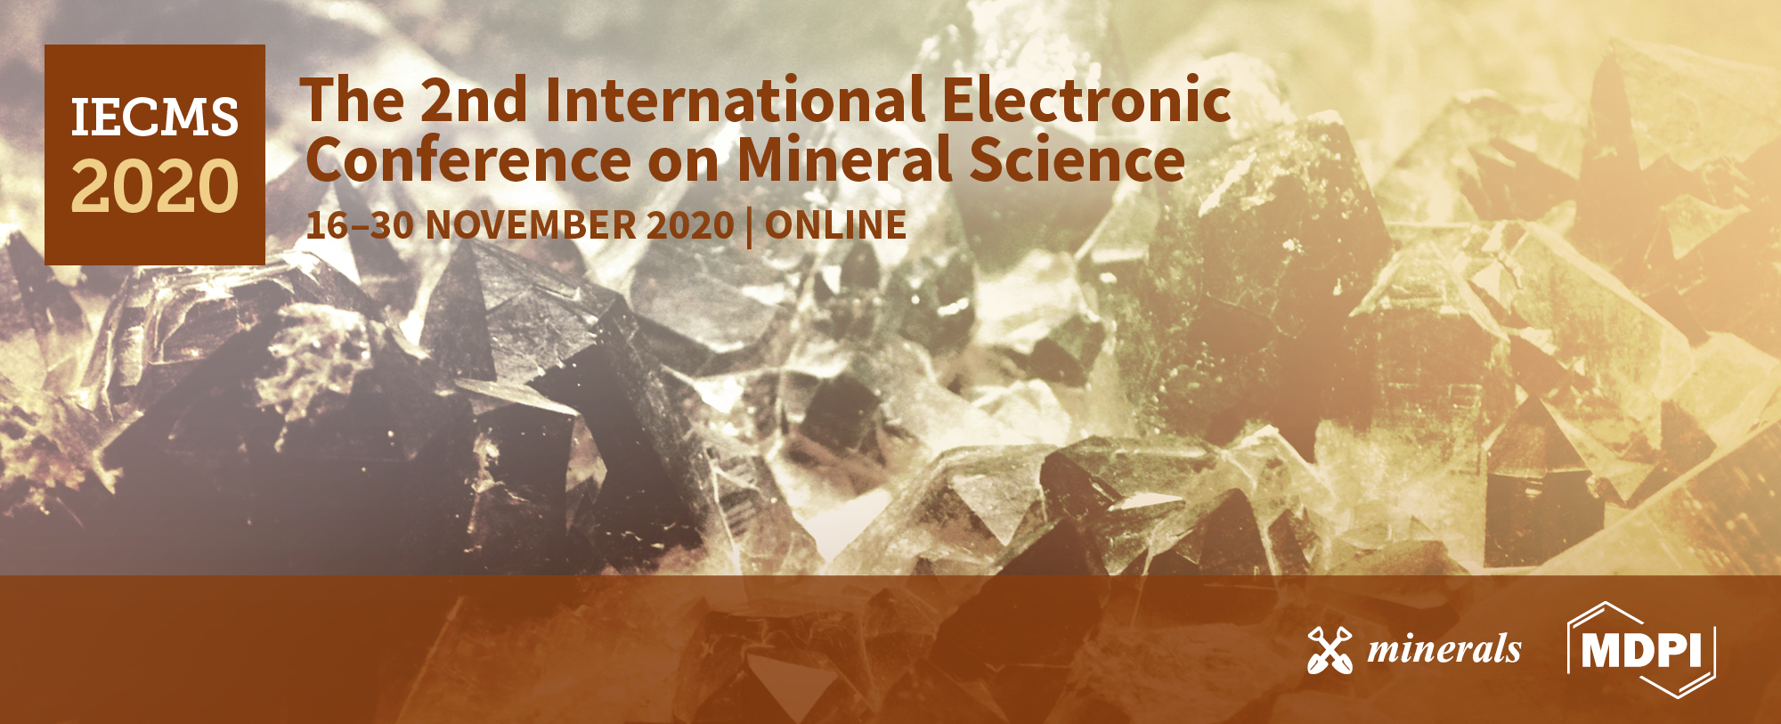


Characterization, classification, dry high intensity magnetic separation (DHIMS) and re-grinding techniques to improve the mineral performance of Sn-Ta-Nb mineral concentrates
Jennire Nava^{1,}*, Teresa Llorens¹, and , Juan M. Menéndez-Aguado²
¹ Strategic Minerals Spain, Ctra/ OU-0901 Km 14, Penouta Mine, Viana do Bolo, 32558, Ourense, Galicia, Spain; tllorens@strategicminerals.com;
² Escuela Politécnica de Mieres, Universidad de Oviedo,33600,Oviedo, Spain; maguado@uniovi.es.
* Corresponding author: jvanessanavar@gmail.com

Slide 2

Abstract: Ta and Nb are considered critical raw materials; due to their properties and potential applications in wide sectors. This study deals with Sn-Ta-Nb minerals from the Penouta mine (Orense, Spain), the only active mine in Europe producing tantalum minerals. These are obtained from mining wastes accumulated during old mining jobs in tailing ponds. The industrial processing flowsheet is based on successive gravimetric stages followed by low intensity magnetic separation to reduce ferromagnetic contaminants. Sn-Ta-Nb concentrate, with grades between 35-45% Sn and 4-7% Ta₂O₅ and Nb₂O₅, is obtained in this stage with plant recoveries around 60-70%, respectively. A chemical-mineralogical characterization by size fractions, XRF and XRD was carried out to implement a size classification stage using a circular vibrating screen in the processing plant. The finest fractions, containing higher grades of well liberated Sn, Ta, Nb minerals, were the feeding for dry high intensity magnetic separation (DHIMS) multifactorial tests, while, coarse fractions were re-grinded to maximize performance. The good results obtained in these tests demonstrate that two products with commercial quality could be obtained, a cassiterite concentrate with grades between 70-78% SnO₂ and a tantalite-columbite concentrate with grades ranging between 12 and 14% Ta₂O₅ and Nb₂O₅, also increasing the overall recovery of the plant.
Keywords: high intensity magnetic separation; Sn-Ta-Nb; critical raw materials; Penouta mine.

Slide 3

Introduction
Sn, Ta, Nb are strategic metals for the EU with important applications in technology sectors
Ta
Nb
Sn
https://roskill.com/market-report/tin/ (10/25/20)
Roskill (2016)
Tantalite-columbite contains Ta and Nb
Consulting, C (2018)

Slide 4
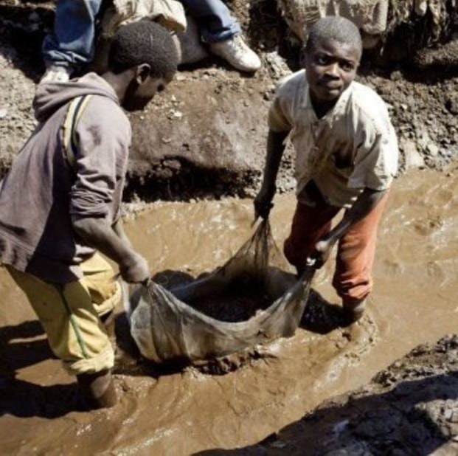


Introduction
Origin of Ta and Nb imports in the EU
Investigation of CRM deposits and processes in Europe
Import from conflict zones
To decrease import dependence
Regulation of the European Parliament
Dodd-Frank Law
(EC, 2020)

Slide 5
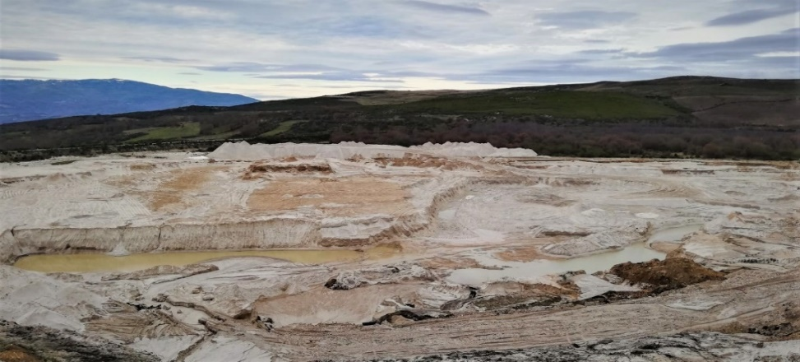
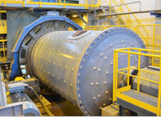


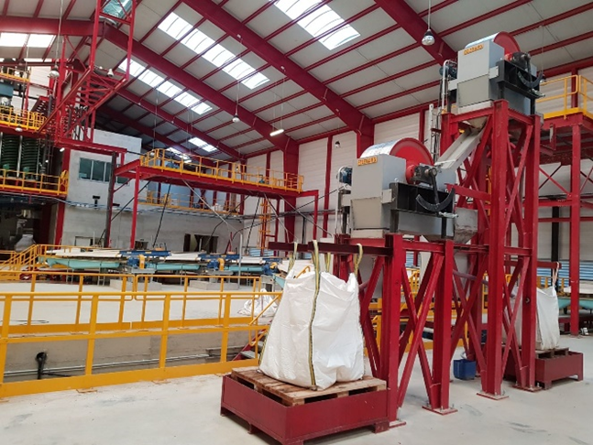
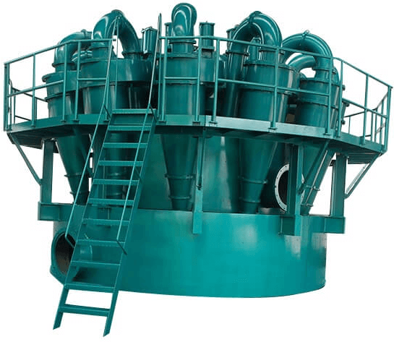
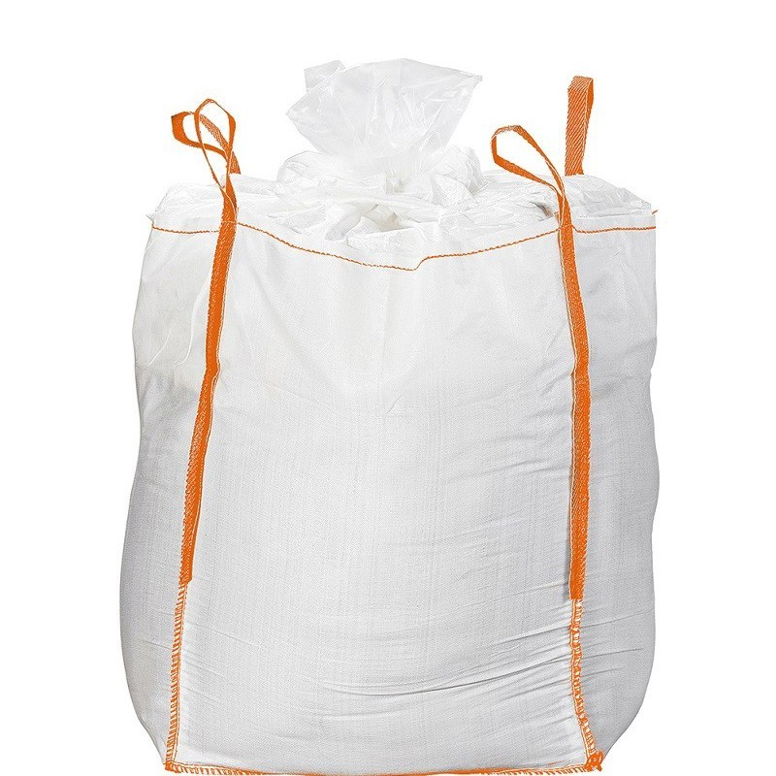
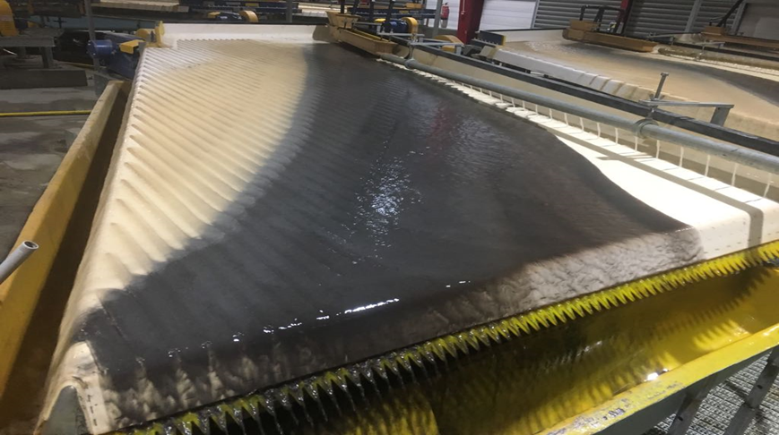
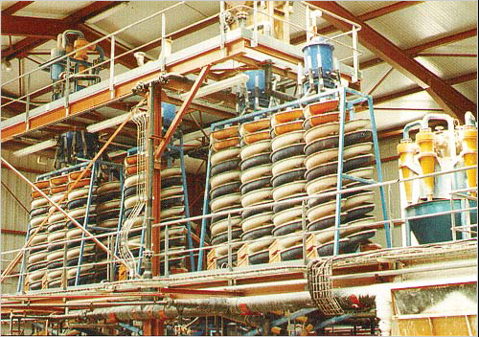
Introduction
Tailings Pond
Wet Low Intensity Magnetic Separation Stage
Grinding-Classification Circuit Stage
The Penouta mine (Orense, Spain), the only tantalite active mine in Europe
Sn-Ta-Nb Primary concentrate
35-45% Sn and 4-7% Ta₂O₅ and Nb₂O₅
Gravimetric Concentration Stages

Slide 6

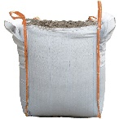
Objective
Sn-Ta-Nb Primary concentrate
35-45% Sn and 4-7% Ta₂O₅ and Nb₂O₅
How?
How?
¿ How to obtain independent concentrates of Sn and Ta-Nb that could be more competitive at the commercial level and thus contribute to an increasing yields in the industrial plant of the Penouta mine?
Sn concentrate
Nb-Ta concentrate

Slide 7
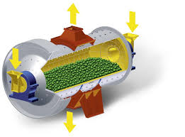
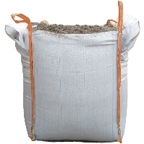
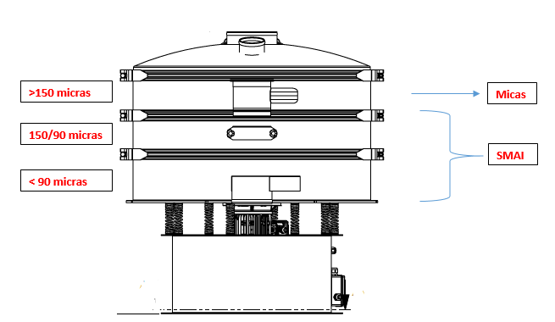
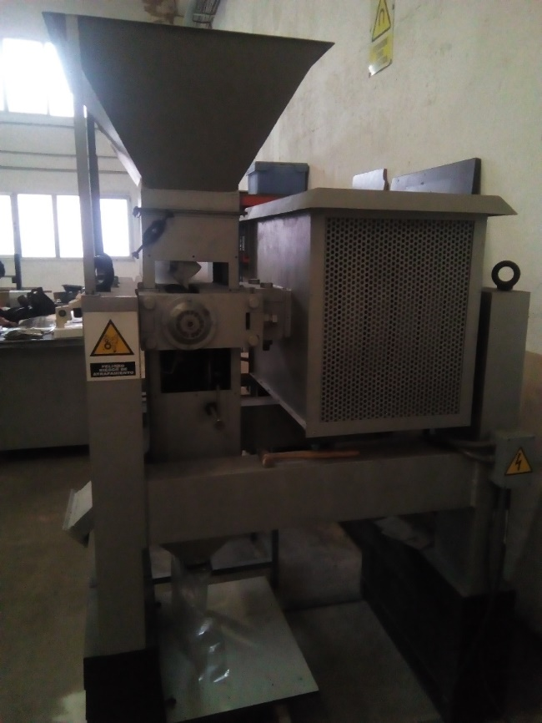
Materials and Methods
Characterization
Sn-Ta-Nb
Primary concentrate
Re-grinding
>150 µm
150/90µm
Sn concentrate
<90 µm
Classification and Assay by Size (XRF)
Nb-Ta concentrate
DHIMS test work

Slide 8
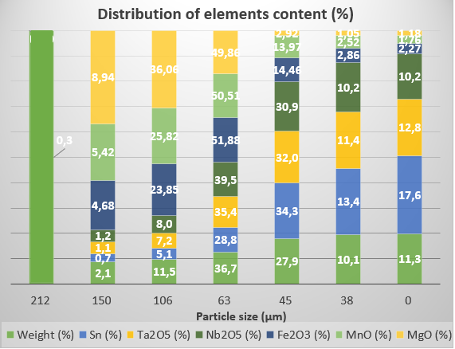
Results and Discussion
Feed:
Sn-Ta-Nb concentrate
33.75% Sn, 5.24% Ta, 4.64% Nb
Increasing Sn, Ta and Nb contents with decreasing size particle. Highest concentrations below 106 µm.

Slide 9
Results and Discussion
DHIMS multifactorial assays (XRF)
Test Nº | Size fraction (µm) | Magnetic field intensity (A) | Roll speed (rpm)
1 | 150/0 | Low | High
2 | 150/90 | Low | High
3 | 150/90 | High | High
4 | 150/90 | High | Low
5 | 150/90 | Low | Low
6 | 150/90 | Changing split inclination
7 | 90/0 | Low | High
8 | 90/0 | High | High
9 | 90/0 | High | Low
10 | 90/0 | Low | Low
11 | 90/0 | Changing split inclination
DHIMS assays configuration.
(Due to SMS data protection, they are considered qualitatively)
Paramagnetic Concentrate (Tantalite-columbite)
Test 6: 150/90 µm fraction. The best grades and recovery.
Test 7: <90 µm fraction. The best grades.
Test 10: <90 µm fraction. The best recovery.
Tantalite has a well-liberated size below 100 µm.
Granulometric size influencing both the increase of the grades and the yields of the species.
Higher content of SiO₂, Fe₂O₃ and MnO in coarser fraction.
Notes:
FALTA

Slide 10
Results and Discussion
DHIMS multifactorial assays (XRF)
Test Nº | Size fraction (µm) | Magnetic field intensity (A) | Roll speed (rpm)
1 | 150/0 | Low | High
2 | 150/90 | Low | High
3 | 150/90 | High | High
4 | 150/90 | High | Low
5 | 150/90 | Low | Low
6 | 150/90 | Changing split inclination
7 | 90/0 | Low | High
8 | 90/0 | High | High
9 | 90/0 | High | Low
10 | 90/0 | Low | Low
11 | 90/0 | Changing split inclination
Roller speed→ greater recoveries
Particle size → greater intensity is necessary
The selectivity, when the feed is classified in two fractions
No magnetic Concentrate (Cassiterite)
Test 6: 150/90 µm fraction. The best grades and recovery.
Test 8: <90 µm fraction. The best grades and recovery.
Finally, the test 6 is the optimal configuration to treat the 150/90 µm fraction, since it shows the best results for both grades and yields of SnO₂ and Ta₂O₅.
The fraction <90 µm through the configuration of the test 7.
Notes:
FALTA

Slide 11
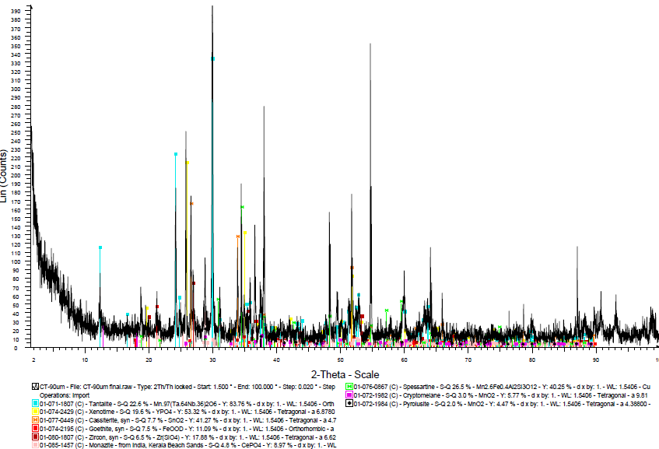
Results and Discussion
Tantalite-columbite concentrate <90 µm (XRD)
XRD results complement the information obtained by XRF, confirming that elements such as Mn and Fe are intrinsically associated with the mineralogy of tantalite-columbite, indeed. Consequently, their physical separation is impossible; despite, the present investigation recommends the recovery of minerals such as zircon and xenotime by means of electrostatic separation.

Slide 12
Results and Discussion-Regrinding of >150 µm fraction.
The assay by size of the resulting products passing the 100 µm mesh, after regrinding of the >150 µm fraction for each grinding time (0.5, 2.5, 5, 10 and 15 min)
As grinding time increase, the amount of mineral ground through the 100 µm mesh increase.
The distribution of the metal content in the ground product through the 100 µm mesh after the milling time has elapsed, shows an increase, reaching a well-liberated of at least 50% in the species of interest such as Sn, Ta and Nb after 10 min to avoid regrinding of fines and loss of energy efficiency.

Slide 13
Conclusions
Implementing a size classification, better grades and recoveries of Sn, Ta and Nb are obtained when performing DHIMS instead of using a wide granulometric interval (150/0 µm), since selectivity increases during operation, and for this reason, the fraction >150 µm is also regrinded.
The multifactorial DHIMS test works on the Sn, Ta and Nb primary concentrate generate two new products, a magnetic columbo-tantalite concentrate and a non-magnetic cassiterite concentrate with better grades and feasibility for the Penouta mine project.
The XRF and XRD techniques combined with size fraction analysis were key for the characterization of both the feeds and the products obtained in all the test works carried out.
The present work proposes to achieve electrostatic separation multifactorial tests to cut down on minerals such as zircon, monazite and xenotime and to purify the paramagnetic and non-magnetic concentrates obtained.

Slide 14


Acknowledgments
This research has been carried out thanks to the financing of Industrial Ph.D. "Oviedo Siembra Talento" from the Council of Oviedo, in coordination with the University of Oviedo. The authors thank Strategic Minerals Spain, S.L. access to concentrates and Felemamg the use of its facilities and equipment to carry out these test works.

Slide 15
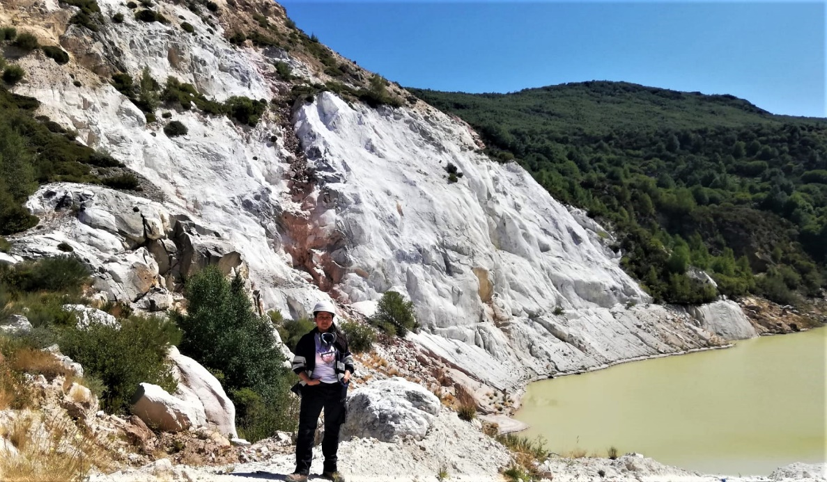
thanks for your attention...
Jennire Vanessa Nava Rosario
Metallurgical engineer
Email: jvanessanavar@gmail.com

