Slide 1
Spectral response (VNIR-SWIR) associated to isomorphic substitutions in the octahedral sheet of the smectites.
Adrián Lorenzo ¹*, Andrea García ¹, Juan Morales ¹, Emilia García ²⁻³, and Mercedes Suárez ¹.
¹ Departamento de Geología, Universidad de Salamanca. Plaza de la Merced, S/N, 37008 Salamanca
² Departamento de Mineralogía y Petrología. Universidad Complutense de Madrid. C/. José Antonio Novais. 28014 Madrid.
³ Instituto de Geociencias (UCM-CSIC), 28040 Madrid.
* Correspondence: adrianlorenzo@usal.es

Slide 2
Abstract:
A mineralogical characterization of a group of bentonites samples was done by X-ray diffraction (XRD), chemical analysis by inductively coupled plasma mass spectroscopy (ICP-MS) and visible-near infrared and short-wave infrared spectroscopy (VNIR-SWIR). As tested by XRD, all samples are very pure, composed mainly by smectites with very small amounts of impurities like quartz and feldspar. The results of the chemical analysis show high contents of Al₂O₃ in all the samples except COU(V), which has high contents of Fe₂O₃, and R4 which is a trioctahedral smectite. Within VNIR-SWIR spectra, absorption features characteristics of the smectites due to the presence of Fe are observed at lowest wavenumber, while at the SWIR region the absorptions are related to the M-OH bonds, and there are differences among the samples according to their octahedral content.
Keywords:
dioctahedral smectites; trioctahedral smectites; Fe-rich smectite; XRD; VNIR-SWIR spectroscopy.

Slide 3
Mineralogical characterization |  | Chemical characterization
X-Ray diffraction | VNIR-SWIR spectroscopy | Chemical analysis by FUS-ICP
Bruker D8 Advance ECO | ASD FieldSpec 4 Standard-Res
Materials and Methods
Materials
Samples | Localization
APA | Arizona, USA (Clay Repository)
COU(V) | Washington, USA (Clay Repository)
PUT | Putifigari, Italy
R4 | Esquivias, Spain
SAN | Arizona, USA (Clay Repository)
SUD | Cabo de Gata, Spain
CGA | Cabo de Gata, Spain
Methods
Mineralogical characterization
Chemical characterization
X-Ray diffraction
VNIR-SWIR spectroscopy
Chemical analysis by FUS-ICP
Bruker D8 Advance ECO
ASD FieldSpec 4 Standard-Res

Slide 4
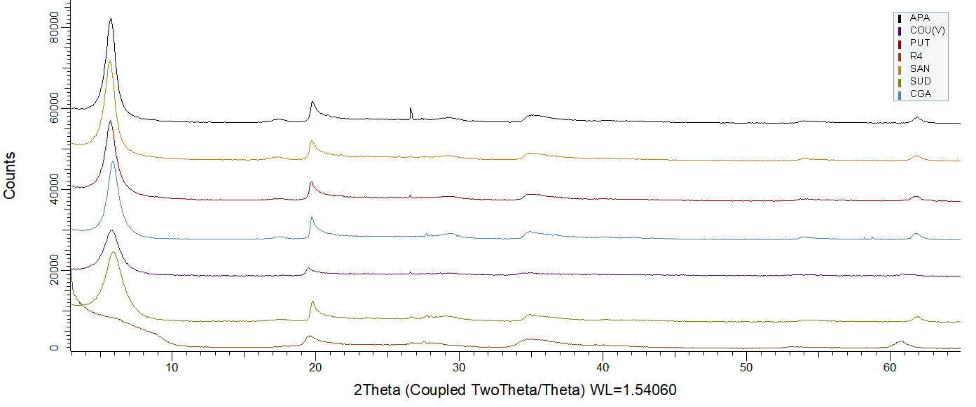
Results and Discussion
X-Ray diffraction
Smc
Q
Plg

Slide 5
Results and Discussion
Chemical analysis
 | SiO₂ | Al₂O₃ | MnO | MgO | CaO | Na₂O | K₂O | FeO | Fe₂O₃
APA | 51.95 | 14.18 | 0,08 | 5.04 | 2.48 | 0.08 | 0.17 | 0.00 | 1.23
COU(V) | 49.90 | 7.41 | 0.02 | 1.41 | 1.61 | 0.02 | 0.02 | 0.50 | 18.17
PUT | 50.52 | 14.02 | 0.07 | 4.11 | 1.17 | 0.50 | 0.18 | 0.00 | 5.06
R4 | 52.91 | 1.83 | 0.01 | 25.81 | 0.46 | 0.03 | 0.32 | 1.00 | 0.00
SAN | 53.71 | 14.52 | 0.09 | 5.16 | 2.57 | 0.16 | 0.17 | 0.40 | 0.98
SUD | 53.82 | 16.60 | 0.02 | 4.27 | 1.26 | 1.05 | 0.56 | 0.40 | 3.15
CGA | 53.03 | 16.82 | 0.06 | 5.10 | 1.38 | 0.99 | 0.34 | 0.20 | 2.20
Al₂O₃
MgO
Fe₂O₃
CaO
Na₂O
K₂O

Slide 6
Results and Discussion
VNIR-SWIR spectroscopy
Visible and near wavelength range
Features at 650 nm and 950 nm
Electronic transitions of Fe.

Slide 7
Results and Discussion
VNIR-SWIR spectroscopy
Short-wave zone of the spectra (I)
Features at 1410 nm and 1910 nm Combinations of the vibration modes of H₂O.

Slide 8
Results and Discussion
VNIR-SWIR spectroscopy
Short-wave zone of the spectra (II)
Features at 2310 nm and 2390 nm 3Mg−OH bonds vibration.
Features at 2210 nm
Al−Al−OH bonds vibration.
Features at 2290 nm Fe³⁺−Fe³⁺−OH bonds vibration.
Features at 2250 nm
Al−Fe³⁺−OH bonds vibration.

Slide 9
Conclusions
The samples present clear and discriminatory absorption bands related to the octahedral content of the smectites:
Dioctahedral Al-rich smectites are characterized by the absorption at 2210 nm
Fe-rich dioctahedral smectites present the most intense absorption at 2290 nm.
The presence of dioctahedral Al-Fe³⁺-OH bonds causes an adsorption located at 2250 nm.
Trioctahedral 3Mg-OH bonds produce significant absorption bands located at ~ 2310 nm and ~ 2390 nm.
These discriminatory absorptions allow to identify the smectite type by means of the field spectroscopy.

Slide 10
Acknowledgments

