Slide 1
Field spectroscopy applied to the kaolinite polytypes identification
García-Vicente,A. ^{1,}*, Lorenzo, A. ¹, Morales,J. ¹, García-Romero,E. ²⁻³and Suárez,M.¹
¹ Departamento de Geología, Universidad de Salamanca. Plaza de la Merced, S/N, 37008 Salamanca.
² Departamento de Mineralogía y Petrología. Universidad Complutense de Madrid. Avda. José Antonio Novais. 28014 Madrid.
³ Instituto de Geociencias (UCM-CSIC), 28040 Madrid.
* Corresponding author: andrea_gar@usal.es

Slide 2
Abstract:
A detailed characterization of some minerals of the kaolinite group has been done. The mineralogical and structural characterization has been conducted by X-ray diffraction (XRD) together with the study of the spectroscopy response in the visible-near infrared and short wave (VNIR-SWIR), and the main objective was the determination of Kaolinite polytypes. For this purpose, 13 samples were selected from a wide group of samples. The statistical analysis of the patterns groups the samples according to the kaolinite polytype in 5 kaolinites, 2 dickites and 6 halloysites. Groups of diagnostic peaks for kaolinite, dickite y and halloysite polytypes have been identified in the second derivative of the spectrum, of which position and intensity have been treated statistically with the aim of classifying the spectra according to the polytype. In good agreement to the XRD results, the statistical analysis of the spectroscopic data, both by cluster analysis and by principal components analysis (PCA), allow an unequivocal classification of the samples according to the polytype from their VNIR-SWIR spectra.
Keywords: kaolinite polytypes; kaolinite; dickite; halloysite; VNIR-SWIR.

Slide 3
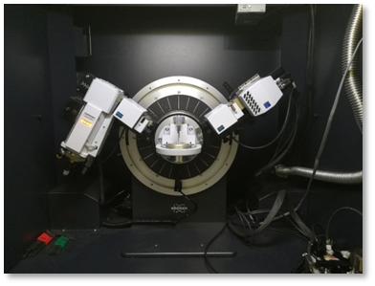
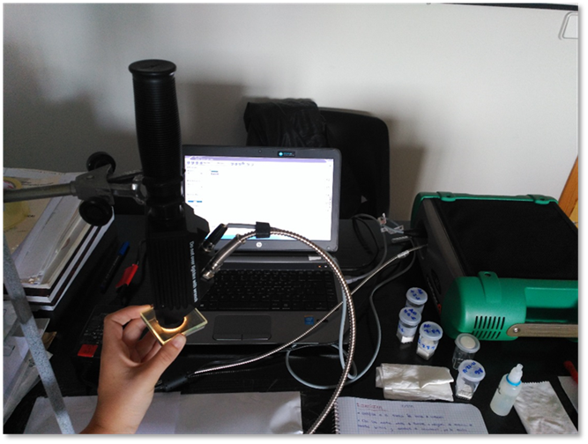
Methods
X-ray powder diffraction (XRD) measurements were carried out on a BRUKER D8 ADVANCE ECO diffractometer with theta-2theta configuration.
Spectroscopy analysis has been carried out in the near infrared and short-wave infrared with an ASD Field Spec 4 Standard Res.

Slide 4
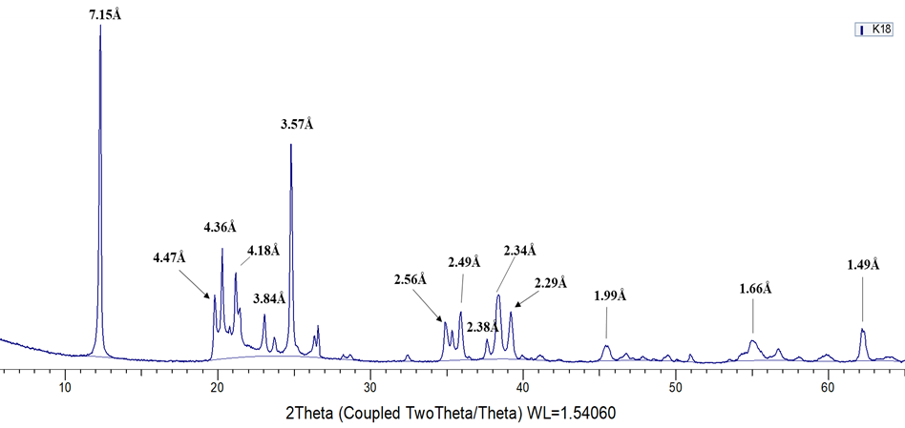
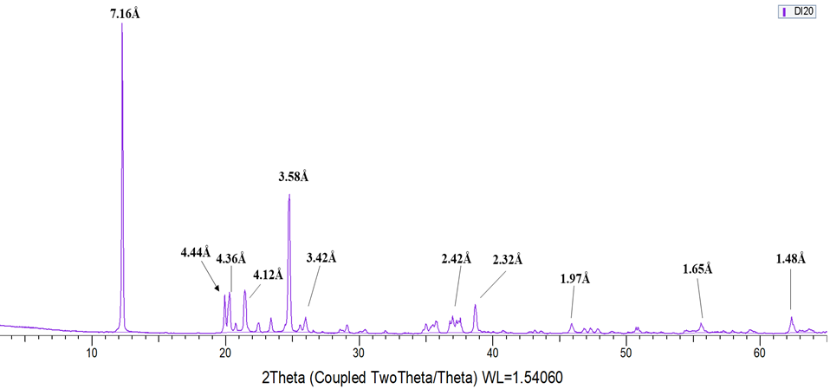
Results and discussion (X-ray diffraction)
Kaolinite
-001 reflection at 7.15Å
-Ordered kaolinite
-14 diagnostic reflections
Dickite
-001 reflection at 7.16Å
-12diagnostic reflections

Slide 5
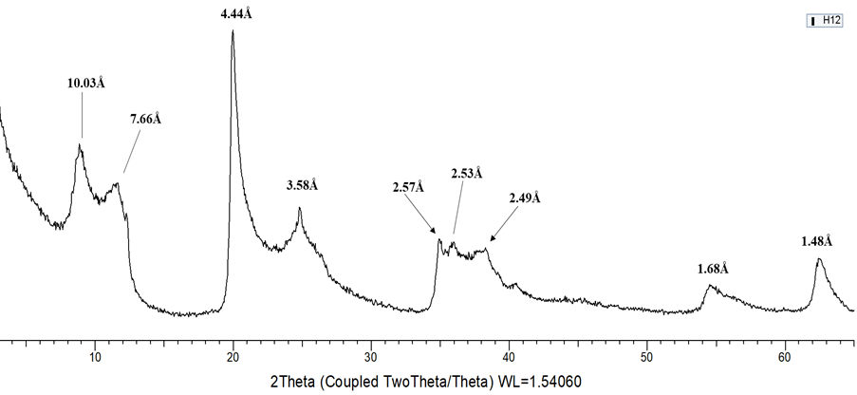
Results and discussion (X-ray diffraction)
Halloysite
-Basal reflection 001 located between 7.2-7.6Å depending on whether it is halloysite or metahalloysite

Slide 6
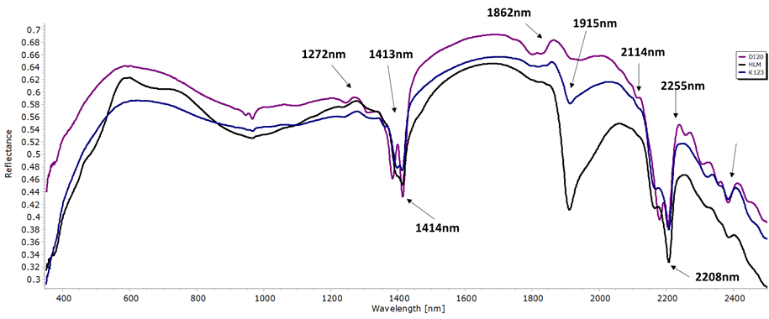
Results and discussion (VNIR-SWIR spectroscopy)
-Kaolinite and its polytypes, dickite and halloysite, give rise to common absorption bands located in 1414 nm, 2114 nm, 2208 nm and 2383 nm.
-The global reflectance is higher in the dickite and kaolinite spectra, thus decreasing for the halloysite spectra.
Kaolinite polytypes

Slide 7
Conclusions
-5 kaolinites, 2 dickites and 6 halloysites have been identified.
-The main discriminatory absorption bands of the different polytypes are the following: 1397 nm, 1414 nm and 2208 nm with kaolinite, 1381 nm and 2178 nm with dickite and finally, 1913 nm and 2138 nm with halloysite.
-Groups of diagnostic peaks for kaolinite, dickite and halloysite polytypes have been identified in the VNIR-SWIR spectrum and in good agreement to XRD mineralogical identification allow an unequivocal classification of kaolinite polytypes.

