Slide 1




Siliceous fly ash utilization conditions for zeolite synthesis
Title of the Presentation
Silvana Gjyli ^{1,*}, Arjan Korpa ², Valdet Teneqja ², Dritan Siliqi ³, Claudia Belviso ^{4*}
¹ Department of Industrial Chemistry, Faculty of Natural Sciences, University of Tirana, 1000 Albania;
² Department of Chemistry, Faculty of Natural Sciences, University of Tirana, 1000 Albania;
³ Istituto di Cristallografia, Consiglio Nazionale delle Ricerche, 70126 Bari, Italy;
⁴ Institute of Methodologies for Environmental Analysis - IMAA-CNR, Tito Scalo (PZ), 85050 Italy;
* Corresponding author: vanagjyli@yahoo.com (S.Gj); claudia.belviso@imaa.cnr.it (C.B)

Slide 2

Abstract:
Fly Ash is a coal combustion product partly disposed of in landfills since it finds no other application. Recycling this solid is of great benefit in terms of quality, cost effectiveness and environment. The chemical and mineralogical composition of siliceous fly ash makes it an attractive and economic raw material for the synthesis of zeolites. Zeolites are microporous, aluminosilicate minerals characterized by a three-dimensional network of tetrahedral units produced industrially on a large scale. In this work synthetic X and A-type zeolite with high crystallinity and high value of surface area were synthesized by pre-fusion method followed by hydrothermal treatment at various conditions. The data indicate that zeolitic products were obtained using NaOH while no zeolitic material was crystallized using KOH and LiOH. Pre-treatment of fly ash with acid before being used in the synthesis of artificial zeolites is considered an important parameter for the purity phase of zeolites. Without sodium aluminate additions, synthetic zeolite A was not formed. The results confirm that temperature, crystallization time, SiO₂/Al₂O₃ ratio, type of water (distilled water and seawater), are also important parameters influencing type of zeolite synthesized. Zeolite X was used as novel catalyst for alkylation of phenol using diethyl carbonate.
Keywords: fly ash; synthesis; zeolite structure; crystallinity

Slide 3
Zeolites are hydrated aluminosilicate minerals with a three-dimensional open structure.
They consist of SiO₄ and AlO₄ tetrahedra which gives it an anionic framework with the negative charge of Al being compensated by extra framework cations (positively charged ions), some being Na+, K+, Ca²⁺ Mg²⁺ and water molecules.
Cement
Zeolites are used in several applications because of their special structure and properties.
Environmental
pollution
Catalysis
Emerging applications

Slide 4
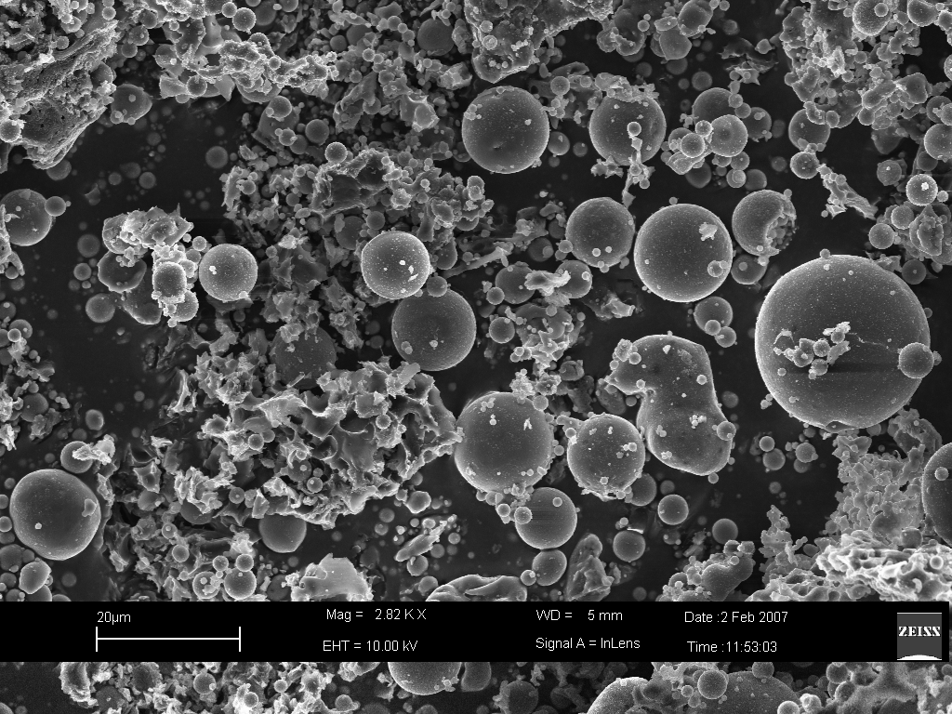
Waste fly ash can be employed for the synthesis of zeolites;
Fly ash contains abundant aluminosilicate and silicate phases; it is typically composed of:
amorphous materials, ranging from 34% to 80 %, and
crystalline phases (e.g., quartz, mullite, hematite, etc.
The main crystalline phase consists mainly of quartz (SiO₂) (Ref. 01-089-8936) and mullite (Al₆Si₂O₁₃) (Ref. 00-015-0776) where sharp points are observed.
The SEM image shows the typical fly ash morphology characterized by most spherical particles which consist of cenospheres and plerospheres.
Quartz
Mullite
Mullite
Quartz
Mullite
Mullite
Quartz
Mullite
Mullite
Amorphous material
10
20
30
40
50
60
70
°2θ

Slide 5
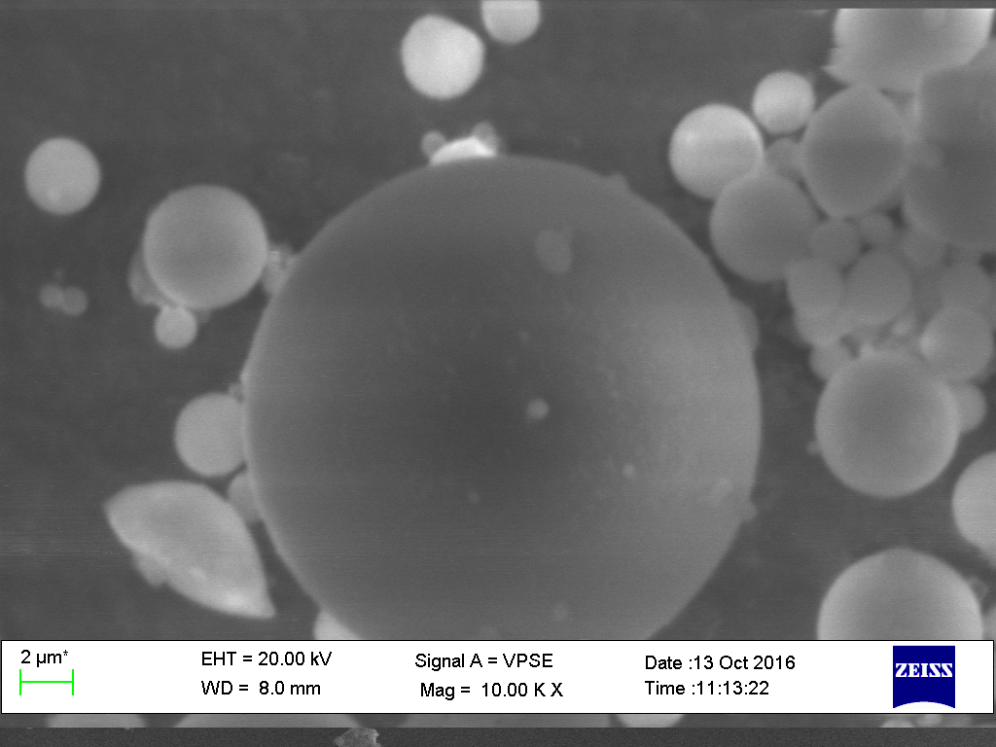





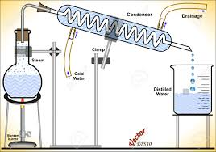
The experiments were carried with:
Fly Ash
Silicious fly ash (FA
Hydrothermal
Multi-step
Process
treatment
Alkaline pre-fusion hydrothermal process
Alkaline fusion
Sonication
Microwave heating
Process
approach
With and without fly ash HCl treatment
Zeolite
NaOH/fly ash with different ratio
Crystallization temperature from 40°C to 90°C
Incubation time ranging from 1h to 72h
Distilled water or seawater as incubation solution
With and without NaAlO₂ addition

Slide 6
Main parameters studied:
Acid pre-treatment of fly ash before the fusion and hydrothermal process
NaOH, KOH, LiOH pre-fusion hydrothermal process
NaOH/FA and Si/Al ratio
Study of the effect of seawater vs. distilled water on the type and purity of zeolite
With and without NaAlO₂ addition

Slide 7
Results and Discussion
The chemical composition of fly ash determined by means of XRF, contains mainly 78 % SiO₂ + Al₂O₃, whereas the impurities consist of metallic oxides such as Fe₂O₃ and CaO defined as class F coal fly ash corresponding with ASTM C618. Fly ash was treated with acid-washing XRF data (Table 1) indicate that most of the impurities (Fe₂O₃, CaO, were removed, thus increasing the mass ratio of SiO₂/Al₂O₃ which was 1.8% before acid treatment and became 2.25% after treatment.
Table 1. Chemical composition of raw and acid-treated fly ash analyzed by XRF.
Chemical composition (wt. %) | Fly ash raw | Fly Ash acid treatment
SiO₂ | 50.96 | 61.66
Al₂O₃ | 27.45 | 24.20
Fe₂O₃ | 7.02 | 5.47
CaO | 4.22 | 1.07
K₂O | 3.34 | 3.21
TiO₂ | 1.74 | 1.92
SO₃ | 1.52 | 0.18
MgO | 1.28 | 0.75
Na₂O | 0.92 | 0.68
P₂O₅ | 0.77 | 0.23
SiO₂/Al₂O₃ | 1.86 | 2.55

Slide 8
XRD data indicate that the mineral composition of fly ash does not change with the acid treatment. The untreated carbon fly ash had a purity of 79% (Na₂O, SiO₂ and Al₂O₃), while the HCl treatment provided a purity of the material of up to 87% (Na₂O, SiO₂ and Al₂O₃). The specific surface, instead, slightly increases after the treatment with acid, from 1.5 m²/g to 2.9 m²/g.
XRD patter displays also FA after fusion at 550 °C for 1 hour with NaOH. The profile indicates the formation of sodium silicate (Na₂SiO₃) (Ref. 00-016-0818) and silicon oxide dealuminate (Al₂SiO₅) (Ref. 01-088-0890).
Intensity
FA after acid treatment
FA pretreated with acid and fused with NaOH
0
10
20
30
40
50
60
70
Position [°2Theta] (Copper (Cu))

Slide 9
Conversion of FA to zeolite materials using an alkaline fusion, followed by hydrothermal treatment revealed that KOH and LiOH showed a poor efficiency to activate FA, compared to the case where NaOH was used as activator. XRD data show the presence of amorphous/geopolymer phase in the sample treated with KOH as activator and lithium silicate (Li₂SiO₃) when LiOH was used.
All zeolite products were obtained when NaOH was used as an activator. A and X-type zeolites after NaOH pre-fusion treatment followed by hydrothermal process.
NaOH
Intensity
KOH
LiOH
0
10
20
30
40
50
60
70
Position [°2Theta] (Copper (Cu))

Slide 10
X-ray diffraction pattern shows that the generated X zeolite has a high crystallinity and is pure phase. The surface area (BET) for this synthetic product was 412 m²/g. The diffraction peaks of the powder pattern are well described by Na₇₁(Si₁₂₁Al₇₁)O₃₈₄ crystal structure (Ref. 00-150-7214).
The synthesis of zeolites A is attributed to the modified Si / Al ratio with the addition of NaAlO₂ which enables the synthesis of zeolites A instead of zeolites X.
XRD model shows that zeolite A is characterized by a very high crystallinity phase (80-97%). However, the results show that the surface area of this zeolite is 30 m²/g (BET) much lower than X-type zeolite. The diffraction peaks of the powder pattern are well described by Na₁₂(Al₁₂Si₁₂O₄₈)(H₂O)₂₇ crystal structure (Ref. 00-8104-214).
X – type Zeolite
Intensity
A – type Zeolite
0
10
20
30
40
50
60
70
Position [°2Theta] (Copper (Cu))

Slide 11
Both zeolite X and zeolite A belong to the cubic system. Synthesis conditions strongly influenced the morphology of the synthesis products.
SEM micrograph shows the typical octahedral crystals of zeolites X (Figure a) and cubic shape of zeolite A (Figure b).
It is worth mentioning here that the synthesis of type A zeolite requires much shorter crystallization time (starting from 4 hours compared to the synthesis of type X zeolites which requires 72 hours.
Zeolite have been successfully synthesized from fused fly ash by using seawater as a crystallization medium. Using distilled water zeolite X with a specific surface area 412 m²/g was formed, meanwhile when sea water was used was synthesized zeolites type X a lower specific surface area 362 m²/g.

Slide 12
The surface area of type X zeolite increased from 44 to 412 m²/g when increasing the crystallization temperature from 40 to 60°C, and then dropped to 318 m²/g at 90°C.
In short time of crystallization 24h, low temperature 60 °C and low ratio of NaOH/FA 0.75, the use of sea water was favorable compared to distilled water in the synthesis of zeolite type X.
However, it was confirmed from XRD profile, when it was used sea water, time of crystallization 72 h, crystallization temperature 90 °C and ratio of NaOH/FA 1.25, sodalite was generated together with, an undesired secondary.
Synthetic zeolites were tested as heterogeneous basic catalyst in the gas-phase alkylation of phenol with diethyl carbonate. It was obtained phenol conversions up to 95% with a selectivity to phenetole higher than 85% thus demonstrating that the catalytic activity of the zeolites synthesized from fly ash i very high.
Results obtained show that the method described is clean, cost-effective, and environmentally friendly.

Slide 13
Conclusions:
The zeolites were synthesized from waste coal fly ash through dissolution of alkali-fused aluminosilicates, followed by hydrothermal treatment.
Acid-washing pre-treatment and synthesis conditions have a significant effect on the type and properties of the synthesized zeolite product.
Without addition of NaAlO₂ the zeolite A could not be synthesized.
When sea water is used instead of distilled water the zeolite type X has lower purity and specific surface area.
The NaOH/FA ratio of 1.25 seems to be advantageous for type X zeolites than the NaOH/FA ratio of 0.75.

Slide 14
The optimal synthesis conditions for zeolite X were fly ash pre-treatment, NaOH/FA ratio of 1.25, fusion at 550°C for 1h, crystallization 60°C for 72 hours and employment of distilled water.
The optimal synthesis condition for zeolite A were fly ash pre-treatment, NaOH/FA ratio of 1.25, fusion at 550°C for 1h, NaAlO₂/FA ratio of 0.5, crystallization 90°C for 72 hours and employment of sea water.
The methods described are clean, cost-effective, and environmentally friendly.
The applicability of our innovative synthetic zeolites for catalytic application as heterogeneous basic systems makes zeolite synthesis from FA an alternative for the common commercial catalysts used in industries.

Slide 15


Acknowledgments
This research was funded by Erasmus Mundus SUNBEAM Scholarship Programme, grant number SUNB1500545.
We thank the support offered by Prof. Dr. Cavani F. and Dr. Tabanelli T. from the “Department of Industrial Chemistry "Toso Montanari" Alma Mater Studiourum University of Bologna” Italy on different techniques of characterization of zeolites. We also thank the company Bau Mineral GmbH for the cooperation for collecting fly ash for this research.

