Slide 1
Susceptibility of Campylobacter Strains to Selected Natural Products and Frontline Antibiotics
Noel Gahamanyi ^{1,2,*}, Dae-Geun Song ¹, Kwang Hyun Cha ¹, Kye-Yoon Yoon ¹, Leonard E.G. Mboera ², Mecky I. Matee ³, Dieudonné Mutangana ⁴, Raghavendra G. Amachawadi ⁵, Erick V.G. Komba ² and Cheol-Ho Pan ^{1, 6,*}
¹ Natural Product Informatics Research Center, KIST Gangneung Institute of Natural Products, Gangneung 25451, Korea;
² SACIDS Foundation for One Health, College of Veterinary Medicine and Biomedical Sciences, Sokoine University of Agriculture, P.O. Box 3015, Chuo Kikuu, Morogoro, Tanzania;
³ School of Medicine, Muhimbili University of Health and Allied Sciences, P.O. Box 65001, Dar es Salaam, Tanzania;
⁴ College of Science and Technology, University of Rwanda, P.O. Box 3900, Kigali, Rwanda;
⁵ Department of Clinical Sciences, College of Veterinary Medicine, Kansas State University, Manhattan, KS 66506-5606, USA;
⁶ Division of Bio-Medical Science and Technology, KIST School, Korea University of Science and Technology, Seoul 02792, Korea
* Correspondence: noel.gahamanyi@kist.re.kr ; panc@kist.re.kr

Slide 2
1. Introduction
Gastoenteritis
Sequelae:
GBS: Guillin- Barré Syndrome
RA: Reactis Arthritis
IBD: Inflammatory Bowel Disease
Why testing Campylobacter species against frontline antibiotics?
Campylobacter species causes diarrhea, different sequelae (GBS, RA, IBD), & have developed resistance to existing antibiotics.
The resistance to drugs of choice (Quinolones & Macrolides) and alternative drugs is of concern.
The over/misuse of antibiotics in human and veterinary medicine contribute to increasing resistance to antibiotics.
Mutations in specific genes & acquiring efflux pumps
Quinolones:
Ciprofloxacin
Nalidixic acid
Macrolides:
Erythromycin
Azithromycin
Growth promotion, prophylaxis, therapy
gyrA, tet(O), cmeABC

Slide 3
Mechanisms of resistance

Slide 4
1. Introduction cont’d…
natural products:
Plant extracts
Essential oils
Phytochemicals
Why testing Campylobacter species from chicken against natural products?
Fluoroquinolone-resistant Campylobacter species in on WHO list of pathogens requiring urgent alternative treatment.
By 2050, if no adequate actions are taken, the annual death rate due to AMR would reach 10 M people worldwide and cost USD 100 trillion.
Poultry is at the top of major reservoirs of fluoroquinolone-resistant Campylobacter strains.
End of antibiotic era.
Herbal medicines are safe, cheap, and 87% of citizens of LMICs rely on medicinal plants for primary healthcare.
WHO: World Health Organization
AMR: Antimicrobial resistance
LIMCs: Low and middle income countries

Slide 5
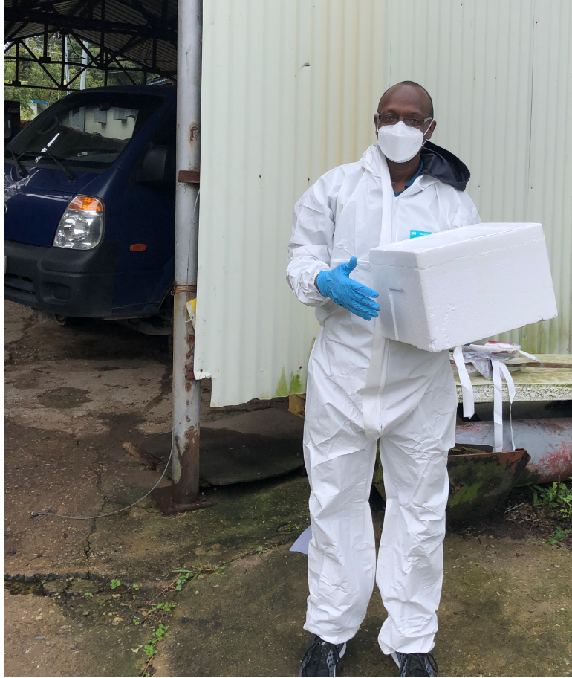
2. Materials & methods
Sample collection
ATCC cultures
Swabs put on ice
Two poultry farms in Korea
Transported to the laboratory within 1hr

Slide 6
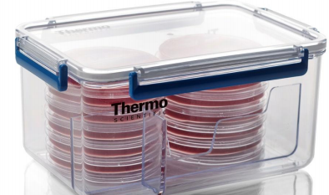
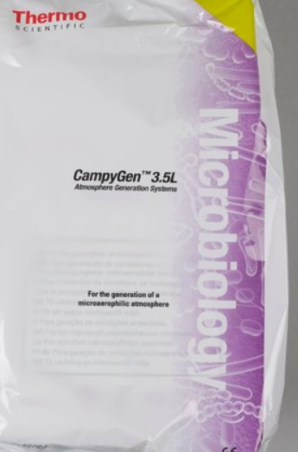
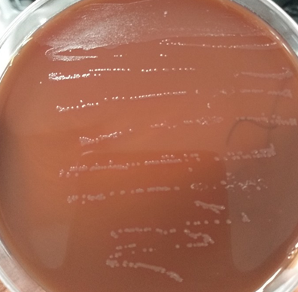
Isolation & antimicrobial susceptibility testing (AST)
Isolation
Species confirmation: PCR & sequencing
Inoculation
Selective media
(mCCDA + SR155E)
Incubation
37°C for 48 h
Microaerophilic conditions
Subculture
Mueller Hinton Agar (MHA) + 5% Horse Blood
Antimicrobial susceptibility testing
Antibiotics
Quinolones (ciprofloxacin, nalidixic acid)
Macrolide (erythromycin)
Tetracyclines (tetracycline)
Aminoglycosides (gentamicin)
mCCDA: modified charcoal cefoperazone deoxycholate agar

Slide 7
Target gene | Primer name | Sequence (5' -3') | Amplicon size | Annealing Tº
16S rRNA | C412F | GGATGACACTTTTCGGAGC | 816 | 55
 | C1228R | CATTGTAGCACGTGTGTC
cj0414 | C1F | CAAATAAAGTTAGAGGTAGAATGT | 161
 | C3R | CCATAAGCACTAGCTAGCTGAT
ask | CC18F | GGTATGATTTCTACAAAGCGAG | 502
 | CC519R | ATAAAAGACTATCGTCGCGTG
tet(O) | tet(O)F | GCGTTTTGTTTATGTGCG | 559
 | tet(O)R | ATGGACAACCCGACAGAAG
cjgyrA | QRDRF | GCCTGACGCAAGAGATGGTTTA | 454
 | QRDRR | TATGAGGCGGGATGTTTGTCG
cmeB | cmeBF | TCCTAGCAGCACAATATG | 241
 | cmeBR | AGCTTCGATAGCTGCATC
Target genes, primer sequences, & amplification conditions

Slide 8
Information on used Natural products
Plant extracts
Library code | Family | Scientific name | Common name | Collection site | Collection date | Part of plant | Extraction solvent
BE0005B1 | Lamiaceae | Meehania urticifolia (Miq.) Makino | Nettle-leaf mint | Gangneung, Gangwon | 2016 | Aerial part | Ethanol
BE0165A1 | Lamiaceae | Scutellaria baicalensis Georgi | Skullcap | Yeosu, Jeonnam | 2017 | Root | Ethanol
BE0167A1 | Lamiaceae | Mentha canadensis L. | Wild mintt | Andong, Gyeongbuk | 2017 | Aerial part | Ethanol
BE1192A1 | Lamiaceae | Salvia plebeia R.Br. | Common sage | Paju, | 2015 | Whole plant | Ethanol
 |  |  |  | Gyeonggi
BEA585A1 | Lauraceae | Cinnamomum cassia (L.) J.Presl | Cinnamon | Gyeongdong Seoul | 2015 | Bark | Ethyl acetate
Essential oils
Phytochemicals
Eugenol
(E)-Cinnamaldehyde
Baicalein
Kuraridin
Emodin
Clove oil
Cinnamon oil

Slide 9
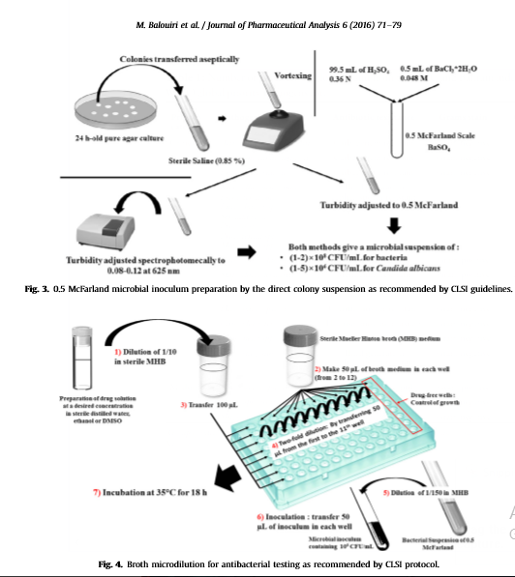
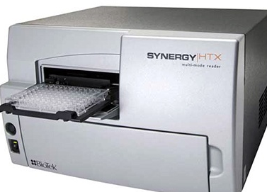
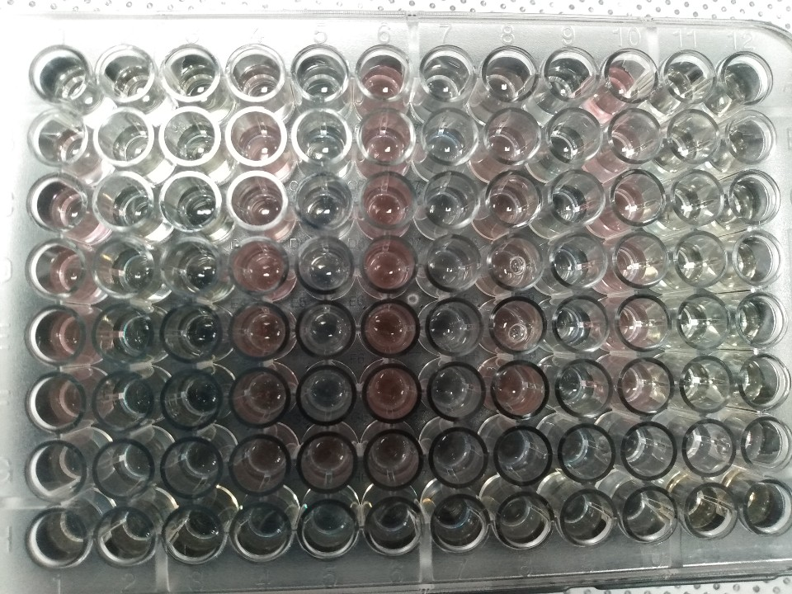
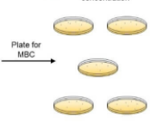
MIC: minimal inhibitory concentration
MBC: minimal bactericidal concentration
EUCAST cut-off values
OD at 600nm
Iodo nitro tetrazolium chloride (INT addition)

Slide 10
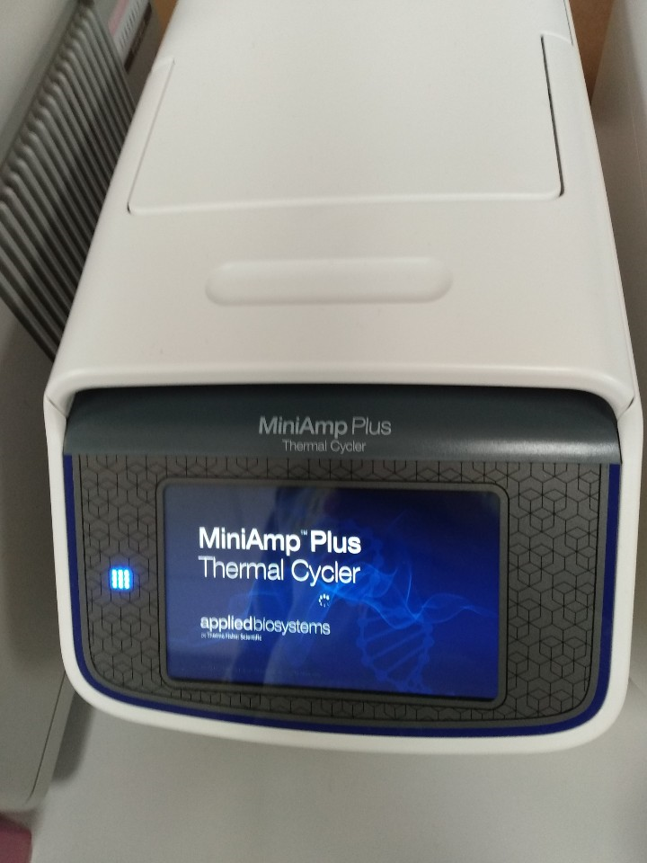
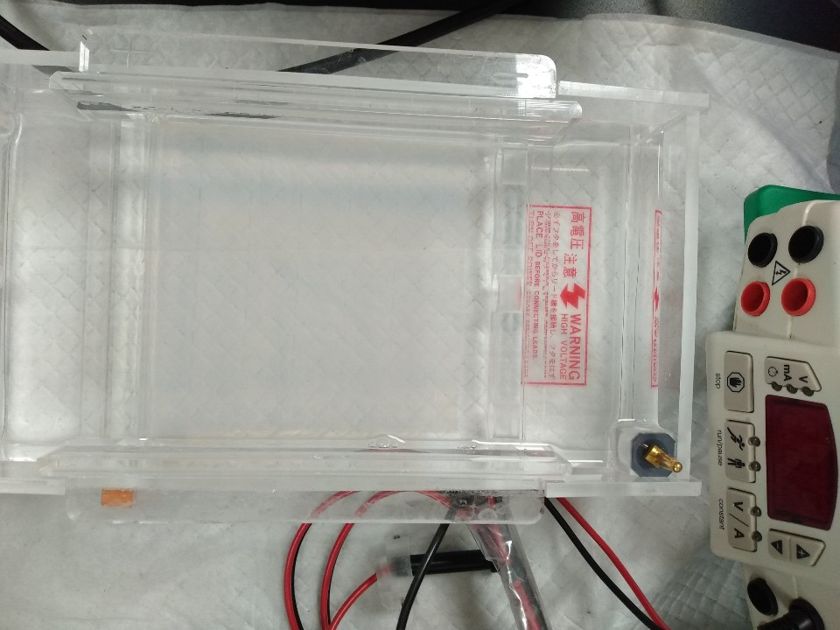
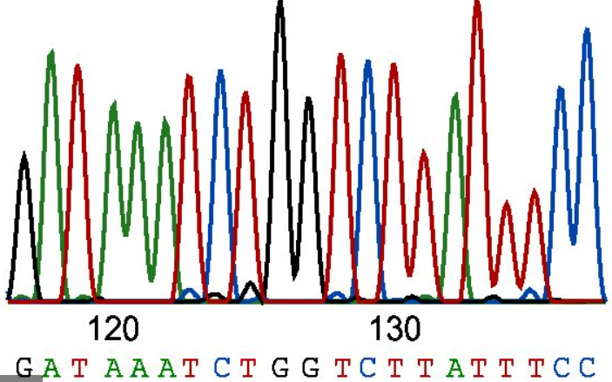
DNA Extraction and Sequencing
Data Analysis
Gel Electrophoresis
Recording image
DNA extraction
PCR
Sequencing
PCR was done for species identification and antimicrobial resistance genes confirmation
Multiple sequence alignment
BLAST
Translation
Submission
Chromatogram analysis
Compare our sequence to those from database
Sequences were submitted to:
GenBank to get accession numbers
Editing
Aligning
Analyzing
ExPASyTranslate tool
BioEdit version 7.2.6.1

Slide 11
3. Results
MIC & MBC for essential oils & phytochemicals
NP/antibiotic | CJ–RS |  | CC–RS |  | CJ–CI |  | CC–CI
 | MIC | MBC | MIC | MBC | MIC | MBC | MIC | MBC
Clove oil | 50 | 100 | 100 | 400 | 50 | 100 | 200 | 400
Cinnamon oil | 25 | 25 | 50 | 100 | 25 | 50 | 50 | 100
Eugenol | 50 | 100 | 100 | 200 | 50 | 100 | 100 | 200
(E)-Cinnamaldehyde | 25 | 25 | 50 | 50 | 25 | 50 | 50 | 50
Baicalein | 32 | 64 | 64 | 64 | 32 | 64 | 64 | 64
Kuraridin | 48 | ND | 48 | ND | 48 | ND | 48 | ND
Emodin | 50 | ND | 200 | ND | 50 | ND | 200 | ND
Ciprofloxacin | 0.125 | 1 | 0.5 | 1 | 32 | 64 | 64 | 128
Erythromycin | 0.5 | 1 | 1 | 4 | 0.5 | 1 | 2 | 4
Gentamicin | 2 | 8 | 2 | 8 | 1 | 2 | 1 | 8
Tetracycline | 1 | 4 | 1 | 4 | 256 | 512 | 64 | 128
Nalidixic acid | 16 | 32 | 8 | 32 | 128 | 256 | 64 | 128
Bands of C. jejuni, C. coli, tet(O), and gyrA. 1: marker; 2: CJ-RS; 3: CJ-CI; 4: CC-RS; 5: CC-CI; 6–7: tet(O) gene (559 bp), and 8–9: gyrA gene (454 bp) from antibiotic-resistant strains.
MIC & MBC for plant extracts
NP/antibiotic | CJ–ATCC |  | CC–ATCC |  | CJ–Chicken |  | CC–chicken
 | MIC | MBC | MIC | MBC | MIC | MBC | MIC | MBC
M. urticifolia | 400 | 800 | 400 | 800 | 400 | 800 | 400 | 800
S. baicalensis | 400 | 800 | 400 | 800 | 400 | 800 | 400 | 800
M. canadensis | 400 | 800 | 400 | 800 | 800 | 1600 | 400 | 800
S. plebeia | 400 | 800 | 400 | 800 | 800 | 1600 | 400 | 800
C. cassia | 200 | 400 | 200 | 400 | 200 | 400 | 200 | 400
MIC: minimal inhibitory concentration (µg/mL)
MBC: minimal bactericidal concentration
CJ: C. jejuni; CC: C. coli

Slide 12
Mutations in gyrA sequences of C. jejuni (A) and C. coli (B).
Mutation (Thr86Ile) is caused by change from ACA to ATA (C. jejuni) & ACT to ATT (C. coli).
Silent mutations in gyrA are also depicted. Mutations are bolded and underlined.
L04566.1 & U63413.1 are standard strains (without mutation), while KX982339.1 & MT176401.1 are resistant strains.
MT947448 and MT947449 are chicken isolates of this study.
Tet(O) genes of
C. jejuni (MT967269) &
C. coli (MT967270)
100% similarity
tet (O)-resistance genes sequences in Genbank.

Slide 13
4. Discussion
The objective of this study was to evaluate the susceptibility of Campylobacter strains to various NPs and frontline antibiotics.
Cinnamon extract, oil, & (E)-Cinnamaldehyde had the lowest MIC values (25-200 µg/mL), which concurs with previous results (46.8–600 µg/mL) (Hossan et al., 2018).
Exception: MIC for cinnamon oil <1000 µg/mL reported in Egypt (Hassan et al., 2019).
Clove oil & eugenol had MICs (50–100 µg/mL) > 20 µg/mL for clove oil (Kovács et al., 2016) but <500 µg/mL previously reported for eugenol(Hassan et al., 2019)
Essential oils are given to broilers to control Campylobacter.
Why differences in MIC values?
The method used (agar-based vs broth microdilution).
The location and extraction procedures
The presence of biofilm, virulence, and antibiotic-resistance genes

Slide 14
4. Discussion Cont’d
Except for cinnamon, other extracts had MIC values of 400-800 µg/mL.
The susceptibility of screened extracts was found to be moderate to weak according to the classification of Kuete (2010):
Significant (MIC < 100), moderate (100 < MIC < 625), & weak (MIC > 625μg/mL)
There is lack of information on the biological activity of M. urticifolia but it is expected to have antimicrobial activities (phenolic compounds & phenylpropanoids).
Scutellaria baicalensis is used in the treatment of H. pylori & S. aureus infections, & it is advocated to be a source of new drugs against H. pylori.
The MIC for Baicalein from S. baicalensis was 32–64 µg/mL which concurs with the previous report on S. aureus (Chan et al.,2011).
Mentha canadensis L. (antidiarrheic and anti-dysentery plant) has been reported to inhibit H. pylori and C. jejuni (Thawkar et al., 2016).
The antimicrobial activities of S. plebeia on different pathogens have been extensively reported (Liang et al., 2020).

Slide 15
4. Discussion Cont’d
The MIC of Kuradin against all isolates was 48 µg/mL which is more or less similar to the value of 50 µg/mL reported for S. aureus but >20 µg/mL previously reported.
Kuraridin, from Sophora flavescens, has been reported as a potential antimicrobial compound.
The MIC of emodin was 50 µg/mL <70–90 µg/mL reported for P. aeruginosa &S. aureus.
The literature on both kuraridin and emodin is scanty, and there are no previous findings against Campylobacter species. Further studies on Campylobacter strains from different sources are needed to confirm the effectiveness of both kuraridin and emodin.
The Thr86Ile substitution was found in Campylobacter species isolated from chicken (this study), which is in agreement with the broth microdilution and PCR results.
Irrational use of antibiotics like quinolones in animal husbandry
mutation in gyrA (Thr86Ile)
Ciprofloxacin is used in treating diarrhea cases of unknown etiology
Resistance to fluoroquinolones can be maintained in populations even after being banned in animal production
Genbank strains
81-176,
NG_048260.1,
CP044175.1
Chicken isolates
Quinolones (CIP & NAL)
tet(O) genes:
MT967269
MT967270
High resistance
High similarity
Tet (O) gene is found:
Either on plasmid or bacterial chromosome

Slide 16
3.4. Discussion Cont’d
The screened NPs may be candidates for in-vivo studies.
The C. jejuni isolated from chicken (MT947450) showed 100% similarity with C. jejuni (CP047481.1) isolated from patients with gastroenteritis in Chile suggesting possible transmission of Campylobacter from poultry to humans and several reports confirmed this association.
Control measures & adherence to hygienic practices are required to reduce the transmission of Campylobacter from animals to humans.
We also recommend studies on the synergistic activities of both NPs & existing antibiotics aimed at reducing the MIC values of drugs of choice &, thus, slow down AMR and extend the effectiveness of existing antibiotics.

Slide 17
5. Conclusion
The isolates from chicken were sensitive to erythromycin and gentamicin, but they were resistant to quinolones (ciprofloxacin & nalidixic acid) and tetracycline.
The mutations in gyrA and tet(O) were confirmed by PCR & sequencing.
The tested NPs were active against both antibiotic-sensitive and antibiotic-resistant Campylobacter strains.
Effective NPs can be exploited by the food processing industry and poultry farms to control foodborne pathogens.
We also recommend studies on the synergistic activities of both NPs and existing antibiotics aimed at reducing the MIC values of drugs of choice &, thus, slow down AMR & extend the effectiveness of existing antibiotics.

Slide 18
References
Chan, B. C., Ip, M., Lau, C. B., Lui, S. L., Jolivalt, C., Ganem-Elbaz, C., ... & Fung, K. P. (2011). Synergistic effects of baicalein with ciprofloxacin against NorA over-expressed methicillin-resistant Staphylococcus aureus (MRSA) and inhibition of MRSA pyruvate kinase. Journal of ethnopharmacology, 137(1), 767-773.
Hassan, W. H., Abdel-Ghany, A. E., Afifi, S. I., & Sedik, S. H. (2019). Genotypic characterization of Campylobacter species isolated from livestock and poultry and evaluation of some herbal oil antimicrobial effect against selected Campylobacter species. Adv. Anim. Vet. Sci, 7(12), 1083-1092.
Hossan, M. S., Jindal, H., Maisha, S., Samudi Raju, C., Devi Sekaran, S., Nissapatorn, V., ... & Wiart, C. (2018). Antibacterial effects of 18 medicinal plants used by the Khyang tribe in Bangladesh. Pharmaceutical biology, 56(1), 201-208.
Kovács, J. K., Felső, P., Makszin, L., Pápai, Z., Horváth, G., Ábrahám, H., ... & Schneider, G. (2016). Antimicrobial and virulence-modulating effects of clove essential oil on the foodborne pathogen Campylobacter jejuni. Applied and environmental microbiology, 82(20), 6158-6166.
Kuete, V. (2010). Potential of Cameroonian plants and derived products against microbial infections: a review. Planta medica, 76(14), 1479-1491.
Liang, Y. Y., Wan, X. H., Niu, F. J., Xie, S. M., Guo, H., Yang, Y. Y., ... & Zhou, C. Z. (2020). Salvia plebeia R. Br.: an overview about its traditional uses, chemical constituents, pharmacology and modern applications. Biomedicine & Pharmacotherapy, 121, 109589.
Thawkar, B. S. (2016). Phytochemical and pharmacological review of Mentha arvensis. International Journal of Green Pharmacy (IJGP), 10(2).

Slide 19
Acknowledgements
Supervisory team
The world bank
3. PASET-RSIF/ICIPE
4. KIST
5. SUA & SACIDS Foundation for One Health
6. Government of Rwanda

