Slide 1
Title of the Presentation
Mahmut Camalan ^{1,}*
¹ Mining Engineering Department, Middle East Technical University, Turkey
* Corresponding author: camalanmahmut@gmail.com

Slide 2
Abstract: The kinetic population balance model (PBM) is widely used to predict the particle size distributions of grinding products. However, the model may not be solved if the rate of particle accelerates or decelerates in the mill hold-up, i.e., non-first-order breakage. This study presents a computational algorithm coupled with a pseudo-matrix model to simulate the product size distributions (PSDs) of successive breakage events at grinding. The algorithm’s applicability and accuracy were validated against PSDs taken from different grinding equipment. The advantages of the algorithm are as follows: (i) Time can be implicitly or explicitly added to the algorithm. (ii) The parameters required to run the algorithm is quite few. (iii) The proposed algorithm can predict PSDs in the normal or abnormal breakage region. Even a short-time grinding test will be sufficient to estimate the parameters if abnormal breakage effects are reduced or eliminated. (iv) The algorithm can work with arbitrary sets of parameters that are irrelevant to the mill feed and mill type. Also, the algorithm’s framework shows that grinding is not a chaotic process; yet it may be due to the surface/gravitational attraction forces between particles and grinding media.
Keywords: Matrix Model; Grinding Simulation; Breakage Function; Selection Weights; Attraction Forces

Slide 3
Introduction
Population Balance Model: To predict product size distributions in a size-reduction equipment
Kinetic Model:
$\frac{dm_{i}(t)}{dt}=−S_{i}∗m_{i}\left(t\right)+\sum_{j=1}^{i−1}{S_{j}∗b_{ij}∗m_{j}\left(t\right)}, where N ≥ i ≥ j ≥ 1, b_{ii}=0$
* For grinding, May not be solved due to uncertainties in S_{i}
Matrix Model:
$$p_{i}=b_{ij}∙R_{j}∙f_{j}+\left(1−R_{i}\right)∙f_{i} , where N ≥ i ≥ j ≥ 1, b_{ii}=0$$
* For short-time events, e.g. crushers

Slide 4
Motivation: Use of Matrix PBM for Grinding ?
Objective
A pseudo-matrix model restricted to a single breakage event
+
Iteration of successive breakage events.
= A computational algorithm to simulate successive breakage events in grinding.
FLOWSHEET

Slide 5
PARTICLE SELECTION (PSEUDORANDOM NUMBER GENERATOR)
Probability vector | Formulation | Description of the terms
Mass | $y_{i}/\sum_{i}{y_{i}}$ | $y_{i}$ : the weight % of the size class i in the mill feed (or new feed) before an iteration. $d_{i}$ : the geometric mean size of the monosize class I n : an empirical constant
Power (P) | $d_{i}^{n}/\sum_{i}{d_{i}^{n}}$
Mass & Power (MP) | ${(y}_{i}∗ d_{i}^{n})/\sum_{i}{ {(y}_{i}∗ d_{i}^{n})}$
Experimental Conditions:
Monosize and artificial (-3.35) clinker samples
Monosize feldspar sample
Experimental Tests: Ball Milling, Planetary Ball Milling
* EXPERIMENTAL PSDs vs. SIMULATED PSDs

Slide 6
Results and Discussion
✖
✖
✖
Breakage events do not occur !!!
randomly
due to abundance of monosize fractions
due to the sizes of particles (≈ their strength)
They occur in a non-random order
Probability of a particle to be selected for a breakage event:
(Mass of near size particles)*(Inverse power of its size)
= MP probability vector

Slide 7
Formulation of the MP Probability Vector
≈ Gravitational/Surface Attraction Forces ?
Feed Size | Range of n [minimum, maximum]
-3.35+2.36 mm | [-4.9,-3.7]
-2.36+1.7 mm | [-4.3, -4.1]
-1.7+1.18 mm | [-3.9, -3.8]
Abnormal Breakage
A single ‘n’ sufficient for the simulation
(Time-implicit)
Coarser Feed > Abnormal Breakage > Preferential Breakage of Fines
> Surface Attraction Forces > Higher ‘n’ values
Finer Feed > Normal Breakage > No preferential breakage
> Gravitational Attraction Forces > Lower ‘n’ values

Slide 8
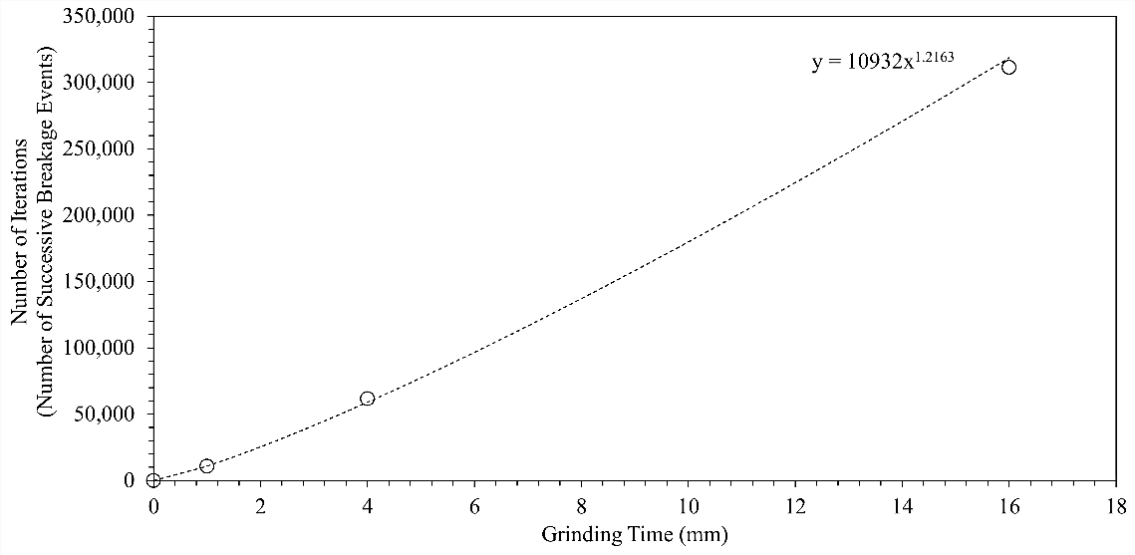
Grinding the mixture of coarse and fine particles: A narrow range of ‘n’ is sufficient
Planetary Ball Milling of Feldspar: Arbitrary n and Breakage Distribution Functions
A power function between the number of successive breakage events and grinding time
Time-explicit algorithm : >2 Experimental PSDs must be simulated, because 2 parameters in the function !!!

Slide 9
Conclusions
A computational algorithm coupled with a pseudo-matrix model to accurately simulate the PSDs of different grinding mills.
The evolution of PSDs at grinding may be due to the surface/gravitational attraction forces.
The algorithm work with few parameters which can be also irrelevant to the mill feed and mill environment.
A short-time grinding test will be sufficient to execute the time-implicit algorithm if abnormal breakage effects are reduced or eliminated.
Running the time-explicit algorithm requires the simulation and further evaluation of 2 or more experimental PSDs.

