Slide 1
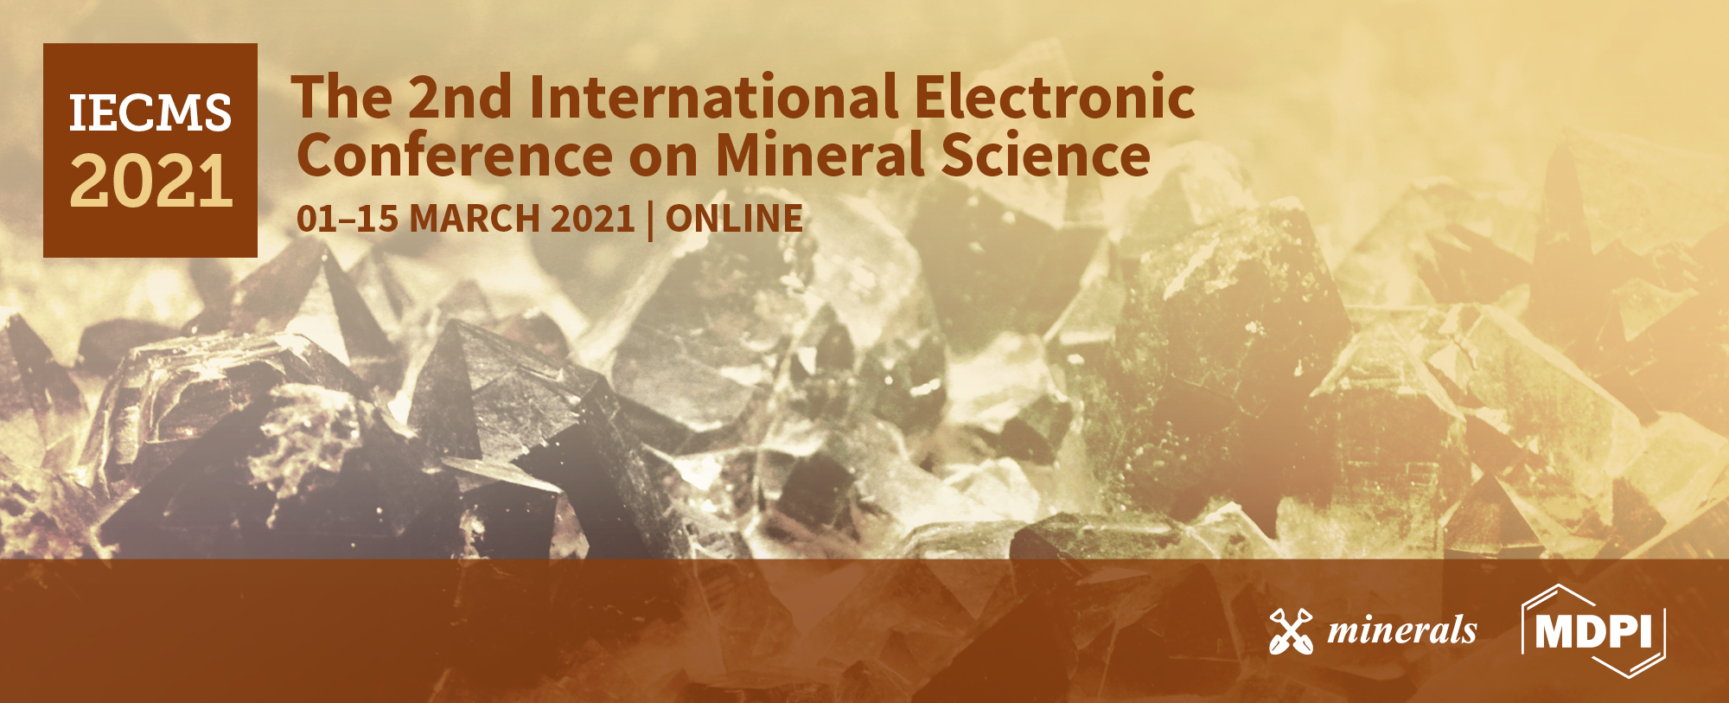
Fine, coarse and fine-coarse particle flotation in mineral processing with a particular focus on the technological assessments
Title of the Presentation
Ahmad Hassanzadeh^{1,}*, Mehdi Safari², and Duong Huu Hoang³
¹ Ahmad Hassanzadeh, Independent Scholar, Am Apostelhof 7A, 50226 Frechen, North Rhine-Westphalia, Germany;
² Mehdi Safari, Centre for Minerals Research, Department of Chemical Engineering, University of Cape Town, Private Bag Rondebosch, Cape Town 7700, South Africa.
³ Maelgwyn Mineral Services Ltd, Ty Maelgwyn, 1A Gower Road, Cathays, Cardiff, CF24 4PA, United Kingdom;
* Corresponding author: a.hassanzadeh@gmx.de

Slide 2
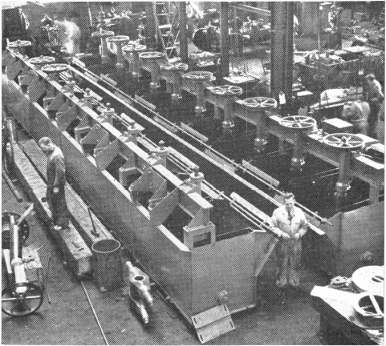
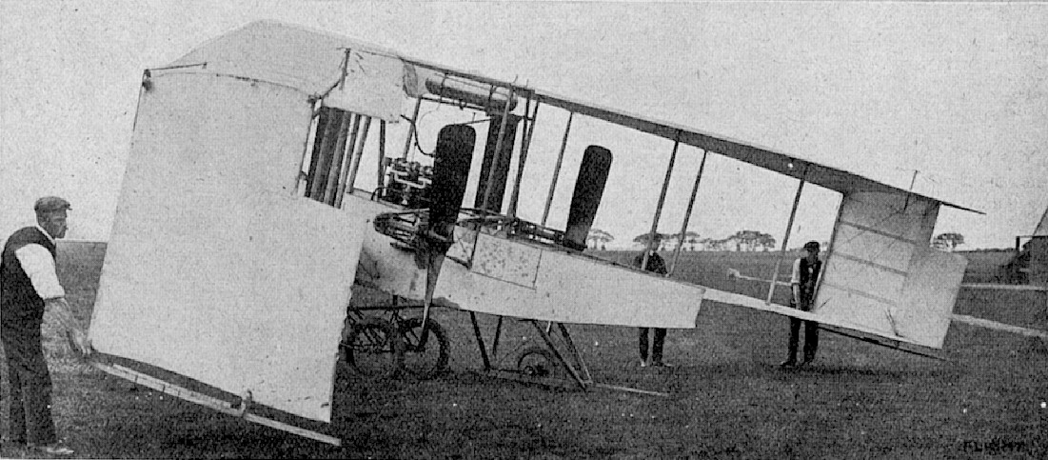
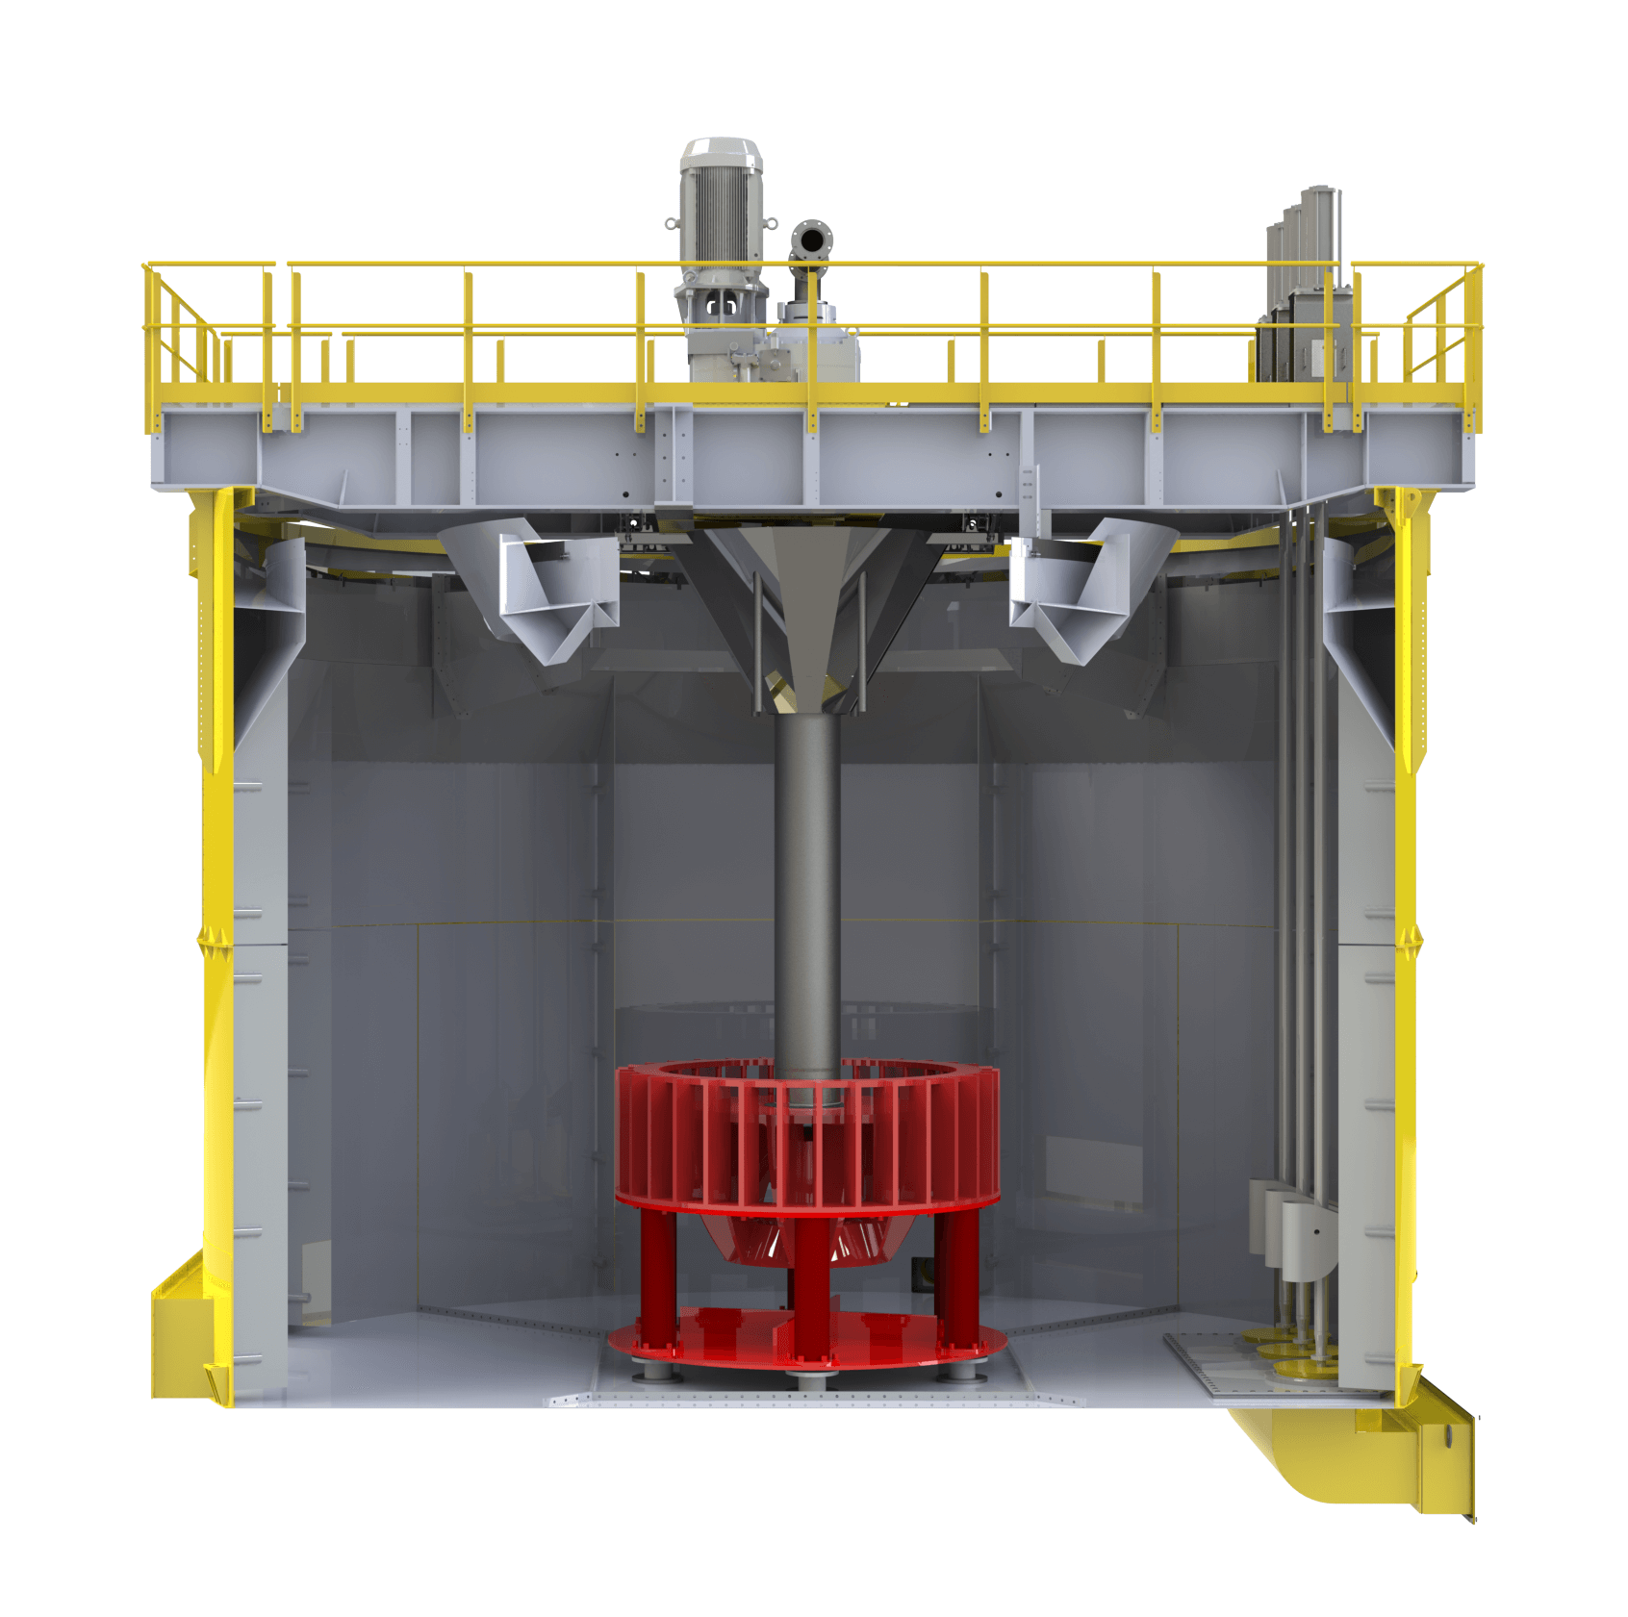


1903-Airplane
1905 or even 1885 Flotation machine
VS.

Slide 3
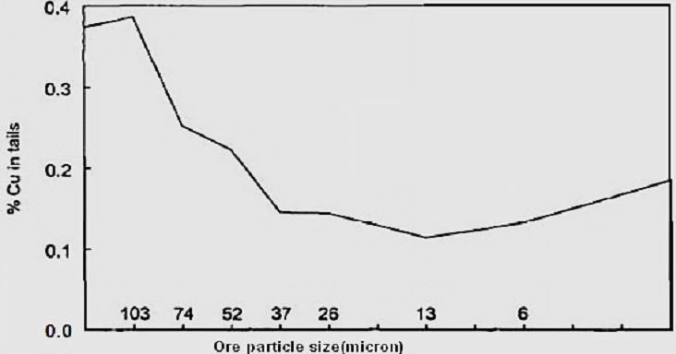
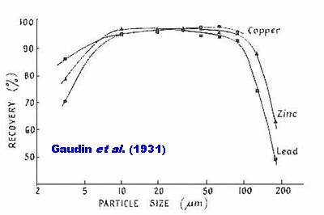
What is the problem?

Slide 4

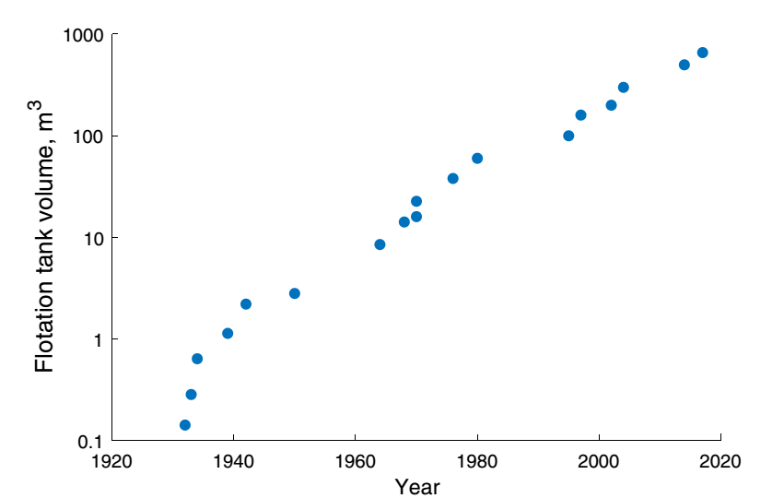
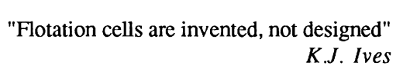
What was the solution so far?
Mesa, D., Brito-Parada, P.R., 2018

Slide 5
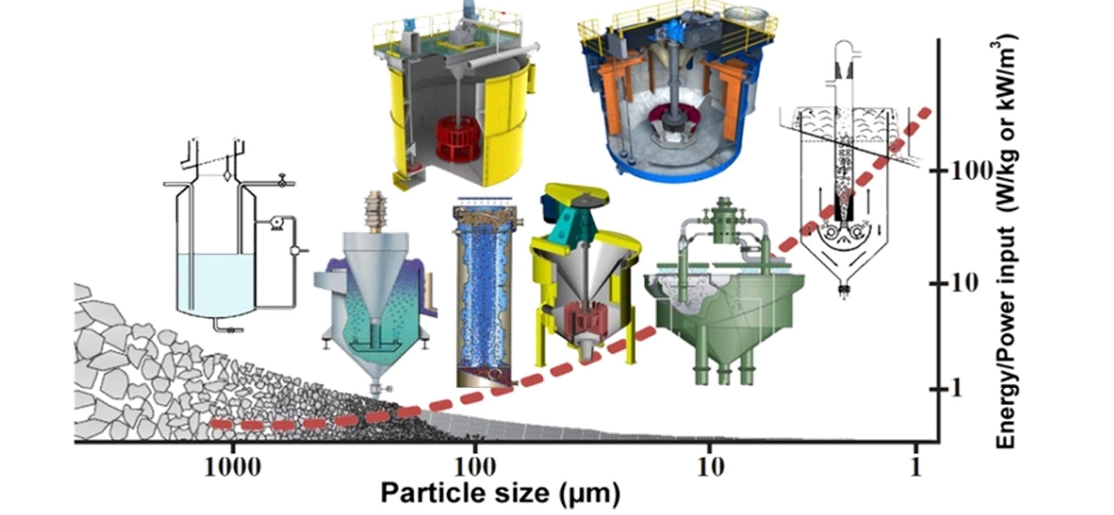
Fine or coarse flotation?
Conventional mechanically agitated flotation cell
Flash, ConcordTM and HydroFloatTM
Jameson, RFC and ImhoflotTM
Electro-flotation
Carrier flotation
Reactive oily bubble
Notes:
oscillating grid flotation (OGC) and Reflux flotation cells

Slide 6
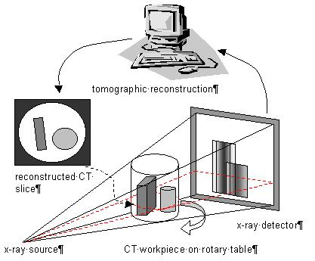
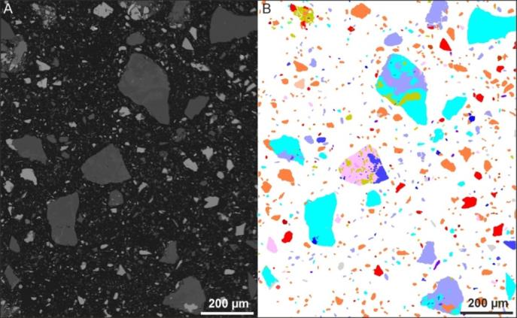
Characterization issues?(MLA vs. XCT)
Representitivity shortcoming and sample preparation
Stereological bias (2D) and number of analyzed particles
Not applicable for coarse particles
Agglomeration issue for fine particles
Rotating
stage
0-360°
Low resolution (tens of microns)
Lack of chemical information
Requirement for an electron density difference
Notes:
I’m pretty sure most of you are familari with mineralogcal tools such as MLA, TSCan, QEMSCAN….
Concept of MLA: EDS+SEM: Energy-dispersive X-ray spectroscopy
Sample preparation and how it must be representative …………………………Results in an overestimation of LD
Aggregation of fine particles

Slide 7
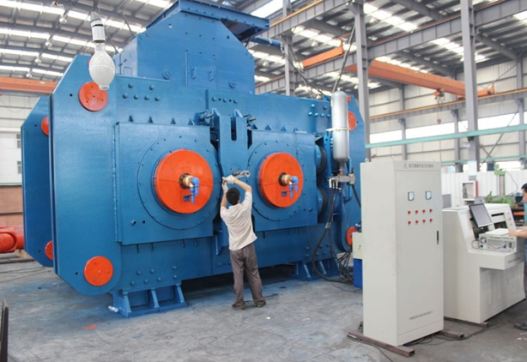
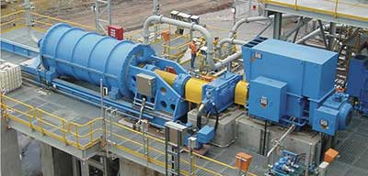
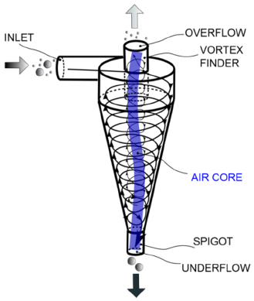
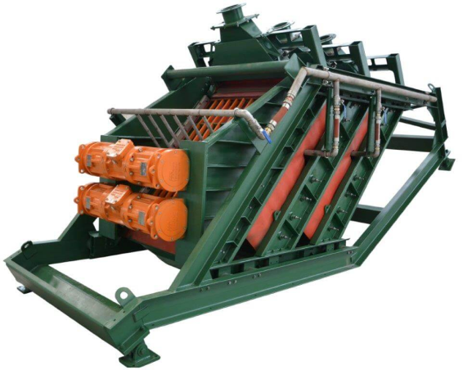
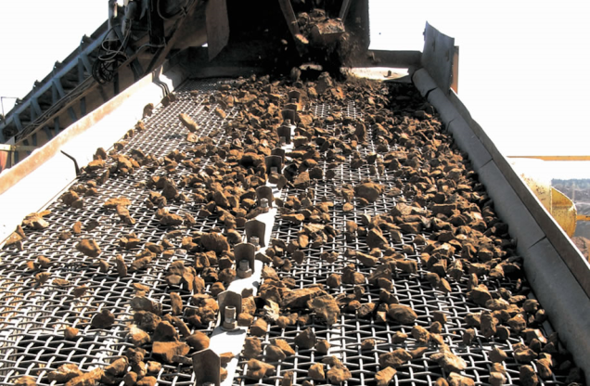
Grinding and classification issues?
Inefficiency of hydrocyclones and overgrinding in a closed circuit
Low performance efficiency of screening and clogging issues
Notes:
Replacing the ubiquitous cyclone cluster with Stack Sizer screens creates additional capacity, improved mineral recovery and a simultaneous reduction in power consumption. He said that payback ranges from two to seven months, based on sixteen case studies where before and after audits were performed, replacing cyclones with Stack Sizers.

Slide 8
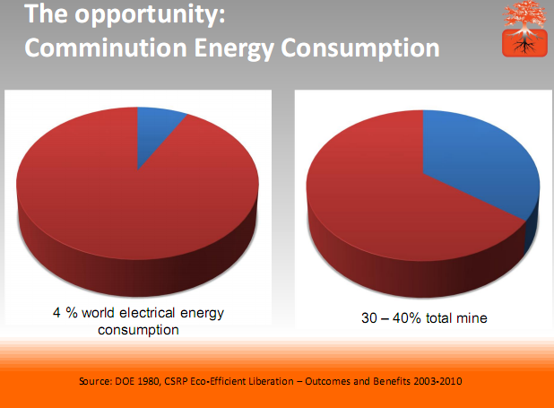
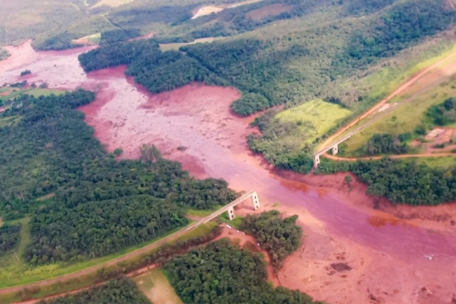
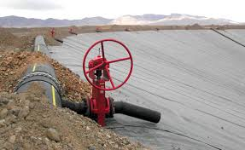

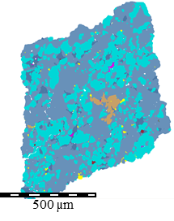
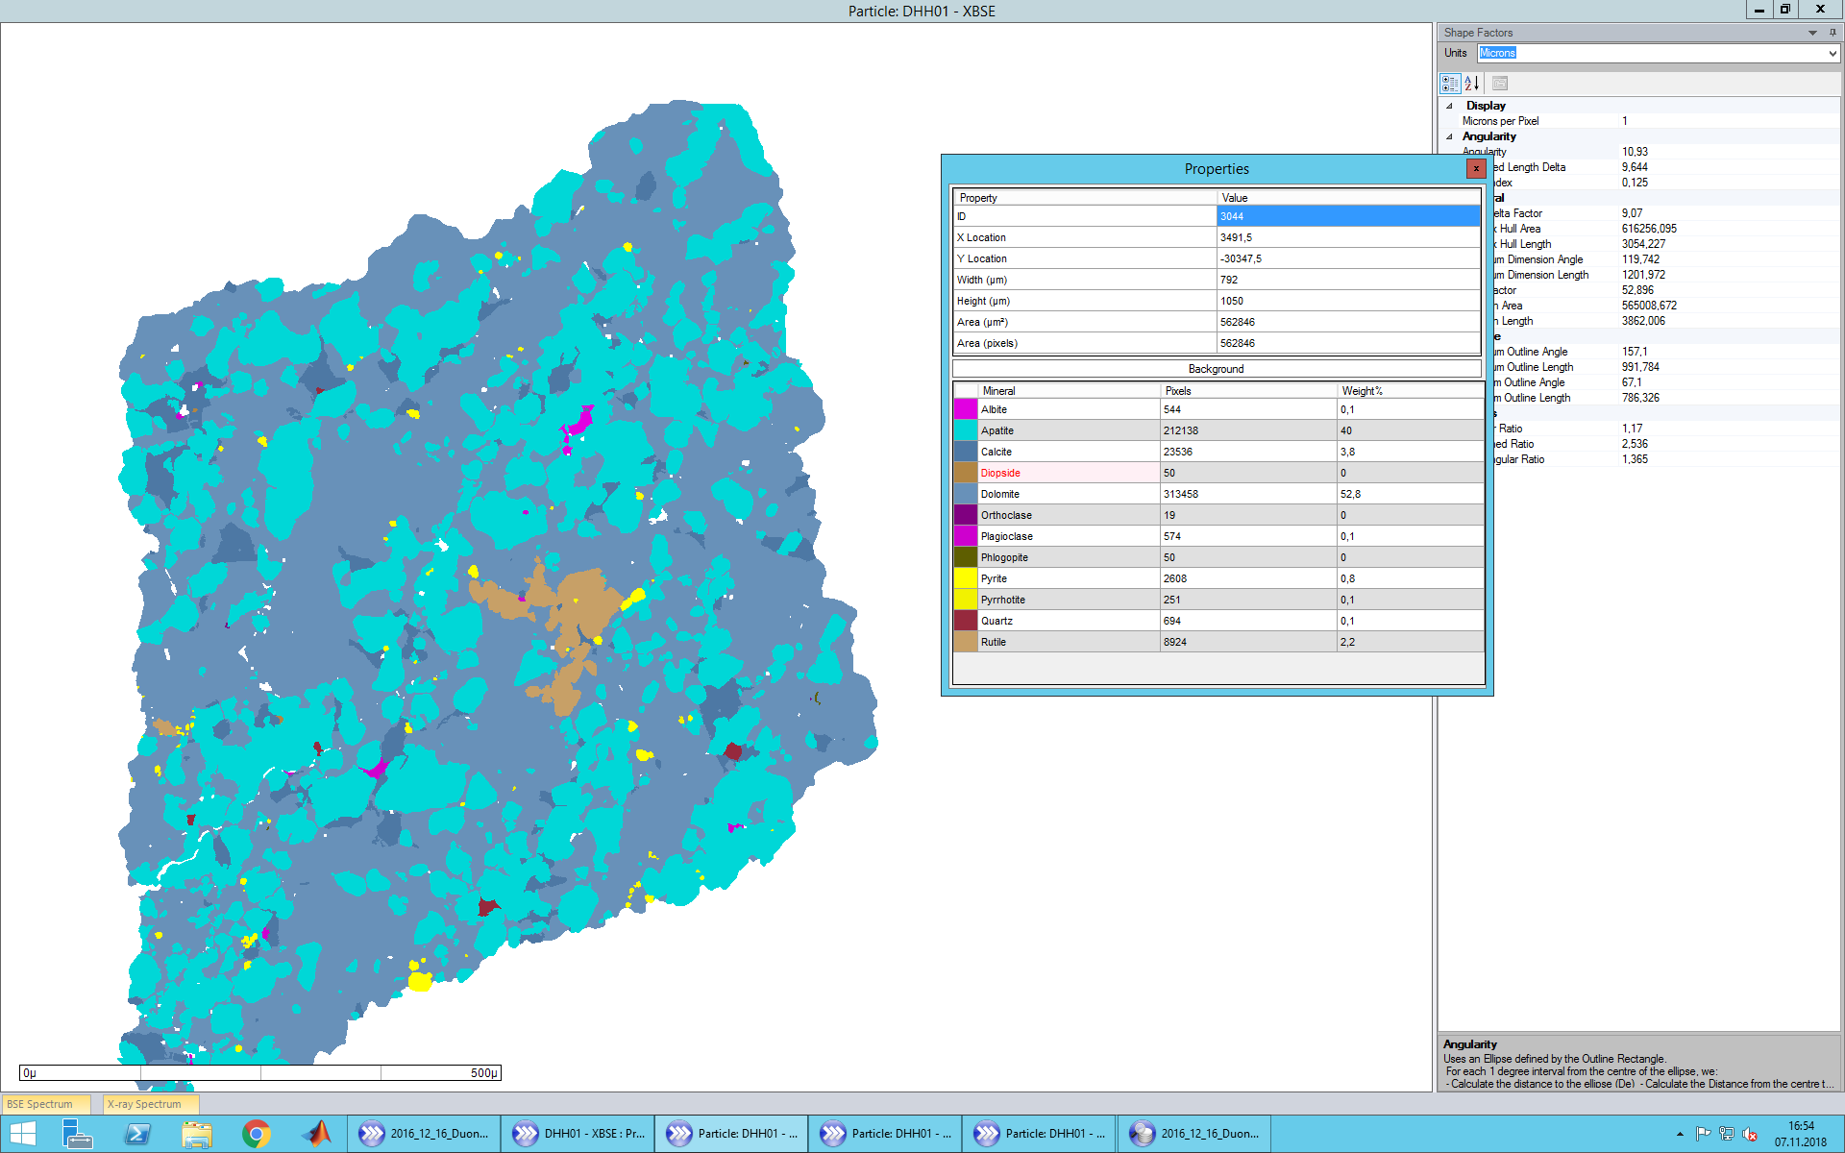
Fine flotation Coarse flotation
Notes:
First , positive sides of each process:
Water consumption, energy, technology availability, sustainability, environmental impacts,

Slide 9
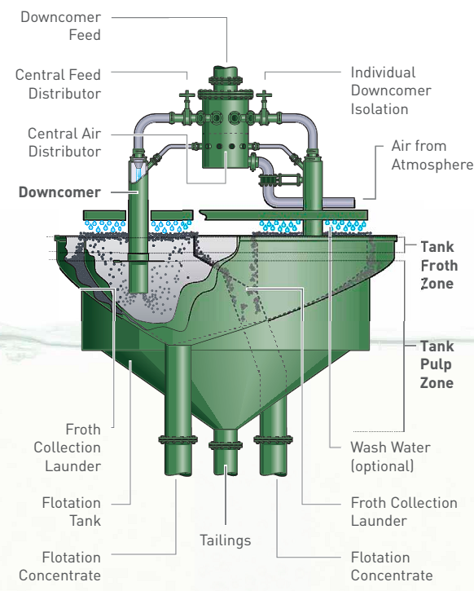
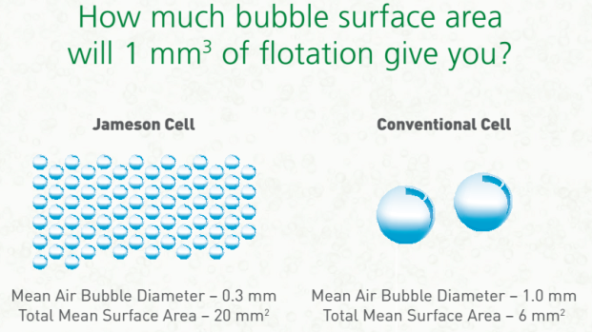
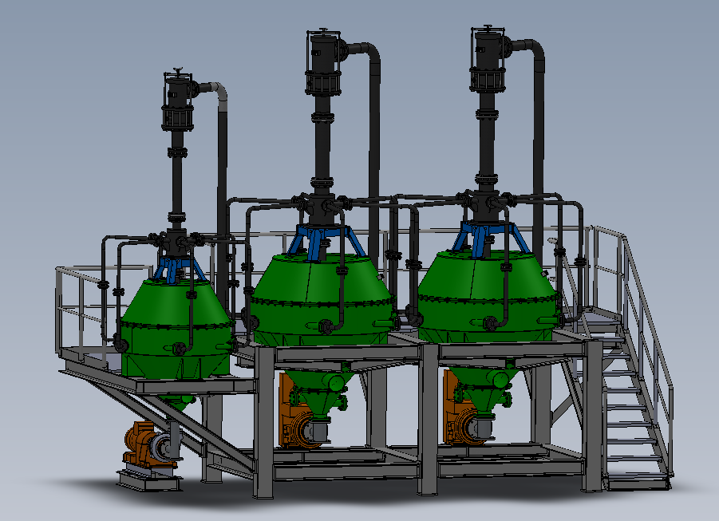
Fine flotation (Jameson and ImhoflotTM)

Slide 10
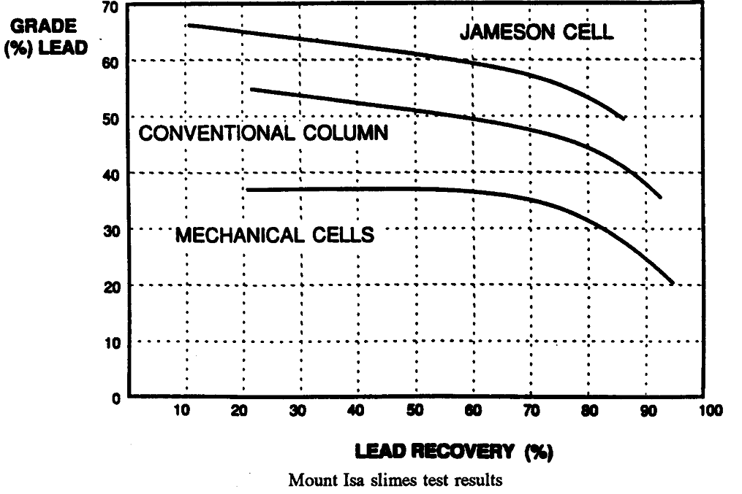
Advantages of pneumatic cells
Very short slurry residence time
Relatively small bubble sizes
Fast kinetic rate and froth washing ability (low entrainment)
No agitation part leading to reduction of energy consumption
Simple installation, coupled with high throughputs

Slide 11
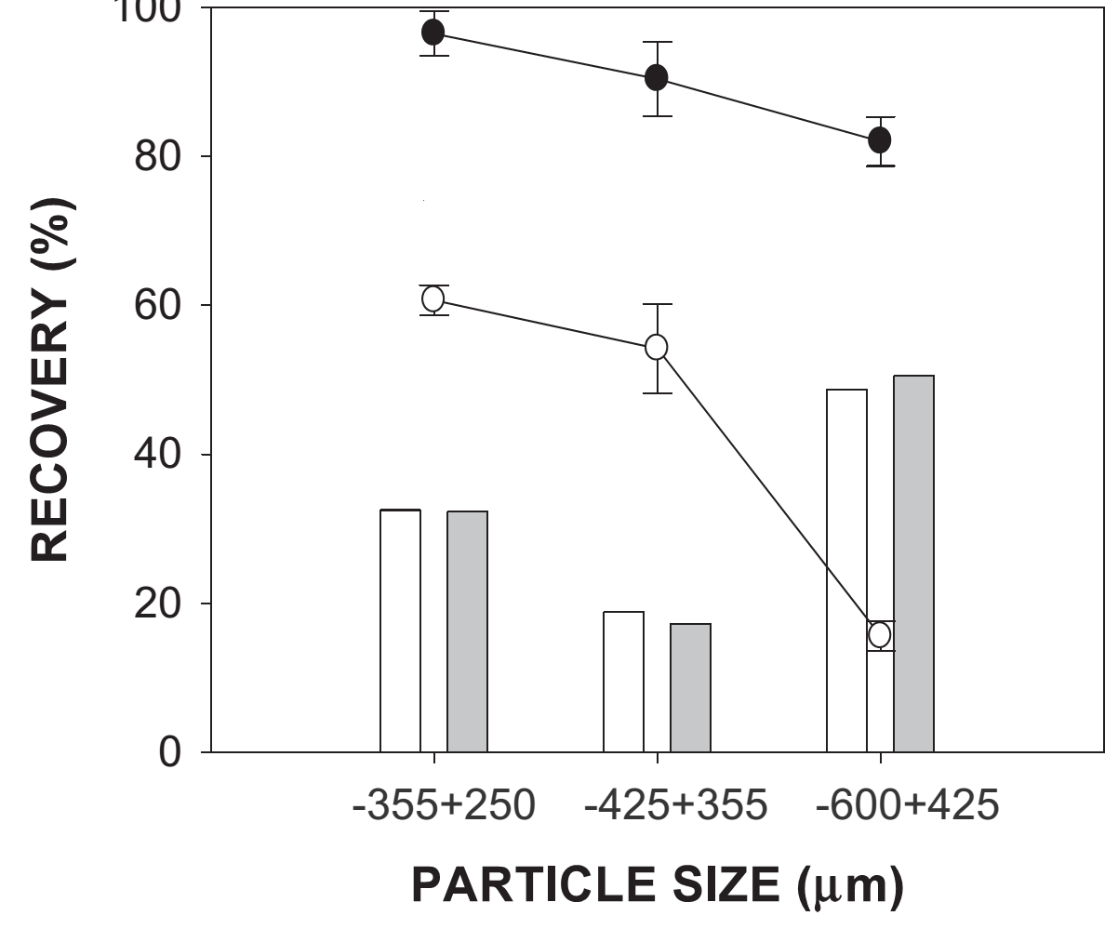
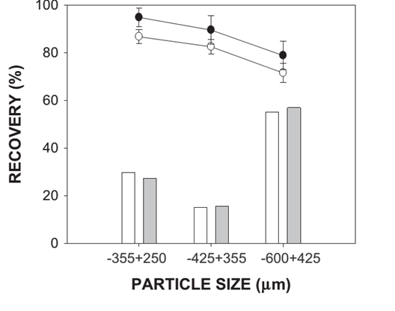
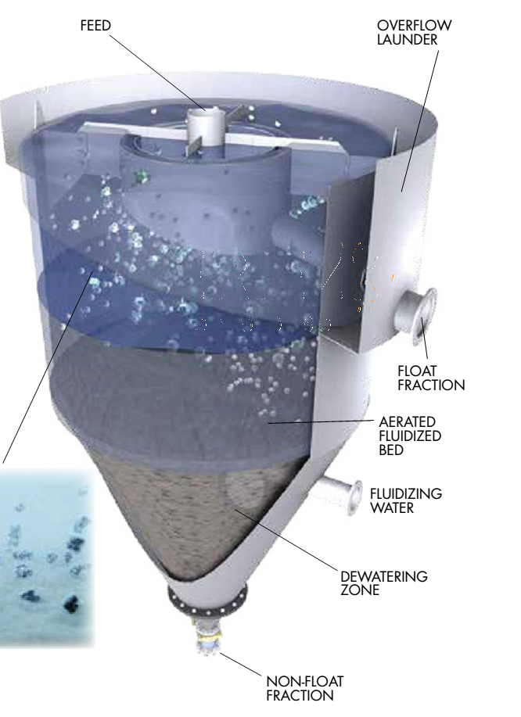
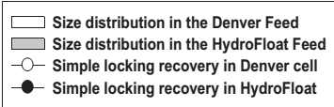
Coarse flotation (HydroFloatTM)
Fosu et al. 77(2015), Miner. Eng.
Potash (Canada),
Coal, vermiculite (U.S.A.)
Spodumene (Australia)
Diamonds (Canada)
Notes:
Sample of quartz (Geo Discoveries, Australia)
different locking textures (simple, A and complex B)

Slide 12
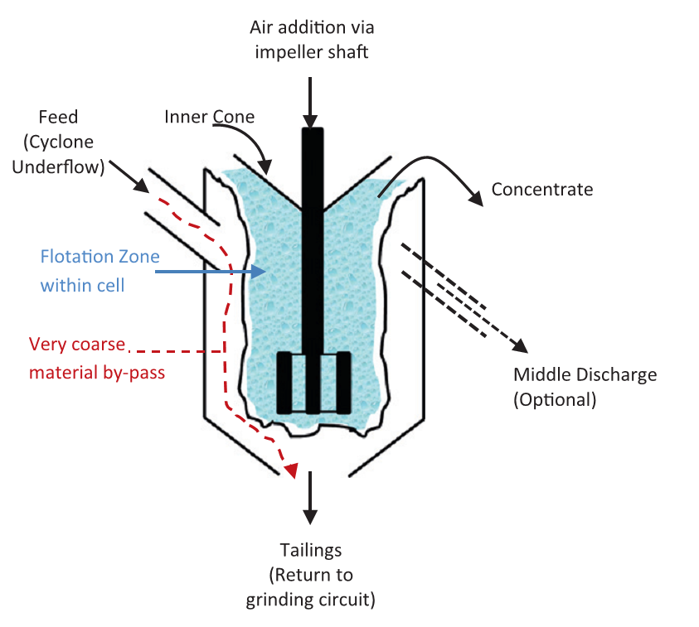
Coarse flotation (Flash: SkimAir®)
Designed to avoid over-grinding of the valuable dense sulfide minerals in circulating load
Minimizes over-grinding, enhances overall recovery, increases mill throughput and improves dewatering
Processing complex ores containing coarse (-212+38 μm) or free gold
Hydrocyclone underflow with high slurry % solids (up to 70%) is the flash flotation feed and its tailings recirculate into the grinding unit
Minimal contact time of particles with reagents and almost no conditioning stage prior to the flotation
Newcombe et al., 2012, Miner, Eng.

Slide 13
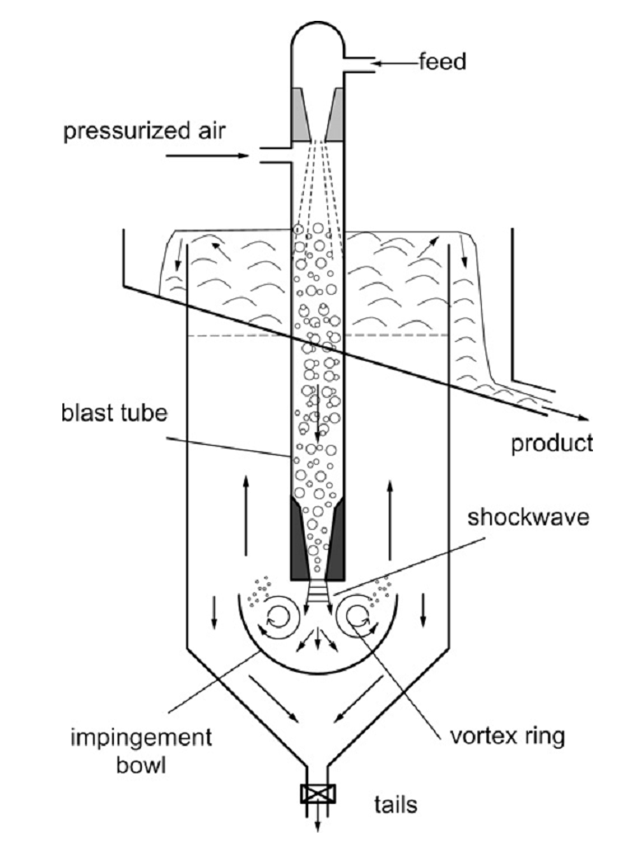
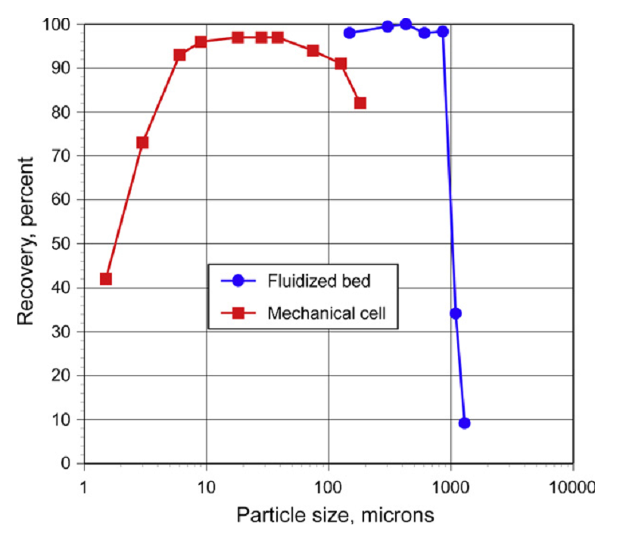
Coarse flotation (Concorde Cell)
Jameson, 23 (2010), Miner. Eng.

Slide 14
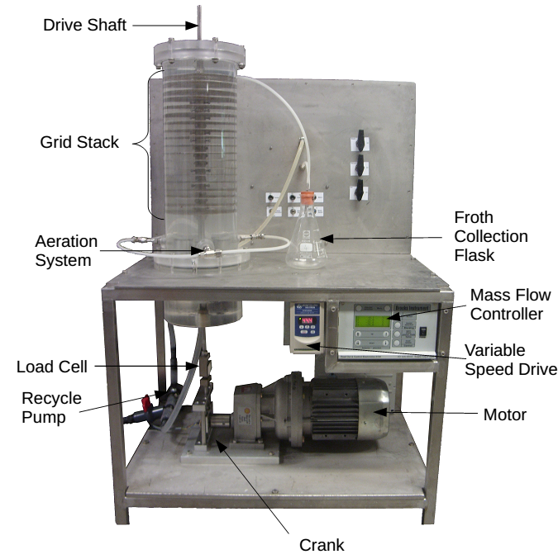
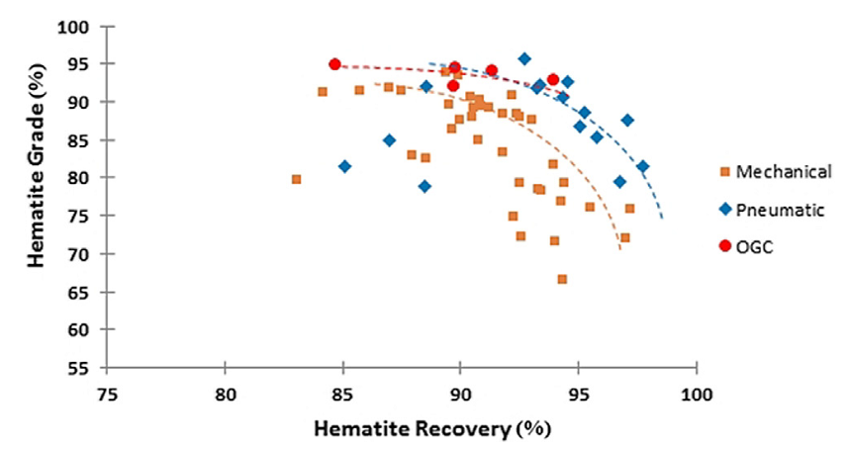
Fine and Coarse flotation (OGC)
Relatively isotropic and homogeneous turbulence
Variable energy dissipation rate (0.5– 5 kW/m3)
Generate small bubble sizes (0.13- 0.83 mm)
Safari et al., 150, 2020

Slide 15
Take away messages…
Finally deciding with fine, coarse and fine-coarse particle treatments
Development of appropriate particle characterization utilities
Elaboration of milling and classification machineries
Replace pneumatic cells for treating tailing repositories
Lowering the gap between research and industry

Slide 16




a.hassanzadeh@gmx.de
+4917620666711

