Slide 1
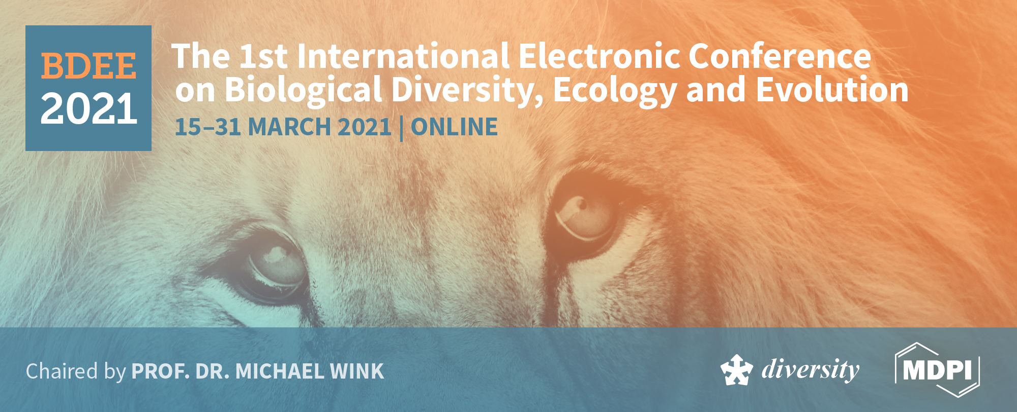
Title of the Presentation
Use of Dunaliella salina in environmental applications
Hakan Çelebi ^{1*}, Tolga Bahadır ², İsmail Şimşek ³ and Şevket Tulun ⁴
Aksaray University, Department of Environmental Engineering
¹Aksaray University, Department of Environmental Engineering
²Aksaray University, Department of Environmental Engineering
³Aksaray University, Department of Environmental Engineering
⁴Aksaray University, Department of Environmental Engineering
* Corresponding author: hakancelebi@aksaray.edu.tr

Slide 2

Abstract: A macro and microalgae are widely used in environmental and biotechnological applications due to their unique natural properties. Algae groups are aquatic organisms that can be found in many parts of the world and vary in size from 3-10 μ to 70 cm. Algae are divided into two as prokaryotic (microalgae) and eukaryotic (macroalgae) according to their biological formations. "Cyanophyta" as microalgae and "Phaeophyta, Rhodophyta, Chlorophyta, Flagelleta" as macro algae are known. Dunaliella salina is a living thing that can live in saltwater ecosystems and belong to the microgreen algae group. Since these algae are a natural source of beta-carotene, they are of particular importance in the cosmetics and food industries compared to other green microalgae species. Almost all algae groups are used for different purposes in a wide variety of sectors. Dunaliella spp. types are used extensively in areas such as the energy sector (bio fuel), cosmetics, medical applications, bioplastic production, wastewater treatment, food industry. In addition, the most basic effect parameter of pink color formation in lakes with salt content due to seasonal changes is D. salina, which is not an environmental problem. Increasing environmental pollution, unconscious energy consumption, and climate change have led countries to seek alternative solutions to environmental issues and to develop environmentally friendly-technological methods. For sustainable environmental management and minimization of pollution; The benefits of using algae species have been demonstrated by different applications. In the literature, D. salina has focused on algae production and the use of pigments in the cosmetics and food industry. The aim of this study is to investigate the recent researches on D. salina and reveal the importance of this algae, especially in terms of sustainable environment and energy.
Keywords: Dunaliella salina; Microalgae; Pink lake; Sustainable environment.

Slide 3
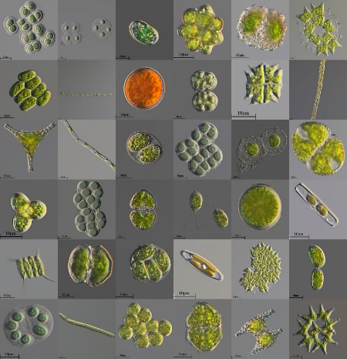
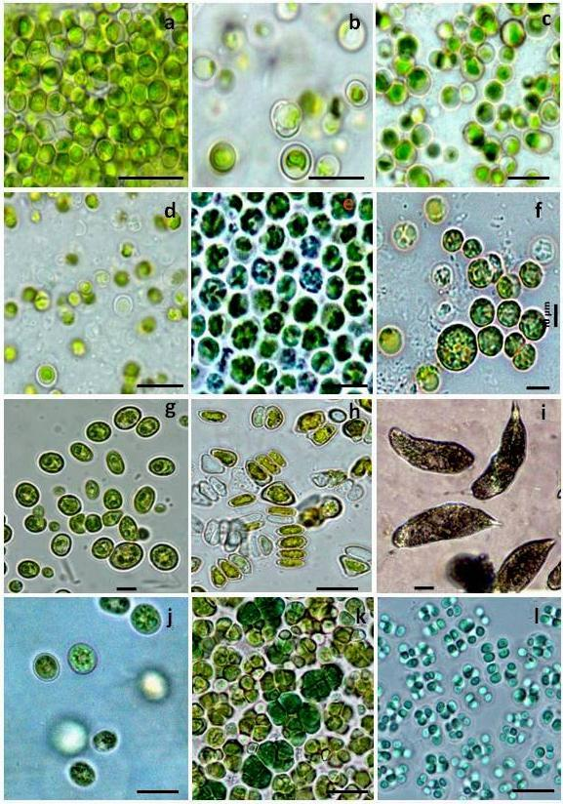
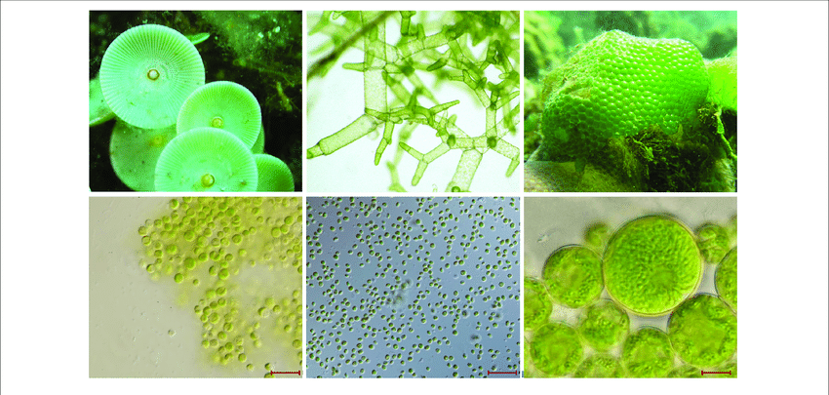
Introduction
Algae are the oldest microorganisms that have a simple photosynthetic cell structure and a high content of chlorophyll [1,2]. Macro-and micro-scale algae are quite widely used in environmental and biotechnological applications due to their unique natural properties [3,4]. Algal groups (Cholophyceae, Rhodophyceae, Cyanophyceae, and Pheophyceae) are aquatic creatures that can be found in many parts of the world and vary in size from 3-10 µ to 70 cm [5-7]. In terms of their biological formation, algae are divided into two as prokaryotic (microalgae) and eukaryotic (macroalgae). Microalgae are known as “Cyanophyta”, while macroalgae are known as “Phaeophyta, Rhodophyta, Chlorophyta, and Flagelleta”. The most common chemical formula of microalgae is C₁₀₆H₁₈₁O₄₅N₁₆P, and for their optimal growth, the basic nutrition elements must be present in certain proportions in the environment. In particular, the contents of these elements are of great importance in the production and use of microalgae. Pigments (chlorophyll-a, carotene, astaxanthin, phytocyanin, xanthophyll, phytoeritrosin, etc.) produced by algae are frequently used in the food, pharmaceutical, textile, and personal care sectors [8,9].

Slide 4
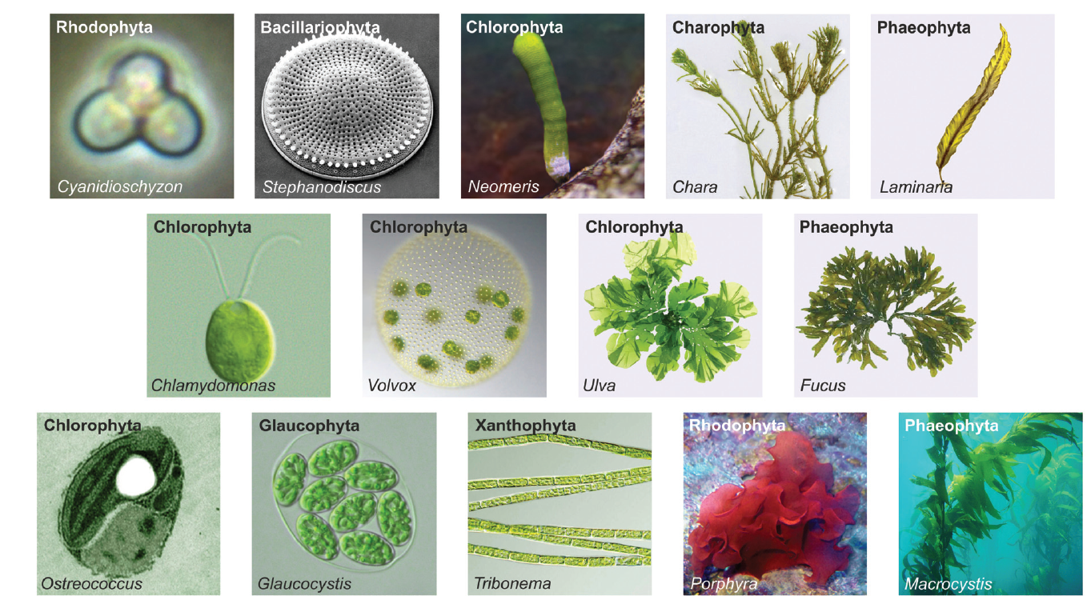
Introduction
Today, environmental pollution comes to the fore as a result of every product produced in the world, from food to clothing and from cars to technological equipment. Global warming and climate change emerging as a result of increasing environmental pollution all over the world have led countries to seek alternative solutions to environmental issues and to develop environmentally-friendly technological methods. For sustainable environmental management and minimizing pollution, the benefits of using algae species have been shown through many applications. In the literature, with regard to D. salina, it has been often focused on the production of algae and the use of pigments in the cosmetic and food sectors. In recent years, microalgae have been constantly being investigated for nutraceuticals, pharmaceuticals, and other bioactive substances which are industrially important due to their complex metabolic capacity. The purpose of this study is to demonstrate the importance of these creatures in terms of sustainable environment and energy by examining the recent research on D. salina.

Slide 5
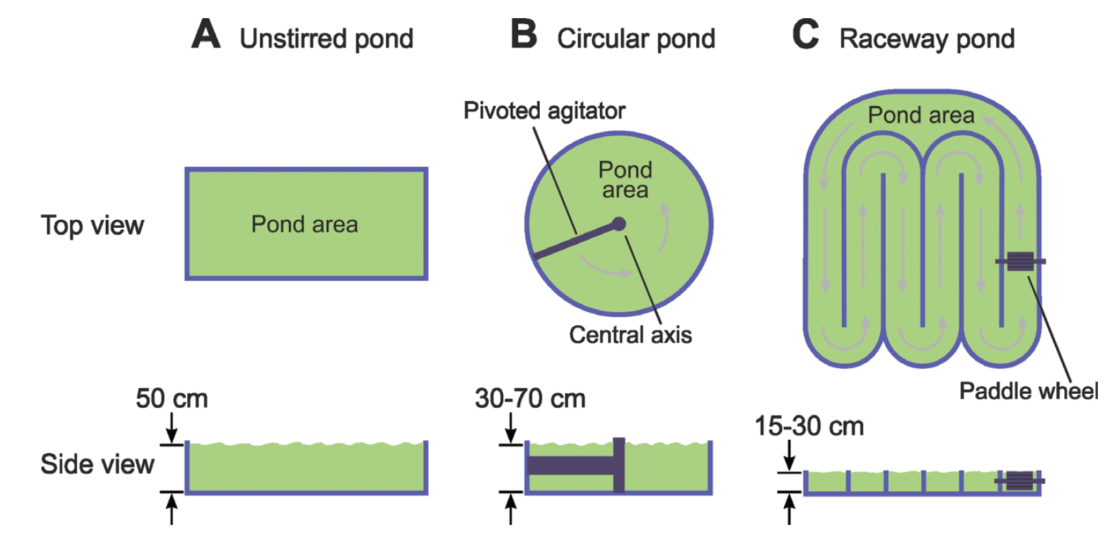
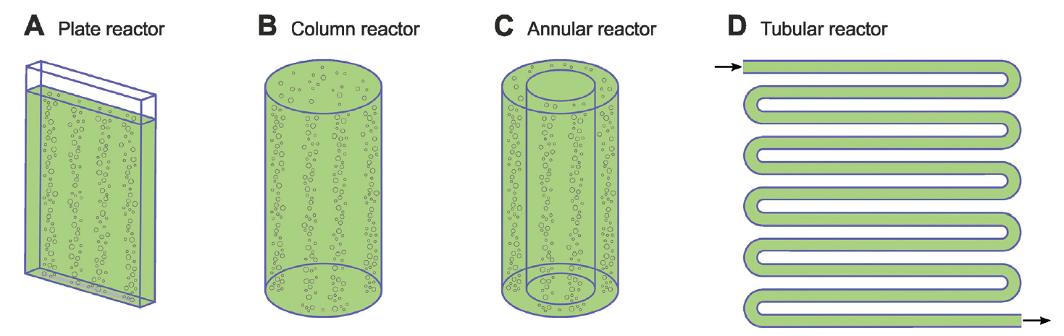
Usage areas
Microalgae Production Systems
If it is to be produced as a food source, the protein, carbohydrate, fatty acids, vitamin and mineral contents of the microalgae species should be considered. If used in treatment to prevent environmental pollution, species isolated from the contaminated receiving environment should be preferred.
Microalgae selection
Purposeful selection is important in the production of microalgae species.
Abiotic Factors
Factors such as light (400-700 nm), temperature (20-30 ⁰C), nutrient (carbon, nitrogen, phosphorus), oxygen, carbon dioxide, pH (7-9), salinity and toxic chemicals.
Biotic Factors
The competition environment caused by pathogens such as bacteria, fungi, viruses and other algae species are biotic factors that affect production.

Slide 6
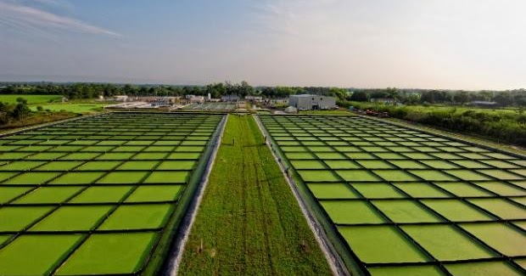
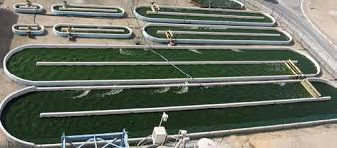
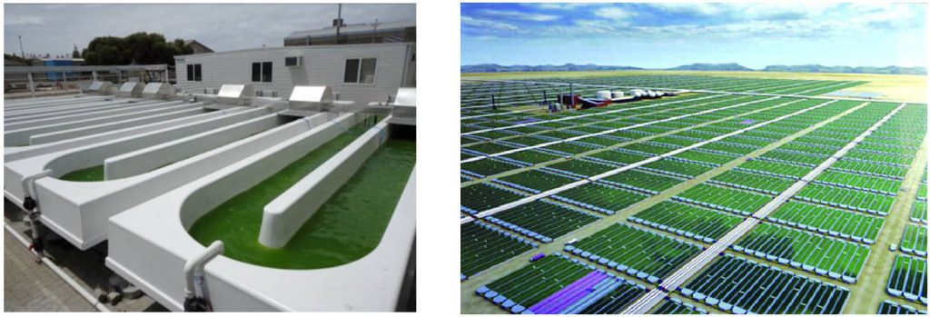
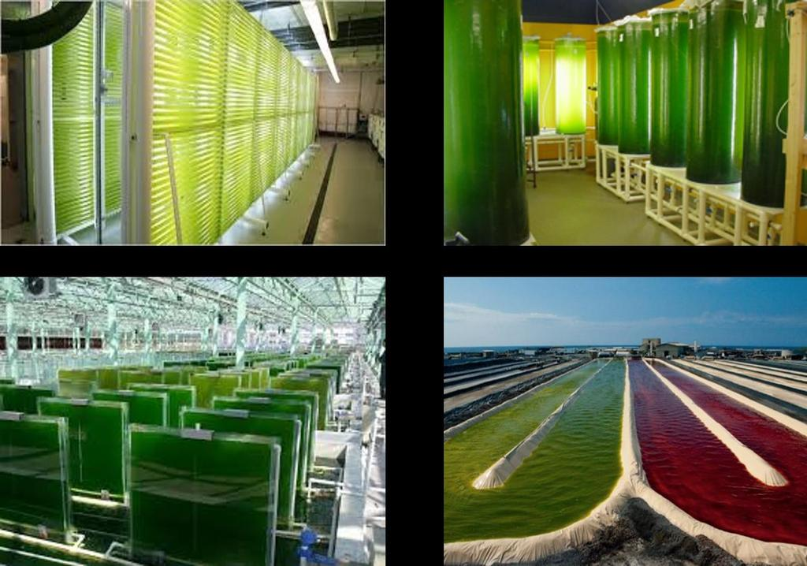
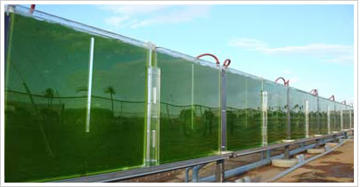
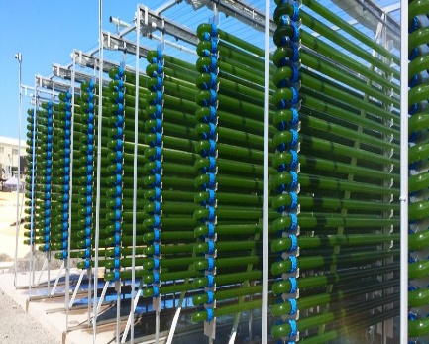
Two types of systems are used in microalgae production: outdoor pools and indoor photo bioreactors (Figure 1). The method of outdoor pools is the simplest and cheapest system used most widely in microalgae production. However, due to the poor system control, problems are experienced frequently in production. It has circular and racetrack-type designs, and Chlorella sp., Spiriluna platensis, Haematococcus sp., and D. salina are the most common species commercially produced in racetrack-type pools. Compared to outdoor pools, indoor photo bioreactors have higher performance in terms of light utilization, high biomass yield, low risk of contamination and water loss (evaporation), and ease of mixing and gas transfer. But the investment cost is higher [7,15,16].

Slide 7
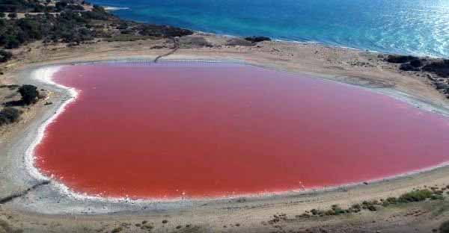
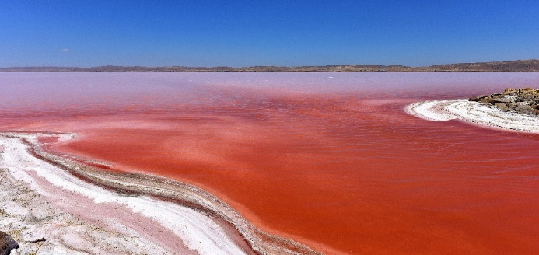
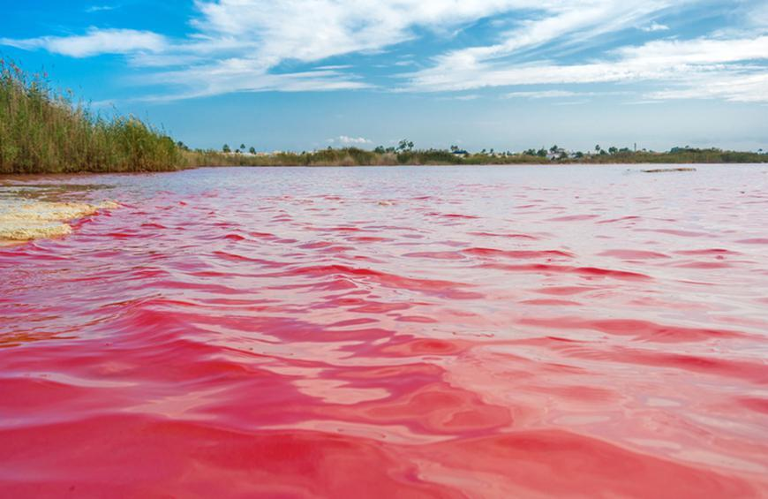
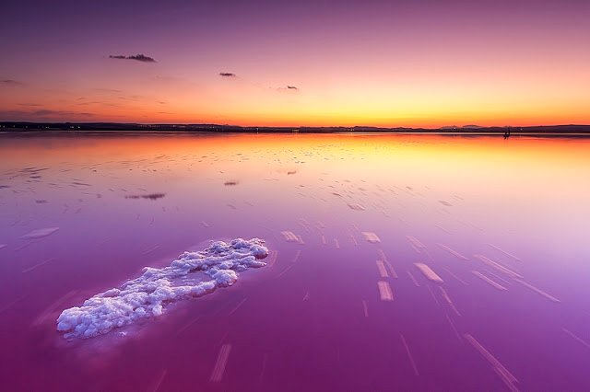
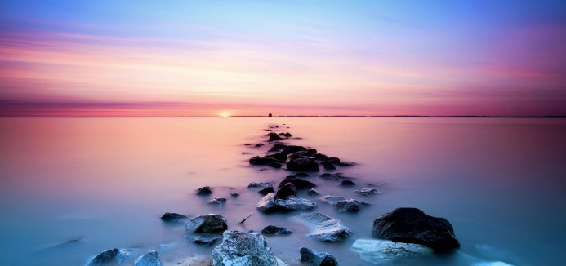
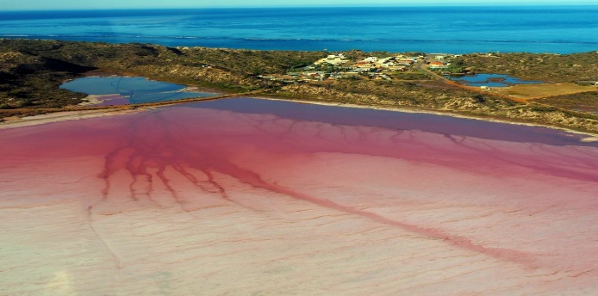
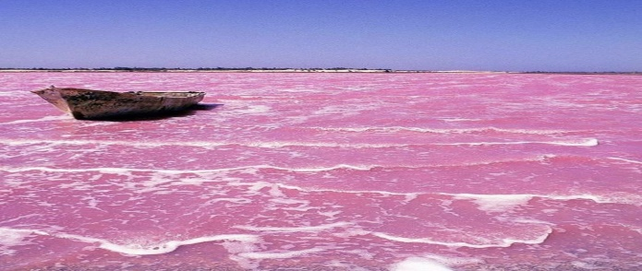
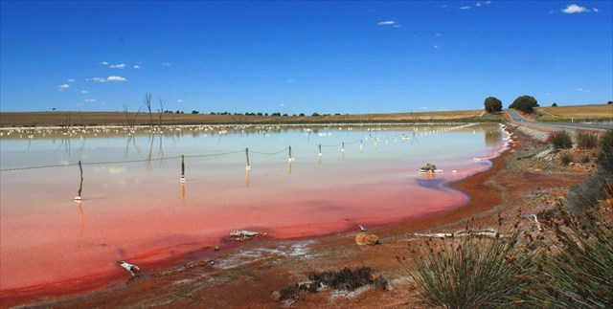
Dunaliella Salina
D.salina is a halophilic, green pigmented, and unicellular microalgae species, which usually feeds in saline environments and have different uses in the health, food, and energy sectors [17-19]. The Dunaliella group microalgae consist of the family Polyblepharidaceae ( Volvo Ales-type), and 28 species of Dunaliella have been identified so far. 5 of them continue their vital activities in freshwater and 23 of them in marine and salty water environments [20]. The best-known Dunaliella species are D. tertiolecta, D. salina, D. primolecta, D. bioculata, D. viridis, and D. bandawil [19]. Among the Dunaliella species, D. salina is the most famous and widely used species. D. salina was first identified by Teodoresco in 1960. These algae are usually found in natural marine habitats and are generally responsible for turning the color of the water to red [21,22]
Dalyan Lake, Turkey
Tuz Lake, Turkey
Dusty Rose Lake (Canada)
Torrevieja Lake (Spain)
Hillier Lake (Australia)
Hutt Lake (Australia)
Retba Lake (Senegal)
Quairading Lake (Australia)

Slide 8
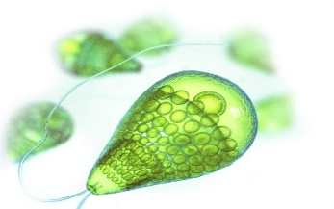
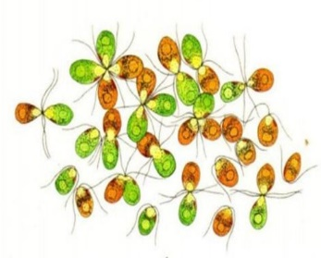
They are egg-shaped in terms of cell formation, and depending on growth conditions and light intensity, they vary in length from 5 µm to 25 µm and in width from 3 µm to 13 µm. D. salina cells have organelles such as nucleus, membrane, mitochondria, vacuoles, and golgi. In addition to chlorophyll A and B, carotene A and B, neoxanthin, kemanantin, lutein, and useful carotenoid pigments similar to zeaxanthin are involved among the intracellular compounds of D. salina species [23,24]. D. salina microalgae species are essential as phytoplankton, especially in saltwater, marshes and wetlands. These species can live at a salt concentration of about 35% and are known as salt-tolerant green algae. In addition to the exceptional adaptation of most D. salina species to saline environments, D. acidophila species can grow in a highly acidic environment (pH=0-1) [25,26]. D. salina antarctica species can grow at temperatures below 0°C, and D. salina species can tolerate the exposure to high-intensity light [19]. These species have a higher tolerance to oil-fuel contamination compared to other planktonic algae [27]. Chemical compositions of the D. salina microalgae species in terms of natural and commercial are given in Table 1. As indicated in Table 1, natural D. salina contains 6.63% moisture and 48.74% ash. Carbohydrates are the main component with a ratio of 25.31%, and this is followed by proteins with 10.03%, carotenoids with 3.46%, and lipids with 3.49% [28-30].
Table 1. Natural and commercial chemical properties of Dunaliella salina
Dunaliella salina natural composition (%) |  | Dunaliella salina commercial composition (powder form) (%)
Humidity | 6.63 | Proteins | 36.4
Ash | 48.74 | Carbohdyrates | 33.0
Proteins | 10.03 | Lipids | 7.8
Carbohdyrates | 25.31 | Caroteonids | 4.5
Lipids | 3.49 | Nucleic acid | 7.7
Caroteonids | 3.46 | Chlophyll | 5.0
ΣSFAs (mg/100 g dry) | 1532.68 | Ascorbic acid (mg/100 g) | 102
ΣMUFAs (mg/100 g dry) | 567.56 | Potasium (mg/100 g) | 432
ΣPUFAs (mg/100 g dry) | 1055.97 | Sodium (mg/100 g) | 35.4
Histidine | 2.6 | Calcium (mg/100 g) | 210
Phenylalanine | 11.5 | Magnesium (mg/100 g) | 137
Trytophan | 2.6 | Phosphorus (mg/100 g) | 158
Leucine | 7.3 | Iron (mg/100 g) | 4.5
SFAs: saturated fatty acids; MUFAs: monosaturated fatty acids; PUFAs: polyunsaturated fatty acids

Slide 9
Environmental applications: Use in Wastewater Treatment
Physical, chemical, and biological processes applied in water and wastewater treatment cover separation of the specific groups of pollutants (heavy metals, dyes, etc.) from wastewater and discharging of them in forms that will cause less damage to the environment [31,32]. There are two important reasons for use of microalgae in wastewater treatment. The first is the oxygenation of the dissolved oxygen-poor wastewater pools thanks to the ability of microalgae to produce oxygen by photosynthesis. The second reason, on the other hand, is that microalgae can be used in the treatment of nitrogen and phosphate contaminated water due to the fact that they can multiply rapidly in waters with high organic content. In particular, they are very successful in biological wastewater treatment and removal of toxic pollutant groups [33,34]. The treatment of wastewater by using microalgae has been practiced for many years, and today bioremediation and phytoremediation studies have gathered speed [35,36]. The low cost of these systems and the inhibition of pathogenic organisms due to the antibacterial properties of some microalgae species provide a great advantage. In addition, they can act as disinfectants at high pH levels in wastewater treatment systems. Compared to other biological processes in wastewater treatment, the use of microalgae stands out with its advantages such as cost, low energy requirement, useful biomass production, low sludge formation, success in removing heavy metals, the ability to re-evaluate the resulting biomass and use it in biodiesel production, and the high purification efficiency. In recent years, microalgae are considered an attractive and innovative biosorbents for the biosorption process too. In particular, in the removal of heavy metals by biosorption, different types of microalgae, which are economical and environmentally friendly, are used instead of expensive biosorbents [37,38]. In addition, laboratory-scale studies are also carried out in membrane filtration and advanced oxidation systems [21]. Especially in areas where water is limited and in salty water environments, D. salina is also used in the desalination process [39].

Slide 10
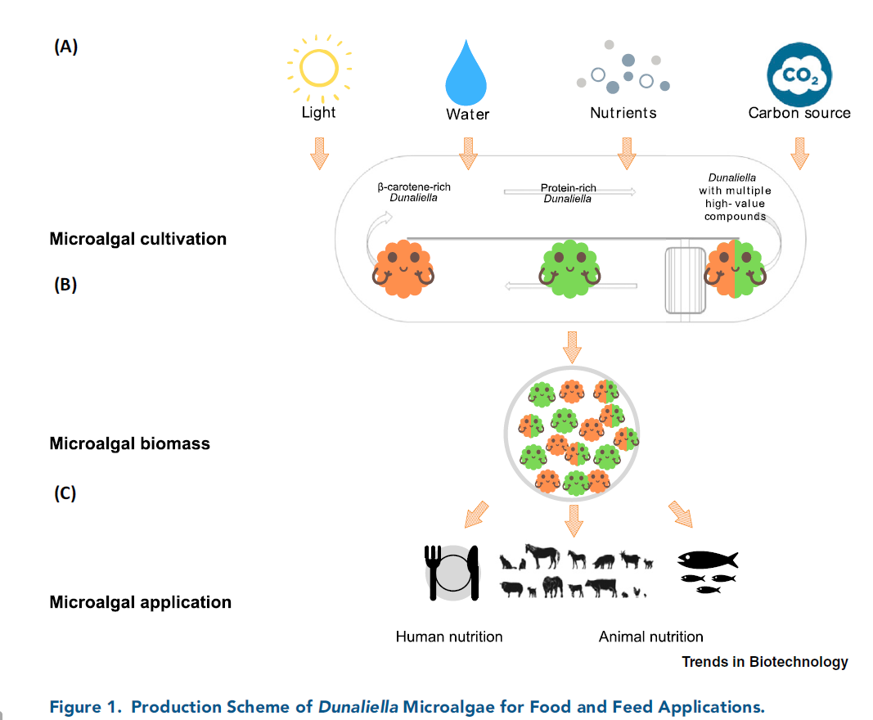
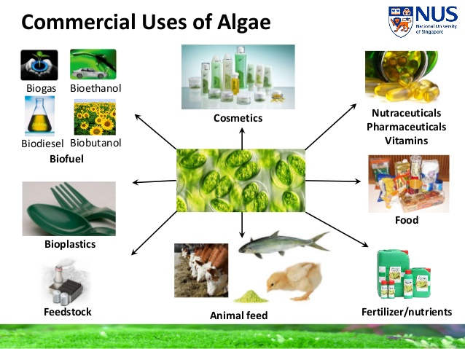
Environmental applications: Food and Food Supplement
Microalgae are used as a nutritional source for both humans and other living groups thanks to carbohydrates, proteins, enzymes, and fibers contained in their chemical structure. In addition to basic nutrients, they also contain vitamins A, C, B1, B2, B6, many vitamins such as niacin, and basic elements such as iron, potassium, calcium, and magnesium [10,40]. D. salina and other species are used as nutritional supplements, especially in athletes' diets. They are also used as feed for aquatic (shrimp, trout, aquarium fishing, etc.) and terrestrial animals (cattle, goats, sheep, etc.). In capsule forms and in the form of solid (food bars, cookies, etc.) and liquid (antioxidant drinks, juices, etc.) nutrients, D. salina tablets are applied as dietary supplements for human health [1,41].

Slide 11
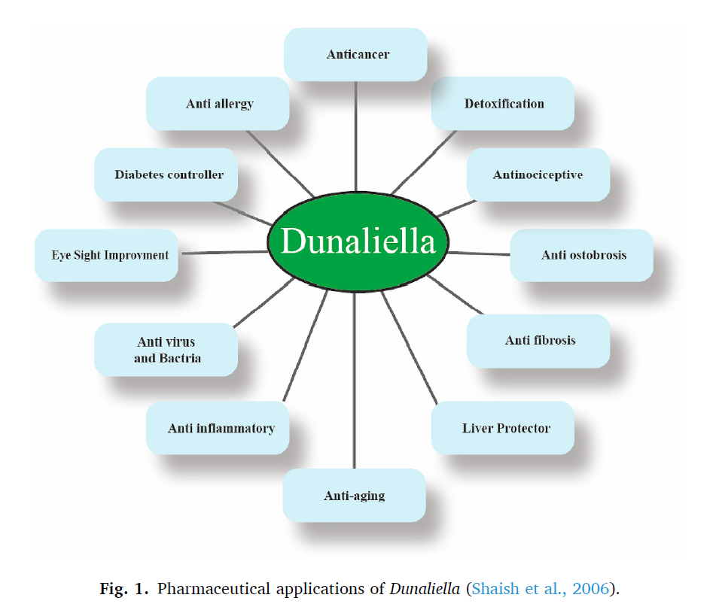
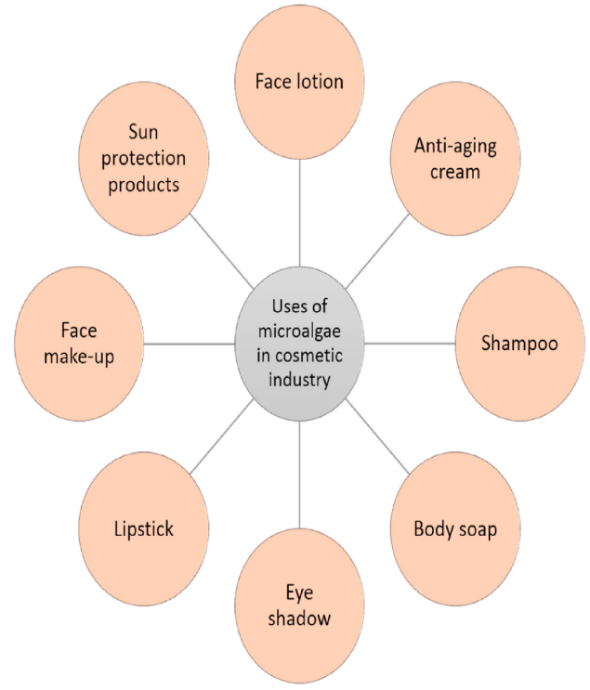
Environmental applications: Medical and Cosmetic Industry
Microalgae are constantly exposed to stress conditions due to their cellular structure, and in order to adapt to these conditions, they produce some valuable products (cosmeceuticals) that are important in the cosmetic industry [42,43]. Pigments and other compounds in microalgae are widely used as hydration component and antioxidant in anti-aging and moisturizing skin creams in the cosmetic industry[19]. D. salina is widely used in skin-hair care and sun protection products thanks to the substance of sporopollenin found in its structure. According to the World Health Organization, microalgae are promising sources of bioactive compounds in terms of their anti-cancer properties [41,44]. D. salina is one of the marine microalgae containing significant amounts of essential carotenoids such as α and β-carotene, cryptoxanthin, zeaxanthin and lutein, and it is a source of antioxidants [1,45,46]. Figure 1 briefly summarizes the use of D. salina in terms of both medicine (anti-cancer, anti-allergy, diabetes, anti-inflammatory, anti-virus, anti-bacteria and anti-arteriosclerosis, etc.) and treatment (Parkinson's disease).
Table 1. Potential cosmetics and medical applications of Dunaiella Salina
Cosmetic | Compound | Application
 | Glycerol, Phenols (e.g., gallic, caffeic, salycilic, p-coumaric, and ferulic acid) | Moisturize and Smoothen skin
Medicine | Compound | Application
 | β-carotene, α-carotene, Cryptoxanthin, Zeaxanthin, Lutein, Glutathione | Anticancer activity, AntiParkinson's disease, Antioxidant activity, Antihypertensive, Analgesic drugs

Slide 12
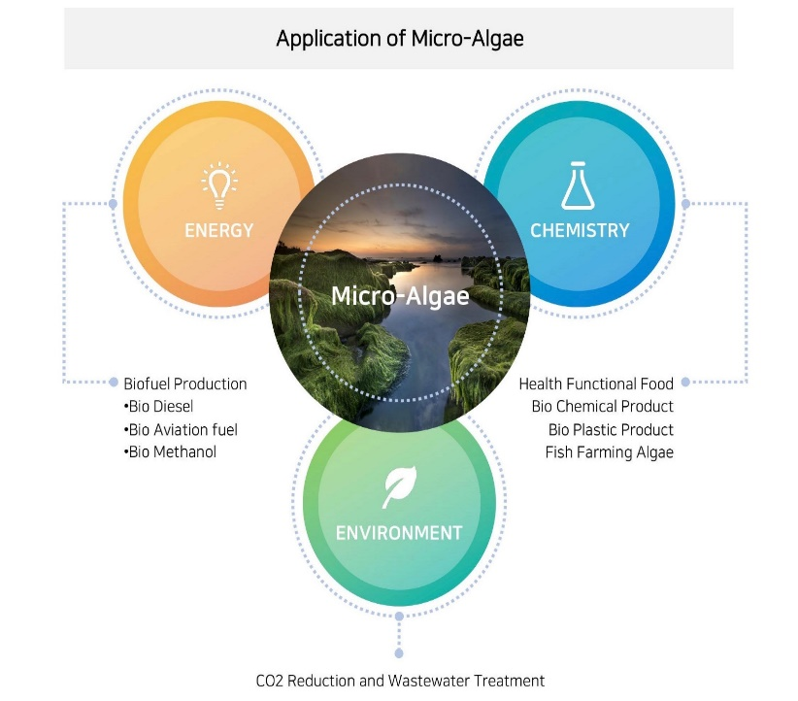
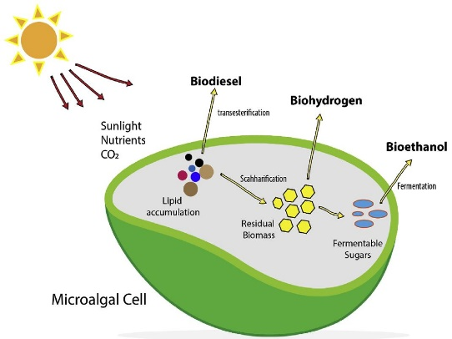
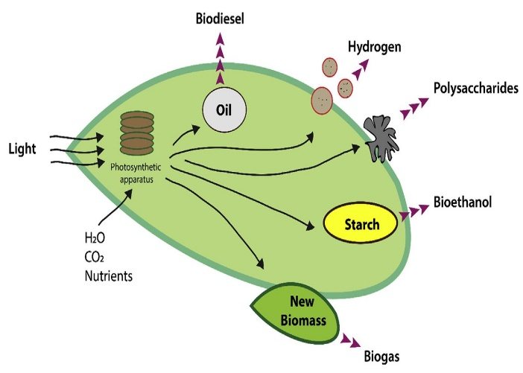
Environmental applications: Applications in the energy sector
In recent years, as a result of the use of fossil fuels and thereby the negative effects of CO2 and greenhouse gases on the environment, sustainable and environmentally friendly alternative energy sources have been being explored. In this context, microalgae come to the fore. Nowadays, many energy sources such as solar, wind, geothermal, ocean energy, and biofuels have begun to replace fossil fuels [47.48]. Since energy is an important need for people after water, environmentally friendly and sustainable energy resources are constantly being explored. Microalgae, which have largely carbohydrate, fat and protein in their structure and can live in both aquatic and terrestrial ecosystems, have some advantages (capacity to hold solar energy, specific compounds, adaptation to stressful conditions, high growth rate, etc.) as a source of biofuel. Because of these advantages, they are also used as raw material in the energy sector [49,50]. Biofuel production from microalgae consists of four steps: isolation, characterization, biomass production, and harvesting. Today, Dunaliella salina and other microalgae are used as a raw material source for many types of biofuels, such as the production of biogas by anaerobic degradation of biomass, biodiesel production from oil content (D. salina: 116 mg/L oil productivity), and biohydrogen production by photo-biological reactions [51,52].

Slide 13

CONCLUSIONS
CONCLUSION-1
CONCLUSION-2
Microalgae are photosynthetic organisms that are mostly single-celled and generally survive in aquatic environments. Due to the natural compounds they contain, their use in environmental applications and other areas is increasing day by day.
Microalgae, which are used in many areas from the production of biomass for food source (food and animal feed) to ecological applications such as the production of biofuels and bioremediation (wastewater treatment), are seen as a promising natural resource for the production of a wide variety of valuable compounds due to their rich biodiversity.
Infographics
Infographics
CONCLUSION-4
CONCLUSION-3
Infographics
Beta-carotene is a valuable product that is used in different fields such as medicine, paint and feed industry due to its orange pigment and high antioxidant properties. In this regard, D. salina constitutes one of the important sources used for natural beta-carotene production.
D. salina is a species included in the green algae class that can survive in salt waters. The level of beta-carotene secretion in its structure increases as a result of cellular changes due to stress occurring in ambient conditions.
Infographics

Slide 14

Thank You

Slide 15
Title of the Presentation
Use of Dunaliella salina in environmental applications
Hakan Çelebi ^{1*}, Tolga Bahadır ², İsmail Şimşek ³ and Şevket Tulun ⁴
Aksaray University, Department of Environmental Engineering
¹Aksaray University, Department of Environmental Engineering
²Aksaray University, Department of Environmental Engineering
³Aksaray University, Department of Environmental Engineering
⁴Aksaray University, Department of Environmental Engineering
* Corresponding author: hakancelebi@aksaray.edu.tr

