Slide 1
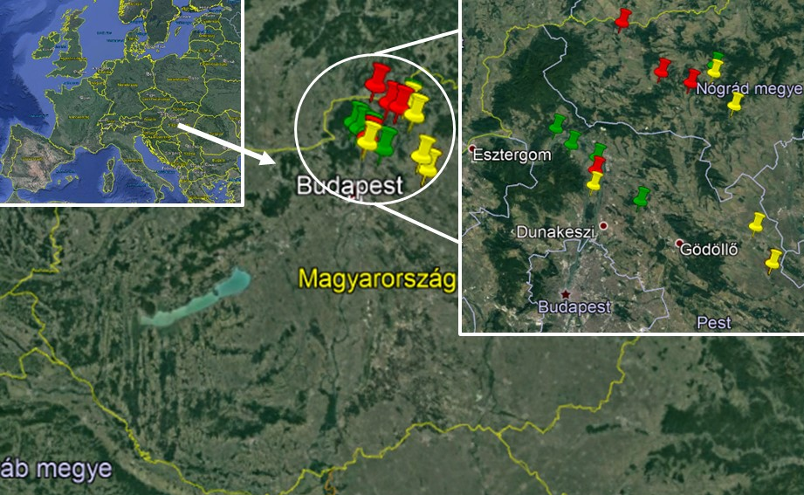
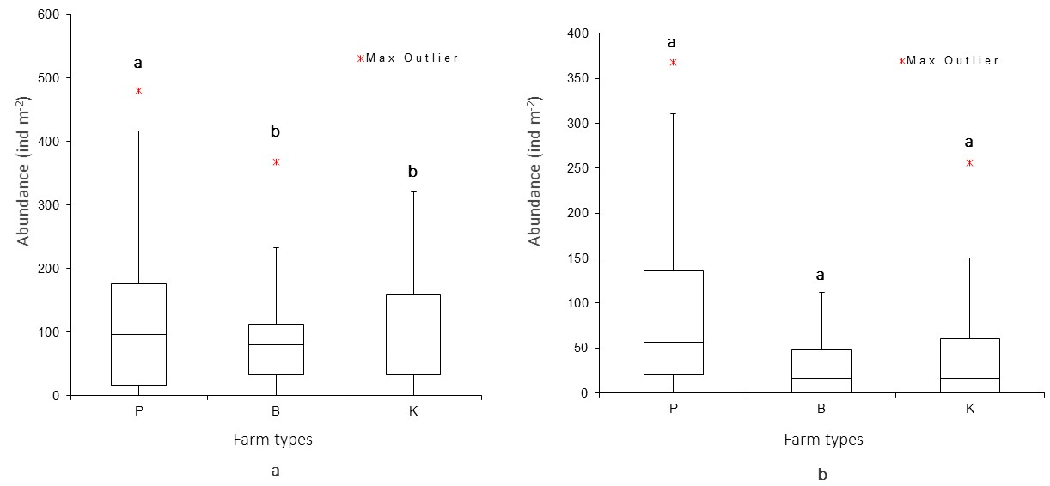
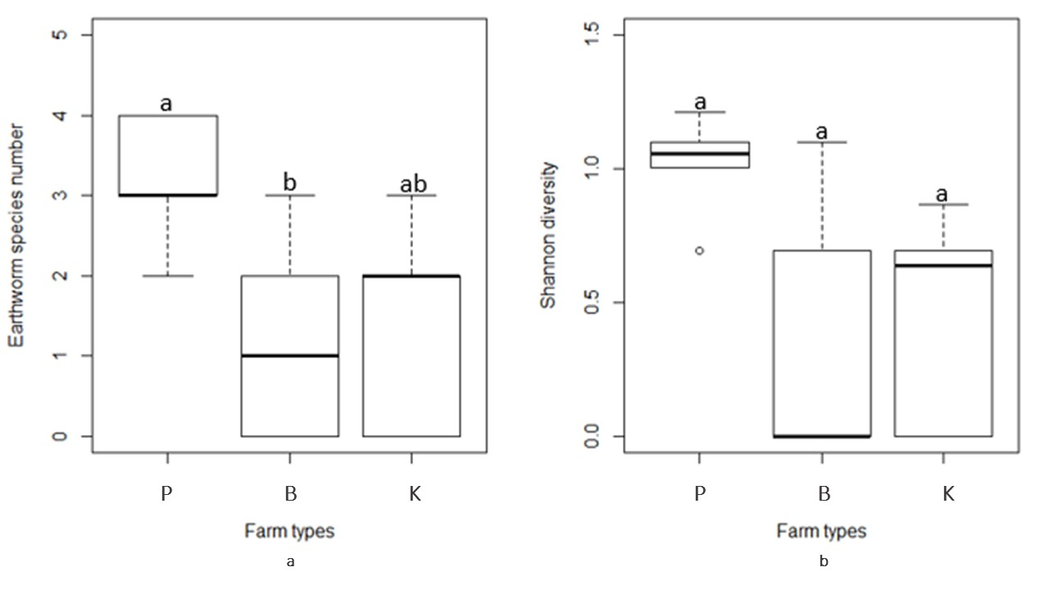
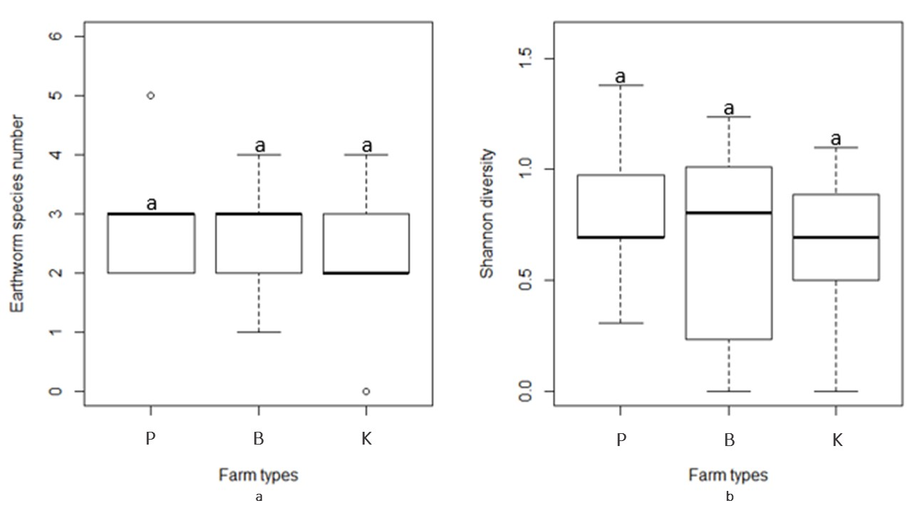
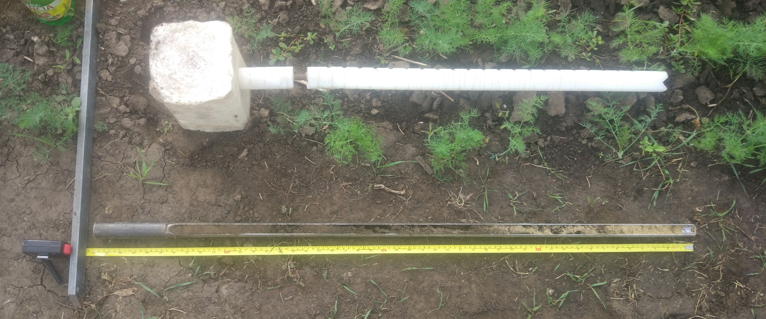
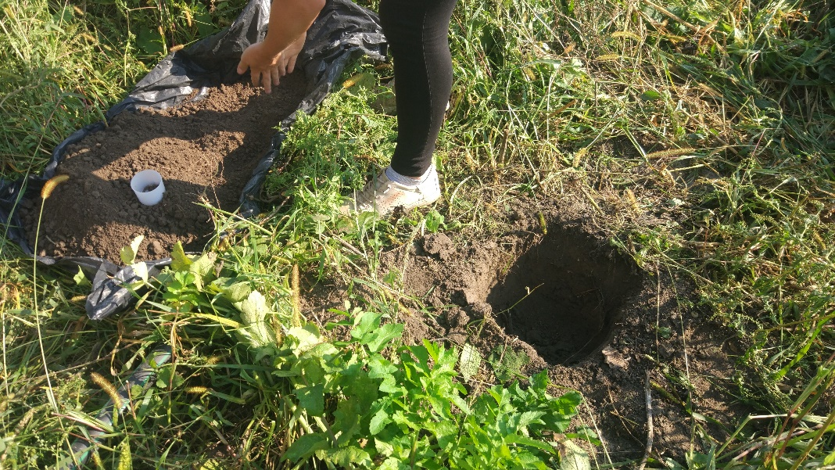
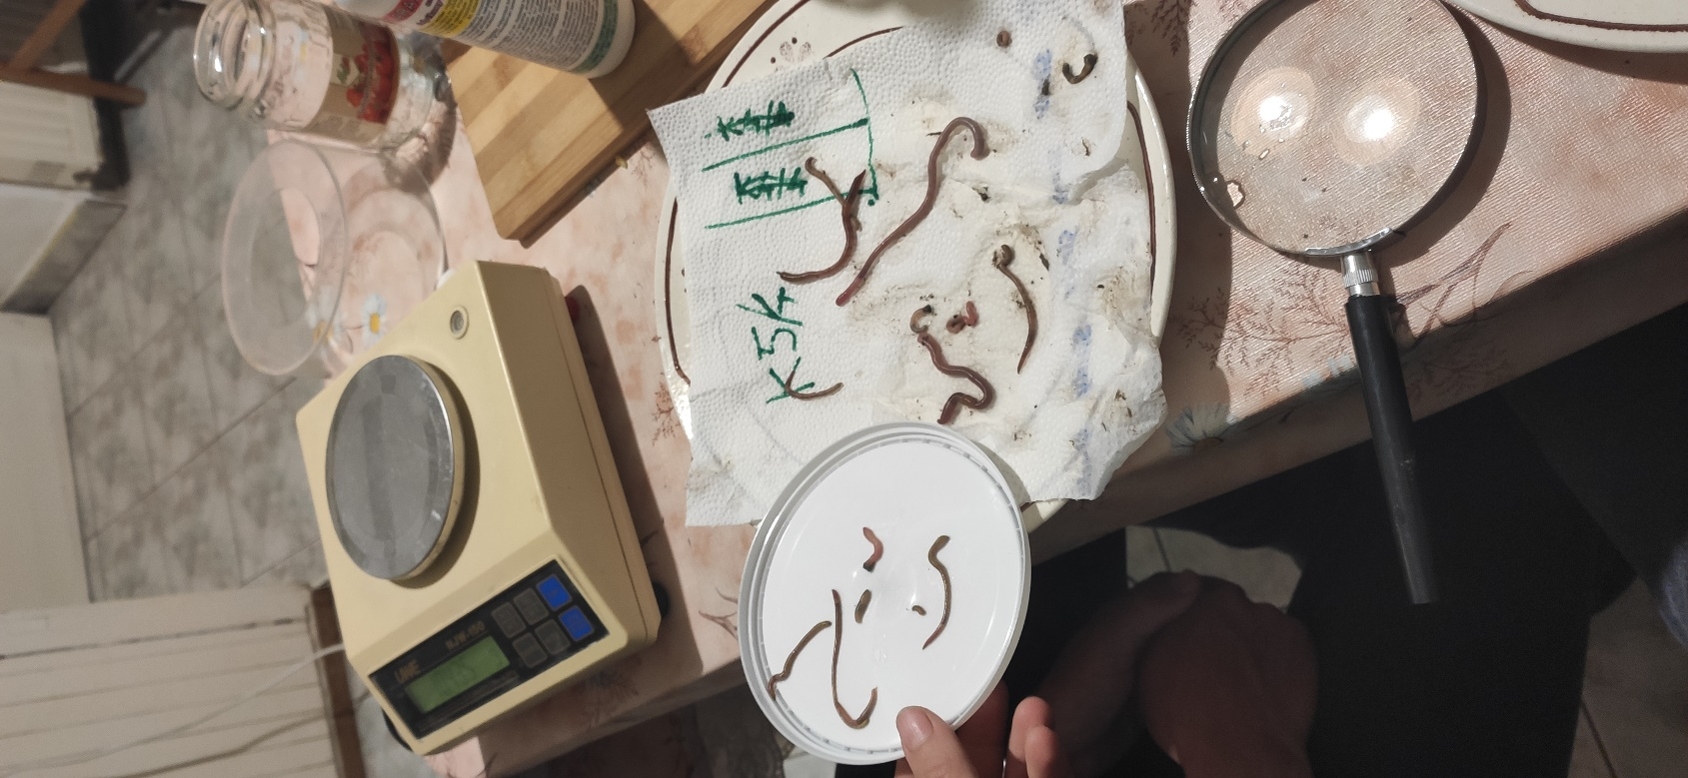
Assessing earthworm populations in some Hungarian horticultural farms: comparison of conventional, organic and permaculture farming
Alfréd Szilágyi¹, Evelin Plachi, Péter Nagy, Barbara Simon, Csaba Centeri
Introduction
Soil quality → ecosystem services
Earthworms → soil ecosystem engineers → soil health indicator
Earthworm population → abundance, diversity
Farm management → soil biota and functioning → soil quality
Objective → comparison of conventional, organic and permaculture farming systems
Methods
Study area → 5 conventional (K), 5 organic (B) and 5 permaculture (P) farms (Fig.1.) (horticulture production, 0.3-3 Ha)
Earthworms → 25×25×25 cm soil blocks, hand sorting, 6 points/ site (May and September 2020) (Fig. 5. left)
Species indentification → external and internal characteristics (Fig. 5. middle)
Soil type → Pürckhauer type core sampler (Fig. 5., right)
Permaculture farm
Farms | Soil type | Thickness of all humus layers
P1 | Arenosol | 0-30
P2 | Luvisol | 0-30
P3 | Luvisol | 0-67
P4 | Luvisol | 0-23
P5 | Fluvisol | 0-105
B1 | Chernozem | 0-58
B2 | Arenosol | 0-20
B3 | Luvisol | 0-41
B4 | Luvisol | 0-20
B5 | Luvisol | 0-84
K1 | Chernozem | 0-50
K2 | Luvisol | 0
K3 | Luvisol | 0
K4 | Fluvisol | 0-70
K5 | Luvisol | 0-100
Organic farm
Conventional farm
Fig. 1. Location of the studied sites, Hungary
Table 1. Soil types and humus layer in the studied farms
Figure 2. Earthworm abundance (individual per m2 in the upper 25 cm, n=5) in the three farming system in May (a) and September (b) (P= permaculture; B= organic; K= conventional)
Figure 3. Earthworm species number (a) and Shannon diversity (b) in the three studied farming system (n=5) in May (P= permaculture; B= organic; K= conventional).
Figure 4. Earthworm species number (a) and Shannon diversity (b) in the three studied farming system (n=5) in September (P= permaculture; B= organic; K= conventional).
Fig. 5. Soil sampling for the earthworms (left), identification (middle), soil type assessment (right) (photos by A. Szilágyi, 2020)
Discussion
Permaculture farm had the highest abundance of earthworms which was significant in May, but it is important to investigate several environmental factors like soil texture.
It is of great importance to know as much soil information as possible for considering earthworms data as good indicator for soil quality assessment.
Sampling method and circumstances of sampling (soil moisture, cultivated crop etc.) potentially influenced the results, moreover low sample size is also an issue for the statistical analysis, with more robust database we could have found more reliable statistical results.
Conclusions
Ecosystem service → promotion of biodiversity to farmers BUT environmental factors must be analyzed carefully → impact indicators are not always enough to explain differences stand-alone
Future goal → analyse farm management and soil characteristics & explore connections of soil biota characteristics to ecosystem service delivery
Acknowledgement
We would like to thank for participating farmers for the opportunity to conduct this research in their farms, also Róbert Kun for his valuable contribution to the statistical analysis. Supported by the ÚNKP-20-1-I New National Excellence Program of the Ministry for Innovation and Technology from the source of the National Research, Development and Innovation Fund.
¹Environmental Sciences Doctoral School, Hungarian University of Agriculture and Life Sciences, Gödöllő, Hungary. For further info email szilagyialfred@gmail.com.

