Slide 1
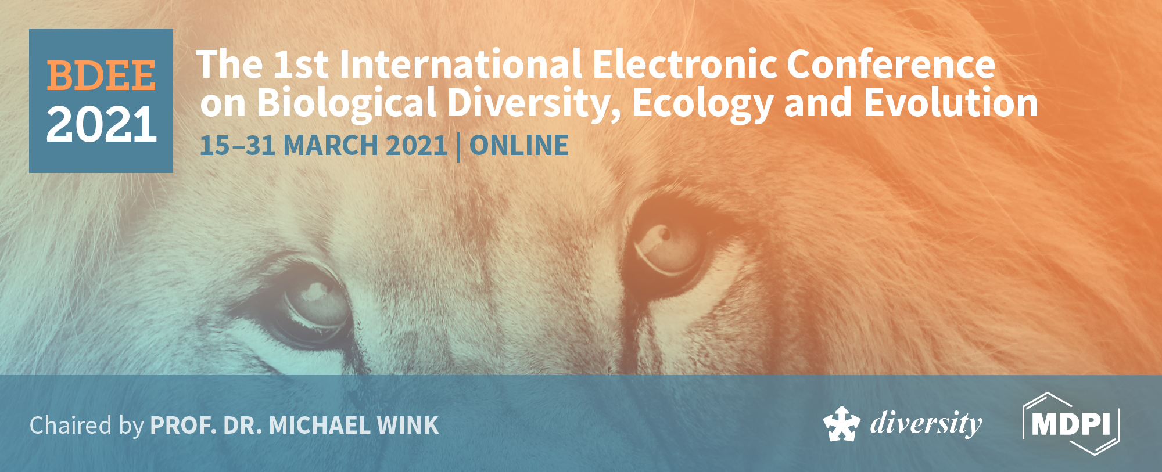
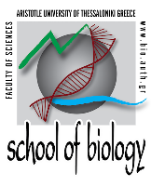
Investigating the distribution of foraging sites of
loggerhead sea turtles, Caretta caretta, in the Mediterranean Sea
Vasiliki Almpanidou^{1,*}, Anastasia Chatzimentor¹, Vasiliki Tsapalou^{1,2}, Antonios D. Mazaris¹
¹ Department of Ecology, School of Biology, Aristotle University of Thessaloniki, 54124 Thessaloniki, Greece
² Groningen Institute for Evolutionary Life Sciences, University of Groningen, 9712 CP Groningen, The Netherlands
* Corresponding author: valmpani@bio.auth.gr
This research is co-financed by Greece and the European Union (European Social Fund- ESF) through the Operational Programme «Human Resources Development, Education and Lifelong Learning» in the context of the project “Reinforcement of Postdoctoral Researchers - 2nd Cycle” (MIS-5033021), implemented by the State Scholarships Foundation (ΙΚΥ).

Slide 2
Abstract
A better understanding on the distribution of highly migratory marine megafauna and the potential exposure of their habitats to anthropogenic activities is essential for their effective protection.
Here, we deliver a comprehensive view on the distribution of foraging grounds for the representatives of marine megafauna, loggerheads, Caretta caretta, in the Mediterranean Sea, along with an assessment on their exposure to fisheries.
Using the available published satellite tracking information on the adult Mediterranean foraging loggerheads, we built a series of distribution models to develop a map of the foraging grounds across the basin. We also assessed the exposure of the delineated foraging grounds to the cumulative risk due to different types of fisheries.
Our findings revealed that the foraging grounds for adult loggerheads extended over the 9% of the Mediterranean Sea. We identified well-established areas in the central Mediterranean Sea but also sites, at the western part, for which the current knowledge was restricted. The exposure of the foraging grounds to fisheries differed across the basin, with the Adriatic Sea being under the highest level of risk.
The developed approach, combining modeling techniques and risk assessment, allowed to reveal critical sites for loggerheads on which conservation actions should focus.
Keywords: bycatch; conservation planning; ecological niche models; marine turtles; risk assessment

Slide 3
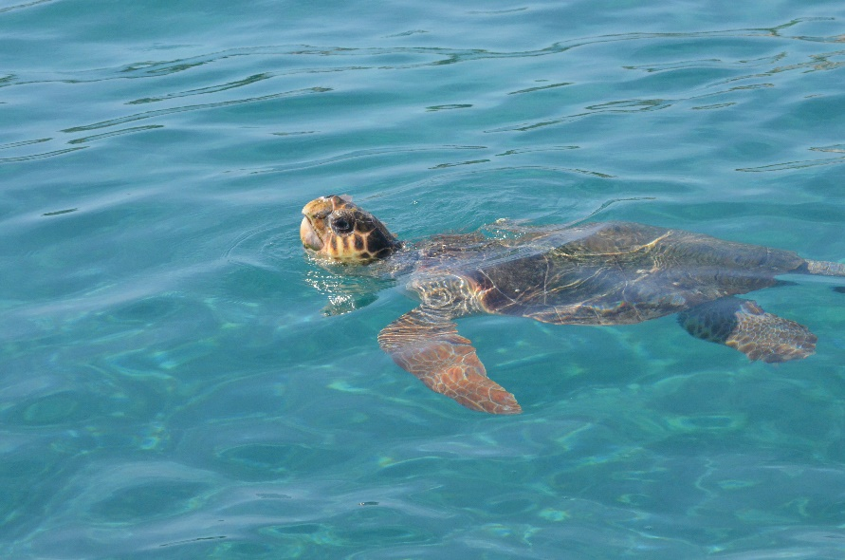
Introduction
Loggerhead sea turtles:
representatives of charismatic marine megafauna
highly migratory species
use distinct areas for different life-cycle stages

Slide 4
Introduction
Mediterranean loggerhead sea turtles:
represent a distinct population with specific biogeographical, demographic and genetic characteristics
local studies have been conducted at the basin focusing on foraging period
?
What is the distribution of foraging areas at the basin scale?

Slide 5
Introduction
Mediterranean loggerhead sea turtles:
fisheries represent a major threat
over 132000 incidents of bycatch have been recorded on a yearly basis
more than 44000 deaths have been estimated per year
?
To what extent are foraging grounds subjected to risk due to fisheries?

Slide 6
Aim
The delineation of foraging grounds of adult loggerhead sea turtles in the Mediterranean basin
The assessment of the exposure of these habitats to the cumulative risk due to different types of fisheries

Slide 7
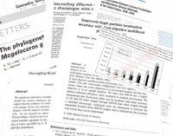
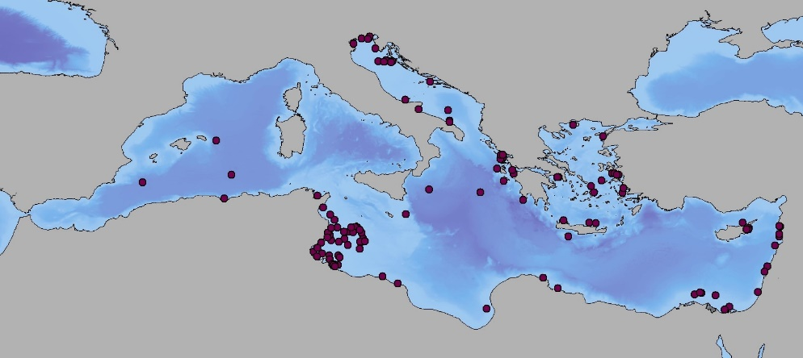
Methods
Step 1:
Collection of presence points of foraging sea turtles via literature review
Adult individuals
Spatial data from satellite telemetry
Exclusion of rehabilitated turtles
Georeference and digitization of presence points (n=119)

Slide 8
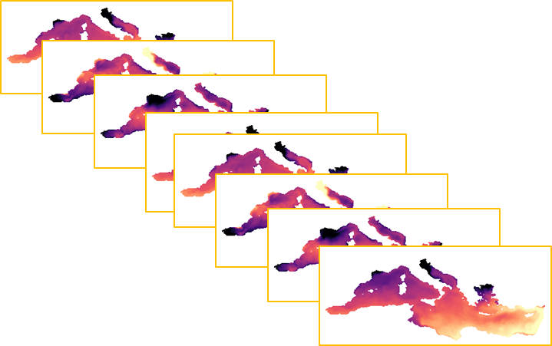
Methods
Step 2:
Determination of current climatic conditions
Sea surface temperature (SST) data for the Mediterranean Sea
0.0625º spatial resolution over the period 1991-2020
SSTs from September to March
the most representative period of foraging activity in the region
Estimation of bioclimatic variables
Mean diurnal range
Exclusion of highly correlated variables
SST range of the 7month period
SST seasonality
Minimum SST of the coldest month

Slide 9
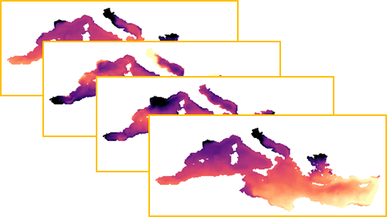
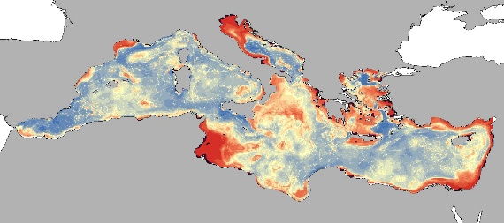
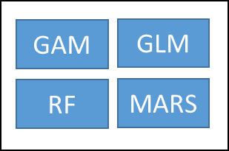
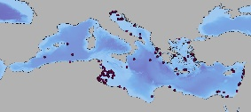
Methods
Step 3:
Development of species distribution models
Bioclimatic variables
ensemble modelling approach
Distribution map with continuous probability of occurrence
Presence points
Delineation of foraging grounds across the Mediterranean Sea
Transformation of the continuous model output
to binary presence/absence map
Intersection with neritic zone, i.e., depth less
than 200m
Intersection with the seven marine ecoregions
in the basin

Slide 10
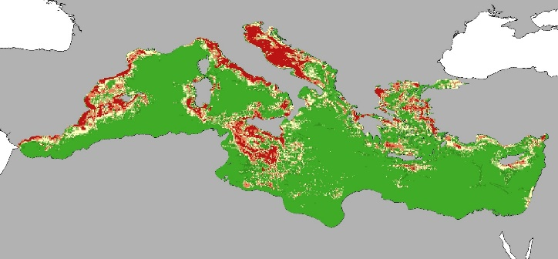
Methods
Step 4:
Collation of data on fishing effort for four types of fishing gears:
longline
trawling
fixed net
purse seine
Estimation of cumulative risk from the different types of fisheries
Ranking risk values within five classes with equal number of features based on their probability distribution.
1 cell
or
or
or
or
Very low
Low
Medium
High
Very high

Slide 11
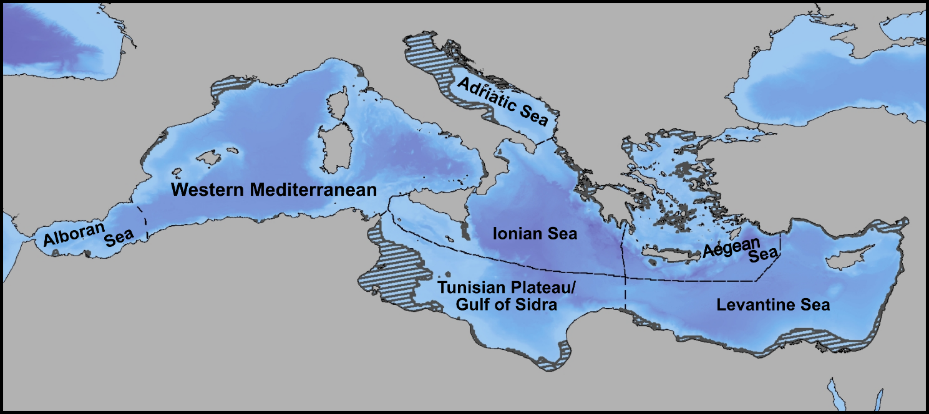
Results and Discussion
Foraging grounds for adult loggerheads covered the 9% of the Mediterranean Sea
Largest percentage of foraging grounds was located at the Central and Eastern Mediterranean
Well established areas such as the Adriatic sea (24% of the total foraging area) and the Tunisian Plateau (31.75%)
Known frequented areas such as the Levantine Sea (19.19%) and parts of the Aegean Sea (13.05%)
Limited extent of foraging grounds was found at the Western Mediterranean, at French and Spanish coasts (7.13% of the total foraging area), for which the current knowledge was restricted.

Slide 12
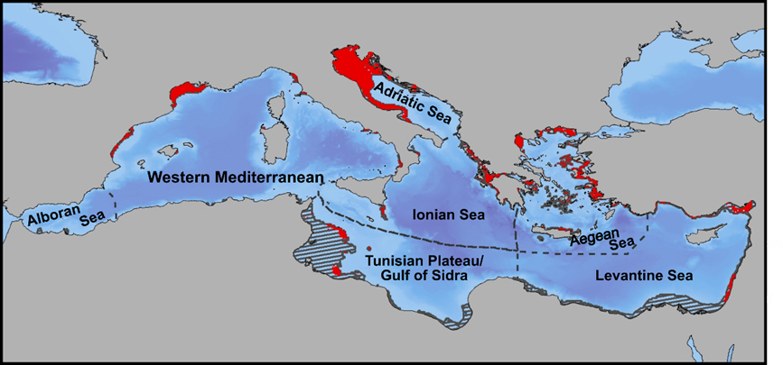
Results and Discussion
More than 40% of the foraging grounds were exposed from medium to very high levels of threat, with variations being detected across the Mediterranean Sea
Adriatic sea: a hotspot of risk of interaction with fisheries (73.47% of its extent subjected to high and very high risk)
Western Mediterranean: 57.51% of the foraging grounds under high and very high levels of threat, confirmed by large number of capture events in Spanish waters.

Slide 13
Results and Discussion
Lower percentages of risk detected at Levantine Sea and Tunisian Plateau/Gulf of Sidra; however, they should be treated with caution due to poor coverage of fisheries data.
More than half of the foraging area hosted within the Aegean and Ionian Sea exposed from medium to very high levels of risk (54.38% and 51.52% of the foraging area, respectively), with increased frequency of interactions between fishermen and sea turtles to have been observed both in Greece and Turkey

Slide 14
Conclusions
The current study provided a profound knowledge on the distribution of key foraging sites for loggerhead sea turtles across the entire Mediterranean basin.
The assessment of the exposure of the foraging grounds to different types of fisheries allowed us to identify critical regions for which potential interventions should be considered
Additional fine-scale assessments should be conducted to provide specific guidelines for an effective protection and conservation of the habitats of loggerhead sea turtles.

Slide 15
Acknowledgments
This research is co-financed by Greece and the European Union (European Social Fund- ESF) through the Operational Programme «Human Resources Development, Education and Lifelong Learning» in the context of the project “Reinforcement of Postdoctoral Researchers - 2nd Cycle” (MIS-5033021), implemented by the State Scholarships Foundation (ΙΚΥ).

