Slide 1
A comparative analysis of the diets of Pelusios turtles across Africa
Luca Luiselli^{1,2,3}*, Gift Simon Demaya, John Sebit Benansio⁴, Fabio Petrozzi⁵, Godfrey C. Akani², Edem A. Eniang⁶, Stephanie N. Ajong⁷, Massimiliano Di Vittorio⁸, NioKing Amadi² , Daniele Dendi^{1,2,3}
¹Institute for Development, Ecology, Conservation & Cooperation, via G. Tomasi di Lampedusa 33, I-00144 Rome, Italy; ² Department of Animal and Environmental Biology, Rivers State University of Science and Technology, PMB 5080, Port Harcourt, Rivers State, Nigeria; ³Department of Zoology, University of Lomé, Lomé, Togo; ⁴AERD – Alliance for Environment and Rural Development; El Hikma Medical Centre Street, Gudele West, Block II. P.O.Box 445, Juba, South Sudan; ⁵ Ecolobby, Rome, Italy; ⁶ Department of Forestry and Wildlife, University of Uyo, Nigeria; ⁷ Department of Fisheries, Lagos State University, Ojo, Lagos, Nigeria; ⁸ Ecologia Applicata Italia s.r.l., Termini Imerese (PA), Italy
* Corresponding author: l.luiselli@ideccngo.org; lucamaria.luiselli@uniroma3.it.

Slide 2
Abstract: Pelusios is an Afrotropical endemic genus of freshwater turtles that have adapted to a variety of habitats, with savannahs and forests being their two main habitat types. Although considered generally carnivorous, these turtles have rarely been subjected to detailed field surveys for determining their quantitative diet. In this paper, by using both literature and original data, we analyse the diet of several Pelusios populations: three P. adansonii populations from South Sudan, one P. nanus from Zambia, seven P. castaneus from Nigeria, Benin and Togo, and four P. niger from Nigeria. All species were omnivorous but with a clear preponderance of the prey items being of animal origin (amphibians, fish, arthropods and anellids). Saturation curves revealed that the diet composition of all the surveyed populations was adequately assessed, and the diversity profiles indicated that all the populations were relatively similar in terms of overall dietary diversity. All species appeared substantially generalist in terms of their diet composition, although the effects of season (wet versus dry) were not adequately assessed by our study.
Keywords: Chelonians; Pelomedusidae; Foraging ecology

Slide 3
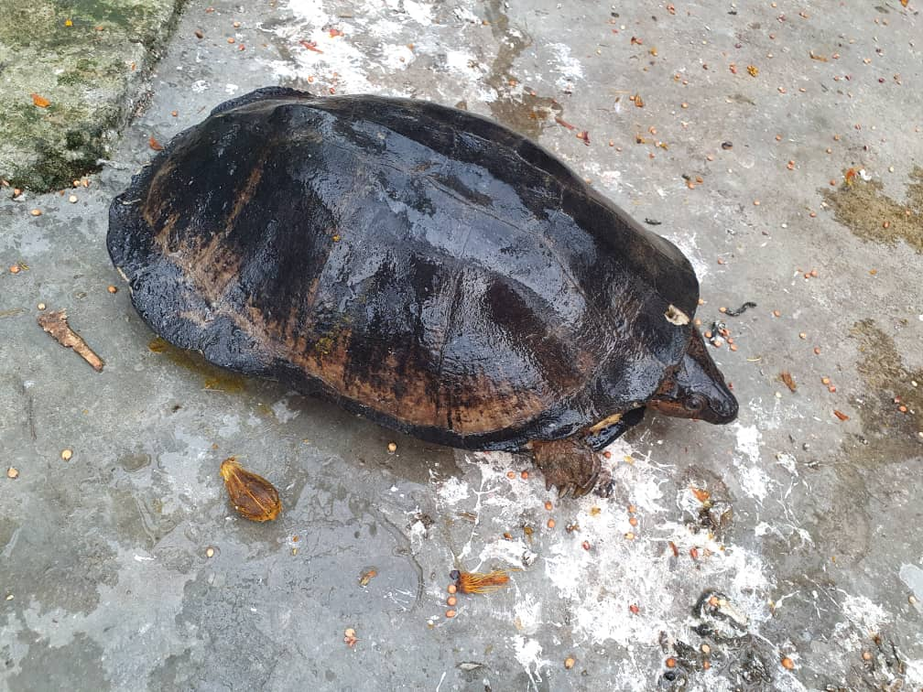
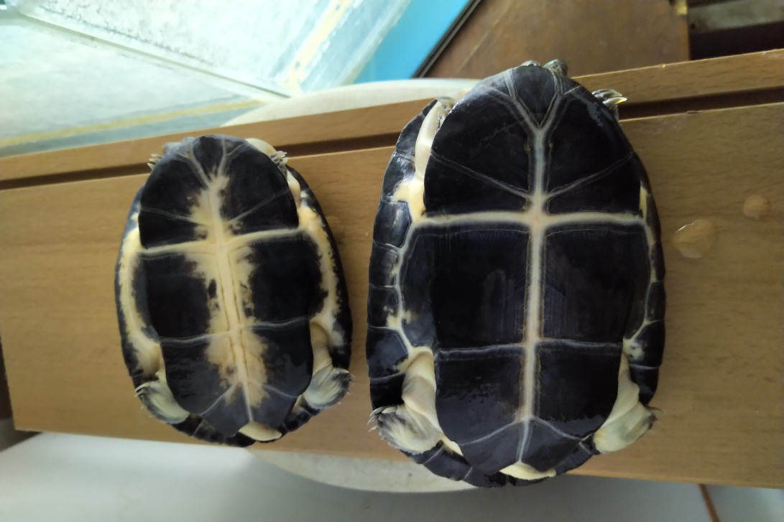
Introduction
Pelusios is an Afrotropical endemic genus of freshwater turtles that have adapted to a variety of habitats, with savannahs and forests being their two main habitat types. Although considered generally carnivorous, these turtles have rarely been subjected to detailed field surveys for determining their quantitative diet. In this paper, by using both literature and original data, we analyse the diet of several Pelusios populations: three P. adansonii populations from South Sudan, one P. nanus from Zambia, seven P. castaneus from Nigeria, Benin and Togo, and four P. niger from Nigeria.
Dorsal and ventral view of Pelusios niger from the Niger Delta (southern Nigeria). This species is linked to forest and forest-derived areas, and inhabits permanent waterbodies

Slide 4
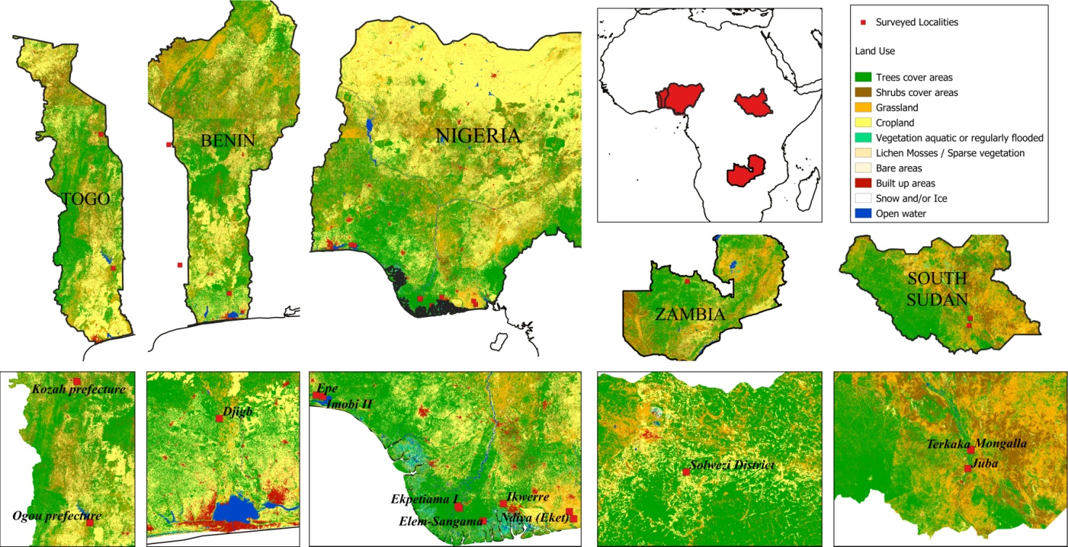
Methodology
Literature data included three populations of P. castaneus and two populations of P. niger studied in the Niger Delta, Nigeria (Luiselli, 1998; Luiselli et al., 2004).
Original data came from additional four populations of P. castaneus, two of P. niger, and one of P. nanus. Overall, original field studies were conducted between 1996 and 2020, in some savanna sites as well as in rainforest sites, in both perennial waterbodies (rivers, streams, lakes) and in temporary ponds.
Study areas
Map of Africa showing the location of the sites where the diet of Pelusios spp. was studied. Land use categories are also shown in the maps. Localities for both literature and original data are pooled in this map.

Slide 5
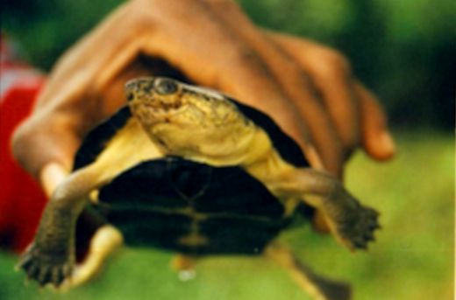
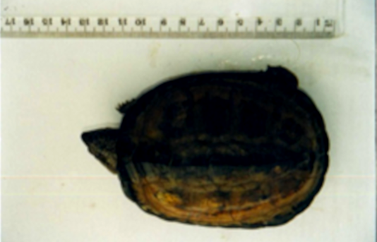
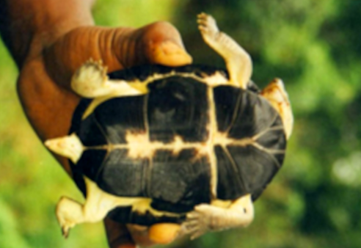
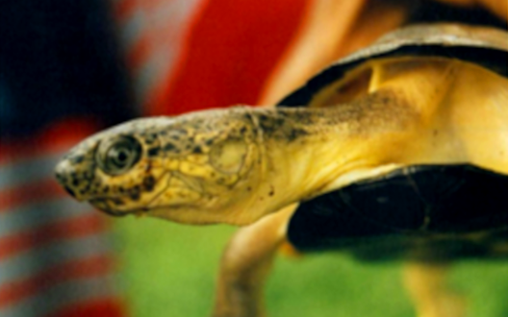
All captured turtles were sexed by examining their plastron and caudal shape, measured for curved carapace length, curved carapace width, plastron length and plastron width, and permanently individually marked by unique sequences of notches filed into the marginal scutes. The dietary study is based on both stomach analysis of a few dead specimens (offered in bush-meat markets), stomach-flushing and fecal pellet analysis of living specimens (specimens were singly kept into plastic boxes until defecation occurred). No specimen was killed or injured by the researchers. Feces were separately placed into alcohol for later dissection and examination under binocular microscope.
Diet composition of each population was described as the percentage of stomachs containing a given food item and not on the basis of the total number of items of each food category in stomachs. This was necessary because it is often impossible to count the number of items from feces analysis. We evaluated whether our sampling effort captured the true food items richness and diversity within each study population by building a rarefaction curve for food type discoveries at each site

Slide 6
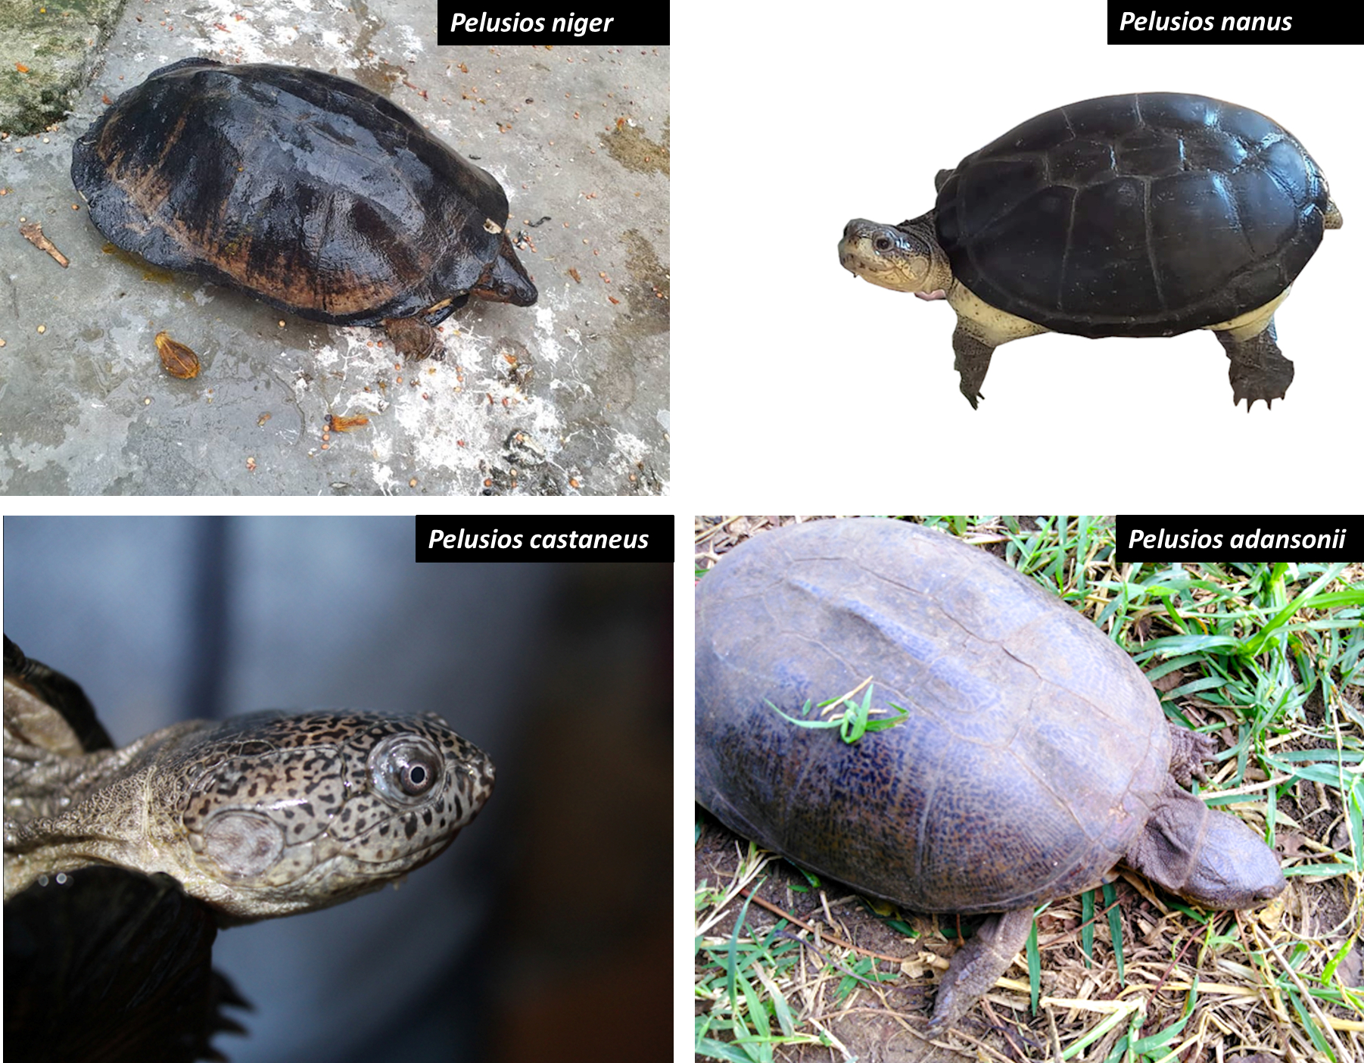
The study species

Slide 7
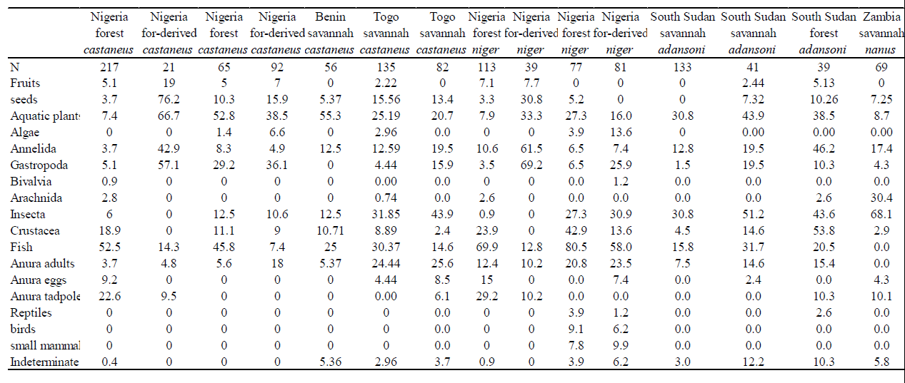
Results and Discussion
Overall, diet data on 1260 Pelusios individuals were collected: 668 were P. castaneus, 310 were P. niger, 213 were P. adansonii, and 69 were P. nanus. 705 turtle individuals were captured in Nigeria, 56 in Benin, 217 in Togo, 213 in South Sudan and 69 in Zambia. The synopsis of the diet composition by species and by country/study area is given in Table 1.
Table 1. Synopsis of the diet composition of turtles

Slide 8
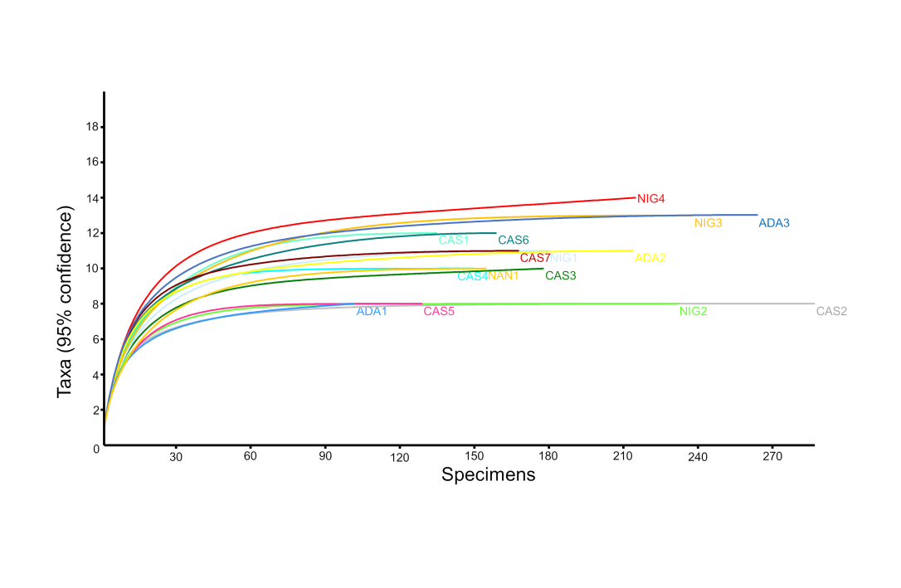
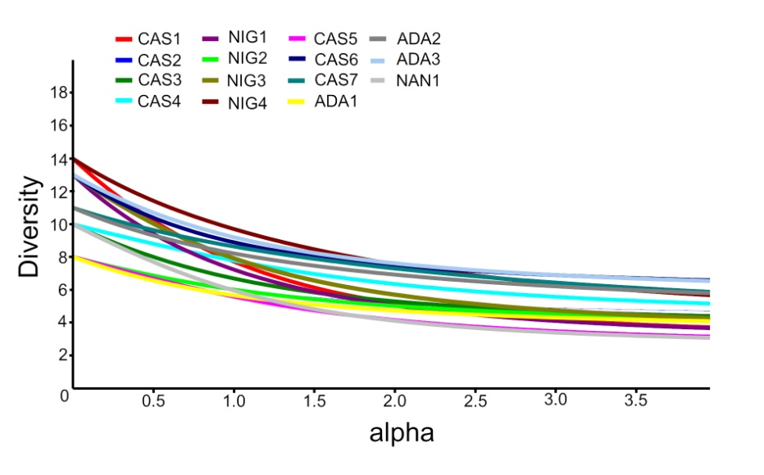
Saturation curves revealed that the diet composition of all the surveyed populations was adequately assessed (Graphic 1), and the diversity profiles indicated that all the populations were relatively similar in terms of overall dietary diversity (Graphic 2).
Graphic 1. Saturation curves for the diet of the various populations of Pelusios spp. analyzed in this paper. NIG = P. niger; CAS = P. castaneus; ADA = P. adansonii; NAN = P. nanus. The numbers represent distinct populations within each species
Pelusios niger fed on larger sized prey types (including terrestrial vertebrates) than the other species, but this was an effect of its much larger body size. On the other hand, P. nanus (the smallest species in the group) fed mainly upon invertebrates, and was the only species that had no fish remains in stomachs or faeces
Graphic 2. Diversity profiles for the diet of the various populations of Pelusios spp. analyzed in this paper. NIG = P. niger; CAS = P. castaneus; ADA = P. adansonii; NAN = P. nanus. The numbers represent distinct populations within each species

Slide 9
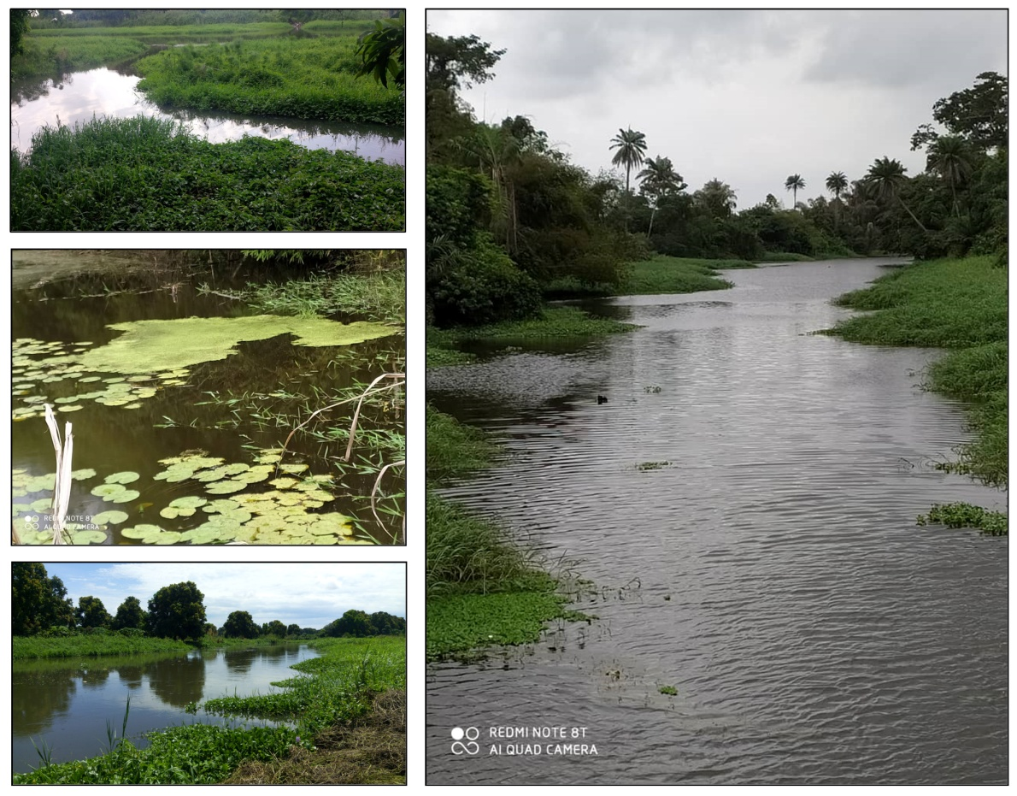
a)
d)
More in detail, terrestrial vertebrates were found in three out of four P. niger populations, and in up to 9.9% of the examined individuals within each population, whereas they were never observed in other Pelusios species apart from one population of P. adansonii (2.6% of the examined individuals). Fish remains, that as reported in the previous slide were never seen in P. nanus, were found in all the other 14 Pelusios populations, with frequencies of occurrence ranging from 7.4% (in a P. castaneus population from a forest-derived area) to 80.5% (in a P. niger population from a rainforest area in Nigeria).
b)
c)
Habitat features of Pelusios species in Africa: (a) (c) P. adansonii in South Sudan; (b) (d) P. cupulatta and P. castaneus in Cote d’Ivoire

Slide 10
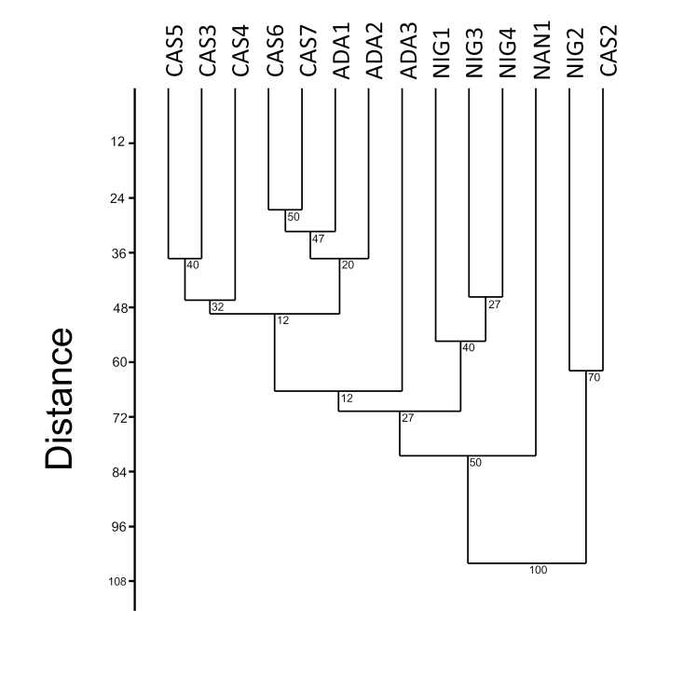
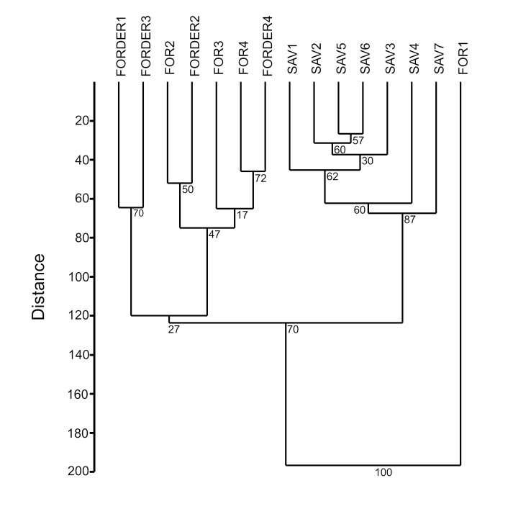
If we consider, as a metric of dietary preference by Pelusios spp., the % frequency of occurrence of a given prey type across populations (calculated based on the number of populations in which at least one individual ate a certain type of food compared to the total number of populations examined (n = 15)), aquatic plants, Gastropoda, fish and frogs represented the main food categories for these turtles (Graphic 3)
The various turtle populations did not show any clear species-specific pattern, but most P. castaneus populations clustered together, and two of out of three P. adansonii populations clustered together with P. castaneus, in a UPGMA tree-diagram with Euclidean distances (Graphic 4). A UPGMA tree-diagram with Euclidean distances also showed that forest and forest-derived populations clustered together in terms of taxonomic diet composition, whereas savannah populations formed another well defined group (Graphic 5).
Graphic 4
Graphic 5

Slide 11
Effects of vegetation cover and turtle body size
Our GLM results (Table 2) showed a negative effect of vegetation cover on Anura adults consumption by turtles, while showed that the frequencies of Anura tadpoles, fish, reptiles and birds on Pelusios diets increased with the increase of vegetation cover. The GLM model also showed positive effects of individual body size on algae, Bivalvia, reptiles, birds and small mammals consumption by turtles, while underlined that the predation on Arachnida decreased with the increased of turtles body size (Table 3).
 | Estimate | St. Error | Wald | p
Anura tadpoles | 0.035197 | 0.009961 | 12.48426 | 0.000410
Anura adults | -0.13081 | 0.019494 | 45.02788 | 0.000000
Fish | 0.009662 | 0.002308 | 17.52001 | 0.000028
Reptiles | 0.274646 | 0.056558 | 23.58069 | 0.000001
Birds | 0.210985 | 0.025179 | 70.21284 | 0.000000
Table 2. Output of the GLM model on the relationship between vegetation cover and diet in four species of Pelusios from tropical Africa. Only significant variables are presented in this table.
Table 3. Output of the GLM model on the relationship between turtle body size and diet in four species of Pelusios from tropical Africa. Only significant variables are presented in this table.
 | Estimate | St. Error | Wald | p
Algae | 0.112020 | 0.009507 | 138.8375 | 0.000000
Bivalvia | 1.514130 | 0.231157 | 42.90536 | 0.000000
Arachnida | -0.060554 | 0.015102 | 16.0784 | 0.000061
Reptiles | 0.389812 | 0.000062 | 38937600 | 0.000000
Birds | 0.098272 | 0.032757 | 9.00000 | 0.002700
Small mammals | 0.084896 | 0.028299 | 9.00000 | 0.002700

Slide 12
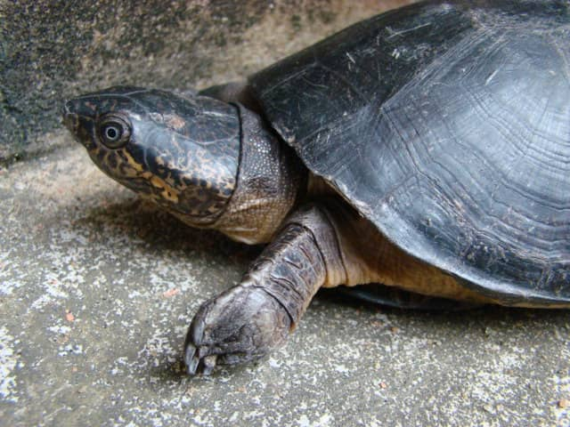
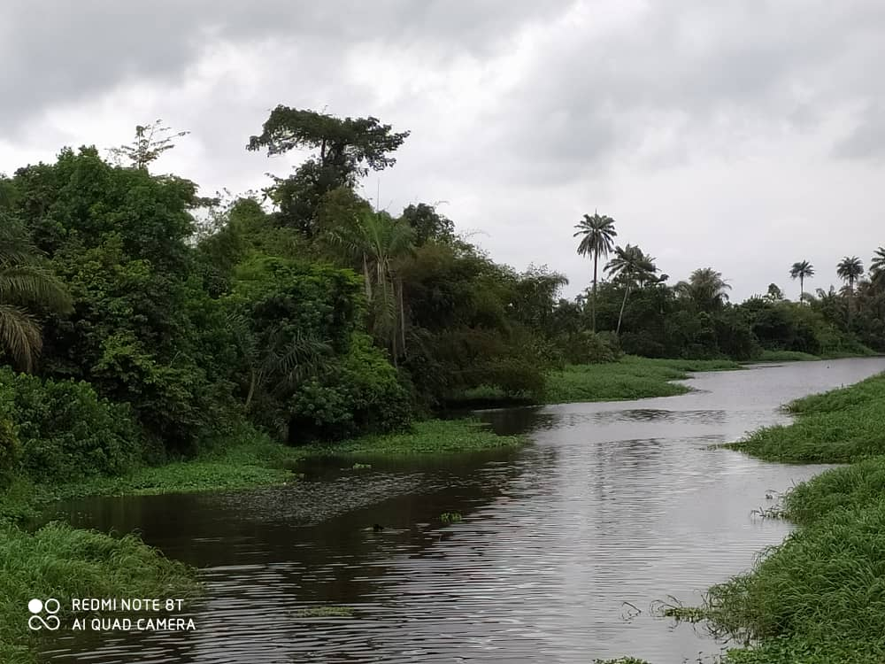
Conclusions
Overall, our study revealed that all species were substantially generalist in terms of their diet composition, although the effects of season (wet versus dry) were not adequately assessed by our study. In addition, we showed that all species were omnivorous but with a clear preponderance of the prey items being of animal origin (amphibians, fish, arthropods and anellids). The relative head size and shape probably influenced the ingestion performance of the various species: indeed, when considering only the prey items that were found almost intact in the flushed stomachs, the species with the most massive head (P. niger) at a given body size was particularly able to ingest very large prey items compared to other species. The ecological consequences (minimization of interspecific competition strength) of these differences in ingestion performance should be further analyzed by ad-hoc studies.

Slide 13
Acknowledgments
We thank Prof J. E. Fa, Dr G. H. Segniagbeto, Dr E, M. Hema, and Dr S. Gonedele Bi, for helpful collaboration during the various research phases of this study.
Author Contributions: For research articles with several authors, a short paragraph specifying their individual contributions must be provided. The following statements should be used “Conceptualization, L.L.; methodology, L.L.; formal analysis, L.L., M.D.V.; investigation, all authors; resources, L.L.; data curation, F.P., D.D.; writing—original draft preparation, L.L.; writing—review and editing, all authors; supervision, L.L., G.C.A., E.A.E.; funding acquisition, L.L., F.P.; All authors have read and agreed to the published version of the manuscript.

