Slide 1
Title of the Presentation
Tatiana Deniskova ¹*, Arsen Dotsev ¹, Henry Reyer ², Marina Selionova ³, Klaus Wimmers ², Gottfried Brem ^{1,4}, and Natalia Zinovieva ¹
¹ L.K. Ernst Federal Research Center for Animal Husbandry, Russia;
² Institute of Genome Biology, Leibniz Institute for Farm Animal Biology, Germany;
³ Russian State Agrarian University - Moscow Timiryazev Agricultural Academy, Russia;
⁴ Institute of Animal Breeding and Genetics, University of Veterinary Medicine, Austria.
* Corresponding author: horarka@yandex.ru
A study of biodiversity of Russian local sheep breeds based on pattern of runs of homozygosity

Slide 2
Abstract: A rapid spreading of cosmopolite breeds leads to decrease of population sizes of Russian local sheep that consequently might result in their biodiversity loss. Estimation of runs of homozygosity in local sheep genomes will be informative tool to address their current genetic state. In this work, we aimed to address the distribution of the ROH and to estimate genome inbreeding in Russian local sheep breeds based on SNP-genotyping. Medium-density SNP-genotypes of twenty-three local sheep breeds (n=332) were obtained in our previous study. We used a consecutive runs method implemented in the R package “detectRUNS” to calculate ROH which were estimated for each animal and then categorized in the ROH length classes (1-2 Mb, 2–4 Mb, 4–8 Mb, 8–16 Mb, >16 Mb). The frequency of short ROH segments (≤ 2 Mb) were the highest in all studied breeds (63.15% - 93.10%). The longest segments (> 16 Mb) were the least frequent and were missing in four breeds. The genomic coefficients based on ROH estimation varied from medium (0.114) to low (0.035). Thus, we found that Russian local sheep breeds are characterized by a low level of genomic inbreeding.
Keywords: sheep; genetic diversity; SNPs; genomic inbreeding

Slide 3
Results and Discussion
The frequency of short ROH segments (≤ 2 Mb) was the highest in all studied breeds (63.15% -93.10%). The longest ROH segments (> 16 Mb) were the least frequent (0.07% - 1.22%).
Length classes (Mb)
Figure 1. Distribution of the runs of homozygosity in length classes in Russian local sheep breeds

Slide 4
Results and Discussion
The minimum F_{ROH} was calculated in the Lezgin breed (F_{ROH} = 0.035) and the maximum was detected in the Russian Longhaired breed (F_{ROH} = 0.114).
Figure 2. Values of inbreeding coefficient calculated based on ROH (F_{ROH}) in Russian local breeds

Slide 5
Results and Discussion
Russian
Mean ROH length from 93.7 to 301.7 Mb. Max. ind. ROH length – 470 Mb.
F_{ROH} from от 0.035 to 0.114 Mb.
Short ROH segments predominant
Italian local
Mean F_{ROH} varied from 0.016 to 0.099.
Short ROH segments predominant.
Charollais, Suffolk, and Texel
Mean ROH length from 92.61 to 128.31 Mb.
Border Leicester, Merino, and Poll Dorset
Mean ROH length from 94.9 to 126.1 Mb. Max. ind. ROH length - 427, 410 and 396 Mb.
Swiss local
Mean F_{ROH} from 0.022 to 0.153.
Short ROH segments predominant.
Short ROH segments predominant
ROH segments with length classes from 1 to 10 Mb were the most frequent in all breeds using 50k data.
Present study
Al‑Mamun et al., 2015
Signer-Hasler et al., 2019
Mastrangelo et al, 2018
Purfield et al., 2017
Conclusions
Our findings based on 50k data provide an evidence of a low genomic inbreeding in Russian local sheep populations.
The study results provide useful information to design conservation programs for local genetic recourses of sheep.

Slide 6
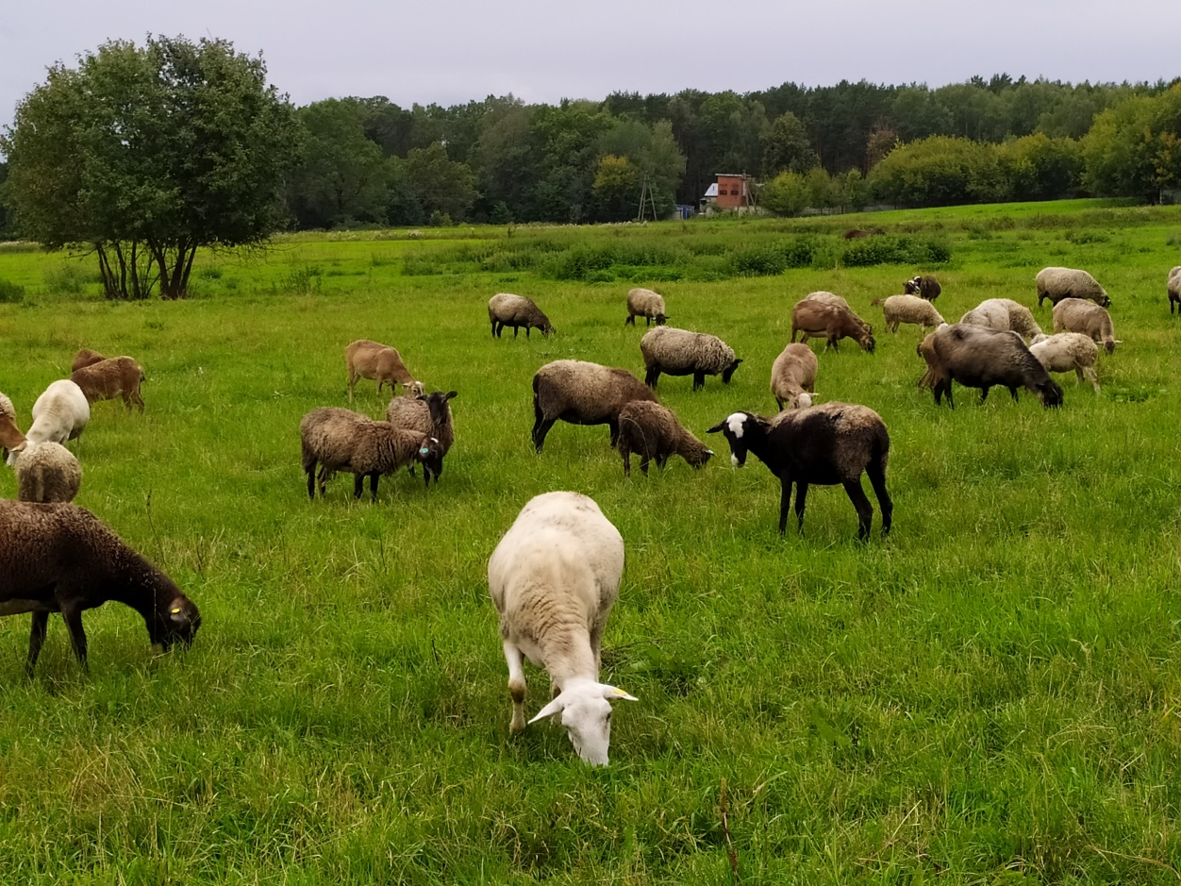
Supplementary Materials
The details on the relevant dataset including the sampling locations for each breed, the SNP quality control and the phylogenetic links between the breeds are available online at https://gsejournal.biomedcentral.com/articles/10.1186/s12711-018-0399-5.

Slide 7
Acknowledgments
The study was supported by Ministry of Science and Higher Education of the Russian Federation within theme No. 0445-2019-0024.
Link to photo: https://www.facebook.com/minobrnaukigov/
Thank you for your attention!

