Slide 1
Ex situ phenological examinations of wild plant species, and comparing the results with national and international studies
Verbényiné Neumann Krisztina PhD Student, Department of Nature Conservation
and Landscape Management, Gödöllő

Slide 2
Actuality and importance of the research
Global climate change, global warming
Climate change significantly affects the life cycle of plants, phenology is a good indicator of global warming
There is less available phenological data on wild-growing plants, especially long-term data which suits international standards
Urban heat island as a model and forecast for possible future climate change
Results may help adapting to climate change

Slide 3
Literature background of the study
Long term monitoring of flowering phenology of geophites in the ELTE Botanical Garden by Szaniszló Priszter (1960-2000)
Non-systematic phenological obsevations of cultivated and wild-growing plant species organized by the Hungarian Meteorological Service (1951-2000)
Walkowsky: long term data of flowering phenology of Robinia pseudoacacia (1998)
Primack (1985) described the methodology of collecting flowering phenology data.
Differences and trends of spring phenophases in urban and rural areas in central Europa – Roetzer et. al (2000)
Phenological patterns of flowering across biogeographical regions of Europe - Templ et. al (2017)

Slide 4
Plan of research
Plants representing six different life forms
Two locations with different mesoclimate: Budapest, ELTE Botanical Garden (Füvészkert), MATE Botanical Garden of Gödöllő.
Observation of phenological patterns during 3 growing seasons (2020-2021-2022) with weekly recording of data
Meteorological equipment for exact local data (installation in November 2020)

Slide 5
Aim of study and hypothesis
How excess heat in urban environments affects the phenological patterns of species belonging to different life forms, and how different the effect is in colder rural mesoclimactic environments?
We hypothesized that locations with higher mean temperatures would result (i) in an earlier onset and (ii) and an earlier end of flowering, compared to colder locations.

Slide 6
Material and methods
6 different life-forms of the Raunkiær system (phanerophytes, chamaephytes, hemicryptophytes, geophytes, hemitherophytes, therophytes) – 5 species in each life form – 5 repetitions in each locations
Standard-sized flowerpots, standard soil mix, maximized genetic conformity in each species, standard irrigation protocol
2 locations – Budapest, Gödöllő

Slide 7
Material and methods

Slide 8
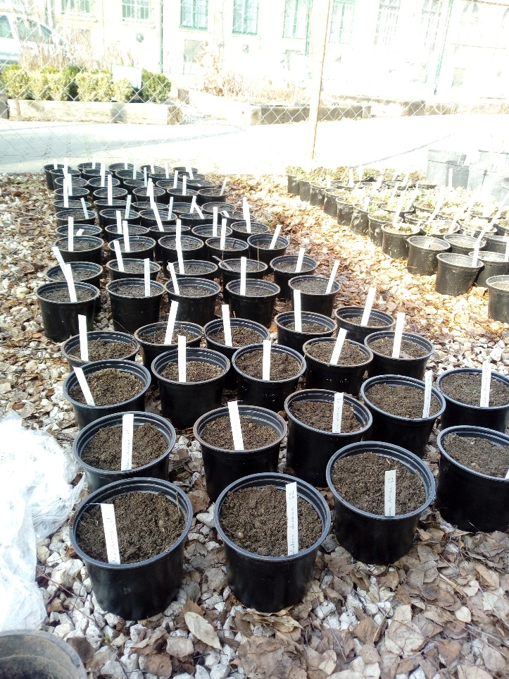
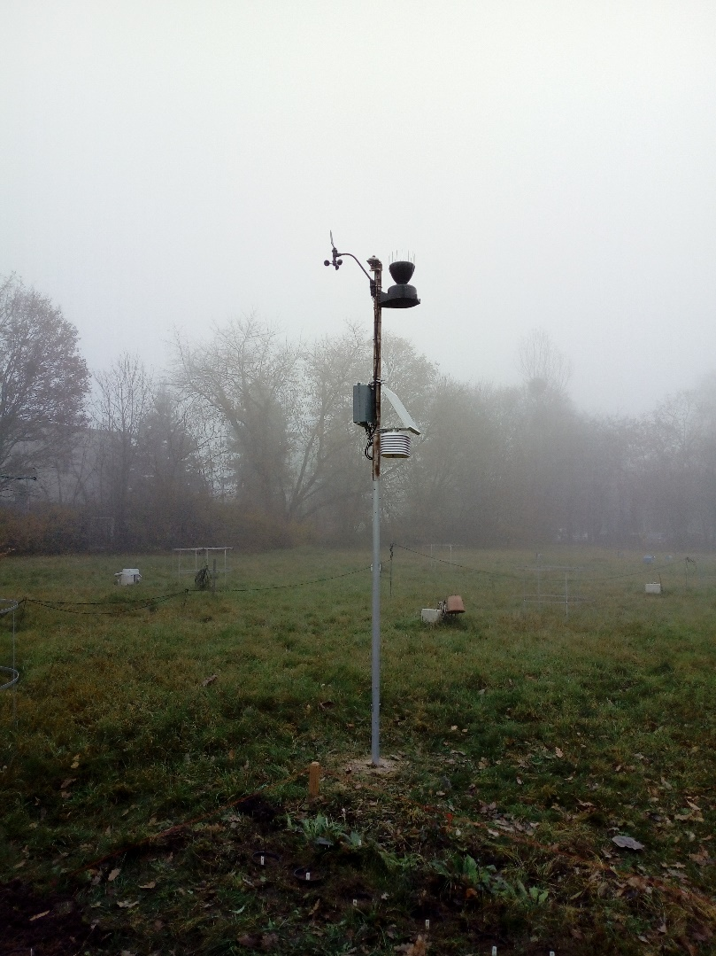
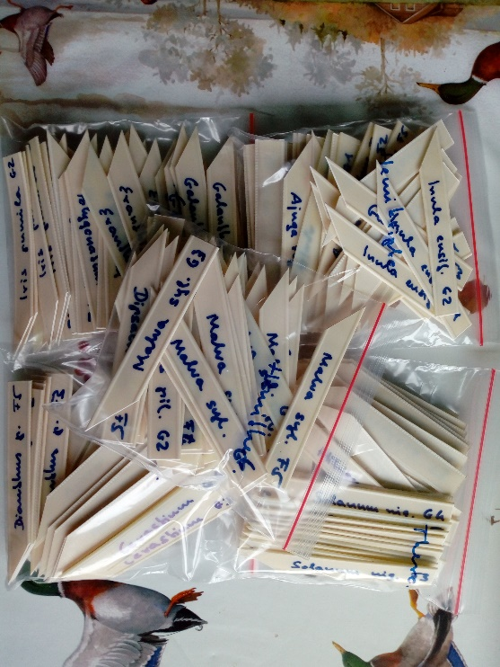
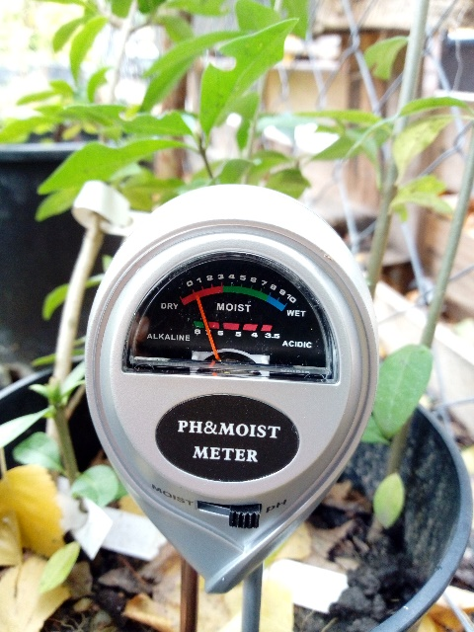
Material and methods

Slide 9
Material and methods
Reconding frequency: once a week on the same day on both locations by phenological data, every 5 minutes by meteorological data
Recorded phenological data: appearance of seedlings by therophytes, appearance of leaves by geophytes, budburst, leaf out, beginning, maximum and end of flowering (Primack’s method), fruit ripening, percentage of leaf coloration, percentage of leaf fall
Recorded meteorological data: amount of precipitation, wind direction and wind speed, air temperature, relative humidity of the air, barometric pressure, global radiation

Slide 10
Preliminary Results
Earlier flowering in Budapest: the average difference in the onset of flowering was 10.66 days. The peak of the flowering showed 12.94 days of difference, the end of flowering showed 2.9 days of difference. According to our expectations. ☺
Strong significant difference (P ˂ 0.001) in the onset of the flowering of Globularia cordifolia between the locations and peaks of flowering there was a strong significance (P ˂ 0.001) for Inula ensifolia medium significance (P ˂ 0.01) end of flowering there is a strong significance (P ˂ 0.001) for Polygonatum multiflorum

Slide 11
Preliminary Results
Hibiscus trionum

Slide 12
Preliminary Results
Silene latifolia subsp. alba

Slide 13
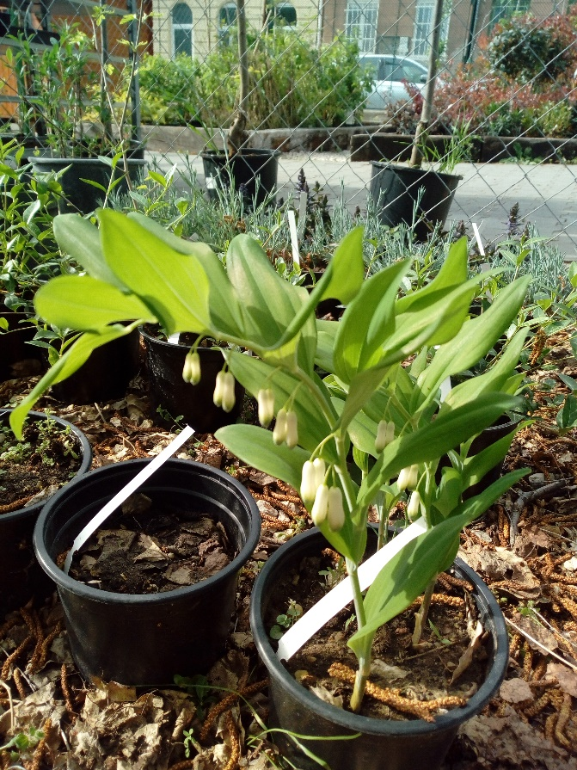
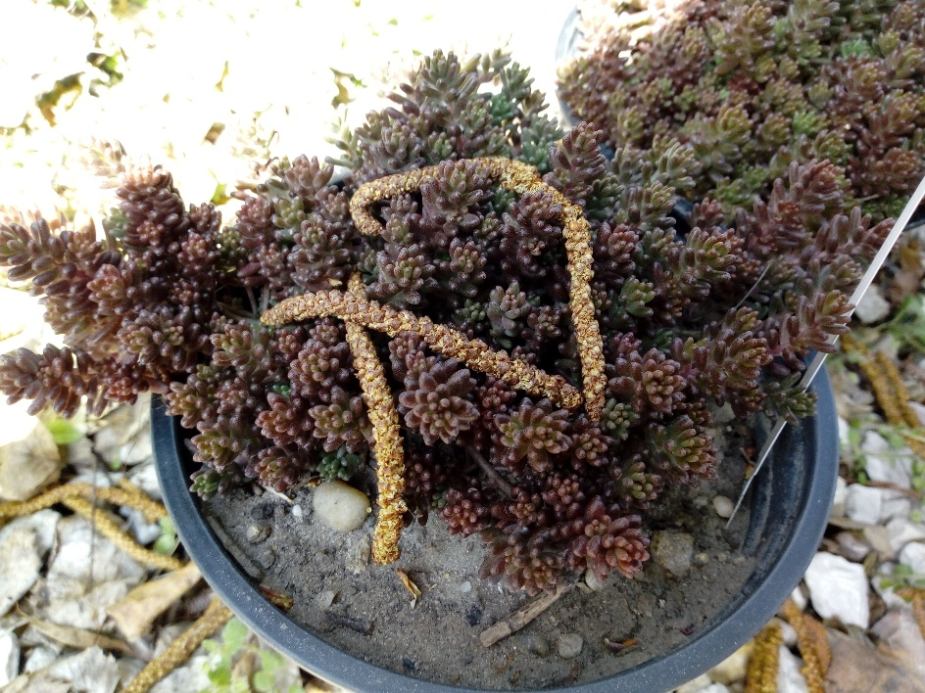
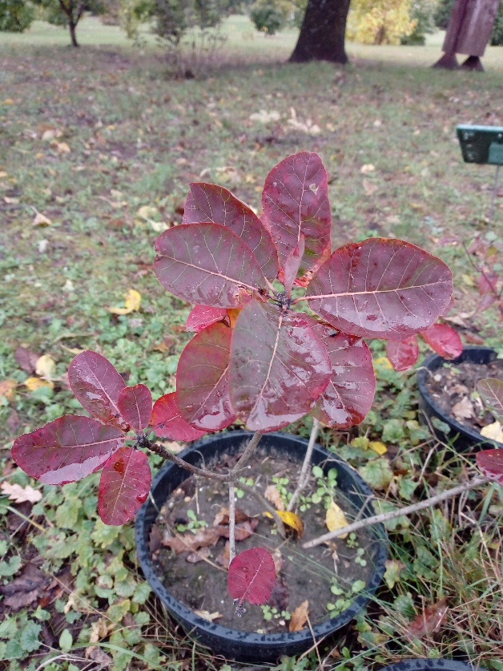
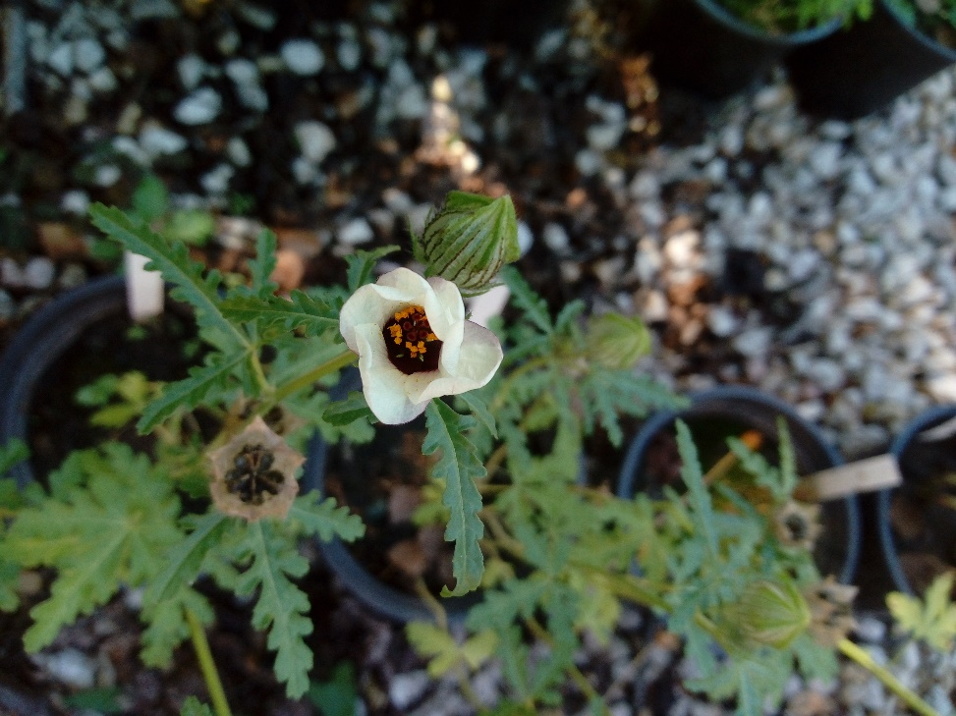
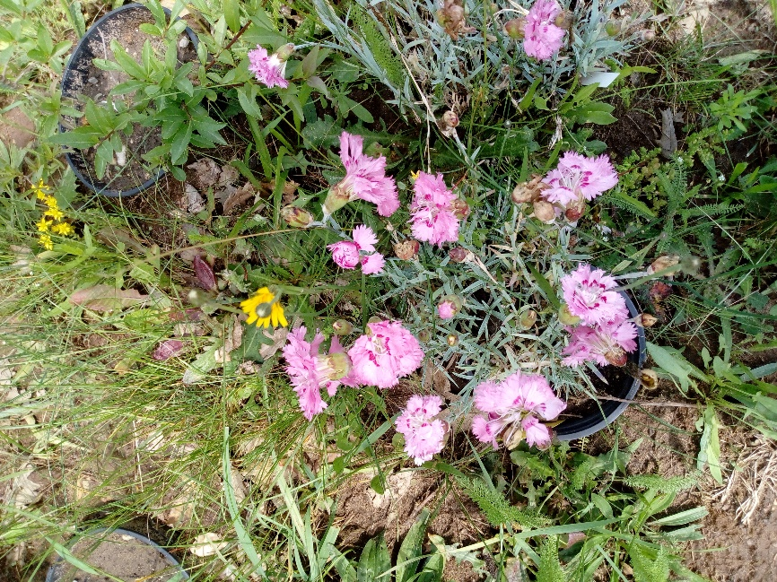
Preliminary Results

Slide 14
Discussion
Roetzer et. al. (2000) showed, that in European cities with strong urban climate effects e.g., Munich, Vienna and Hamburg, phenophases are beginning 3–16 days earlier. His results are in agreement with our results.
To clarify the driving forces of flowering phenology patterns we installed micrometeorological equipment to continuously measure abiotic parameters on both locations.

Slide 15
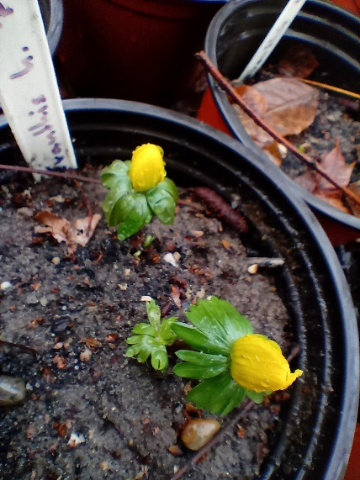
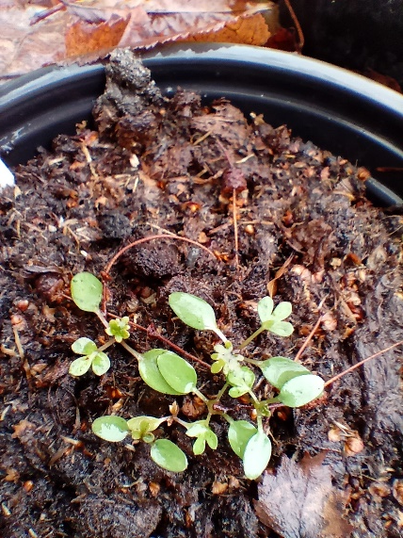
Conclusion
The experiment confirmed our hypotheses. ☺
As a result of increasing temperature, we can count on earlier onset and end of flowering.
Excess heat in urban environments can serve as model of ongoing and upcoming global warming.

Slide 16
Aknowledgement
Sütöriné Dr. Diószegi Magdolna – Budai Arb.
University Botanical Garden of Gödöllő
ELTE Botanical Garden, Füvészkert
Beretvás Kertészet Ltd.
ÚNKP Scholarship

Slide 17
References
Eppich, Boglárka & Dede, Lilla & Ferenczy, Antal & Ágnes, Garamvölgyi & Horváth, Levente & Isépy, István & PRISZTER, SZ & Hufnagel, Levente. (2009). Climatic effects on the phenology of geophytes. Applied Ecology and Environmental Research. 7. 253-266.
Hunkár, Márta & Vincze, Eniko & Szenyan, Ildiko & Dunkel, Zoltán. (2012). Application of phenological observations in agrometeorological models and climate change research. Idojaras. 116. 195-209.
Lehoczky A., Szabó B., Pongrácz R., Szentkirályi, F. (2016) Testing plant phenophase as proxy: sensitivity analysis of first flowering data from the 19th century, ALÖKI Applied Ecological Research and Forensic Institute Ltd.
Leifang Li, Renyu Cao, Kecheng Wei, Wenzhuo Wang, Lei Chen (2019) Adapting climate change challenge: A new vulnerability assessment framework from the global perspective, Journal of Cleaner Production, Volume 217, Pages 216-224, ISSN 0959-6526,
Menzel A, Fabian P (1999) Growing season extended in Europe. Nature 397:659
Menzel, Annette. (2000). Trends in phenological phases in Europe between 1951 and 1996. International journal of biometeorology. 44. 76-81. https://doi.org/10.1007/s004840000054.
Neil, K., Wu, J. Effects of urbanization on plant flowering phenology: A review. Urban Ecosyst 9, 243–257 (2006).
Primack R.B. (1985) Patterns of Flowering Phenology in Communities, Populations, Individuals, and Single Flowers. In: White J. (eds) The Population Structure of Vegetation. Handbook of Vegetation Science, vol 3. Springer, Dordrecht.
Szabó, B., Vincze, E. & Czúcz, B. (2016) Flowering phenological changes in relation to climate change in Hungary. Int J Biometeorol 60, 1347–1356.
Walkovszky A (1998) Changes in phenology of the locust tree (Robinia pseudoacacia L.) in Hungary. Int J Biometeorol 41:155–160

Slide 18
Thank you for your attention!

