Slide 1
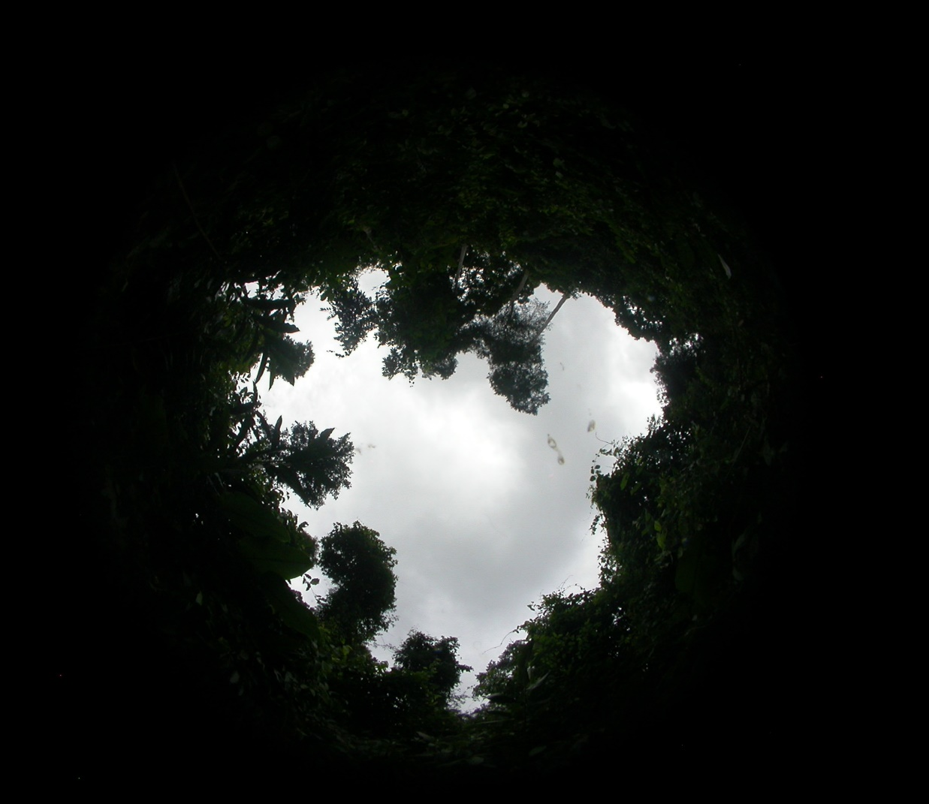
Impact of canopy gap ecology on the diversity and dynamics of natural regeneration in a tropical moist semi-deciduous forest, Ghana.
By
Maame Esi Hammond* and Radek Pokorný
Department of Silviculture, Faculty of Forestry and Wood Technology, Mendel University in Brno, Czech Republic

Slide 2
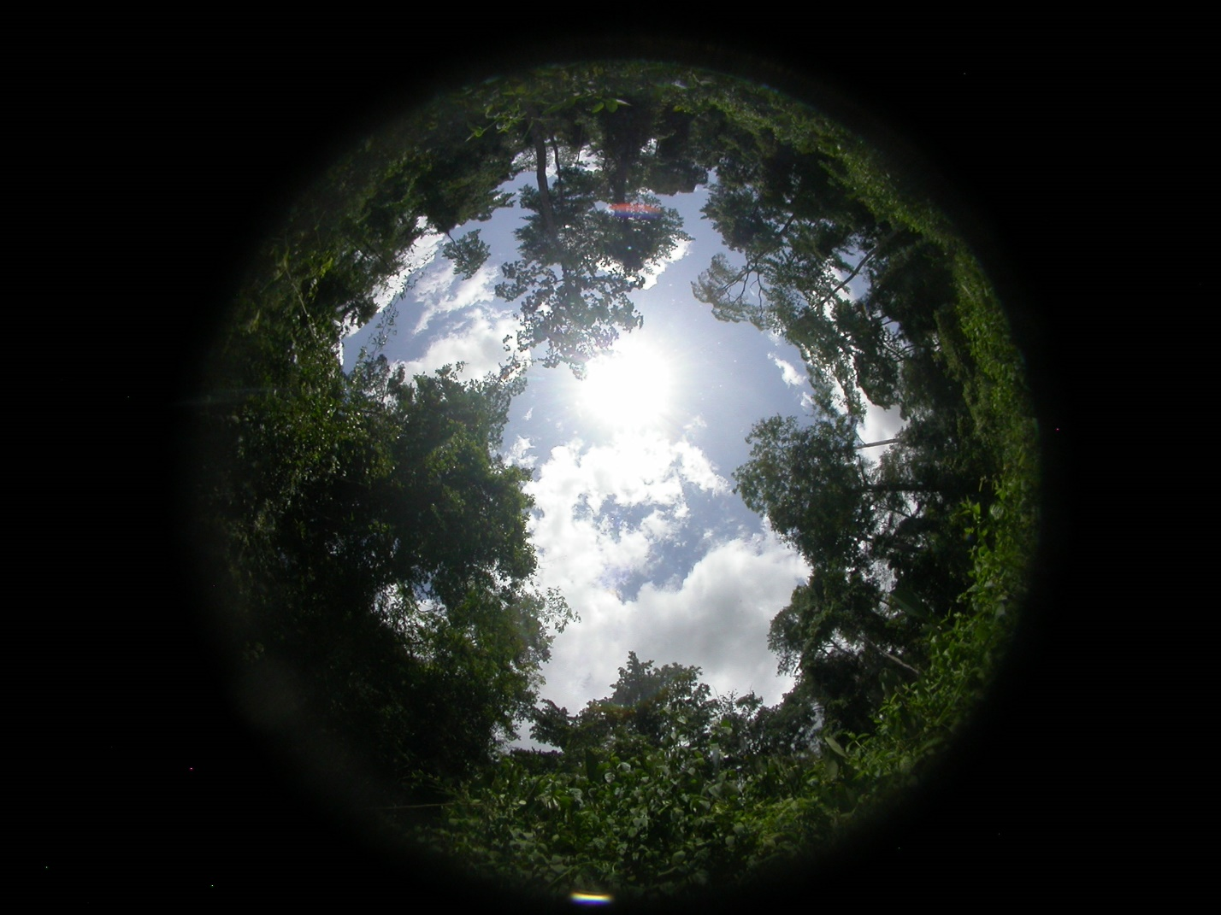
INTRODUCTION
Canopy gaps are indispensable growing sites for the sustainable succession of different natural regeneration tree species.
However, the role of gap size on ecological regeneration dynamics of natural regeneration has so far received little attention.
Study Objectives
To evaluate species diversity of natural regeneration tree species in gaps of different sizes.
To evaluate regeneration dynamics between different naturally regenerated tree species in gaps of different sizes.
To evaluate growth dynamics among different naturally regenerated tree species in gaps of different sizes.

Slide 3
METHODS
Study Area
Bia Tano forest reserve, a tropical moist semi-deciduous forest in Ghana.
Study Gaps
Twenty-three randomly selected gaps categorized as small (n = 2; ≤ 300 m²), medium (n = 7; 301 – 1000 m²), large (n = 11; 1001 – 2000 m²) and very large (n = 3; > 2000 m²) sizes were defined.
Data Collection
Forty-one subsampling circular 1 m² plots at 2 m intervals were delineated within each gap. Natural regeneration tree species with height 0 – 350 cm and diameter 0 – 100 mm were surveyed.
Data Analysis
ANOVA and post hoc Tukey’s HSD test were carried out to show significance of means at p < 0.05 level using STATISTICA (13.4.0.14).

Slide 4
RESULTS & DISCUSSION
Effects of Canopy Gap Ecology on Species Diversity
85 species from 25 families and 65 genera were enumerated in the study.
As revealed by all estimated diversity indices, there were overall significant improvements of species diversity of gap regeneration.
Nonetheless, biodiversity did not vary greatly from gap to gap.

Slide 5
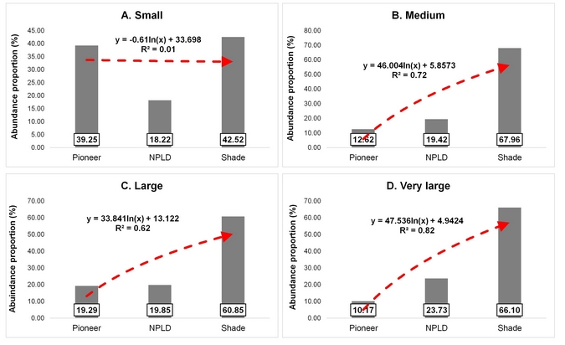
RESULTS & DISCUSSION cont’d
Evaluation of Regeneration Shift between Pioneers and Shade-tolerant species
Figure 1: Ecological regeneration shift of Pioneer-Pioneers, NPLD—Non-pioneer light-demanding species and Shade—Shade-tolerant tree species in small (n =2); medium (n = 7); large (n= 11) and very large (n=3) gaps.

Slide 6
RESULTS & DISCUSSION cont’d
Effects of Canopy Gap Ecology on Diameter Growth Dynamics
Figure 2: Multiple comparison of diameter growth of different naturally regenerated tree species in small (n =2); medium (n = 7); large (n= 11) and very large (n=3) gaps.

Slide 7
RESULTS & DISCUSSION cont’d
Effects of Canopy Gap Ecology on Height Growth Dynamics
Figure 3: Multiple comparison of height growth of different naturally regenerated tree species in small (n =2); medium (n = 7); large (n= 11) and very large (n=3) gaps.

Slide 8
CONCLUSIONS
Gap size was not a significant factor in improved species diversity of naturally regenerated tree species in gaps. However, regeneration dynamics differed significantly among gap sizes.
Conclusively, the present study demonstrates some beneficial effects of canopy gap ecology on the diversity and dynamics of natural regeneration in a moist tropical forest and adds a valuable contribution to tropical forestry, especially in Ghana and tropical African regions.
Thank you !

Slide 9
Acknowledgements
We are profoundly grateful to the Internal Grant Agency of Mendel University in Brno (LDF_VP_2019015) and the Framework of Bilateral Mobility Program for Traineeship of Doctoral Students, MENDELU for funding this research.
Department of Silviculture, Faculty of Forestry and Wood Technology, Mendel University in Brno, Czech Republic.

