Slide 1
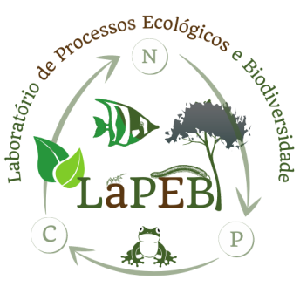
Title of the Presentation
THE ENVIRONMENTAL CONTEXT AS A DRIVER FOR DIVERSITY EFFECTS ON LITTER DECOMPOSITION
André Belo ^{1*}, Mery Alencar ², Adriano Caliman³, and Adriano Mota⁴
^{1*}Universidade Federal do Rio Grande do Norte, Natal. andreyurispb@gmail.com
²Universidade Federal do Rio Grande do Norte, Natal. alencarmery@gmail.com
³Universidade Federal do Rio Grande do Norte, Natal. caliman21@gmail.com
⁴Universidade Federal do Rio Grande do Norte, Natal. adrianosoaresmota@gmail.com
*Correspondence: andreyurispb@gmail.com; Tel.: +55-084-98833-7954

Slide 2
THE ENVIRONMENTAL CONTEXT AS A DRIVER FOR DIVERSITY EFFECTS ON LITTER DECOMPOSITION
Abstract: Studies from the past two decades indicate the important role of functional diversity and litter identity as a determining factor in decomposition. So far, researchers have search to understand the effects of litter diversity in opposite environmental contexts, in which the abiotic pathway prevails over the biotic pathway. We search to test the effects of the functional diversity of litter on decomposition in sites under vegetation (i.e., more favorable to biological decomposition), and in sites exposed to the sun (i. e., more favorable to photodegradation), prioritizing the litter functional diversity. We used an experimental approach in situ with litterbags in two different environmental contexts in a rainforest in RN, Brazil. We used four species with different specific leaf areas (SLA) and put in mono and bicultures, totaling 120 litterbags, placing 60 of them in the most exposed to the sun and the rest in the shaded environment. We observed that the decomposition rate in habitats with greater exposure to photodegradation was on average 34% higher than that observed in habitats with vegetation. There were also effects of diversity in some treatments, indicating the effect of functional identity, in which combinations of litter leaf with greater differences in SLA values (i. e., discrepant bicultures) showed a slower decomposition in bicultures than in the corresponding monocultures. With the predictions of climate change, regions such as rainforest can become increasingly arid, so our work suggests that in these environments the high rate of photodegradation can accelerate the decomposition of the litter with high SLA.
Keywords: Specific Leaf Area (SLA); photodegradation; functional diversity; functional identity; litter decomposition.

Slide 3
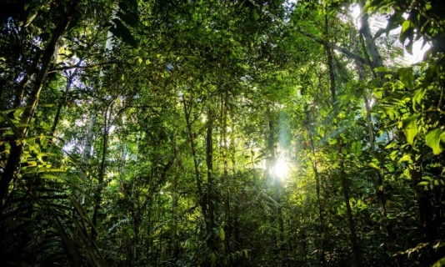
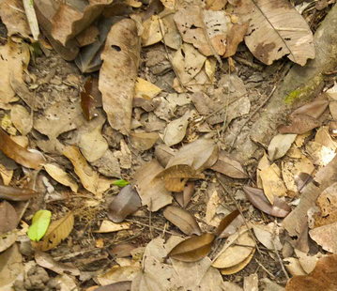
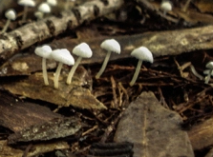
Introduction
The litter decomposition process is the mechanism by which nutrients and carbon return from dead organic matter (MOM) to the environment (Schlesinger and Andrews 2000, Schmidt et al. 2011).
CARBON
NITROGEN
PHOSPORUS

Slide 4
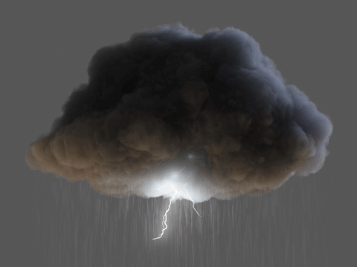
Introduction
Factors that affect the litter diversity on decomposition:
ABIOTIC FACTORS
Moisture
Solar radiation
Soil fertility
Temperature
(King et al. 2012, Huang et al. 2017)
BIOTIC FACTORS
Diversity and abundance of decomposers.
Physical structure and chemical quality of litter
(Gartner & Cardon 2004)
C:P:N
C:P:N

Slide 5
Introduction
The positive effects on the litter decomposition can be generated by the functional diversity (i.e., functional dissimilarity) of the litter itself (Gartner and Cardon 2012). However, in many cases, the magnitude and direction of non-additive effects that occur in a given litter mixture can vary according to the environmental context (Cardinale et al. 2008, García-Palacios et al. 2016).

Slide 6
Introduction
Aim: Test whether and how the effects of litter diversity vary in magnitude and direction, between opposite environmental contexts concerning the importance of photodegradation and biological decomposition of the litter.
Hypothesis: the effects of the functional litter diversity to vary between the environmental contexts studied and tend to increase the decomposition synergistically in environments where there is greater favoring the decomposition via biotic mechanisms (i.e. area under vegetation).

Slide 7
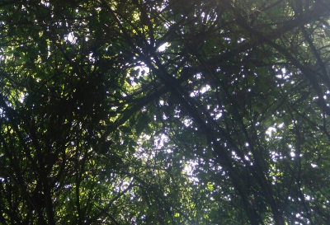
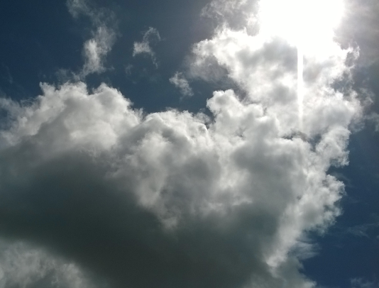
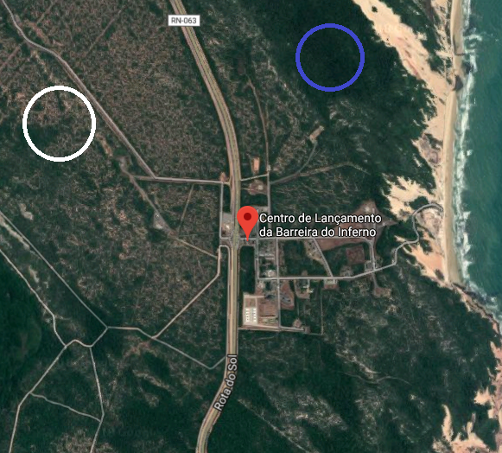
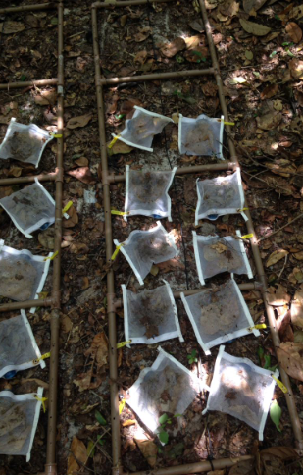
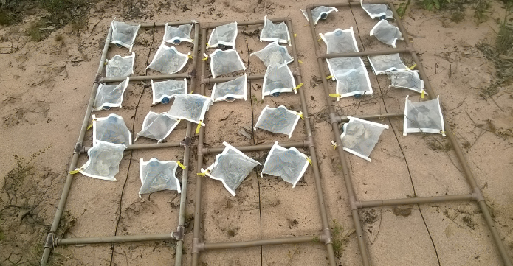
Materials and Methods
The study was carried out in a sandbank ecosystem, located at the Barreira do Inferno Launch Center (CLBI), in RN-BRAZIL. The place is characterized by a tropical climate with prolonged periods of dry seasons (Peel et al. 2007), with an average annual temperature of 26 ° C and an average annual rainfall of 1746 mm (Silva et al. 2015). The place has typical Restinga vegetation, most of which is represented by shrub-tree vegetation (Oliveira Filho, 2009). The experiment was carried out in both regions (i.e. under vegetation and exposed to solar radiation).
Barreira do Inferno Launch Center (CLBI), in RN-BRAZIL

Slide 8
Materials and Methods
The experiment was carried out with senescent leaves of the species Sterculia chicha (Sc), Ficus benjamina (Fb), Erythrina velutina (Ev), and Bauhinia forficata (Bf) that were collected six months before implementing the experiment. The species chosen have a wide difference in their SLAs (Specific Leaf Area), such as 62.0 cm2 / g, 79.5 cm2 / g, 178.4 cm2 / g, and 328.3 cm2 / g for the Sc, Fb, Ev, and Bf species, respectively. The collected leaves were stored in paper bags and dried in an oven at 40ºC for 72 hours, and then they were stored in black plastic bags and sealed. The experiment consisted of 10 treatments, divided into 4 monocultures (ie debris of each species individually) and 6 bi-cultures (ie pairs formed by all possible combinations between the four species used), with each treatment replicated 6 times in each environmental context, thus totaling 120 literbags. We used only two levels of species richness in the experiment due to the fact that combinations between pairs of species allow us to calculate the greatest range of functional dissimilarity among a given set of species (Barantal et al. 2011). The litterbag has a mash thickness of 5 mm opening and an area of ​​0.04 m2 - 0.2m x 0.2m, and received 4g of debris in monocultures and 2g for each species in biocultures

Slide 9
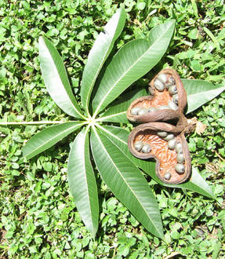
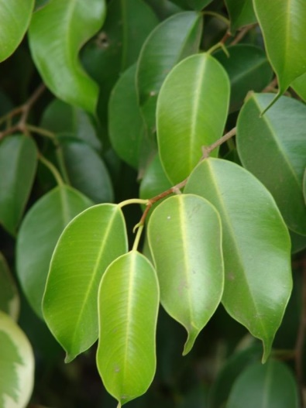
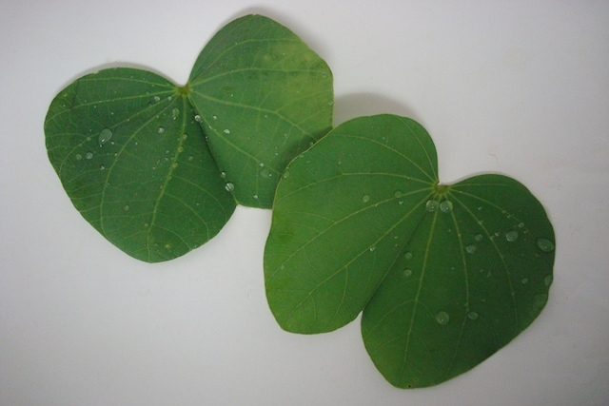
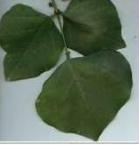
Materials and Methods
SLA
SLA
Sterculia chicha (Sc)
AFE = 62,0 cm2/g
Ficus benjamina (Fb)
AFE = 79,5 cm2/g
SLA
SLA
Bauhinia forficata (Bf)
AFE = 178,4 cm2/g
Erythrina velutina (Ev)
AFE = 328,3 cm2/g

Slide 10
Materials and Methods
To quantify the non-additive effects of debris mixtures, in both experiments the Relative Mixture Effect (ERM) was calculated:
ERM (%) = ((Esp – Obs) / (Esp)) × 100
Two-way ANOVA was used to test the individual and interactive effects of the litter diversity, and the environmental context on the decomposition, both at the level of the mixture and in species-specific.
Linear regressions were used to assess the non-additive effects of the functional dissimilarity of the detritus on the decomposition,

Slide 11
Results and Discussion
Decomposition rate was higher in the sunny than in the shaded environment, due to the wide uptake of UV rays that plants with high SLA may have. The species that was most affected by the rate of decomposition in the shaded environment was Bf, followed by Ev, Fb and Sc. There was an effect of antagonistic non-additive functional identity in the species between higher and lower SLA, due to a possible shading effect and overlapping of the debris of smaller SLA over those of higher SLA.
Conclusions
Our work shows that in tropical forests photodegradation can play an equally important role as biotic factors, in terms of influencing the magnitude of the effects of the diversity of debris. Species with different SLA’s can interact in ways that delay decomposition if the environment has a strong abiotic rather than biotic influence.

Slide 12
Acknowledgments
I thank the Federal University of Rio Grande do Norte (UFRN), for financing my project. To my professor Adriano Caliman, and the laboratory companions, for having helped me in the field and research development stages.

