Slide 1
Title of the Presentation
Paweł K. Bereś ¹, Patrycja Ziętara ², Mirosław Nakonieczny ^{2,*}, Łukasz Kontowski ³, Michał Grzbiela ⁴, Maria Augustyniak ²
¹ Institute of Plant Protection - NRI, Regional Experimental Station in Rzeszów, ul. Langiewicza 28, PL 35-101 Rzeszów, Poland; p.beres@iorpib.poznan.pl
² University of Silesia in Katowice, Faculty of Natural Sciences, Institute of Biology, Biotechnology and Environmental Protection; ul. Bankowa 9, PL 40-007 Katowice, Poland; patrycja.zietara1997@gmail.com; miroslaw.nakonieczny@us.edu.pl; maria.augustyniak@us.edu.pl
³ Agricultural holding in Szałkowo, ul. Szałkowo 36A, PL 14-200 Iława, Poland; lukaszkont@wp.pl
⁴ United Phosphorus Limited, ul. Stawki 40, PL 01-040 Warszawa, Poland; michal.grzbiela@onet.eu
* Corresponding author: miroslaw.nakonieczny@us.edu.pl

Slide 2
Abstract:
The box tree moth (Cydalima perspectalis Walker; Lepidoptera, Crambidae) origins from East Asia. In Europe, it was recorded for the first time in 2007 in south-western Germany, Switzerland and the Netherlands, where probably arrived with boxwood bushes (Buxus spp.) imported from China.
In Poland, C. perspectalis was found for the first time in 2012 in the south-western part of the country. From 2015, it was recorded in subsequent provinces of southern Poland and a year later in the east. In 2017 it appeared in the central part of the country. By the end of 2020, C. perspectalis was found all over Poland. As it is not a quarantine pest in the European Union, it is not subject to official monitoring in Poland. Hence the lack of official information on the range of occurrence in the country.
The studies conducted in 2018-2020 determined the current range of C. perspectalis occurrence in Poland, along with the selection of places with the highest intensity of occurrence. The caterpillars are most harmful in Poland's southern and central part, causing total plant defoliation. Without encountering any natural enemies, it quickly became an invasive alien species that threaten plants of the genus Buxus, both wild and cultured.
Keywords:
Poland; Europe; Cydalima perspectalis; box tree moth; invasive species

Slide 3
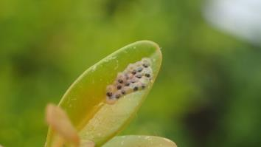
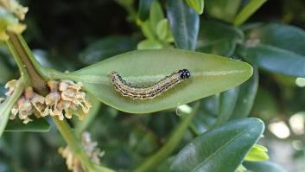
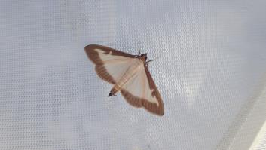
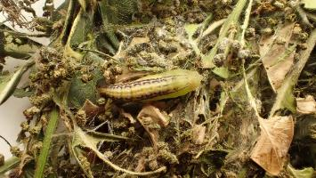
Introduction
Cydalima perspectalis – life cycle
Egg cluster
Caterpillar
Moth
Pupa
Photo: P. Bereś
At least two generations in Poland; possible third generation.

Slide 4
Introduction
Cydalima perspectalis – short description
In Europe, Cydalima perspectalis:
develops two or three generations;
occurs in box trees all year round;
it comes in two colour forms of butterflies: light (dominant) and dark;
can feed on substitute plants, mainly of the genus Euonymus sp.;
has no effective natural enemies;
does not damage all species of boxwood to the same degree;
has no selective chemical or biological agents dedicated to controling it;
is not monitored, which makes it difficult to determine the optimal date of controling it;
due to the 2-3 generations per year, requires several chemical treatments per year, which increases the risk of the pest becoming resistant to the active substances used.
Pupa

Slide 5
Introduction
Cydalima perspectalis in Europe.
CLIMEX map of predicted distribution and relative abundance (Ecoclimatic Index) of Cydalima perspectalis in Europe.
Triangles represent the
published distribution of Cydalima perspectalis in Europe in 2012. In heavily infested areas, triangles may represent several notifications.
Nacambo et al., 2013
Nacambo et al., 2013

Slide 6
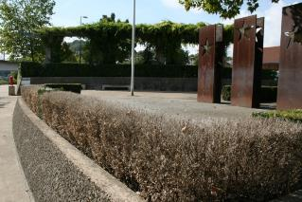
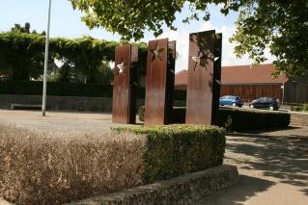
Introduction
Cydalima perspectalis in Europe – an underestimated problem
"Motion for a European Parliament resolution on the box tree moth (Cydalima perspectalis)", which encourages the Commission to:
• recognize the box tree moth as a harmful organism under Directive 2000/29/EC;
• support research into biological controls for the box tree moth through existing funding programs;
• promote joint monitoring of the box tree moth by the competent European authorities.
D’Ornano et al., 2016; MOTION FOR A RESOLUTION B8-1209/2016
Photo: M. Nakonieczny
Twist of fate – a boxwood hedge in front of the European Museum in Schengen, damaged by a East Asian invasive box tree moth.

Slide 7
Marterials and Methods
The period of data collection: April 2018 - November 2020.
Area covered by the dataset: all of Poland.
Data collection method: field visits and e-mail submissions from gardeners and plant breeders.
Method of confirming records: field visits, photos, e-mail addresses and correspondences, social media (Facebook, Instagram).
Place of data submission: "Allotment and Garden Our Passion" website: www.dionp.pl

Slide 8
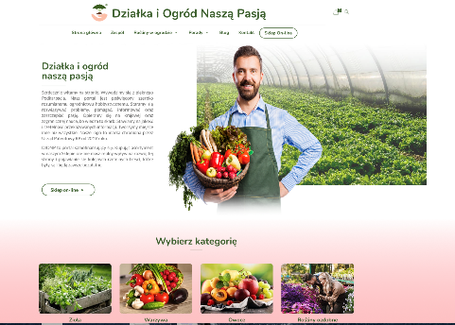
Materials and Methods
How did we collect the data?
Allotment and Garden Our Passion
Contact
Select a category
Social media: Facebook, Instagram
Professional gardener

Slide 9
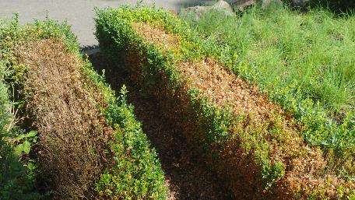
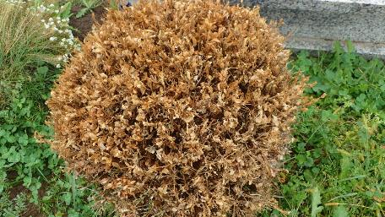
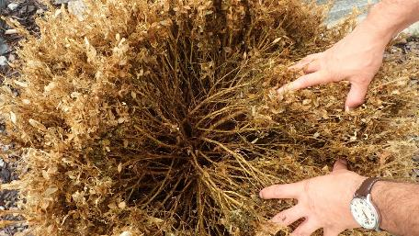
Materials and Methods
1
2
Photo: P. Bereś
The photographs show the boxwood bushes damaged by C. perspectalis as part of the control of reported pest records.
1 – Locality: Rzeszów (July 2018)
2 – Locality: Trzebownisko (September 2020)
3 – Locality: Trzebownisko (September 2020)
3

Slide 10
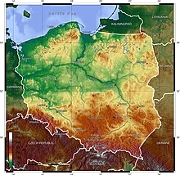
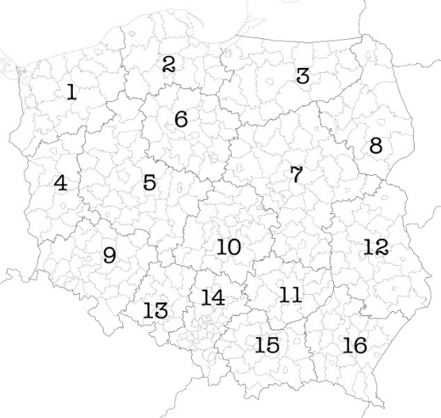
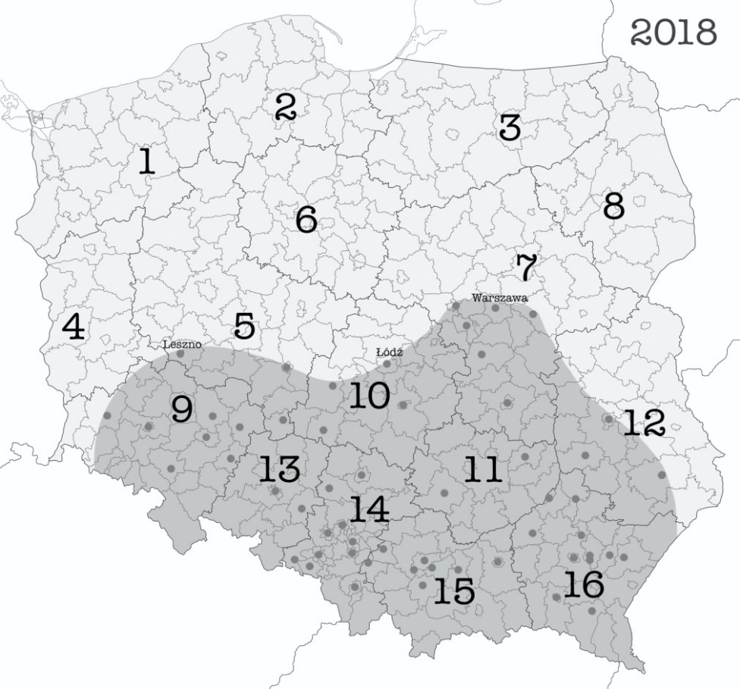
Results and Discussion
www.wikipedia.pl
Topographic map of Poland
Administrative divisions of Poland
Number | Voivodeship (PL) | Voivodeship (ENG)
1 | zachodniopomorskie | West Pomeranian
2 | pomorskie | Pomeranian
3 | warmińsko-mazurskie | Warmian-Masurian
4 | lubuskie | Lubusz
5 | wielkopolskie | Greater Poland
6 | kujawsko-pomorskie | Kuyavian-Pomeranian
7 | mazowieckie | Masovian
8 | podlaskie | Podlaskie
9 | dolnośląskie | Lower Silesian
10 | łódzkie | Łódź
11 | świętokrzyskie | Holy Cross
12 | lubelskie | Lublin
13 | opolskie | Opole
14 | śląskie | Silesian
15 | małopolskie | Lesser Poland
16 | podkarpackie | Subcarpathian
Distribution of Cydalima perspectalis in Poland in 2018, according to data obtained as part of social monitoring.

Slide 11
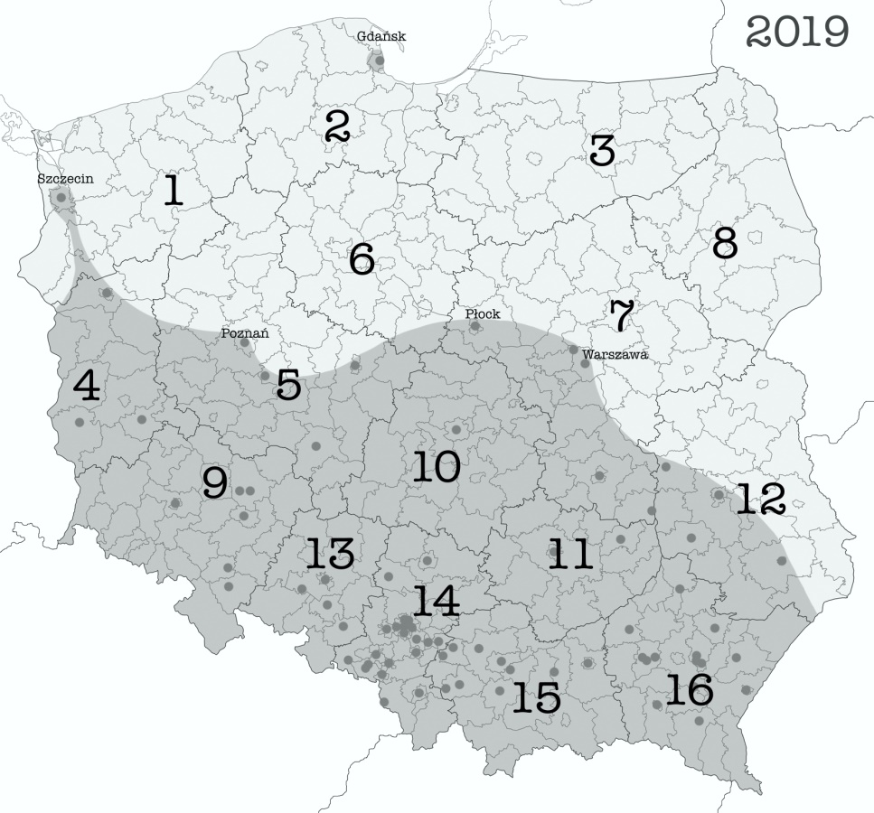
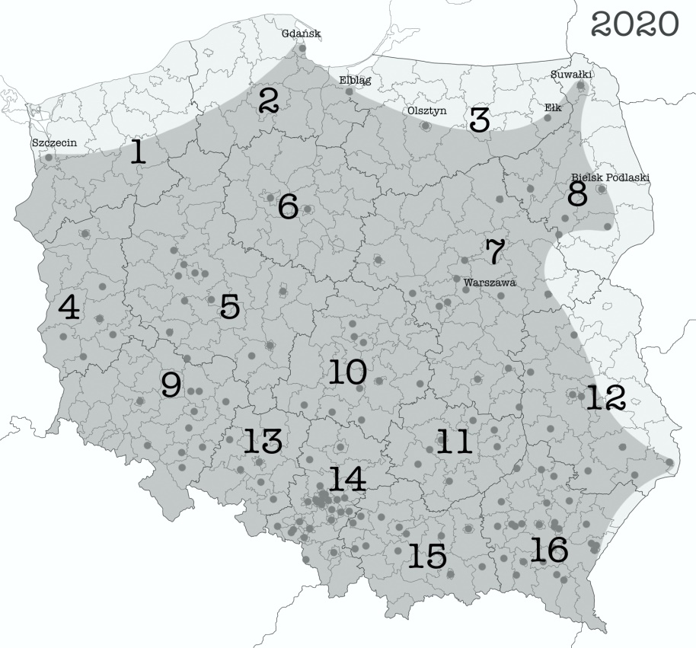
Results and Discussion
?
?
The number of confirmed records: 674 (2018-2020).​
Number of voivodships where the presence of C. perspectalis has been confirmed: 16 (all voivodeships).
Number of places (towns) where the presence of C. perspectalis has been confirmed: 166.​

Slide 12
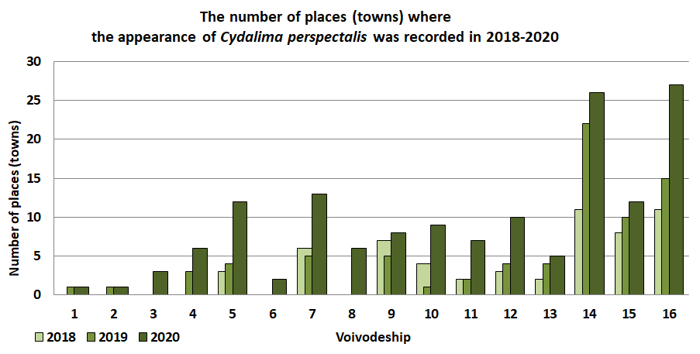
Results and Discussion
Number | Voivodeship (PL) | Voivodeship (ENG)
1 | zachodniopomorskie | West Pomeranian
2 | pomorskie | Pomeranian
3 | warmińsko-mazurskie | Warmian-Masurian
4 | lubuskie | Lubusz
5 | wielkopolskie | Greater Poland
6 | kujawsko-pomorskie | Kuyavian-Pomeranian
7 | mazowieckie | Masovian
8 | podlaskie | Podlaskie
Number | Voivodeship (PL) | Voivodeship (ENG)
9 | dolnośląskie | Lower Silesian
10 | łódzkie | Łódź
11 | świętokrzyskie | Holy Cross
12 | lubelskie | Lublin
13 | opolskie | Opole
14 | śląskie | Silesian
15 | małopolskie | Lesser Poland
16 | podkarpackie | Subcarpathian

Slide 13
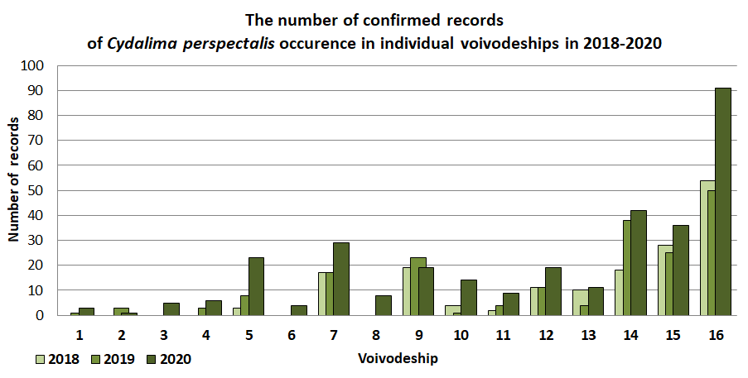
Results and Discussion
Number | Voivodeship (PL) | Voivodeship (ENG)
1 | zachodniopomorskie | West Pomeranian
2 | pomorskie | Pomeranian
3 | warmińsko-mazurskie | Warmian-Masurian
4 | lubuskie | Lubusz
5 | wielkopolskie | Greater Poland
6 | kujawsko-pomorskie | Kuyavian-Pomeranian
7 | mazowieckie | Masovian
8 | podlaskie | Podlaskie
Number | Voivodeship (PL) | Voivodeship (ENG)
9 | dolnośląskie | Lower Silesian
10 | łódzkie | Łódź
11 | świętokrzyskie | Holy Cross
12 | lubelskie | Lublin
13 | opolskie | Opole
14 | śląskie | Silesian
15 | małopolskie | Lesser Poland
16 | podkarpackie | Subcarpathian

Slide 14
Results and Discussion
The calculated rate of confirmed records per million inhabitants of the voivodeship for 2020 year would indicate that the population of C. perspectalis is over two times more numerous in the south than in the north part of Poland.
Note: The high rate for the Podkarpackie Voivodeship results from the website's local impact on the inhabitants, whose seat is in Rzeszów.
Number | Voivodeship (PL) | Voivodeship (ENG)
1 | zachodniopomorskie | West Pomeranian
2 | pomorskie | Pomeranian
3 | warmińsko-mazurskie | Warmian-Masurian
4 | lubuskie | Lubusz
5 | wielkopolskie | Greater Poland
6 | kujawsko-pomorskie | Kuyavian-Pomeranian
7 | mazowieckie | Masovian
8 | podlaskie | Podlaskie
Number | Voivodeship (PL) | Voivodeship (ENG)
9 | dolnośląskie | Lower Silesian
10 | łódzkie | Łódź
11 | świętokrzyskie | Holy Cross
12 | lubelskie | Lublin
13 | opolskie | Opole
14 | śląskie | Silesian
15 | małopolskie | Lesser Poland
16 | podkarpackie | Subcarpathian

Slide 15
Results and Discussion
Discussion 1
Since the appearance of the pest in Poland in 2012 in the south-western part of the country, the direction of its further spread has not been investigated.
Comparisons from 2012-2017 indicated the presence of C. perspectalis only in a few localities in southern and south-eastern Poland. Such localities mean the migration of the species from the west to the south-east.
Own observations of 2018 years have shown that the species' population is more severe than the literature indicates. The pest was already common in southern Poland and also reached the central part of the country. Thus, the range of its migration assumed the northern direction, extending to the east and west of the country.

Slide 16
Results and Discussion
Discussion 2
In 2019-2020, C. perspectalis rapidly increased its range in Poland, especially in its central and northern parts. It has also significantly shifted its range towards the eastern border, mainly with Ukraine and Belarus.
In 2019, the pest appeared near the Baltic Sea (Gdańsk, Szczecin). It is debatable whether it reached the area by sea or by land.
The greatest number of localities occupied by the box tree moth was found in southern Poland. It is also here that the most damaged boxwood plants as a result of caterpillars feeding were observed.
On the basis of the obtained data, it should be stated that the population of the box tree moth is at least twice as numerous in the south of Poland as in the areas of central Poland.

Slide 17
Results and Discussion
Discussion 3
Based on the collected biomonitoring records, it can be concluded that in Poland, Cydalima perspectalis:
occurs in box trees all year round;
develops two generations and in warm and dry years, it develops three;
occurs in the dominant light form;
has no effective natural enemies;
feeds mainly on box trees, but few substitute plants have been detected: spindles: (Euonymus alata, E. japonicus), holly (Ilex purpurea), cotoneaster (Cotoneaster sp.), cherry laurel (Prunus laurocerasus). In 2020, single caterpillars were recorded on birches (Betula sp.) and willows (Salix sp.).

Slide 18
Conclusions
The collected data indicate that the box tree moth (Cydalima perspectalis) from its first discovery in 2012 in Poland in 2020 took over its entire area.
The greatest threat to boxwood is in southern and central Poland.
The lack of a countrywide monitoring system for C. perspectalis makes it challenging to control its spread.
The lack of a nationwide counselling system makes it challenging to control C. perspectalis, especially in areas where it appears for the first time.
The developed coverage maps, together with the data on recording the presence of C. perspectalis allow gardeners and plant breeders to analyze the situation on an ongoing basis and undertake adequate methods of control and eradication.

Slide 19
Supplementary Materials
https://www.dionp.pl
https://www.iop.krakow.pl/ias/species/1717
https://gd.eppo.int/reporting/article-1295
https://ebts.org/
SCAN ME

Slide 20
Acknowledgments
Special thanks to the owner of gardening website "Allotment and Garden Our Passion (DIONP)", Mrs Beata Bereś
Thanks Mr. Tomasz Konefał from the Main Inspectorate of Plant Health and Seed Inspection in Toruń
Contractor and project partners:

