Slide 1
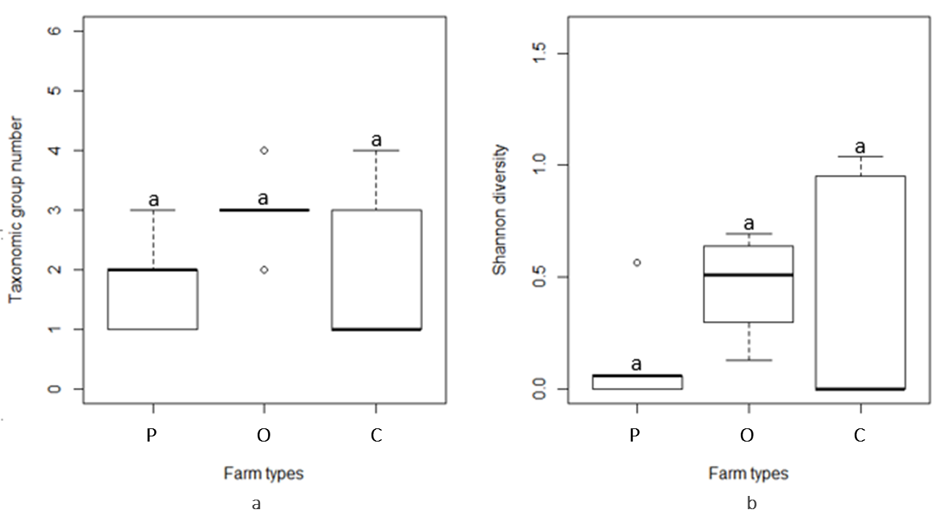
Pollinator communities in some selected hungarian conventional, organic and permaculture horticultures Alfréd Szilágyi*, Fanni Mészáros, Róbert Kun and Miklós Sárospataki
Introduction
Increasing agricultural intensification→ decreasing biodiversity
Habitat fragmentation, farming practices→ serious decline in pollinator communities’ abundance, diversity
Pollination is essential → 75% of cultivated crops would drop
Objective → compare different farming systems (permaculture, organic and conventional farming) by pollinator communities
Methods
Site selection → similar size (0.3±3 hectares), agro-ecological features, horticultural production → 15 sites (conventional, organic, permaculture) in northern Hungary (Fig.1.)
Pollinators → transect sampling 0,5 hour duration/site, 3 times in 2020, 14 different taxonomic categories
Analyses→ Excel 2016, R 3.5.1.
Permaculture farm
Conventional farm
Organic farm
Figure 1. Location of the 15 study sites in northern Hungary (own editing)
Figure 4. Bombus terrestris feeding on Phacelia tanacetifolia (photo by Fanni Mészáros, 2020)
Figure 2. Pollinator taxonomic group number (a) and Shannon diversity (b) in the three studied farming system (P= permaculture, O= organic, C= conventional farms, n=5) in August, 2020.
Figure 5. (left) member of Halictidae family feeding on Picris hieracioides, Figure 6 (right) member of Syrphidae family feeding on Convolvulus arvensis (photos by Fanni Mészáros, 2020)
Figure 3. Total number of pollinators (a), frequency of Apidae pollinators (b), and number of Apis mellifera individuals (c) in the three studied farming system (P= permaculture, O= organic, C= conventional farms, n=5) in August, 2020.
Sampling date | May | May | May | July | July | July | August | August | August
Farming system | P | O | C | P | O | C | P | O | C
Taxon number (MEAN ± SD) | 4.40 ± 1.14 | 4.00 ± 1.22 | 2.40 ± 1.34 | 4.00 ± 1.22 | 4.20 ± 0.84 | 3.20 ± 1.10 | 1.80 ± 0.84 | 3.00 ± 0.71 | 2.00 ± 1.41
Shannon diversity (MEAN ± SD) | 0.85 ± 0.47 | 0.70 ± 0.32 | 0.58 ± 0.54 | 0.55 ± 0.28 | 0.68 ± 0.26 | 0.65 ± 0.28 | 0.14 ± 0.24 | 0.45 ± 0.24 | 0.40 ± 0.55
Figure 7. Oxythyrea funesta and Apis mellifera feeding on Onobrychis viciifolia (photo by Fanni Mészáros, 2020)
Table 1. Average Shannon diversity and taxon number of pollinators in the three studied farming systems with standard deviations during samplings in 2020 may, july and august (n=5). P=Permaculture farms, O=Organic farms, C=Conventional farms.
Results
The total number of pollinators were significantly higher in August in the permaculture and organic farms compared to the conventional (Figure 3a).
Apidae species (Figure 3b) and honey bees (Figure 3c) were significantly higher both in permaculture and organic farms compared to the conventional farms.
We did not find significant difference in the pollinator taxonomic group number nor in Shannon diversity in the three farming systems in neither of sampling times, figure 2 shows the results in August, 2020 (Figure 2 ab).
Shannon diversity index average was highest in permaculture farms in May, while in the organic farms in July and August, 2020. Average taxon number values showed the same trend (Table 1.).
Conclusion
Based on the pollinator abundance data we suggest that permaculture farms could provide favorable conditions for pollinators, specially for Apidae taxon.
We emphasize that besides ecological indicators and conditions we have to investigate the attitude of farmers as it determines farm management decisions.
Acknowledgement
We are grateful for the farmers who participated in this research. The research was supported by the ÚNKP-20-2-I New National Excellence Program of the Ministry for Innovation and Technology from the source of the National Research, Development and Innovation Fund.
*Environmental Sciences PhD School/Faculty of Environmental and Agricultural Sciences, Szent István University, Gödöllő, Hungary. For further info email szilagyialfred@gmail.com.

