Slide 1
Title of the Presentation
Mery Alencar^{1,}*, Ana Asato², and Adriano Caliman¹
¹ Laboratório de Processos Ecológicos e Biodiversidade, Departamento de Ecologia, Universidade Federal do Rio Grande do Norte, Natal, 59072-970, Brazil.
² German Centre for Integrative Biodiversity Research (iDiv) Halle-Jena-Leipzig, German.
* Corresponding author: merypynck@hotmail.com

Slide 2
Abstract: Organs and nutrient allocation are link the evolved strategies of plant species with their variations affecting the effects on ecosystems process. The differences in litter quality are important factors shaping the decomposition rate, although the works are centered in leaf litter quality. We to analyze the trait coordination and phylogenetic signal in leaf and flower litter for 29 species. We evaluated the decomposition rate and measured 13 functional traits. In addition, we estimated phylogenetic signal in litter decomposition rates for each litter type using Blomberg’s K. Flower litter had higher rates of decomposition, exhibited 11.81% mean remaining mass, while the leaf litter had 40%. The measured traits reflected a gradient from a conservative to acquisitive, but their prediction was dependent of each litter type. Despite, we found the un-coordination among flower and leaf litter and the absence of phylogenetic signal. In this work we were able to show that floral and leaf litter are uncoordinated and poorly correlated. Despite the lack of phylogenetic signal, we show that leaf litter is not a good predictor for the plant as a whole, so to better understand decomposition we need to take into account other compartments of variation, such as within-individual.
Keywords: non-additive, reproductive, evolution

Slide 3
Aim
We aim was to analyze the trait coordination in
leaf and flower litter and their consequences on decomposition
phylogenetically.
Photo: Mery Alencar

Slide 4
Hypothesis I
Flower litter, on average, will
presents a higher decomposition rate compared to the leaf litter
Photo: Mery Alencar

Slide 5
Hypothesis II
We will not be traits coordination between
floral and foliar litter
Photo: Mery Alencar

Slide 6
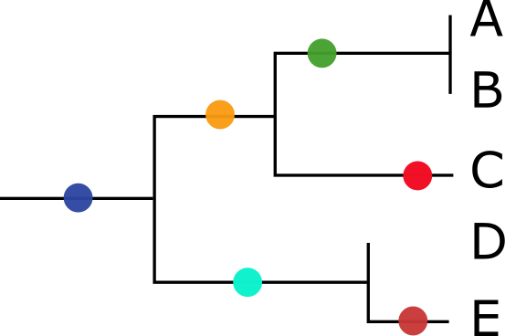
Hypothesis III
The phylogenetic history will affect the decomposition
rates through its influences on organ traits.
Photo: Mery Alencar
Image: Nextstrain

Slide 7
Remaining mass was lower in flower litter, thus, higher decomposition rates
11,81%
40%
t=-6.0143; p<0,0001

Slide 8
Higher decomposition rates in flower litter
Nutrients concentration
Water holding capacity
Lower reabsorption
Makkonen et al. 2012

Slide 9
Traits important for decomposition
Flower and leaf belong to the same physiological category, but they are functionally distinct organs.
Leaves present structural compounds such as lignin, cellulose, and complex compounds responsible for mechanical protection structuring.
While flowers are ephemeral organs with large concentrations of soluble compounds and carbohydrates, then higher water holding capacity

Slide 10
Lower reabsorption
During the senescence, the differences between these organs tend to increase, because the reabsorption of nutrients occurs strongly in the leaves, while the flowers seem to fall into the soil without any changes in chemical composition.
Some studies show the decomposers preference by flower litter.
Quiao et al. 2016
Schmitt and Perfecto, 2020
Whigham et al. 2013

Slide 11
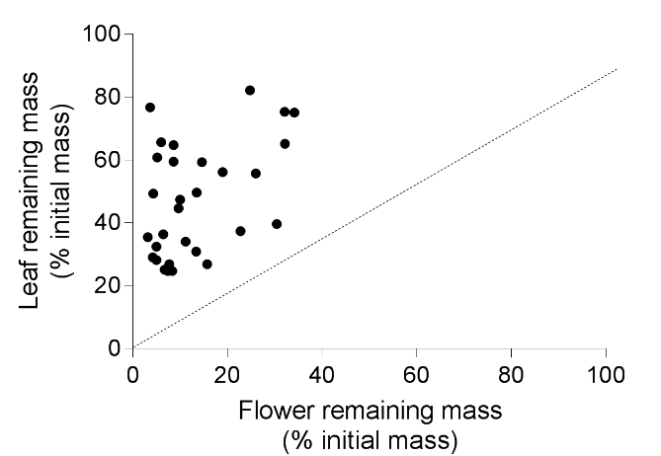
Coordination among litter type
We did not find a significant correlation among the remaining mass of the litter types.
R= 0.2843; p=0.1279

Slide 12
Uncoordination among flower and leaf litter
The differences in nutrients reabsorption among litter types explains the absence of coordination.

Slide 13
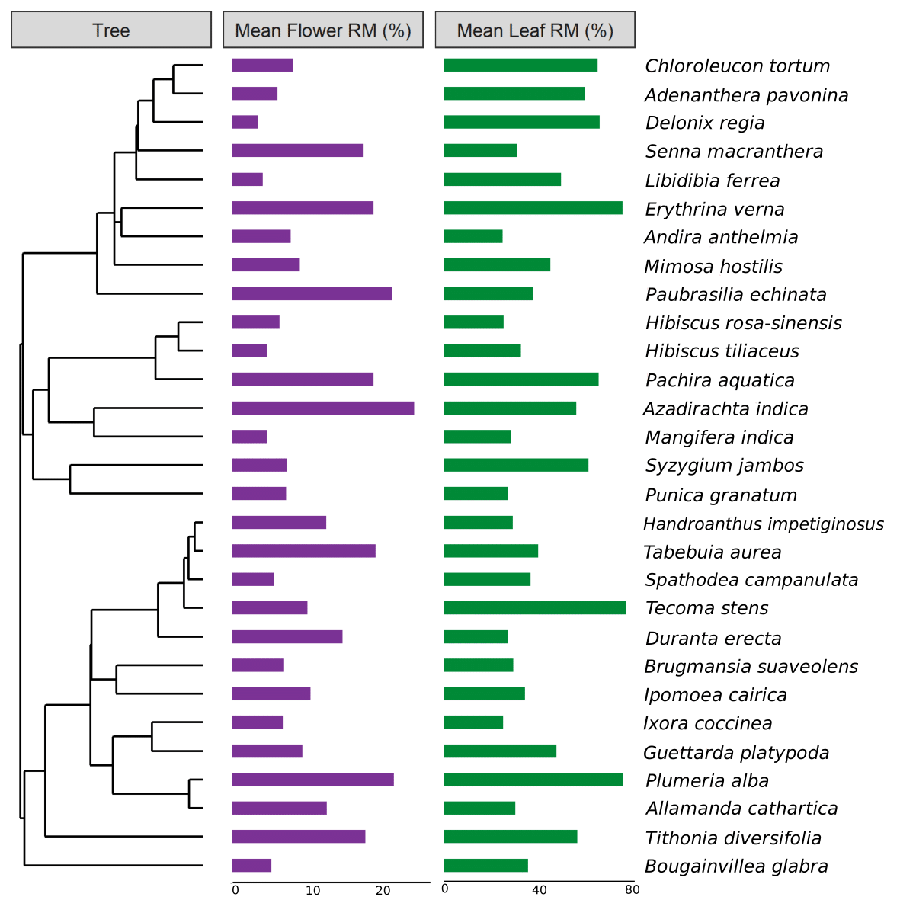
No phylogenetic signal
The phylogenetic patterns in decomposition rates were similar among the litter types, showed
low values of phylogenetic signal
leaves (K = ~ 0.26, p-value = 0.68)
flowers (K = 0.29, p-value = 0.53)

Slide 14
The absence of phylogenetic signal
A previously work that evaluated phylogenetic signal in leaf litter globally, find a relation among decomposition rate and species evolution¹.
Although they evaluated this effects on aquatic environment, thus the pattern could be different in terrestrial systems.
Also the context is important ecological processes, as decomposition, to use the common garden approach, we affected the decomposition rates of the species.
¹LeRoy et al. 2019
Pavoine et al. 2010

Slide 15
Conclusion
Despite the lack of phylogenetic signal, we show that leaf litter is not a good predictor for the plant as a whole, so to better understand decomposition we need to take into account other compartments of variation, such as within-individual.
Also, we need to expand the works with phylogenetic signal, and their to understand the possible predictions on ecological process.

Slide 16
Acknowledgments

