Slide 1
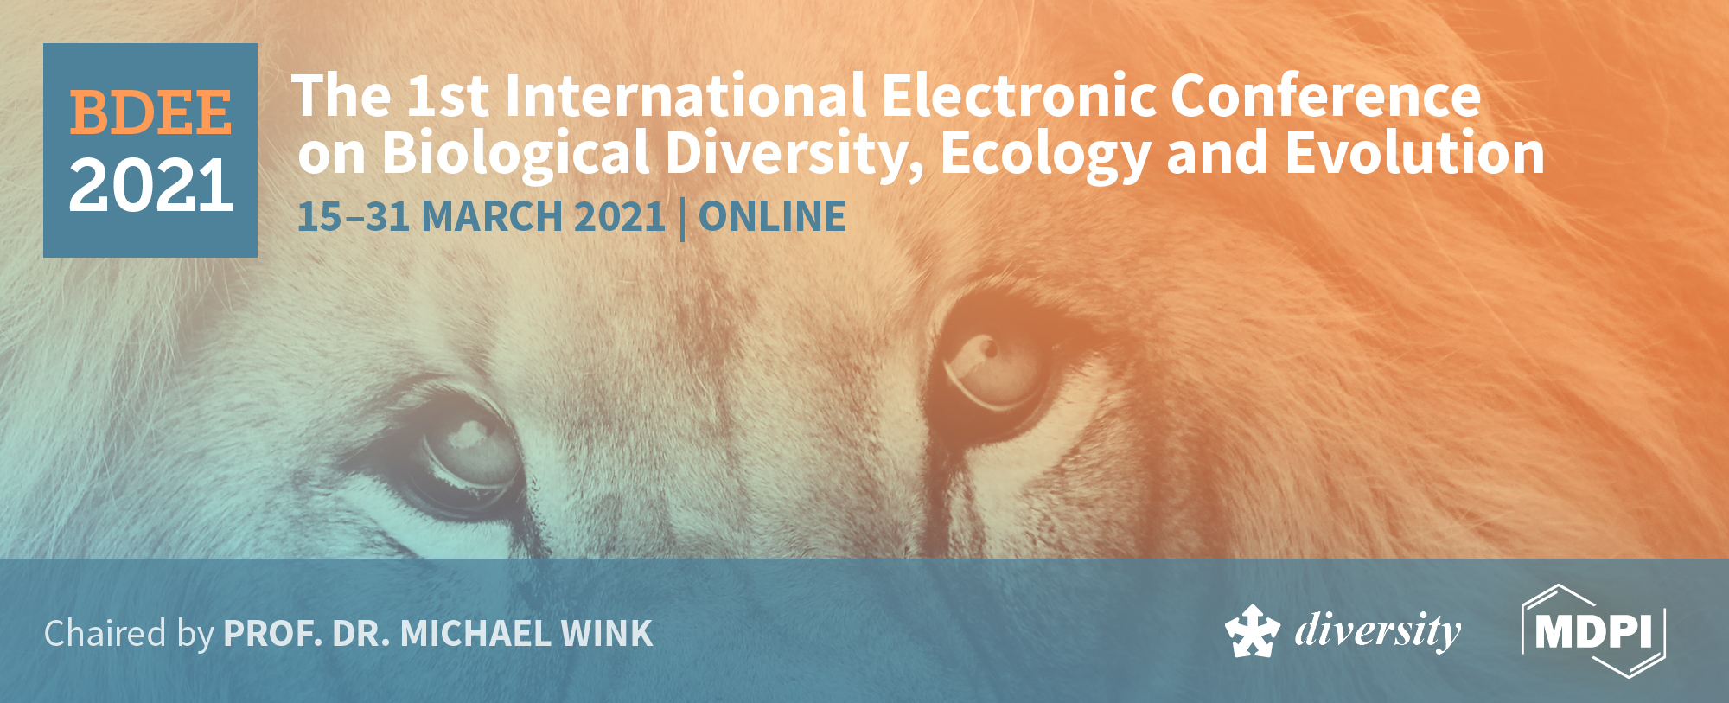
Integrative descriptions of three new tardigrade species along with the new
record of Mesobiotus skorackii Kaczmarek et al., 2018 from Canada
Pushpalata Kayastha¹*, Milena Roszkowska^{1,2}, Monika Mioduchowska^{3,4}, Magdalena Gawlak⁵, and Łukasz Kaczmarek¹
¹Department of Animal Taxonomy and Ecology, Adam Mickiewicz University in Poznań, Uniwersytetu Poznańskiego 6, 61-614 Poznań, Poland; pushpalata.kayastha@gmail.com, mil.roszkowska@gmail.com, kaczmar@amu.edu.pl
²Department of Bioenergetics, Faculty of Biology, Adam Mickiewicz University in Poznań, Uniwersytetu Poznańskiego 6, 61-614 Poznań, Poland
³Department of Genetics and Biosystematics, Faculty of Biology, University of Gdańsk, Wita Stwosza 59, 80-308 Gdańsk, Poland; e-mail: monika.mioduchowska@ug.edu.pl
⁴Department of Marine Plankton Research, Institute of Oceanography, University of Gdańsk, Marszałka Piłsudskiego 46, 81-378 Gdynia, Poland
⁵Institute of Plant Protection – National Research Institute, Władysława Węgorka 20, 60-318 Poznań, Poland, e-mail: m.gawlak@iorpib.poznan.pl
*Correspondence: pushpalata.kayastha@gmail.com

Slide 2
Abstract:
We describe three new tardigrade species from Canada, i.e., one representing Paramacrobiotus richtersi complex, the other Macrobiotus hufelandi complex and one belonging to the genus Bryodelphax. Integrative analysis is made based on morphological and morphometrical data (using both light and scanning electron microscopy (SEM)) combined with multilocus molecular data (nuclear sequences, i.e., 18S rRNA, 28S rRNA and ITS-2 as well as mitochondrial COI barcode sequences). Paramacrobiotus sp. nov. differs from most species of the genus by a different type of the oral cavity armature, details of egg morphology (number of areoles around egg processes and shape of egg processes) and some morphometric characters of adults (presence or absence of eyes, presence or absence of granulation on legs, dentate lunules under claws IV). Based on COI molecular data, Macrobiotus sp. nov. is most similar to Mac. canaricus Stec, Krzywański & Michalczyk, 2018 (p-distance 17%). Bryodelphax sp. nov. is most similar to Bry. parvulus Thulin, 1928 (p-distance 16%). Moreover, both species differs also from their congeners in some morphological and morphometrical characters of adults and/or details of eggs. Additionally, a large population of Mesobiotus skorackii Kaczmarek, Zawierucha, Buda, Stec, Gawlak, Michalczyk & Roszkowska, 2018 was found in Canada and this is the first report of this species outside terra typica in Kirghizia. The original description of this species was based solely on the morphology. Here we provide an updated description of the species by means of integrative taxonomy.
Keywords: DNA barcoding, Eutardigrada, Heterotardigrada, Tardigrada, Taxonomy, Water bears.

Slide 3
Results
Bryodelphax sp. nov.
DNA sequences
We obtained good quality sequences for the applied molecular markers:
18S rRNA: two sequences; 528 bp long;
28S rRNA: two seguences; 671 bp long;
COI: three sequences; 584-672 bp;
Based on COI molecular data, Bryodelphax sp. nov. is most similar to Bry. parvulus Thulin, 1928 (p-distance 16%).
Short diagnosis: Bryodelphax from weglarskae group. Colour light yellow. Cirri interni and externi with poorly developed cirrophores. Cirri A of typical length for Bryodelphax, i.e. reaching ca. 25% of the total body length. Paired and median plates divided into anterior and posterior parts. Dorsal sculpture, visible in PCM, composed of dark granules and white pores. Venter with three rows of greyish plates (III:2-2-1). Spine on leg I absent. Papilla on leg IV present. Dentate collar absent on leg IV. Claws slender, claws IV always slightly longer than claws I–III. External claws smooth, internal ones with a small spur pointing downwards and placed very close to the claw bases.

Slide 4
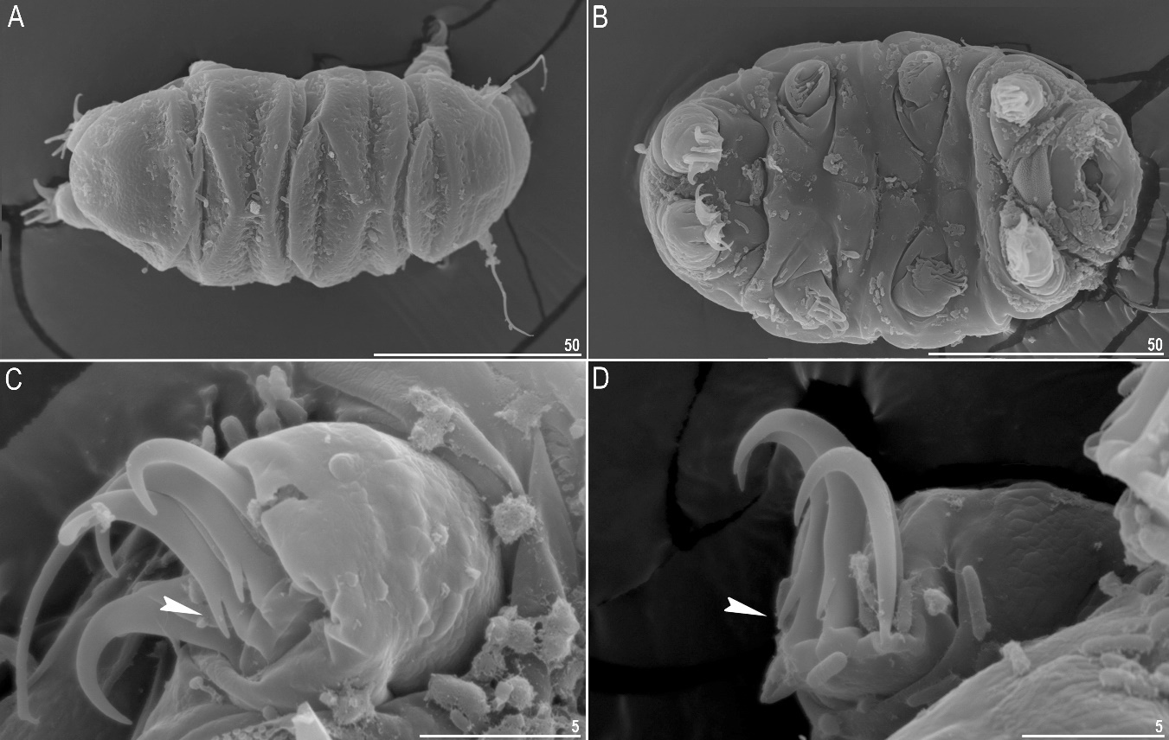
Figure 1. Bryodelphax sp. nov.: A – Dorsal view, adult (SEM); B – Ventral view, adult (SEM); C – Claws of leg I (SEM), arrowhead indicates spur; D – Claws of leg IV (SEM), arrowhead indicates spur. Scale bars in μm.

Slide 5
Macrobiotus sp. nov.
DNA sequences
We obtained good quality sequences for the applied molecular markers:
18S rRNA: single sequence; 553 bp long;
28S rRNA: single sequence; 721 bp long;
ITS-2: single sequence; 350 bp long;
COI: single sequence; 609 bp long;
Based on COI molecular data, Macrobiotus sp. nov. is most similar to Mac. canaricus Stec, Krzywański & Michalczyk, 2018 (p-distance 17%).
Short diagnosis: Macrobiotidae with Y-shaped claws. Colour white. Eyes present. Cuticle with small pores 0.6 – 1.8 μm in diameter. Two macroplacoids and a relatively small microplacoid close to the last macroplacoid. The oral cavity armature of the hufelandi-type with first and the second band composed of numerous minute teeth and a system of three dorsal and three ventral transverse ridges. Macroplacoid length sequence 2<1. Granulation present on all legs. Eggs spherical, ornamented, white and laid freely. Egg chorion reticulated (hufelandi type). Processes in the shape of inverted concave cups with terminal discs (diameter 3.2 – 6.1 μm). Morphologically, Macrobiotus sp. nov. is most similar to Mac. porifini [25] and differs from it by higher mean buccal tube length, higher mean stylet support insertion point, higher mean buccal tube external and internal width, higher pt of placoid row, higher egg bare and egg full diameter.

Slide 6
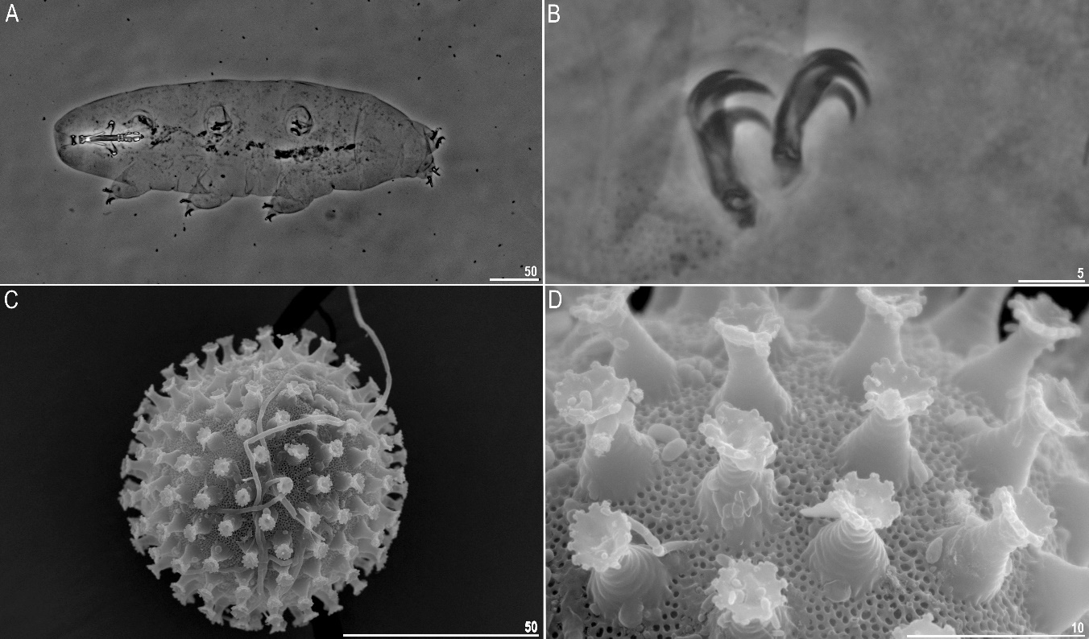
Figure 2. Macrobiotus sp. nov.: A – Dorsal view, adult (PCM); B – Claws of leg II (PCM); C – Egg general view (SEM); D – Egg surface and egg processes (SEM). Scale bars in μm.

Slide 7
Mesobiotus skorackii Kaczmarek et al., 2018
DNA sequences
We obtained good quality sequences for the applied molecular markers:
18S rRNA: two sequences; 667-715 bp long;
28S rRNA: single sequence; 735 bp long;
COI: single sequence; 631 bp long;
Based on COI molecular data, Mesobiotus skorackii is most similar to Mesobiotus occultatus Kaczmarek et al., 2018 (p-distance 20%).
Short diagnosis: Macrobiotidae with Y-shaped claws. Colour white. Eyes present. Cuticle smooth and without pores. Three roundish macroplacoids and a relatively large microplacoid close to the last macroplacoid. The oral cavity armature well developed and composed of three bands of teeth (harmsworthi type). Macroplacoid length sequence 2<3<1. Granulation hardly visible on legs I–III, whereas on legs IV always clearly visible. Eggs laid freely, white, spherical and ornamented, with short wide cones and delicate areolation. Egg processes reticulated with mesh and surrounded by six areolae delimited by thin brims which are often discontinuous, thus areolae are not always fully formed (semi-areolation).

Slide 8
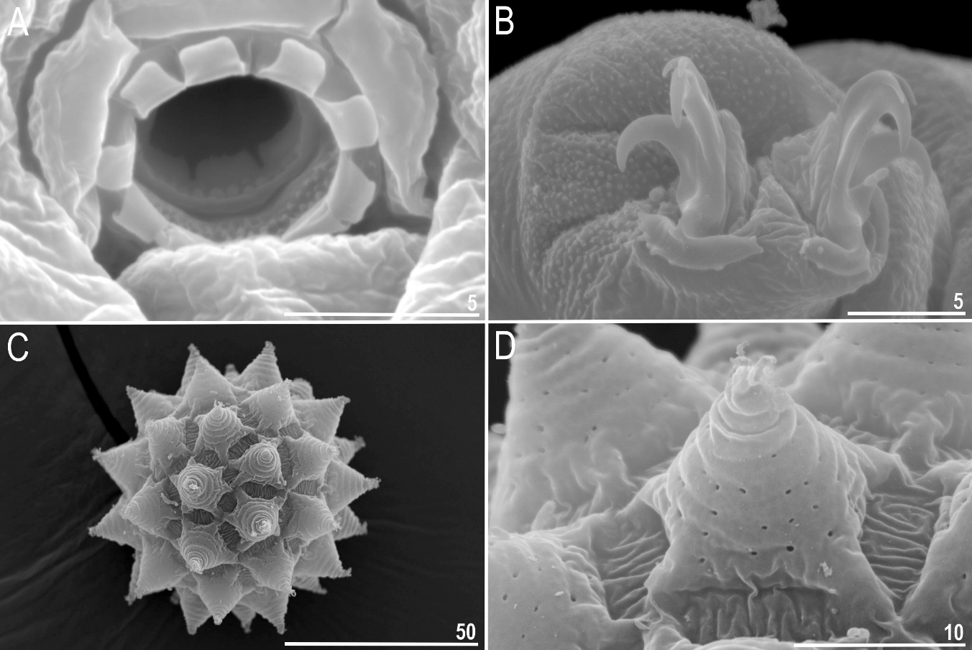
Figure 3. Mesobiotus skorackii.: A – Oral cavity amature, adult (SEM); B – Claws of leg IV (SEM); C – Egg general view (SEM); D – Egg surface and egg processes (SEM). Scale bars in μm.

Slide 9
Paramacrobiotus sp. nov.
Diagnosis: Macrobiotidae with Y-shaped claws. Colour white. Eyes absent. Cuticle smooth and without pores. Oral cavity armature typical with three bands of teeth. Macroplacoid length sequence 2<1<3. Granulation present on all legs. Smooth lunules under all claws. Eggs laid freely, white, spherical with processes in shape of short wide cones ended with flat and granulated cap. Egg shells areolated with ca. 10 areolae around each process and internal surface of the areoles with pores (richtersi type). Morphologically, Paramacrobiotus sp. nov. is most similar to Pam. gerlachae (Pilato, Binda & Lisi [26]) but it differs from it by longer placoid row, longer macroplacoid row, higher pt of microplacoid, larger primary branches of legs I–III and larger anterior and posterior primary branches of leg IV.

Slide 10
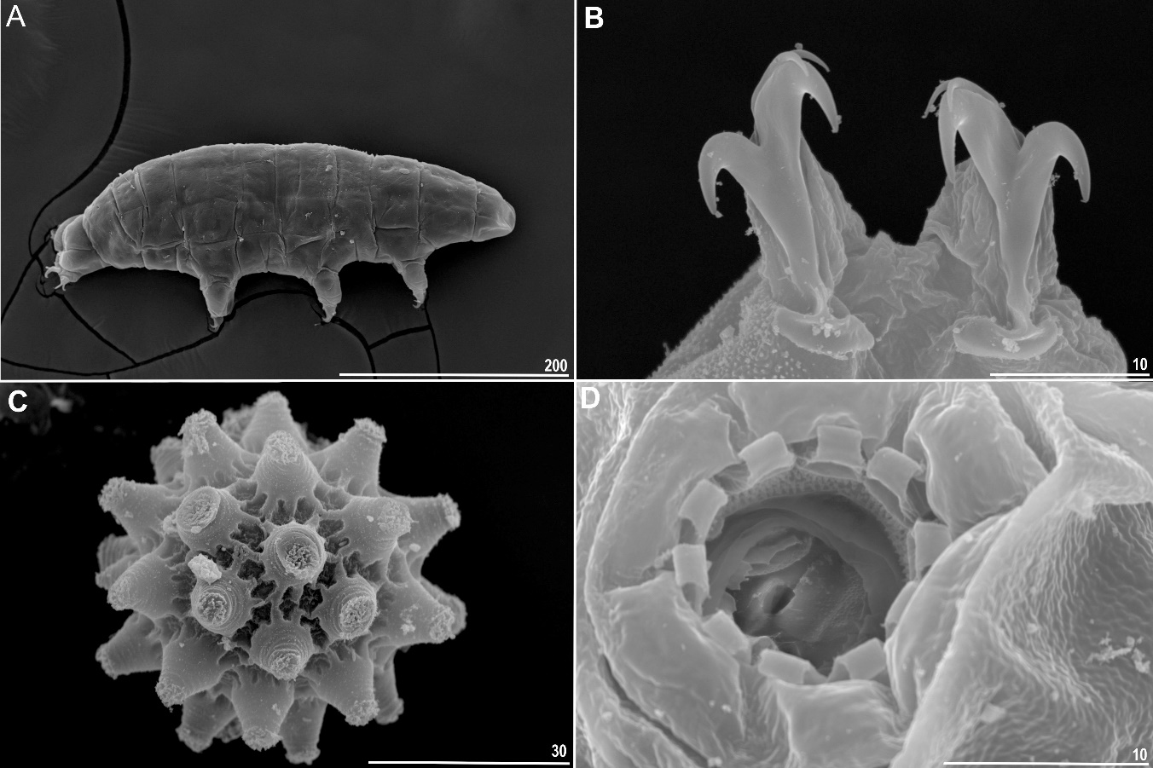
Figure 4. Paramacrobiotus sp. nov.: A – Dorsal view, adult (SEM); B – Claws of leg IV (SEM); C – Egg general view (SEM); D – Oral cavity amature (SEM). Scale bars in μm.

Slide 11
Conclusions
Bryodelphax sp. nov., Macrobiotus sp. nov., Mesobiotus skorackii and Paramacrobiotus sp. nov. were found in a single moss sample collected in Canada. We described all these species using an integrative approach. These four species discovery brings the current number of tardigrade taxa in Canada to ca. 124.
Taking into consideration that in the present study, in one analysed sample we found three species new for science and one new regordmeans that with hight probability we can assume that many new species will be discovered in this region in the future.

Slide 12
Acknowledgments
Studies have been partially conducted in the framework of activities of BARg (Biodiversity and Astrobiology Research group). Milena Roszkowska and Pushpalata Kayastha is a scholarship holder of 506000/604/4102000000BW002029 (GDWB-06/2019) & (GDWB-08/2020) and Passport to the future - Interdisciplinary doctoral studies at the Faculty of Biology, Adam Mickiewicz University in Poznań (No: POWR.03.02.00-00-I006/17).

