Slide 1
Ampelographic and ampelometric characterization of berries and seeds from traditional vineyards in Morocco
Younes Hmimsa ^{1,2}*, Widad Benziane² , Zineb Mouden², Mohammed Ater² and Salama ELFatehi ^{1,2}
¹ Department of Life Sciences, Polydisciplinary Faculty (Abdelmalek Essaadi University) (Larache, Morocco);
² Bio-agrodiversity team, Laboratory of applied botany; Department of Biology, Faculty of Science (Abdelmalek Essaâdi University) (Tetouan, Morocco).
* Corresponding author: y.hmimsa@uae.ac.ma

Slide 2
Abstract:
Morocco, like the other Mediterranean countries, is characterized by a great diversity of indigenous varieties of vines "Vitis vinifera ssp. vinifera", taking advantage of the climate and also of the heterogeneity of their landscapes Without forgetting, the know-how and agricultural practices adopted by traditional farmers who have contributed in one way or another to preserve the genetic diversity of these indigenous grape varieties. Within the framework of this study, we are seeking the identification and characterization of 36 indigenous grape varieties sampled in the north and south of Morocco. The samples studied were taken from traditional vineyards in these regions. For the ampelographic and ampelometric description, 26 characters were used according to a list of descriptors developed by the International Organization of Vine and Wine (OIV). Thus, the ampelographic and ampelometric approach were refined by a principal component analysis (PCA) which made it possible to group the grape varieties into five distinct groups according to their correlations to the variables linked to the bunch, the berry and the seed. The results obtained from these different approaches confirmed the presence of great inter-grape and intra-grape variability within the samples studied. This observation leads us to make more efforts to maintain this variability and to fight against genetic erosion and the threat of environmental changes.
Keywords: Vine, Vitis vinifera ssp. vinifera, traditional grape, ampelographic,
ampélometric, OIV

Slide 3
Ampelographic description
A
Notes:
© Copyright Showeet.com – Creative & Free PowerPoint and Google Slides Templates

Slide 4
The ampelographic characteristics of the bunch of grapes
01
01
Notes:
© Copyright Showeet.com – Creative & Free PowerPoint and Google Slides Templates

Slide 5
The ampelographic characteristics of the bunch of grapes
01
01
Notes:
© Copyright Showeet.com – Creative & Free PowerPoint and Google Slides Templates

Slide 6
Les caractères ampélographiques de la grappe:
01
The ampelographic characteristics of the bunch of grapes

Slide 7
Les caractères ampélographiques de la grappe:
The ampelographic characteristics of the bunch of grapes
01

Slide 8
The ampelographic characters of the berry
02
Notes:
© Copyright Showeet.com – Creative & Free PowerPoint and Google Slides Templates

Slide 9
Les caractères ampélographiques de la baie :
The ampelographic characters of the berry
02

Slide 10
The ampelographic characters of the berry
02

Slide 11
Les caractères ampélographiques de la baie :
The ampelographic characters of the berry
02

Slide 12
Les caractères ampélographiques de la baie :
The ampelographic characters of the berry
02

Slide 13
02
The ampelographic characters of the berry

Slide 14
The ampelographic characters of seeds:
03
They are completely formed with the absence of transverse grooves on their dorsal face.
Notes:
© Copyright Showeet.com – Creative & Free PowerPoint and Google Slides Templates

Slide 15
Ampelometric description
B
Notes:
© Copyright Showeet.com – Creative & Free PowerPoint and Google Slides Templates

Slide 16
The ampelometric characters of the bunch of grapes
01
Code OIV | 202 | 203 | 206 | 502
Max | 326 mm (LADH) | mm (LADH ) | mm (JNY) | 1186,58 g (LADH)
Min (mm) | 130 mm (BABH) | 86,25 mm (ALK ) | 30 mm (SBLB) | 112,65 g (FRY)
BAHB
ALK
SBLB
FRY
Notes:
© Copyright Showeet.com – Creative & Free PowerPoint and Google Slides Templates

Slide 17
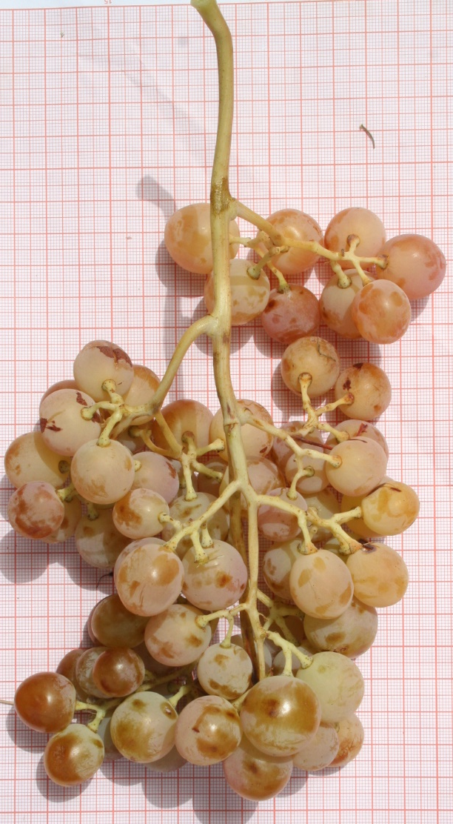
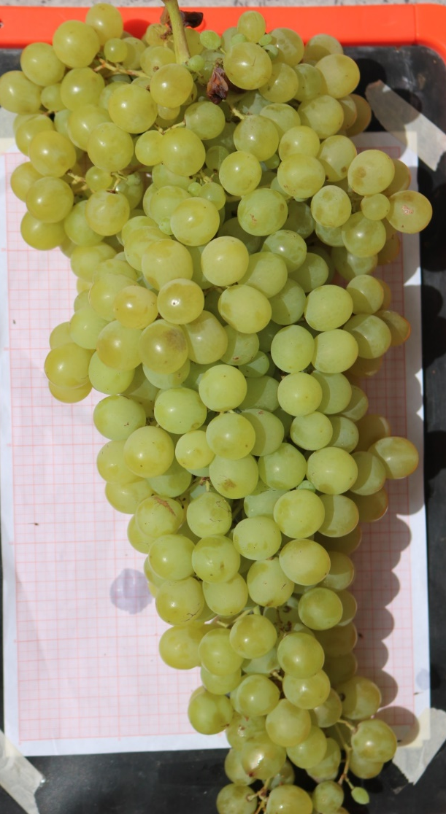
01
JYN
LADH

Slide 18
The ampelometric characters of berry
02
Code OIV | 220 | 221 | 238 | 503
max | 27,75mm (BCHK) | 21,25 mm (BZA) | 10,973 mm (TFR) | 6,3625 g (BZA)
min | 15 mm (HOU) | 14 mm (HOU) | 6,25 mm (TFRS) | 1,03 g (AlLKO)
BCHK
BZA
HOU

Slide 19
The ampelometric characteristics of the seeds
03
Code OIV | 242 | 243
max | 7,858 mm (LADH ) | 79,74 mg (ABH)
min | 5,65 mm (DOU) | 30,01 mg (ALKO)
ABH
DOU
ALKO
Notes:
© Copyright Showeet.com – Creative & Free PowerPoint and Google Slides Templates

Slide 20
Correlation matrix of variables
C
Notes:
© Copyright Showeet.com – Creative & Free PowerPoint and Google Slides Templates

Slide 21
Correlation matrix of the different variables analyzed
OIV | 202 | 203 | 206 | 502 | 220 | 221 | 238 | 503 | 242 | 243 | 505
202 | 1 | 0,795 | 0,543 | 0,783 | 0,371 | 0,230 | 0,029 | 0,246 | 0,397 | 0,292 | -0,055
203 |  | 1 | 0,533 | 0,835 | 0,481 | 0,374 | 0,003 | 0,436 | 0,419 | 0,250 | -0,050
206 |  |  | 1 | 0,284 | 0,272 | -0,042 | 0,078 | 0,265 | 0,260 | 0,221 | -0,194
502 |  |  |  | 1 | 0,472 | 0,464 | -0,138 | 0,447 | 0,503 | 0,371 | -0,100
220 |  |  |  |  | 1 | 0,359 | -0,057 | 0,624 | 0,404 | 0,388 | -0,233
221 |  |  |  |  |  | 1 | 0,077 | 0,714 | 0,459 | 0,341 | 0,084
238 |  |  |  |  |  |  | 1 | 0,055 | 0,097 | -0,049 | 0,258
503 |  |  |  |  |  |  |  | 1 | 0,574 | 0,579 | -0,238
242 |  |  |  |  |  |  |  |  | 1 | 0,847 | -0,224
243 |  |  |  |  |  |  |  |  |  | 1 | -0,402
505 |  |  |  |  |  |  |  |  |  |  | 1
Analysis of the correlations between the measured parameters:
- Links between the various quantitative parameters
- A positive and very significant correlation

Slide 22
Discussion:
According to the different ampelometric and ampelographic results obtained, we can confirm the presence of a clear differentiation, not only within the same grape variety, but also between the different grape varieties.
The comparison of this results with other Mediterranean grape varieties has confirmed the existence of a significant diversity but also a resemblance of some ampelographic characteristics.
The morphological characteristics vary considerably depending on the region, ecology, care practices, location, hence the need for validation by molecular analysis.
Notes:
© Copyright Showeet.com – Creative & Free PowerPoint and Google Slides Templates

Slide 23
CONCLUSION:
First opportunity to better understand the Moroccan wine heritage, and their situation among the other Mediterranean countries.
Existence of fairly significant inter-varietal and intra-varietal variability.
Strong differentiation of variance; for two characters; the weight of the bunch and seed.
The importance of the characterization of a rare viticultural genetic resource can be explained by the answers that will be provided through the identification of grape varieties tolerant to changing climatic conditions and promoting of sustainable viticulture.
Notes:
© Copyright Showeet.com – Creative & Free PowerPoint and Google Slides Templates

Slide 24
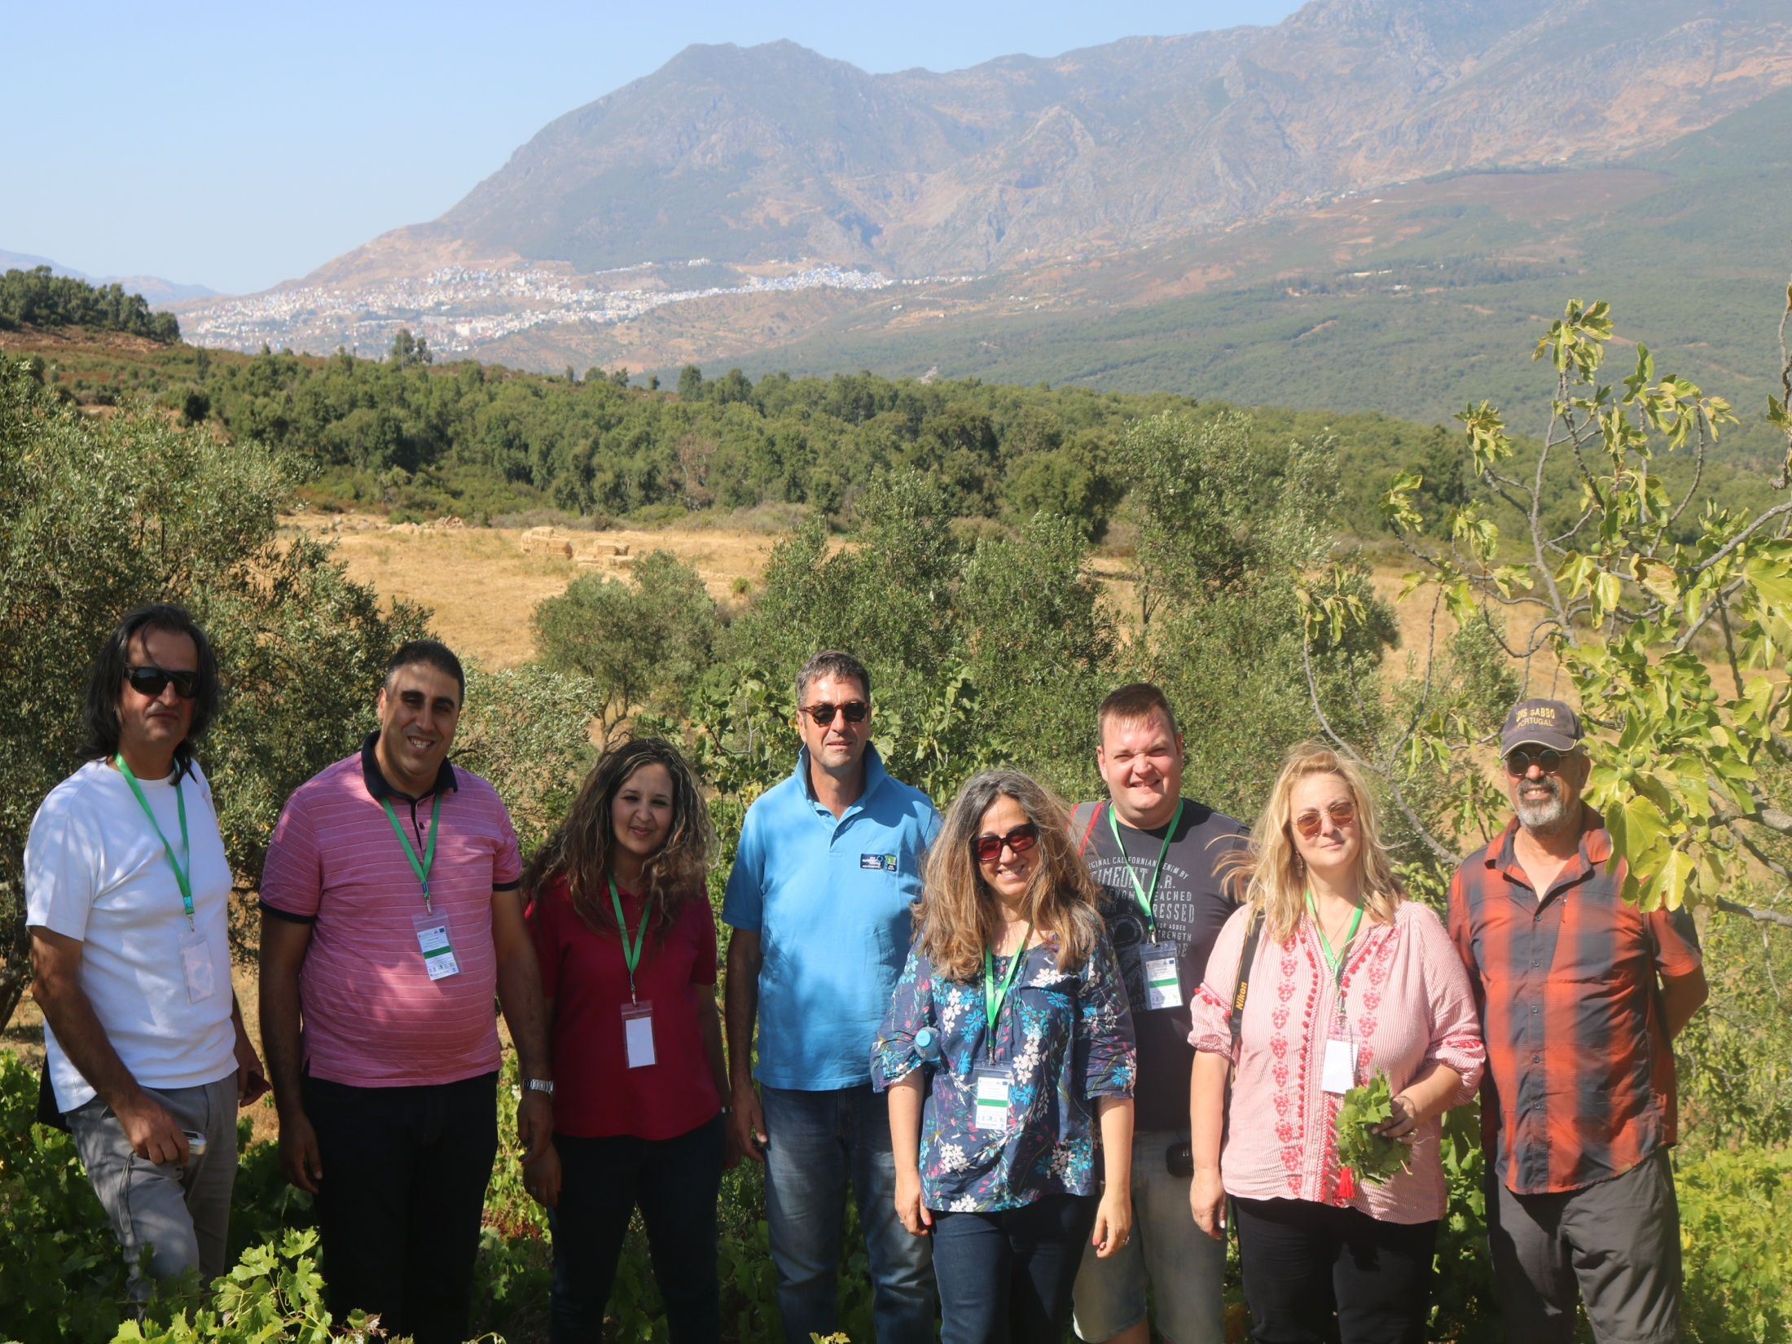
The authors thank the farmers of the various villages who contributed to the realization of this study. This research Was funded by ARIMNET 2 Project "MedVItis" Convention No. 7.
Notes:
© Copyright Showeet.com – Creative & Free PowerPoint and Google Slides Templates

