Slide 1

Nanotribological investigation of the poly (3-hydroxybutyrate) films manufactured from the storage polyesters produced by Halomonas elongata DSM 2581
Marius Pustan^{1,}*, Adorján Cristea², Corina Birleanu¹, Horia Leonard Banciu²
¹ Department of Mechanical Systems Engineering, Technical University of Cluj-Napoca, Cluj-Napoca, Romania;
² Department of Molecular Biology and Biotechnology, Faculty of Biology and Geology, Babeş-Bolyai University, Cluj-Napoca, Romania.
* Corresponding author: Marius.Pustan@omt.utcluj.ro

Slide 2

Abstract:
This study aims to the evaluation of the tribological behavior of different polyester biofilms fabricated via the solvent casting method. Three polyester films were designed and investigated in this study each containing 1% w/v constituents including a PHBh film prepared out of the PHB extracted from the extremely halotolerant bacteria Halomonas elongata DSM2581^{T}, a PHBc film fabricated using a commercially available PHB, and a PHBVc film generated using the commercial poly(3-hydroxybutyrate-co-3-hydroxyvalerate) (PHBV). The spectroscopy-in-point of AFM was used for adhesion force measurements and the AFM lateral mode was applied for friction analysis. The tribological investigations of PHBh film revealed a biodegradable material with low roughness as well as small adhesion and friction forces. The wear behavior was analyzed by considering three scratching forces (10 µN, 20 µN, 30 µN), 40µm the scratching length and 5 minutes the scratching time for all investigated materials. After, by using the scanning mode of AFM, the removed scratched material was estimated. The obtained experimental results indicate a good tribological behavior of the new developed PHBh film compared with the biofilms obtained from commercially raw material.
Keywords: Poly(3-hydroxybutyrate) films, AFM, Adhesion, Friction, Wear

Slide 3
Contents:
Introduction
Samples preparation and description
Topographical analysis
Hardness and Modulus of elasticity
Adhesion forces
Friction analyses
Wear tests
Results and Discussion
Conclusions

Slide 4
Introduction
The scope of this study is orientated to the evaluation of the tribological properties as adhesion, friction and wear behaviors of different polyester films fabricated using the solvent casting method [1]. Poly(3-hydroxybutyrate) - PHB is a biodegradable polyester, produced by numerous bacteria. To overcome the negative impact of plastic waste on environment, bio-based and biodegradable substituents are required to replace petroleum-derived plastics [2]. Polyhydroxyalkanoates (PHAs) are a class of energy storage compounds produced by prokaryotes, algae, and plants and are considered vital candidates to replace conventional plastics in the packaging field and biomedical sectors [3]. These polyesters are fully biodegradable, immunologically inert and have physical properties as conventional plastics [3].
The improvement of the PHB material lifetime involves the mechanical and tribological characterization which can be accurately performed by using the atomic force microscopy (AFM) technique. The tribological behavior evaluation of developed PHBh film by AFM is the main research scope of this work. The same method based on the tapping mode of AFM was used to examine the microstructure of polyester films degradation before and after exposure to an alkaline solution [4]. The AFM technique was also successfully applied to determine the material behavior of Microelectromechanical (MEMS) components fabricated from soft materials as SU-8 integrated with metallic materials on the same structure [5].

Slide 5

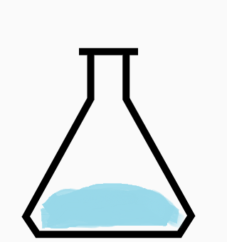

2. Samples preparation and description
Quantitative (crotonic acid assay) and qualitative (Nile Red staining of whole cells, NMR spectroscopy of extracted powder) assessment of produced PHBh
H. elongata starter culture on complete medium (0.1% glucose, 8% NaCl)
H. elongata culture on nitrogen-limited medium (1 % glucose, 8 % NaCl)
PHB extraction by hypochlorite, purification and film preparation (repeated water washing).
Three polyester films were designed in this study, each containing 1% w/v constituents as follows:
PHBh (Sample 1) film prepared out of the PHB extracted from the extremely halotolerant bacterium Halomonas elongata DSM2581^{T},
PHBc (Sample 2) film fabricated using a commercially available PHB and
PHBVc (Sample 3) film generated using the commercial poly(3-hydroxybutyrate-co-3-hydroxyvalerate) (PHBV).

Slide 6
3. Topographical analysis
Scope: Analyses of the surface morphology and roughness of investigated samples
Using method: The non-contact scanning mode of AFM was applied. The type of AFM probe used in this experiment was PPP-NCHR with a force constant of 42N/m and 330kHz the RF. In this operating tapping mode, the AFM tip is vibrating close to the surface measuring the topography by use the attractive atomic force between the tip and sample surface
Input parameters: Scanning area was of 40µm×40µm
Operating conditions: Controlled humidity of 40%RH and temperature of 20°C; antivibration stage to avoid the external noises
Output results: 3D images, roughness parameters and the grains distribution

Slide 7
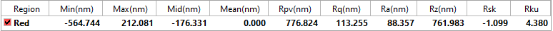
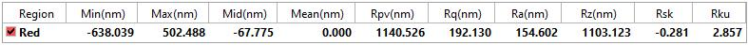
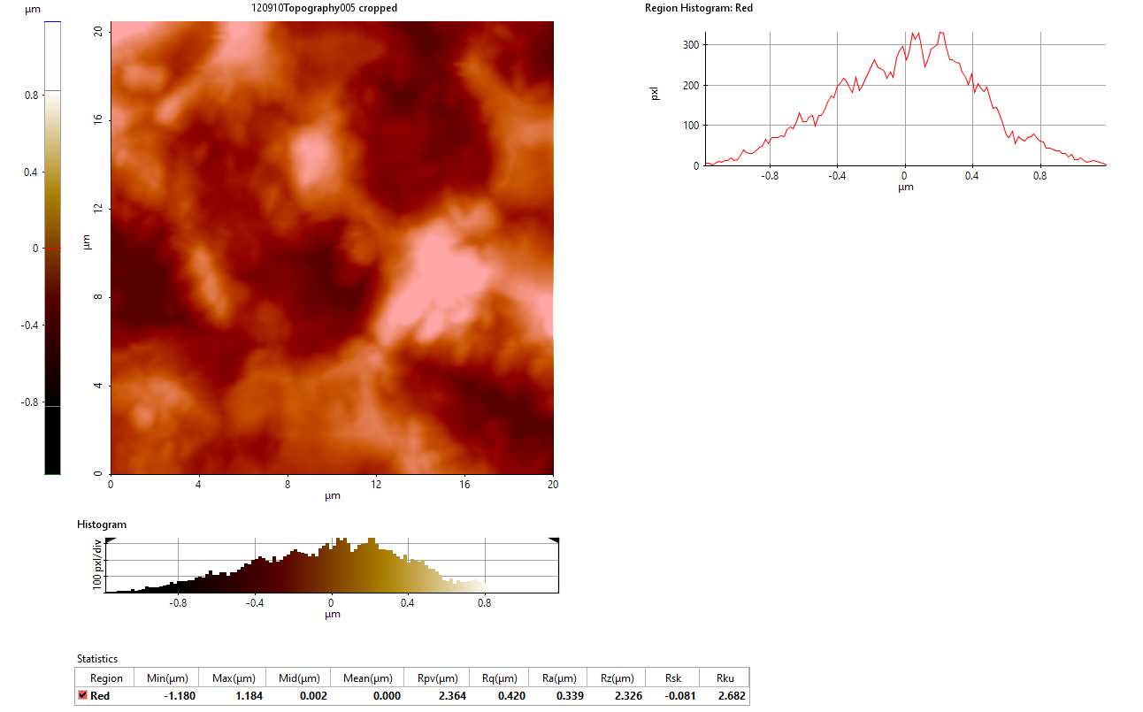
(a) PHBh
(b) PHBc
(c) PHBVc
Fig. 1 Images (3D) and roughness parameters of samples: (a) PHBh; (b) PHBc; (c) PHBVc

Slide 8
4. Hardness and modulus of elasticity
Scope: To determine the modulus of elasticity and the hardness of PhBh, PHBc and PHBVc investigated biomaterials
Using method: The nanoindentaion method was applied by using the nanoindentation module of AFM and a Berkovich tip. The results were interpreted based on the Oliver and Pharr Model . The AFM probe used is TD23838 with 272N/m the constant force
Input parameters: The force set-up was selected to 5µm and the indentations were performed in different locations on the material under 30µN the indentation force. The Poisson ration used in the results interpretation was 0.36 [6]
Operating conditions: Controlled humidity of 40%RH and temperature of 20°C; antivibration stage to avoid the external noises
Output results: Nanoindentation curves, hardness and modulus of elasticity

Slide 9
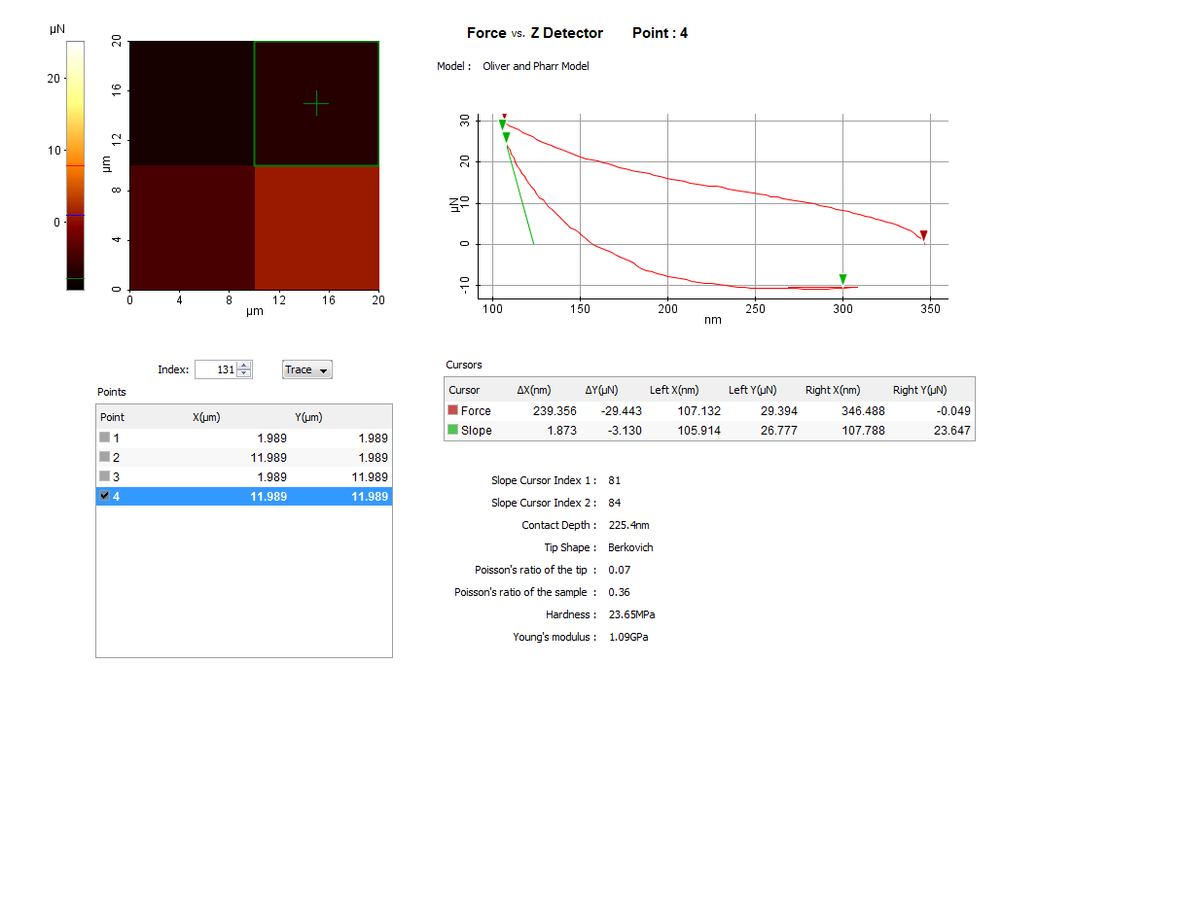
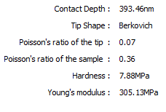
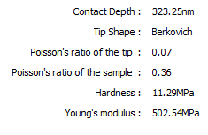
(a) PHBh
(b) PHBc
(c) PHBVc
Fig.2 Nanoindentation curves of PHBh sample under a force of 30µN and results of: (a) PHBh; (b) PHBc; (c) PHBVc

Slide 10
5. Adhesion force
Scope: To determine the adhesion force between the AFM tip material and the investigated samples
Using method: The tests are performed using the spectroscopy in point of AFM. The adhesion tests were repeated 4 times and the average values were considered
Input parameters: The normal force was selected at 50µN. The AFM probe was PPP-NCHR type with a constant force of 42N/m and the tip radium of 7 nm
Operating conditions: Controlled humidity of 40%RH and temperature of 20°C; antivibration stage to avoid the external noises
Output results: The adhesion force was measured and interpretated using the XEI software

Slide 11
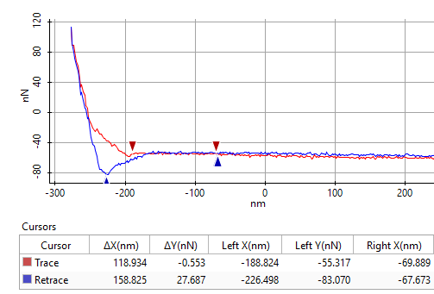
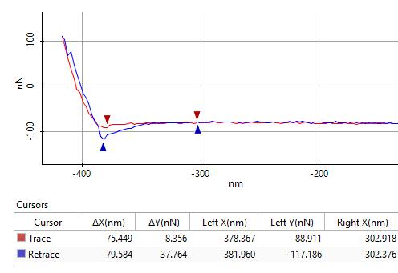
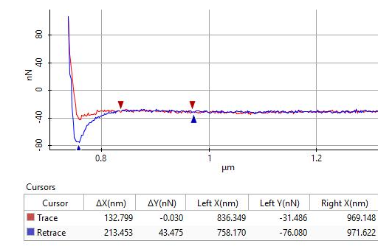
Fig. 3 Adhesion force between AFM tip (Si) and the PHBh material
Fig. 4 Adhesion force between AFM tip (Si) and the PHBc material
Fig. 5 Adhesion force between AFM tip (Si) and the PHBVc material

Slide 12
6. Friction analysis
Scope: To measure the friction force between investigated materials and AFM tip (Si) Using method: The AFM lateral mode is used for this measurements. The friction map gives information about the torsional deflection of the AFM probe during lateral movement on the direct contact with samples surface.
Input parameters: The AFM probe used in friction characterization is PPP-NCHR with the following parameters: force constant 42N/m, length 125μm, width 30μm, thickness 4μm, the tip height 15μm. The normal applied force (set-point) was 200nN
Operating conditions: Controlled humidity of 40%RH and temperature of 20°C; antivibration stage to avoid the external noises
Output results: The friction maps and the friction coefficients

Slide 13
Based on torsion beam theory, the friction force between AFM probe and investigated polymers can be computed as:
where dz[µm] is the calibrated deflection of AFM probe determined based on the difference between profiles toward and backward Y/2 (Fig.6) in volts [V] and divided to the sensitive factor 98.97 V/µm (provided by manufacturer), r = 0.33, G – shear modulus of the AFM cantilever material, l – cantilever length, h – cantilever thickness, b – cantilever width, s – tip height of the AFM probe.
Then, the friction coefficient is determined as the friction force divided by the sum between the normal applied force and the adhesion force presented in Figs. 3 - 5.

Slide 14
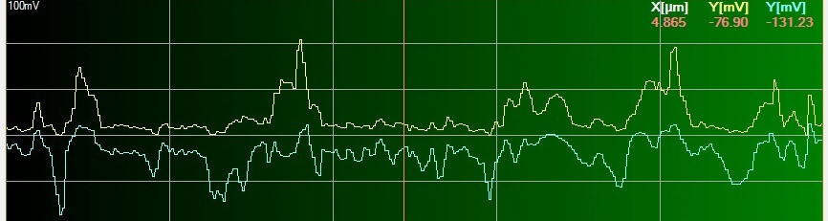
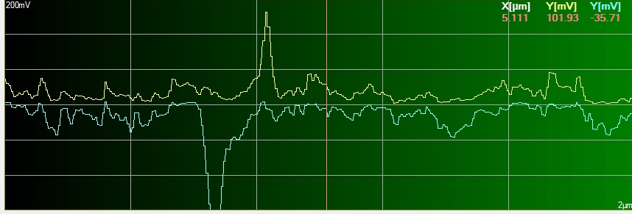
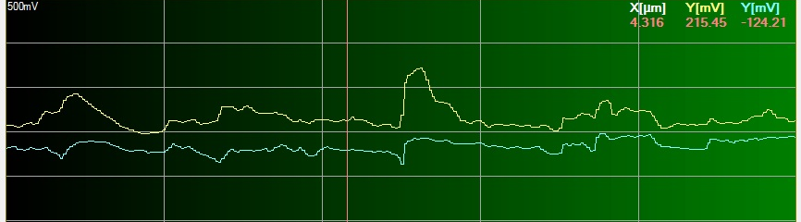
Si/PHBh
F_{f} = 47 nN
µ = 0.15
Si/PHBc
F_{f} = 119.14 nN
µ = 0.35
Si/PHBVc
F_{f} = 295.15 nN
µ = 0.85
Fig.6 Friction maps, friction force F_{f} and friction coefficient µ between AFM tip (Si) and investigated materials

Slide 15
7. Wear tests
Scope: To determine the difference between the wear resistance of investigated bio-materials PHBh and PHBc with higher and smaller hardness (Fig.2)
Using method: The scratching of material by using the contact mode of AFM and a diamond Berkovich tip. After, the scanning of the scratched area by AFM was done for the interpretation of the removed material volume. XEI software used to measure the dimensions of the triangular section of the removed area. After by considering the length of scratch, the volume of the removed material was estimated
Input parameters: Normal load = 10µN, 20µN, 30µN; Scanning rate 1Hz, Scratching time = 5 minutes; Length of scratching 40µm
Operating conditions: Humidity of 40%RH; temperature of 20°C
Output results: Variation of the materials wear as a function of applied loads

Slide 16
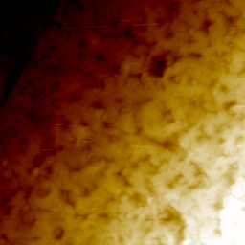
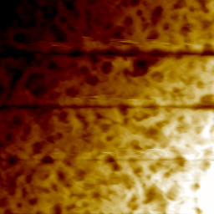
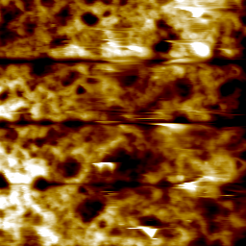
30µN
20µN
10µN
(a) PHBh
(b) PHBh
Fig.7 The wear test under different scratching forces: (a) is the initial surface of PHBh, after scratching the same probe is shown in (b), and the PHBc material is represented in (c)
30µN
20µN
10µN
(c) PHBc

Slide 17
Fig.8 Wear area dimensions (high and length) of samples for different scratching forces F

Slide 18
Fig.9 Variation of the volume of the removed material based on wear under different loads and for a controlled sliding time (5 minutes) for PHBh and PHBc materials

Slide 19
8. Results and Discussion
PHBh film prepared out of the PHB extracted from the extremely halotolerant bacteria Halomonas elongata DSM2581T has superior tribological and mechanical properties compared with a PHBc film fabricated using a commercially available PHB and a PHBVc film generated using the commercial poly(3-hydroxybutyrate-co-3-hydroxyvalerate) (PHBV). The roughness of PHBh is smaller than the roughness paramenter of the PHBc and PHBVc sample and its modulus of elasticy and hardness are higher. In the same way, the adhesion and the friction forces is decreasing as well as the wear of the material removed by scratching. The AFM technique is an adequate testing technology to predict the wear behavior and the lifetime of biodegradable materials starting from nanoscale analysis.
9. Conclusions
Halomonas elongata DSM 2581^{T} used to produce PHB undergoing single nutrient limitation in nonsterile culture medium with high salinity (8% w/v NaCl) is an adequate material to obtain biodegradable samples with proper tribological and mechanical properties. The extensive experimental tests performed in this study demonstrated an improved tribo-mechanical properties of bacterial PHBh material compared to the films made of commercial PHB and poly(3-hydroxybutyrate-co-3-hydroxyvalerate (PHBV).

Slide 20
References
[1] Cristea A, Pustan M, Birleanu C, Dudescu C, Floare CG, Tripon AM, Banciu HL., Mechanical evaluation of solvent casted poly(3-hydroxybutyrate) films derived from the storage polyesters produced by Halomonas elongata DSM 2581^{T}. J Polym Environ, Submitted: ID: JOOE-S-21-00260, 2021.
[2] Lau WWY, Shiran Y, Bailey RM, Cook E, Stuchtey MR, Koskella J, Velis CA, Godfrey L, Boucher J, Murphy MB, et al. Evaluating scenarios toward zero plastic pollution. Science 369, 1455–1461, 2020.
[3] Keshavarz T, Roy I., Polyhydroxyalkanoates: Bioplastics with a green agenda. Curr Opin Microbiol. 13(3), 321-326, 2010.
[4] Gu X., Raghavan D.T., Nguyen T., VanLandingham M.R., Yebassa D., Characterization of polyester degradation using tapping mode atomic force microscopy: Exposure to alkaline solution at room temperature, Polym Degrad Stabil 74(1), 139-149, 2001.
[5] Pustan M., Birleanu C., Dudescu C., Rymuza Z.. Nanomechanical studies and materials characterization of metal / polymer bilayer MEMS cantilevers, Int J Mater Res, 104(4), 2013.
[6] Farah S., Anderson D.G., Langer R., Physical and mechanical properties of PLA, and their functions in widespread applications — A comprehensive review, Adv Drug Deliv Rev 107, 2016.
Acknowledgments
AC and HLB acknowledge the projects PN-III-P4-ID-PCCF-2016-0016 and PN-III-P4-ID-PCE-2020-1559 granted by UEFISCDI-CNCS (Romanian Minstry of Research, Innovation and Digitalisation).

