Slide 1



Title of the Presentation
The internal cracks influence on the stress behavior of Al₂O₃ tribo-mechanical system under contact pressures
Corina Bîrleanu^{1,}*, Marius Pustan¹, and Florina Șerdean¹
¹ Departament of Mechanical Systems Engineering, Micro and Nano Systems Laboratory, Technical University of Cluj-Napoca, Blv. Muncii 103-105, Cluj-Napoca, Romania
* Corresponding author: Corina.Barleanu@omt.utcluj.ro

Slide 2
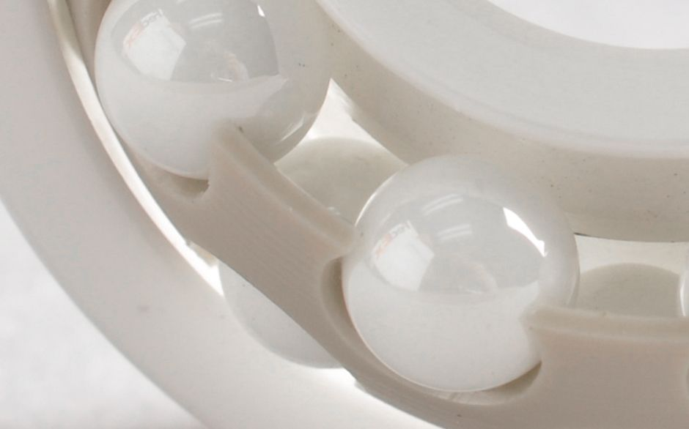

Abstract:
This paper is based on the behavior of alumina ceramics in terms of stress and strain in the contact area and the tribological behavior of these materials. A mathematical concept of fracture the ceramic materials in which there are defects in the form of internal cracks has been developed.
A defect criterion has been formulated to allow the evaluation of the propagation of the semicircular crack which shapes the places where there are natural defects in the ceramic mass.
The model highlighted is the contact between two curved surfaces, specific to the ball-ring contact in the bearings. It has highlighted tensions stress and the stress factors, taking into account the coefficient of conformability and the influence of the friction effects. A large number of experimental tests were performed based on couple ball - bearing ring.
Key words: alumina; internal crack; stress , SIF, tribology

Slide 3
The internal cracks influence on the stress behavior of Al₂O₃ tribo-mechanical system under contact pressures
Outlines:
Scope of paper
Theoretical aspects
Experimental characterizations
Results and discussions
Conclusions

Slide 4
The scope of the research work:
The main goal of the conducted research is to establish the quantitative connection between external forces, part geometry, including defect dimensions and ceramic material characteristics.
Particularly, the customization of the concepts from fracture mechanics on a continuous ceramic medium in order to analyze the behavior at tribomechanical stresses of a ceramic bearing

Slide 5
Why alumina ceramic bearing?
Alumina ceramic is a kind of structural ceramics, with insulation resistance, voltage resistance, corrosion resistance, lower density, higher hardness, higher compressive strength, longer fatigue life, stable electrical performance characteristics.
Alumina bearings features:
low density, strong solidity, low friction coefficient, abrasion resistance, magnetic resistance, acid and alkali resistance, good resistance to wear and tear, electric insulation, self-lubrication.
Applications:
circulating pump bearings in central heating systems, washing machines and car cooling systems, food processing, vacuum applications, medical equipment, electronics applications, wet applications.

Slide 6
Theoretical aspects. Plane elastostatic problem of crack medium.
the natural defect in the volume of technical ceramics is shaped in the form of a sphere, ellipsoid or a flat crack
the cracks are defects with maximum severity, the stress estimates have a covering character
estimation - relationship between the intensity of the stress, the geometry of the body and the defect and the stress intensity factor (SIF)

Slide 7
Stress intensity factor (SIF)
Irwin approximation
G(x_{o}) – Green function for SIF calculus for any normal distribution of forces on the flanks of crack
the validity of the Irwin approximation is for:

Slide 8
Stress intensity factor (SIF) – semicircular crack
shapes the natural defect in the ceramic mass
constant normal stress:
variable normal stress:
overlapping effects (stress):

Slide 9
Modeling the defects distribution in technical ceramic mass
Normal and tangetial stress:

Slide 10
Static contact ball- plate
For alumina Al₂O₃, E =380 GPa, ν=0,23,
from literature

Slide 11
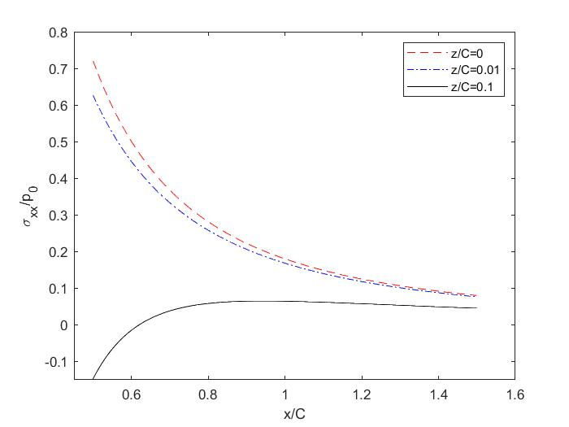
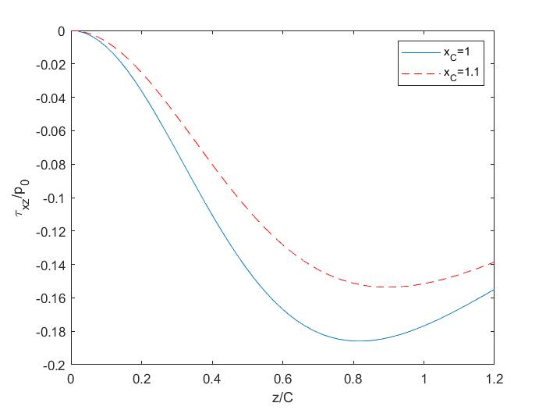
Normal stress area in Al₂O₃ semi space
Tangential stress area in alumina Al₂O₃ semi space
the edge of the contact area
Crack depth

Slide 12
Stress intensity factor (SIF) in Al₂O₃ semi space
based on the relationships presented before for

Slide 13
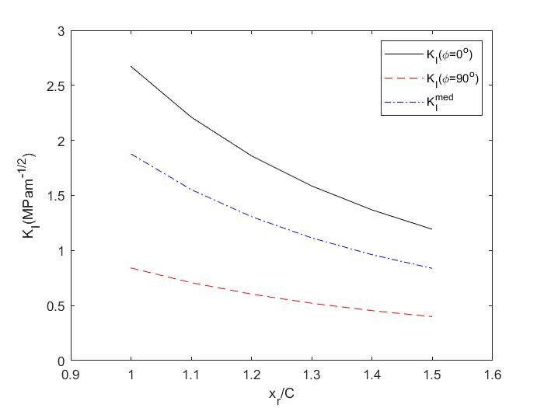
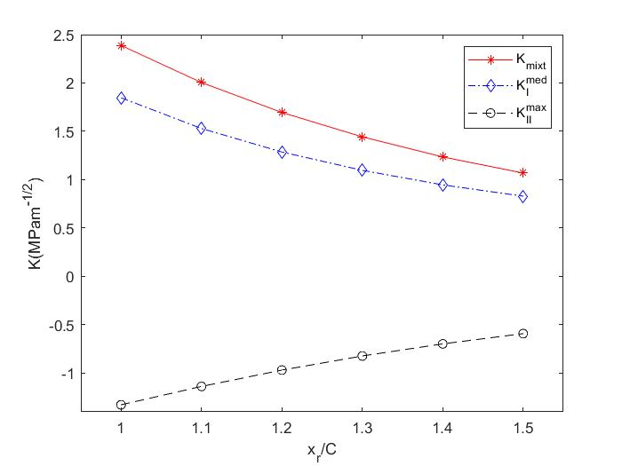
Stress intensity factor (SIF) in Al₂O₃ semi space
Stress intensity factor (SIF) in Al₂O₃ semi space for compound stress
R = 2,5 mm
P = 2820 N
C = 297 µm
p_{o} = 15,2 GPa
a_{o} = 15 µm
R = 2,5 mm
P = 2820 N
C = 297 µm
p_{o} = 15,2 GPa
a_{o} = 15 µm

Slide 14
Modeling the contact between curved surfaces (contact in the bearing)
R_{B} – ball radius, [mm]; R_{K} – raceway radius, [mm]; R_{L} – outer ring bearing radius, [mm];
P – normal force, [N]
Assumptions:
to use Hertz's method in the contact situation of curved surfaces in the same direction, the accuracy of the solution depends on the analytical description of h.
h - distance on the z axis between the two bodies in contact
for small contact areas compared to the radii of curvature it was determined that the considered error is ̴7%
the basic parameter in the design of the bearings is the conformability coefficient
In this work,

Slide 15
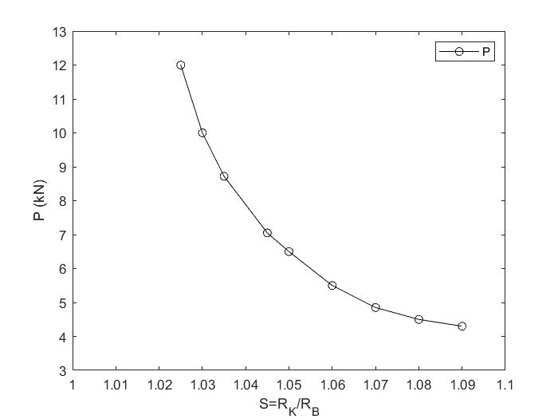
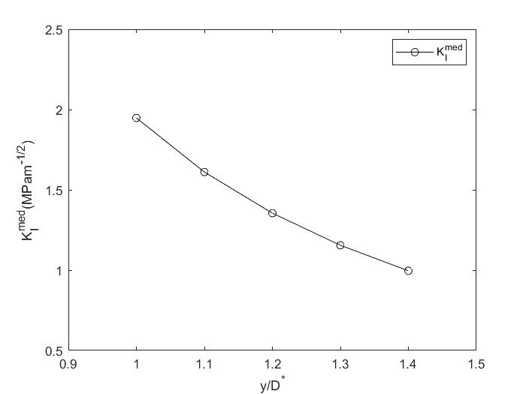
Stress intensity factor (SIF) depending on
D* - semi major axis of elliptical contact area
interpolation curve
model point
technical field
R_{K} = 3,17 mm
R_{B} = 3,336 mm
R_{L} = 23 mm
P = 9000 N
a_{o} = 15 µm
Variation of P depending on conformability coefficient S to achieve a value for

Slide 16
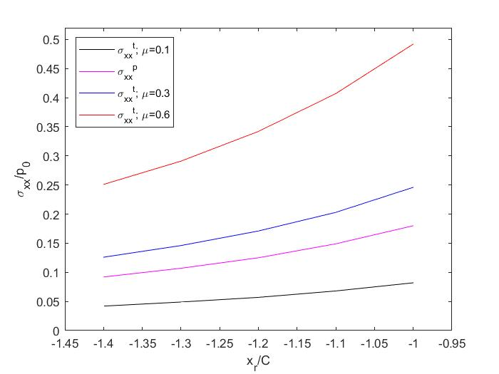
If in the ball plate system we also consider the presence of the sliding contact given by a force Q = µ∙P, µ - friction coefficient, the total stress will be the sum between the normal and the tangential one :
and - based on tangential stress
Specification: all values for the friction coefficients were determined experimentally on the Three Pins tribometer for the coupling of alumina / alumina material in dry friction conditions, in water and in mineral oil.

Slide 17
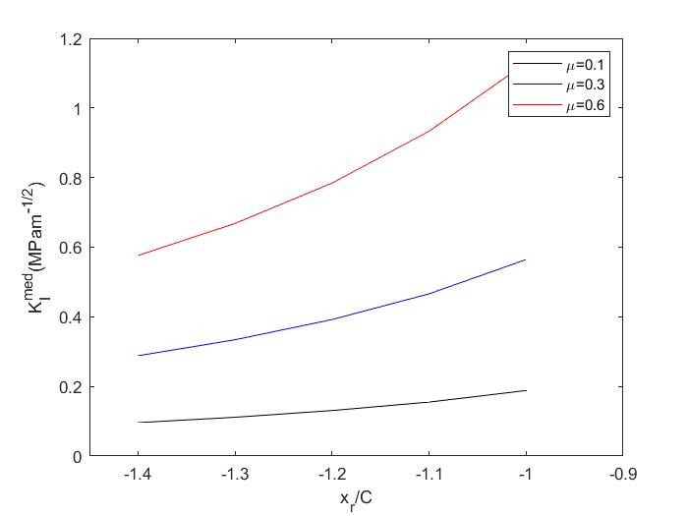
In the situation where the surface crack develops in depth under the influence of the presence of the sliding force and different friction conditions, is represented in the figure below.
The edge of contact area

Slide 18
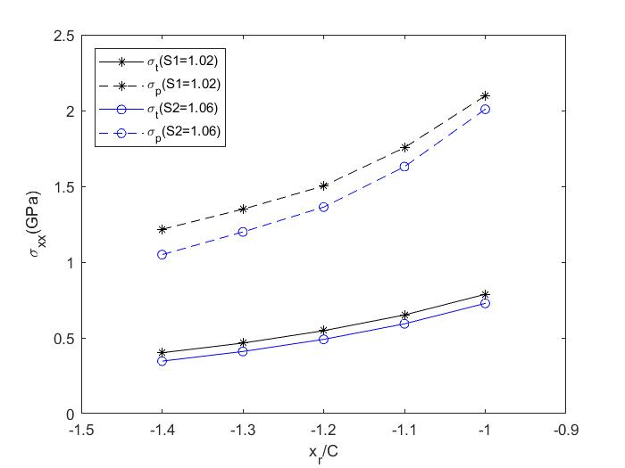
Taking into account the overlapping effects and the influence of the conformability coefficient S in micro-slip conditions, the results are presented in the graph below

Slide 19
Results and Discussion
the theoretical and practical approach of the complete ceramic bearing is complex and interdisciplinary
the mechanical stresses in the contact area are higher especially in the lack of lubrication, which justifies the application of ceramic bearings compared to metal ones
the individual contact problems of the ceramic media with cracks were approached and a mathematical concept of breaking was developed for them
the types of stress and the stress intensity factors were determined in the assumption of the elastic behavior of the ceramic body before breaking
it went from linear crack to semi-circular crack that shapes the places with natural defects in the ceramic mass
the contact between two curved surfaces characteristic of the ball - bearing ring contact was modeled

Slide 20
the stress field and the stress intensity factors were studied on this model, taking into account the conformability coefficient and the fact that we cannot eliminate the influence of friction effects.
from a tribological point of view, the friction coefficients on the three-pins tribometer were determined in different states of dry lubrication, water and mineral oil.
Conclusions
over 30 tests were performed for each case in order to establish the formation of cracks depending on the normal force applied
99.7% alumina balls with diameters between 4.5 mm and 12.7 mm were used and ceramic rings were made to ensure a coefficient of conformability of 1.02 and 1.06.
the paper will be extended by verifying the experimental results as well as the model proposed by finite element method
from a tribological point of view, the experimental study will be extended by determining the wear on the Amsler tribometer and highlighting the traces of wear by SEM images.

