Slide 3
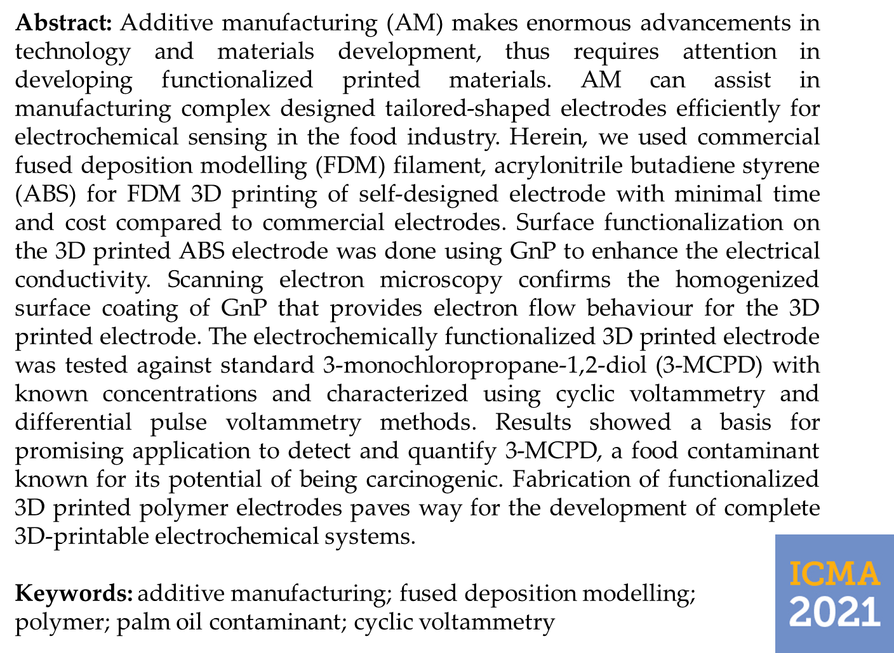

Slide 8
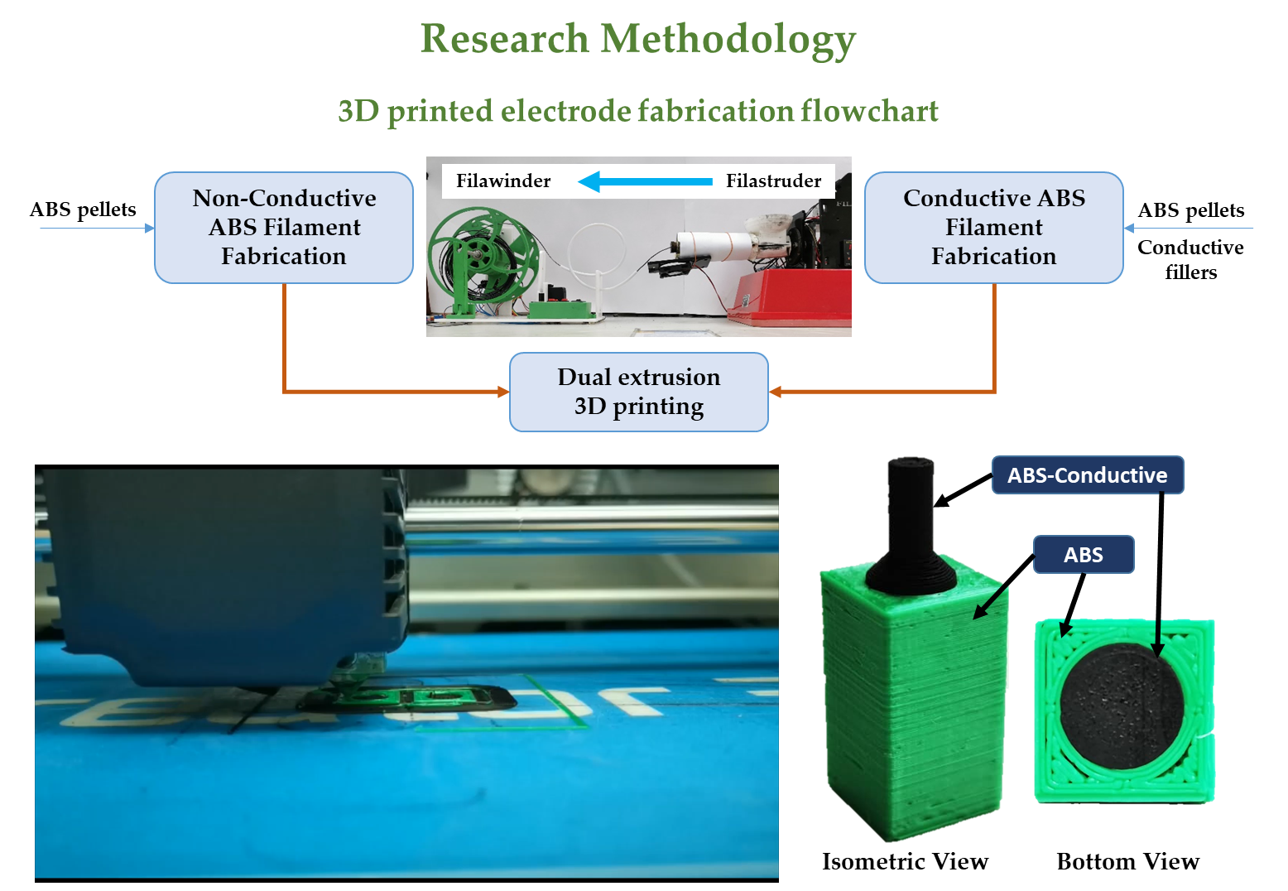

Slide 15
Conclusions and Future Works
3D printing technology could be utilised in electrochemical sensing applications by incorporation of conductive fillers/nanomaterials in commercially available polymers.
Further functionalisation by electrodeposition on 3D printing materials could enhance the redox capability of the tailor designed 3D printed products.
The functionalised 3D printed transducer showed promising application towards 3-MCPD detection and paving way towards rapid and cheap electrochemical sensing of contaminants in palm oil.

Slide 16
References
D. Mohan, A.N. Bakir, M.S. Sajab, S.B. Bakarudin, N.N. Mansor, R. Roslan, H. Kaco, Homogeneous distribution of lignin/graphene fillers with enhanced interlayer adhesion for 3D printing filament, Polym. Compos. (2021) 1–14.
D. Mohan, M.S. Sajab, H. Kaco, S.B. Bakarudin, A.M. Noor, 3D Printing of Uv-Curable Polyurethane Incorporated With Surface-Grafted Nanocellulose, Nanomaterials. 9 (2019) 1–15.
F. Ibrahim, D. Mohan, M.S. Sajab, S.B. Bakarudin, H. Kaco, Evaluation of the Compatibility of Organosolv Lignin-Graphene Nanoplatelets with Photo-Curable Polyurethane in Stereolithography 3D Printing, Polymers (Basel). 11 (2019) 1544.
S. Su, R. Kopitzky, S. Tolga, S. Kabasci, Polylactide (PLA) and its blends with poly(butylene succinate) (PBS): A brief review, Polymers (Basel). 11 (2019) 1–21.
P.F. Flowers, C. Reyes, S. Ye, M.J. Kim, B.J. Wiley, 3D printing electronic components and circuits with conductive thermoplastic filament, Addit. Manuf. 18 (2017) 156–163.
S.W. Kwok, K.H.H. Goh, Z.D. Tan, S.T.M. Tan, W.W. Tjiu, J.Y. Soh, Z.J.G. Ng, Y.Z. Chan, H.K. Hui, K.E.J. Goh, Electrically conductive filament for 3D-printed circuits and sensors, Appl. Mater. Today. 9 (2017) 167–175..
S.E. Vollset, E. Goren, C. Yuan, J. Cao, A.E. Smith, T. Hsiao, C. Bisignano, G.S. Azhar, E. Castro, J. Chalek, A.J. Dolgert, T. Frank, K. Fukutaki, S.I. Hay, R. Lozano, A.H. Mokdad, V. Nandakumar, M. Pierce, M. Pletcher, T. Robalik, K.M. Steuben, H.Y. Wunrow, B.S. Zlavog, C.J.L. Murray, Fertility , mortality , migration , and population scenarios for 195 countries and territories from 2017 to 2100: a forecasting analysis for the Global Burden of Disease Study, Lancet. (2020) 1–22.
E. Iacovidou, A.P.M. Velenturf, P. Purnell, Science of the Total Environment Quality of resources : A typology for supporting transitions towards resource ef fi ciency using the single-use plastic bottle as an example, Sci. Total Environ. 647 (2019) 441–448.
D. Zindani, K. Kumar, An insight into additive manufacturing of fiber reinforced polymer composite, Int. J. Light. Mater. Manuf. (2019).
M. Tanase-Opedal, E. Espinosa, A. Rodríguez, G. Chinga-Carrasco, Lignin: A biopolymer from forestry biomass for biocomposites and 3D printing, Materials (Basel). 12 (2019) 1–15.
M. Heidari-Rarani, M. Rafiee-Afarani, A.M. Zahedi, Mechanical characterization of FDM 3D printing of continuous carbon fiber reinforced PLA composites, Compos. Part B Eng. 175 (2019) 107147.
D. Adhikari, M. Mukai, K. Kubota, T. Kai, N. Kaneko, K.S. Araki, M. Kubo, Degradation of Bioplastics in Soil and Their Degradation Effects on Environmental Microorganisms, J. Agric. Chem. Environ. 05 (2016) 23–34.
A. Shrestha, M.C.A.A. van-Eerten Jansen, B. Acharya, Biodegradation of bioplastic using anaerobic digestion at retention time as per industrial biogas plant and international norms, Sustain. 12 (2020).
C.W. Park, W.J. Youe, S.J. Kim, S.Y. Han, J.S. Park, E.A. Lee, G.J. Kwon, Y.S. Kim, N.H. Kim, S.H. Lee, Effect of lignin plasticization on physico-mechanical properties of lignin/poly(lactic acid) composites, Polymers (Basel). 11 (2019) 1–12.

Slide 17
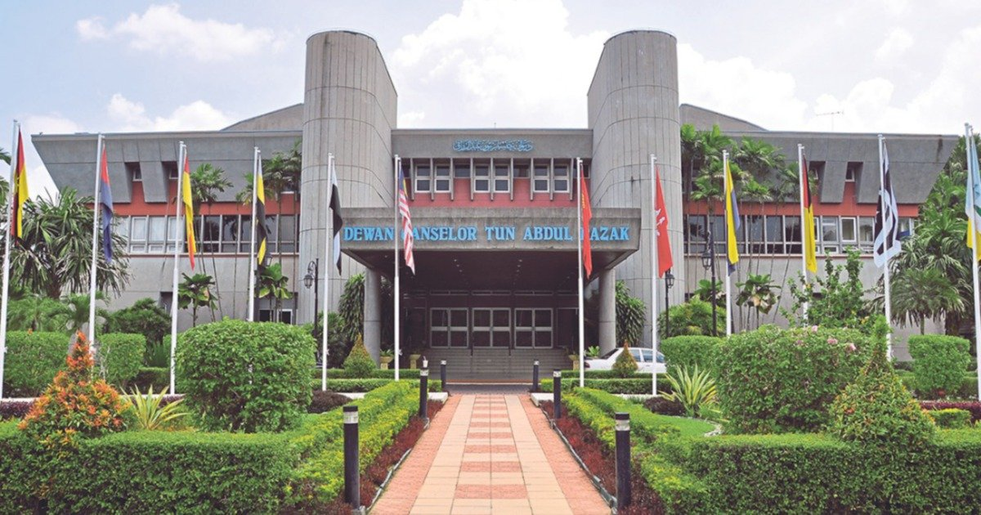
Acknowledgments
Funding: This work was supported by the Universiti Kebangsaan Malaysia [DIP-2020-006].

