Slide 1
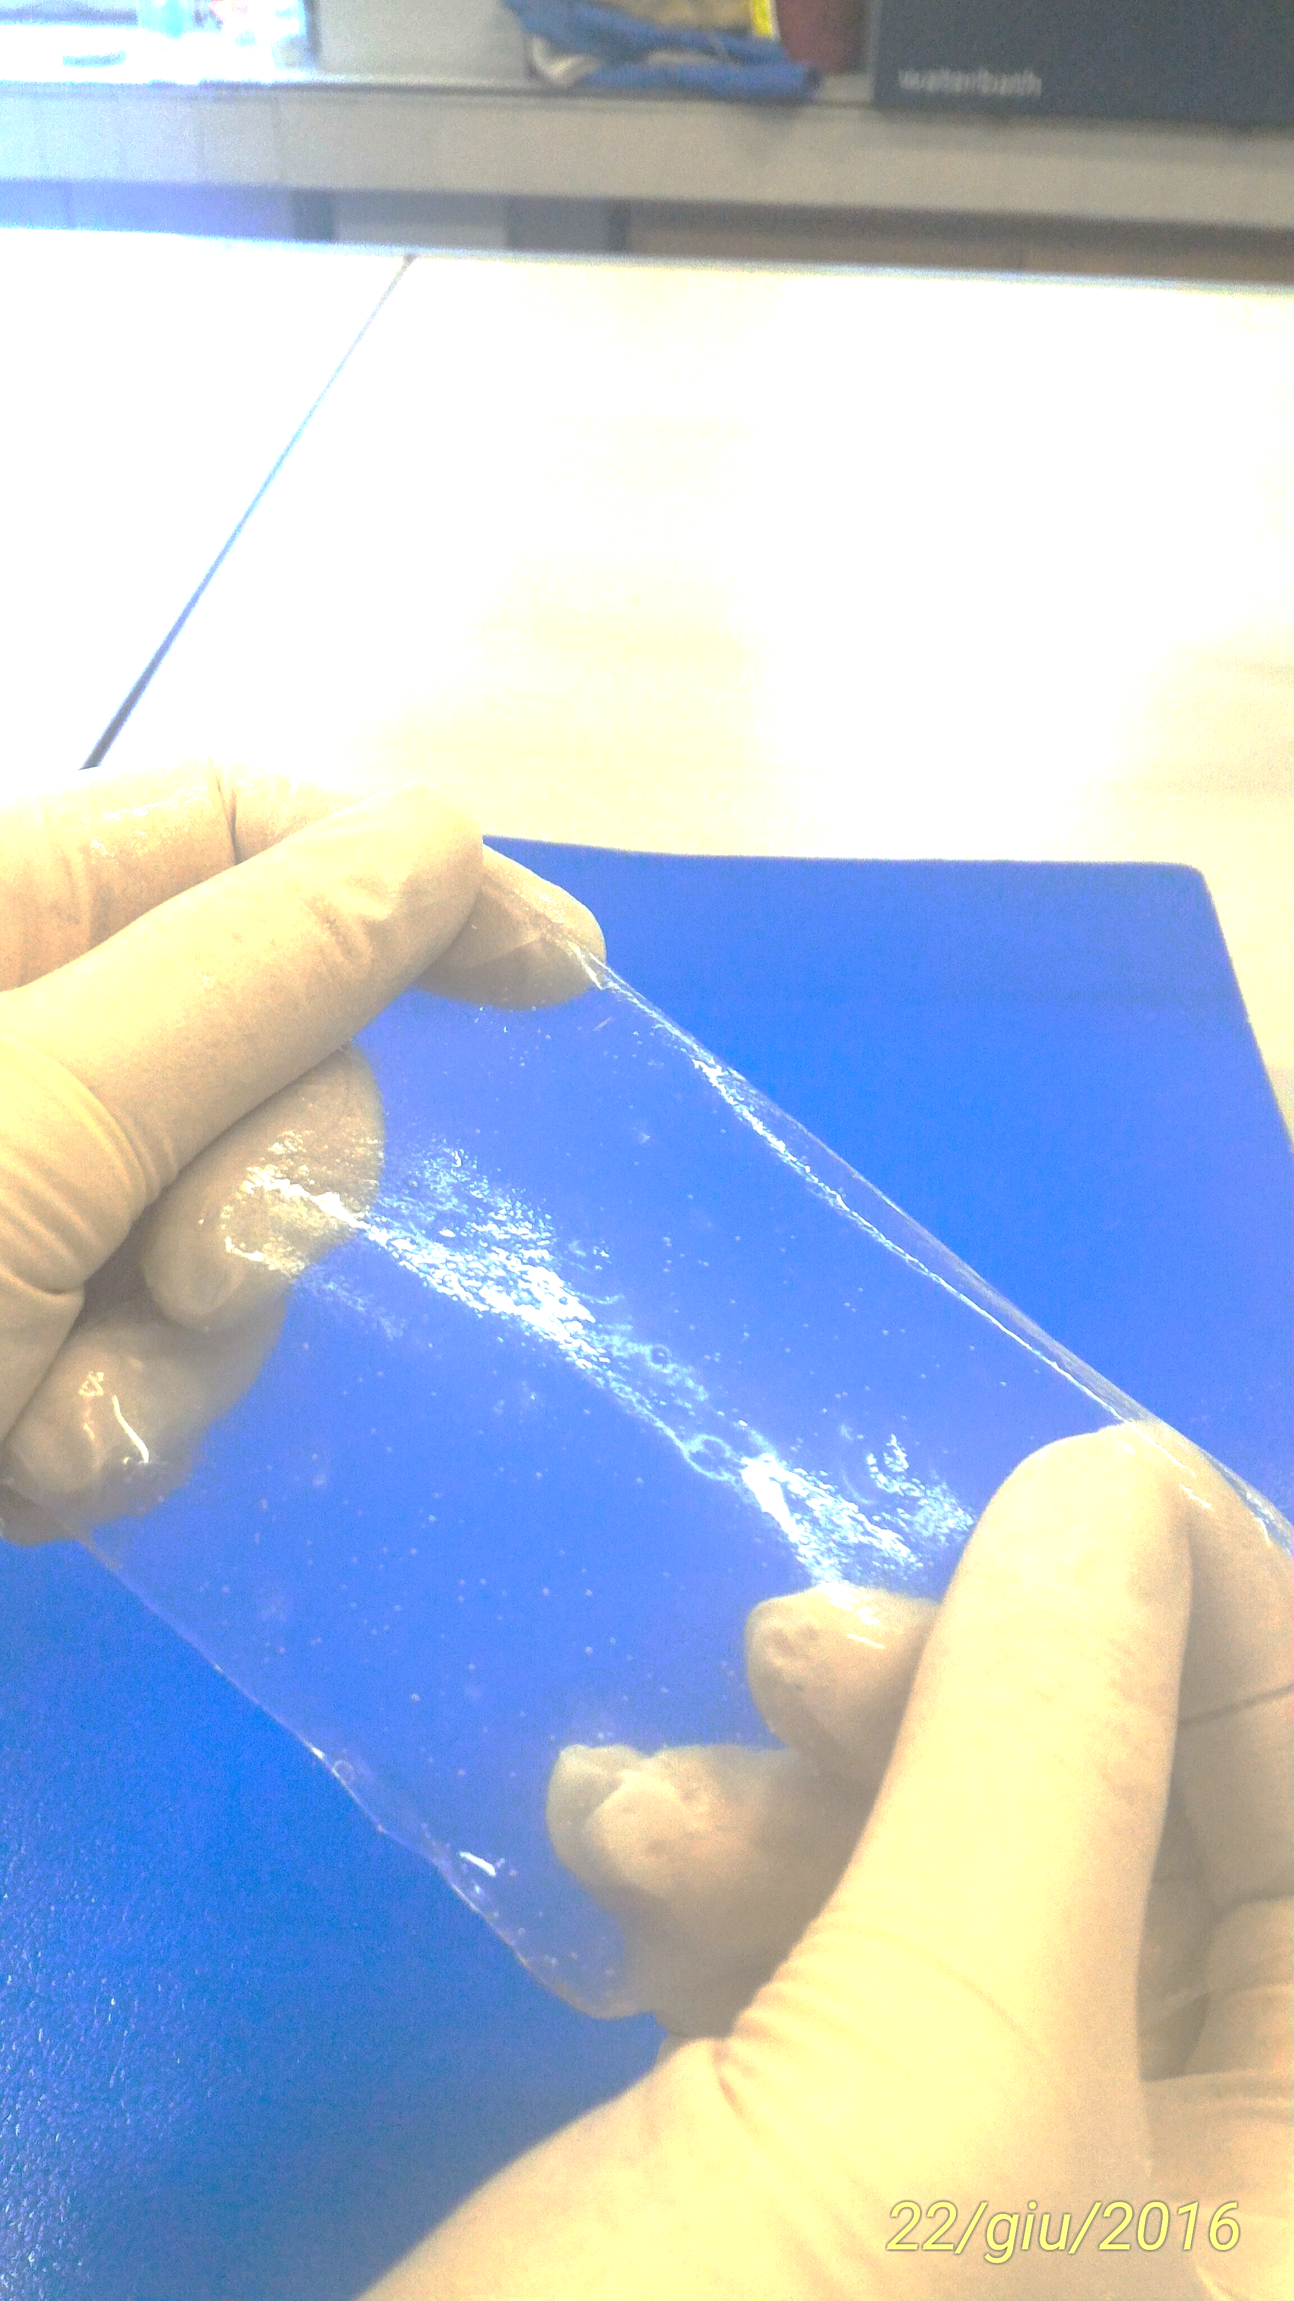
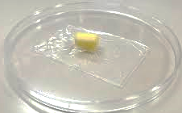
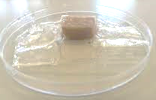
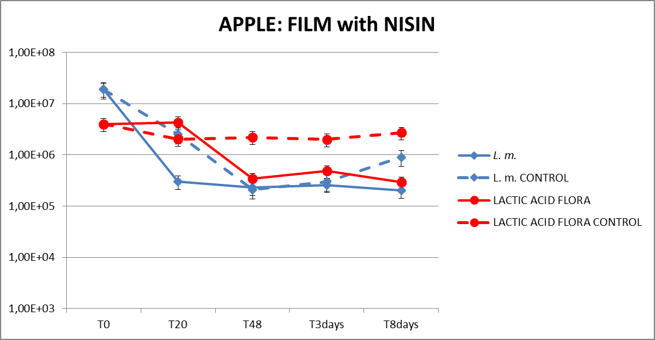
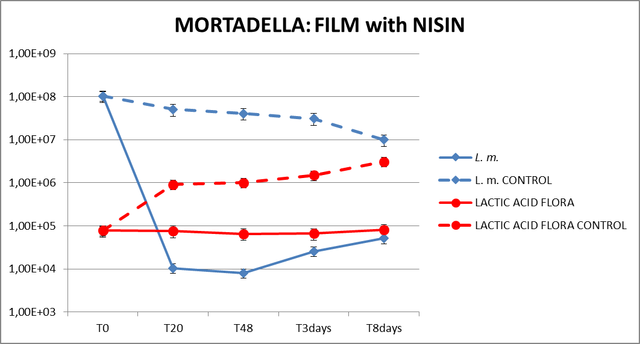
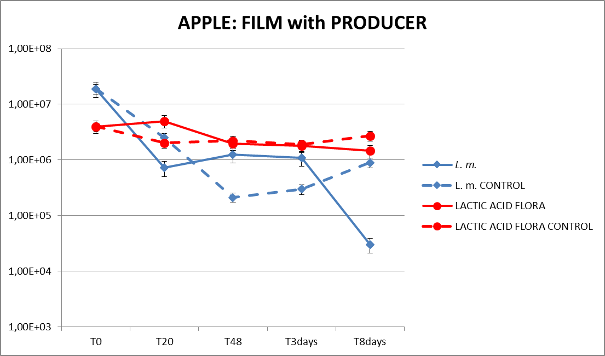
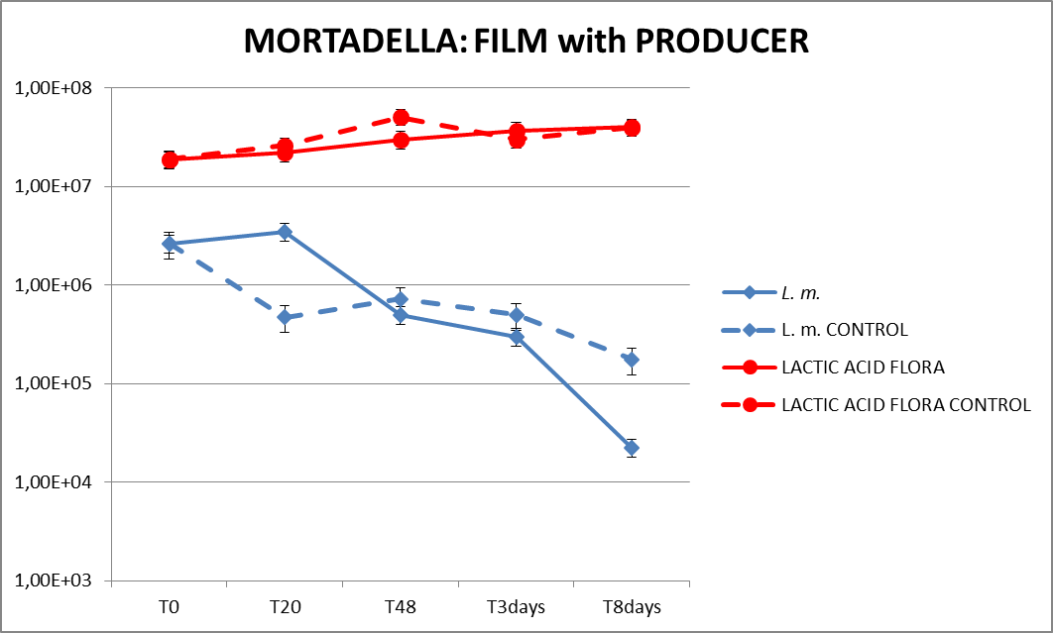
Natural antimicrobial peptides and their use in edible food films
Authors: Dr. PhD Immacolata Anacarso; Dr. Elisa Pino
Natural antimicrobial peptides can belong to different protein families founding in particular in plant, molds and bacteria as a part of innate immune responses as well as defence barrier (1).
The FAO (Food and Agriculture Organization) has indicated that about one-third of the produced food is wasted every year because of shelf-life expiring, alteration or spoilage due to bacterial activity (2). About antimicrobial peptides, bacteriocins are a large group of bioactive peptides ribosomally synthetized by bacteria with antimicrobial activity, usually against other bacteria taxonomically related but also unrelated when with a narrow spectrum (3).
Bacteriocins in the last years have attracted always more interest because of their use as safe food preservatives also because they are easily digested by human gastrointestinal tract (4). For these reasons, they could be used to inhibit or limit foodborne pathogen growth and consequently to increase also the shelf-life of food, limiting their waste.
We are showing results about an edible and antimicrobial film which composition we patented (Patent n° 102018000006424 at UIBM in Italy) in which it is possible to insert a bacteriocin like Nisin or its producer Lactococcus lactis producing it on site.
Our study was a 30 days long challenge test using two different edible films, one made antimicrobial using pure Nisin (Sigma Aldrich) and the other one using the producer Lactococcus lactis ATCC 19435 (Sigma Aldrich) to wrap a fruit (apple) and a meat product (mortadella) artificially contaminated with L. monocytogenes NCTC 10888.
We started with a centrifuged liquid culture of L. lactis, washed twice with physiological solution to eliminate media culture, then we saved the pellet and dissolved it in physiological solution to use in the mixture film, to obtain a final concentration of about 10⁶/ml of bacteria. The same process was done about Listeria that we dissolved it in 100 ml of physiological solution and used to contaminate the food by immersion then dried under the air flow of a biological hood for 5 minutes.
About film production, we mixed two different solutions, the first one composed by the powder of NaCl, sodium alginate and pectin; the second one composed by water and glycerol.
The mixture obtained was boiled for 10-15 minutes to dissolve all components and then it was cooled to reach 50°C. Then, we used this preparation to create two different film:
Film with Lactococcus lactis: in this case, we added the amount of bacterial solution to obtain a final concentration of about 10⁶/ml.
Film with Nisin: in this case, we added an amount of pure bacteriocin to obtain the final concentration of 1%.
APPLE
MORTADELLA
Both films, after over-night at 4°C, were polymerized by 2% calcium chloride and washed with purified water.
Some cubes (dimension 1.5 cm³) of apple and mortadella were immersed for 15 minutes into a solution of L. monocytogenes NCTC 10888 with the concentration said before.
We made two parallel challenge tests of 8 days plus a final evaluation at 30th day of conservation, using both apple and mortadella, but using in one hand film with Nisin and in the other hand film with producer to wrap these products. For negative control of Listeria and lactic acid indigenous flora we wrapped the food products without antimicrobial substances (Nisin or producer).
The results we obtained were very encouraging showed for both films high decrease of Listeria count. In particular, the film containing Nisin showed capacity to decrease L. monocytogenes count of both apple and mortadella artificially contaminated of about 2 log and 4 log respectively.
About the film containing the producer L. lactis ATCC 19435 the reduction obtained was of 3 log and 2 log for the apple and mortadella respectively artificially contaminated and wrapped with this film.
The evaluation at 30th day of conservation at 4°C showed either apple and mortadella with a good organoleptic characteristics as smell, colour and texture. This proves that the our film has a selective permeability to atmospheric gases. In particular the apple had no visible signs of oxidation.
Our antimicrobial and edible films were composed exclusively of edible and biodegradable ingredients, easy to reach and low-cost, meeting environment and companies requests. It increases food shelf-life, reducing food waste, using a bacteriocin, named Nisin or its producer L. lactis that being a probiotic bacteria can be ingested giving benefits by consumers in particular by lactose intolerant people that can ingest this film like probiotic integrator. Thanks to its characteristics, our antibacterial film is a potential solution to the actual environment problems, to packaging and food business and to consumers’ requests increasingly aware of the quality of food on their tables
Diamond, G., Beckloff, N., Weinberg, A., and Kisich, K. O. (2009). The roles of antimicrobial peptides in innate host defense. Curr. Pharm. Des. 15, 2377–2392. doi:10.2174/138161209788682325
Ludmila Motelica, Denisa Ficai, Anton Ficai, Ovidiu Cristian Oprea, Durmuş Alpaslan Kaya, and Ecaterina Andronescu (2020). Biodegradable Antimicrobial Food Packaging: Trends and Perspectives. Foods 9, 1438.
Célia C. G. Silva,* Sofia P. M. Silva, and Susana C. Ribeiro (2018). Application of Bacteriocins and Protective Cultures in Dairy Food Preservation. Front Microbiol. 9, 594.
Mills S., Serrano L., Griffin C., O’connor P. M., Schaad G., Bruining C., et al. (2011). Inhibitory activity of Lactobacillus plantarum LMG P-26358 against Listeria innocua when used as an adjunct starter in the manufacture of cheese. Microbial Cell Factories 10, S7.

