Slide 1
Lab-on-chip platform for on-field analysis of Grapevine leafroll-associated virus 3
Ilaria Buja^{1,2}*, Erika Sabella³, Anna Grazia Monteduro^{1,2}, Maria Serena Chiriacò^{,2}, Rizzato Silvia^{1,2}, Luigi De Bellis³, Andrea Luvisi³and Giuseppe Maruccio^{1,2}
1 Department of Mathematics and Physics “Ennio De Giorgi”, University of Salento, Omnics Research Group,
Via per Monteroni, 73100 Lecce, Italy;
2 Institute of Nanotechnology, CNR NANOTEC, Via per Monteroni, 73100 Lecce, Italy;
3 Department of Biological and Environmental Sciences and Technologies, University of Salento, via Monteroni, Lecce, 73100, Italy
* Corresponding author: Ilaria.buja@unisalento.it

Slide 2
Abstract:
Human activities, especially the globalization of trade or tourism mass, had lead to he spreading of phytopathological adversities, all over the world.
These pathogens can have serious economic/environmental repercussions, due to the absence of therapeutic techniques and the need of rapid, in-field and low-cost detection methods.
Here we present a Lab-on-chip (LOC) platform, with electrochemical transduction method, recognizing serial dilutions of Grapevine leafroll-associated virus 3 (GLRaV-3).
LOC require small sample volumes, allowing a rapid detection of the target.
Keywords: Plant pathogens, environmental monitoring, sensors, lab-on-chip

Slide 3
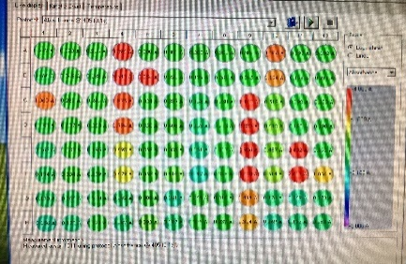
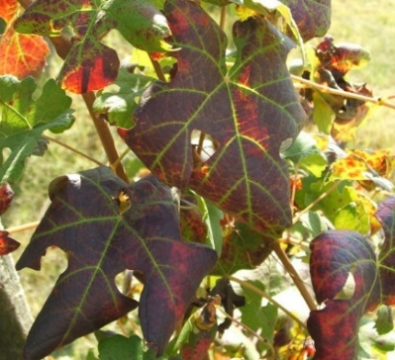
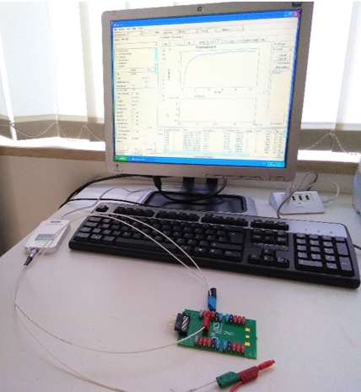
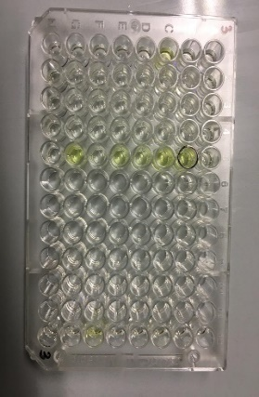
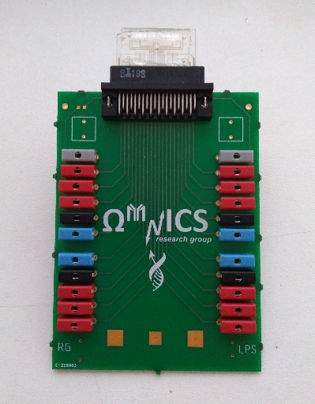
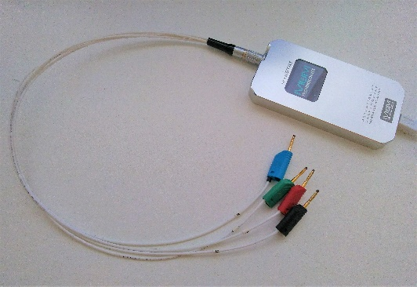
ELISA TEST
Host
Vector
Pathogen
(Maree et al., 2013 – licensed under the Creative Commons Attribution.)
(Adapted from Wikimedia Commons - licensed under the Creative Commons Attribution.)
(Scagliusi et al., 2002 – licensed under the Creative Commons Attribution.)
Significant yield losses!
An estimated economic impact from $ 25,000 to $ 40,000 per hectare,
in the absence of any control measure (Atallah et al., 2012)

Slide 4
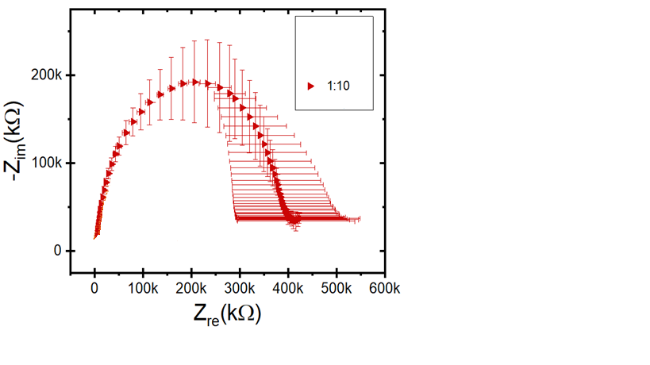
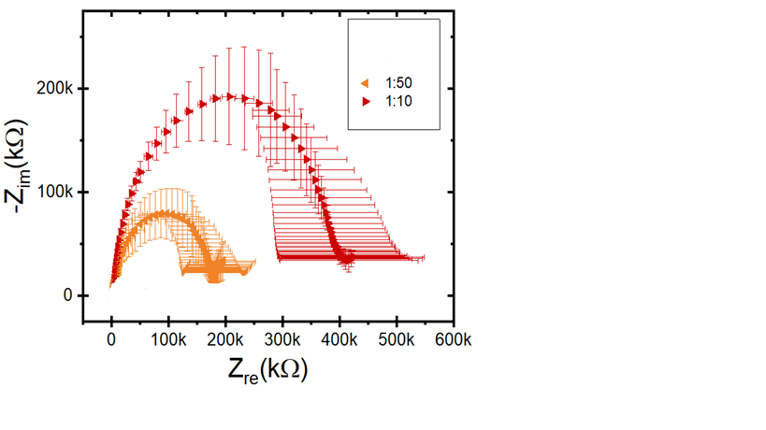
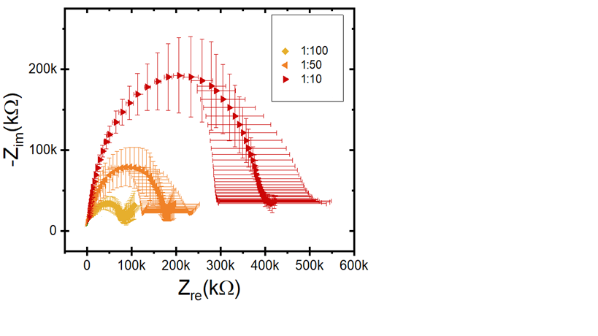
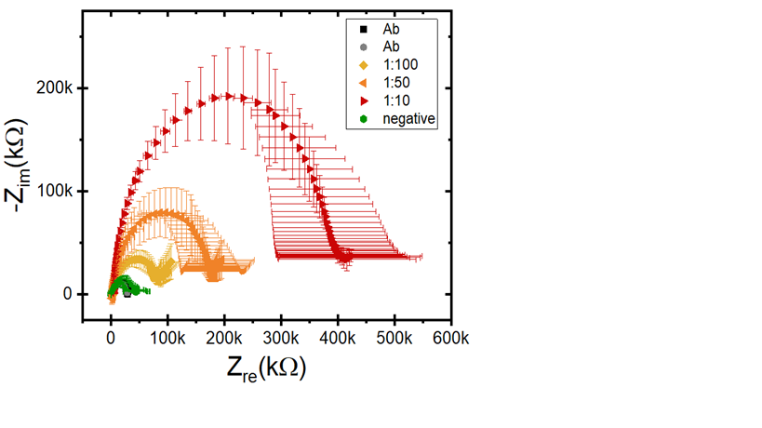
Results and discussion
ELISA test
Sample dilution | LOC | ELISA
1:3 | + | +
1:5 | + | +
1:10 | + | -
1:20 | + | -
1:50 | + | -
1:100 | + | -
1:1000 | - | -
CURRENT DETECTION METHODS
Blouin, A. et al., 2017;
Rowhani, A. et al., 2017;
Bendel et al., 2020.
The electron transfer resistance is about 40 kΩ after immobilization of the GLRaV-3 antibody and healthy sample.

Slide 5
Conclusions
LOC devices shows higher sensitivity compared to ELISA test.
This device can be competitive with conventional diagnostic methods for costs and portability, making the difference in real time detection of the pathogens.
Due to its ease of use, sensibility and specificity, is possible to extend its application, for the detection of other viruses.

Slide 6
THANKS FOR
YOUR ATTENTION!

Slide 7
Supplementary Materials
Links:
Maree, H. J.; Almeida, R. P. P.; Bester, R.; Chooi, K. M.; Cohen, D.; Dolja, V. V.; Fuchs, M. F.; Golino, D. A.; Jooste, A. E. C.; Martelli, G. P.; Naidu, R. A.; Rowhani, A.; Saldarelli, P.; Burger, J. Grapevine Leafroll-Associated Virus 3. Front. Microbiol. 2013, 4. https://doi.org/10.3389/fmicb.2013.00082.
Scagliusi, S. M. M.; Vega, J.; Kuniyuki, H. Cytopathology of Callus Cells Infected with Grapevine Leafroll-Associated Virus 3. Fitopatologia Brasileira 2002, 27 (4), 384–388. https://doi.org/10.1590/S0100-41582002000400008.
Atallah, S. S.; Gómez, M. I.; Fuchs, M. F.; Martinson, T. E. Economic Impact of Grapevine Leafroll Disease on Vitis Vinifera Cv. Cabernet Franc in Finger Lakes Vineyards of New York. Am J Enol Vitic. 2012, 63 (1), 73–79. https://doi.org/10.5344/ajev.2011.11055.
Buja, I.; Sabella, E.; Monteduro, A. G.; Chiriacò, M. S.; De Bellis, L.; Luvisi, A.; Maruccio, G. Advances in Plant Disease Detection and Monitoring: From Traditional Assays to In-Field Diagnostics. Sensors 2021, 21 (6), 2129. https://doi.org/10.3390/s21062129.

Slide 8
Supplementary Materials
Links:
Blouin, A. G.; Chooi, K. M.; Cohen, D.; MacDiarmid, R. M. Serological Methods for the Detection of Major Grapevine Viruses. In Grapevine Viruses: Molecular Biology, Diagnostics and Management; Meng, B., Martelli, G. P., Golino, D. A., Fuchs, M., Eds.; Springer International Publishing: Cham, 2017; pp 409–429. https://doi.org/10.1007/978-3-319-57706-7_21.
Rowhani, A.; Osman, F.; Daubert, S. D.; Al Rwahnih, M.; Saldarelli, P. Polymerase Chain Reaction Methods for the Detection of Grapevine Viruses and Viroids. In Grapevine Viruses: Molecular Biology, Diagnostics and Management; Meng, B., Martelli, G. P., Golino, D. A., Fuchs, M., Eds.; Springer International Publishing: Cham, 2017; pp 431–450. https://doi.org/10.1007/978-3-319-57706-7_22.
Bendel, N.; Kicherer, A.; Backhaus, A.; Köckerling, J.; Maixner, M.; Bleser, E.; Klück, H.-C.; Seiffert, U.; Voegele, R. T.; Töpfer, R. Detection of Grapevine Leafroll-Associated Virus 1 and 3 in White and Red Grapevine Cultivars Using Hyperspectral Imaging. Remote Sensing 2020, 12 (10), 1693. https://doi.org/10.3390/rs12101693.

Slide 9
Acknowledgments
This work was supported by PON FSE—FESR 2014–2020 (CCI 2014IT16M2OP005)—Axis I “Investments in Human Capital” Action I.1 “Innovative PhDs with industrial characterization”—project DOT1712250 code 1 and by the Italian National FISR-CIPE Project “Inno-Sense”: Development of an innovative sensing platform for on-field analysis and monitoring (delibera CIPE n.78 del 07/08/2017).

