Slide 1
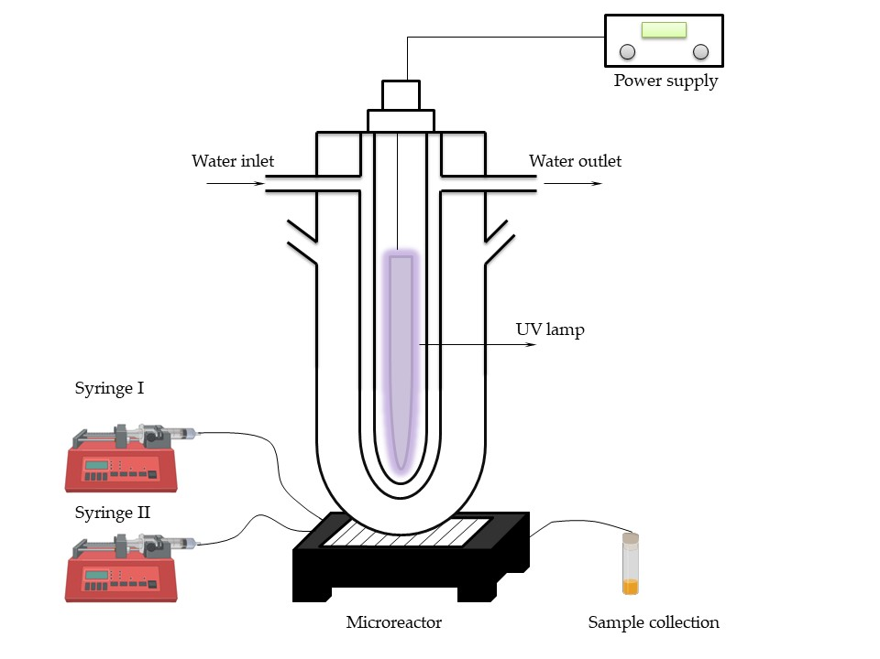
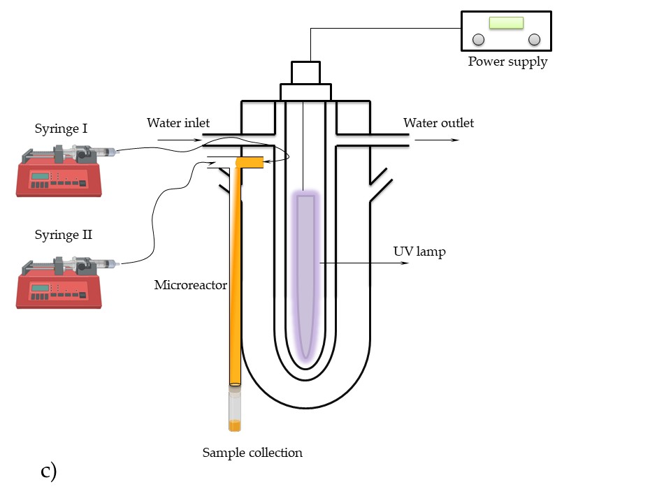
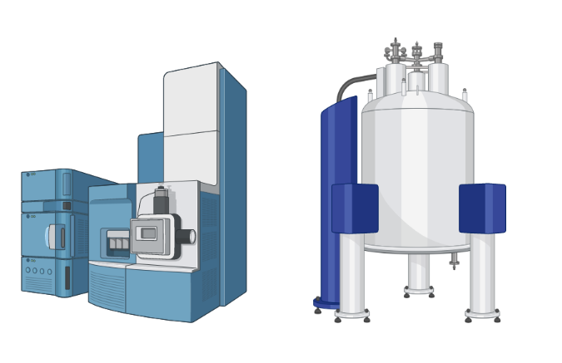
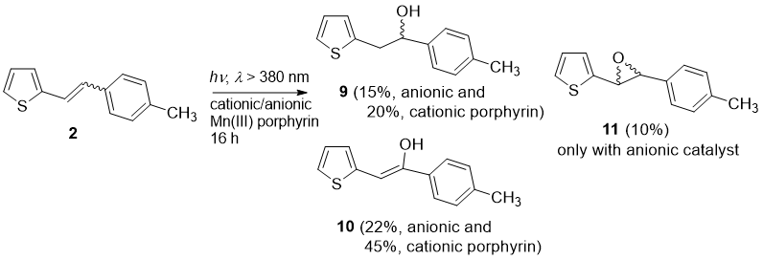
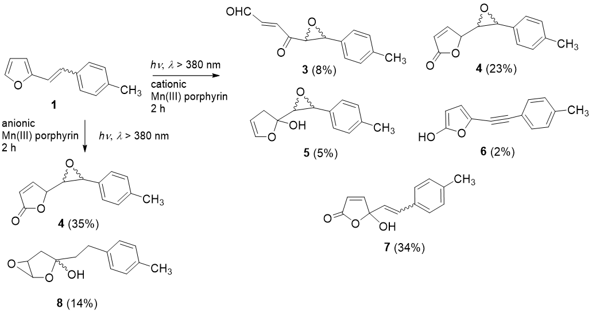
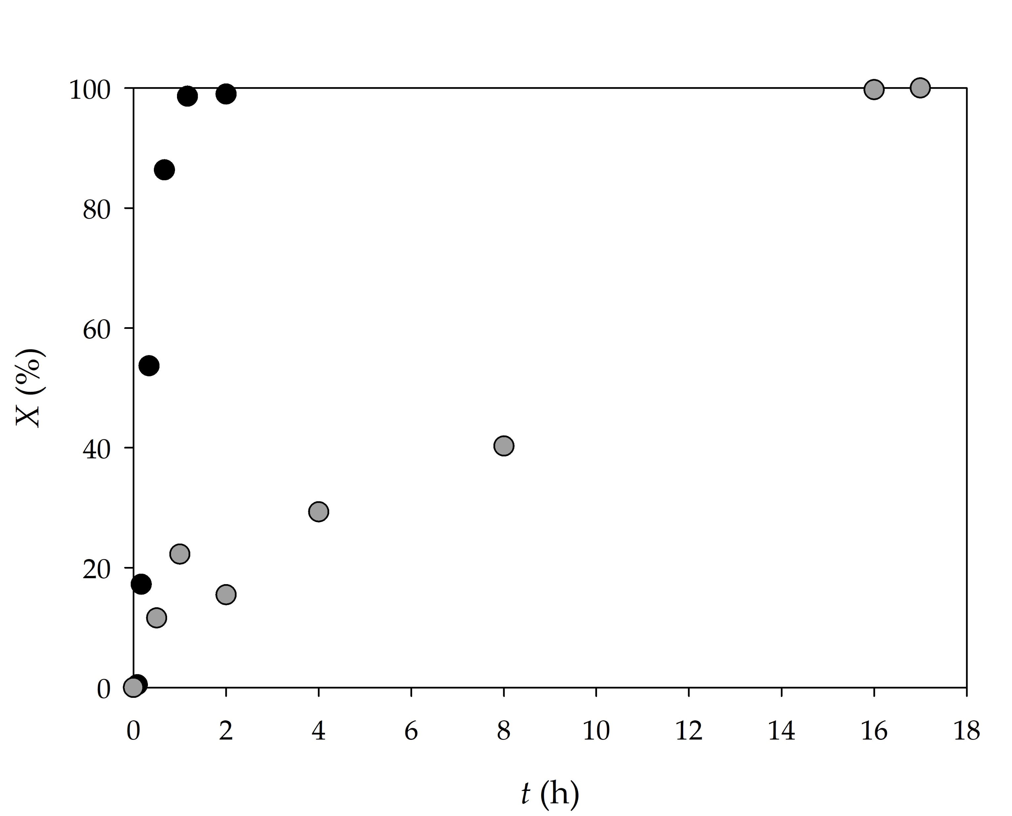
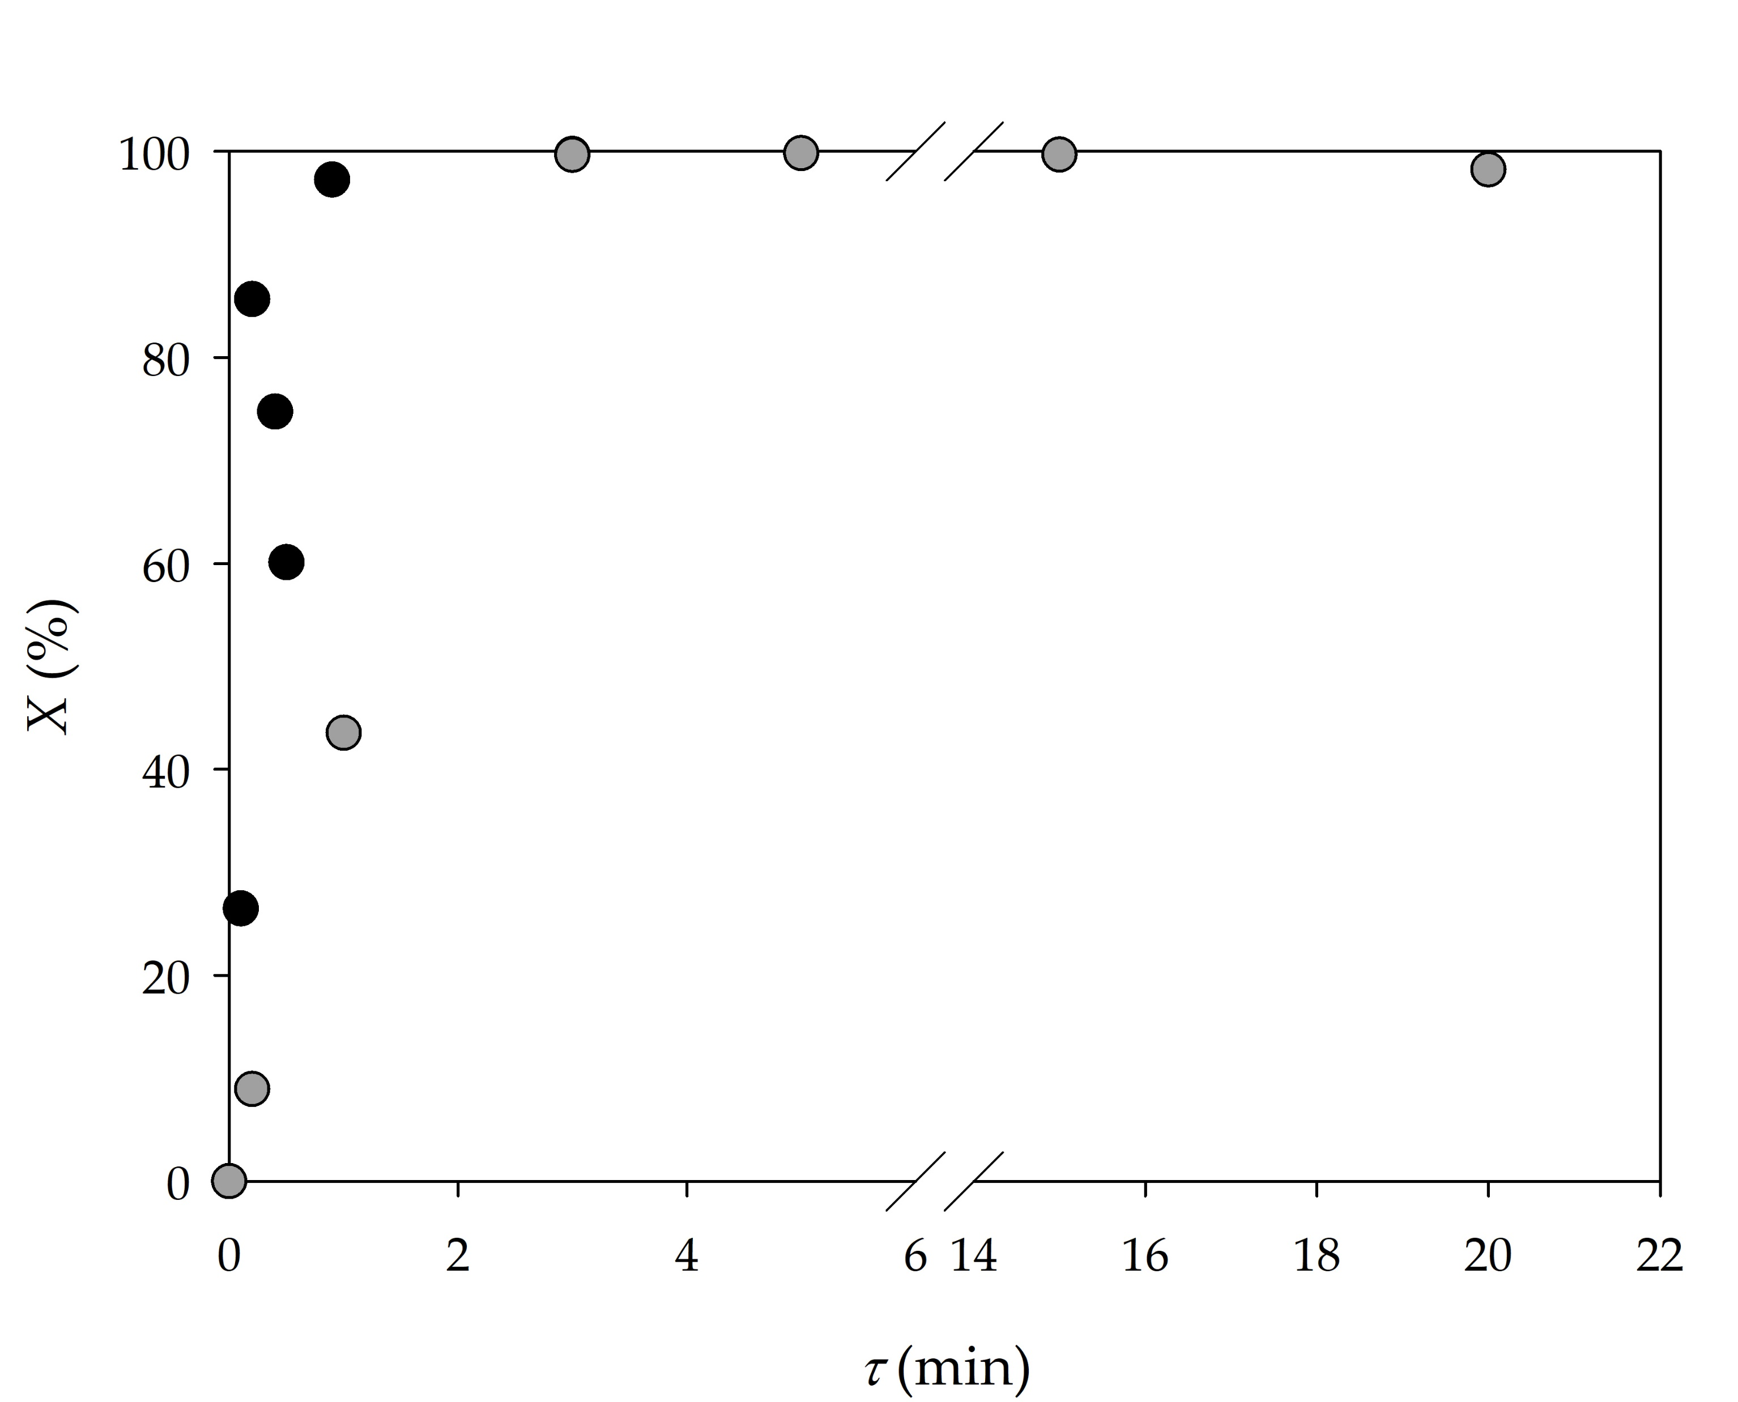
Photocatalytic oxygenation of heterostilbenes in microflow reactors
Matea Bačić¹, Milena Mlakić², Anita Šalić¹, Irena Škorić² and Bruno Zelić¹
¹ Department of Reaction Engineering and Catalysis, Faculty of Chemical Engineering and Technology, University of Zagreb, Marulićev trg 19, HR-10000 Zagreb, Croatia; asalic@fkit.hr mbacic@fkit.hr; bzelic@fkit.hr
² Department of Organic Chemistry, Faculty of Chemical Engineering and Technology, University of Zagreb, Marulićev trg 19, HR-10000 Zagreb, Croatia; mdragojev@fkit.hr; iskoric@fkit.hr
In recent years, photochemistry in microreactors receives a lot of attention from both, researchers in academia and industry area, as this technology provides reduced reaction times, higher selectivity, straightforward scalability, and the possibility to safely use hazardous intermediates and gaseous reactants. Generally, providing photochemistry in a batch reactor is limited by poor light penetration, therefore, scaling up to larger batch reactors is impractical. Consequently, performing photochemistry in a continuous flow has been indicated as a widely suitable method to perform photochemical reactions on larger scales. In the past decade, microscale technology has enormously improved, using the features proper to the microscale, such as small amounts of fluid, short molecular diffusion distance, intensified heat and mass transfers, safety to upgrade reaction selectivity and yield. For photochemistry, microreactors offer additional advantages, namely higher spatial illumination homogeneity and better light penetration throughout the entire reactor depth than in large-scale reactors. Promising results are obtained in reactions where porphyrin complexes coordinated with certain metals are used as catalysts and the most common one, that is also used for these reactions, are manganese porphyrins. A significant shift in photochemical synthesis can be noticed as a result of microreactor technology application (reduction of reaction time, the minimum amount of different by-products,.. ). In this research, a total of four different tubular microflow reactors (one with winding geometry and three with straight microchannel) were studied and compared with results obtained in a batch reactor based on substrate conversion and reaction time.
INVESTIGATION
Water inlet
Water outlet
Power supply
Sampling
port
O₂ inlet
UV lamp
Reaction mixture
START
4
1
2
3
PRESENT
BATCH
PROCESS
MICROREACTOR
- STRAIGHT CHANNEL
MICROREACTOR
- WINDING GEOMETRY
ANALYSIS
RESULTS
Table 1. Reaction rates and rate constants of selected reactions
Catalyst | Substrate (S) | c (mol dm⁻³) | c_{cat} (mol dm⁻³) | r (mol dm⁻³ h⁻¹) | Confidence interval | k (h⁻¹)
CATIONIC | FH | 0.00113 | 11·10⁻⁵ | 8.61·10⁻⁵ | 8.31·10⁻⁶ | 0.045
 | FH | 0.00225 | 11·10⁻⁵ | 1.38·10⁻⁴ | 1.05·10⁻⁵
 | FH | 0.00450 | 11·10⁻⁵ | 1.36·10⁻⁴ | 1.69·10⁻⁵
 | TH | 0.00120 | 11·10⁻⁵ | 1.59·10⁻³ | 1.19·10⁻⁴ | 1.338
 | TH | 0.00245 | 11·10⁻⁵ | 1.55·10⁻³ | 4.29·10⁻⁴
 | TH | 0.00490 | 11·10⁻⁵ | 7.17·10⁻³ | 6.02·10⁻⁴
ANIONIC | FH | 0.00113 | 9.8·10⁻⁵ | 5.56·10⁻⁵ | 9.57·10⁻⁷ | 0.052
 | FH | 0.00225 | 9.8·10⁻⁵ | 1.04·10⁻⁴ | 1.41·10⁻⁵
 | FH | 0.00450 | 9.8·10⁻⁵ | 2.50·10⁻⁴ | 5.79·10⁻⁵
 | TH | 0.00120 | 9.8·10⁻⁵ | 2.83·10⁻³ | 7.14·10⁻⁴ | 1.503
 | TH | 0.00245 | 9.8·10⁻⁵ | 9.93·10⁻³ | 2.60·10⁻⁴
 | TH | 0.00490 | 9.8·10⁻⁵ | 6.57·10⁻³ | 6.53·10⁻⁴
Figure 1. Comparison of the photocatalytic oxygenation process performed in a) a batch reactor and b) a winding channel geometry microflow reactor (• thienyl, • furyl as substrate)
Table 2. Comparison of conversions obtained in different microflow reactors for the residence time of τ = 0.2 min
Microflow reactor geometry |  | Reaction
 |  | c(FH) = 0.00225 mol dm⁻³ c_{cationic} = 11·10⁻⁵ mol dm⁻³ | c(TH) = 0.00245 mol dm⁻³ c_{anionic} = 9.8·10⁻⁵ mol dm⁻³
 |  | X (%) | X (%)
Winding channel |  | 8.92 | 85.66
Straight channel | I. | 4.84 | 82.49
 | II. | 4.61 | 81.64
 | III. | 3.89 | 80.94
According to the results, both the products and the conversion rates in the photocatalytic oxygenation of furo-(FH) and thieno (TH) heterostilbenes were highly affected by the heteroatom in the aromatic moiety and the charge of the manganese(III) porphyrin catalysts. Based on the reaction rate constants, the furyl derivate proved to be more reactive than the thienyl one as already demonstrated. Also, reactions carried out with the cationic catalyst were slower than those performed with the anionic porphyrin. (Table 1.) A total of four different tubular microflow reactors were studied and compared with results obtained in a batch reactor, based on substrate conversion, formed products and reaction time. The obtained results are summarized in Table 2. and Figure 1. The reactions were significantly accelerated in microflow reactors, where the complete conversions for substrates furyl (FH) and thienyl (TH) were observed for residence times of 3.5 and 0.7 min, respectively.
References:
* Mlakić, M.; Šalić, A.; Bačić, M.; Zelić, B.; Šagud, I.; Horváth, O.; Škorić, I. Photocatalytic Oxygenation of Heterostilbenes—Batch versus Microflow Reactor. Catalysts 2021, 11, 395.

