Slide 1
Droplet formation in a cross-junction with non-Newtonian dispersed phase
Maryam Fatehifar ^{1,}*, Alistair Revell ¹, and Masoud Jabbari ¹
Department of Mechanical, Aerospace and Civil Engineering, University of Manchester, Manchester, M13 9PL, UK
* Corresponding author: maryam.fatehifar@manchester.ac.uk

Slide 2
Abstract
Microfluidics enables generating series of isolated droplets for high-throughput screening. As many biological/chemical solutions are of shear thinning non-Newtonian nature [1,2], we studied non-Newtonian droplet generation to improve the reliability of simulation results in real-life assays. We considered non-Newtonian power-law behaviour for Xanthan gum aqueous solution as the dispersed phase, and Newtonian canola oil as the continuous phase. Simulations were performed in OpenFOAM, using the interFoam solver and volume of fluid (VOF) method [3].
A cross-junction geometry with each inlet and outlet channel height (H) and width (W) equal to 50 micrometer with slight contractions in the conjunctions was used to gain a better monodispersity. Following validation of the numerical setup, we conducted a series of tests to provide novel insight into this configuration.
With Capillary number ($Ca=μ_{c}U_{c}/σ$), of 0.01, dispersed phase to continuous phase flow-rate ratio of 0.05, and contact angle of 160˚, simulations revealed that by increasing the Xanthan gum concentration (0, 800, 1500, 2500 ppm) or in other words, decreasing the n -flow behaviour index- from 1 to 0.491, 0.389, and 0.302 in power-law model [4] : (a) breakup of the dispersed phase thread occurred at 0.0365, 0.0430, 0.0440, 0.0450 s; (b) the dimensionless width of the thread ($W_{thread}/W$) at the main channel entrance increased from 0 to 0.066, 0.096, 0.16; and (c) the dimensionless droplet diameter ($D_{droplet}/W$) decreased from 0.76 to 0.72, 0.68, 0.67, respectively. Our next plan is to study effect of shear-thinning behaviour on droplet generation in different Ca and flow-rate ratios.
Keywords: droplet microfluidics; non-Newtonian fluid; volume of fluid

Slide 3
High-throughput Screening
Technology
Engineering
Natural Science
Biomedical Technology
prediction, diagnosis, and treatment of various inherited and acquired illnesses.
Traditional biomedical tests are:
being laborious
time-consuming
expensive
in need of experienced operator
High-throughput screening (HTS) has been developed which refers to scientific experimental methods allowing rapid conduction of series of chemical and biological tests.
Introduction
Methodology
Result and Discussion
Conclusion

Slide 4
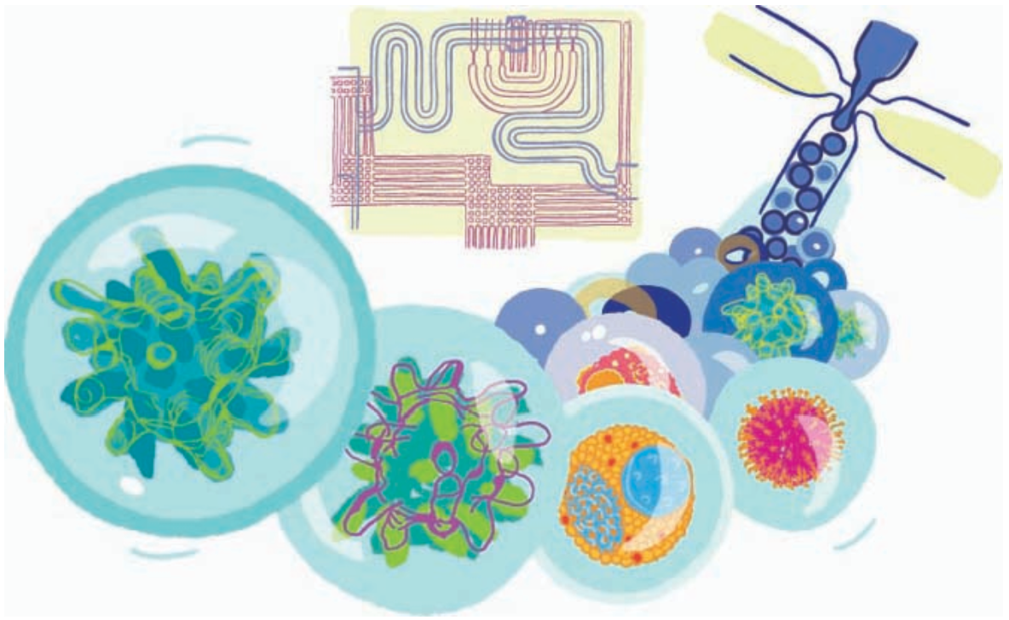
Microfluidic Technology
Microfluidics is becoming a preferred choice for research and diagnosis due to two main reasons:
low sample/ reagent consumption and high processing speed
extreme flow confinement (Re < 1) high control over the fluid molecules in space and time
Droplet-based microfluidics
an intriguing subject with promising future
enables control over:
volume
frequency
composition
Fig 1- Droplet microfluidics
(Taken from https://www.kth.se/pro/nanobio/droplet-microfluidics-1.366373)
Introduction
Methodology
Result and Discussion
Conclusion

Slide 5
Microfluidic CFD
Many researches have used CFD tools to investigate the microfluidic devices behaviour including droplet generation in different regimes and novel geometries.
Computational fluid dynamics (CFD) can investigate
influence of different physical parameters
their relations to generated droplets size/ frequency
in a less expensive systematically manner.
Yet, there are some aspects in need of further investigation so that the CFD results would become more reliable and accurate.
Introduction
Methodology
Result and Discussion
Conclusion

Slide 6
Aim of Research
Aim:
Generating series of non-Newtonian isolated droplets for high-throughput screening
Justification:
Many biological/chemical solutions used in biotechnology
shear thinning non-Newtonian
Most studies consider Newtonian fluids
To improve the reliability of simulation results in real-life assays
Introduction
Methodology
Result and Discussion
Conclusion

Slide 7
Governing Equations
Volume of Fluid (VOF) Navier-Stokes equations for both fluids is combined with advection equation for the fluid fraction α
$$∇.U=0$$ | (Equation 1)
$$ρ\left(\frac{∂U}{∂t}+U.∇U\right)=−∇P+ρg+∇.μ(∇U+∇U^{T})+F_{s}$$ | (Equation 2)
$$\frac{∂α}{∂t}+∇.\left(Uα\right)=0$$ | (Equation 3)
$ρ=ρ_{1}α+ρ_{2}(1−α)$ | (Equation 4)
$$μ=μ_{1}α+μ_{2}(1−α)$$ | (Equation 5)
$$μ\left(γ\right)=Kγ^{n−1}$$ | (Equation 6)
VOF
Power-law Fluid:
Introduction
Methodology
Result and Discussion
Conclusion

Slide 8
Software
Software:
OpenFOAM 8
Free, open source CFD software developed primarily by OpenCFD Ltd since 2004.
Solver : interFoam
Solver for 2 incompressible, isothermal immiscible fluids using a VOF
Multidimensional universal limiter with explicit solution (MULES) algorithm to solve the advection equation for the volume fraction
Introduction
Methodology
Result and Discussion
Conclusion

Slide 9
Numerical Settings
Pressure-velocity coupling: PISO scheme
Transient terms discretised scheme: first order implicit Euler
Interpolation scheme: linear
Spatial discretisation scheme: combination of second order upwind and central differencing with the van Leer limiter
Maximum Courant number: 0.5
Maximum Courant number of the interface: 0.25
$$Co=U\frac{∆t}{∆X}$$
Introduction
Methodology
Result and Discussion
Conclusion

Slide 10
Fluid Properties
Material:
Dispersed phase: Xanthan gum aqueous solution
non-Newtonian power-law fluid
Continuous phase: canola oil (Newtonian fluid)
Table 1- Properties of the liquids and parameters of the power-law fit of the xanthan solutions [4]
Fluid | Viscosity [Pa.s] | Density [kg/m³] | n | K [Pa.s^{n}]
water | 0.00089 | 997 | - | -
oil | 0.0223 | 930 | - | -
800 ppm (w/w) xanthan/ water | 0.076 | 997 | 0.491 | 0.0755
1500 ppm (w/w) xanthan/ water | 0.312 | 997 | 0.389 | 0.3125
2500 ppm (w/w) xanthan/ water | 0.985 | 997 | 0.302 | 0.985
Introduction
Methodology
Result and Discussion
Conclusion

Slide 11
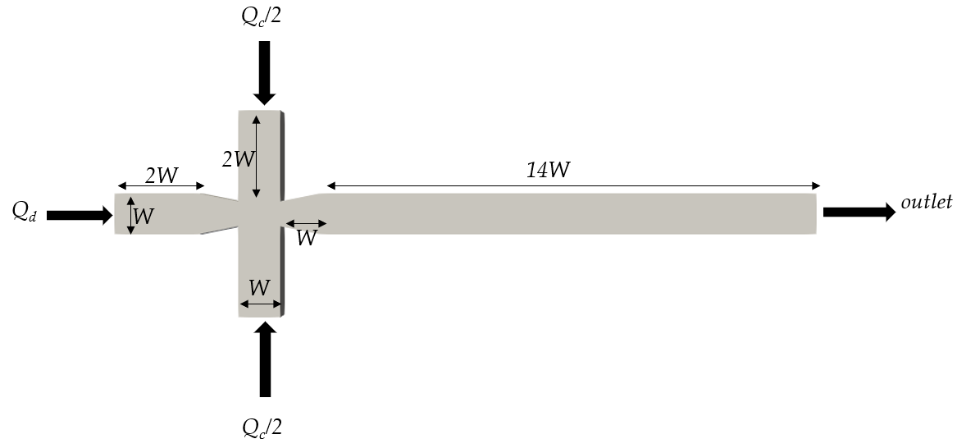
Geometry
Geometry specification:
W= 50 μm
Slope of contraction/expansion = 1/5
Fig 2 - Geometry of studied cross-junction
Introduction
Methodology
Result and Discussion
Conclusion

Slide 12
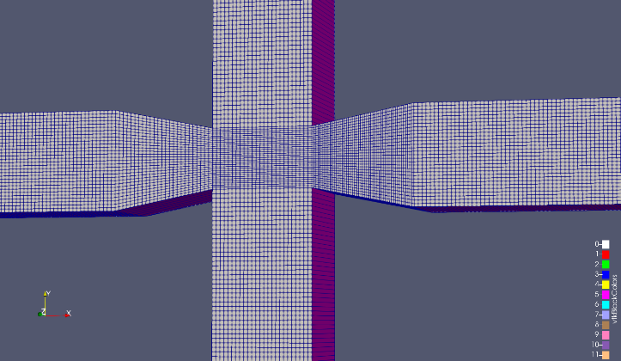
Mesh
Mesh was generated using “blockMesh”
Structured mesh
Different mesh size were studied 25 , 50, 75, 100 per 100 microns
Optimum: 50 cells per 100 microns accurate results as well as sharp interface
Fig 3 - Meshed geometry
Introduction
Methodology
Result and Discussion
Conclusion

Slide 13
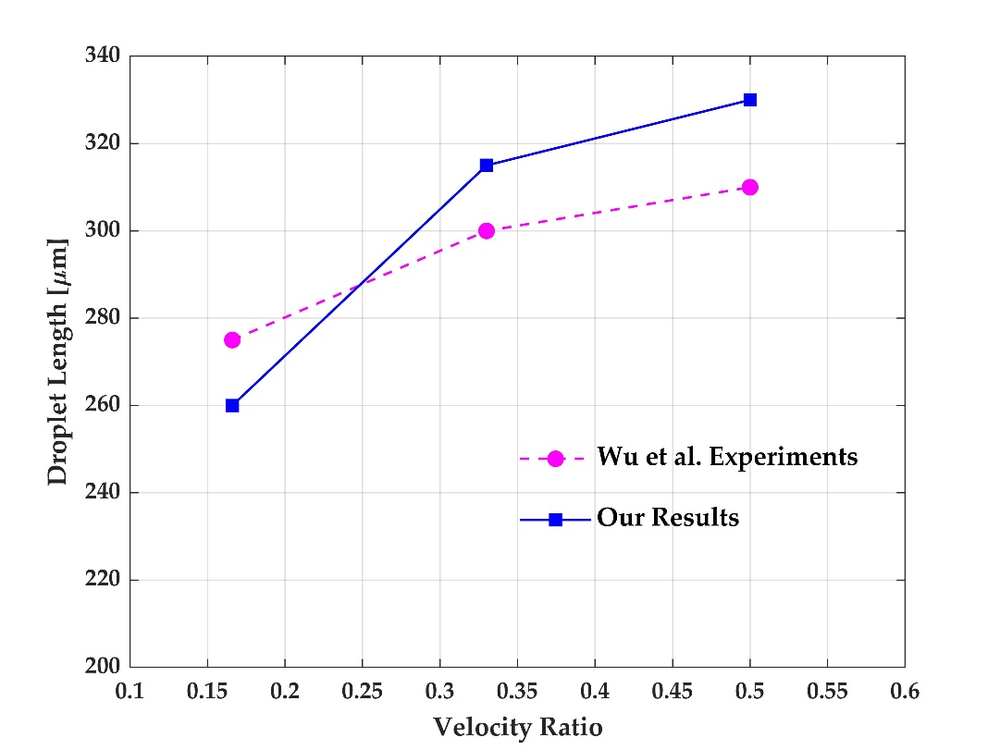
Validation
The results were validated against Wu et al. [6] and error was less than 7% in all studied cases.
Figure 4 - Droplet length results compared against the experimental results of Wu et al. [6] for U_{o} = 0.00252 (m/s) , σ = 30 (mN/m), and μ_{o}/ μ_{w} = 0.416
Introduction
Methodology
Result and Discussion
Conclusion

Slide 14
Results
In the simulations:
the capillary number and flow rate ratio were kept constant:
$$Ca=\frac{μ_{c}U_{c}}{σ}=0.01 ; \frac{Q_{d}}{Q_{d}}=0.05 ; \text{contact} \text{angle} \text{=} \text{160˚}$$
while the concentration of polymer and thus, the power-law index was changed.
Increasing the Xanthan gum concentration (0, 800, 1500, 2500 [ppm])
Decreasing the n from 1 to 0.491, 0.389, and 0.302 in power-law model
Droplet detachment time
Thread width
Droplet diameter
Three effects were studied:
Introduction
Methodology
Result and Discussion
Conclusion

Slide 15
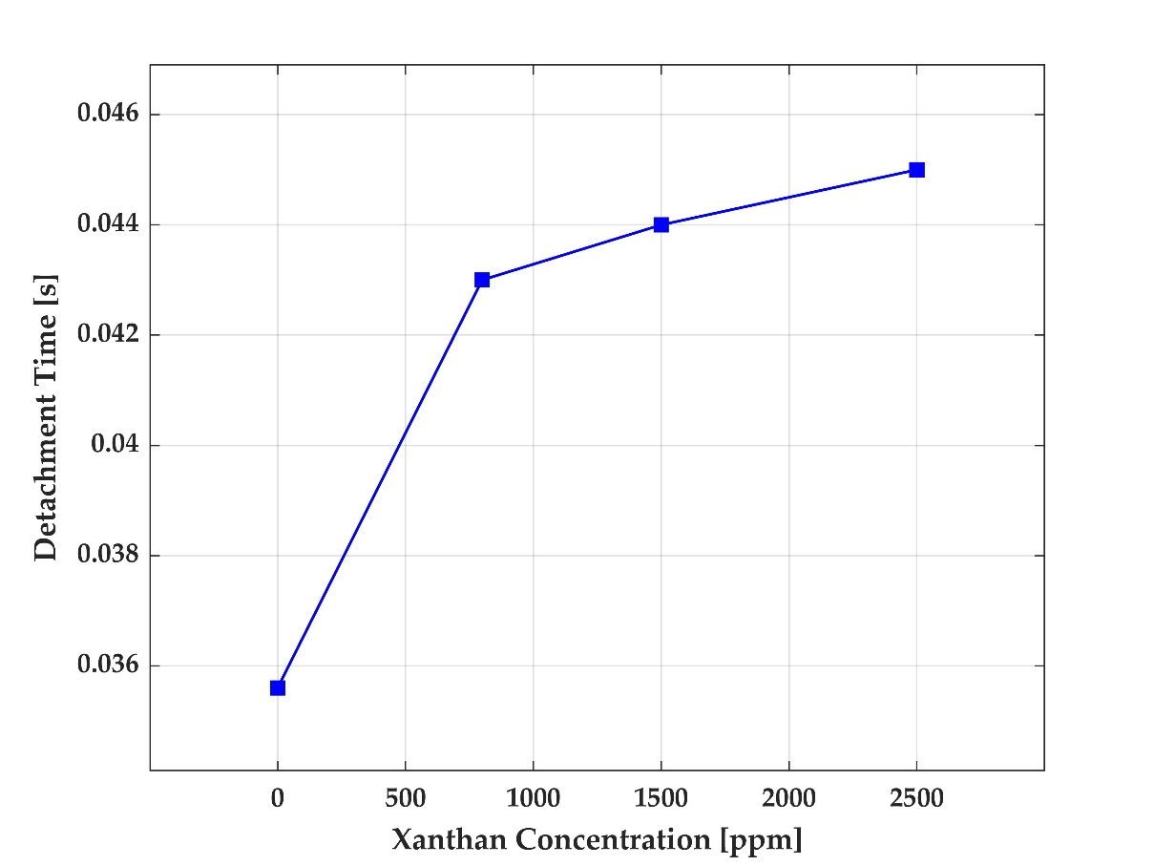
A. Effect on Droplet Detachment Time
Breakup of the dispersed phase thread experienced a delay by up to 23%.
a
b
c
d
Fig 5 – Effect of increasing the polymer concentration on droplet formation
Fig 6 – Effect of the polymer concentration on droplet detachment time
Introduction
Methodology
Result and Discussion
Conclusion

Slide 16
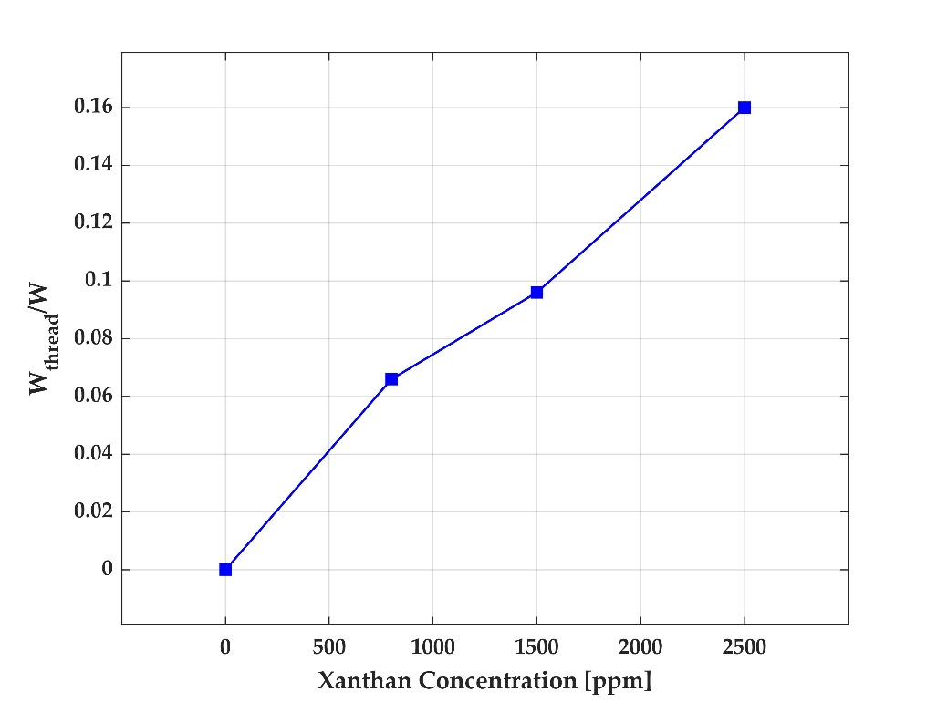
B. Effect on Thread Width
Dimensionless width of the thread ( $\frac{W_{thread}}{W}$ ) at the main channel entrance increased from 0 to 0.066, 0.096, 0.16.
Fig 7 – Effect of the polymer concentration on thread width
Introduction
Methodology
Result and Discussion
Conclusion

Slide 17
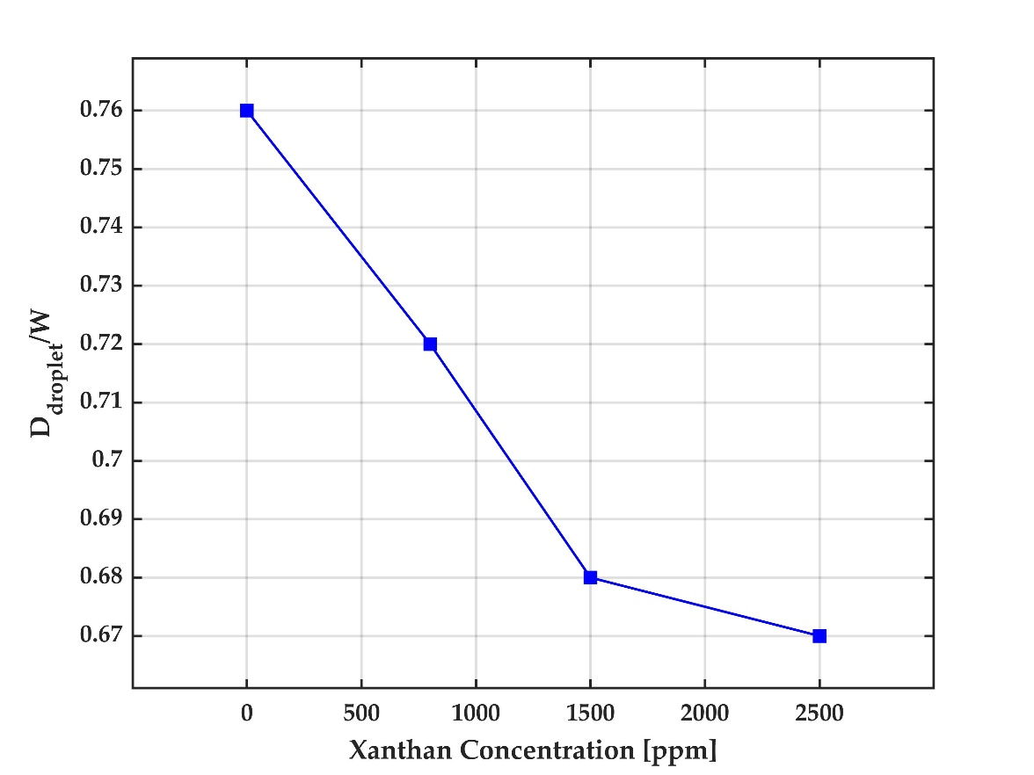
C. Effect on Droplet Diameter
Dimensionless droplet diameter ($\frac{D_{droplet}}{W}$) decreased from 0.76 to 0.72, 0.68, 0.67.
a
b
c
d
Fig 8 – Effect of increasing the xanthan concentration from a) 0, b) 800, c) 1500 d) 2500 [ppm] on droplet formation
Fig 9 – Effect of the polymer concentration on droplet diameter
Introduction
Methodology
Result and Discussion
Conclusion

Slide 18
Conclusion
Many studies that use CFD tools to investigate droplet generation, focus on Newtonian fluids only. As most of solutions used in biological tests are non-Newtonian, this gap was addressed in this research.
By considering non-Newtonian power-law fluid as dispersed phase and simulating the droplet generation using VOF in OpenFOAM 8 software , the following was achieved.
By increasing the polymer concentration:
Droplet detachment time is increased between 18% to 23%.
Necking started to occur and increased respectively.
Dimensionless droplet diameter ( $\frac{D_{droplet}}{W}$ ) decreased between 5.5% to 12%.
Introduction
Methodology
Result and Discussion
Conclusion

Slide 19
References
Eun, Y. J., Utada, A. S., Copeland, M. F., Takeuchi, S., & Weibel, D. B. (2011). Encapsulating bacteria in agarose microparticles using microfluidics for high-throughput cell analysis and isolation. ACS chemical biology, 6(3), 260-266
Khater, A., Abdelrehim, O., Mohammadi, M., Azarmanesh, M., Janmaleki, M., Salahandish, R., ... & Sanati-Nezhad, A. (2020). Picoliter agar droplet breakup in microfluidics meets microbiology application: numerical and experimental approaches. Lab on a Chip, 20(12), 2175-2187.
Chen, Q., Li, J., Song, Y., Christopher, D. M., & Li, X. (2020). Modeling of Newtonian droplet formation in power-law non-Newtonian fluids in a flow-focusing device. Heat and Mass Transfer, 56(9), 2711-2723.
Taassob, A., Manshadi, M. K. D., Bordbar, A., & Kamali, R. (2017). Monodisperse non-Newtonian micro-droplet generation in a co-flow device. Journal of the Brazilian Society of Mechanical Sciences and Engineering, 39(6), 2013-2021.
Sontti, S. G., & Atta, A. (2019). Numerical insights on controlled droplet formation in a microfluidic flow-focusing device. Industrial & Engineering Chemistry Research, 59(9), 3702-3716.
Wu, L., Tsutahara, M., Kim, L. S., & Ha, M. (2008). Three-dimensional lattice Boltzmann simulations of droplet formation in a cross-junction microchannel. International journal of multiphase flow, 34(9), 852-864.
Soh, G. Y., Yeoh, G. H., & Timchenko, V. (2016). Improved volume-of-fluid (VOF) model for predictions of velocity fields and droplet lengths in microchannels. Flow Measurement and Instrumentation, 51, 105-115.

Slide 20
Thank you for your attention
Any questions?

