Slide 1
Manipulation of Microrobots Using Chladni Plates and Multimode Membrane Resonators
MIDN Lillian Usadi *, LT Steven Yee, Dr. Hatem Elbidweihy, Dr. Samara Firebaugh
United States Naval Academy, 121 Blake Rd, Annapolis, MD 21402
* Corresponding author: lillian.usadi@gmail.com

Slide 2
Abstract: The advent of micro/nanorobotics promises to transform the physical, chemical, and biological domains by harnessing opportunities otherwise limited by size. Most notable is the biomedical field in which the ability to manipulate micro/nanoparticles has numerous applications in biophysics, drug delivery, tissue engineering, and microsurgery.
Acoustics, the physics of vibrational waves through matter, offers a precise, accurate, and minimally invasive technique to manipulate microrobots or microparticles (stand-ins for microrobots). One example is through the use of flexural vibrations induced in resonant structures such as Chladni plates.
In this research, we developed a platform for precise two-dimensional microparticle manipulation via acoustic forces arising from Chladni figures and resonating microscale membranes. The project included two distinct phases: (1) macroscale manipulation with a Chladni plate in air and (2) microscale manipulation using microscale membranes in liquid. In the first phase (macroscale in air), we reproduced previous studies in order to gain a better understanding of the underlying physics and to develop control algorithms based on statistical modeling techniques. In the second phase (microscale in liquid), we developed and tested a new setup using custom microfabricated structures. The macroscale statistical modeling techniques were integrated with microscale autonomous control systems. It is shown that control methods developed on the macroscale can be implemented and used on the microscale with good precision and accuracy.
Keywords: Chladni Plates; Microscale Membranes; Acoustic Actuation; Displacement Maps

Slide 3
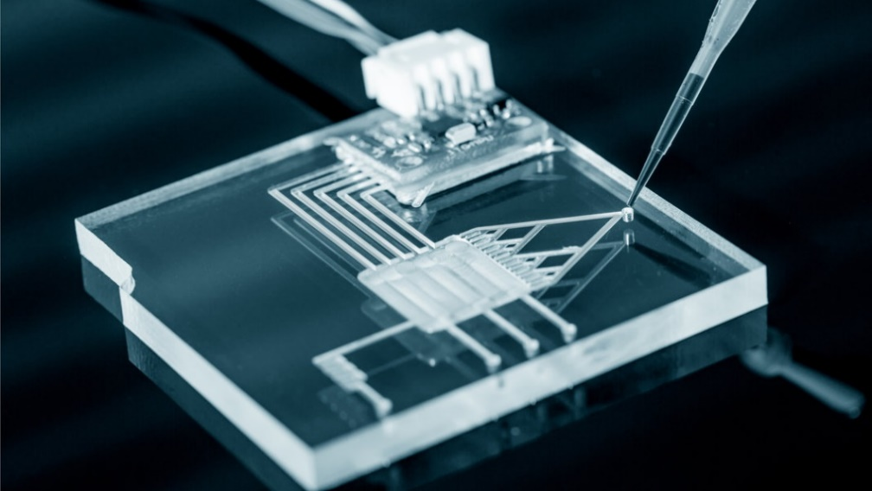
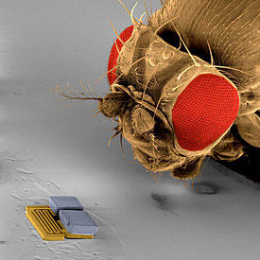
Motivation:
Microrobots (~10-100 μm) are able to interact with biological structures on their same size scale that macroscale robots cannot.
Biomedical applications: Lab on a Chip (2-D), drug delivery, tissue repair
There are various ways to manipulate microrobots: optical, chemical, electrical, magnetic, and acoustical.
Acoustic actuation is a non-invasive way to manipulate microrobots.
Fig. 1. Lab on a Chip [3]
References:
[2] NIST and Nanosoccer .https://www.nist.gov/topics/nanotechnology/nist-and-nanosoccer . Accessed: 2020-11-24.
[3] This One-Cent Lab-on-a-Chip Can Diagnose Cancer and Infections.https://singularityhub.com/2017/02/19/one-cent-lab-on-a-chip-can-detect-cancer-and-infections . Accessed: 2020-11-24.
Fig. 2. Microbot next to a fly [2]

Slide 4
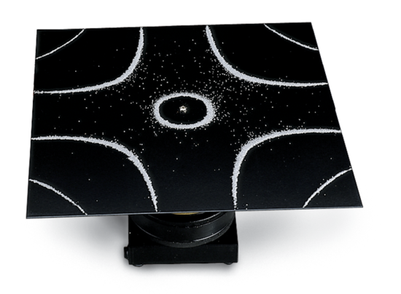
Background:
Chladni Plates are thin, metal plates that have natural resonant frequencies with standing wave patterns visualized by particles displaced on the plate.
Chladni figures are complex patterns formed in response to vibrations. See Figs. 3-4.
Fig. 3. Chladni plate with the sand on top forming a Chladni Figure [4]
Fig. 4. Chladni plate resonating at various resonant frequencies [1]
References:
[1] Quan Zhou, Veikko Sariola, Kourosh Latifi, and Ville Liimatainen. Controlling the motion of multiple objects on a chladni plate. Nature communications, 7:12764, 09 2016
.com/2017/02/19/one-cent-lab-on-a-chip-can-detect-cancer-and-infections . Accessed: 2020-11-24.
[4] Chladni Plates.https://www.pasco.com/products/lab-apparatus/waves-and-sound/ripple-tank-and-standing-waves/wa-9607

Slide 5
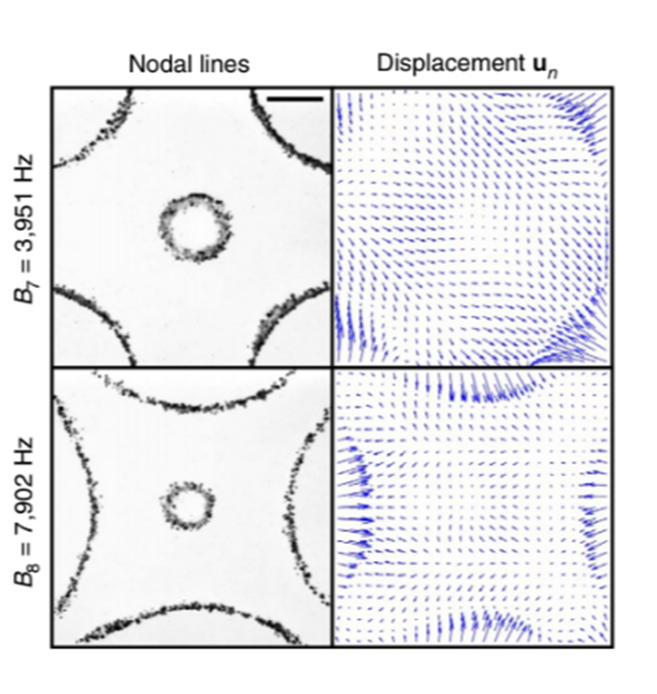
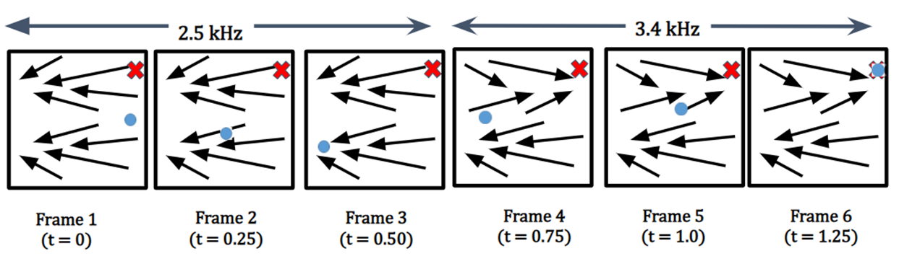
Background:
Displacement maps show the direction of movement of a particle at every single point on the Chladni plate as a result of plate oscillation at the indicated frequency.
Displacement maps are referenced as tables by a control algorithm to control movement of a microrobot or other particle.
Fig. 5. Visual representations of the nodal lines and displacement maps resulting from driving a 50mm square Chladni plate with two different frequencies. [1]
Fig. 6. Notional schematic that shows the movement of the blue bead over time by using the displacement maps of two different frequencies.
Time
References:
[1] Quan Zhou, Veikko Sariola, Kourosh Latifi, and Ville Liimatainen. Controlling the motion of multiple objects on a chladni plate. Nature communications, 7:12764, 09 2016
.com/2017/02/19/one-cent-lab-on-a-chip-can-detect-cancer-and-infections . Accessed: 2020-11-24

Slide 6
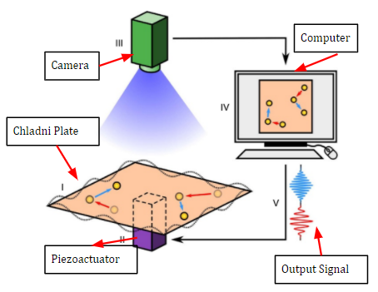
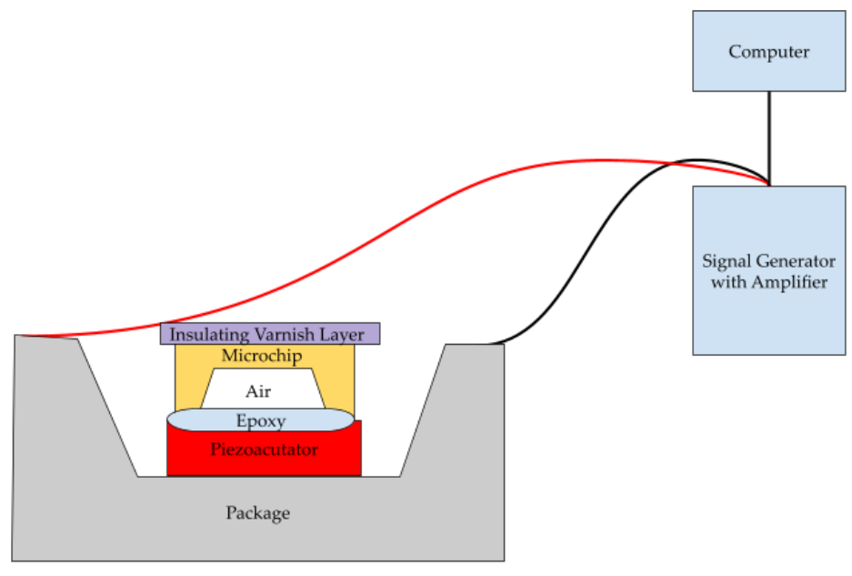
Project Phasing
Experiment has two parts: macroscale manipulation in air and microscale in water.
Macroscale manipulation in water will be performed if necessary to understand microscale experiment.
Reproducing
Macroscale Manipulation with Chladni Plate in Air
Control Methods
Microscale Manipulation with Microscale Membranes
Fig. 7. Project phasing
 | Particle Size | Frequency | Picture
Macroscale Manipulation with Chladni Plate in Air | ~750 um (Solder Beads) | ~1 kHz – 20 kHz
Microscale Manipulation with Microscale Membranes | ~50 um (Microbeads) | ~10 kHz - 1 MHz
Table 1. Table shows the various stages of this experiment [1]
References:
[1] Quan Zhou, Veikko Sariola, Kourosh Latifi, and Ville Liimatainen. Controlling the motion of multiple objects on a chladni plate. Nature communications, 7:12764, 09 2016
.com/2017/02/19/one-cent-lab-on-a-chip-can-detect-cancer-and-infections . Accessed: 2020-11-24.

Slide 7
Reproducing
Control Methods
Macroscale Manipulation with Chladni Plate in Air
Microscale Manipulation with Microscale Membranes
Fig. 8. Project phasing

Slide 8
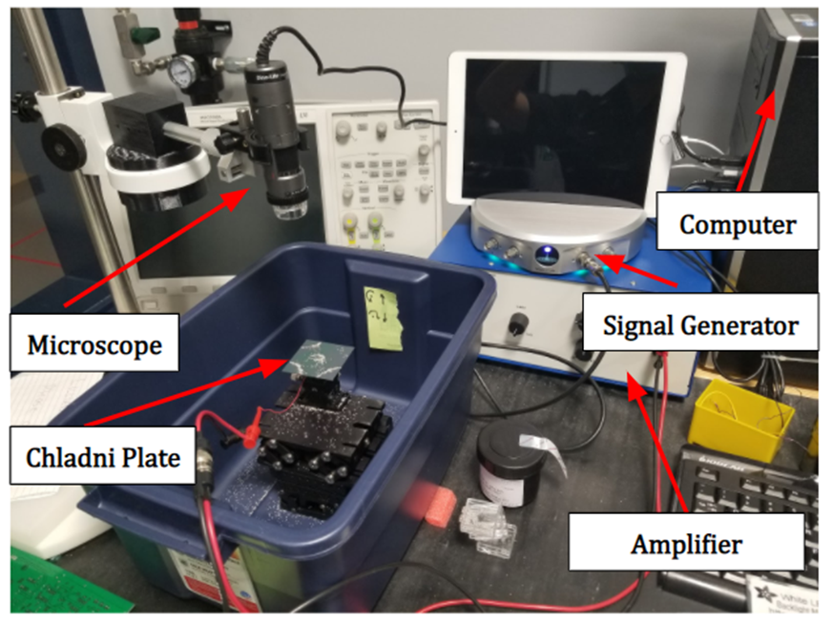
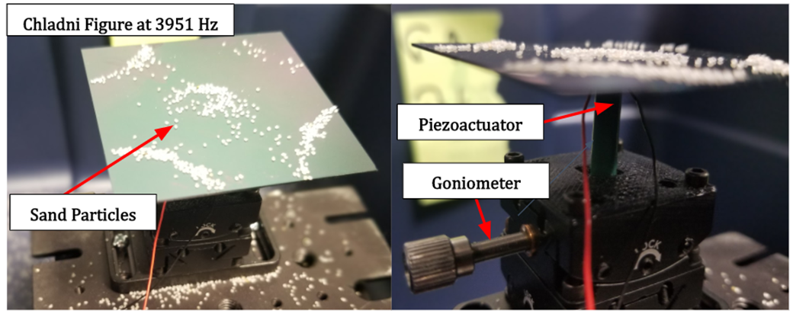
Macroscale Experiment
Random frequencies from Fig. 4 were played via MATLAB-controlled signal generator to drive a piezoelectric actuator and a 50mm square Chladni plate.
Images were acquired concurrently using a USB microscope.
Fig. 9. Macroscale manipulation with Chladni plate in air experimental setup
Fig. 10. Picture of Chladni figure developed at 3951 Hz
References:
[1] Quan Zhou, Veikko Sariola, Kourosh Latifi, and Ville Liimatainen. Controlling the motion of multiple objects on a chladni plate. Nature communications, 7:12764, 09 2016
.com/2017/02/19/one-cent-lab-on-a-chip-can-detect-cancer-and-infections . Accessed: 2020-11-24.
[4] Chladni Plates.https://www.pasco.com/products/lab-apparatus/waves-and-sound/ripple-tank-and-standing-waves/wa-9607

Slide 9
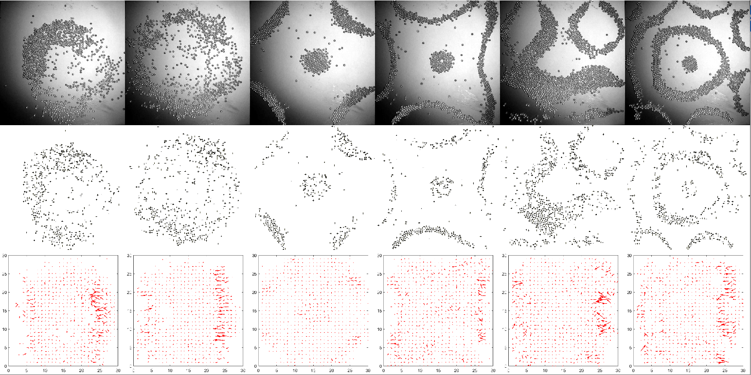
Macroscale Experiment – Displacement Maps
(a) Grayscale Images
(b) Object Identified Particles
(c) Displacement Maps
1245 Hz | 1976 Hz | 3951 Hz | 7902 Hz | 11175 Hz | 19912 Hz
Table 2. Images Acquired and Post-Processed

Slide 10
Reproducing
Control Methods
Macroscale Manipulation with Chladni Plate in Air
Microscale Manipulation with Microscale Membranes
Fig. 11. Project phasing

Slide 11
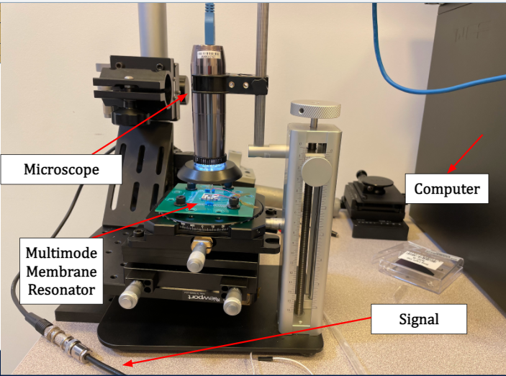
Microscale Experimental Setup
Frequencies to drive the piezoelectric actuator and multimode membrane resonator were chosen based off of [5] and prior analytical computations.
Images were acquired concurrently using
a USB microscope.
Fig. 12. Sketch of the microscale setup
Fig. 13. Experimental microscale setup including the multimode membrane resonator
References:
[5] H. Jia, X. Liu and P. X. -. Feng, "Manipulating and Patterning Micro/Nanoparticles in Liquid Using Multimode Membrane Resonators," 2018 IEEE Biomedical Circuits and Systems Conference (BioCAS), Cleveland, OH, USA, 2018, pp. 1-4, doi: 10.1109/BIOCAS.2018.8584705.

Slide 12
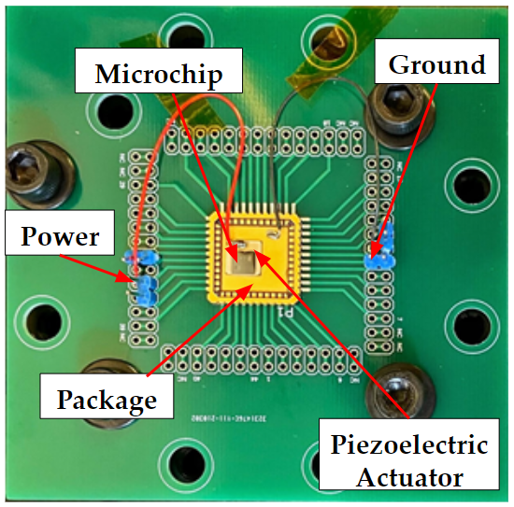
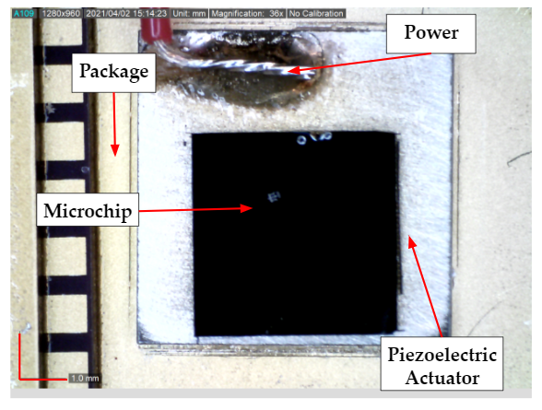
Design of Microchip
10μm-thick silicon microscale membranes were designed in-house and then manufactured by MEMSCAP.
Each chip quadrant contains different membrane shapes and boundary conditions.
Fig. 14. Picture of multi-mode membrane resonator on a PCB
Fig. 15. Picture of multi-mode membrane resonator, piezoelectric actuator, and chip package

Slide 13
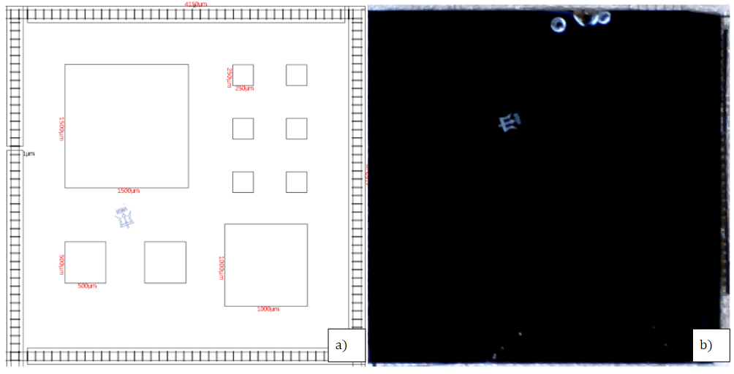
2-D Drumhead (Clamped)
Fig. 16. Drumhead (Clamped)
a) Layout Editor Design b) Actual Photograph

Slide 14
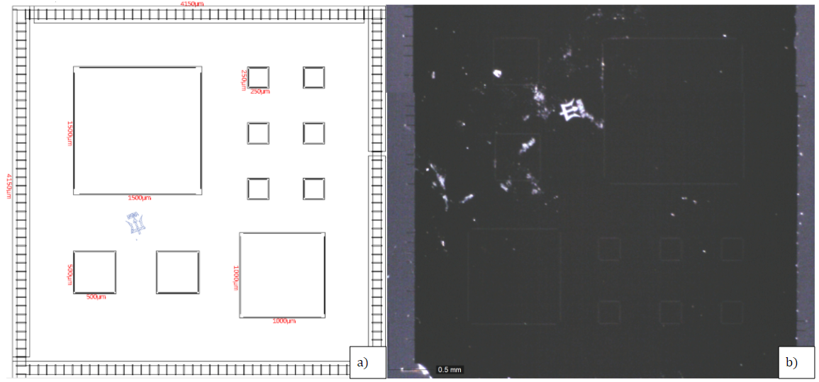
2-D Trampoline (Unclamped)
Fig. 17. Trampoline (Unclamped)
a) Layout Editor Design b) Actual Photograph

Slide 15
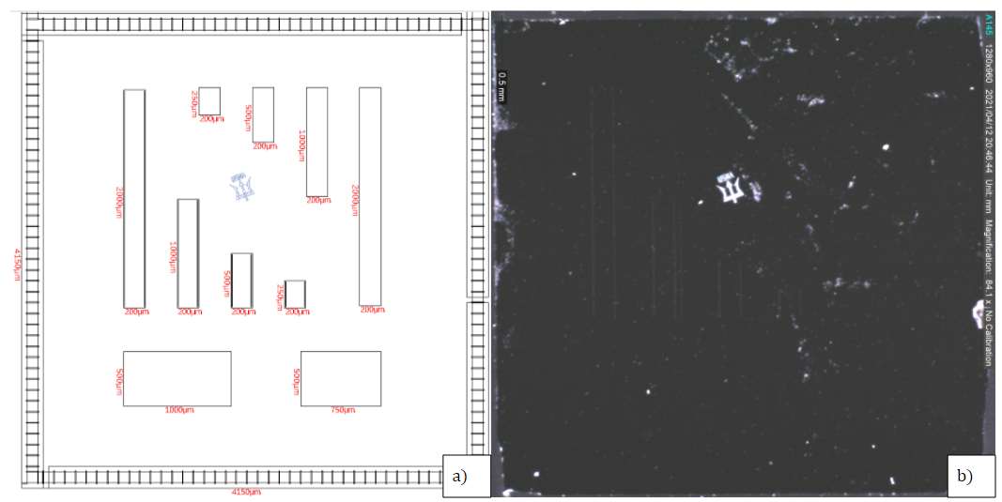
1-D Beam (Unclamped and Clamped)
Fig. 18. 1-D Beam (Unclamped and Clamped)
a) Layout Editor Design b) Actual Photograph

Slide 16
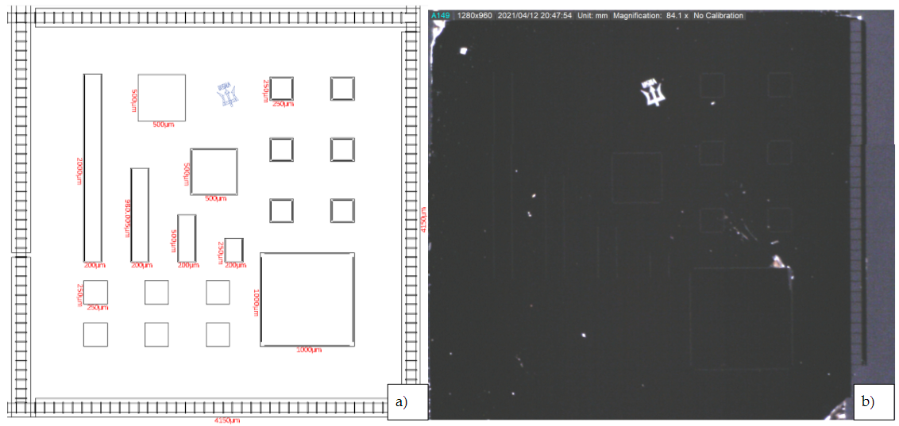
Mixture: 2-D Drumhead (Clamped), 2-D Trampoline (Unclamped) and 1-D Beam (Unclamped and Clamped)
Fig. 19. 2-D Drumhead and 1-D Beam (Unclamped and Clamped)
a) Layout Editor Design b) Actual Photograph

Slide 17
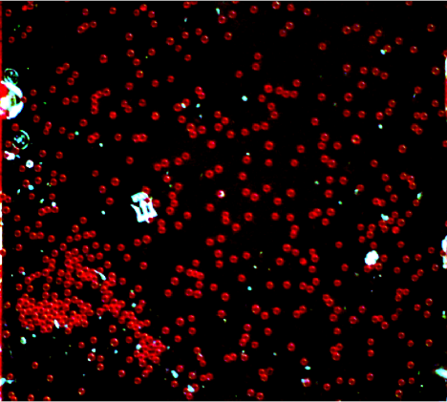
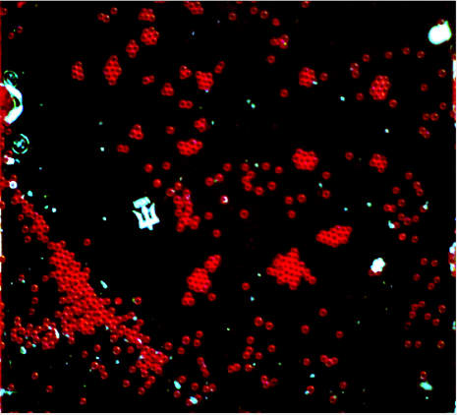
Imaging and Microparticle Detection
Microparticle detection techniques used on the macroscale are effective on the microscale
Frame 1 at 890 kHz | Frame 50 at 890 kHz
Fig. 20. Microparticles (50 μm) are imaged on the 2-D Drumhead (clamped) chip at 890 kHz
Microparticles (50 μm) identified effectively using post-image processing algorithms

Slide 18
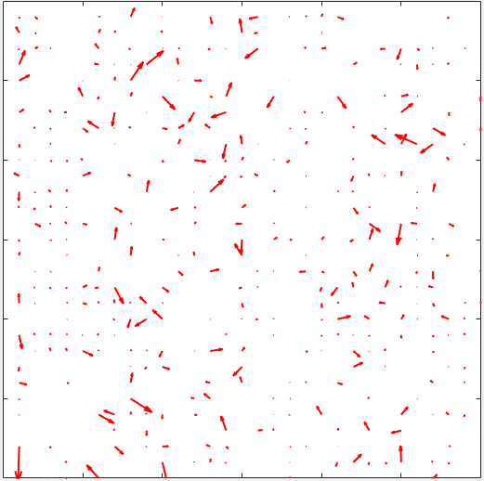
Displacement Maps on the Microscale
Displacement map algorithim used on the macroscale is effective on the microscale
890 kHz
440 kHz
Fig. 21. Displacement maps of particle movement at 890 kHz and 440 kHz

Slide 19
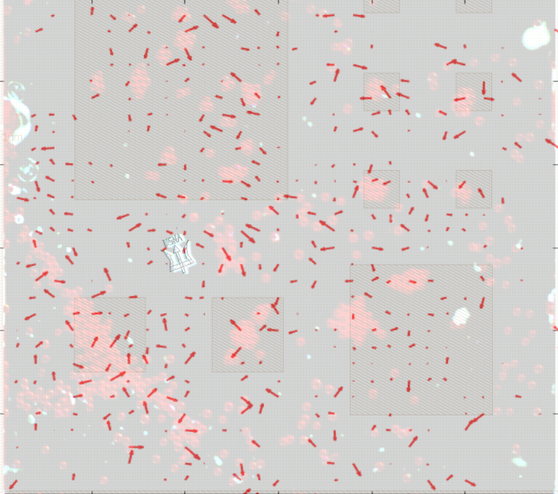
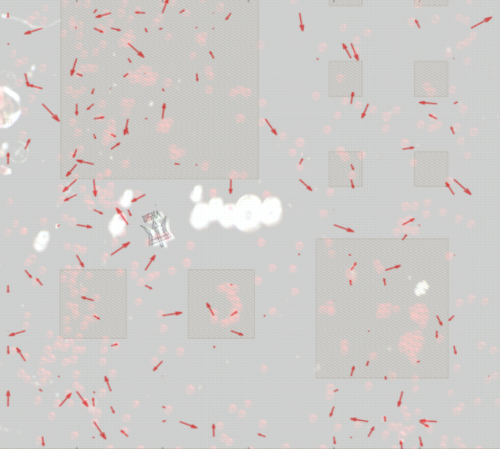
Displacement Maps Overlaid with Original Images on the Microscale
890 kHz
440 kHz
Fig. 22. Microchip Design, original last frame, and displacement maps are overlaid at 890 kHz and 440 kHz

Slide 20
Results and Discussion
Microscale experiments require new displacement maps due to differing physics and resonators, but the process is similar and informed by the macroscale results.
On the microscale, the effects of acoustic streaming and effective weight forces severely affect the movement of the particles.
Conclusions
Further work needs to be done in implementing control algorithim for these displacement maps
Acknowledgments
This research is supported by the National Science Foundation under grant number 1923154 and the Trident and Bowman Scholar program of the United States Naval Academy.

