Slide 1

Dynamic characterization of biosensing MEMS cantilevers with different position of the driving electrode - vacuum response versus ambient conditions
Marius Pustan^{1,}*, Corina Birleanu¹, Florina Serdean¹
¹ Department of Mechanical Systems Engineering, Micro & Nano Systems Laboratory, Technical University of Cluj-Napoca, Cluj-Napoca, Romania;
* Corresponding author: Marius.Pustan@omt.utcluj.ro

Slide 2

Abstract:
The scope of this research work is orientated to analyze the effect of the driving electrode position on the dynamic response of electrostatically actuated sensing MEMS used in bio-mass detection. The mass-absorption detection is based on the change in the resonant frequency of vibrating elements. The modifications in the dynamic response of a vibrating cantilever if the driving electrode is moved from the beam free-end toward the beam anchor is experimentally investigated using a Polytec Laser Vibrometer and different operating conditions (air and vacuum). Moreover, the effect of the 1st and 2nd modes of oscillations on the dynamic response is analyzed. The obtained results indicate that, different responses of MEMS sensing cantilevers can be achieved if the position of the driving electrode is moved from the cantilever free-end toward the anchor. The results are useful to MEMS designer to produce reliable oscillating structures used in biosensing detection.
Keywords: MEMS, Resonant Frequency, Oscillation Modes, Air vs. vacuum

Slide 3
Contents:
Introduction
Sample description
Experimental methodology
Dynamic response of cantilever as a function of the electrode position
Results and discussions
Conclusions

Slide 4
Introduction
This research work presents the effect of the driving electrode position on the dynamical response of an electrostatically actuated polysilicon MEMS cantilever used in mass-detection applications. This detection technique is based on the change in the resonant frequency of an oscillating cantilever as a function of the absorbed mass [1]. For mass-detection, an absorbing polymeric film is deposited on the sensing cantilever. The operating medium conditions change the behavior of the dynamic response including the resonant frequency, amplitude and velocity of oscillations as well as the quality factor and the loss of energy. Reliability design of sensing MEMS depends on the geometrical dimensions as well as the operating conditions [2]. The analysis from this work are performed on a cantilever with a width of 30µm, a thickness of 1.9µm, a length of 157µm and different positions of the driving electrode [2]. The interest is to determine the response of this cantilever in vacuum and to compare with its behavior in ambient conditions [3]. The dynamic response is modified if the cantilever is oscillating in the 1st vibration mode compared with the dynamic behavior of sample from the 2nd modes both in vacuum and in air.

Slide 5
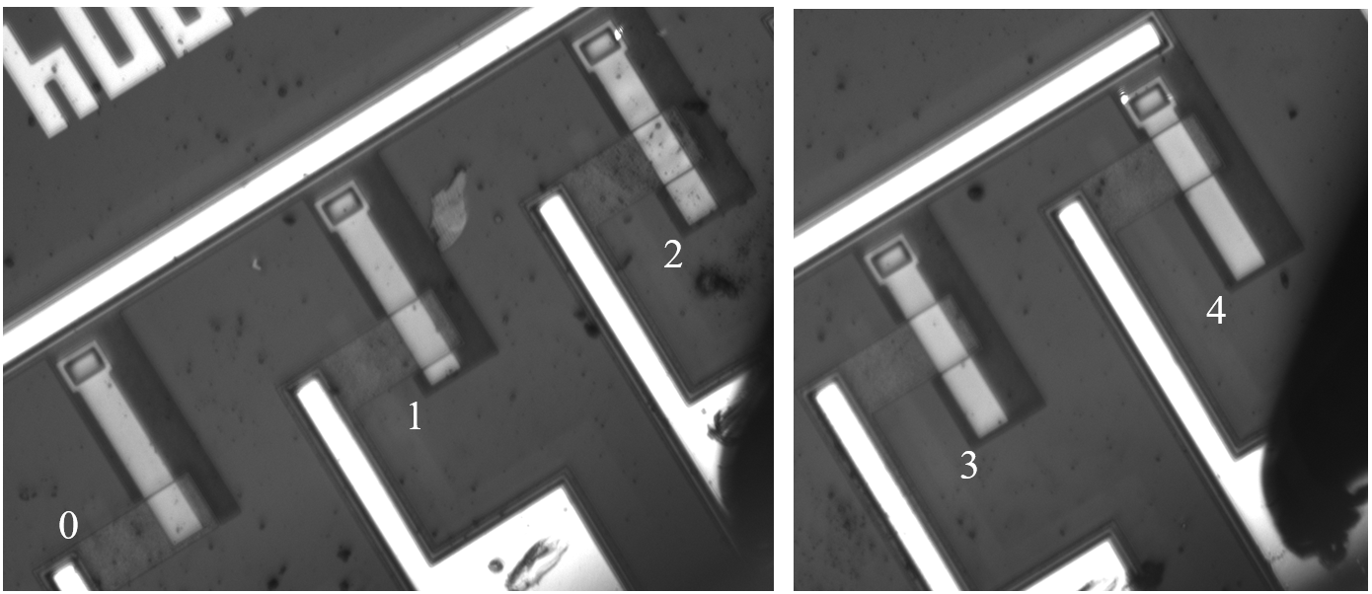
2. Sample description
Fig. 1 Polysilicon cantilevers with different position of the driving electrode
The geometrical dimensions : the length of cantilever l= 157µm; the width w= 30µm; the thickness t= 1.9µm; the gap between cantilever and the driving electrode g₀= 2µm; the width of the lower electrode w_{e} = 50µm.
Position of the driving electrode is modified from the beam free-end toward anchor as:
0- the electrode is at the free-end of cantilever, 1- the electrode is moved with 16.38µm from the free end toward anchor; 2- with 38.39µm; 3- with 61.67µm and 4- with 85.15µm.

Slide 6
3. Experimental methodology
Scope: To determine the dynamic response of a polysilicon cantilever with different positions of the driving electrode
Using method: The dynamic behavior of MEMS is investigated
by a scanning laser vibrometer MSA 400 and a vacuum chambers
Input parameters: . The input signal is the same for all samples:
white noises signal, DC=5V and AC=5V. The experiments were repeated 5 times for each of samples and the average results are presented and discussed
Operating conditions: Test 1 - ambient conditions; Test 2 - vacuum (7x10⁻⁴ mbar)
Output results: Resonant frequency, velocity and amplitude of oscillations, in air and vacuum for the 1st and 2nd vibration modes

Slide 7
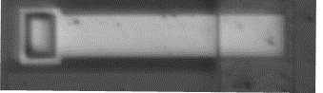
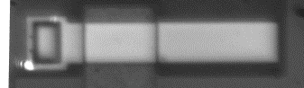
4. Dynamic response of cantilever as a function of the electrode possition
2nd mode
1st mode
2nd mode
1st mode
1st mode
1st mode
2nd mode
2nd mode
Fig. 2 Experimental response of the cantilever with the driving electrode at the free-end (a), and with the electrode close to anchor (b)

Slide 8
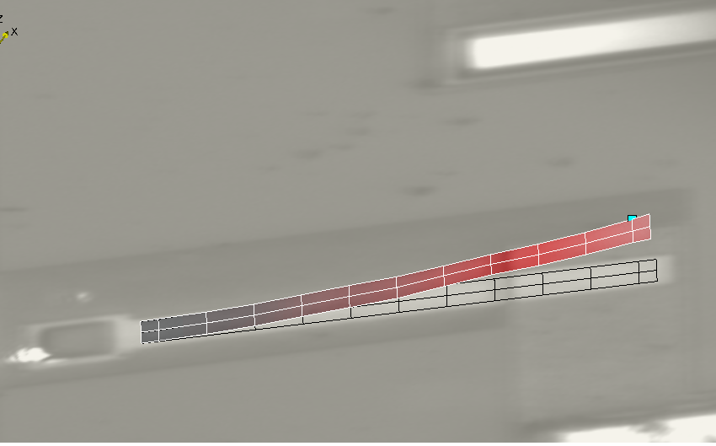
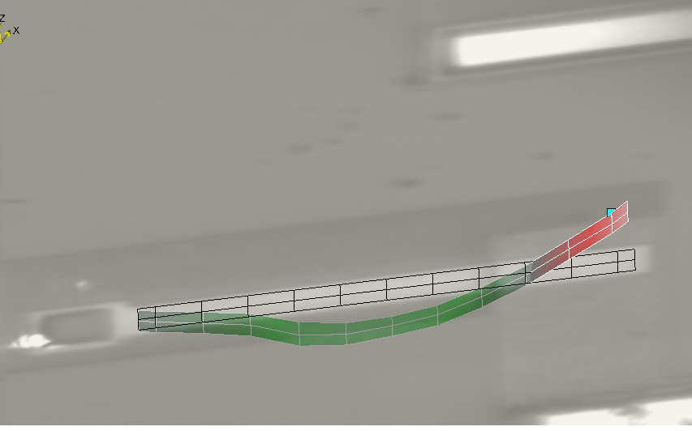
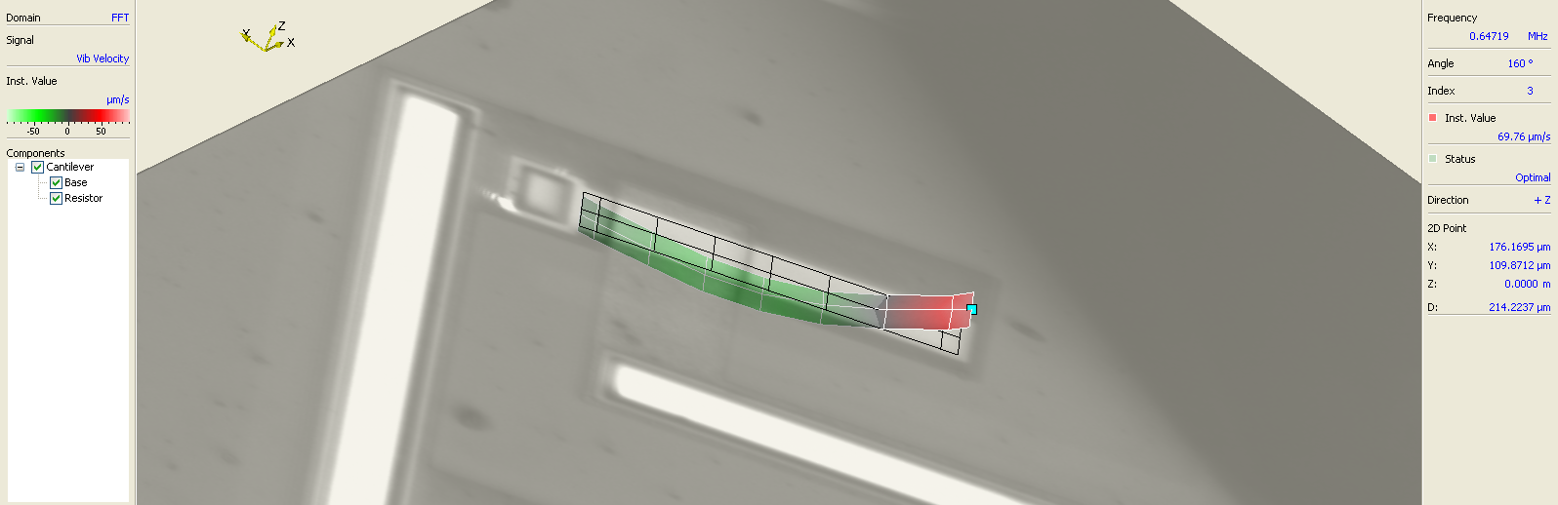
1st mode
2nd mode
0
0
Driving electrode at the free-end of cantilever
2nd mode
4
Driving electrode close to the anchor
Fig. 3 1st and 2nd modes of oscillations of cantilevers

Slide 9
(a)
Fig. 4 Resonant Frequency variation as a function of the electrode position in the 1st mode of oscillations (0 is the free-end of cantilever, 4 close to anchor):
(a) in air, (b) in vacuum
(b)

Slide 10
(a)
Fig. 5 Velocity of oscillation variation as a function of the electrode position in the 1st mode of oscillations (0 is the free-end of cantilever, 4 close to anchor):
(a) in air, (b) in vacuum
(b)

Slide 11
Fig. 6 Amplitude of oscillation variation as a function of the electrode position in the 1st mode of oscillations (0 is the free-end of cantilever, 4 close to anchor):
(a) in air, (b) in vacuum
(a)
(b)

Slide 12
(a)
Fig. 7 Resonant Frequency variation as a function of the electrode position in the 2nd mode of oscillations (0 is the free-end of cantilever, 4 close to anchor): (a) in air, (b) in vacuum
(b)

Slide 13
(a)
Fig. 8 Velocity of oscillation variation as a function of the electrode position in the 2nd mode of oscillations (0 is the free-end of cantilever, 4 close to anchor):
(a) in air, (b) in vacuum
(b)

Slide 14
(a)
Fig. 9 Amplitude of oscillation variation as a function of the electrode position in the 2nd mode of oscillations (0 is the free-end of cantilever, 4 close to anchor):
(a) in air, (b) in vacuum
(b)

Slide 15
5. Results and Discussion
The changes in the dynamic response of a sensing MEMS cantilever as a function of the driving electrode position is evaluated using a Polytec Laser Vibrometer in air and vacuum. The amplitude and velocity of the oscillations are modified if the driving electrode is moved from the beam free-end toward the anchor. Small effect of the electrode position (force position) on the resonant frequency of microcantilever is determine in the case of vacuum and air condition for the 1st and 2nd vibration modes. A strong effect is determined in on the velocity and amplitude of oscillations for the 1st vibration mode which are significantly degreasing if the electrode position is moved from the beam free-end toward anchor. For the 2nd vibration modes, the change in velocity and oscillation amplitude of the free end of the cantilever varies nonlinearly, with higher values for intermediary positions of the driving electrode.
6. Conclusions
Based on the experiments performed in this research work we can observe that, different responses of a vibrating cantilever can be obtained if the position of the driving electrode is modified. Indeed, velocity and amplitude of oscillations are significantly modified. This aspect is useful for MEMS manufacturers because they can obtain different responses of sensing element only by modifying the position of the driving electrode.

Slide 16
References
[1] Pustan M., Birleanu C., Effect of the acting electrode position on a microcantilever dynamic response under different excitation mode, International Semiconductor Conference (CAS) 2017
[2] Pustan M., Dudescu C., Birleanu C., Reliability design based on experimental investigations of paddle MEMS cantilevers used in mass sensing applications, Sensor Letters 12(11), 1600-1606(7), 2014
[3] Pustan M., Paquay S., Rochus V., Golinval J-C., Effects of the electrode positions on the dynamical behaviour of electrostatically actuated MEMS resonators, 12th Int. Conf. on Thermal, Mechanical & Multi-Physics Simulation and Experiments in Microelectronics and Microsystems, 2011

