Slide 1
Fiber optic sensor for detecting neoplastic lesions in biological tissues - a preliminary study
Anna Sękowska-Namiotko^{1,}*
¹ Department of Metrology and Optoelectronics, Faculty of Electronics, Telecommunications and Informatics, Gdańsk University of Technology, 11/12 Narutowicza Street, 80-233 Gdańsk, Poland.
* Corresponding author: anna.sekowska94@gmail.com
Notes:
Welcome, my name is Anna Sękowska-Namiotko. I am a PhD student at Gdańsk University of Technology. I would like to present the results of my research in the presentation entitled:

Slide 2
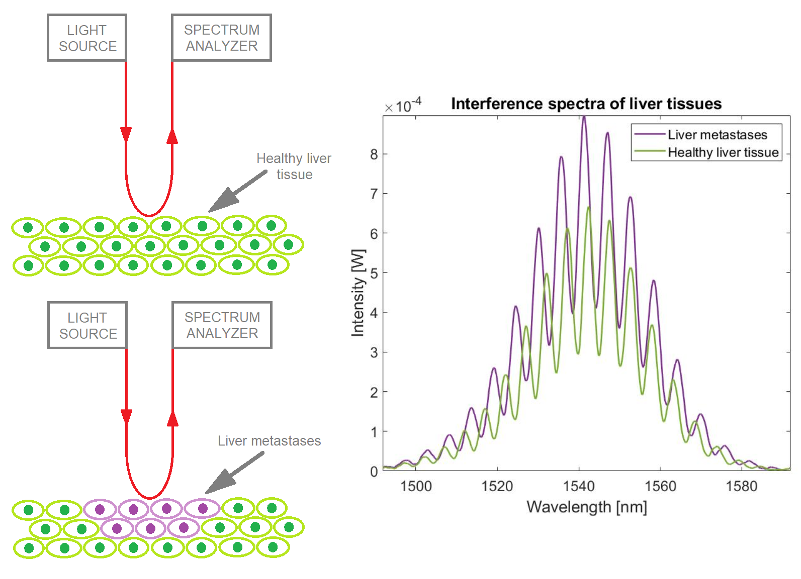
Graphical Abstract
Notes:
Opracowanie optycznej sondy pozwalającej na wykrycie zmian patologicznych w towarzystwie tkanek zdrowych

Slide 3
Abstract:
Tissues affected by neoplastic lesions differ from healthy tissues in terms of functionality and anatomy. These changes affect light propagation in tissue, therefore modifying the refractive index, as well as scattering and absorption coefficients. The primary purpose of the research was to create a system to detect local changes in the refractive index using a fiber optic sensor. A prototype of a micromachine for biomedical applications has been developed. The measurements were performed using the low-coherence interferometry method, i.e. a measurement technique based on the phenomenon of interference of light waves from a broadband light source. The constructed optical system uses a light source with a central wavelength of 1550 nm, a spectrum analyser, a fiber optic sensor operating on the basis of a Fabry-Pérot interferometer and a silver mirror acting as a reflective layer. Measurements of the interference spectrum of reference oils, used for calibration due to the high stability of their parameters, were performed. It has been shown that the developed fiber optic sensor is able to detect changes in the refractive index based on the shift in the position of the central peak in the interference spectrum. It is also sensitive to changes of the absorption coefficient.
Keywords: fiber optic sensors; Fabry-Pérot interferometer; refractive index; neoplastic lesions

Slide 4
Introduction
functional and anatomical differences between normal tissue and neoplastic lesions affect the light propagation in tissue
significant changes of refractive index, scattering and absorption coefficients
Thesis: It is possible to differentiate normal tissues from neoplastic lesions based on the changes in interference spectra.
→ We have designed and developed a micromechanical system with a fiber optic sensor for detecting changes in the refractive index of biological tissues.

Slide 5
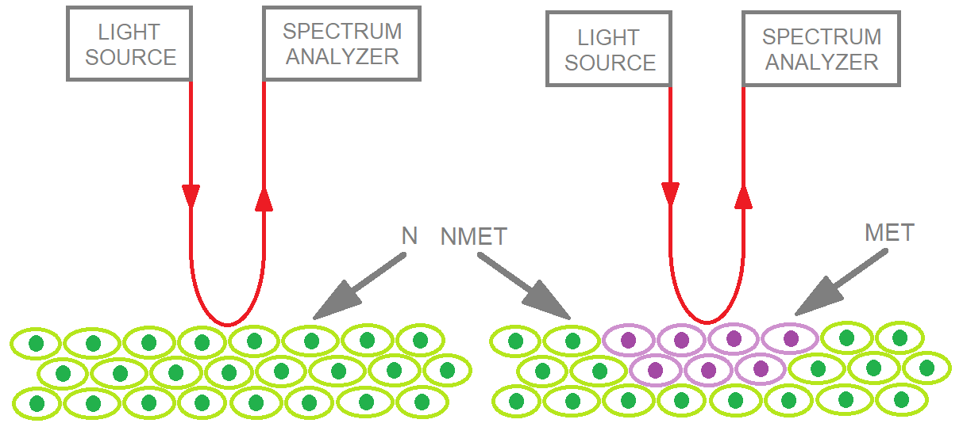
Introduction – RI of liver in 1550 nm
Tissue | Mean real index ± SD | Mean imaginary index ± SD
N (reference group, healthy liver tissue) | 1.362 ± 0.003 | 0.0024 ± 0.0009
MET (liver metastases) | 1.343 ± 0.011 | 0.0038 ± 0.0016
NMET (non-cancerous liver tissue) | 1.361 ± 0.010 | 0.0039 ± 0.0015
Giannios, P., Toutouzas, K., Matiatou, M. et al. Visible to near-infrared refractive properties of freshly-excised human-liver tissues: marking hepatic malignancies. Sci Rep 6, 27910 (2016). https://doi.org/10.1038/srep27910
Notes:
Tissue specimens from the liver of 17 patients who underwent surgical treatment were investigated in this study. All individuals provided their informed consent, while all methods were carried out in accordance with the guidelines approved by the administrative board (IRB) of the Hippocration General Hospital of Athens. Four samples were surgically excised from four patients who were not associated to cancer or any other disease that could adversely affect the liver parenchyma (reference group, N). Ten samples of non-cancerous liver tissue (NMET) and ten metastatic samples (MET) were also excised from ten patients with liver metastases.

Slide 6
Methods – Measurement Setup
The constructed optical system consists of:
a Fabry-Pérot interferometer working in reflective mode,
cavity length: 150 μm
reflective layer: silver mirror
an optical spectrum analyzer (Ando AQ6319, Tokyo, Japan),
broadband NIR-radiation sources (S-1550-G-I-20: λ = 1550 nm, Δλ_{FWHM} = 45 nm Superlum),
a single-mode 1 × 2 coupler with 50: 50 power splitting ratio,
single-mode optical fibers (SMF-28, Thorlabs).

Slide 7
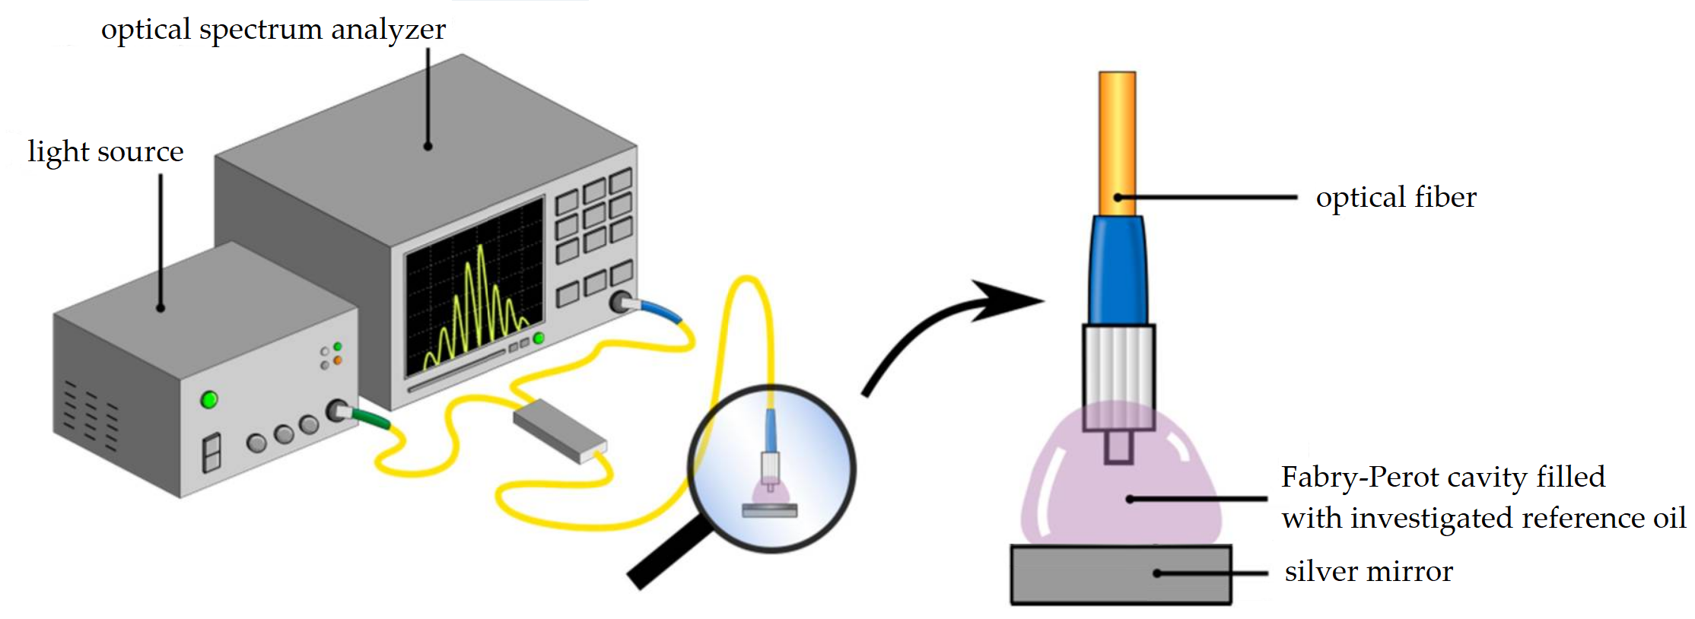
Methods – Measurement Setup
Kosowska M, Majchrowicz D, Sankaran KJ, Ficek M, Haenen K, Szczerska M. Doped Nanocrystalline Diamond Films as Reflective Layers for Fiber-Optic Sensors of Refractive Index of Liquids. Materials. 2019; 12(13):2124. https://doi.org/10.3390/ma12132124

Slide 8
Methods
Examined parameters of the interference spectra:
position of the central peak [nm]
signal intensity of the central peak [μW]
visibility (V) [a.u.]
absorption (signal intensity of I_{min}) [μW]

Slide 9
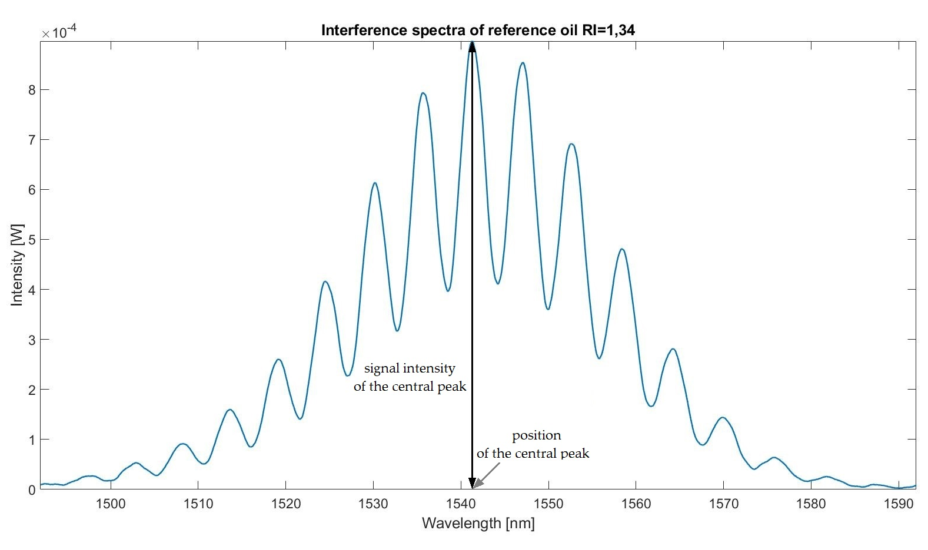
Examined parameters

Slide 10
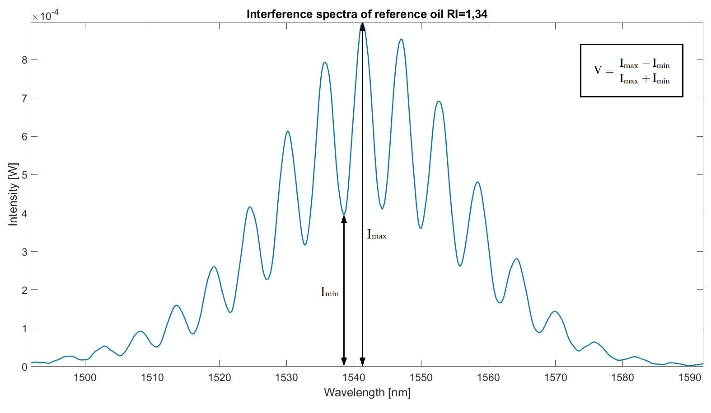
Examined parameters – visibility (V) and absorption

Slide 11
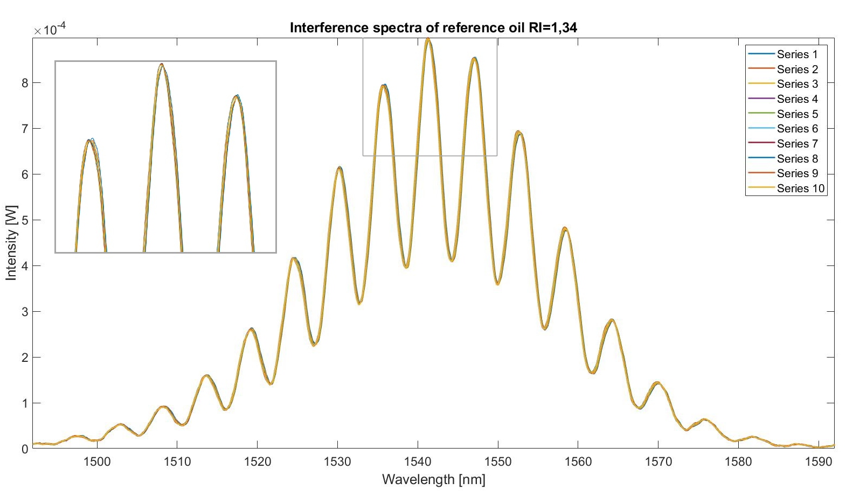
Results

Slide 12
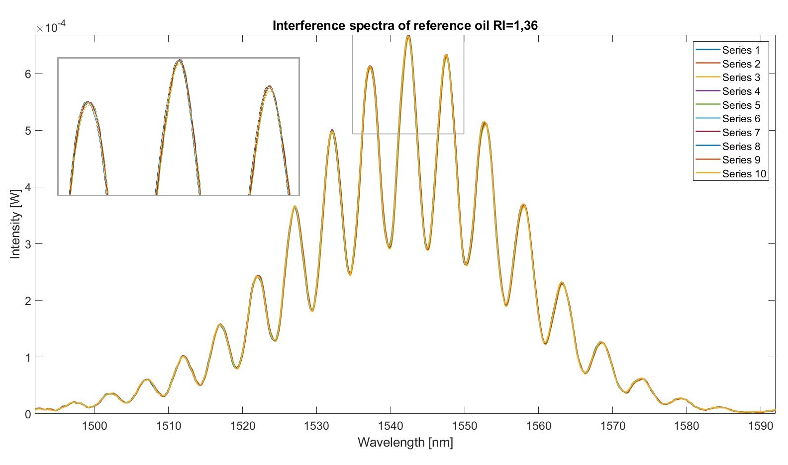
Results

Slide 13
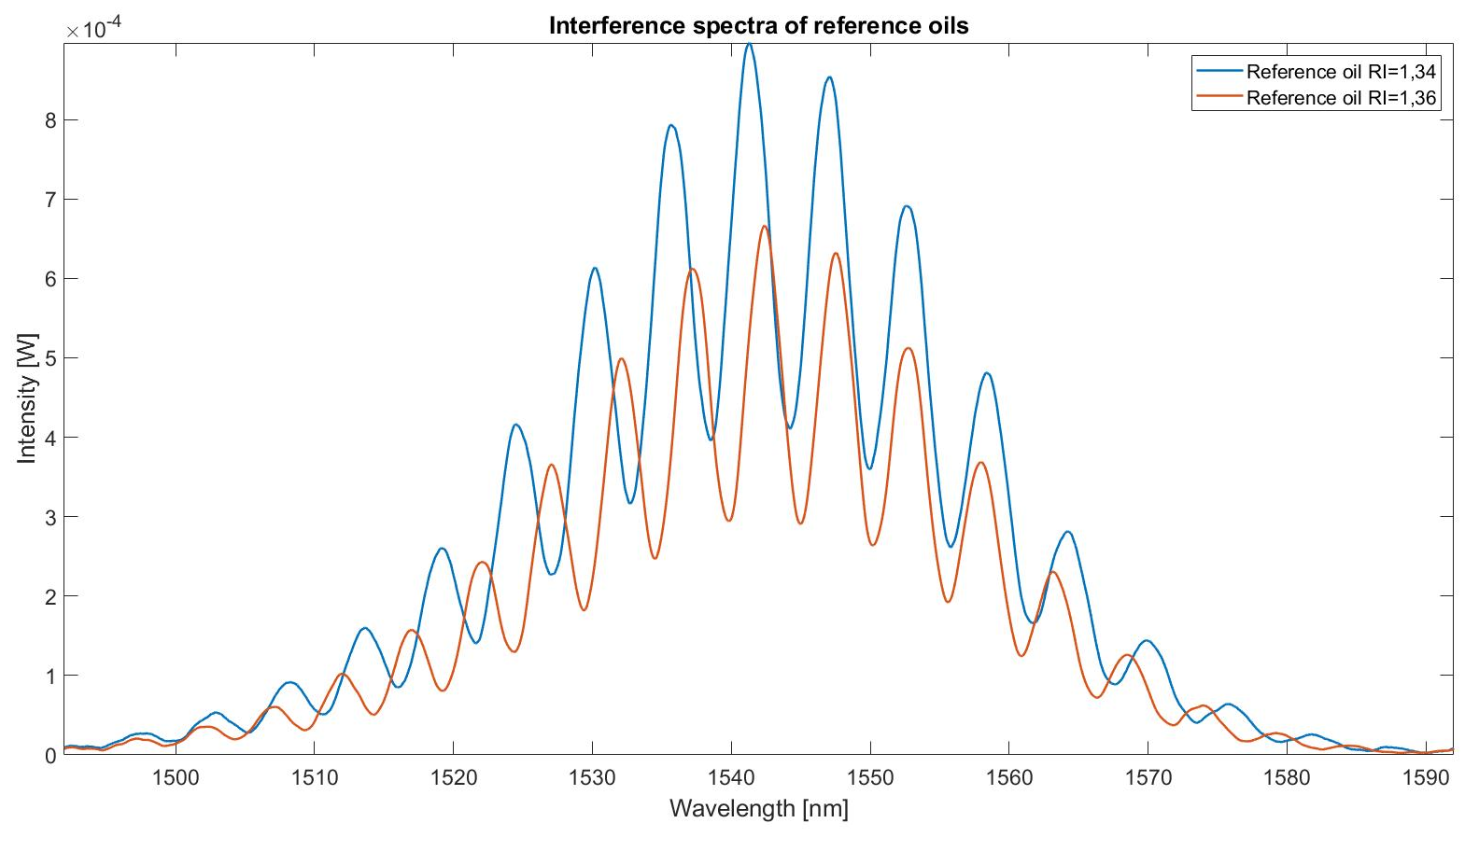
Results

Slide 14
Discussion
Parameters | RI = 1,3400 | RI = 1,3600
position of the central peak [nm] | 1541,32 ± 0,04 | 1542,40 ± 0,04
signal intensity of the central peak [μW] | 896,10 ± 1,61 | 666,52 ± 1,64
visibility (V) [a.u.] | 0,38798 ± 0,00105 | 0,39295 ± 0,00169
absorption (signal intensity of I_{min}) [μW] | 395,50 ± 1,14 | 290,47 ± 1,33

Slide 15
Discussion
Visible differences between obtained interference spectra for examined reference oils.
Developed setup is sensitive to the changes of:
refractive index,
absorption.

Slide 16
Conclusions
The interference spectra can be used as a source of information about changes in optical parameters of the tested material.
The developed fiber optic sensor is able to detect changes in the refractive index based on the changes in the spectra.
Developed measurement method will be used to distinguish between healthy and neoplastic tissues – need for further research on biological tissues.
Developed method will be used to design and produce a micromachine for biomedical applications.

Slide 17
Conclusions
The interference spectra can be used as a source of information about changes in optical parameters of the tested material.
The developed fiber optic sensor is able to detect changes in the refractive index based on the changes in the spectra.
Developed measurement method will be used to distinguish between healthy and neoplastic tissues – need for further research on biological tissues.
Developed method will be used to design and produce a micromachine for biomedical applications.

Slide 18
Supplementary Materials
References:
Marzejon, M., Karpienko, K., Mazikowski, A., Szczerska, M. (2019). FIBRE-OPTIC SENSOR FOR SIMULTANEOUS MEASUREMENT OF THICKNESS AND REFRACTIVE INDEX OF LIQUID LAYERS. Metrology And Measurement Systems, 26, 561-568. https://doi.org/10.24425/mms.2019.129584
Ficek, M., Majchrowicz, D., Karpienko, K., Milewska, J., Dec, B., Wierzba, P., Struk, P., Szczerska, M. (2017). Low-coherence sensors with nanolayers for biomedical sensing. Nanoscale Imaging, Sensing, And Actuation For Biomedical Applications Xiv, 1-8. https://doi.org/10.1117/12.2250744
Hirsch M, Majchrowicz D, Wierzba P, Weber M, Bechelany M, Jędrzejewska-Szczerska M. Low-Coherence Interferometric Fiber-Optic Sensors with Potential Applications as Biosensors. Sensors (Basel). 2017 Jan 28;17(2):261. https://doi.org/10.3390/s17020261
Giannios, P., Toutouzas, K., Matiatou, M. et al. Visible to near-infrared refractive properties of freshly-excised human-liver tissues: marking hepatic malignancies. Sci Rep 6, 27910 (2016). https://doi.org/10.1038/srep27910
Jędrzejewska-Szczerska, M. (2014). Response of a new low-coherence Fabry-Perot sensor to hematocrit levels in human blood. Sensors (Basel, Switzerland), 14(4), 6965–6976. https://doi.org/10.3390/s140406965
Sękowska, A., Majchrowicz, D., Sabisz, A. et al. Nanodiamond phantoms mimicking human liver: perspective to calibration of T1 relaxation time in magnetic resonance imaging. Sci Rep 10, 6446 (2020). https://doi.org/10.1038/s41598-020-63581-9

Slide 19
Acknowledgments
Financial support of these studies from Gdańsk University of Technology by the DEC-034877 grant under the Technetium Talent Management Grants - ‘Excellence Initiative - Research University’ program is gratefully acknowledged.
Study title: ‚Examination of optical parameters of biological tissues and tissue phantoms as a function of temperature’.
Notes:
Grant technetium
Badanie parametrów

Slide 20
Fiber optic sensor for detecting neoplastic lesions in biological tissues - a preliminary study
Anna Sękowska-Namiotko^{1,}*
¹ Department of Metrology and Optoelectronics, Faculty of Electronics, Telecommunications and Informatics, Gdańsk University of Technology, 11/12 Narutowicza Street, 80-233 Gdańsk, Poland.
* Corresponding author: anna.sekowska94@gmail.com

