Slide 1
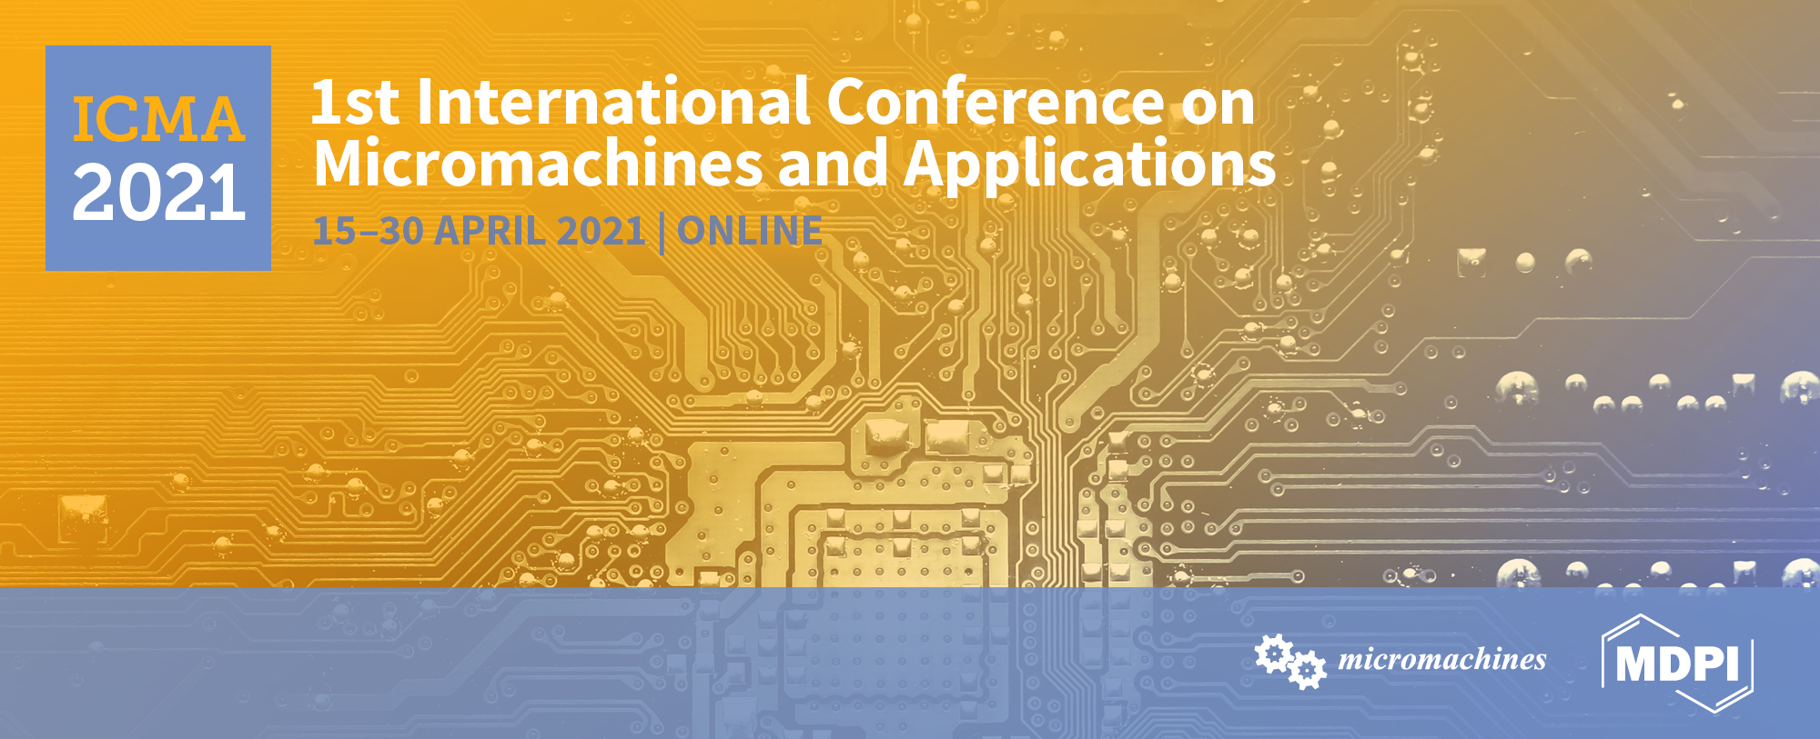
Magneto-catalytic Janus micromotors for selective inactivation of bacteria biofilms
Beatriz Jurado-Sánchez,* Alberto Escarpa* and Kaisong Yuan
¹ Universidad de Alcalá; Departamento de Química Analítica, Química Física e Ingeniería Química; Alcala de Henares, Madrid, Spain
* Corresponding author: beatriz.jurado@uah.es; alberto.escarpa@uah.es

Slide 2
Magneto-catalytic Janus micromotors for selective inactivation of bacteria biofilms
Angewandte Chemie International Edition, 60, 2021, 4915-4924

Slide 3
Abstract:. Herein we will describe the preparation of graphene oxide (GO)/PtNPs/Fe₂O₃) Janus micromotors for highly selective capture/inactivation of gram-positive bacteria units and biofilms. The strategy is based on the combination of a lanbiotic (Nisin) with Janus micromotors. Such peptide can bind to lipid II unit of the bacteria membranes, damaging its morphology and releasing its contents. The micromotors possess adaptative propulsion mechanisms, including catalytic mode (PtNPs) in peroxide solutions or magnetic actuation (fuel free) by the action of an external magnetic field. The enhanced movement and localized delivery of the micromotors (both in catalytic and magnetic actuated mode) results in a 2-fold increase of the capture/killing ability towards Staphylococcus Aureus bacteria in raw media (juice, serum and tap water samples), as compared with free Nisin and static counterparts. Unlike previous micromotors based strategies, this approach displays higher selectivity towards a type of bacteria along with enhanced stability, prolonged use and adaptative propulsion modes, holding considerable promise to treat methicillin resistant antibiotic infections, for environmental remediation or food safety, among other applications.
Keywords: Janus, peptide, bacteria, biofilm

Slide 4
Introduction
Enhanced fluid mixing
Localized delivery
Functionalization
10 global causes of death
~750,000 deaths worldwide
BACTERIAL INFECTIONS
SOLUTION
MICROMOTORS
Lower treatment times
Efficiency!
New ways of treatment: decrease mortality rate!

Slide 5
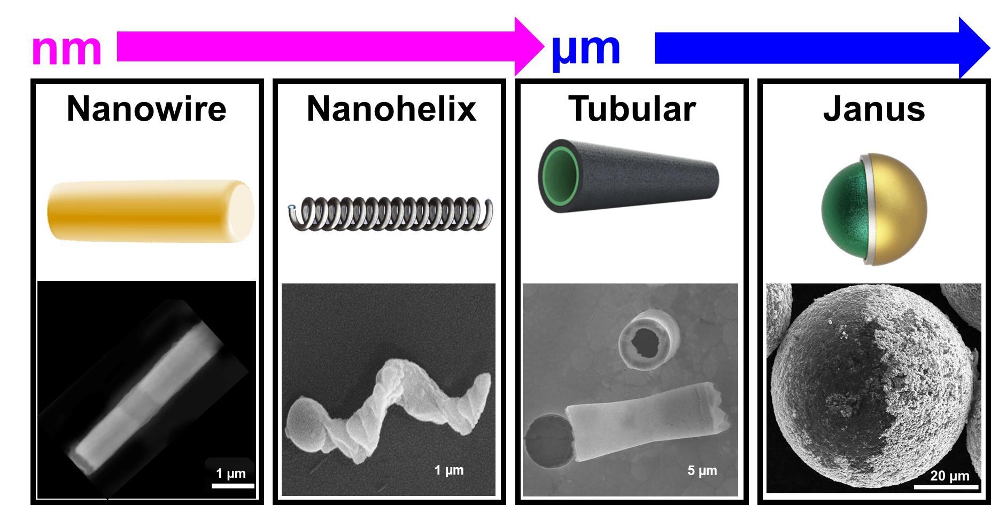
Introduction
MICROMOTORS
Nanoscale devices designed to perform selected mechanical movements in response to specific stimuli. Can convert energy into mechanical movement

Slide 6
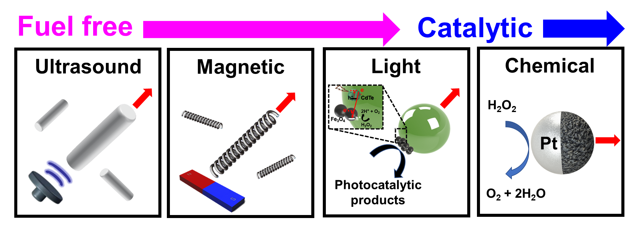
Introduction
PROPULSION MODES

Slide 7
Introduction
Peptides with methyl-lanthionine residues and
antimicrobial activity
LANBIOTICS
NISIN
Selective for gram-positive bacteria inactivation: highest efficiency for multidrug resistance bacteria killing!

Slide 8
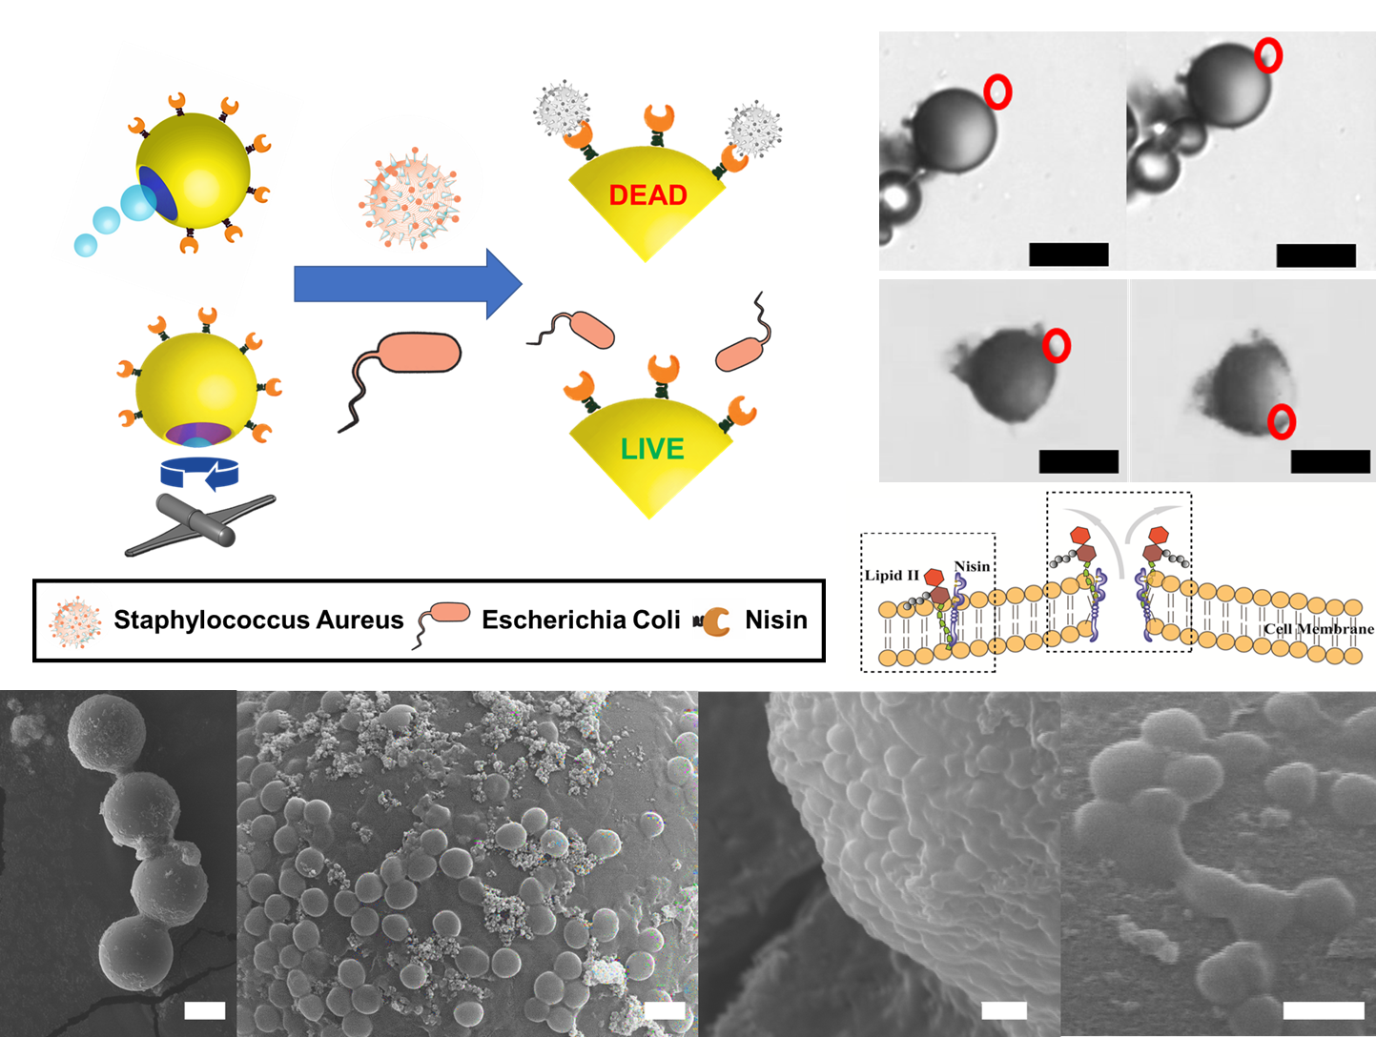
Results and Discussion
DUAL PROPELLED LANBIOTIC BASED JANUS MICROMOTORS FOR SELECTIVE BACTERIA INACTIVATION AND BIOFILM KILLING
GO/PtNPs:
Catalytic mode
Bubble
mode
Magnetic
mode
GO/Fe₂O₃ : Magnetic mode

Slide 9
Results and Discussion
MICROMOTOR SYNTHESIS: SELF-ASSEMBLY
MORPHOLOGY: SEM AND EDX

Slide 10
Results and Discussion
MICROMOTOR PROPULSION
BUBBLE MODE
MAGNETIC

Slide 11
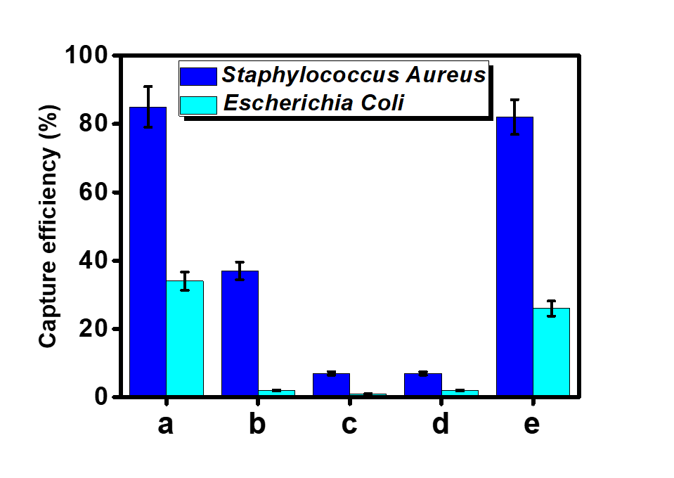
Results and Discussion
Enhanced bacteria capture in complex raw media with high efficiency
A
B
Catalytic
S. Aureus
Catalytic
E. Coli
Static
1
Magnetic
S. Aureus
Magnetic
E. Coli
a) moving (catalytic mode);
b) static
c) Unmodified catalytic
d) unmodified magnetic
e) moving (magnetic mode).
Unmodified

Slide 12
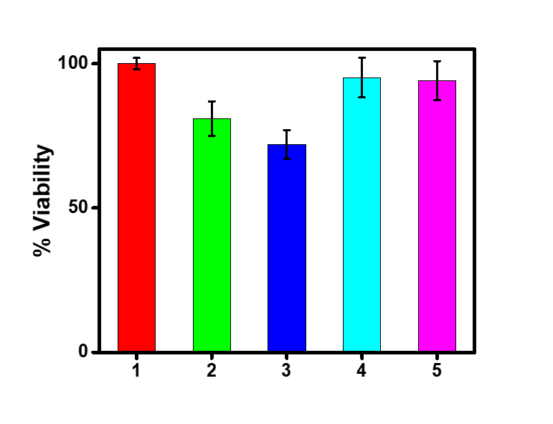
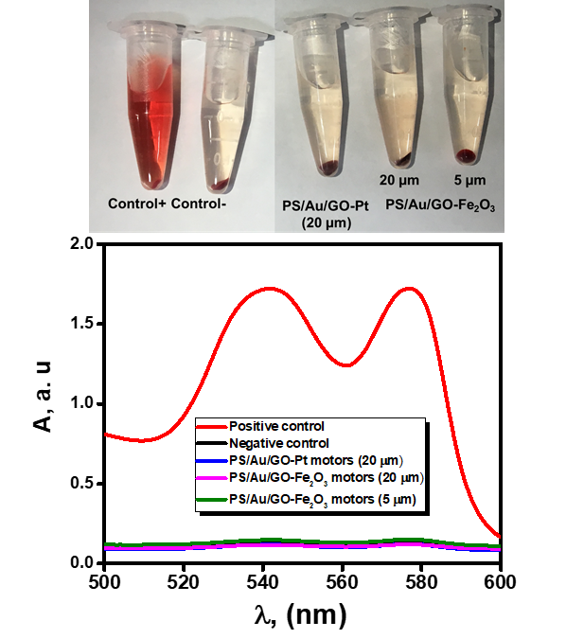
Results and Discussion
Biocompatibility and efficient movement against blood flows in magnetic mode: great potential for in-vivo applications
Hemocompatibility
MTT
1)control ; 2)20µm PS-Au; 3)20µm Nisin Pt motor;
4)20µm Nisin Fe2O3 motors ; 5)5 µm Nisin modified
Fe2O3 motors

Slide 13
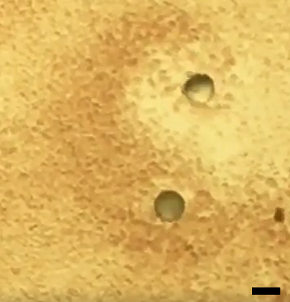
Results and Discussion
Movement in blood and against blood flood in magnetic mode

Slide 14
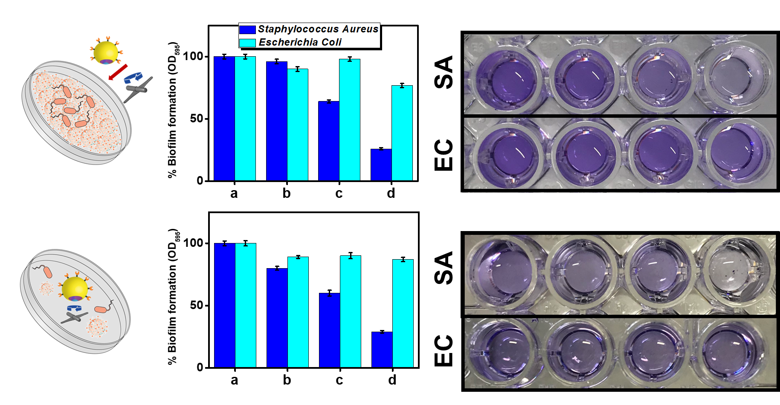
Results and Discussion
Selective inactivation of biofilms
Fast killing
Long-term
inactivation
a) Initial; b) unmodified moving; c) static modified motor; d) modified moving motor

Slide 15
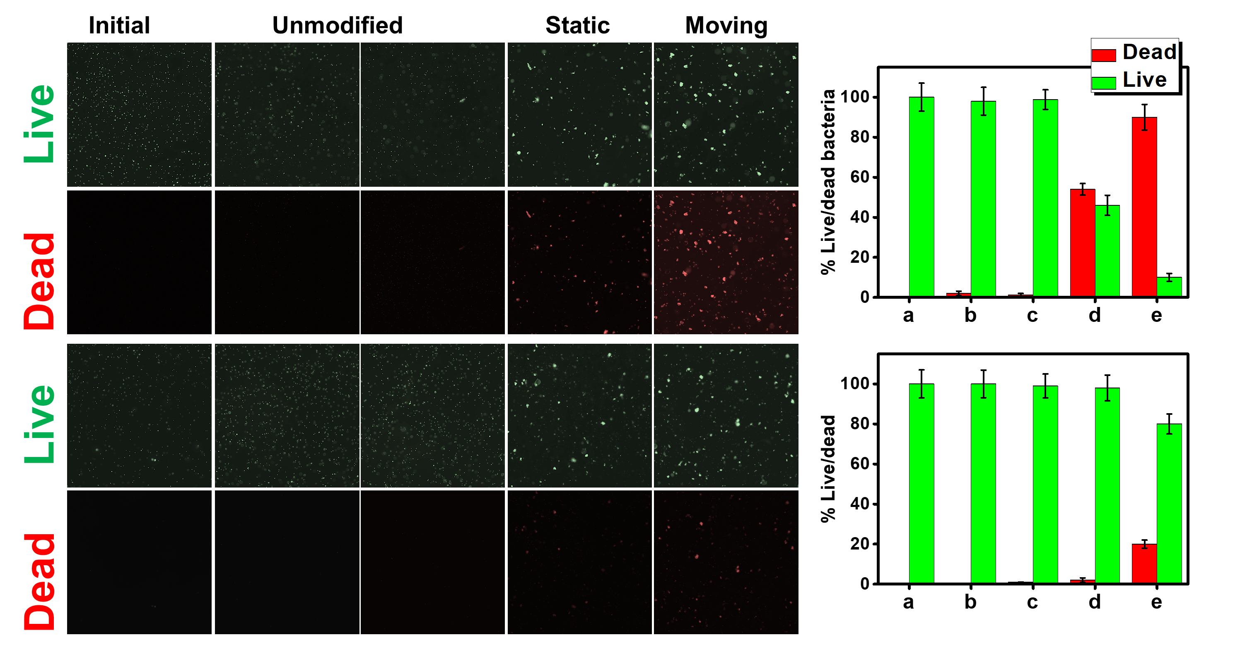
Results and Discussion
Selective bacteria inactivation (magnetic mode)
S. aureus
E. coli
a)initial; b) unmodified moving motor, c) unmodified motors with free peptide, d) static modified motors, e) moving modified motor

Slide 16
Results and Discussion
Selective extracellular polymeric substances (biofilm) deactivation

Slide 17
Conclusions
First combination of self-propelled micromotors with lanbiotics.
Specific interaction of amine groups in Nisin molecule with the pyrophosphate groups of the lipid II molecules in the membrane of gram-positive bacteria result in a damage and killing.
The strategy does not require additional pre-treatment of the bacteria or sample purification, allowing for its usage in raw complex samples, which is a major advantage over other micromotors strategies based on labile receptors (such as antibiotics or biological components).
The presence of two engines (catalytic and magnetic) in the micromotors allow for an adaptative behavior to tailor each application.
Accelerated kinetics for improved capture (as reflected by the 83% capture efficiency percentages of moving micromotors towards Staphylococcus Aureus) and prolonged contact for fast inactivation.

Slide 18
Acknowledgments

