Slide 1
Evaluation of the performance of permutation entropy
variants for classifying auditory evoked potentials
W. Legnani, M. Baldiviezo, C. Bontempo, Y. Corsaro, F. Fernandez Biancardi, A. Paglia, R. Hernando, M. Rodriguez and J. Barberia
Corresponding author: walter@frba.utn.edu.ar

Slide 2
Motivation
Find an objective classifier to detect auditory evoked potentials of patients with problems in the auditory pathway.

Slide 3
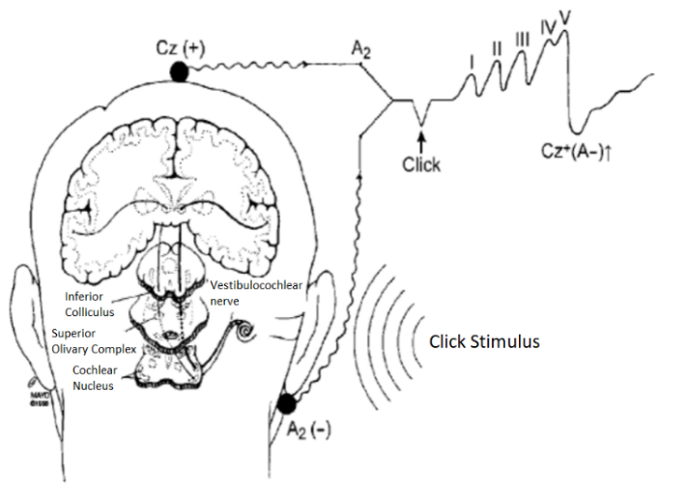
What is an Evoked Potential Study
It is composed of the electrical response of the auditory nerve to a stimulus.
It is a simple and accessible electrophysiological study that provides a lot of information in the clinical practice.
Electrodes placement and characteristic record obtained in a typical auditory evoked potencial of short latency, and scheme of the stimulus.

Slide 4
Data and Permutation Entropies Applied
The database was composed by signals of minors (24 samples) (from few months to four years) and adults (28 samples), of auditory short latency evoked potentials. 50 % of the records corresponds to normal hearing and the other 50 % were patients with diverse pathologies.
The entropies computed were:
Permutation Entropy – Version Bandt & Pompe (PE) [1]
Weighted Permutation Entropy (WPE) [2]
Modified Permutation Entropy (MPE) [3]
As a kind of preliminary analysis, we have applied a hypothesis test to study the difference between means in both groups of signals, resulting different at a significance level of 0.01.
Bandt, C., & Pompe, B. Permutation entropy: a natural complexity measure for time series. Physical review letters, 2002.
Fadlallah, B., Chen, B., Keil, A., & Príncipe, J, Weighted-permutation entropy: A complexity measure for time series incorporating amplitude information. Physical Review E, 2013
Cuesta-Frau, D, Using the Information Provided by Forbidden Ordinal Patterns in Permutation Entropy to Reinforce Time Series Discrimination Capabilities. Entropy, 2020

Slide 5
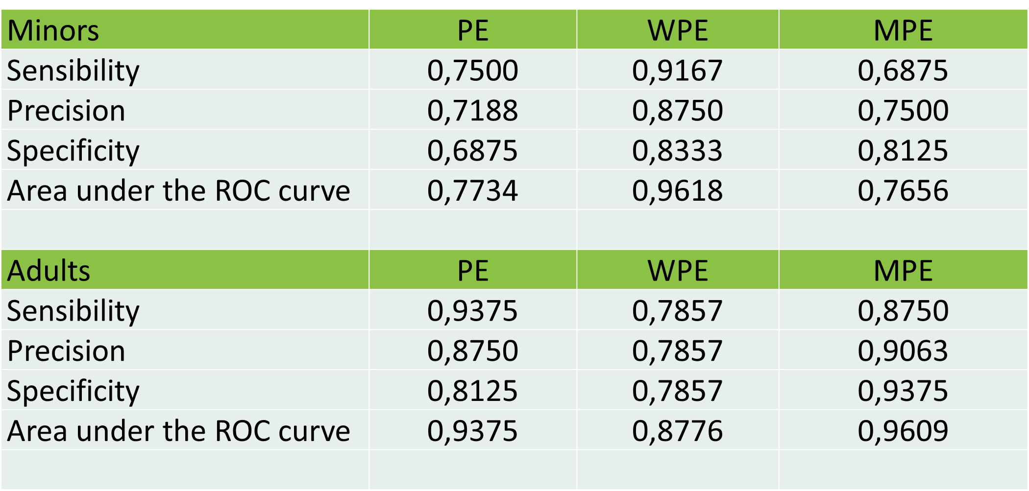
Results
We have applied the PE, WPE and MPE to analyze the ability of the information quantifiers to differentiate groups of normal hearing- and hearing-impaired records.
We have selected the best classifier upon the compute of the sensibility, precision and specificity and area under the receiver operating characteristic curve (ROC) .
The embedding dimension and offset applied were 4 and 1 respectively.

Slide 6
Conclusions
In the case of minors, the weighted permutation entropy (WPE) was the best classifier, with the maximum sensitivity, precision, specificity and area under the curve with respect to the others.
For the case of adults, it was the modified permutation entropy (MPE).
The result of the calculated entropies of pathological patients was greater than that of normal hearing patients, showing that the response of the auditory nerve is, in some sense. more random.

