Slide 1
MSU measuring interactions in categorical patterned datasets
Santiago Gómez Guerrero
Email: sgomezpy@gmail.com
2021

Slide 2
Collaborators
Inocencio Ortiz, UNA, Paraguay
Gustavo Sosa Cabrera, UNA, Paraguay
Miguel García Torres, UPO, Spain
Christian E. Schaerer, CIMA, UNA, Paraguay

Slide 3
Introduction
Interaction is often found in statistical models where the response variable is numeric.
However, there is a lack of methods to detect and measure interactions when the variables are categorical, or a mix of numerical and categorical.
Our findings occurred while exploring various datasets using the Multivariate Symmetrical Uncertainty.
MSU is a recently developed entropy-based correlation measure. It is unbiased for representative samples, and it detects linear and non-linear associations between any mix of categorical and discretized numerical variables. MSU values range from 0 to 1.

Slide 4
Patterned Records on Categorical Variables
Let D be a dataset of n categorical variables X₁, …, X_{n}. These attributes have cardinalities │ X₁ │, …, │ X_{n} │ each representing the number of possible categories or values in the attributes.
The variety of records that may be sampled from D is │ X₁ │ * …* │ X_{n} │, the number of different n-tuples that can be formed by combining categories in the given order.
An n-way pattern is a subset taken from such a variety of records on n categorical variables.
We say that a sample taken from D is patterned if, of the possible attribute value combinations, not all of them are present in the actual sample. The size of the sample need not be fixed, and a given record may appear 0 or more times in the sample.

Slide 5
Dataset, Pattern and Sample
Dataset Pattern Sample
sex | age | car
M | R1 | T
F | R2 | N
F | R1 | S
M | R1 | N
M | R3 | Y
F | R1 | S
M | R2 | S
F | R2 | H
F | R3 | T
F | R1 | Y
M | R3 | C
sex | age | car
F | R1 | S
M | R3 | Y
F | R2 | H
M | R3 | C
sex | age | car
M | R3 | Y
F | R1 | S
M | R3 | C
F | R2 | H
M | R3 | Y
F | R1 | S
In this example, the first and the second pattern records have frequency 2 in the sample; the other two have frequency 1.
⁞

Slide 6
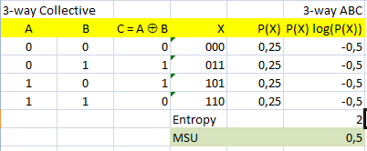
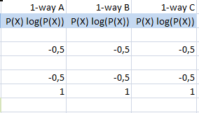
Simulations: 3-way XOR Experiment
Calculations of MSU were performed on a spreadsheet for easier handling and understanding of the pattern’s behavior.
Known experiments, assuming that the four records are equally likely, compute the MSU for the plain pattern (two-variable XOR function) as just 1/2.
However, samples with more than four records allow unequal likelihoods, and the computed sample MSU increases. Try for example, the probability vector (0,25; 1E-80; 1E-80; 0,75) which gives an MSU of 0.75.

Slide 7
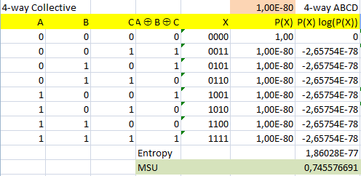
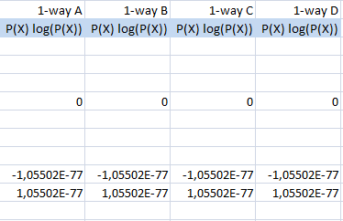
4-way XOR Experiment
With eight equally likely records, the MSU for the plain pattern (three-variable XOR function) is exactly 1/3.
Again, samples with more than eight records allow unequal likelihoods, increasing the MSU of the sample. With seven very small P(X) values and one large P(X), we observed a maximum 4-way MSU value of almost 0.75.

Slide 8
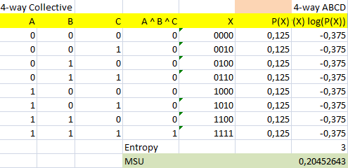
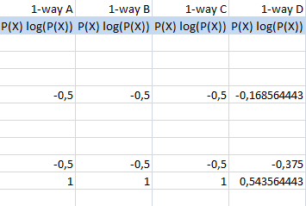
4-way AND Experiment
With eight equally likely records, the MSU for the plain pattern (three-variable AND function) is 0.2045.
With unequal likelihoods, sample MSU increases again. The maximum MSU is 1 when P(X) is (0.2; 1E-80; …; 1E-80; 0.8) or any permutation thereof.
Does equiprobable sampling scenarios always imply a minimum MSU value? An example disproving this is coming up soon.

Slide 9
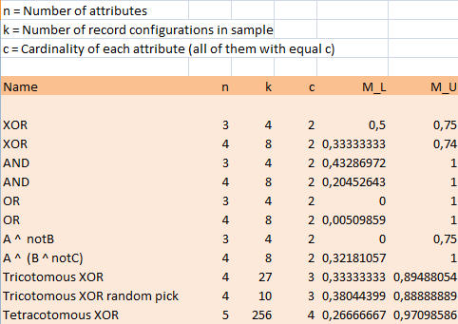
Further Experiments
The following list shows other similar experiments performed, using a variety of patterns and variable cardinalities. Here is a comparative behavior of MSU on some specific patterns.

Slide 10
Interaction implied by pattern
Our simulation procedure consisted of keeping a pattern fixed and then running different sampling scenarios under that pattern. It is observed that every n-variable pattern is characterized by a lower MSU bound M_{L} and an upper MSU bound M_{U}.
The M_{L} value is attained when the sample consists of a certain combination of frequencies within the pattern. By definition, the pattern is the common denominator among the various sampling scenarios. The MSU of each sample expresses the correlation among the n variables, and it varies from one scenario to another but never gets below M_{L}. Thus, we are hinted that this is the interaction inherent to the pattern itself – the least amount of n-way correlation that will be found every time a sample follows this pattern.
The difference M_{U} – M_{L} can be considered as additional correlation induced by the variation in relative frequencies from configuration M_{L} to configuration M_{U}.

Slide 11
Do we see any interaction?
st.c | mc.c | bf
-5,805 | 1,48 | 11,9
-0,605 | 0,58 | 22,8
5,395 | 9,38 | 18,7
4,495 | 3,48 | 20,1
-6,205 | 3,28 | 12,9
0,295 | -3,92 | 21,7
6,095 | -0,02 | 27,1
2,595 | 2,98 | 25,4
-3,205 | -4,42 | 21,3
0,195 | -2,82 | 19,3
5,795 | 2,38 | 25,4
5,095 | 0,68 | 27,2
-6,605 | -4,62 | 11,7
-5,605 | 0,98 | 17,8
-10,705 | -6,32 | 12,8
4,195 | 2,48 | 23,9
2,395 | -1,92 | 22,6
4,895 | -3,02 | 25,4
-2,605 | -0,52 | 14,8
-0,105 | -0,12 | 21,1
The following data were obtained from [Joseph] . Among various body measurements, skinfold thickness (st) and midarm circumference (mc) are proposed as possible predictors of body fat (bf). Also find whether there is any evidence of interactions among the 3 variables. Data have been centralized with respect to their means. The plan is to choose a regression model such as
bf = k + a∗st + b∗mc + c∗st∗mc
and then
Discretize bf, st and mc.
Take as Pattern the set of distinct observed records, discretized.
Simulate sampling scenarios to find M_{L} .
Check whether M_{L} values reveal interactions.

Slide 12
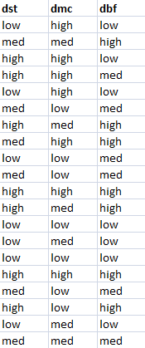
Regression without interaction
A 2-variable regression model that fits the data is:
bf = 20.375 + 0.9815 st − 0.4234 mc + 0.0226 st∗mc (1)
with r² = 0.7945.
The summary table shows that the interaction term st∗mc is not significant in this case, with a p-value of 0.4321.
Discretization of bf, st and mc into 3 categories each, gives us an all-categorical-variable database, as shown on the right hand side. Under this discretization, the global correlation in the database is MSU = 0.3667.

Slide 13
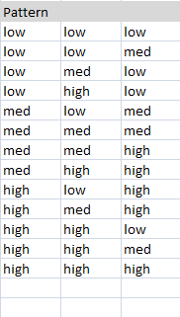
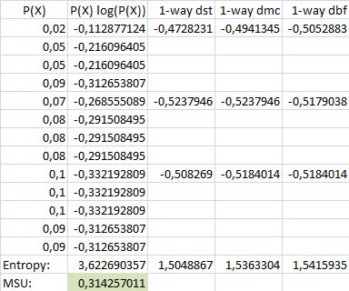
Regression without interaction
Pattern 1 as implied by this database is shown below on the left, and a simulation of sampling scenarios leads to M_{L} = 0.31425701 as the lowest value of MSU. This is even lower than in the equiprobable configuration where MSU is 0.32646521.

Slide 14
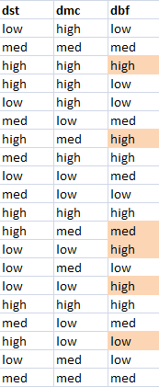
Regression with interaction
In order to exhibit st∗mc interaction, some values on the bf column were modified. Now the model becomes
bf = 19.9453 + 0.4108 st − 0.2549 mc + 0.2265 st∗mc (2)
with r² = 0.8055.
This time the interaction term is significant as per the summary table, with p-value very close to 0.
Again we discretize bf, st and mc into 3 categories each. The resulting categorical database is shown on the right hand side; the highlighted cells indicate that underlying numerical values were modified to compute the model. For this discretized dataset, the MSU value of (modified) observations is 0.3667 – same as before because the frequency profiles are similar.

Slide 15
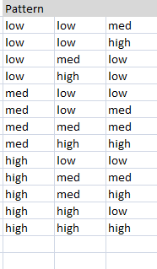
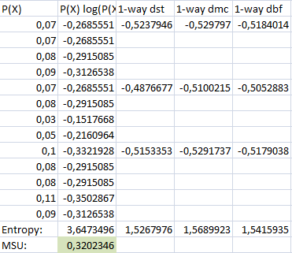
Regression with interaction
Thus the Pattern 2 is as shown on the left, and the simulation of sampling scenarios finds M_{L} = 0.3202346.

Slide 16
M_{L} and Linear Models
In a 3-way XOR pattern, it is easy to check that any two variables have no correlation with the third, giving MSU(A, C) = MSU(B, C) = 0; but when we consider the full 3-way pattern the MSU(A, B, C) = M_{L} = 0.5. Thus, we say that 0.5 is the intrinsic interaction due to the XOR pattern.
The body fat example shows that smaller M_{L} values are associated to a “no interaction” linear model, as compared to the same model with interaction.
In this example, looking at variables pairwise we have MSU(bf, st) = 0.4405 and MSU(bf, mc) = 0.0973. When we consider the 3-way Pattern 1, the M_{L} value becomes 0.3143. But in this case, we can only say that 0.3143 partially represents intrinsic interaction due to the first pattern, and partially represents the correlation due to relevant variables st and mc.
As for Pattern 2, its M_{L} value of 0.3202 seems to indicate that, with the same values of independent variables and some modified response values, interaction is more visible. This gives support to the interaction term in regression model (2).

Slide 17
Conclusion
From the point of view of observational statistics and linear models with a numeric response, interaction is a way for Nature to not follow a linear behavior all the time. For models with a categorical response, a more general definition of interaction is necessary.
Interaction is really a very frequent phenomenon in linear models. Often times though, its size is not that large compared to the direct effect of relevant variables, and it is disregarded for model simplicity.
Our method of detecting n-way categorical interactions opens up new questions on the behavior of datasets exhibiting multivariate correlation, as for example the mixed-patterned and non-patterned datasets or unknown patterns.
Finding out how the M_{L} values relate to the interaction coefficient and/or to the r² values in statistical linear models is still an open issue.

Slide 18
Acknowledgements
- COMIDENCO: CONSTRUCTION OF A DENGUE INCIDENCE MODEL APPLIED TO COMMUNITIES OF PARAGUAY, PINV15-706, CONACYT.
- CONACYT, PRONII.

Slide 19
References
Lawrence Joseph. Interactions in Multiple Linear Regression. Department of Epidemiology and Biostatistics, McGill University.
https://www.medicine.mcgill.ca/epidemiology/joseph/courses/EPIB-621/interaction.pdf
https://stats.blue/Stats_Suite/multiple_linear_regression_calculator.html
Gustavo Sosa-Cabrera, Miguel García-Torres, Santiago Gómez-Guerrero, Christian E. Schaerer, Federico Divina. A multivariate approach to the symmetrical uncertainty measure: Application to feature selection problem. Information Sciences, Volume 494, 2019, Pages 1-20, https://doi.org/10.1016/j.ins.2019.04.046.
Gustavo Sosa-Cabrera, Miguel García-Torres, Santiago Gómez-Guerrero, Christian E. Schaerer, Federico Divina. Understanding a multivariate semi-metric in the search strategies for attributes subset selection. Proceeding Series of the Brazilian Society of Computational and Applied Mathematics, volume 6, number 2 (2018). https://proceedings.sbmac.org.br/sbmac/article/view/2506

