Slide 1
On the Implementation of Downsampling Permutation Entropy variants in the detection of Bearing Faults in Rotatory Machines
Antonio DÁVALOS-TREVIÑO
Meryem JABLOUN
Philippe RAVIER
Olivier BUTTELLI
Mathématiques, Informatique, Physique, Théorique et Ingénierie des Systèmes [MIPTIS] Doctoral School
PRISME Laboratory,
University of Orléans, Fr.

Slide 2
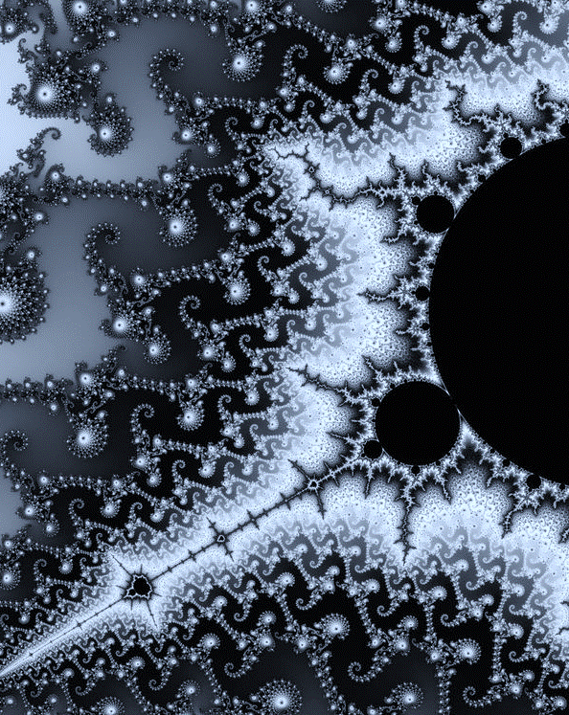
MPE - Background
Multiscale Permutation Entropy (MPE) of dimension 𝑑 analyzes the information contained in the ordinal patterns of a signal at different time scales. (Aziz & Arif., 2005).
Refinements to this method, like rcMPE (Humeau-Heutier 2015), greatly improve the precision of MPE, particularly for short time signals.
Our contribution: First, we propose an alternative multiscaling method, using composite downsampling instead of composite coarse-graining, which further improves the method’s precision.
Motivation: Composite multiscaling creates artifact correlations within the signal, which increases the MPE variance. By downsampling, we avoid the unwanted effects of preprocessing in the final MPE value.

Slide 3
Contents
1
Theoretical Background
2
3
Permutation Entropy and Multiscaling techniques
Refined Composite Downsampling Permutation Entropy
Composite Downsampling and Statistics comparison
Results
Experimental Setup, Results and Discussion
Notes:
Repeat this slide each time we enter a new chapter.
You can expand in a new “Sub-Contents”, maybe in gray, to show the points I want to show inside.

Slide 4
Theoretical Background
Multiscale Permutation Entropy

Slide 5
Permutation Entropy
Probability of each pattern
Permutation Entropy
$$\hat{ℋ}=\frac{−1}{ln⁡(d!)}\sum_{i=1}^{d!}{{\hat{p}}_{i}ln⁡({\hat{p}}_{i})}$$
All $d!$ possible ordinal patterns (for $d=3$)
Bandt & Pompe, 2002

Slide 6
Multiscale Permutation Entropy
*
$$x_{1}$$
$$x_{2}$$
$$x_{m}$$
$$x_{m+1}$$
$$x_{2m}$$
$$x_{2m+1}$$
$$x_{3m}$$
$$x_{3m+1}$$
$$x_{4m}$$
$$x_{4m+1}$$
Original Series
…
…
…
…
…
$$x_{1}^{(m)}={\overline{x}}_{1,m}$$
$$x_{2}^{(m)}={\overline{x}}_{2,m}$$
$$x_{3}^{(m)}={\overline{x}}_{3,m}$$
$$x_{4}^{(m)}={\overline{x}}_{4,m}$$
Scale $m$
Series
…
…
…
…
$$x^{(m)}=\left[\begin{matrix}x_{1}^{(m)} \\ ⋮ \\ x_{\frac{N}{m}}^{(m)}\end{matrix}\right]$$
$$x=\left[\begin{matrix}x_{1} \\ ⋮ \\ x_{N}\end{matrix}\right]$$
Multiscaling
Coarse-graining procedure
Aziz & Arif, 2005. Costa et al. 2002

Slide 7
Refined Composite Multiscale Permutation Entropy
*
For $k=1,…,m$, we can construct m different coarse signals by starting the classical coarse-graining procedure at element $k$. (Humeau-Heurtier et al. 2015)
Improved Precision
Artifact Cross-Correlation
$x_{k=1,1}^{\left(m=3\right)} =\frac{1}{m}\left(x_{1} + x_{2} +x_{3}\right)$
$x_{k=2,1}^{\left(m=3\right)} =\frac{1}{m}(x_{2} + x_{3} + x_{4})$
$$x$$
$$x_{1}$$
$$x_{2}$$
$$x_{3}$$
$$x_{4}$$
$$x_{5}$$
$$x_{6}$$
$$x_{7}$$
$$x_{8}$$
$$x_{9}$$
$$x_{10}$$
…
$$x_{1}^{(m)}$$
$$x_{1,1}^{(m)}$$
$$x_{1,2}^{(m)}$$
$$x_{1,3}^{(m)}$$
…
$$x_{2}^{(m)}$$
$$x_{2,1}^{(m)}$$
$$x_{2,2}^{(m)}$$
$$x_{2,3}^{(m)}$$
…
$$x_{3}^{(m)}$$
$$x_{3,1}^{(m)}$$
$$x_{3,2}^{(m)}$$
$$x_{3,3}^{(m)}$$
…
$$H_{rc}\left({\hat{p}}^{\left(m\right)}\right)=\sum_{i=1}^{d!}{{\hat{\overline{p}}}_{i}^{(m)} log({\hat{\overline{p}}}_{i}^{(m)})}$$
$$x_{1,1}^{(m)}=\frac{x_{1}+x_{2}+x_{3}}{m}$$

Slide 8
Multiscale Permutation Entropy Characteristics
Ordinal Patterns are invariant to signal’s amplitude.
Robust Robust to signal’s noise and artifacts.
Length Constraint
The precision of the pattern probability estimations decrease for short signals.
Artifact Cross-Correlation For composite approaches, the use of redundant terms leads to MPE underestimation.

Slide 9
Refined Composite Downsampling Permutation Entropy
Composite Downsampling and Statistics comparison

Slide 10
Composite Downsampling
*
We combine the classical downsampling procedure with the multiscaling.
Build downsampled signals with different starting point.
Retains improved precision from Composite Coarse-graining.
Avoids Artifact Cross-correlation.
$$x$$
$$x_{1}$$
$$x_{2}$$
$$x_{3}$$
$$x_{4}$$
$$x_{5}$$
$$x_{6}$$
$$x_{7}$$
$$x_{8}$$
$$x_{9}$$
$$x_{10}$$
…
$$x_{1}^{(τ)}$$
$$x_{1,1}^{(τ)}$$
$$x_{1,2}^{(τ)}$$
$$x_{1,3}^{(τ)}$$
$$x_{1,4}^{(τ)}$$
…
$$x_{2}^{(τ)}$$
$$x_{2,1}^{(τ)}$$
$$x_{2,2}^{(τ)}$$
$$x_{2,3}^{(τ)}$$
…
$$x_{3}^{(τ)}$$
$$x_{3,1}^{(τ)}$$
$$x_{3,2}^{(τ)}$$
$$x_{3,3}^{(τ)}$$
…
$$H_{rcd}\left({\hat{p}}^{\left(τ\right)}\right)=\sum_{i=1}^{d!}{{\hat{\overline{p}}}_{i}^{(τ)} log({\hat{\overline{p}}}_{i}^{(τ)})}$$
$$x_{1,1}^{(τ)}=x_{1}$$
Davalos et al., 2020.

Slide 11
MPE Statistics
MPE Exp. Value
rcMPE Exp. Value
rcDPE Exp. Value
MPE Variance
rcMPE Variance
rcDPE Variance
$$E\left[H_{c}\left({\hat{p}}^{\left(m\right)}\right)\right]≈ H\left(p^{\left(m\right)}\right)−\frac{1}{2} \left(d!−1 \right)\left(\frac{m}{N}\right)$$
$$E\left[H_{rc}\left({\hat{p}}^{\left(m\right)}\right)\right]≈ H\left(p^{\left(m\right)}\right)−\frac{1}{2} \left(d!−1 \right)\left(\frac{1}{N}\right)$$
$$E\left[H_{rcd}\left({\hat{p}}^{\left(τ\right)}\right)\right]≈ H\left(p^{\left(τ\right)}\right)−\frac{1}{2} \left(d!−1 \right)\left(\frac{1}{N}\right)$$
$$var\left( H_{c} \left({\hat{p}}^{\left(m\right)}\right)\right)≈\left(\frac{1}{N}\right)m l^{\left(m\right)}′ Σ_{p}^{\left\{\left(m\right)\right\}} l^{\left(m\right)}+{\left(\frac{1}{N}\right)}^{2}m^{2}\left( 1′ l^{\left(m\right)}+d!H\left(p^{\left(m\right)}\right)+\frac{1}{2} \left(d!−1\right)\right)$$
$$var\left( H_{rc} \left({\hat{p}}^{\left(m\right)}\right)\right)≈\left(\frac{1}{N}\right) l^{\left(m\right)}′ Σ_{p}^{\left\{\left(m\right)\right\}} l^{\left(m\right)}+{\left(\frac{1}{N}\right)}^{2}\left(1′ l^{\left(m\right)}+d!H\left(p^{\left(m\right)}\right)+\frac{1}{2} \left(d!−1\right)\right)$$
$$var\left( H_{rcd} \left({\hat{p}}^{\left(τ\right)}\right)\right)≈\left(\frac{1}{N}\right) l^{\left(τ\right)}′ Σ_{p}^{\left\{\left(τ\right)\right\}} l^{\left(τ\right)}+{\left(\frac{1}{N}\right)}^{2}\left(1′ l^{\left(τ\right)}+d!H\left(p^{\left(τ\right)}\right)+\frac{1}{2} \left(d!−1\right)\right)$$
Embedding dimension d, time scale m, signal length N, and probability p.

Slide 12
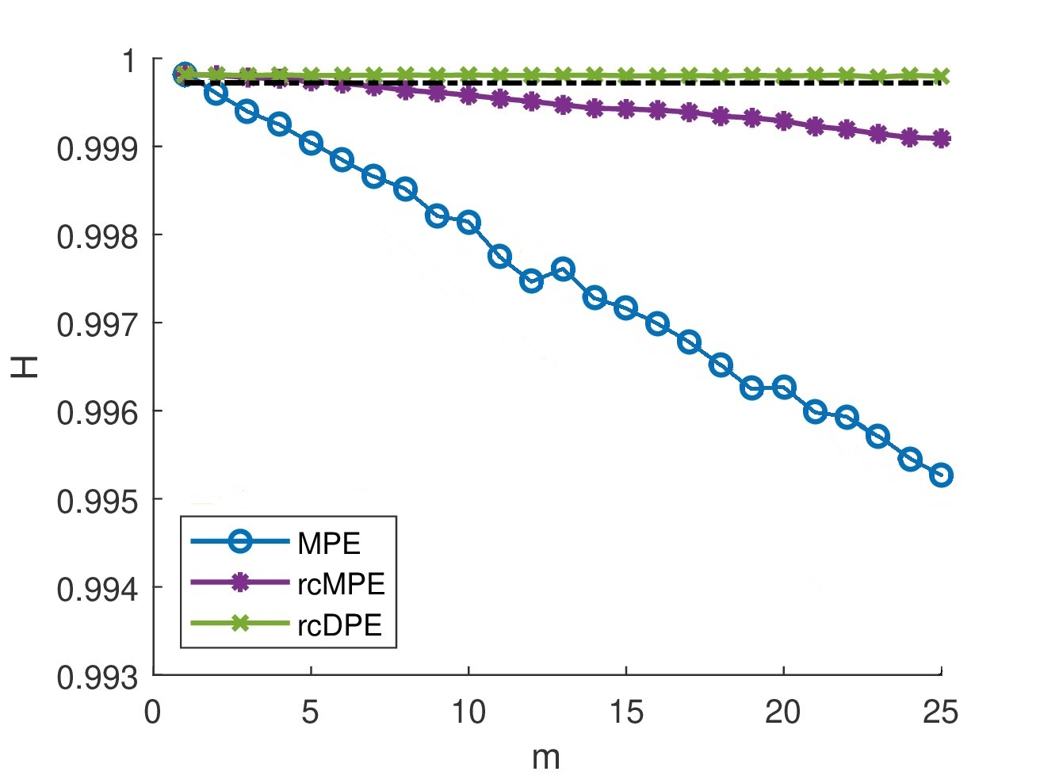
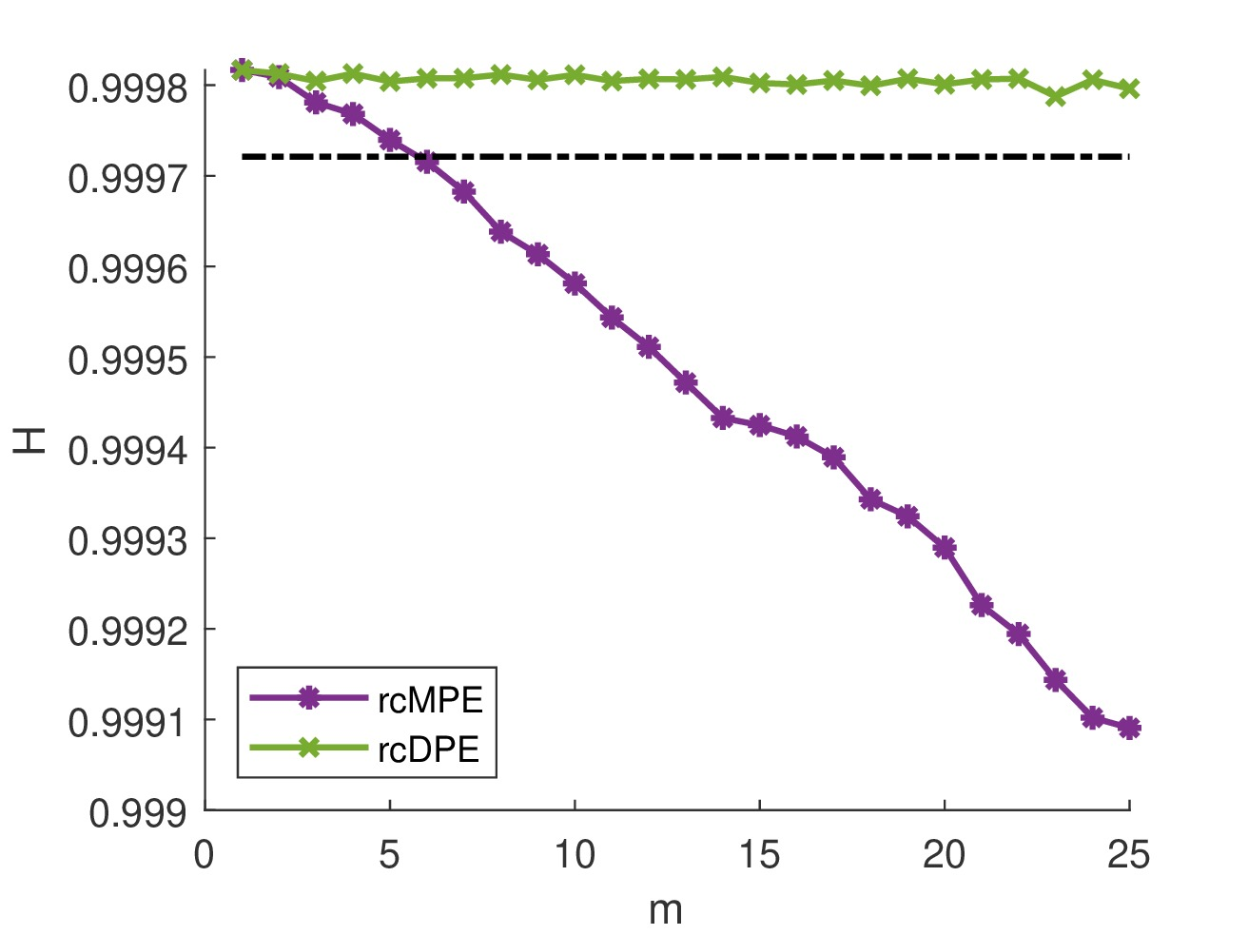
MPE Expected Value – White Noise
All methods
Refined methods

Slide 13
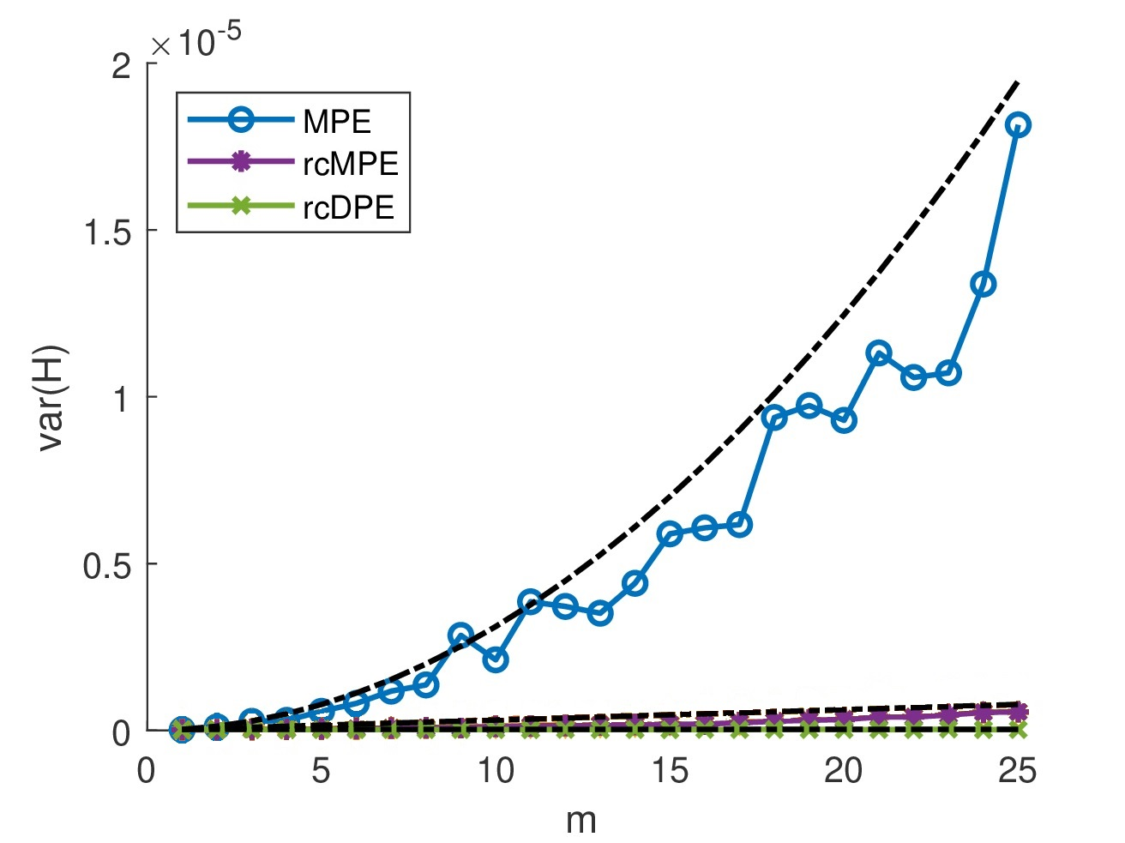
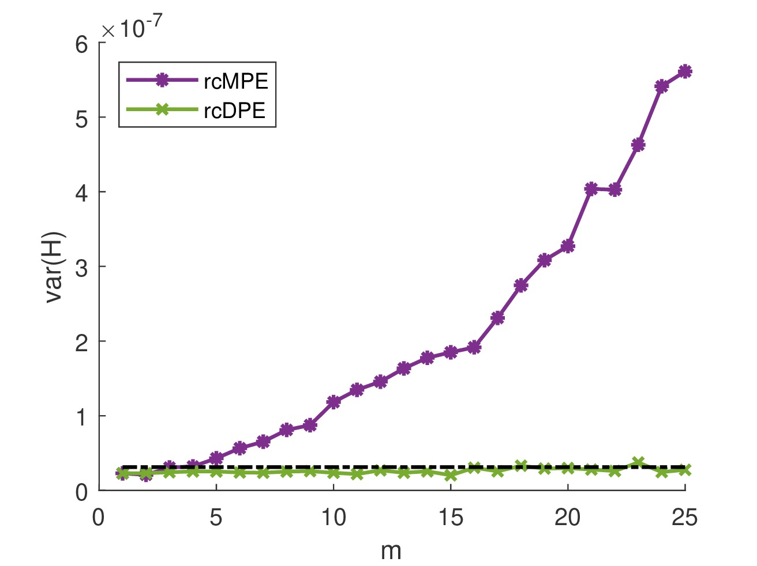
MPE Variance – White Noise
All methods
Refined methods

Slide 14
Main Findings
Artifact Cross-correlation Limits the refined composite precision
Downsampling
Avoids redundancy by using composite downsampling instead of coarse-graining
Variance
rcDPE presents the lowest variance of all the methods discussed so far. It outperforms classic MPE by two orders of magnitude on white noise.
Scale-invariant
rcDPE is the only method here discussed with no effects related to scale.

Slide 15
Results
Experimental Setup, Results, and Discussion.

Slide 16
Experimental Setup
Dataset
Methods
Bearing fault signal dataset (Bechhoeffer 2013).
Sampling frequency 100kHz for 6 seconds.
Bearing test rig with 270 lb load.
Rotation frequency 25 Hz.
3 signals with labels:
Base: no defects.
Fault: with defects
3-way ANOVA test.
Factors:
Type: Base and Fault
Methods: MPE, rcMPE, rcDPE, and rcDPE (filtered)
$d=3,…,6.$
$m=1,…,20$, with $τ=m$.

Slide 17
Sample Signal Spectrum
* Dotted lines showcase the Nyquist frequency at each scale. For m>3, we experience aliasing.

Slide 18
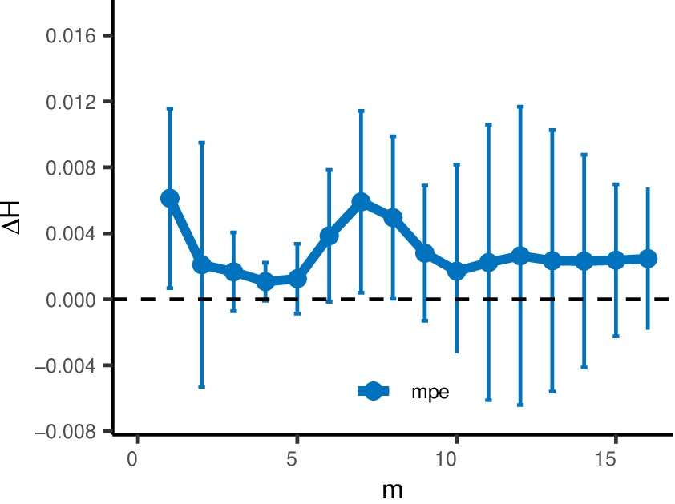
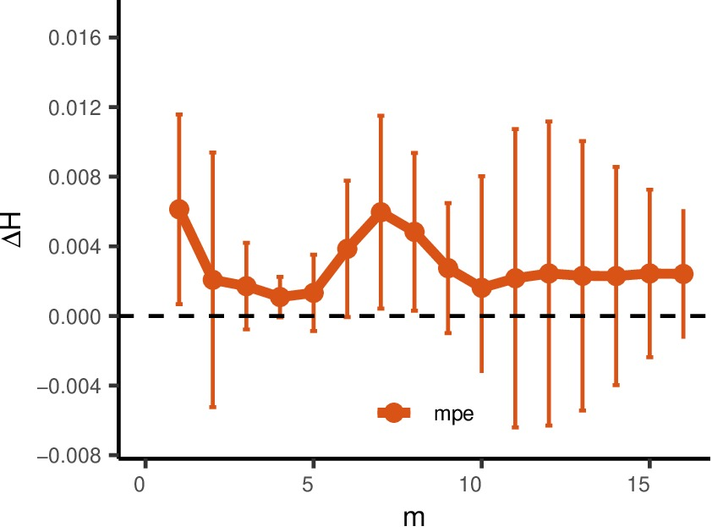
Entropy Difference $ΔH={\overline{H}}_{Base}−{\overline{H}}_{Fault}$
MPE
rcMPE
Error bars computed using $S_{ΔH}= ±1,96 \sqrt{S_{H, Base}^{2}+S_{H, Fault }^{2}}$ with significance $α=0,05$

Slide 19
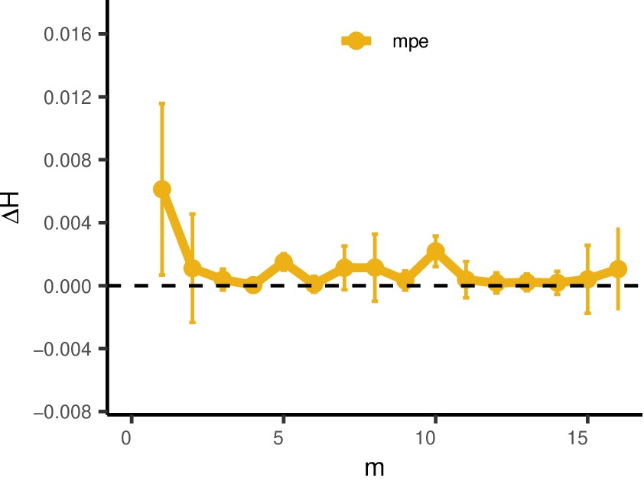
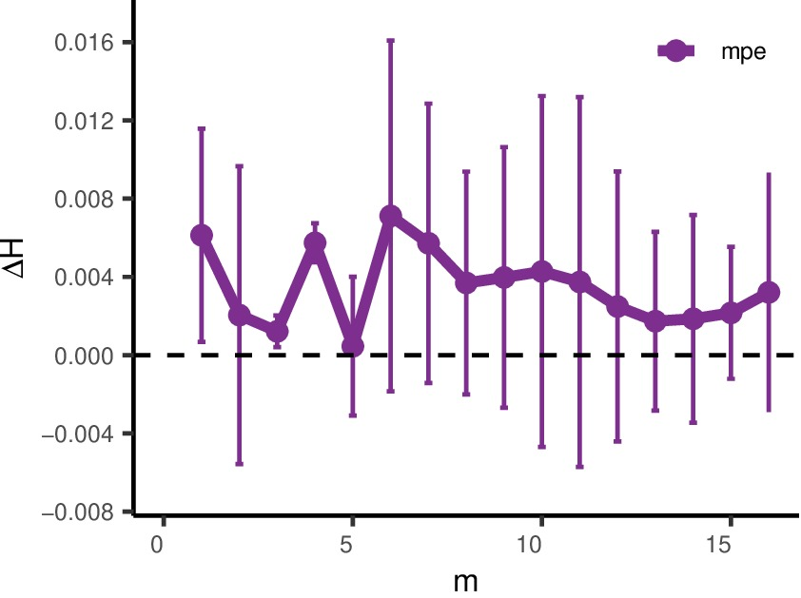
rcDPE
Entropy Difference $ΔH={\overline{H}}_{Base}−{\overline{H}}_{Fault}$
rcDPE – Aliasing Filter
Error bars computed using $S_{ΔH}= ±1,96 \sqrt{S_{H, Base}^{2}+S_{H, Fault }^{2}}$ with significance $α=0,05$

Slide 20
 | Df | Sum Sq. | Mean Sq. | F-value | P-Value | Significant
Type | 1 | 0.0000358 | 0.0000358 | 12.346 | 0.000730 | ***
Method | 3 | 0.0007515 | 0.0002505 | 86.392 | < 2e-16 | ***
Dimension | 1 | 0.0004970 | 0.0004970 | 171.397 | < 2e-16 | ***
Type & Method | 3 | 0.0003514 | 0.0001171 | 40.398 | 5.37e-16 | ***
Type & Dimension | 1 | 0.0000410 | 0.0000410 | 14.134 | 0.000322 | ***
Method & Dimension | 3 | 0.0000955 | 0.0000318 | 10.981 | 4.09e-06 | ***
Type & Method & Dimension | 3 | 0.0000219 | 0.0000073 | 2.514 | 0.064282
Residuals | 80 | 0.0002320 | 0.0000029
ALL FACTORS AND INTERACTIONS ARE SIGNIFICANT
Significance $α=0,05$

Slide 21
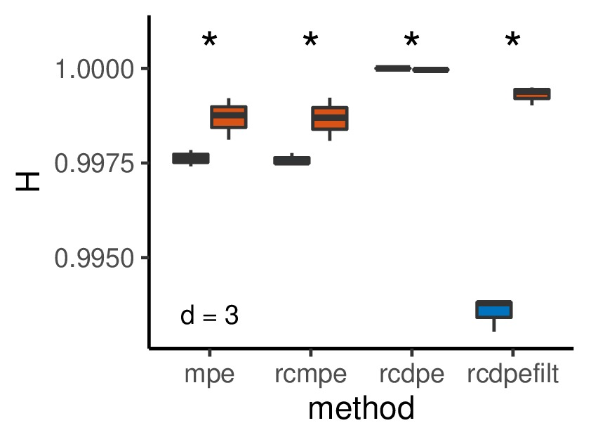
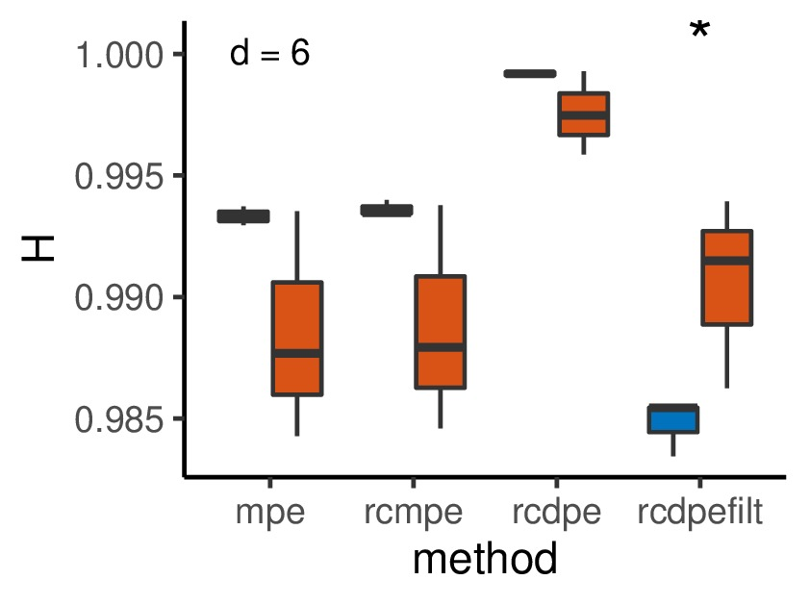
Base-Fault Classification
d=3
d=6
*
Significant with $α=0,05$ , $m=τ=4$

Slide 22
Main Findings
Optimal Settings rcDPE with aliasing filter
Time scale m=4
Low dimension (d=3)
MPE behavior
Unfiltered rcDPE has the lowest variation, but erases the difference between faulty and non-faulty signals.
MPE dimension
For this particular dataset, higher dimensions actually perform worse than lower dimensions. Filtered rcDPE maintains significant differences.
Aliasing
There is a trade-off between statistical precision and aliasing effects.

Slide 23
Conclusions
Main Insights

Slide 24
Conclusion
The refined Composite Downsampling Permutation Entropy improves the precision of the classical rcMPE by avoiding the artifact cross-correlations, product of the signal’s preprocessing.
rcDPE enhances the classification between faulty and non-faulty bearings in rotatory machines.
In order to avoid aliasing effects, we applied an anti-aliasing filter matching the Nyquist frequency for each time scale. This allowed a better classification, even with increased variance compared to the unfiltered rcDPE method.
For this dataset, lower dimensions allowed a better classification of the faulty components. Nonetheless, the filtered rcDPE method successfully detected the difference, even for higher dimensions.

Slide 25
References
W. Aziz and M. Arif, “Multiscale permutation entropy of physiological time series,” in 2005 Pakistan Section Multitopic Conference, 2005, pp.1–6.
A. Humeau-Heurtier, C.-W. Wu, and S.-D. Wu, “Refined composite multiscale permutation entropy to overcome multiscale permutation entropy length dependence" IEEE Signal Processing Letters, vol. 22, pp. 2364{2367, 12 2015.
C. Bandt and B. Pompe, “Permutation entropy: A natural complexity measure for time series,” Physical Review Letters, vol. 88, no. 17, p. 174102, 2002.
M. Costa, A. Goldberg, and C. Peng, “Multiscale entropy analysis of biological signals,” Phys. Rev. E 71, 021906, 2005.
A. Davalos, M. Jabloun, P. Ravier, and O. Buttelli, “Improvement of Statistical Performance of Ordinal Multiscale Entropy Techniques Using Refined Composite Downsampling Permutation Entropy,” Entropy 2021, 23(1), 30, 2020.
Bechhoefer, E. Fault Data Sets. Society For Machinery Failure Prevention Technology. Vibration Institute. 518 2013. https://www.mfpt.org/fault-data-sets/, 2013.

Slide 26
Thank you!
Q&A Session

