Slide 1
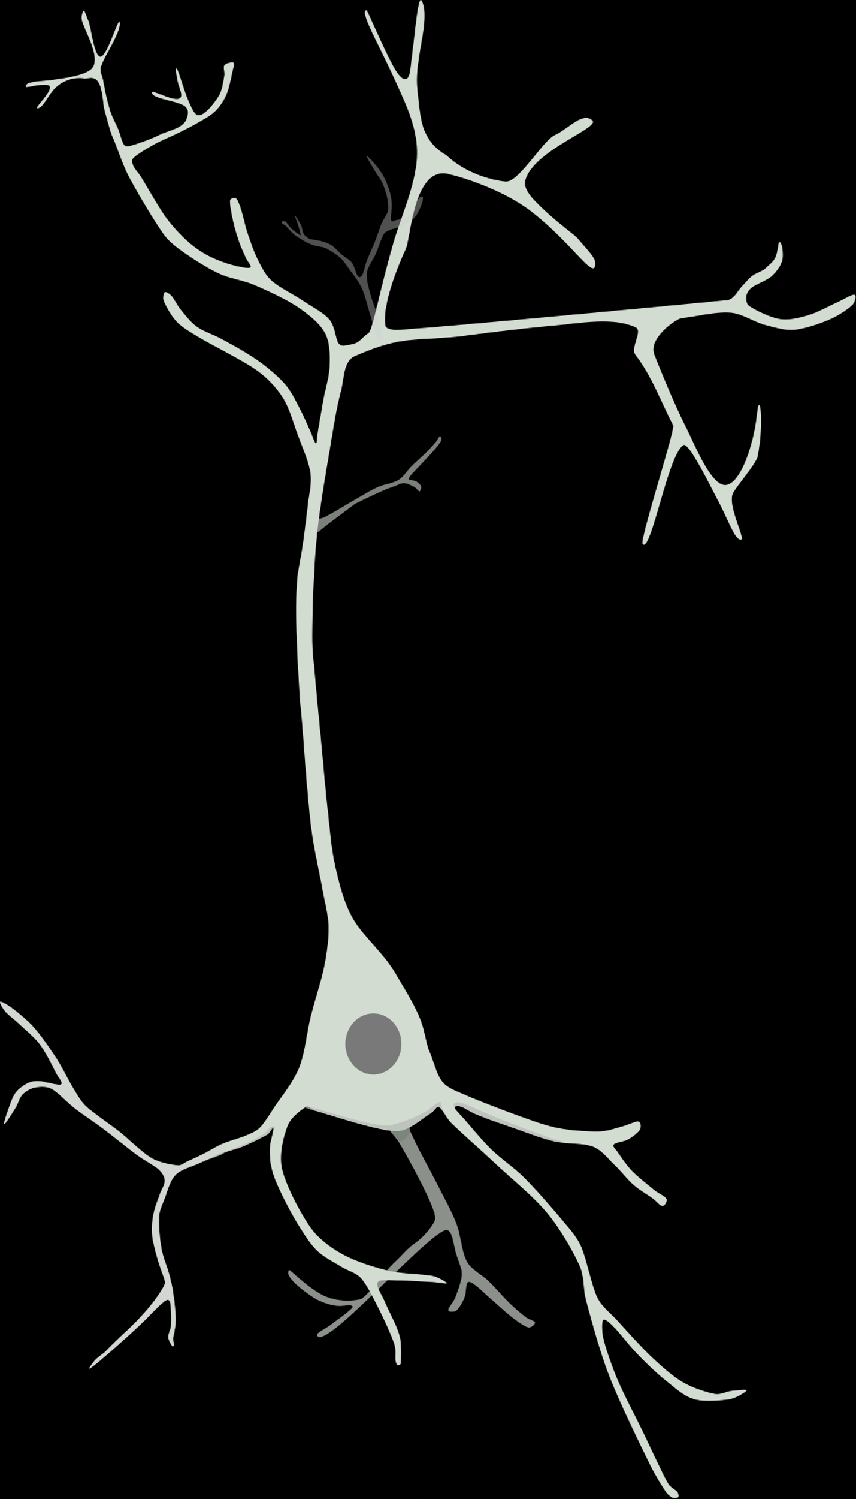
The sample entropy of inter-spike intervals as a possible measure of relations between neuronal activity and individuum behaviour
Anastasiia Bakhchina
nastya18-90@mail.ru
Laboratory of neural basis of mind
named after V.B.Svyrkov
Institute of Psychology
Russian Academy of Science
sciforum-030268
Supported by RSF Grant №18-78-10114

Slide 2
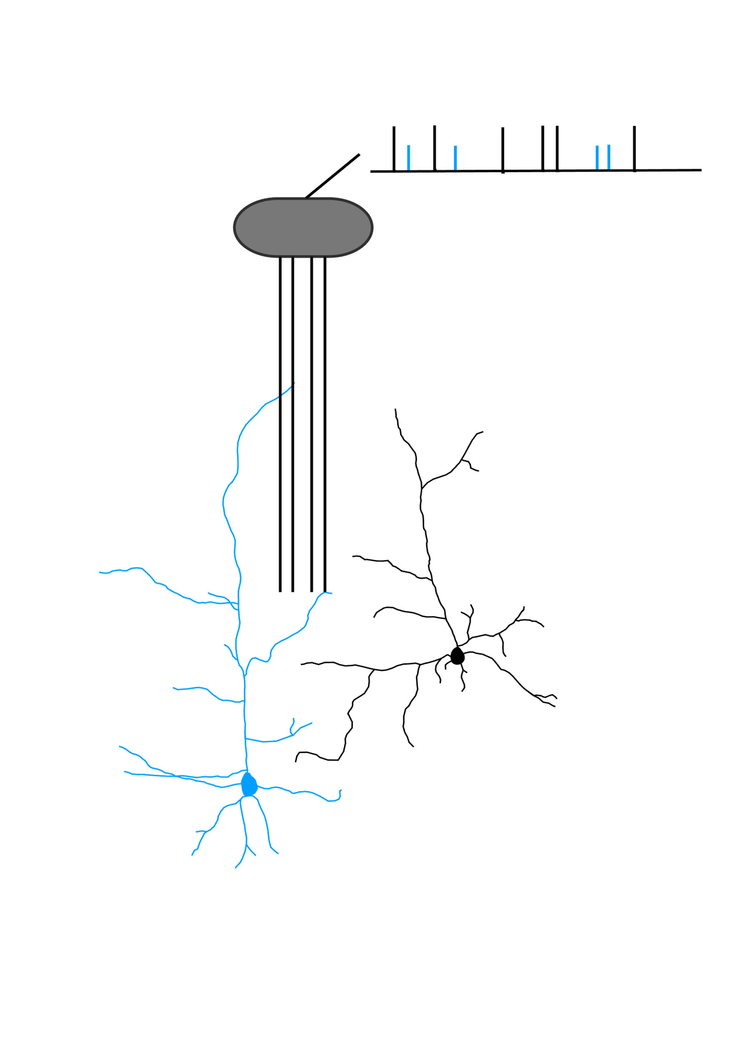
Extracellular recording of neuronal activity (in vivo)
Extracting of time intervals between sequenced spikes in cellular activity
The neuronal underpinnings of newly acquired operant appetitive behavior were studied recording the singular activity of neurons in the cingulate cortical areas of freely moving rabbits.
According to the systems-evolutionary theory and the system-selection concept of learning (Shvyrkov 1986), learning is the process of specialization of a group of neurons in relation to a new behavior.
The new behavior is not a substitution but in addition to the previously formed experience. Describing the dynamics of the activity of specialized and other related to the behavior cells is necessary to understand neuronal mechanisms of learning-related processes.

Slide 3
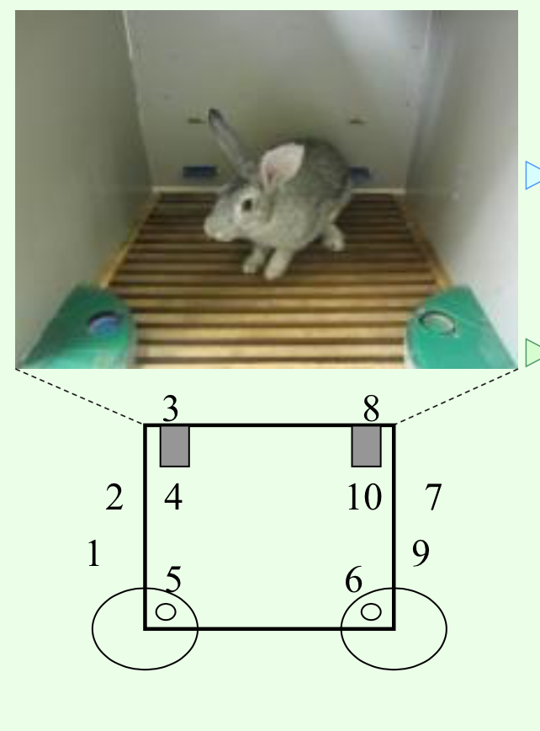
Adult male rabbits (N=8) learned food-acquisition behavior in the two feeders and two levers cage.
The food had been delivered in the feeders after pressing the corresponding lever.
Neuronal activity and behaviour were recorded during the first and the second week after rabbits reach the learning criterion (10 right behaviour cycles performance one after another).

Slide 4
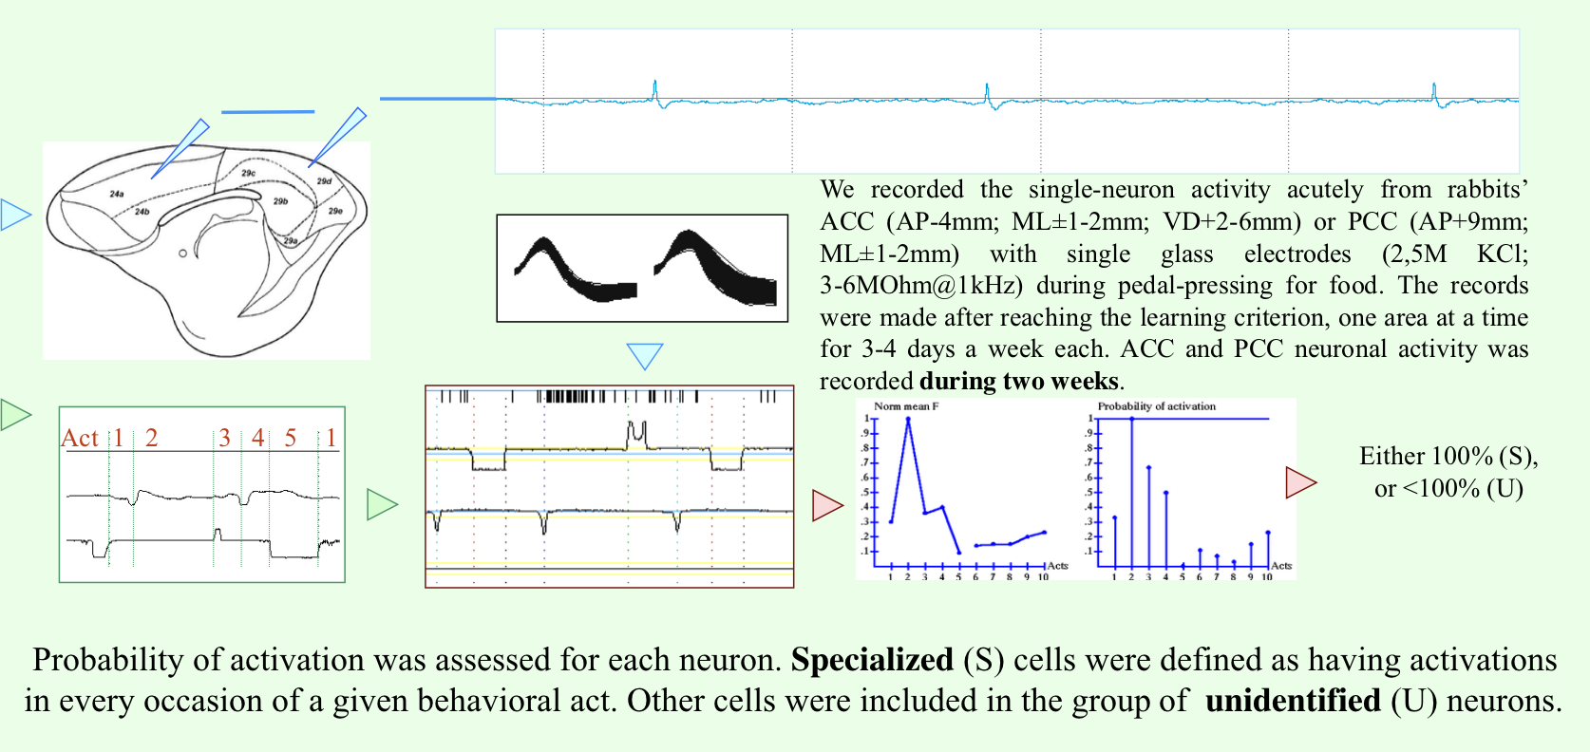

Slide 5
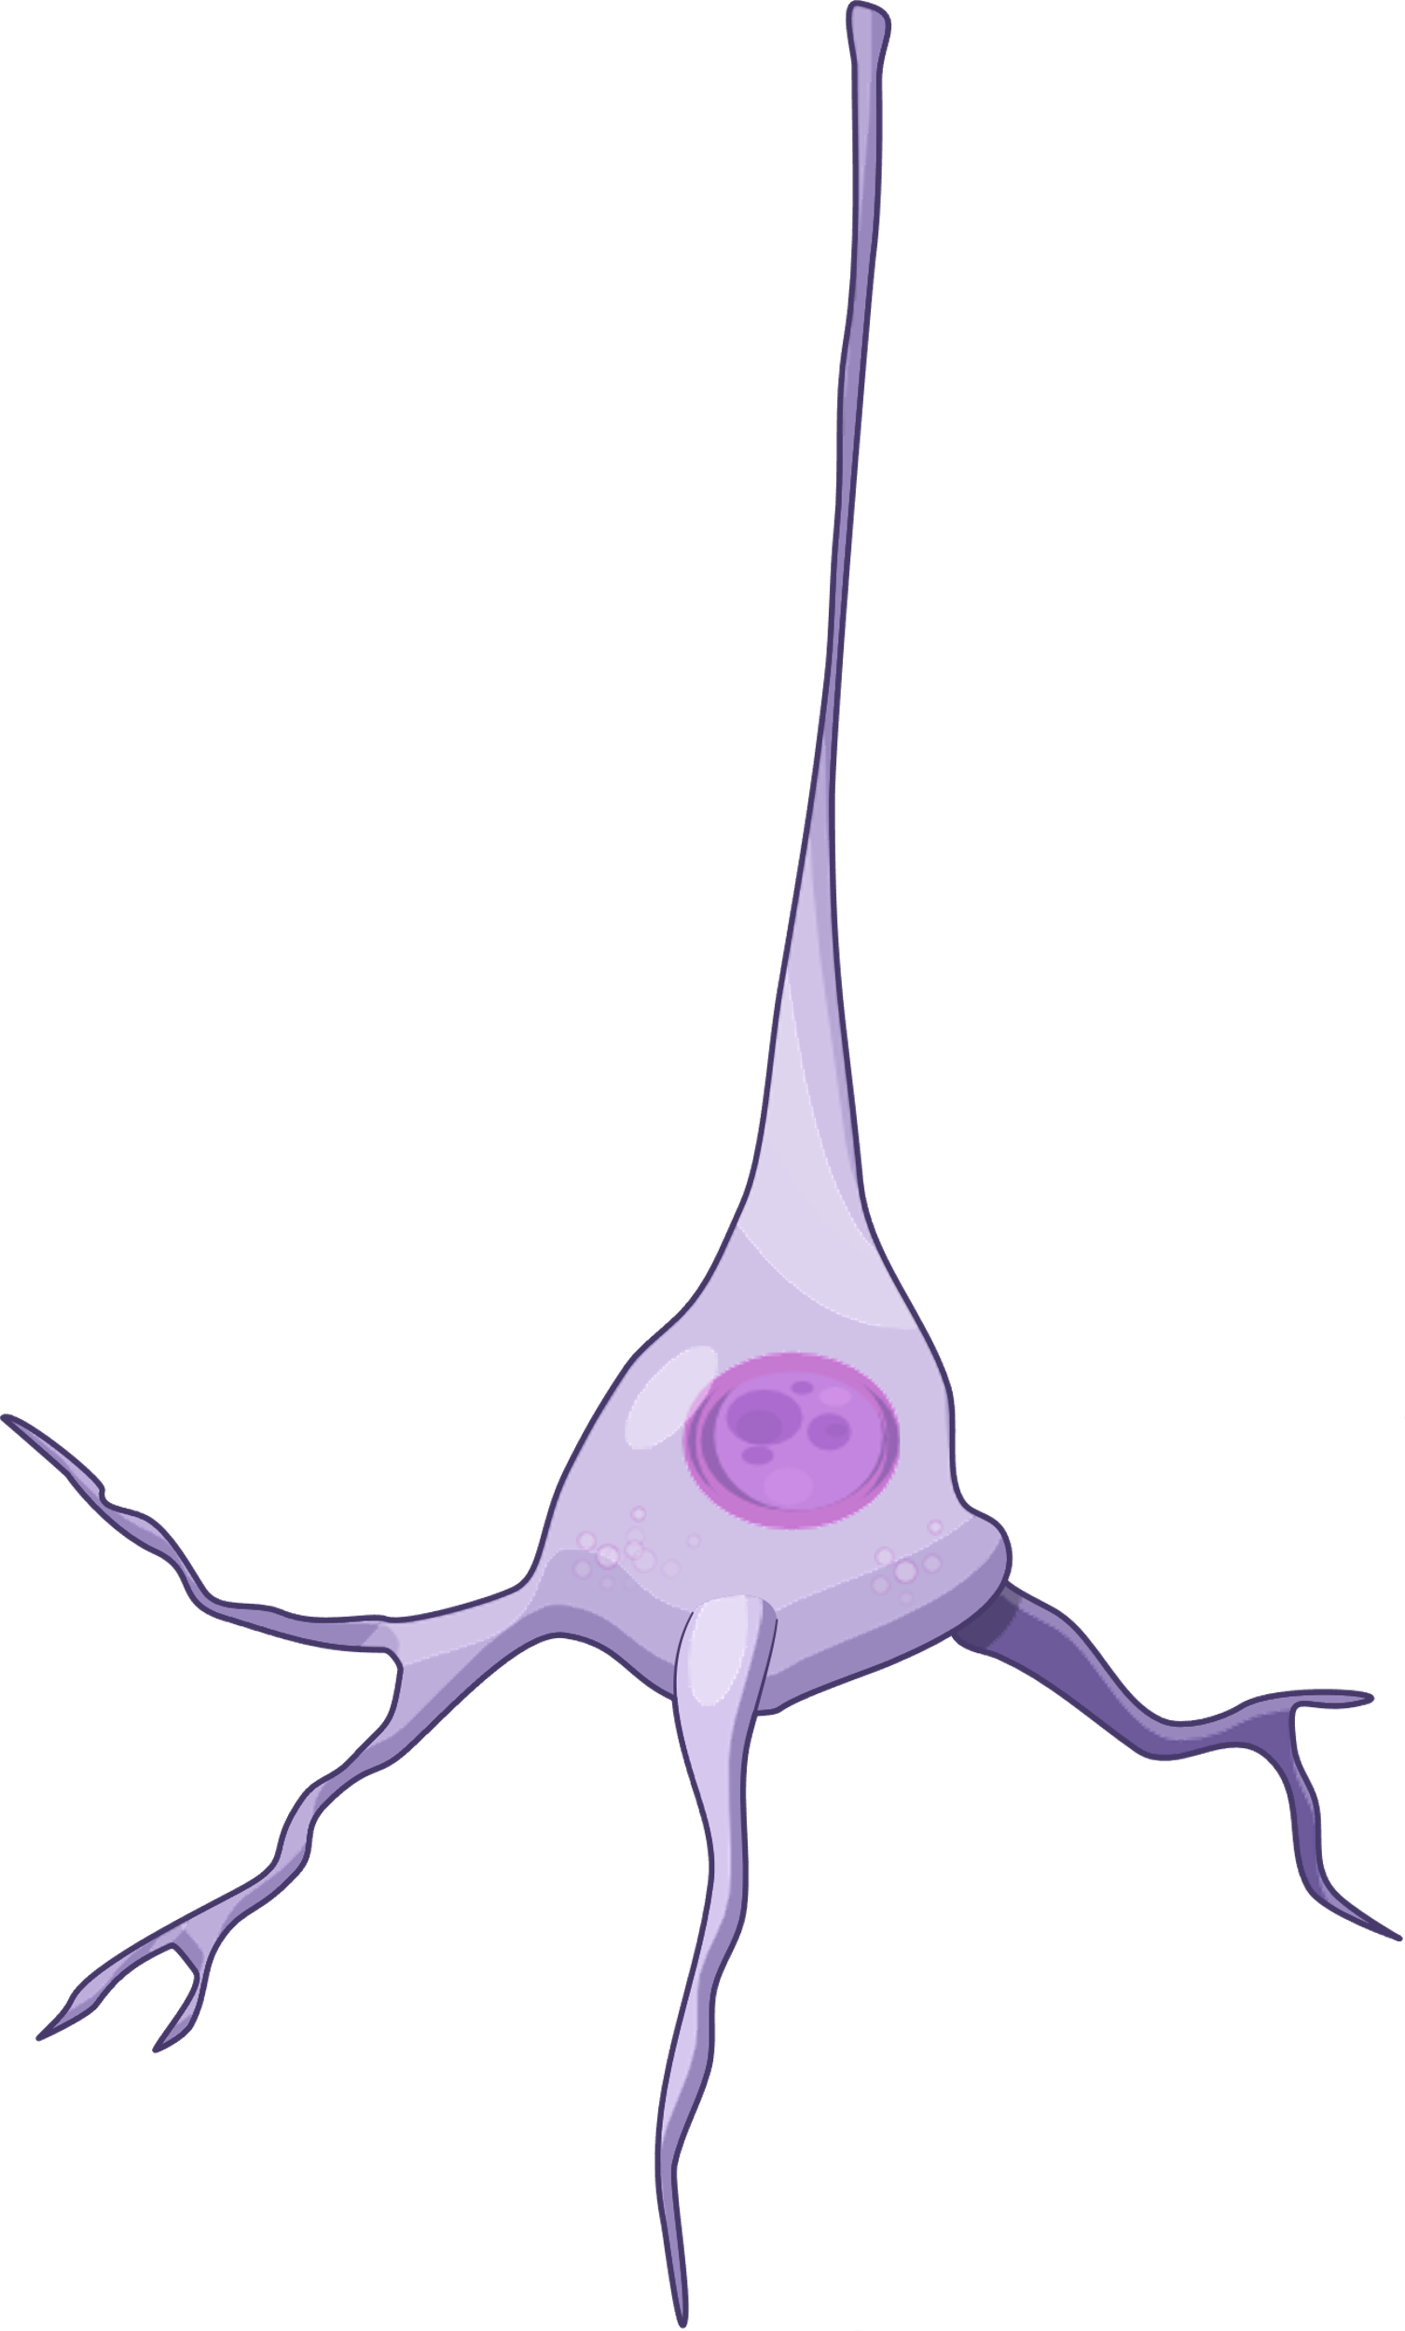
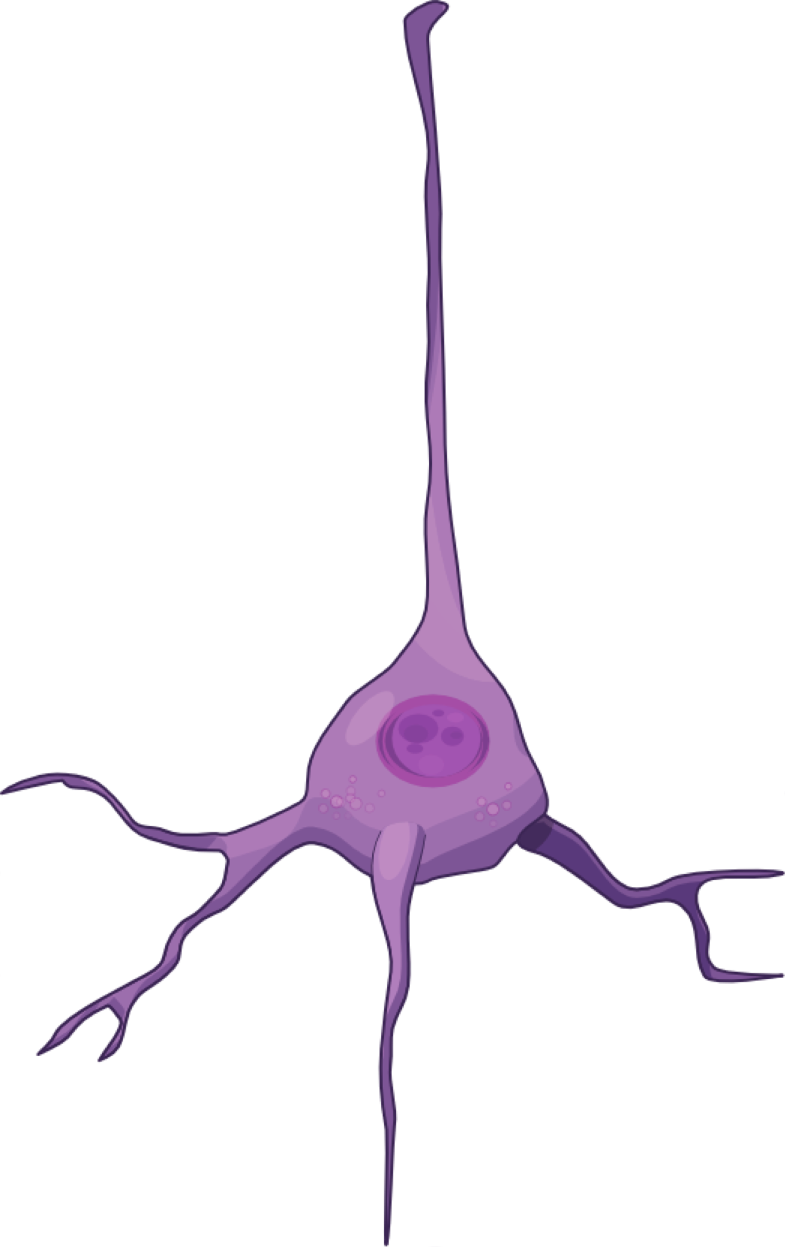
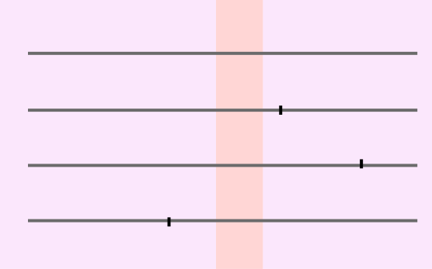
unidentified cells (cells with nonspecific activity) (N=84)
specialized cells (N=29)

Slide 6
Analysis of neuronal activity included the calculation of the sample entropy (the measure of complexity and irregularity) (SampEn) of inter-spike intervals sequences assessed for the behavioural cycles.
Spikes of 113 neurons were taken for analysis as recorded during complete training session in first and the second weeks after the learning. The complexity of neuronal activity was measured as SampEn values for 864 behavioural cycles.
SampEn(m, r, N) = - ln(A/B),
N - the length of the time series, m - the length of vectors to be compared, r - the tolerance for accepting matches, A - the number of pairs of vectors (x) for m points that satisfy the condition d[xm(i), xm(j)] < r, B - the number of pairs of vectors (x) for (m+1) points that satisfy the condition d[xm(i), xm(j)] < r, A low value of SampEn reflects a high degree of regularity.
Additionally, the average frequency of spikes (mF) within the behavioural cycles was calculated as most commonly used metric.

Slide 7
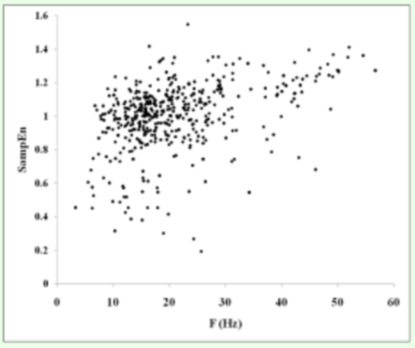
There was not obvious strong correlation between SampEn and mF values.
SampEn
Fm(Hz)

Slide 8
SampEn of inter-spike intervals was significantly lower in the group of specialized cells (1) than in the group of cells with nonspecific activity (0) (Mann–Whitney test; p=0.01).

Slide 9
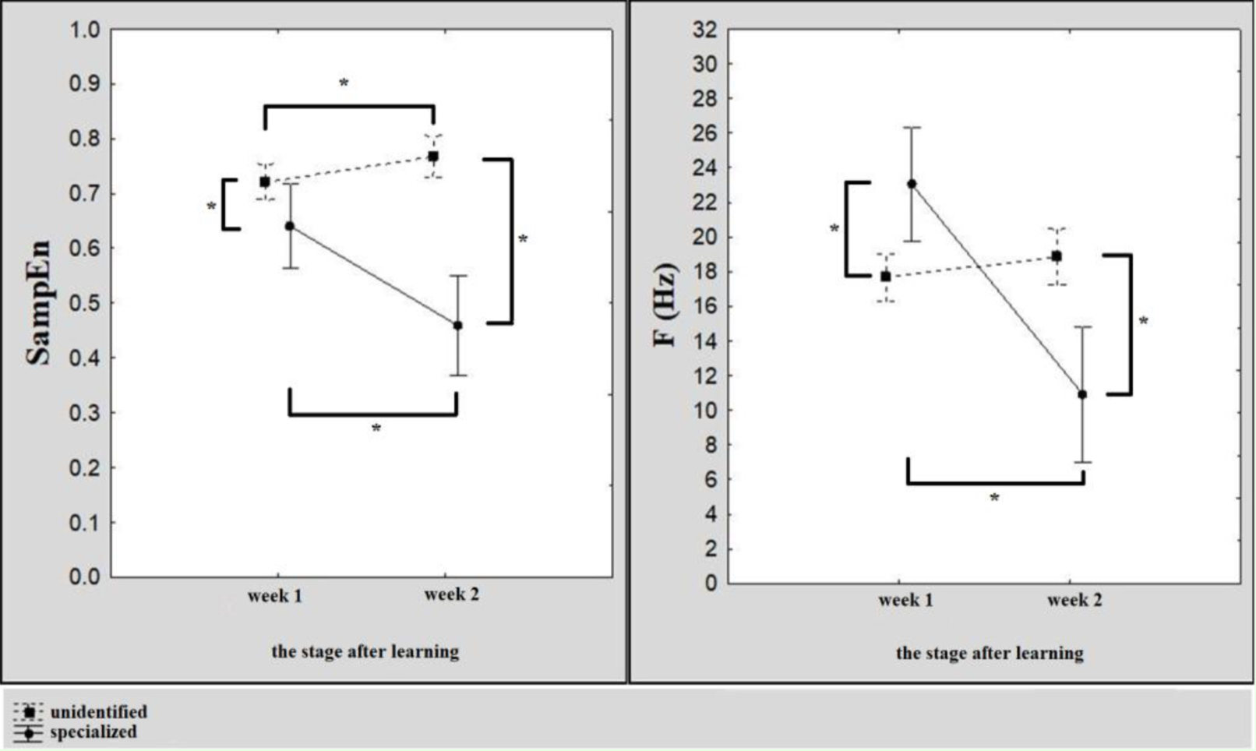
The between-groups difference increased from the 1-st week to the 2-nd week of daily training sessions after learning.
* - p<0.05, Mann-Whitney test

Slide 10
In the whole set of cells, SampEn didn’t differ significantly between the first and the second weeks of training sessions p=0.34).
The group of specialized cells performed lower SampEn during the second week of training than the first week (p=0.03).
The group of cells with nonspecific activity showed higher SampEn during the second week of training than the first week (p=0.02).
* - p<0.05, Mann-Whitney test

Slide 11
The average frequency of spikes didn’t differentiate between groups of specialized cells (1) and cells with nonspecific activity (0) (Mann–Whitney test; p=0.33).

Slide 12
The between-groups difference in the average frequency of spikes was reversed from the 1-st week to the 2-nd week.
* - p<0.05, Mann-Whitney test

Slide 13
Conclusions
Complexity of inter-spike intervals was lower in the group of specialized neurons.
Specialized neurons performed decreasing complexity within the training period.
Unidentified neurons performed increasing complexity within the training period.

Slide 14
Discussion
According to the previous studies, the variability of neuron’s spike-timing depends on synaptic modulations. Therefore, one can discuss the results in terms of relations into and between neuronal groups that orchestrate the newly formed behavior.
The results can reflect the difference in the constancy of relations between neurons in the group.
Specialized cells have a more constant set and links between each other than cells that have unidentified specialization in the experiment.
Their activity is less constant in the observed behaviour and they are more changeable in the set and the structure of links.
It can be proposed that systems specialized to newly acquired behavior develop in the way of reducing relations between internal elements that become more constant. Systems, which are not specialized to particular behavior but actualized in it, develop in the way of expansion of relations between own elements and other systems.

Slide 15
THANK YOU FOR ATTENTION

